Slide 1
School-wide PBS : Correcting Problem Behavior & Developing Self-Discipline
December 8, 2016

Slide 2
Agenda – 9:00 – 3:30
Morning
  Sharing School-wide Successes
  Systems to Correct Problem Behavior
  Action Planning
Lunch
Afternoon
  Systems to Develop Self-Discipline
  Action Planning

Slide 3
DE-PBS MTSS Framework Components
Program Development & Evaluation
  Problem-Solving/Leadership Team
  Data
  Professional Development & Resources
Developing SW and Classroom Systems to Prevent Problem Behavior
  Expectations and Teaching
  Positive Relationships
Correcting Problem Behaviors
  Consistent and clear procedures
  Disciplinary encounters used as learning opportunities to teach problem solving strategies
Developing Self-Discipline

Slide 4
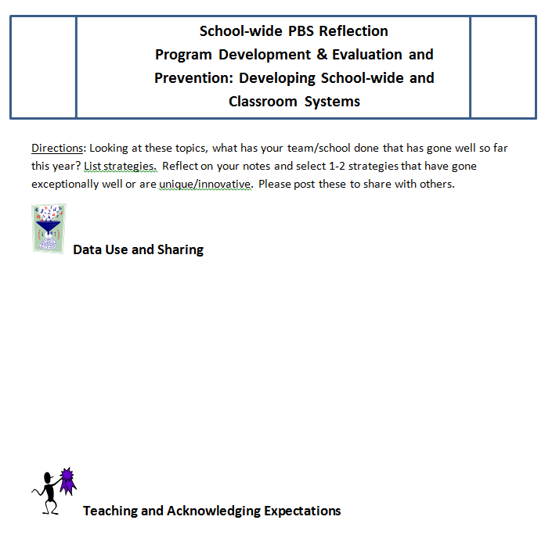
Success Brainstorm
At your table, think & list strategies that have been successful this year.
Data use and sharing
Teaching & Acknowledging
Expectations
Buy-in for Students, Staff, Parents
Facilitating Positive Teacher-Student
Relationships

Slide 5
Success Sharing
Select 1-2 unique/innovative strategies, or ones that have gone very well.
Write strategies on wall under category heading; Note elementary (E) vs. secondary (S) ideas.
Explore categories where you need additional ideas.
Participants will have a chance to ask follow-up questions on a strategy they are interested in knowing more about.

Slide 6
DE-PBS MTSS Framework Components
Program Development & Evaluation
  Problem-Solving/Leadership Team
  Data
  Professional Development & Resources
Developing SW and Classroom Systems to Prevent Problem Behavior
  Expectations and Teaching
  Positive Relationships
Correcting Problem Behaviors
  Consistent and clear procedures
  Disciplinary encounters used as learning opportunities to teach problem solving strategies
Developing Self-Discipline

Slide 7
Keep in Mind
Not time to answer all the questions proposed, but time to learn more about what the questions are & prioritize team efforts and plan to address them.
Activities and resources to support conversations with teams and staff around these framework components.

Slide 8
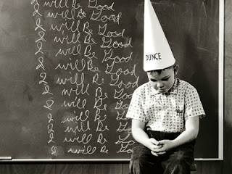
Developing Self-Discipline

Slide 9
DE-PBS MTSS Framework Components
Program Development & Evaluation
  Problem-Solving/Leadership Team
  Data
  Professional Development & Resources
Developing SW and Classroom Systems to Prevent Problem Behavior
  Expectations and Teaching
  Positive Relationships
Correcting Problem Behaviors
  Consistent and clear procedures
  Disciplinary encounters used as learning opportunities to teach problem solving strategies
Developing Self-Discipline

Slide 10
Self-Discipline is more than learning concrete behaviors
“…teachers often think of school demands in fairly simple and concrete terms: paying attention in class, making comments in a discussion, talking with friends in the cafeteria, filling in answers on a worksheet.
But demands like these actually represent a considerable range of behavior that students must learn to negotiate proficiently.
To perform well in school, students must be able to[:]
moderate and shape their behavior to fit changing circumstances, to judge the effects of what they do…
determine the proper times and places to display their actions…
persevere in their behavior, weigh alternative ends, track progress toward desired outcomes and
draw incentive from both the immediate and the long term results of their performance.”
(Dennis Knapczyk, 2004, formatting and emphasis added)

Slide 11
PBS Key Feature
Schools recognize the importance of developing self- discipline, implementing evidence based programs in character education and social and emotional learning, and/or infuse lessons throughout the curriculum that teach social-emotional competencies.

Slide 12
DE’s approach to SWPBS
Although similar to the SWPBS approach found in many other states, Delaware’s approach (DE-PBS) places much greater emphasis on integrating common features of SWPBS with those of the Social and Emotional Learning approach
  (SEL; see www.CASEL.org).
In integrating these two popular approaches, the primary goal of DE-PBS is to create safe and caring learning environments that promote the social-emotional and academic development of all children.

Slide 13
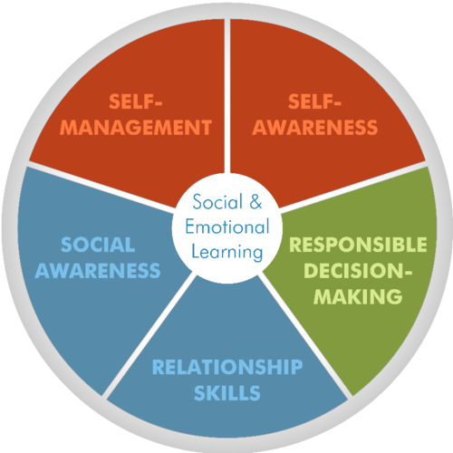
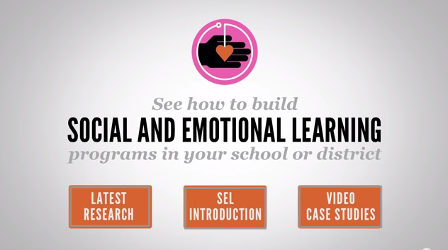
The CASEL Model
http://www.casel.org/
http://www.casel.org/videos/

Slide 14
 | Approach
Components of Comprehensive School Discipline | Traditional SWPBS | SEL
Developing the social and emotional competencies of self-discipline | Weakness | Strength
Preventing behavior problems | Strength (more so for immediate environment) | Strength (more lasting effects)
Correcting behavior problems (short-term goal) | Strength | Weakness
Addressing Tier 2 and 3 Needs | Strength | Weakness

Slide 15
What does the research say regarding integrating the two approaches?
In the areas of school discipline, classroom management, and childrearing, the best approach is that of Authoritative Discipline (combination of structure and support), which blends strategies of SEL and SWPBIS
  Best for achieving compliance
  Best for promoting self-discipline and resilience
  Best for effective prevention and correction
  Best for school climate
  Best for preventing bullying

Slide 16
Brief Definition of Self-Discipline
Self-discipline is
the ability to take responsibility and
ownership for one’s behavior.
(Dennis Knapczyk, 2004)

Slide 17
What is Self-Discipline?
The CASEL Model
Consists of 5 key Social and Emotional Learning skills:
Self-management skills
Social awareness and empathy
Social connectedness and relationship skills
Responsible decision making
Positive sense of self
http://www.casel.org/

Slide 18
What is Self-Discipline?
Consists of each of the social and emotional skills, but especially:
  Responsible decision making at school, home, and in the community
  Self-management of emotions and behavior, and doing so under one’s own volition.
Connotes the critical notion of internalization, as seen in
  Committed compliance or willing compliance
The CASEL Model
http://www.casel.org/

Slide 19
Often used interchangeably with:
  Autonomy
  Self-determination
  Responsibility
  Self-regulation
  Self-control
Self-awareness is a foundational piece:
  This allows students to recognize their values, standards, beliefs, and attitudes and that recognition can impact their SEL skills and their academic behaviors
The CASEL Model
http://www.casel.org/
  Self-Discipline is used to remind educators that there is more to school discipline than the use of discipline.
  LONG-TERM goal!

Slide 20
It’s not just what you see (observed behaviors), but about how children:
How children behave in your absence is more important than how they behave in your presence or when punishment and rewards are not highly salient.
Think
Feel
Act

Slide 21

Incorporating Self-Discipline in Your SW PBS/MTSS Framework
  Relationship building
  School-wide policies and activities
  Student decision making
  Social and Emotional Curriculum
  Strategic Use of Praise and Rewards
  Corrective Procedures

Slide 22

1. Relationship Building
Not only do students like teachers who are caring, respectful, and provide emotional support, but when those qualities are found students also show increased:
school completion, academic engagement, and academic achievement
peer acceptance
motivation to act responsibly and pro-socially
subjective well-being

Slide 23
1. Relationship Building:
Student-Student Relationships
Students with positive peer relationships experience:
  Higher self-esteem and a more positive self-concept
  Greater satisfaction toward school
  Greater academic achievement
  Greater engagement in school
They experience less:
  school avoidance & academic problems
  depression and other internalizing problems
  externalizing problems
  bullying
  drug abuse

Slide 24

1. Relationship Building:
Student-Student Relationship Building
Positive relationships with others. Positive relations with others are expected, taught, and encouraged and planned opportunities (e.g., extracurricular activities, class meetings, structured recess activities) are provided to develop positive relationships.

Slide 25
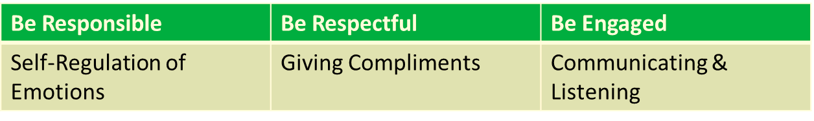
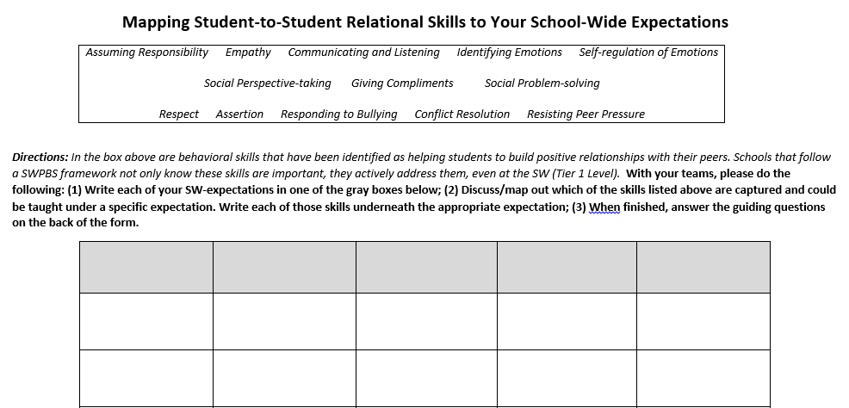
Activity: Student Relations Involve Skills
Stay within your teams
Complete chart connecting Student-Student Relational Skills to SW Expectations
Answer/Discuss guiding questions on the back

Slide 26
School-based activity summary
Relationship Building Discussions
  WORKBOOK – Team Questions (p1)
  EXAMPLES – Relationship Building Strategies (p1-6)

Slide 27


2. Schoolwide (SW) Policies and Activities Encourage
Self-Discipline

Slide 28
2. SW Policies & Activities
Your Current SW Policies
Mission Statement & SW behavioral expectations include the goal of developing self-discipline (character education, social & emotional learning, caring, or social responsibility)
Self-discipline is emphasized in behavioral expectations and rules. At the SW and classroom levels, the importance of self-discipline is highlighted, such as the importance of regulating and accepting responsibility for one’s actions, respecting others, helping others, and exerting one’s best effort.

Slide 29
2. SW Policies & Activities
Your Current SW Policies
Morning announcements & public displays of information
School assemblies
In service learning activities or community service that involved students in multiple classes (e.g., food drive, visits to senior citizen center)
Administrative advisory committee of students
Restorative Practices and Credit Recovery Programming
Growth Mindset Activities

Slide 30
Growth Mindset in Classrooms
  Article Name: Debunking Myths in Brain Research (NASSP, 2008)
  Sample Myths:
  The brain doesn’t grow new cells.
  Some people are left brained while others are right brained.
  Playing Mozart to babies increases their intelligence.
  Brain research is too new to be reliable.
  Medication is the only evidence-based intervention for a number of brain-related problems.
  Sample Classroom Implications
  “Students have to feel safe in the classroom in order for learning to take place. Threats were found to impair brain cells and negatively affect learning (Jensen, 2006)” (pg.4).
  “Tileston (2005) adds that students also have to perceive that they can be successful in achieving the learning task or goal at hand” (pg.4).

Slide 31
Growth Mindset in Classrooms
  Intervention Name: Self-Affirmation Writing
  (Cohen et al., 2009)
  Method: Students are asked to complete a neutral (no right/wrong answer) writing assignment that:
  related to questions about “your ideas, your beliefs, and your life” and
  how they rated the importance of personal values such as athletic ability, being good at art, being smart or getting good grades, etc.
  Study: Randomized, middle school classrooms
  Findings: Intervention worked most for students who were African American and low-achieving in school (GPA and long-term), but it did not harm students who came in initially expecting high success.

Slide 32
Growth Mindset in Classrooms
  Name: Relevance Writing Exercise
  (Hulleman and Harackiewicz, 2009)
  Method: Students were asked “to make connections between their lives and what they were learning in their science courses”.
  Teachers presented summarization activities that instruct students to describe “My application to life”
    How might this information be useful to you, or a friend/relative?
    How does learning about this topic apply to your future plans?
  Study: Randomized, high school science classrooms
  Findings: “…increased interest in science and course grades for students with low success expectations”

Slide 33
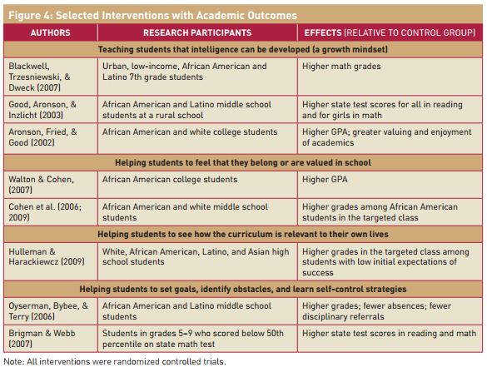
Growth Mindset in Classrooms
http://web.stanford.edu/~gwalton/home/Welcome_files/DweckWaltonCohen_2014.pdf

Slide 34


Growth Mindset Meets SW-PBS
Shields Elementary, Cape Henlopen SD
SCHOOL RULES | ACADEMIC | BEHAVIOR
Be Ready to Learn | Open to new strategies Experiment with new ideas Problem solve | Follow directions Have supplies ready Ready to attend
Be Ready to Try Again | Rewrite/redo/fix it Learn from mistakes Choose another strategy | Follow adult prompts Make a better choice Use calm positive self talk
Be Ready to Accept Help | Seek out critiques of work Learn from corrections Use support to improve | Reflection/goal setting Use behavior strategies Accept consequence
Be Ready to Care | Do your best work Have pride in your work Work toward improvement | Show kindness to others Attend to own emotions Take care of environment
Be Ready to Lead | Take academic risks Share ideas with others Find a new way | Follow rules Solve conflicts Build a caring community
+
=

Slide 35
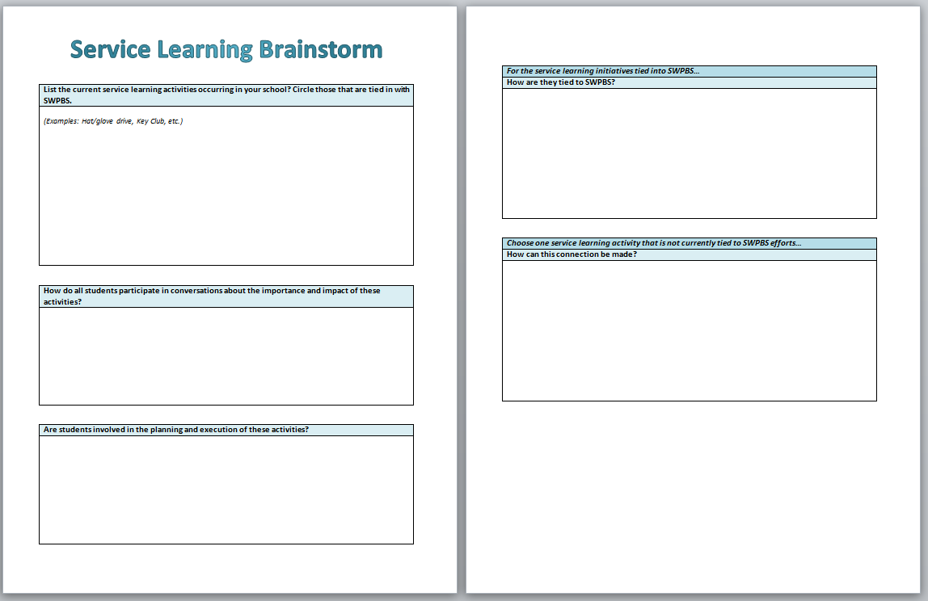
School-based Activity: Service Learning Brainstorm
Complete the “Service Learning Brainstorm” sheet with team
Think about the following:
What activities currently take place?
How are they tied in with SWPBS?
Do students participate in discussions about the impact of these activities?
Are students involved in the planning and execution of these activities?

Slide 36
School-based Activities
School Policies Discussions
  WORKBOOK – Team Questions (p2), Service Learning Brainstorm (p7)
  EXAMPLES – Behavior Matrix & SEL Standards (p7-8)

Slide 37
3. Student Involvement in Decision Making
The school principal meets regularly with students to discuss current school-wide issues and involves them in decisions about the welfare of the school.
    Student council/government
    SWPBS student group,
    other groups representing the student body
Teachers across grade levels create opportunities for students to be active decision makers

Slide 38
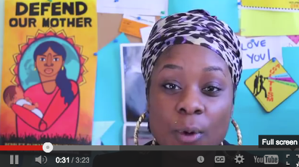
3. Student Involvement in Decision Making - Boston Student Advisory Council
https://www.youtube.com/watch?v=5nH6Pq93C1c

Slide 39

3. Student Involvement in Decision Making:
Students reviewing data
Involve students in reviewing school data and generating solutions.
Remember to first ask students what they can do differently to make things better.
Next ask what students think teachers and other adults can do to help.

Slide 40
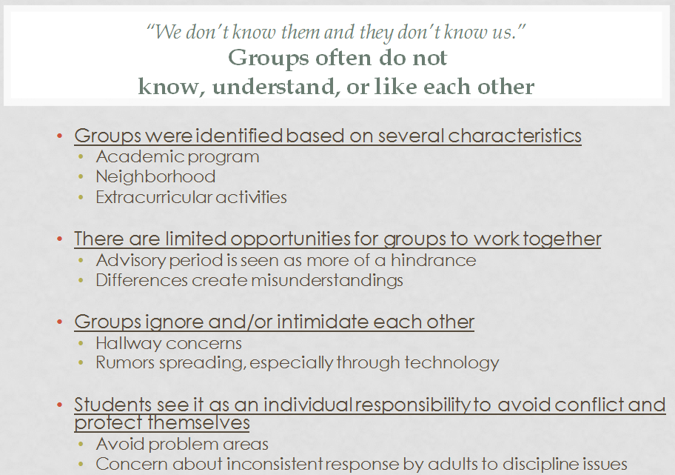
3. Student Involvement in Decision Making:
School Climate Focus Groups

Slide 41
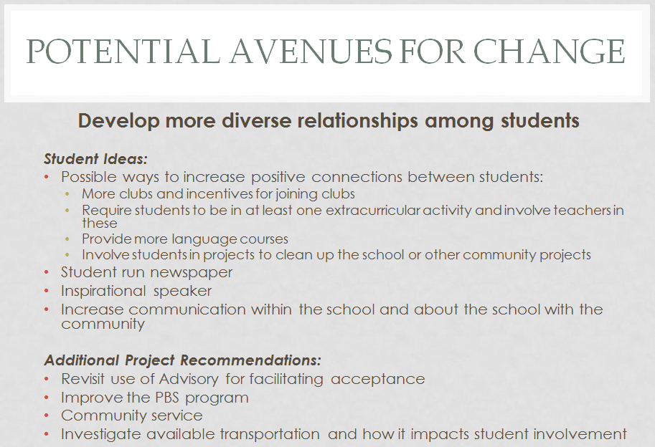
3. Student Involvement in Decision Making:
School Climate Focus Groups

Slide 42
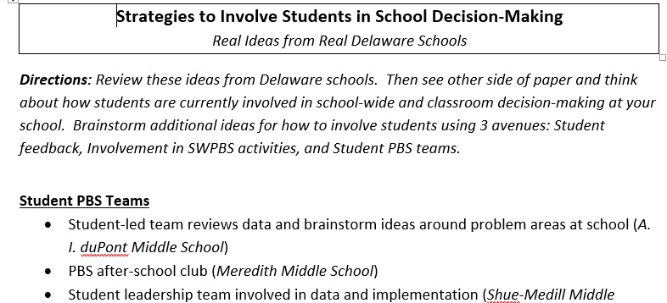
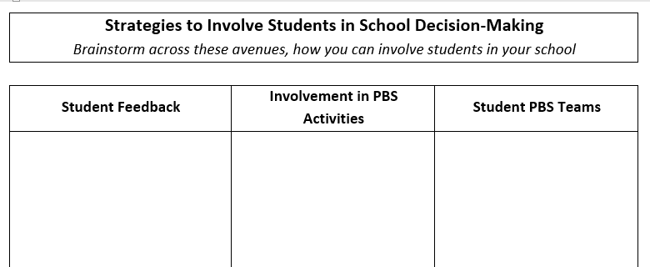
Activity: Students in School Decision-Making
  With your team, review these ideas from DE schools.
  See other side of paper and think about how students are currently involved in school-wide and classroom decision-making at your school.
  Brainstorm additional ideas for how to involve students using 3 avenues:
    Student feedback
    Involvement in SWPBS activities
    Student PBS teams.
Please complete the worksheet
“Strategies to Involve Students in School Decision-Making”
10 min

Slide 43
3. Student Involvement in Decision Making:
School-based Activity: Dream School
Refer to “Ideal School Activities” handout
Activity to gather information on students’ perspective and to provide them with an opportunity to participate in action planning for the school

Slide 44
School-based Activities
Student Decision Making/Voice Discussions
  WORKBOOK – Team Questions (p3), Ideal School Activities (p5-6)

Slide 45
4. Social and Emotional Curriculum
Social Emotional Lessons are infused throughout the school curriculum to promote the development of:
    thoughts,
    feelings,
    and behaviors
associated with responsible behavior.

Slide 46
4. Social and Emotional Curriculum
  Specific SEL lessons are regularly provided to all students (e.g., Second Step, www.casel.org lessons)
    Are staff aware of what is taught in these lessons? If not, how can they be included?
    How can these lessons be tied into daily classroom activities?

Slide 47
4. Social and Emotional Curriculum
Curriculum activities in language arts and social studies highlight the general importance of empathy, perspective taking, and social and moral problem solving.
    How can you incorporate social-emotional learning into your lessons?
    Not just about lesson content – also method of delivery

Slide 48

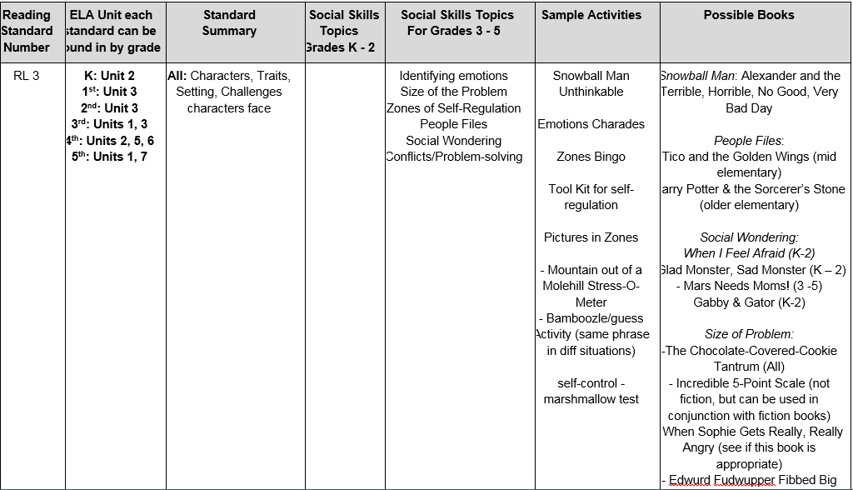
Combining ELA Core & SEL
Jamie to add

Slide 49
4. Social and Emotional Curriculum
School-based Activity: Incorporating SEL in the Curriculum
WORKBOOK - Social-Emotional Learning in the Curriculum (p8-10)
Review and complete worksheets with team and consider how social-emotional learning can be incorporated into your current curriculum
EXAMPLES – Character Education Resource Guide (p11-14)

Slide 50
5. Strategic Use of Praise and Rewards
Praise and rewards are used strategically to recognize and reinforce social and emotional competencies that underlie prosocial behavior.
For example, students are routinely recognized with praise and rewards for demonstrating empathy, caring, responsibility, and respect.

Slide 51
5. Strategic Use of Praise and Rewards
Effective Ways to Praise & Acknowledge
Focus on the message
  Emphasize the informative rather than controlling function of praise and rewards
Highlight the student’s specific achievement demonstrated toward the achievement
Link the behaviors to underlying thoughts, emotions, and dispositions
  These may include: feelings of pride, empathy, autonomy, responsibility, caring, kindness, trustworthiness, etc.
Highlight the future value or usefulness of the behavior

Slide 52
Link the behaviors to underlying thoughts, emotions, and dispositions that that you hope to develop and to attributions of self-discipline.
  feelings of pride
  empathy
  autonomy
  responsibility
  caring, kindness, trustworthiness, and so forth
Most of all: Avoid teaching students that the only, or most important, reason to act in a morally and socially responsible manner is to earn rewards or to be praised.

Slide 53
5. Strategic Use of Praise and Rewards
Examples of recognition
  “ Great! You should feel really proud of yourself for working so hard.”
  “I’m giving you a reward, but I know that you would help Carrie even if you didn't’t receive a reward because you care about others.”
  “The reason I’m giving the class 15 minutes of free time is because you demonstrated responsibility yesterday by being so well behaved when a substitute was here.”

Slide 54
5. Strategic Use of Praise and Rewards
More examples…
  “That’s terrific that you were able to control your anger when teased by Jerome. That’s an important skill that will help you keep friends (and avoid being sent to the office ☺”).
  “Great! You must have stopped and thought about how your behavior might affect others.”

Slide 55

Remember, use acknowledgements that emphasize the informative rather than the controlling function of praise and rewards
Do NOT say:
  “I will give you a sticker if you finish your work.”
  “If you behave, you will get a _____.”
  “You get a token because I caught you being good.”

Slide 56
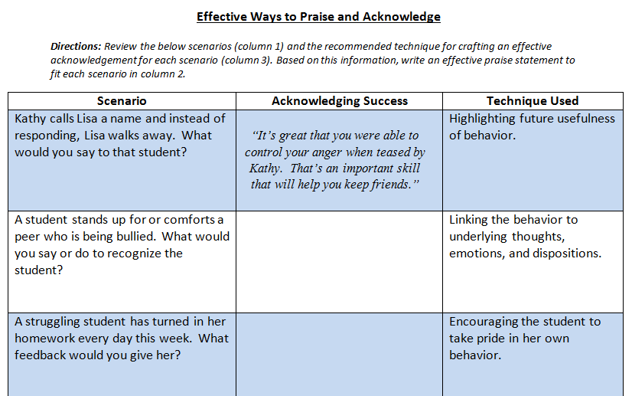
School based activity: Effective Praise
  Review 7 student scenarios and recommended techniques for crafting an effective acknowledgement for each scenario.
  Create effective praise statements for each scenario based on the recommended technique.

Slide 57
What was your new “effective” praise?
A student stands up for or comforts a peer who is being bullied, what would you say or do to recognize the student?
A struggling student has turned in her homework every day this week. What feedback would you give her?
Kathy calls Lisa a name and instead of responding, Lisa walks away. What would you say to that student?

Slide 58
What was your new “effective” praise?
Your class remains quiet and respectful during a school assembly. How could you acknowledge their good behavior?
Charlie gets a perfect score on his spelling test for the first time all year. What might you say to him?
You spot one student praising another. What could you say to recognize that student?

Slide 59
6. Corrective Procedures
Administration and staff view correction not just as use of punishment but also as opportunity to help develop social & emotional problem solving/decision making skills of self-discipline.
Systematic behavioral reflection including impact of behavior on self/others & action planning for positive change with discussion of supports needed for positive choice making

Slide 60
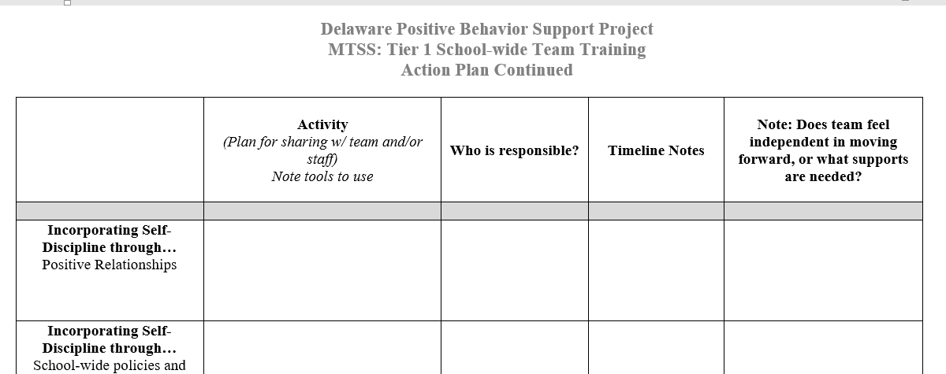
Action Plan Time
Think about Developing Self-Discipline Content
Identify a recorder
Pick 1-2 tools/activities discussed this morning around Self-Discipline
Plan method to share with your team/staff. Who would be involved? When and how will this happen?
At end of day we will collect 1 plan/team and return

Slide 61
Delaware Assessment of Strengths and Needs for Positive Behavior Supports Overview (DASNPBS)
Staff perception survey designed to gain insight & input of school staff in DE-PBS implementation and planning
Aligned to Delaware’s Key Features of Positive Behavior Support
4 sections, 10 items each -
  School-wide Tier 1 - Program Development and Evaluation
  Implementing Schoolwide & Classroom Systems
  Developing Self-Discipline
  Correcting Behavior Problems

Slide 62
DE-PBS Key Feature Status Tracker
4 Framework Components
  Program Development & Evaluation
  Prevention: Developing SW & CR Systems
  Correcting Problem Behaviors
  Developing Self-Discipline
Status
  Discuss as a team if components are:
  In Place, Partially in place, Not in Place
Action Plan
  Discuss as a team the items Partially in place or Not in Place
  Note activities to be completed, who will do them and when

Slide 63

Thank you!
WWW.DELAWAREPBS.ORG
  http://wordpress.oet.udel.edu/pbs/correcting-problem-behaviors/
  http://wordpress.oet.udel.edu/pbs/developing-self-discipline/

