Slide 1
DE-PBS Cadre Meeting
Tuesday, April 12, 2016

Slide 2
District Planning & Coaching

Slide 3
District Planning
www.pbis.org

Slide 4
Components for Successful District Implementation
Leadership Team to actively coordinate implementation efforts
An organizational umbrella composed of adequate funding, broad visibility, and consistent political support
A foundation for sustained and broad-scale implementation established through a cadre of individuals who can provide coaching support for local implementation, a small group of individuals who can train teams on the practices and processes of school-wide PBIS, and a system for on-going evaluation
A small group of demonstration schools that documents the viability of the approach within the local fiscal, political and social climate of the state/district
http://www.pbis.org/school/district-level

Slide 5
Who might serve on a district team?
Members should include individuals whose roles, responsibilities, and activities are associated with the
(a) prevention of the development and occurrence of problem behavior,
(b) development and maintenance of behavior, and
(c) management and evaluation of resources related to the provision of behavioral supports.
Examples of district-wide team members include:
District & School administration
Instruction & Curriculum
Character Education
School-wide Discipline
Special Education
Dropout Prevention
http://www.pbis.org/school/district-level

Slide 6
What does the leadership team do?
Complete a self-assessment
Create a 3-5 year action plan
Establish regularly scheduled meetings
Identify a coordinator to manage and facilitate
Secure stable funding for efforts
Develop a dissemination strategy to establish visibility (website, newsletter, conferences, TV)
Ensure student social behavior is the top priority of the district
Establish trainers to build and sustain school-wide PBS practices.
Develop a coaching network (each school identifies a team leader to facilitate)
Evaluate school-wide PBS efforts
http://www.pbis.org/school/district-level

Slide 7
Coaching Rationale
If school leadership teams are to be successful, structures and routines must be in place to assist, prompt, encourage, and monitor their progress as they develop, implement, and evaluate their school-wide PBS system.
-Anne Todd

Slide 8
Coaching Defined “Goal is to give skills away”
Coaching is the active and iterative delivery of:
(a) prompts that increase successful behavior, and
(b) corrections that decrease unsuccessful behavior.
Coaching is done by someone with credibility and experience with the target skill(s)
Coaching is done on-site, in real time
Coaching is done after initial training
Coaching is done repeatedly (e.g. monthly)
Coaching intensity is adjusted to need
www.pbismaryland.org

Slide 9
Outcomes of Coaching
Fluency with trained skills
Adaptation of trained concepts/skills to local contexts and challenges and new challenges that arise
Rapid redirection from miss-applications
Increased fidelity of overall implementation
Improved sustainability
Most often due to ability to increase coaching intensity at critical points in time.
www.pbismaryland.org

Slide 10
Team Leader Roles & Expectations
Encourage administration & team to consider qualifications
Share & discuss expectations (general/district-specific/school-specific)
Review recommendations
Team Leader PD in development to support organization & communication skills

Slide 11
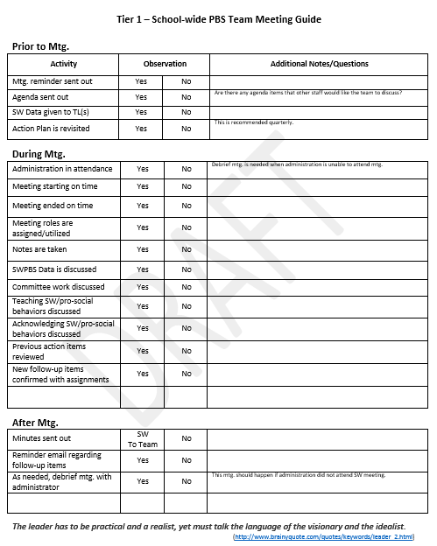
Team Meetings Review Guide
Looks at recommended team meeting protocols/activities
Prior to Meeting
During Meeting
After Meeting
Easy-to-use checkboxes with space for additional activities & notes
Also includes:
Open notes section
Coaching follow-up table

Slide 12
Professional Development

Slide 13
Substitute Reimbursement Reminders
The Department of Education will provide substitute reimbursement for registered participants.
PFA or IV needs to be completed within 30 days after the training. ASAP for May events!
Please send to Beth Draper (beth.draper@doe.k12.de.us).

Slide 14
Since we last met . . .
1 Day School-wide PBS Workshop
Secondary Forum
Inclusion conference
PTR – Day 2 session
Ongoing IEP workshops

Slide 15
SPDG IEP Development PD

Slide 16
Vision
Students with special education services will have IEPs that are data-driven and standards-based, enabling them to access the same educational content as, and alongside, their peers without disabilities.
IEP goals written for behavioral concerns and social skills will be data-driven with a focus on replacement skills each individual needs to learn to access the general education setting

Slide 17
Goal
After 2 years of implementation, 80% of participating schools will achieve fidelity of intervention of implementing behavior anad standards based IEPs.
-U.S. Department of Education Grant Performance Report (ED 524B)

Slide 18
Standards-Based IEPs District Training
Trained 2013-2016 | 2016-2017
Brandywine Colonial Red Clay Capital Christina Seaford Caesar Rodney Lake Forest Cape Henlopen Woodbridge Indian River | Smyrna Laurel Delmar Milford Appoquinimink

Slide 19
The Standards-based IEP
“A standards-based IEP includes goals that promote learning of the state standards.”
“It does not try to include a goal for every state standard in every content area. This would result in a very long document!”
“Instead, it provides goals for the strategies students need to develop to learn the general curriculum content.”
“Sometimes the goals help focus priorities within the general curriculum content for students who take the alternate assessment.”
(Courtade & Browder, 2011)

Slide 20
The Rubric
Based on IEP+ Format
Created in conjunction with DDOE.
Scores IEP components (0-3) based on content.
“3” is reflective of what is considered best practice in the field by researchers and experts.
Rubrics will be shared with School and District teams in order to create inter-rater reliability.

Slide 21
The IEP
Data Considerations
Impact Statement
Other Factors
Present Levels
Goals
Services
Grade-level Standards
Student Strengths

Slide 22
Goal Types
Academic
Grade-level
Access skills
May be off grade level but are needed to access concepts of the curriculum
Non-Academic
Life Skills
Behavioral Goals
Vocational/Transition Planning

Slide 23
Access vs. Grade-level Skills
Access Skills
Grade-level Skills
Aligned with Instructional Level
Addresses foundational skills.
Aligned with Grade-level expectations
Can address learning how to use a support in order to complete grade-level content.

Slide 24
Balancing Exposure with Instruction
Instructional- Level Content
Accommodations & Specialized Instruction
Present Levels
Enrolled Grade-Level Content
Standards-based goals
Grade-Level Standards
Access Skills
Adaptation or Modification of Grade-level Content

Slide 25
Addressing Behavior Concerns of the IEP District Training
2015-2016 | 2016-2017
Brandywine Colonial Red Clay Capital Seaford Lake Forest Woodbridge Indian River | TBD

Slide 26
Functional Behavior Assessment
Describe Observable Behavior, collect data.
Determine the conditions that trigger & reinforce behavior.
Behavior Support Plan
Individual Education Program
Describe behaviors in unique needs.
Determine Services to meet those unique needs (conditions needed or goal for improved performance.)
Specify the intervention strategies.
Teach/Support appropriate, positive behaviors.

Slide 27
Goals with SMART(S)
S. Specific- Are specific skills addressed that could be identified and duplicated by someone else?
M. Measurable- Can it be measured with quantifiable numbers? (Completion %, Opportunities, Frequency, etc.)
A. Achievable- Given a year’s worth of instruction, is it feasible for the student to be able to achieve them within a year?
R. Results-Focused- Do the goals focus on an end product or ability to be demonstrated? Does it relate to overall student improvement?
T. Time-Bound- Are there time limits set forth for the goal to be completed? (benchmarks, timed-assignment criteria, frequency duration)
S. Standards-based- Does the goal seek to teach the skills needed in order to access and achieve the Common Core State Standards for the student’s grade level?

Slide 28
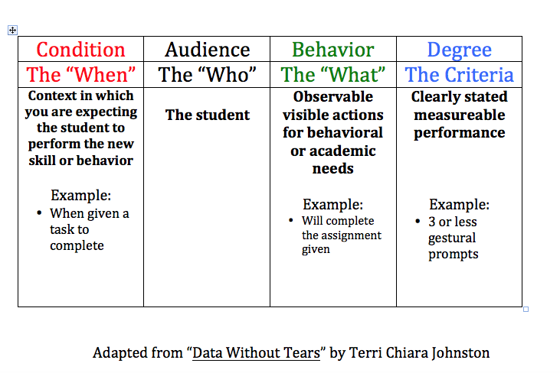

Slide 29
Functionally Equivalent Replacement Skills
Think about the behaviors function!!
Gives you the same outcome as the challenging behavior
Increases the likelihood the student will use their new skill
Developing a hypothesis for the replacement behavior assists the team in selecting a function- based intervention/goal
-Dunlap, Iovannone, Kincaid, Wilson, Christiansen, Strain & English, 2010

Slide 30
Use your data
What does your data collection tell you about the student?
What behavior impacts this student the most?
Is this behavior something that all students are exhibiting (across the school or class) or is this unique to the individual?
You can use this data for your IEP goals!

Slide 31
PEERS Participation Update
Brandywine School District
Mount Pleasant High School
Talley Middle School
Springer
Brandywine Community School
Red Clay
Stanton Middle School
McKean High School
Woodbridge
Woodbridge Middle School
Woodbridge High School
Colonial
Gunning Bedford Middle School
Appoquinimink
Redding Middle School
Gateway Lab School

Slide 32
School-wide PBS – 1 Day Workshop – 2/19/16
Hot topics:
Staff buy-in
Staff turn-over
Staff consistency/fidelity
Follow up:
Overview template
SWPBS slides for use
Buy-in strategies
Shh . . . PBS’s dirty little secret is that it’s about changing STAFF behavior.
-Peter Alter

Slide 33
DE-PBS Program Overview Template
- Suggested activities/discussions
- Prompts to input school-specific information
- Activity related notes
- Notes to share/narrative to deliver

Slide 34
Secondary Forum – 2/23/16
What: Half-day workshop for MS & HS
Who: 37 folks representing 14 schools across 8 school districts
Topics included:
Top Ten Ideas for Rebooting SWPBS at the secondary level
An overview of the Key Feature Evaluation
Tier 2 programming structures and current DE interventions
Adverse Childhood Experiences Study (ACES) and trauma-informed practices

Slide 35
Inclusion Conference – 3/16/16
Classwide Positive Behavioral Interventions and Supports: Foundations and Application – Diane Myers
Prevent - Teach - Reinforce with Children Birth to Five: in Preschool and At Home – Phil Strain

Slide 36
Prevent – Teach – Reinforce (PTR)
Day 2 for 2015-16 participants – intervention focused workshop
Next Year:
Coaching of new PTR Facilitators for 2016-17
Brief PTR and Networking with previously trained facilitators
Continued support of Master Facilitator cohorts and identification of new Master Facilitators
Any interest in new Facilitators or Master Facilitators, please contact Jamie Caruso.

Slide 37
2016 School Climate Data Workshop
Tuesday, May 10, 2016
9:00 am – 12:00 pm (registration 8:40 am)
Dover Downs Conference Center – Ballroom C
Please register by May 2, 2016
Agenda includes:
Overview of the school climate and why climate data is important.
Time to reviewing and interpreting your school’s climate results
Review of resources to support sharing the DSCS data with students, staff, and the community.
Encourage attendance; recommend at least 2 per building
Electronic & paper reports distributed following workshop.

Slide 38
Targeted Networking PD Update *
Special Notes:
Event is by invitation and that is school-specific.
We recommend 3 Tier 2 team members.
Scheduling:
Originally: 1/27/16
Now: 6/1/16
8:30am – 12pm
Del-Tech, Room 400
Invitations go out next week
Session topics/activities:
Review Tier 2 concepts
Opportunities to share successes, challenges, and questions
Networking and problem-solving with other schools
Planning time with your targeted team

Slide 39
School-wide Team Workshop Series (Summer – Fall 2016)
PD is Intended for:
New School-wide PBS teams or
Previously trained teams that are reorganizing their team and revamping their SWPBS system.
* New team members training will be held later in 16-17 SY.
The Format of this PD Series:
Interested teams should:
Email Jamie Caruso jcaruso@udel.edu by May 13th.
To receive additional information and a registration form.
Note: an administrator must attend with the representative team.
Session 1: All teams | Session 2: Individual teams | Session 3: All teams
Date: June 22, 2016 Time: 9:00-3:30 (8:45 registration) Location: Del-tech | Will be scheduled with individual teams & held at their school (Summer 2016) | Teams come back together again (Fall 2016)

Slide 40
Person-Centered Planning
Tuesday, July 26, 2016
Time: 9:00-3:30 (8:45 registration)
Del-tech – Dover, DE
Workshop will include:
Overview of person-centered planning,
Process steps used in the MAPs and PATHs tools,
Practice in roles of verbal and graphic facilitators.

Slide 41
What is PCP?
A group-based process that promotes:
A set of values and strategies that can be used to assist an individual in creating a vision for the future and a plan for working with others toward realizing that vision.
A use of planning strategies that focus on people rather than on services or programs, driven by individual’s unique visions, preferences, likes, and dislikes.
A perspective that sees people’s capacities, building on the strengths, gifts, and abilities of individuals and their circles of support.
Impact, 1998

Slide 42
When can person-centered planning be used?
Strategic planning
School Team Plan
District Planning
Individual student planning
Transition Planning
Collaboration Tool
Tier 3 intervention plan

Slide 43
MAPS – Making Action Plans

Slide 44
PATH – Planning Alternative Tomorrows with Hope

Slide 45
Data

Slide 46
School Climate Survey
154 participating schools
Coaches will receive electronic copies of all school reports & district summary
Sharing tools & interpretation worksheets
Encourage teams to set time to review data and use in action planning for 16-17 SY

Slide 48
DDRT & DASNPBS
Discipline Data Reporting Tool (DDRT)
DDRTs – August 2015– June 2016 - due June 24
Template available on website
84 schools submitted DDRT mid-year summary
DE Assessment of Strengths and Needs (DASNPBS) –Available to teams through June 2016
For teams not having a KFE this SY
10 question survey per implementation area
Staff perspective on program strength/weakness for use in planning

Slide 49
Key Feature Evaluation Update
Key | Total Number Completed
Completed KFE | 17
Scheduled KFE | 14
Completed Status Tracker | 7
Scheduled Status Tracker | 8
Unresponsive | 14

Slide 50
Key Feature Evaluation – School Levels
Level | Number of Schools
Exploring | 0
Developing | 8
Proficient | 5
Exemplary | 3

Slide 51
KFE Reminders
Support schools with using report for action planning
Key Feature Status Tracker Tool– use as self-assessment or coach check in

Slide 52
DE-PBS Phase Recognition

Slide 53
Phase Recognition Important Dates
Applications released on Monday March 21st 2016
Under the “recognition tab” on delawarepbs.org website
Request a KFE for Phase 2 (if needed) by April 18th, 2016
Applications due by Friday, June 24th , 2016
Confirmation of application sent by July 15th, 2016
Notification of recognition the week of September 12th, 2016

Slide 54
15-16 SY Phase Recognition Reminders
Application entails end of the year program reflection
Reflection guides available on website
Recognition reflects CURRENT year effort; schools maintaining or advancing levels should apply yearly
Process should be a team effort
Application feedback support - May

Slide 55
Phase Recognition 2015 – 2016 Phases I, II, III, and now IV!
Phase 1: Tier 1 - School-wide PBS
Phase 2: Tier 1 - Advanced School-wide PBS
the revised
Phase 3: Tier 2 – Targeted Team (Problem-Solving Conversations)
and the newly created
Phase 4: Tier 2 – Targeted Team (Systems Conversations)

Slide 56
Important Reminders – Phase 2
Must have overall rating of Proficient or Exemplary on KFE
If schools need an initial KFE or want a re-evaluation, email Jamie (jcaruso@udel.edu) by April 18th
If earned Exemplary on a 15-16 SY KFE, no application, automatic Phase 2
If earned Exemplary and received Phase 2 recognition for 14 – 15 SY, application is required
If school earned Proficient at any time, application required

Slide 57
Important Reminders
Phase 3
Phase 4
Revised
About Tier 2, but focus on problem-solving conversations.
Analyzes use and execution of one specific Tier 2 intervention
Uses one student case study data
Prerequisite: Phase 2 Recognition
If re-applying for Phase 3, use different intervention
New
About Tier 2, but a focus on systems conversations.
Analyzes decisions made about Tier 2 interventions overall
Uses overall intervention data (multiple students) from one intervention
Prerequisite: Phase 3 Recognition
*Reminder: Be careful not to have individualized, Tier 3- like plans… think group-based!

Slide 58
Looking Forward

Slide 59
2016-2017 Cadre Planning
Are you happy with current timing?
3 Meetings
1/2 day sessions
Fall/Winter/Spring
Are you happy with current structure?
Updates (Data & PD)
Items for review & feedback
New ideas/tools to share
What topics would you like to see?

Slide 60
District Reflection
Reflect on 15-16 School Year
Plans for 16-17 School year

Slide 61
Please complete your evaluations.

