Slide 1
DE-PBS Cadre
Wednesday, February 8, 2017

Slide 2
The Art of Coaching Teams: Building Resilient Communities that Transform Schools By Elena Aguilar

Slide 3
The homepage at www.elenaaguilar.com

Slide 6
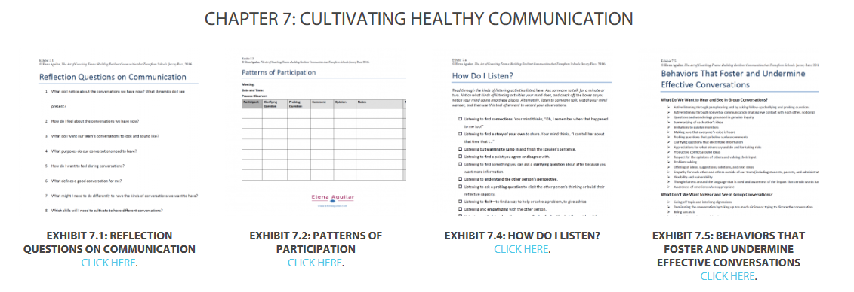

Slide 10
MTSS Professional Development

Slide 11
Housekeeping reminder- Substitute Reimbursement
The Department of Education will provide substitute reimbursement for REGISTERED participants.
PFA or IV needs to be completed within 30 days after the training. Please send completed PFA or IV electronically to Beth Draper (beth.draper@doe.k12.de.us).

Slide 12
ABCs of IEPs update
Strong connection between use of PTR and graduation of ABCs of IEPs
Sharing behavioral supports on the IEP with all team members working with the students

Slide 13
PEERS
Let’s Brainstorm:
What are your recommendations on how to continue to implement PEERS in the secondary level?

Slide 14
Tiered Fidelity Inventory (TFI) & Tier 2 Technical Assistance What is the TFI?
…A tool developed by the OSEP Technical Assistance Center for PBIS
…Encompasses all three tiers of support.
…Intended for use as a guideline for initial implementation as well as sustained use
…For our purposes, we are focusing on the Tier 2 section

Slide 15
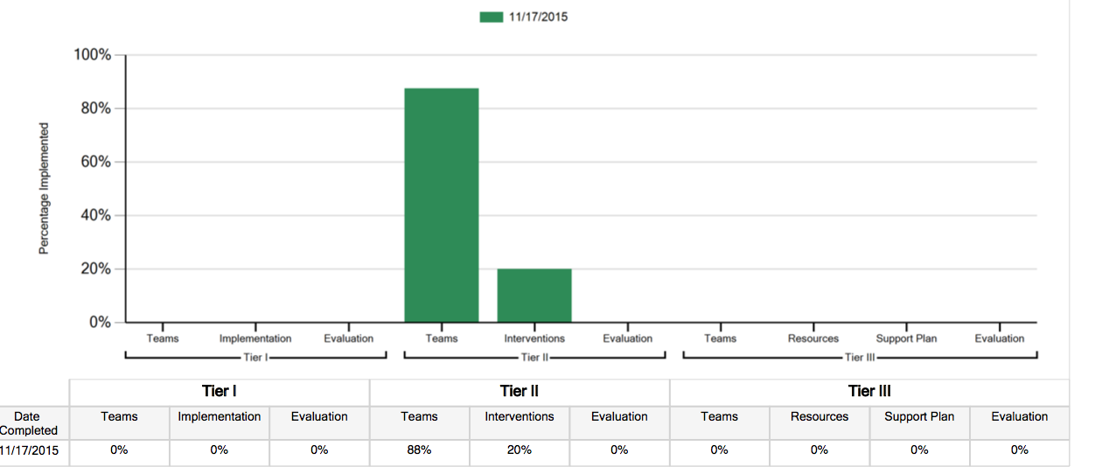
Subscales & Sample Graph
Team
Interventions
Evaluations

Slide 16
statewide tfi Tier 2 Summary
Statewide average for first TFI administration:
Teams: 77%
Intervention: 59%
Evaluation: 26%
Statewide Initial TFI average (15-16 SY)
Teams: 77%
Intervention: 65%
Evaluation: 20%
Statewide End of Year TFI average (15-16)
Teams: 91%
Intervention: 76%
Evaluation: 51%
N= 26 schools
Initial N= 12 schools; End of Year N= 8
Notes:
The top graph represents all initial TFIs across the 2015 and 2016. The N is 26, which is the total number of schools that have ever completed a TFI.
The bottom graph represents initial and end of year comparisons for the 15-16 school year. The initial TFIs only include schools that took the TFI in the Fall of 2015 (12 total schools). The end of year TFIs only include schools that took the TFI in the Spring or Summer of 2016 (8 schools total; all administrations were in May or June). August 2016 TFIs were not included, as they were likely taken as a baseline for the BOY scores for the 16-17 SY. Many of the schools that completed the TFIs in the Fall did not complete again in the Spring/Summer and one of the Spring/Summer schools did not complete the TFI in the Fall (i.e., the Spring was their first administration).

Slide 17
Tier 2 Supports
Training
Networking
Meeting Attendance
TFI Follow-up
Targeted Intervention Supports

Slide 18
Tier 2 Training Updates
Over 33 school teams trained since 2014
Schools receiving a PROFICIENT or EXEMPLARY on most recent KFE are invited to attend
16 schools attended our networking session
26 schools have completed the TFI Tier 2

Slide 19
Coming Soon
Project Coach Attendance at Tier 2 meetings
Follow-up TFI support in May
Additional opportunities to complete TFI
Assistance with action planning around Tier 2 supports

Slide 20
Secondary Forum – 2/14/17
Topics include:
Revitalizing a Team (Dover High)
Summer Planning
Team Leadership
Student Leadership
Universal Screeners
Tier 2 Programming
High School & Middle Schools
Pre-PD Survey

Slide 21
Collaboration around Trauma Informed Practices
Eliza Hurst & Compassionate Schools Initiative
topics
DSEA plans for professional development
Integration with DE-PBS professional development
Self-care PD interest

Slide 22
School Climate Data workshop -5/11/17
Open to all participating schools & district support staff
Del-tech – Dover, DE
Morning workshop
Statewide overview
Understanding data reports & interpretation tools
Staff & student voice
Data Processing Time
2016-17 Staff Data Report – Early Distribution

Slide 23
SWPBS Team Training – 6/28/17
SWPBS Team Training – 3 session series (2 summer, 1 fall)
Think of potential teams based on interest and need
Support Readiness
Planning with administration; Administrator buy-in is key
Discussion of team structure
Overview of MTSS & Tier 1 efforts

Slide 24
New! Online Module Series

Slide 25
Promoting Positive Relationships Online Module Series
Supported as part of the School Climate and Student Success Grant (SCSS)
Goal of the series is to provide information to schools that can lead to improvements in school climate and behavioral outcomes
Each module is presented in the form of approximately hour-long PowerPoint sessions

Slide 26
Relationships Modules
The first two modules focus on relationships:
Student-student relationships
Teacher-student relationships
The presence of both positive student-student and teacher-student relationships in schools has been shown to lead to a multitude of positive academic and social-emotional outcomes for individual students as well as for classrooms and schools as a whole.

Slide 27
Relationships Modules
The two relationship modules will provide educators with:
An overview of what student-student and teacher-student relationships are, why they are important, and the factors that contribute to both positive and negative relationships
Recommended research-based strategies to improve these two types of relationships
Resources and tools (available to download) to support the development of positive relationships
Research-based module narratives (that serve as the basis for the PowerPoint presentations) that focus on each type of relationship in great detail

Slide 28
Potential Uses
In-house professional development
Materials can be accessed for use as:
A whole staff
In professional learning communities
Leadership teams
Individuals

Slide 29
What’s Available Online
Module presentations (with audio)
Slide narratives for the PowerPoints
Handout versions for note-taking
Module Research Narratives
Links to Resources that are referenced throughout the presentations
E.g., sample forms and worksheets, informational sheets and guides, useful tools, etc.

Slide 30
How to Access the Modules
Delawarepbs.org → SCSS Modules
http://wordpress.oet.udel.edu/pbs/scss-modules/student-student-relationships/
http://wordpress.oet.udel.edu/pbs/scss-modules/teacher-student-relationships/

Slide 31
Future Module Topics
Coming soon!
Integrating the SWPBIS and SEL approaches
Bullying Victimization and Prevention
Reminder –
Team Leader Module 1 available for all team leaders

Slide 32
DE-PBS Phase Recognition
2016-2017

Slide 33
2015-2016 Summary
21 schools recognized
9 Districts
Introduced Phase 4

Slide 34
2016 – 2017 – Available Phases
Phase I- Developing a SWPBS System
Phase II- Establishing an Advanced SWPBS System
Phase III- Developing a Targeted Team (Problem Solving Conversations)
Phase IV- Establishing a Targeted Team (Systems Conversations)

Slide 35
2016 - 2017
Applications updated
Reflection Guides updated
New Phase 2, 3, and 4 FAQs

Slide 36
Additional Dates
Applications due Friday, June 30, 2017
If confirmation is not received by July 14, 2017 please contact Melissa Ebling.
District Coaches or Project Staff can review applications beforehand if received by May 1, 2017
If a KFE is required or wanted, please contact Lynn Moss (lynnlm@udel.edu) no later than April 18, 2017
Notifications sent the week of September 14, 2017

Slide 37
MTSS Coaching supports
Data tools & strategies

Slide 38
Coaching supports – Thinking Ahead
Planning for summer team time
Discussing team leader transitions as needed
Discussing team membership transitions as needed

Slide 39
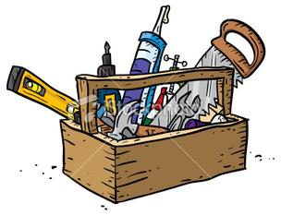
Tier 1 – School-wide PBS Team Meeting Checklist
Use as a coach supporting a team leader
Use as a team leader reflecting on practices
Includes prompts for prior, during and after Tier 1 team meetings

Slide 40
Tier 1 – Buy-in Checklist
Use as a coach supporting a teams
Provides questions to facilitate problem-solving
Includes various avenues to gaining buy-in

Slide 41
DDRT & DASNPBS
DE Assessment of Strengths and Needs
10 question survey per implementation area
Staff perspective on program strength/weakness for use in planning
Discipline Data Reporting Tool (DDRT)
Template available on website
Submission 2x per year
January 13th
June 23rd

Slide 42
School Climate Survey 2016-2017
Timeline
Logistics
Enrollment: open through 11/4/16
Survey window:
Staff: 11/14/16 - 12/16/16
Student and Home: 1/9/17 - 2/24/17
Results: May 2017
Workshop May 11, 2017
Student, Staff, Home Versions
Paper & Online Options
Home ONLINE
Survey Contact per school
Coordinator Checklist

Slide 43
Newly Published Study!
School-wide Practices Associated with School Climate in Elementary, Middle, and High School
(Bear, Yang, Mantz, & Harris, 2017)
Large sample of 30,071 students in grades 3-12
Examined students’ perceptions of the use of 3 types of behavior management practices in their schools
Praise and rewards (positive techniques)
Punitive consequences
Teaching social and emotional competencies
And examined students’ perceptions of school climate

Slide 44
Findings
Praise and rewards for good behavior and teaching social and emotional competencies related positively with school climate
Higher perceptions of these techniques were associated with higher perceptions of school climate
Punitive consequences related negatively with school climate
Higher perceptions of this technique was associated with lower perceptions of school climate
Effects of teaching social and emotional competencies were nearly twice that of the use of praise and rewards
Stronger association between teaching social and emotional competencies and school climate than the other techniques

Slide 45
Supporting & Responding to Behavior
Evidence-Based Classroom Strategies for Teachers

Slide 46
Resource created by OSEP Technical Assistance Center on Positive Behavior Interventions and Supports to summarize positive classroom behavior management strategies for educators.
Strategies are most effective when implemented within a school-wide framework that directly link to classroom practices, supports effective instructional design and delivery, and use classroom based data to guide decision making.
Includes:
Interactive map of classroom PBIS strategies
Self assessment
Examples and non examples of critical practices
Links to resources
Scenarios that illustrate implementation.

Slide 48
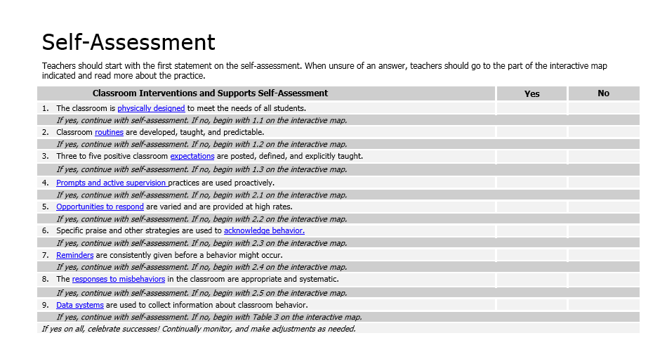

Slide 49
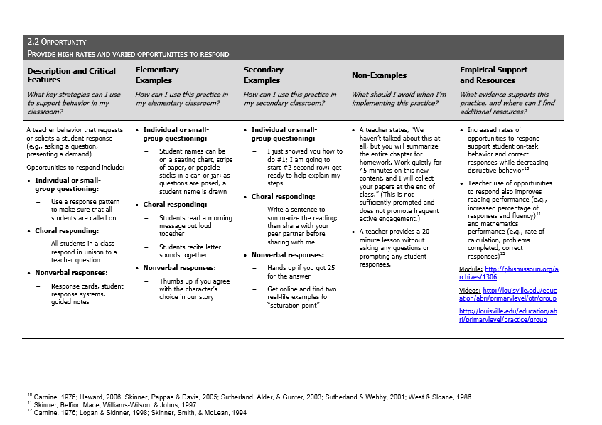
For more information see: http://www.pbis.org/common/cms/files/pbisresources/Supporting%20and%20Responding%20to%20Behavior.pdf

Slide 50
How could this tool be used in your schools?
Professional development for entire school/team
Professional development for targeted staff members
PLC discussions
Self assessment for teachers
Guide for planning Tier 2 or Tier 3 behavioral supports
Use of strategies as universal (Tier 1), intensified for small group instruction (Tier 2) and/or amplified for individual students (Tier 3).

Slide 51
Developing Systems to Support Implementation of Positive Classroom Behavior Supports (PCBS)
Guiding questions:
Are foundational school-wide systems in place for all staff to enable successful implementation of PCBS?
Do all staff know what they are implementing and if they are doing it accurately?
Classroom Management Tool as a guide for professional development!
Do data indicate that staff members are implementing PCBS effectively?
For more information see: http://www.pbis.org/resource/1117/pbis-technical-brief-on-

Slide 53
Potential Next Steps
Review Technical Brief on Systems to Support Implementation
Consider supports needed from DE-PBS Project
Next meeting: Share ideas, what’s worked?

Slide 54
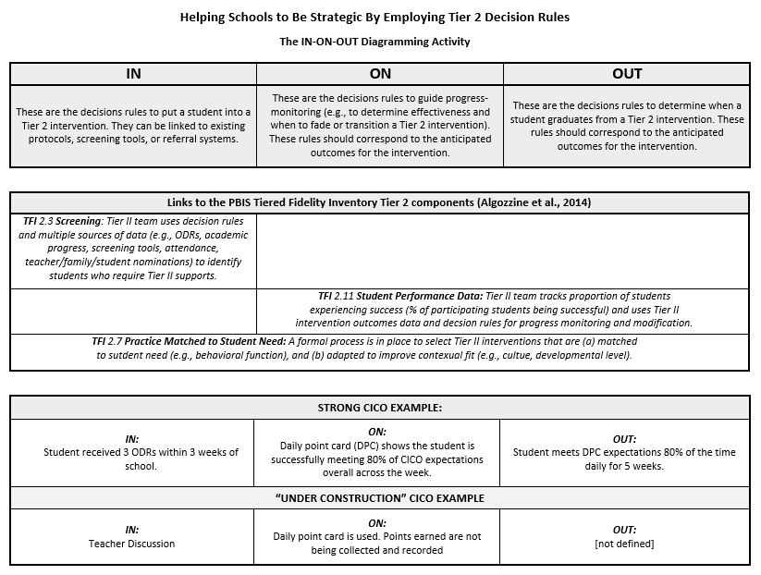
Tier 2 Supports

Slide 55
Your Tier 2 Interventions
 |  |  | Decision Rules:
Intervention Name | Contact Name | Type (S/R) | In | On | Out
Notes:
55

Slide 56
Integration & Communication
Second Step/SEL Curriculum
Compassionate Schools
SWPBS
Leader in Me
Teach Like a Champion
Responsive Classroom
Identify key components of each intervention or approach
Identify areas that share common aims, goals, and practices
Identify differences in key components and decide if these can enhance one another or should be modified or negotiated

Slide 57
Upcoming Event
Delaware's 23rd Annual Inclusion Conference
March 15, 2017
Keynote: Frances Stetson Shared Ownership: It’s Way Past Time! Addressing – No Longer Admiring – the Issue
Behavior Strand: Eric Rossen
Fundamental Considerations in Creating Trauma Sensitive Schools
Evening Parent Session: Eric Rossen
The Impact of Stress & Trauma on Your Child and What You Can Do About It
Notes:
Culturally Responsive Classroom: Strategies for Success—Frances Stetson
Fundamental Considerations in Creating Trauma Sensitive Schools—Eric Rossen
Blended Practices for Addressing the Social-Emotional Health and Well-being of Young Children—Jennifer Grisham-Brown
See Me, Feel Me, Touch Me, Hear Me: Creating Accessible Literacy Experiences for All—Judie Schoonover
Dual Language Learners: The Hows and Whys of Delivering Culturally Relevant Instruction — Barbara Rodriquez

Slide 58
Upcoming Event
Notes:
http://us2.campaign-archive1.com/?u=7a257abbdc5ffa7c7d9bf9b5f&id=729f3334e8&e
ECET² Delaware: Connecting Innovative Educators is a free conference that brings together educators from across the state for an inspirational and empowering day of teacher-led and teacher-focused programming. This event was formerly known as the Rodel Teacher Council Personalized Learning Workshop. The Cultivating a Calling Keynotes and breakout sessions will cover topics relevant to elementary, middle, and high school educators, as well as those in early childhood, CTE, and special education.

Slide 59
Please mark & protect your calendars for our Next DE-PBS Cadre Meetings on April 12, 2017

