Slide 1


Integrating the SWPBIS and SEL approaches
Research and recommended strategies
Lead author: Dr. Sara Whitcomb (University of Massachusetts Amherst)
Funding and support from:
DE Positive Behavior Support Project – School Climate & Student Success

Slide 2
Module Structure
Module series goal:
  Provide information to schools that can lead to improvements in school climate and behavioral outcomes.
Module narratives provide additional information to accompany PowerPoint Presentation.
  Endnotes throughout slides correspond to the references in the module narrative.
Gold star = Resource on Delaware PBS website

Slide 3

A Big Thank You: Credit Given To
George Bear, University of Delaware
Rob Horner, University of Oregon
George Sugai & Brandi Simonsen, University of Connecticut
Bob Putnam, The May Institute
Sarah Fefer, University of Massachusetts
www.pbis.org
SEL4MASS (sel4mass.org)
CASEL (www.casel.org)

Slide 4
Agenda
Rationale for Integrating/Aligning initiatives
PBIS Review
SEL Review
Research and Practical Strategies for Integration

Slide 5
The Problem
1 in 5 students have social-emotional challenges that could be diagnosed.
70% of children do not get services they need.
Mental health problems and challenging behaviors are associated with:
  Poor academic performance
  Dropout
  Unemployment
  Struggles with friendships and relationships

Slide 6
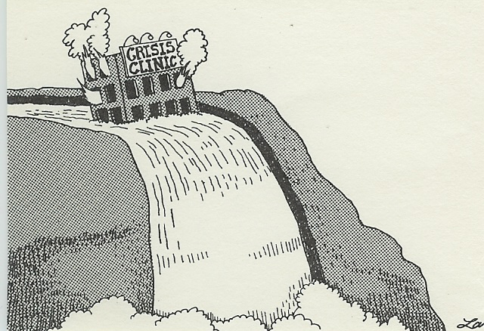


Slide 7
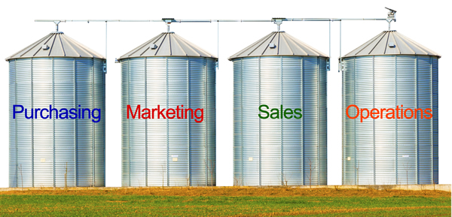
Silos in Research and Practice
Climate
PBIS
SEL

Slide 8
In a randomized controlled group study of SWPBIS in elementary schools in Maryland, Bradshaw et al. (2010) found an average of 5.1 programs were being introduced in each school on “character education and /or development, social-emotional or social skills, bullying prevention, drug prevention (e.g., D.A.R.E.), and conflict resolution and/or peer mediation” (p. 146).
Integration matters!

Slide 9
Model for Prevention
PBIS
(Structure)
SEL
(Support)
Positive School Climate
Internalizing Problems
Externalizing Problems

Slide 10









Positive Behavioral Interventions and Supports (PBIS)

Slide 11
Positive Behavioral Interventions and Supports (PBIS): Supporting the positive behaviors of all children
Coordinated data-based decision-making and instructional programming that focuses on teaching adaptive behaviors and discouraging disruptive behaviors across contexts
Is developmentally appropriate
Spans multiple years
Based on research and systematically evaluated

Slide 12
Tertiary Prevention:
Specialized
Individualized
Systems for Students with High-Risk Behavior
Secondary Prevention:
Specialized Group
Systems for Students with At-Risk Behavior
Primary Prevention:
School-/Classroom-
Wide Systems for
All Students,
Staff, & Settings
Multi-Tiered Assessment and Intervention Logic

Slide 13
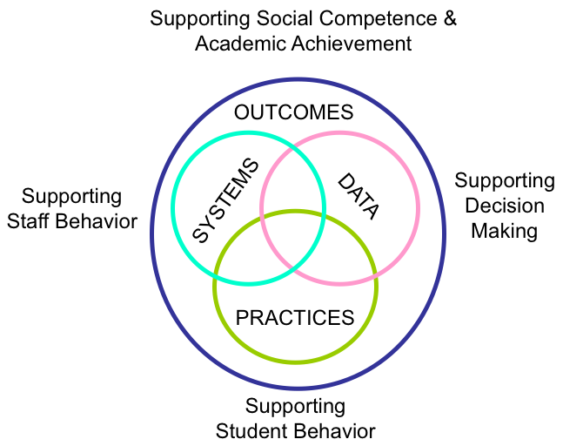

Slide 14
Outcomes
Systems
Data
School climate, discipline, academic performance, attendance, nurse visits, counselor contacts
Team-based leadership, coaching support, data-based decision-making protocols, developed procedures and materials for implementing assessment and practices, active supervision protocols
Climate surveys, office disciplinary referrals, academic and behavioral screening information, attendance and tardy data, frequency of nurse/counselor contacts, fidelity checklists and observations
Practices
3-5 defined school-wide expectations, procedures for teaching and acknowledging expectations, procedures for discouraging problem behaviors, procedures for using data to target needed practices.

Slide 15
Evidence-Base
SW-PBS has the largest research base out of any school-wide intervention⁶
  Lower levels of discipline^{7,8}
  Improved perception of safety in school⁸
  Improved academic performance⁸
  Improved perceptions of organizational health^{8,9}

Slide 16

Strengths of SWPBIS
Well-defined strategies for implementing practices in classroom and non-classroom areas
Clear emphasis and guidelines on structures and systems to enable schoolwide implementation.
Well-developed systems for office disciplinary and implementation fidelity data management and use (e.g. www.pbisapps.org)
Aim is for approach to be context-specific and culturally relevant

Slide 17

Potential pitfalls of SWPBIS
Given short-term aims of PBIS for managing behavior school-wide, not enough emphasis might be placed on the development of long-term life skills
There may be potentially harmful, overreliance on use of external rewards
While data management and use is well-defined for office disciplinary referral information and implementation fidelity, schools may miss using other important data sources

Slide 18
Social and Emotional Learning (SEL)

Slide 19
Social-Emotional Learning (SEL): Ensuring the health of all children
Coordinated instructional programming that focuses on individual social and emotional skill development and infusion of skills across contexts
Is developmentally appropriate
Spans multiple years
Based on research and systematically evaluated

Slide 20
What is SEL?
Social and emotional learning involves the
development of social and emotional competencies and skills in 5 areas:
Recognize one’s emotions, values, strengths, and limitations
Self-awareness
Manage emotions and behaviors
to achieve
one’s goals
Make ethical, constructive choices about personal and social behavior
Self-management
SEL
Responsible decision making
Social awareness
Relationship
skills
Show understanding and empathy for others
Form positive
relationships, work
in teams, deal effectively with conflict

Slide 21
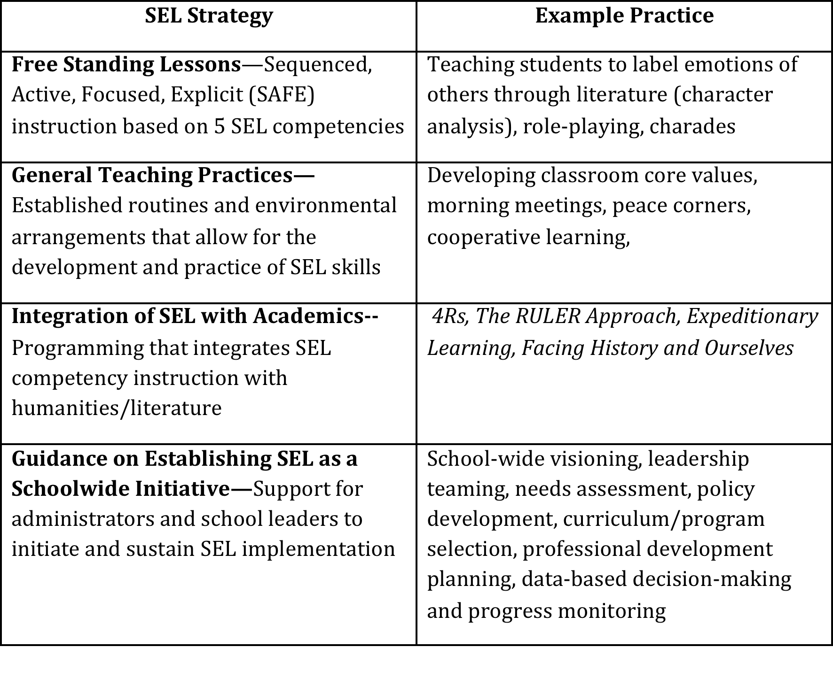

Slide 22
Evidence-Base
Increases in students’ social emotional skills
Increases in positive attitudes about others, self, and school
Increases in positive behavior
Increases in academic achievement
Significant reductions in emotional distress and problem behaviors

Slide 23

Strengths of SEL
Focus on the development of competencies that will foster wellness and development of supportive relationships across the lifespan
Availability of numerous, evidence-based curricula
Availability of a range of classroom structures that support practice of social-emotional strategies

Slide 24
Potential Pitfalls of SEL
It is sometimes difficult to clearly define the primary objectives of an approach or clearly operationalize and build school-wide consistency around desired strategies
External rewards might not be used at all, even when warranted
Fewer examples of data management systems and data use practices available that are clearly connected to the SEL curricula used or skills taught

Slide 25
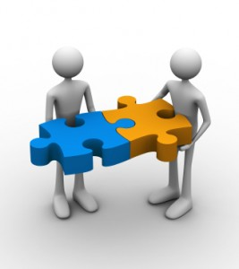
Why Integrate/Align?
To reduce fragmentation and redundancy.
Because SEL and PBIS complement each other.
Because SEL and PBIS in combination can enhance one another.

Slide 26
How Do We Integrate/Align?
Identify key components of each intervention or approach
Identify areas that share common aims, goals, and practices
Identify differences in key components and decide if these can enhance one another or should be modified or negotiated

Slide 27
Initial Effective Examples of Integration
PATHS to PAX-GBG
  Considered two approaches as one continuum (lessons, activities, practice)
  Developed one set of training materials
  Looked for overlapping practices and and adapted to create a common language and guidelines for consistent implementation
  Monitored implementation with developed fidelity tools
  Gained back 391 instructional minutes/week!!!

Slide 28
Integration Examples (cont.)
Strong Kids and CW-PBIS
    Combination of SEL and PBIS was highly effective for decreasing both externalizing (e.g. disruptive behaviors) and internalizing (e.g. depression, anxiety) behavior.
    PBIS was highly effective for externalizing behaviors and only slightly effective for internalizing behaviors.
    SEL was highly effective for externalizing behaviors and moderately effective for internalizing behaviors.

Slide 29

Primary Considerations and Recommendations for Integrating SWPBIS & SEL
Adapted from Bradshaw et al. (2014)

Slide 30
1. Commit to Coordinated Implementation of SWPBIS & SEL
Requires administrator involvement
  Setting the vision
  Allocating resources
  Planning for professional development

Slide 31
2. Obtain Staff/Community Buy-In
Ensure staff understand the key features, strengths, and weaknesses of both models
Have staff share existing examples of PBIS & SEL that they are already implementing in their classes
Build agreements in how to move forward

Slide 32
3. Engage Stakeholders to Form a Team
School Leadership Team
Grade Level Teachers
Counselor / School Psychologist
PE/Health
Teaching Assistants
Parent
SEL Master Teacher
Adminis-trator

Slide 33
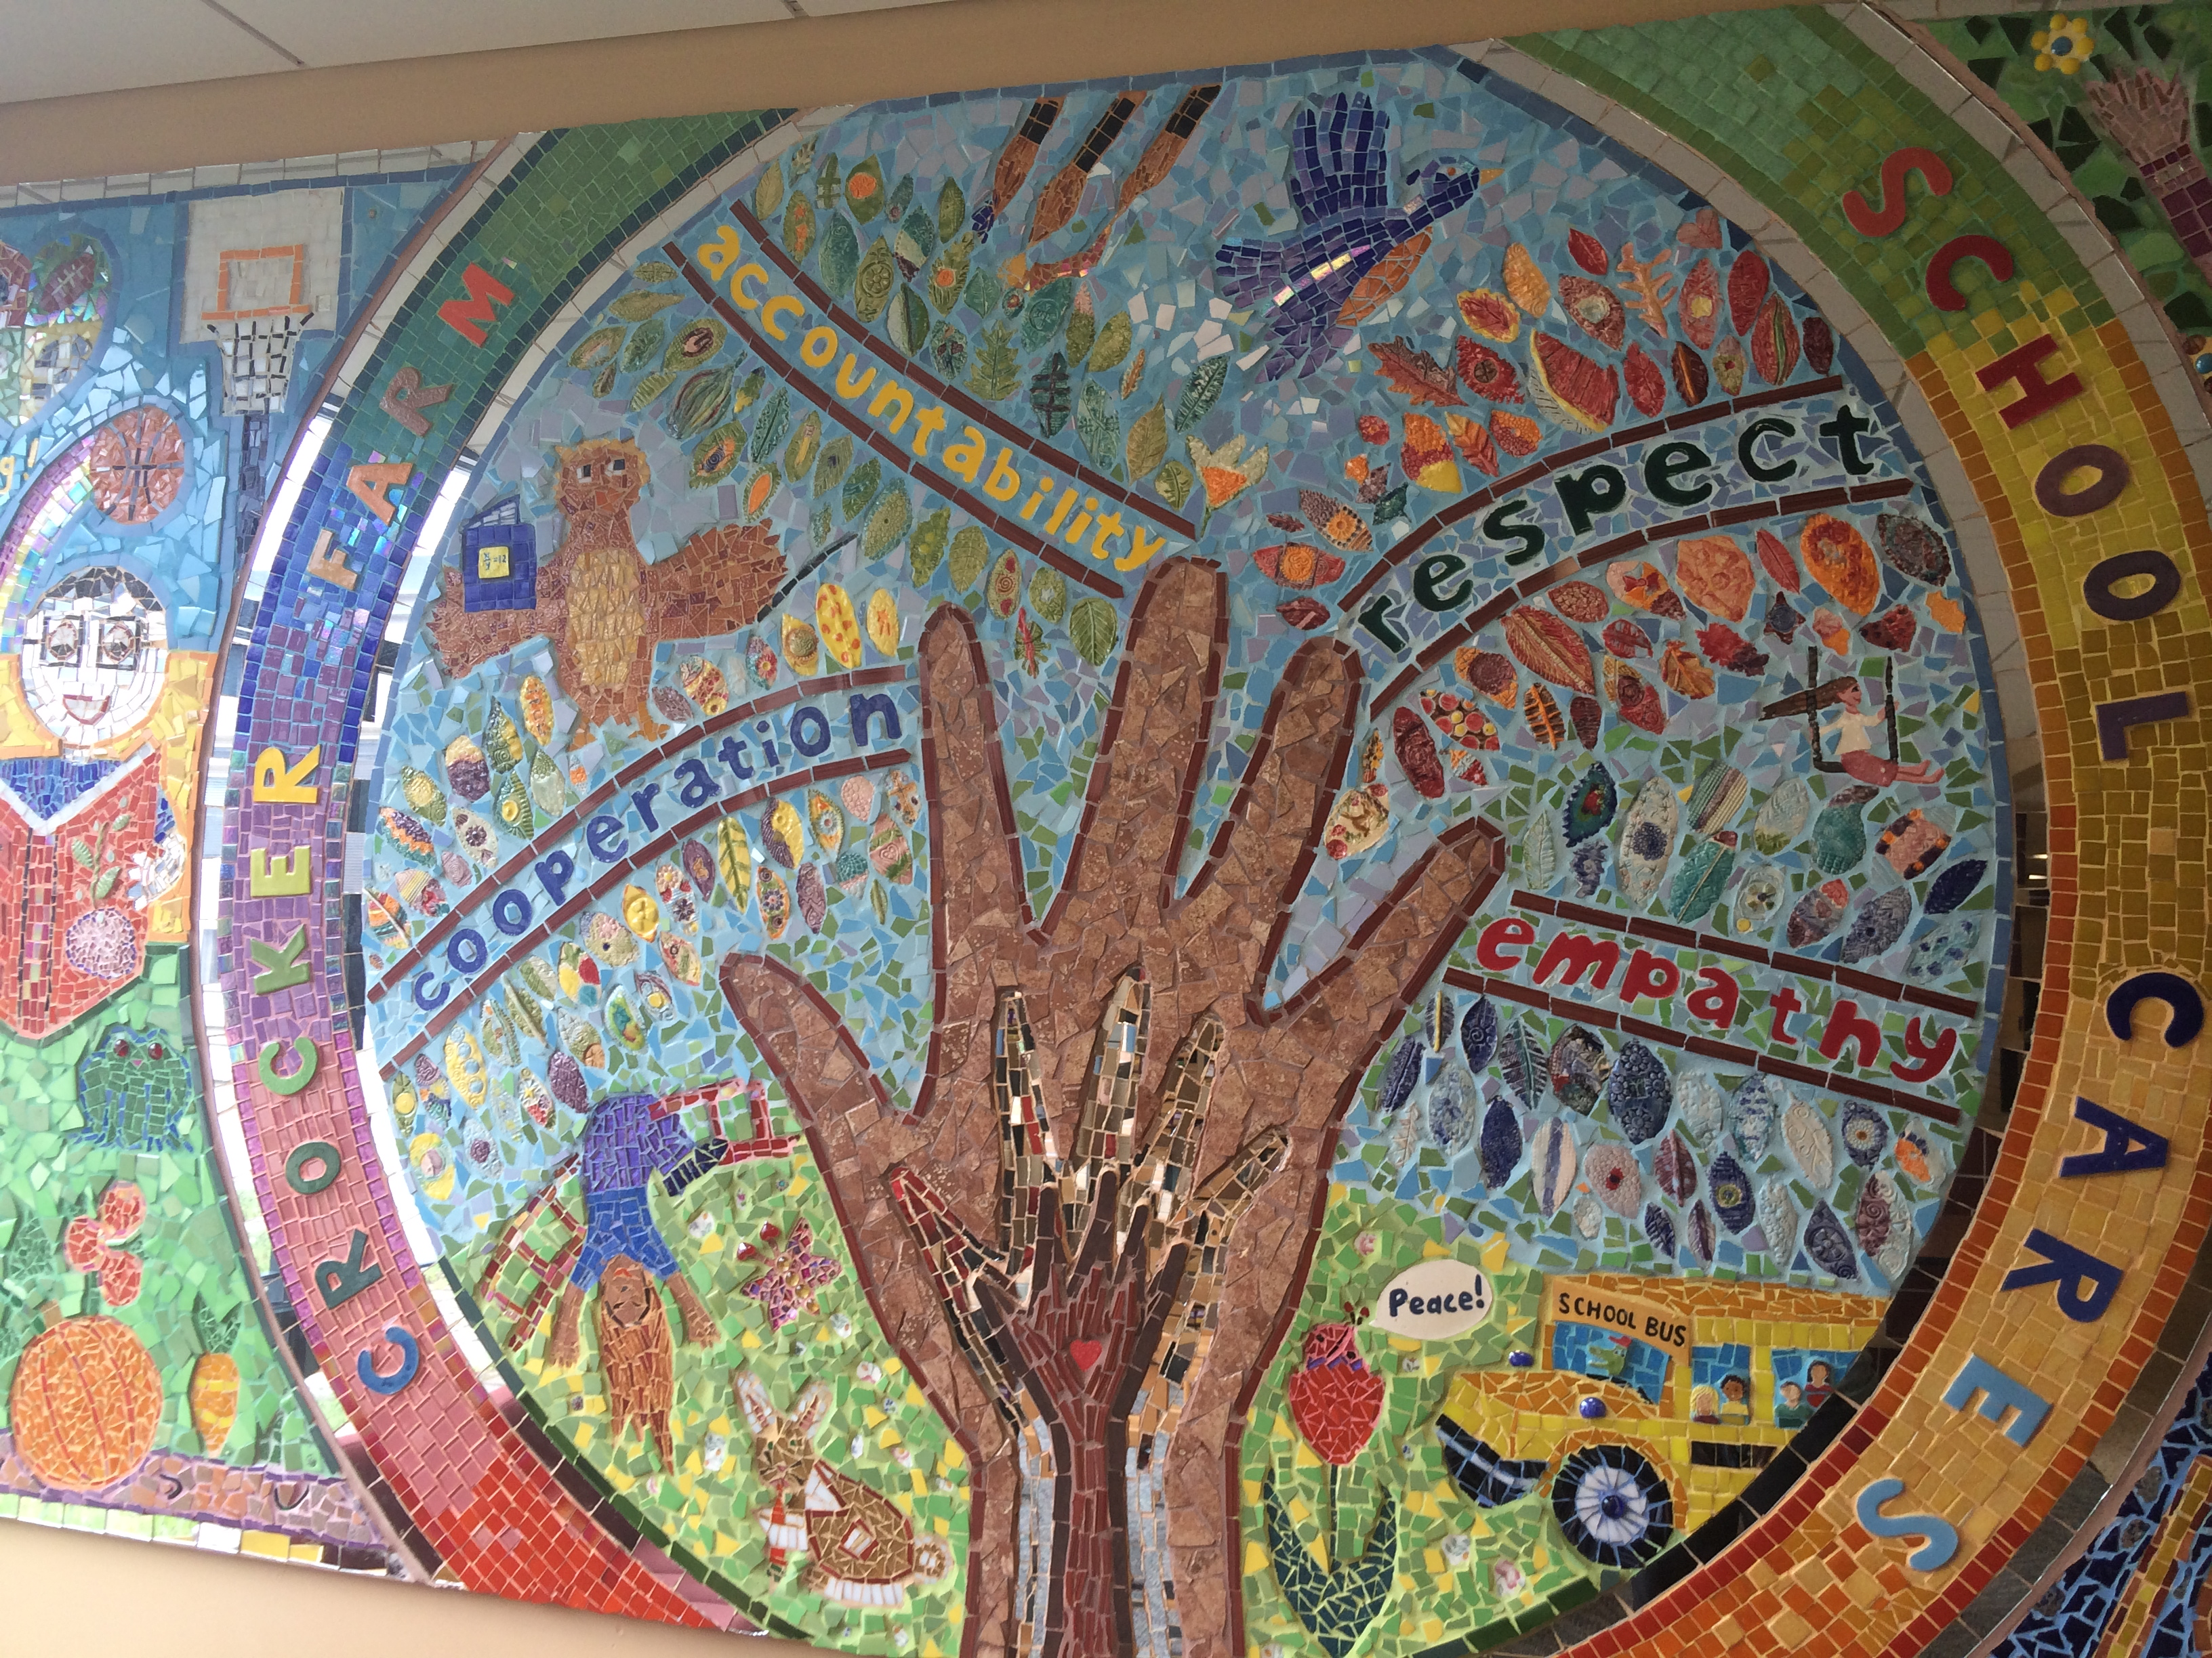
4. Develop a Shared Vision for Integrated Model
Engage in a visioning process with staff, students, parents
Consider how current SEL or PBIS efforts capture core values/vision of the school

Slide 34
5. Conduct a SWOT Analysis
What are the strengths of PBIS and our selected SEL program?
What are the weaknesses?
Where are there opportunities to integrate strengths and enhancements?
What barriers currently exist? What may be barriers to integration?
Do we need more information from our stakeholders (e.g. Delaware School Surveys¹⁸)

Slide 35
6. Use Data to Identify and Select Programming
Use SWOT data
Use extant data to identify important student outcomes to target school-wide:
  School Climate, Social and Emotional Competency, Student Engagement, and Bullying Victimization data (e.g. using the Delaware School Surveys)
  Office disciplinary referrals
  Nurse visits
  Counselor contacts
  Attendance data
Use extant data and requests for assistance to intensify support for some students

Slide 36

Example Request for Assistance Form
Number of ODR: __________ Number of nurses visits: ____________

Slide 37
7. Create an Integration Action Plan
Statement of purpose for integration
Create visuals/”cheat sheets” for teachers to easily use common language
Develop implementation measures that reflect integrated treatment integrity
Explicitly state strategies for maintaining faculty buy-in and orienting new faculty
Set up explicit opportunities for faculty to reflect on implementation and effectiveness
Create an implementation timeline

Slide 38

A Sample Cheat Sheet: Crosswalk SWPBIS with SEL
 | Cooperation | Accountability | Respect | Empathy
Understanding your Feelings |  |  | X
Understanding Other People’s Feelings | X |  | X | X
When You’re Angry | X | X | X | X
When You’re Worried |  | X | X

Slide 39
8. Develop Job-Embedded PD Opportunities
Become a Professional Learning Community dedicated to PBIS & SEL
Build in structures for PLC learning
  Give implementation updates at each faculty meeting
  Use exit tickets at faculty meetings to obtain feedback on implementation
  Use a portion of shared grade level planning time to observe grade level data and do classroom problem-solving
  Use new teacher orientation structures to insure SEL & PBIS implementation is occurring and to troubleshoot barriers.

Slide 40
9. Launch SWPBIS & SEL Together
Help students and staff to connect the dots!
Avoid confusion by giving this initiative one name
Create a calendar for implementation of lessons, practice, and activities

Slide 41
10. Develop an On-Going Technical Assistance Plan
Identify the role that internal coach can take to support implementation of PBIS & SEL
Identify needs for external consultation
Plan should include content, timeline, and format of assistance
District/statewide vision for integrated PBIS & SEL should also be considered in TA planning.

Slide 42
11. Use data to evaluate programming
Identify Problems
Hypothesize/Certify Problem
Explore and Select Solutions
Implement Solution
Evaluate Solution
Use implementation fidelity data
Use extant data, climate data, qualitative/informal data
Develop a problem-solving protocol to drive intervention planning and evaluation

Slide 43
Making a plan
Who is going to do
what actions by
when?

Slide 44
Thank you
Based on areas of need identified by data, check out other resources provided through the School Climate and Student Success Module Series.
www.delawarepbs.org
Questions can be directed to Sarah Hearn
skhearn@udel.edu

