Slide 1
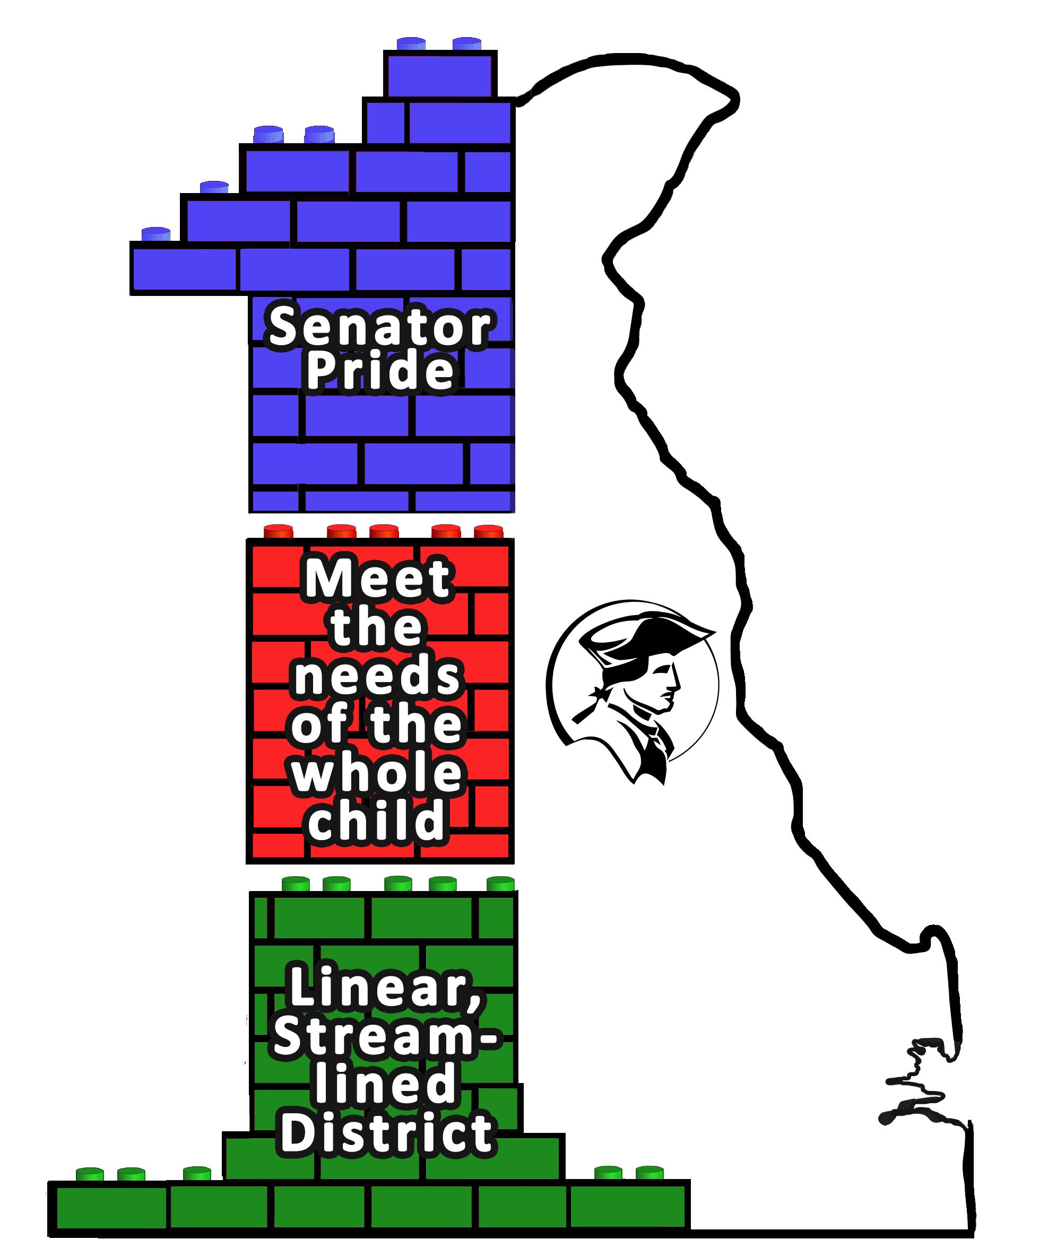
A Journey into Tier III Teaming
Dover High School
Capital School District

Slide 2
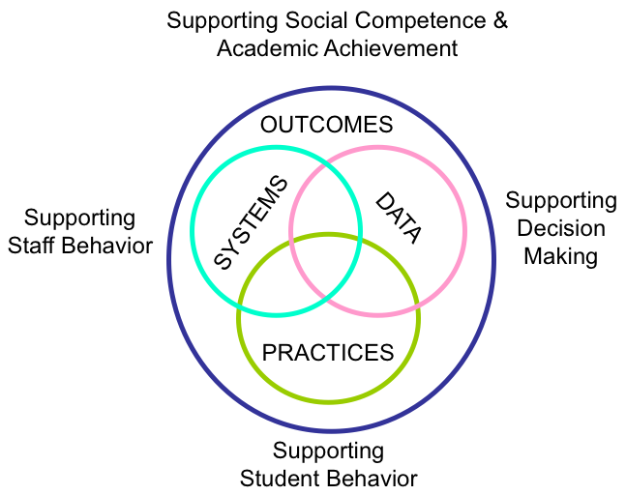
June 2018
District-wide Tier 3 Training
Notes:
District provided training in June of 2018 for “teams” with a focus on:
Myth-busting
Systems, Data & Practices
DHS administration recognized the need to explicitly separate from special education & assigned a dedicated AP to lead the team

Slide 3
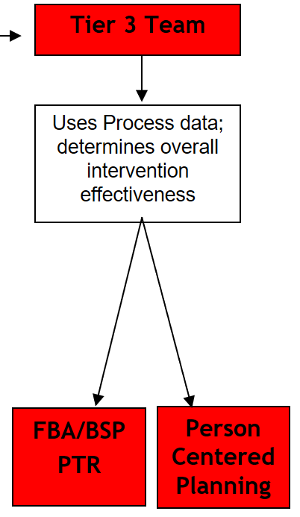
Summer 2018
Teaming & Initial Inventory
Notes:
Team formed with diverse representation (gen ed, special ed, counselors, Tier II leads, etc.). Monthly meetings with LOTS of work between.
Started with what they had – BIPs

Slide 4
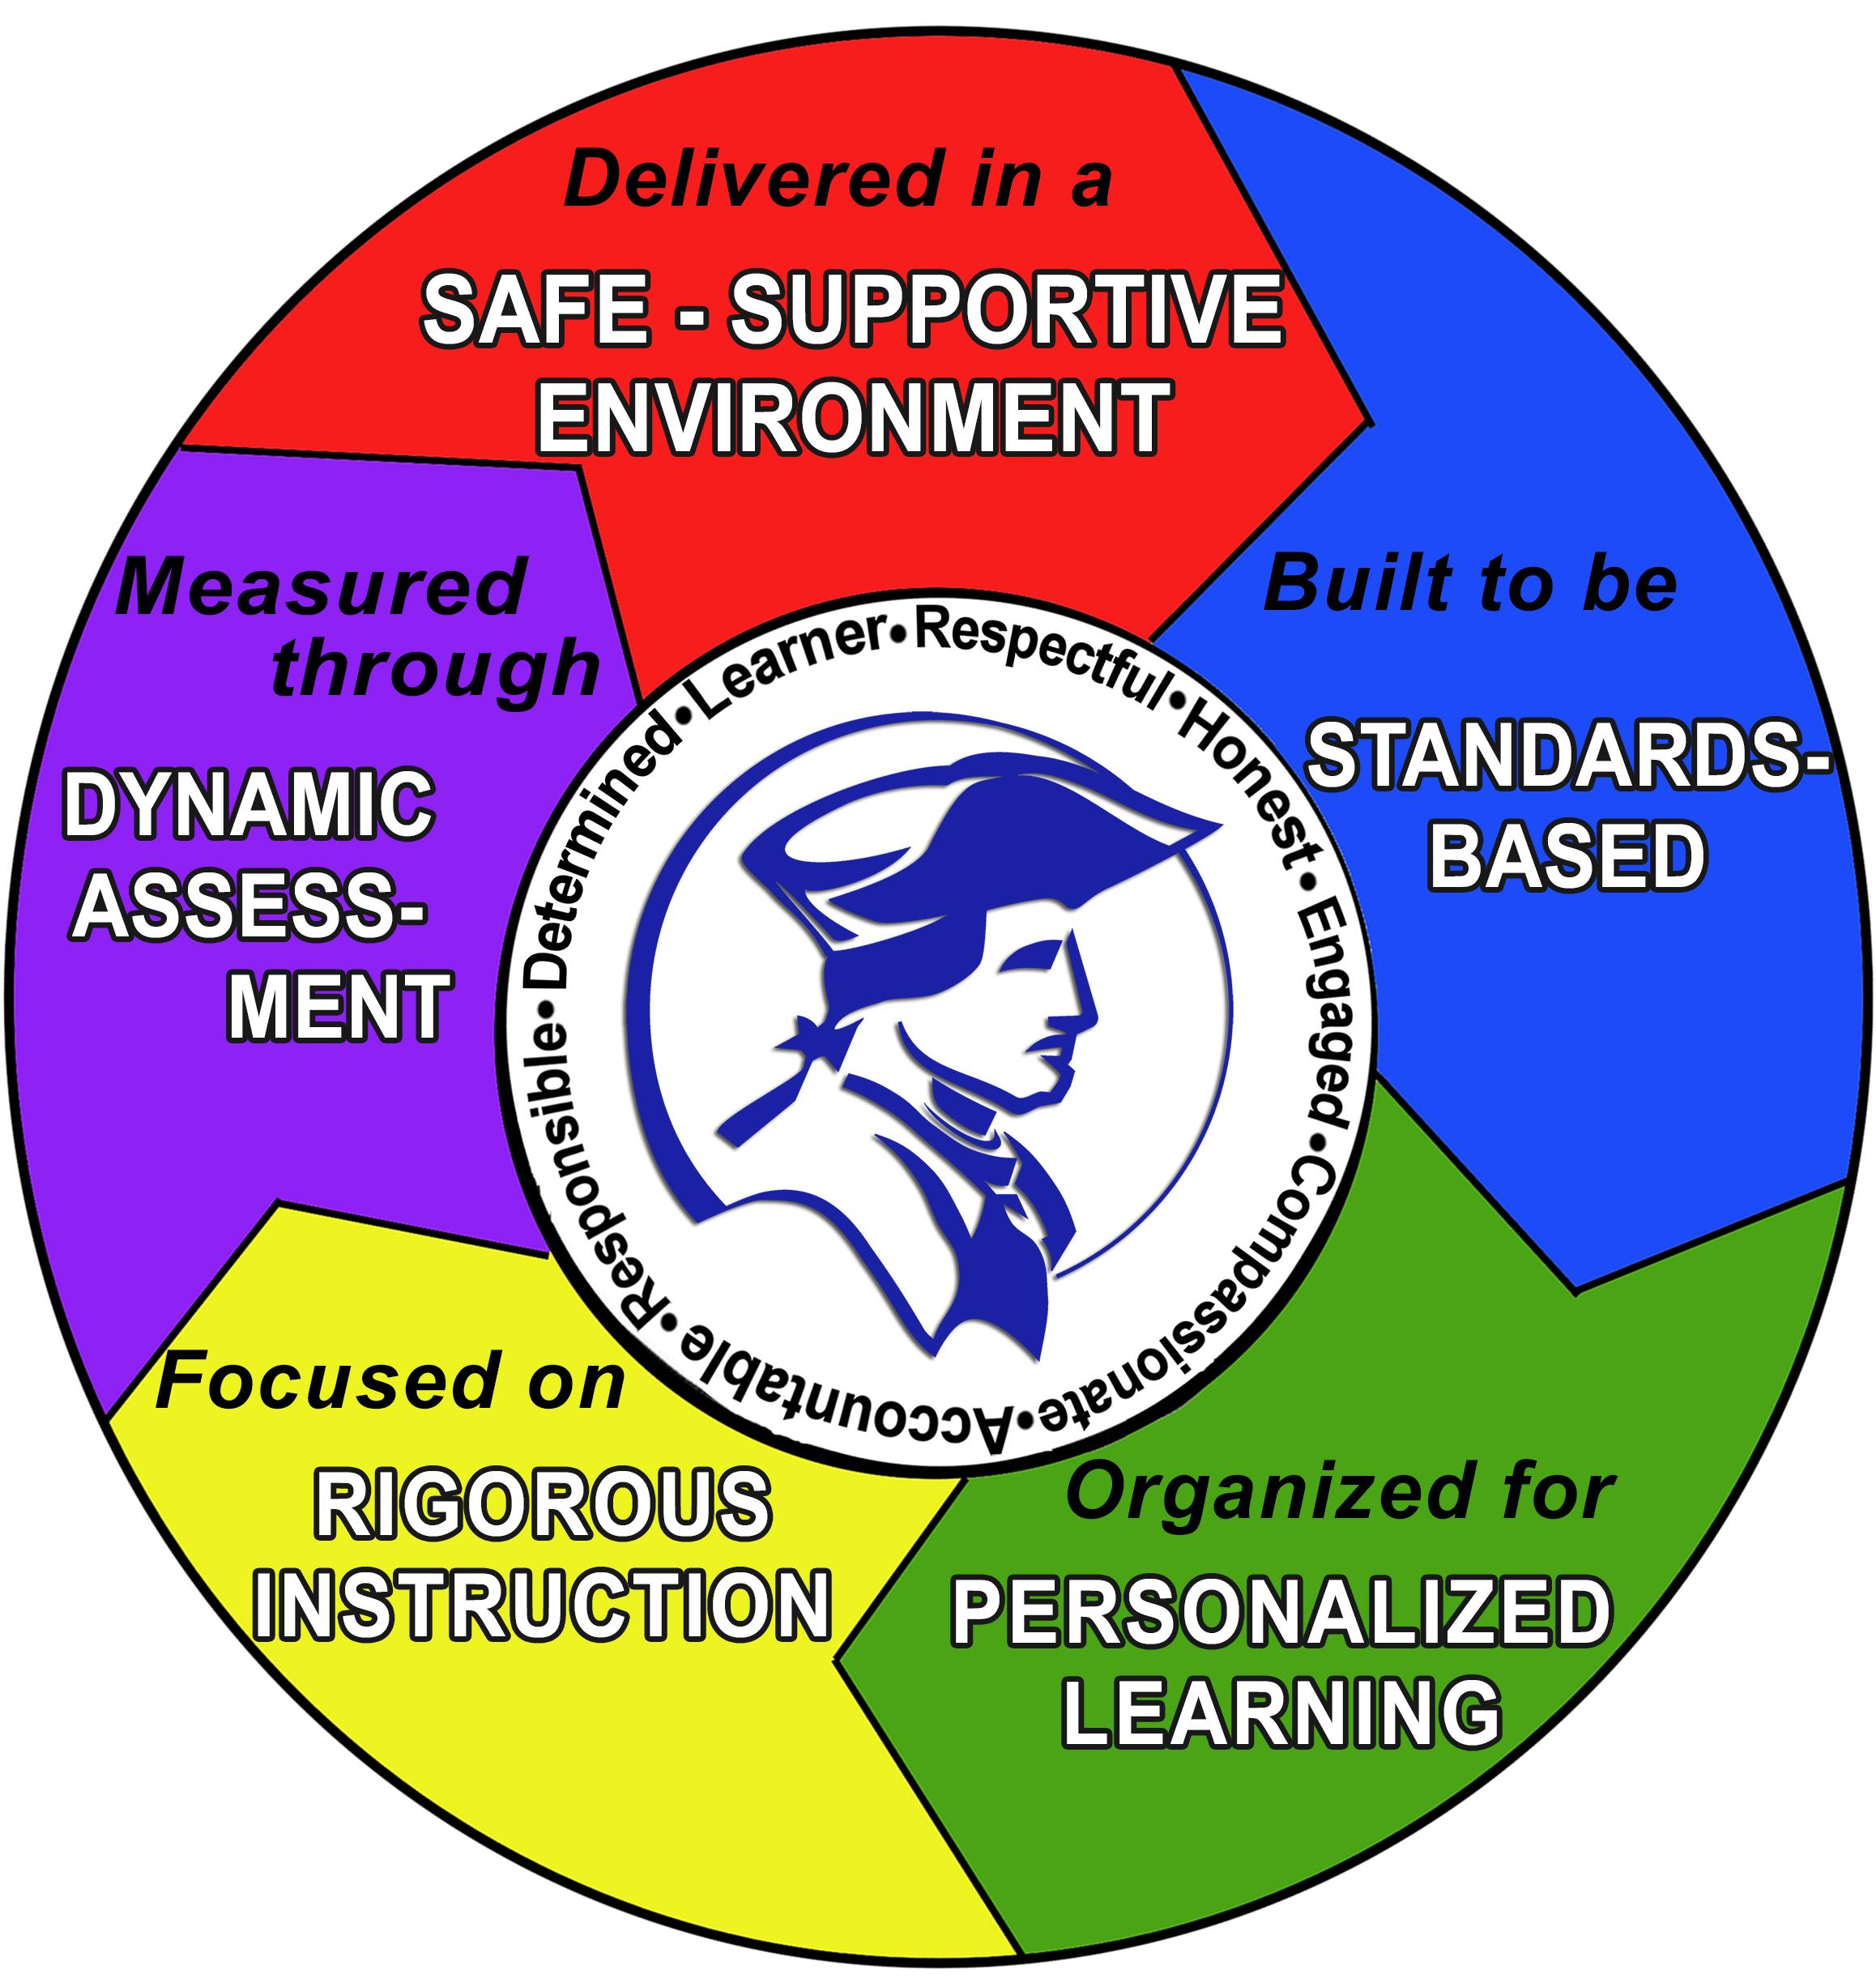
Fall/Winter 2018
Questions!
Notes:
Engaged the team in visioning. Questions considered:
Is Tier III only about BIPs?
Is Tier III only about behavior?
What about attendance? Academics?

Slide 5
Current Status
Notes:
Engage Tier II & Tier I on resource mapping
Build a specific Tier III tracking form (identification, progress monitoring, etc.) so we don’t lose kids!

Slide 6
Questions?
Terri Sharpe, Associate Principal, DHS
Terri.Sharpe@capital.k12.de.us
Joe Fuller, Special Education Department Chair, DHS
Joseph.Fuller@capital.k12.de.us
LaWanda Burgoyne, School Improvement Specialist, CSD
Lawanda.Burgoyne@capital.k12.de.us

