Slide 1
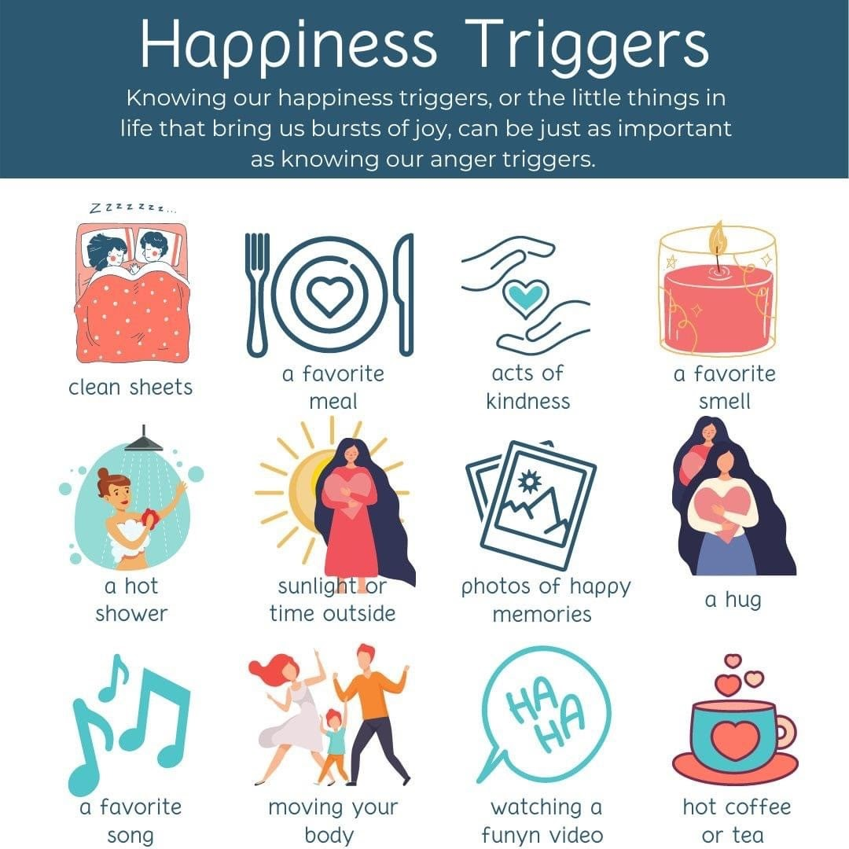
Welcome to the MTSS/PBS Tier 1 Team Training!
Please type one of your “happiness triggers” in the chat box. You can use one from the picture, or share your own

Slide 2
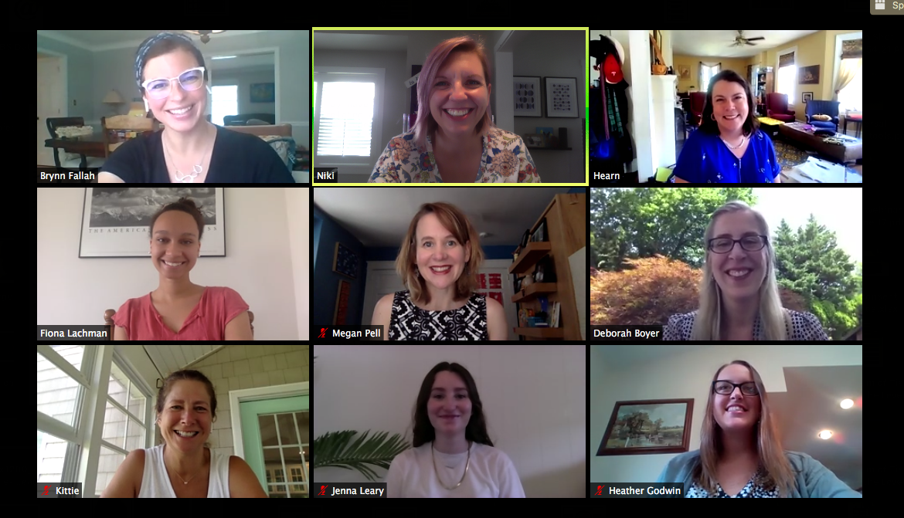
Mark Miller

Slide 3
Who is here with us?
Appoquinimink
Brick Mill Early Childhood
Caesar Rodney
Stokes Elementary
Robinson Elementary
Welch Elementary
Indian River
Georgetown Middle
East Millsboro Elementary
Selbyville Middle
Indian River High
Southern DE School of the Arts
Red Clay Consolidated
Stanton Middle
Cab Calloway School of the Arts

Slide 4
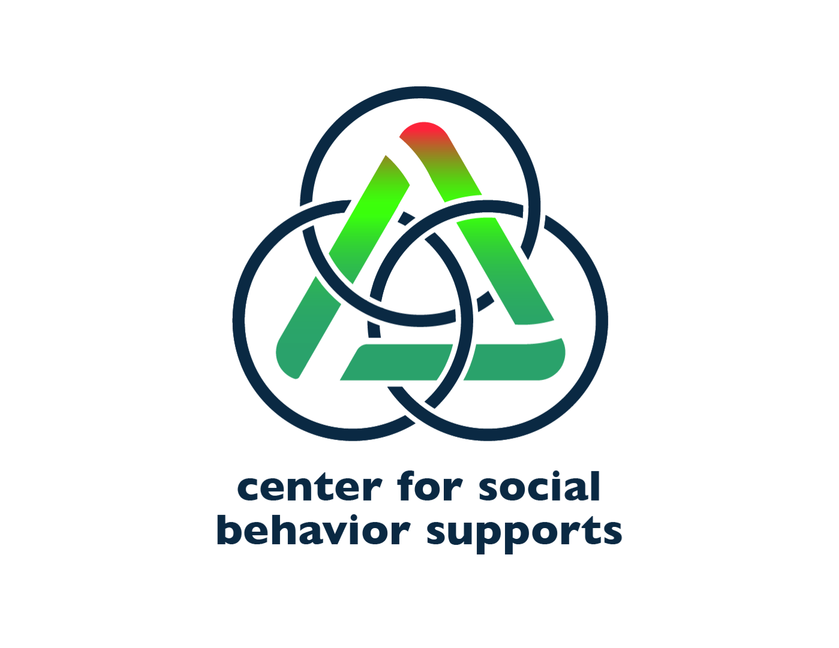
Appreciation is given to the following
for their contributions to this Professional Learning:

Slide 5
The DE-PBS Project serves as a technical assistance center for the Delaware DOE to actualize the vision to create safe and caring learning environments that promote the social-emotional and academic development of all children.
The statewide initiative is designed to build the knowledge and skills of Delaware educators in the concepts and evidence-based practices of Positive Behavior Support (PBS) as a Multi-tiered System of Support (MTSS).

Slide 6
DE-PBS Equity Mission
At the Delaware Positive Behavior Support Project, we are committed to improving outcomes for each student. Educational systems cannot be considered effective until they are effective for all students. A Multi-Tiered System of Support (MTSS) can be a force for dismantling systemic racism and promoting equity or serve to perpetuate oppression. In recognition that black lives matter and given centuries of oppression, violence, and segregation, we must increase our commitment to improving outcomes for Black, Indigenous, and other Students of Color. PBIS teams embed equity into their implementation of all aspects of MTSS.

Slide 7
Materials: Let’s go for a Drive
In the Tier 1 MTSS/PBS Training Drive you will find:
Slides in the Tier 1 MTSS/PBS Training PPTs Folder
These slides are view only, please make a copy
Final versions of the PowerPoint will be posted to our website/shared after the training
Handouts in the Individual School Folders
These materials and folders are not set to private. If you prefer a private workspace for your team, please copy the handouts to a new drive.
Samples of various materials in the Template folder
These materials are view only, please make a copy

Slide 8
Agenda
Day 1
Day 2
Morning 9 – 12:15
Topics: Overview of MTSS, Teaming, Data-based Decision Making
Presentations, team time, break
Lunch – 12:15 – 1:15
Afternoon 1:15 – 3:30
Topic: Responding to Problem Behavior, Action Planning
Presentation, team time
Morning 9 – 12:15
Topics: Establishing & defining expectations and Teaching plan
Presentations, team time, break
Lunch – 12:15 – 1:15
Afternoon 1:15 – 3:30
Topic: Creating + reinforcement systems that foster + relationships, Action Planning
Presentation, team time

Slide 9
Expectations for making the most of our time
BE ENGAGED | Share your experiences and ideas Ask questions via the chat box Turn video on for breakout rooms
BE REFLECTIVE | Compare the ideas shared to your current context and experiences Recognize areas of glow and growth Monitor your own reactions to content
BE STRATEGIC | Use the team time to work on school products Stay on task and use parking lot for issues you can’t address today

Slide 10
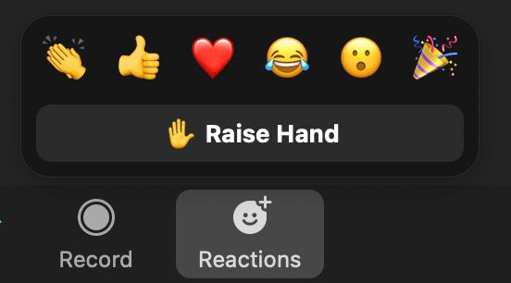
Team Time and Getting Help
We will have breakout rooms for you to use with your teams
We may pop in to check on you but this is your time
You can call us into your breakout room at any time if you need help
You can also use hand raise feature feature in the main room if you have a question or something to share
We may not see private chats right away while presenting or sharing our screen

Slide 11
Overview
Purpose:
Understand the rationales and foundational concepts of multi-tiered behavior supports; Learn specific strategies and tools for building a tier 1 system in your school and prepare for implementation
You should be able to:
Define MTSS/PBS
Understand Data, Systems, Practices as an MTSS framework
Identify ways to ensure equity within MTSS/PBS
Reflect on what your teams “why” and desired outcomes for implementing MTSS/PBS

Slide 12
Why are we here?
Need for prioritizing student social emotional and mental health needs
Support students exposed to trauma and chronic stress
Lack of student engagement
Inequities in education
Learning Loss
Attendance and drop out rate concerns
Negative school climate (for students, staff and/or families)

Slide 13
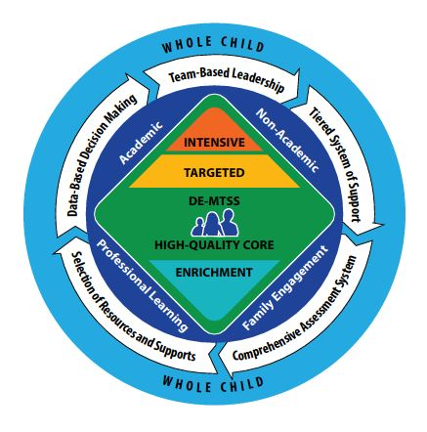
Delaware-Multi-Tiered System of Support (DE-MTSS)

Slide 14
What is Multi-Tiered System of Support (MTSS)?
A system-wide educational framework for
implementing school-wide, integrated tiered system of support for ALL students.
using evidence-based practices to support student academic and non-academic achievement.
MTSS integrates initiatives and brings together district and school-level teams
to evaluate and analyze current practices, establish a supportive infrastructure.
to use data to determine and improve student needs and outcomes.
to include families and community stakeholders.
Math
Reading
Behavior
Health & Wellness
Social-Emotional

Slide 15
Multi-Tiered System of Support
DE-MTSS
Response to Intervention
RTI
Social-Emotional Learning
SEL
Positive Behavior Support
DE-PBS
Delaware Early Literacy Initiative
DELI
Mental-Health
DelAWARE
Reimaging Professional Learning
RPL
Universal Design for Learning UDL
DE State Literacy Plan
Trauma Informed Practices

Slide 16
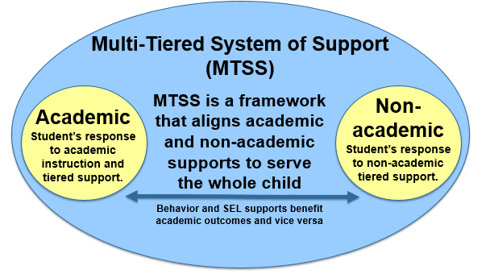
DE-MTSS Integration
Academic and Non-Academic MTSS share elements of quality instruction and effective systems change in an equitable manner*
Use these shared elements to make a more cohesive system for implementing equitable practices that are culturally and linguistically responsive
Integrated approaches may be more sustainable at all levels of the system
Decrease initiative overload across initiatives.
Capacity building of educator skills in one MTSS area can can be applied in other areas of MTSS (data analysis, problem solving, etc.)
*(McIntosh, Goodman, & Bohanon, 2010; Stollar, Poth, Curtis, & Cohen, 2006)

Slide 17
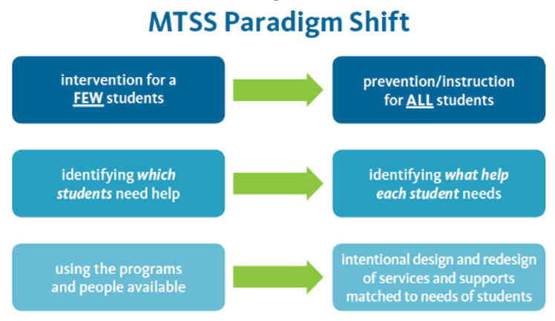
Major Shifts of MTSS
Source: Diaz, Andi. "RTI versus MTSS." https://blog.istation.com/rti-versus-mtss
Source: Diaz, Andi. "RTI versus MTSS." https://blog.istation.com/rti-versus-mtss

Slide 18
Connection to Regulation 508 MTSS
MTSS regulations address general education core academic and non-academic instruction for every student, including those with disabilities.
3.0 Instructional Resources
LEAs shall evaluate and select instructional resources for Tier 1, and interventions for Tier 2 and Tier 3, for academic, behavioral and social-emotional skills which are of high quality, evidence-based and aligned with the State’s appropriate content standards.
https://regulations.delaware.gov/register/january2021/final/24%20DE%20Reg%20663%2001-01-21.pdf

Slide 19
What is PBIS
a data-driven decision making framework for establishing the social culture and behavioral supports needed for a school to be an effective learning environment (academic and social emotional behavioral) for all students. Since contextual fit is a core principle of SWPBIS, it cannot be considered fully implemented until it is culturally responsive.
(Leverson, Smith, McIntosh, Rose & Pinkelman, 2016)
Increase Effectiveness and Efficiency
Process for Continuous Improvement
(OSEP Center on PBIS, 2010)

Slide 20
TIER II: Supplemental, Targeted
TIER III:
Intensive, Individualized
Continuum of Academic & Social Emotional Behavior Support
Tier 3 for a Few: Intensive, Individualized
5%
10%
Tier 2 for Some: Targeted for Small Groups
80%
Tier I for All: Core/Universal

Slide 21
All Students -- All Needs
Meet needs of the whole child:
Behavior
Social Emotional
Academics
Mental Wellness
Relationships, Empathy & Perspective-Taking allow us to:
Trauma informed
Culturally responsive
Equitable use of practices

Slide 22
What does your continuum look like?
T3: FBA/BIP, Wrap Around, Cognitive Behavioral Therapy
T2: 2 x 10, Check In Check Out, Small Group Support for Social Skills, Small Group Instruction for Academics, Informal FBA
T1
Intentional Positive Relationship Building with students, staff, families
School-wide expectations defined, posted, explicitly taught, reinforced, and corrected
SEL skills defined, explicitly taught and embedded throughout instruction
Restorative practices to build relationships

Slide 23
Asset Mapping your school PRACTICES
Intervention Names Coordinators Intent/Outcome Goal
Tier 3
Tier 2
Tier 1

Slide 24
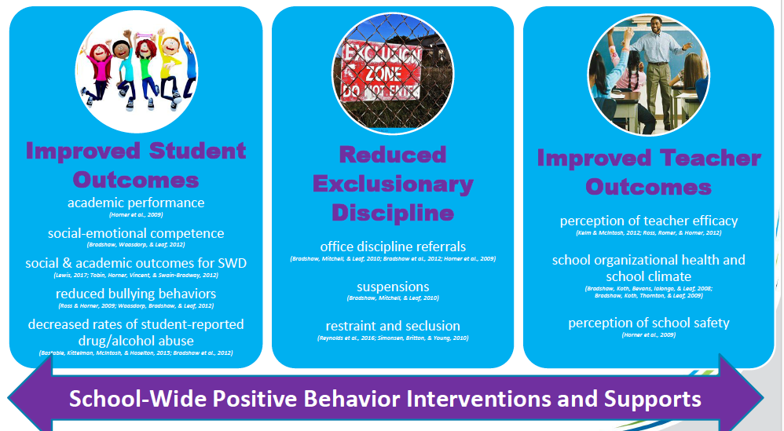
Outcomes associated with Implementation
(George, H. 2018)

Slide 25
Black Students Feel Less Welcome in Schools with Discipline Disproportionality Bottiani, Bradshaw, & Mendelson, 2017
Black high school students who attend high schools where they are disproportionately suspended, more so than White students, feel lower levels of school belonging and fair treatment.
This in turn was also associated with higher levels of mental health symptoms.
These associations persisted even when accounting for school diversity, socioeconomic status, and overall suspension rates.
This is the first study that objectively characterizes schools based on excessive suspension of black students and asks what message this differential treatment sends to kids about their place in the school. Disproportionality can have an impact on students, whether they are suspended or not.
APA Press Release: https://www.apa.org/news/press/releases/2016/10/black-students-suspensions

Slide 26
A Look at 65 Wisconsin Schools
Implementing Behavior & Reading Focused Equitable Multi-Level Systems of Support (MLSS) with fidelity over time
Evaluative and not experimental design
Outcomes suggest that schools, to some extent, are removing obstacles to learning for students who have been historically marginalized
Swain-Bradway, J., Gulbrandson, K., Galston, A., & McIntosh, K. (2019). Do Wisconsin Schools Implementing an
Integrated Academic and Behavior Support Framework Improve Equity in Academic and School Discipline Outcomes?
OSEP Technical Assistance Center on Positive Behavioral Interventions and Supports. www.pbis.o

Slide 27
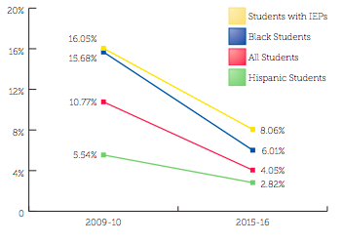
Do schools implementing MLSS show improved outcomes & equity in suspension rates?
(Swain-Bradway, Gulbrandson, Galston, McIntosh, 2016) Wisconsin MLSS

Slide 28
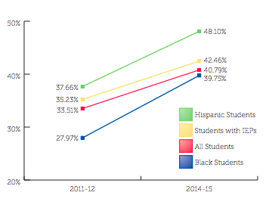
Do schools show improved outcomes & equity in the % of students meeting MAP Benchmarks?
(Swain-Bradway, Gulbrandson, Galston, McIntosh, 2016) Wisconsin MLSS

Slide 29
Outcomes
Identify measurable targets connected to your organization’s priorities and needs
For example:
Equitable Disciplinary Practices
Social and Emotional Competence
Academic Achievement
Organizational Climate and Culture
Student College and Career Readiness
Student Community Readiness
Behavior
Mental Wellness
Relationship Building
Building protective factors for students who experienced trauma
etc.

Slide 30
Put a star next to your top 1-3 outcomes, or type your own
Equitable Disciplinary Practices
Social and Emotional Competence
Academic Achievement
Organizational Climate and Culture
Student College and Career Readiness
Student Community Readiness
Behavior
Mental Wellness
Relationship Building
Building protective factors for students who experienced trauma
Additional outcomes:

Slide 31
DATA
Establish comprehensive universal screening measures (entry and exit criteria) for internalizing and externalizing needs
Select which evidence-based practices to install
Team data-based problem solving for decision-making
Continuous data-based progress monitoring of organizational and student outcomes (grades, attendance, referrals, perception, equity, etc.)
Process for layering up supports
Evaluation of implementation fidelity
Items in bold denote core features of MTSS
McIntosh, K.& Goodman, S. (2016). Integrated Multi-Tiered Systems of Support: Blending RTI and PBIS. New York: Guilford Press.

Slide 32
SYSTEMS
Team-based leadership and coordination (District and School)
District and School Administrator Commitment
Ongoing professional development including coaching and performance feedback
Support for staff in Implementing practices
Communication/input from stakeholders
Documentation and Policies
Items in bold denote core features of MTSS
McIntosh, K.& Goodman, S. (2016). Integrated Multi-Tiered Systems of Support: Blending RTI and PBIS. New York: Guilford Press.

Slide 33
PRACTICES
Three-tiered continuum of evidence-based practices and lessons to support community members
Interventions to match level of need
Practices implemented with fidelity
Practices result in improved outcomes
Tier 3 Individualized Prevention for high need behaviors
~ 5%
~ 15%
Tier 2 Group-based Prevention for at-risk behaviors
Tier 1 Prevention for all community members in all settings
~ 80% Responding
Items in bold denote core features of MTSS
McIntosh, K.& Goodman, S. (2016). Integrated Multi-Tiered Systems of Support: Blending RTI and PBIS. New York: Guilford Press.

Slide 34
Positive Behavioral Interventions and Supports (PBIS) for Continuous Improvement and Alignment of Initiatives
is a Multi-Tiered System of Supports (MTSS) Framework
Supporting culturally equitable Targets including social/emotional competence & academic achievement
OUTCOMES
Supporting culturally knowledgeable Staff Behavior
team-based leadership and coordination
professional development, coaching, and content expertise
Supporting culturally valid Data-based Decision Making
universal screening
progress monitoring
evaluation of fidelity
SYSTEMS
DATA
EQUITY
PRACTICES
Midwest PBIS Network 2/7/19. Adapted from:
“What is a systems Approach in school-wide PBIS?” OSEP Technical Assistance on Positive Behavioral Interventions and Supports. https://www.pbis.org/school
McIntosh, K.& Goodman, S. (2016). Integrated Multi-Tiered Systems of Support: Blending RTI and PBIS. New York: Guilford Press.
Supporting Student Behavior
three-tiered continuum of culturally relevant evidence-based interventions

Slide 35
Why use the MTSS/PBS framework for trauma-informed schools?
“The fundamental purpose of PBIS is to make schools more effective & equitable learning environments.”
Rob Horner, Co-Director of the OSEP Technical Assistance Center for PBIS
Predictable
Positive
Consistent
Safe

Slide 36
Neighborhood Strife
Academic Struggles
Family
Set-backs
Disability
Social Isolation
SW-PBS
Long-term Traumatic Events
Leader in Me
Trauma-Informed
Practices
Restorative Practices
Compassionate Schools
Love
& Logic
Responsive Classrooms
Solution Teams
Staff
Students
Families

Slide 37
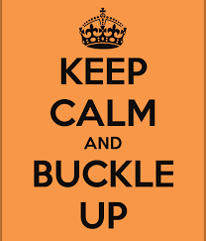
It is a Process…Not a Curriculum
Framework provides process and structure but you decide…
what is important to your school community
how to measure improvement
what strategies are effective, efficient & relevant
how to obtain input & feedback from all

