Slide 1
MTSS Tier 1: School-wide PBS Team Training
Establishing a Continuum of Support for Discouraging Inappropriate Behavior

Slide 2
Today’s Goals
Prepare teams to understand components of behavior response/discipline systems
Share activities for teams to explore/utilize with staff to revise and/or enhance current systems
Initiate a plan for establishing and facilitating implementation of effective discipline procedures with all staff & communicating with families

Slide 3
“When everyone handles infractions with instructional correction procedures, students learn that what happens when they misbehave is procedure not personal.” Bob Algozzine

Slide 4
Definition
Disciplinary policies and practices are part of a cohesive behavior support system within a school. Discipline is a complementary system to expectations and acknowledgements.
Effective discipline includes opportunities for students to LEARN and PRACTICE appropriate behaviors through an instructional approach.

Slide 5
Rationale for
Discipline Definitions and Policies
Clearly defined procedures support consistency with responding to behavioral infractions. Consistency creates the conditions for increased structure, feelings of safety, and a positive learning environment.
Differentiating between behaviors addressed in the classroom, versus those addressed by administration, can (a) improve consistency within the classroom, (b) provide more meaningful information for problem solving, (c) increase instructional minutes, and (d) free up administrative time spent on discipline.

Slide 6
Behavior change is an instructional process
We change STUDENT behavior
by changing ADULT behavior.
Interventions = changes in staff
procedures & practices

Slide 7
Rethinking Discipline
Academic & Social Problems: A Comparison of Approaches
Approaches for Frequent Academic Problems | Approaches for Frequent Social Problems
Assume student has learned the wrong way or has inadvertently been taught the wrong way. Diagnose problem; identify misrule or determine more effective way to teach. Adjust teaching arrangements to accommodate learner needs. Provide practice and feedback. Assume student has learned skill and will perform correctly in the future. | Assume the student is refusing to cooperate; student knows what is right, has been told to stop, and is being insubordinate. Provide more severe consequences; remove the student from normal context (office referral, detention, suspension, etc.) Maintain student removal from the normal context. Assume student has “learned” lesson and will behave in the future.

Slide 8
Rethinking Discipline
Academic & Social Problems: A Comparison of Approaches
Approaches for Frequent Academic Problems | Approaches for Frequent Social Problems
Assume student has learned the wrong way or has inadvertently been taught the wrong way. Diagnose problem; identify misrule or determine more effective way to teach. Adjust teaching arrangements to accommodate learner needs. Provide practice and feedback. Assume student has learned skill and will perform correctly in the future. | Assume the student is refusing to cooperate; student knows what is right, has been told to stop, and is being insubordinate. Provide more severe consequences; remove the student from normal context (office referral, detention, suspension, etc.) Maintain student removal from the normal context. Assume student has “learned” lesson and will behave in the future.

Slide 9
An Effective Behavior Response System:
Includes comprehensive method(s) of data collected with information accessible for decision-making.
Helpful Office Discipline Referral (ODR) collection forms
Consistent data entry procedures
On-going professional development around ODR forms and intent
Helps everyone to be more reliable and accurate – judgment calls are minimized.

Slide 10
Referral Forms:
A purpose of the referral form is to provide (and eventually accumulate/summarize) information from which decisions can be made about interventions
Goal is for forms to be comprehensive yet easy to complete
Clarity on the referral form leaves less room for interpretation
Clear distinction between major (office-managed) vs. minor (classroom-managed) problem behaviors

Slide 11
Office Discipline Referral (ODR) Collection System
Does you current ODR collection system help you capture answers to these 5 questions on each referral:
Who?
Why?
What?
When?
Where?

Slide 12
Function: The Root of the Behavior – the WHY
gain attention from peers?
gain attention from adults
obtain objects (e.g., toys or games, materials, food) from peers or adults?
delay a transition from a preferred activity to a non-preferred activity?
terminate or delay a non-preferred (e.g., difficult, boring, repetitive) task or activity?
get away from a non-preferred classmate or adult?
(Dunlap, Iovannone, Kincaid, Wilson, Christiansen, Strain & English, 2010)

Slide 13
Function-Based Lens Reasons Students Commonly Misbehave
Student(s) don’t know expectations or time and place
Student(s) don’t know how to exhibit expected behavior (e.g., SE skills)
Student is unaware he/she is engaged in the misbehavior
Misbehavior is providing student with desired outcome:
Obtaining attention from adults/peers
Escape from difficult task or non-desired activity

Slide 14
Do your data collection tools have all the information to make data-informed decisions?
Student’s Name
Date
Time of Incident
Location of Incident
Student’s Teacher
Student’s Grade Level
Referring Staff
Others Involved
Problem Behavior
Possible Motivation
What was happening before the behavior (antecedent)?
Possible consequences
Administrative Decision
Other Comments

Slide 15
Responsibility for Behaviors
How does your school/district differentiate between classroom and office managed behaviors?
Classroom-managed (minor) | Office-managed (major)
Discipline incidents that can be handled by the classroom teacher and usually do not warrant a discipline referral to the office. (However still tracked by staff.) Examples: tardiness to class, lack of materials, incomplete classroom assignments, gum chewing, etc. | Discipline incidents that must be handled by the administration. Examples: physical fights, property damage, drugs, weapons, tobacco, etc.
Involve opportunities for teachable moments and minimizing interruption to instruction | Involve school and student physical and emotional safety

Slide 16
EMERGENCY/CRISIS Incidents
Defined
Discipline incidents that require immediate response from administration and/or crisis response team.
These incidences may cause short-term change to a school’s behavior response plan and may include, but are not limited to: student in crisis, bomb threats, weapons alerts, intruder, fire evacuations, etc.
Purpose
Maintain order and safety during emergency situations

Slide 17
“T-Chart” School Example
Teacher Managed Behavior (Minor)
Attendance/Tardy – Inform parents on effect on academic performance
Profanity directed at student
Gum chewing
Homework
No supplies
Tattling
Non-compliance
Name calling
Lying
Minor stealing
Cheating
Dress Code Violations
Minor Harassment
Disrespect
Disruption
Defiance
Office Managed Behavior (Major)
Attendance/Tardy
Vandalism
Substances
Weapons
Profanity directed at Adults
Fighting
Verbal/Physical intimidation
Major stealing
Cutting school
Wanderers
Gang Related Activity
Chronic Dress Code Violation
Harassment (including sexual)
Disrespect
Disruption
Defiance

Slide 18
“T-Chart” School Example
Office Managed Behavior (Major)
Attendance/Tardy
Vandalism
Substances
Weapons
Profanity directed at Adults
Fighting
Verbal/Physical intimidation
Major stealing
Cutting school
Wanderers
Gang Related Activity
Chronic Dress Code Violation
Harassment (including sexual)
Disrespect
Disruption
Defiance
Teacher Managed Behavior (Minor)
Attendance/Tardy – Inform parents on effect on academic performance
Profanity directed at student
Gum chewing
Homework
No supplies
Tattling
Non-compliance
Name calling
Lying
Minor stealing
Cheating
Dress Code Violations
Minor Harassment
Disrespect
Disruption
Defiance
What about these behaviors?

Slide 19
Determining Major vs. Minor Behavior
Sample Staff Activity
Individually, brainstorm problem behaviors place them in a category.
Major
Minor
Need more Thought & Discussion
Compare lists with team members. How do you differ? Why do you differ? Are you on the same page?

Slide 20
Defining Behaviors
Explicit definitions of wanted versus unwanted behavior provides clarity to both students and staff.
Defining behaviors is a critical component of identifying clear procedures for staff to respond to inappropriate behavior objectively.

Slide 21
Appropriate Definitions of Problem Behaviors
When developing a clear set of definitions for all categories on the office discipline referral form
Problem behaviors must be operationally defined
What one teacher may consider disrespectful, may not be disrespectful to another teacher. For that reason, problem behaviors must be operationally defined.
Consistent definitions make data collection much more accurate and reliable
Goal for all problem behaviors are covered and none of the definitions overlap

Slide 22
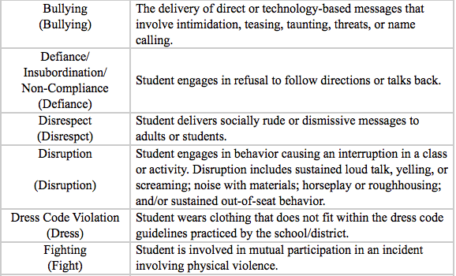
Defining Behaviors -
You don’t have to start from scratch!
Minor Definition Examples
Major Definition Examples

Slide 23
Defining Major vs. Minor Behaviors
Sample Staff Activity
Share discipline data identifying the top 5 behaviors showing up in your data and any descriptive data that describes what happened.
Ask staff: What do you notice?
Arrange staff in vertical teams (multiple perspectives)
Assign each team one of the top 5 behaviors and provide them with the descriptive data
Ask teams to identify behavioral examples of what minor and major types of this behavior look and sound like.

Slide 24
Example of a School Reviewing their Major ODR Data
Infraction | Notes
Disruption | Refusal to do work, throw paper
Disruption | Refusal to do work, cry, pout, stomp
Disruption | Off task, refusal
Disruption | Arguing with teacher
Disruption | Prohibited teaching and learning
Disruption | Playing, throwing water
Disruption | Off task
Disruption | Throwing paper, yelling, hitting, crawling
Disruption | Following directions, playing, off task
Disruption | Not following directions

Slide 25
Analysis of Data on Disruption:
What does Disruption look like and sound like?
Classroom-managed | Office-managed
Refusal to do work | Disruption escalated into a physical or verbal confrontation
Argue with the teacher | Minor actions repeated to the point of an “un-teachable” learning environment
Calling out
Tapping pencil/objects
Talking to others
Unnecessary movement (out of seat/fidgeting)
Touching others

Slide 26
Team Time
Why would having a clear and shared definition of each behavior be important among all stakeholders (staff, students, families, communities)?
What impact would agreements about classroom managed vs office managed behaviors have on our school community?
What is needed to implement or improve in these areas?
Reflect on activities / resources

Slide 27
Why Focus on a Continuum of Strategies to Respond to Inappropriate Behavior?
What is the single most commonly used but least effective method for addressing undesirable behavior?

Slide 28
“The single most commonly used but least effective method for addressing undesirable behavior is to verbally scold and berate a student.” Alberto & Troutman

Slide 29
When responding to inappropriate student behavior, avoid scolding…
Instead…
Focus on the behavior that needs to change
Focus on reinforcing student connectedness during and after consequences
Focus on consistency, not severity
It is less important what the consequence is, than that something is reliably done.
How staff respond or what consequence is used is less important than the certainty that something will be done, even something relatively brief such as redirection or re-teaching.
Focus on setting the tone for feedback. Responses to inappropriate behaviors are always:
Calm, Consistent, Brief, Immediate, Respectful

Slide 30
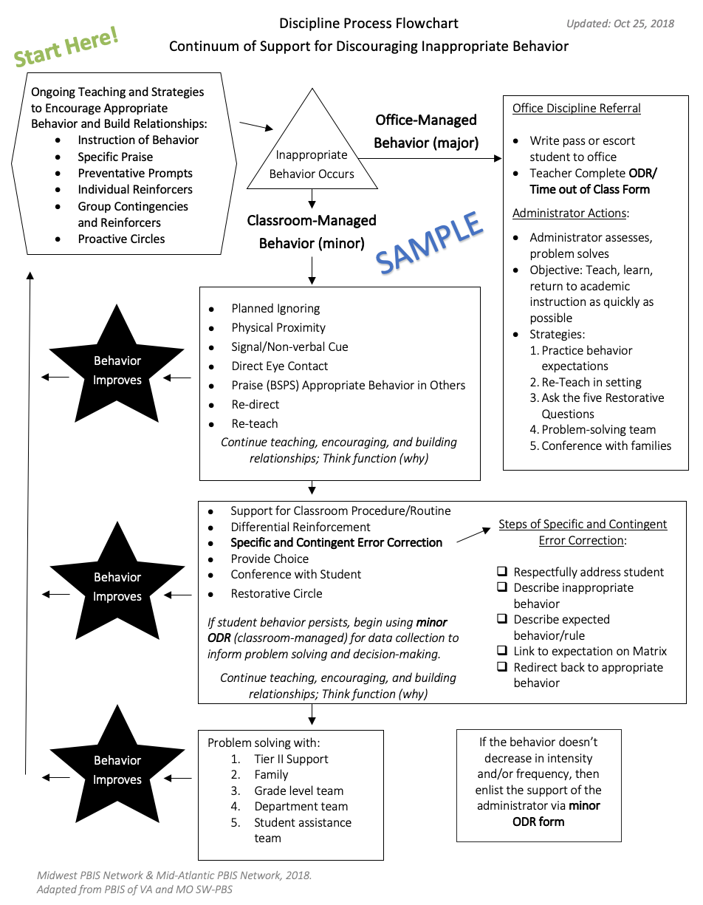
Where do you document the process and practices for how staff prevent and respond to problem behaviors?

Slide 31
Develop a Continuum of Strategies to Respond to Inappropriate Behavior
Re-teach
Planned Ignoring
Physical Proximity
Praise Approximations (Differential Reinforcement)
Direct Eye Contact
Specific Error Correction
Signal/ Non-Verbal Cue
Provide Choice
Praise the Appropriate Behavior in Others
Conference with Student
Redirect
Restorative Circles

Slide 33
Team Time - Continuum of Support Discipline Flowchart Reflection
What are the effective strategies already in use & where they fall on the flow chart template?
Are problem-solving/ instructive/restorative approaches built into the continuum of response to minor and major behaviors?
What would the impact of having a flowchart be your building? Would it make it easier or harder for teachers to navigate discipline procedures?

Slide 34
Remember…
Behavior change is an instructional process
We change STUDENT behavior
by changing ADULT behavior.
Interventions = changes in staff
procedures & practices

Slide 35
Team Time - Action Planning
Responding to Problem Behavior Action Planning: :
Select team activity to facilitate with staff as part of creating T-Chart for problem behaviors
Explore flowchart / continuum of response strategies for problem behaviors. Map existing practices that work well; identify growth areas with plan to address.
Explore if referral form supports revised behavior response system; what revisions are needed?
Revisit today’s previous topics/activities/action plan prompts

