Slide 1
TOP TEN QUESTIONS ANSWERED: UNIVERSAL SCREENING
Notes:
Welcome to a virtual Professional learning top ten questions answered about universal screening!

Slide 2
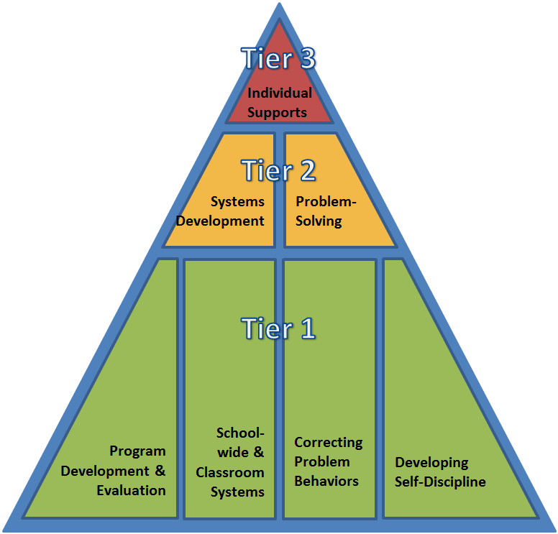
DE-PBS PROJECT IS AN ONGOING COLLABORATION BETWEEN THE DELAWARE DEPARTMENT OF EDUCATION AND THE UD CENTER FOR DISABILITIES STUDIES
Notes:
This webinar series was developed by Niki Kendall on behalf of the DE-PBS Project. The DE-PBS project is an ongoing collaboration between the delaware department of education and the UD center for disabilities studies.
The DE-PBS Project serves as a technical assistance center for the Delaware Department of Education to actualize the vision to create safe and caring learning environments that promote the social-emotional and academic development of all children. The statewide initiative is designed to build the knowledge and skills of Delaware educators in the concepts and evidence-based practices of Positive Behavior Support (PBS) as a Multi-tiered System of Support (MTSS).

Slide 3
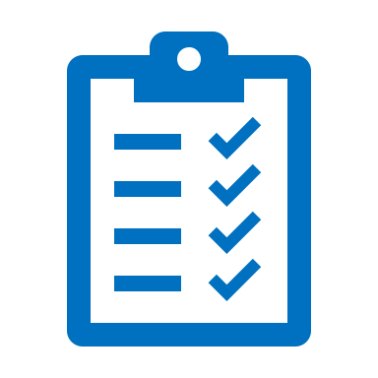
Objective:
In this video I will share the answers to the 10 most asked questions about universal screening. Please share this information with your leadership teams!
Notes:
In this video you will find answers to commonly asked questions about universal screening. Use this information during the pre-implementation phase of installing a comprehensive screening process with your teams to understand screening data and its purpose as mandated in the Delaware MTSS Regulation 508. As you review the information keep your gateway providers in mind. Gateway providers are anyone in your school community that first notices a student might be struggling. These folks often notice because of their relationships with students and make a referral, however we have enough research to know relying only on these referrals often leads to under-identification of students who might be showing less obvious needs.
So, as you listen… think about your gateway providers. People like your teachers, parents, specialists. And consider, what information do they have or need to recognize and respond to the earliest signs that something isn’t going well for their students.

Slide 4
Team-Based Leadership
Tiered Delivery System
Selection and Implementation of Academic and Non-Academic Supports
Comprehensive Screening and Assessment System
Continuous Data-Based Decision Making
Core Features of MTSS...
Notes:
Before we begin, it is essential that we position our universal screening work within the context of the core features of a Multi-tiered system of support. All of this work overlaps. Decisions about supports across all three Tiers depends on team based leadership and effective communication. It also depends on those teams having the right skills and access to various types of screening and assessment data to make effective data based decisions.

Slide 5
What is a comprehensive assessment system?
Who needs support?
Which supports need improvement or adjustments?
Screening Data
Progress monitoring data
How should we adjust instruction?
Evaluation
Have the supports been effective?
Diagnostic data
adapted from: National Center on Intensive Intervention at American Institutes of Research, n.d.
Notes:
Question 1: what is a comprehensive assessment system?
You will notice, a core feature of a Multi-Tiered System of Support is the development of a comprehensive assessment system. It is oftentimes difficult to prioritize what data to collect and as educators it’s easy to feel overwhelmed by having TOO much information. I find it easiest to think about data in four different buckets (screening, diagnostic, progress monitoring and outcome). You can see these four buckets referenced in the figure above.
The type of data you use will depend on the type of questions you ask! Which we will briefly talk about next.

Slide 6
Remember: the data you need depends on the question you ask
Ask questions for improvement
Answer questions with data
Answers lead to improvement efforts
Notes:
Understanding the 4 types of assessment (screening, progress monitoring, diagnostic and evaluation) are helpful to determine the general purpose of a data source. However, in some cases, a data source can be used for multiple purposes and it will depend on the questions posed by your team to know how to interpret the information.
Let’s consider these data sources in the context of the general flow of problem solving referenced in the figure above. Problem solving starts with a question.
For example, your question might lead you to evaluation data (e.g. what was the impact of the new reading curriculum on student performance with State Assessment?). Or perhaps progress monitoring data (e.g. how are the students enrolled in Check in/Check out responding to the intervention)?
The point is, to be able to answer the many school improvement questions asked by districts, schools and teachers, a comprehensive assessment system must produce these four “types” of data. However, teams should understand that we don’t develop solutions based on data, we develop solutions based on the questions we ask. The data helps us along the way, but should never drive our efforts.

Slide 7
Which students are not responding to our Tier 1 behavior support practices?
Which students are not responding to our Tier 1 academic program?
Answer with screening data
Answers lead to improvement efforts
Which students are not responding to our SEL curriculum?
Notes:
So, let’s think about this in terms of screening data. Here are three examples of questions you might answer using screening data.
which students are not responding to our Tier 1 behavior support practices?
which students are not responding to our Tier 1 academic program?
Which students are not responding to our SEL curriculum?
You can see, this approach provides a message that screening is meant to help teams identify which students are not responding to our supports and might benefit from more. It is always linked to school improvement efforts via problem solving rather than a process to identify within-child deficits. Later in this webinar, we will talk more about what this problem solving looks like in practice. But the bottom line is: screening is not an intervention or a solution. It is a process of collecting data/information for your team to use as they problem solve.

Slide 8
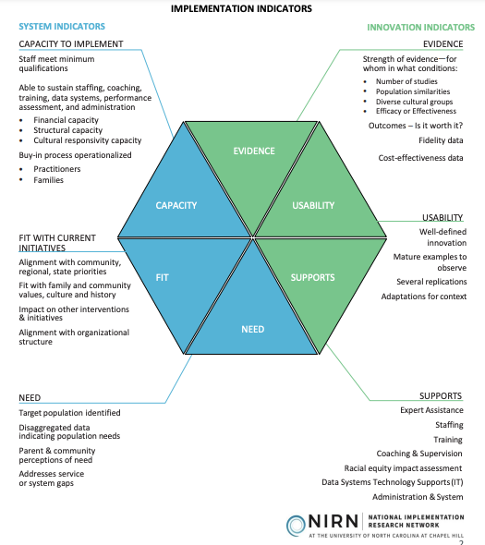
What supports are missing from our core instruction?
Use of data to identify needs
Needs:
Target population identified
Disaggregated data indicating population needs
Parent & community perceptions of need
Addresses service or system gaps
Answers lead to improvement efforts
Notes:
On the other hand, maybe you are in a situation where core supports have not been implemented. Your team is interested in adopting new supports before screening for individual student risk. For example, you are looking to intentionally address listening comprehension or oral expression common core standards within your academic programming. In this case, your question changes from “who is not responding to our core instruction?” to “what supports are missing in our core instruction?” Teams working to answer these types of questions can use screening data as one source of information to identify and address support gaps for systems change (rather than reviewing the data to identify individual student needs). Teams interested adding new initiatives or supports are encouraged to consult the National Implementation Research Network’s Hexagon Tool displayed above. Use of screening data can be particularly supportive while defining the NEED for a new support (see the blue box in the tool above). Please see the reference on the resources slide for more information about the Hexagon tool.
For the remainder of our webinar today, we will assume that you have core supports in place to respond to group or individual needs uncovered in your screening process. If you do not have these supports in place, it is advisable to begin by defining the need (e.g. address service or system gaps) and establishing core supports before screening for individual student needs. Always remember that screening results may uncover gaps in your continuum of support and your questions may shift (at any time) from “who needs support” to “what supports are missing?”

Slide 9
What information do data from screening provide teams?
Notes:
Question 2: what information do data from screening provide teams?
Foundational to MTSS is prevention of poor academic, social, emotional, behavioral and physical health outcomes and screening provides teams with a strategy to predict who might need support. Many indirect sources of screening data are routinely collected (e.g., early warning indicators), while others are contextual and collected based on a school’s instructional focus or specific physical and social, emotional and behavioral (SEB) concerns. Each is predictive of potential outcomes months or years in advance, allowing teams to proactively rather than reactively identify and respond to student needs.
What you see in the table above are examples of routinely collected screening data and other examples of screening data which would only be collected if teams were prioritizing these factors across their core instructional and SEB approach.

Slide 10
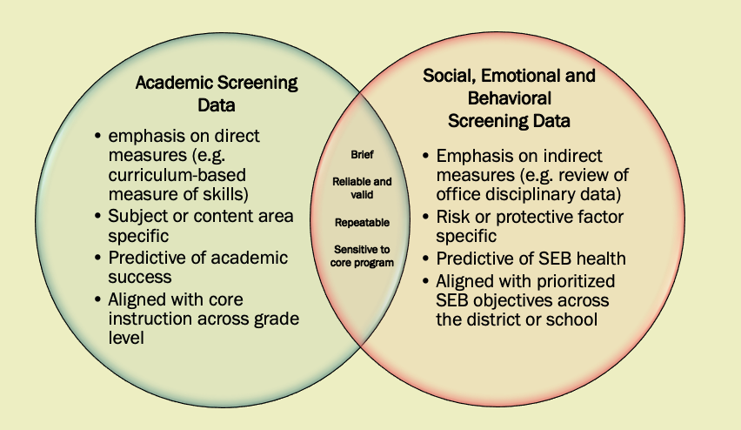
What are the similarities and differences between SEB and academic screening data?
Based on information from: McIntosh & Goodman, 2016
Notes:
Question #3: what are the similarities and differences between SEB and academic screening data?
It is important to point out, the similarities between SEB and academic screening are part of the reason why integration is so important. Screening data are key to addressing the needs of the WHOLE child and the impact of one type of data on another cannot be overlooked. Let’s highlight the main similarities and differences (as shown in the graphic above).
What you see here is a comparison of academic vs. SEB screening data. While there is overlap, there are some fundamental, albeit parallel, differences. One of the main differences is academic screening emphasizes direct measures (e.g. skill based) while SEB screening relies on indirect measures (as direct observation of behavior is not feasible with all children). A similarity that is very important to point out is the necessity to ensure screening data aligns with the behaviors and academic skills you intend to TEACH and REINFORCE. It would not make sense to screen for social and emotional or academic skills if you do not have a plan to teach and support students with these needs.

Slide 11
What screening data should we use?
1
2
Guideline 1: Use multiple screening measures versus a single source
Guideline 2: Use a multi-gate versus direct route process to identify which students to consider for intervention.
Notes:
Question #4: what screening data should we use?
Guideline 1: Use multiple screening measures versus a single source (or type of data) to determine risk prevalence for prioritized academic and SEB indicators. When teams rely on one source of data, they run the risk of over or under-identifying students.
Guideline 2: Use a multi-gate versus direct route process to identify which students to consider for intervention. At the universal level (sometimes referred to as “gate 1”), screening data is used to determine which students may require additional support. Once students are identified, teams can choose to adjust Tier 1 instruction, enroll the student in a standard Tier 2 intervention OR may choose to collect additional data (sometimes referred to as “gate 2”, problem analysis or diagnostic data) to understand or confirm needs. More on this in a moment.

Slide 12
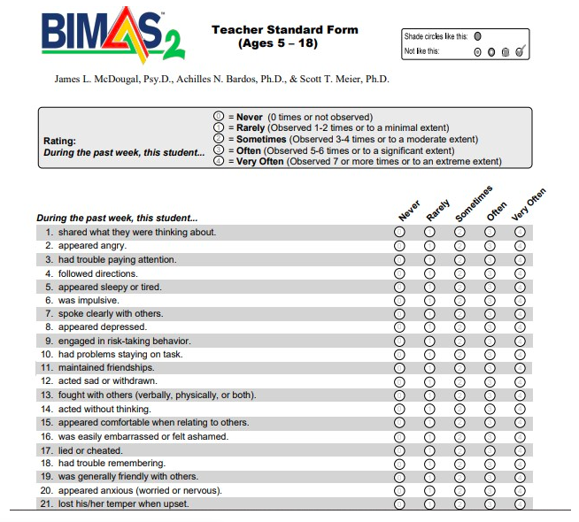
Universal Screener Tools
Data tool used to support data-based decision making about concerning risk factors
VS.
Comprehensive Screening and Assessment Process
Includes multiple sources of data for decision making
A core feature of MTSS to support data- based decision making across all three tiers of support
Notes:
First, when thinking about which screening data to use, it is important to keep in mind the distinction between universal screener tools (or universal screeners) versus universal screening (or a universal screening process). The top box above describes a tool. A screening tool, such as the BIMAS (a common universal screening tool to determine which students demonstrate concerning social and emotional behaviors) is one example. These tools are added to your screening process when you determine you don’t have the right (or enough) information to answer your questions. For example, a team might ask: “are there students with internalizing behaviors that are not responding to our Tier 1 behavioral supports?” They would explore their existing data and might determine some additional data would be helpful to add to their comprehensive screening process. So when people talk about universal screening (as an action) they are referring to the use of multiple sources of screening data to capture student needs not a specific tool.

Slide 13
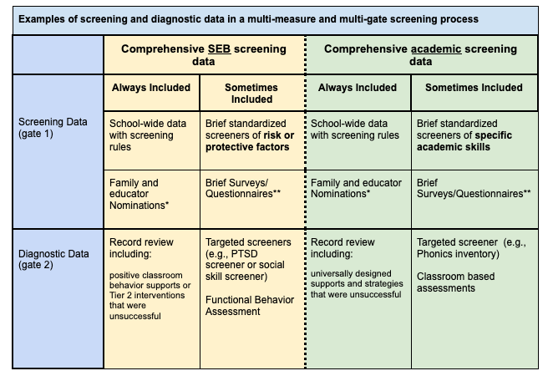
Notes:
The second key idea, is to use a multi-gate vs. direct route to intervention process. Remember this is to help prevent over-identification and support problem solving efforts to link students to the most appropriate level of support.
Our focus for this webinar is on Gate 1 data (shown in the yellow circle above). However, it is important to recognize that after students have exhausted Tier 1 and standard Tier 2 supports, there will likely be a time when additional data analysis is required to appropriately match a student to an intervention. At no point in this process are teams diagnosing a disorder or making a decision about special education eligibility. The goal is simply to understand the student’s needs and make a linkage to the most appropriate supports.
A few things to point out:
Your screening process will always include a direct referral process using a request for assistance or nomination process. Nominations are referrals to the problem-solving team made by families, educators and sometimes even the students themselves.
Your screening process will also always include use of schoolwide data with decision rules (more on decision rules later).
Sometimes included will be additional formal or informal screening tools as discussed on the previous slide.
A quick note on informal screening tools:
These should be relatively easy to integrate into your existing screening processes. The selection of a tool will depend on the priorities of your MTSS team. For example, teams wishing to measure teacher-student relationships and identify disconnected students can use a Connection Survey. Or, if you wish to identify students who are struggling to learn your school-wide expectations, you might consider using your schoolwide expectations as behavioral screening. To identify barriers to learning and inform instructional decisions you may consider collecting information about the strengths, weaknesses and preferences of your students or information about specific academic behaviors that may impact their progress with content (e.g., academic engagement, work completion). Some references to these tools can be found at the end of this webinar.

Slide 14
What makes an effective screening measure?
Leads to a proactive team-based decision making
Has clear criteria to establish risk
Is aligned with the school or district’s core (school-wide) instructional focus
Uncovers or highlights a potential problem at one point in time
Leads to conversations about who and how many may benefit from support
Can be universally administered to an entire classroom/grade/school/district
Developed/selected by a diversity of stakeholders to ensure cultural relevance
Is time-efficient and cost-effective
Is administered, scored and interpreted the same way
Notes:
Question #5: What makes an effective screening measure
So, let’s imagine that your team has developed an efficient process to use school wide data with decision rules and has a direct referral process for the school community to use when they suspect a student is not responding to Tier 1 and needs more support. They have posed a question and found they need to add a screener to their process. What should they look for in a tool?
Screening tools range from district developed surveys to standardized tools for specific types of skills. These tools should:
lead to proactive team based decision making (the only reason to collect this data is to inform problem solving)
have a clear criteria to establish risk (teams should be able to scan and make quick determinations about risk in a standardized way)
be aligned with the school or district’s core instructional focus (remember if you don’t intend to provide support for the behaviors addressed in the screener, it does not make sense to use the tool)
uncovers a potential problem at one point in time (The key is to remember these are screening tools and not designed to be diagnostic. You cannot determine eligibility for special education and a clinician cannot diagnose a disorder such as anxiety with a universal screening tool)
can be universally administered (tools should be efficient and not time intensive)
are developed/selected by a diversity of stakeholders to ensure cultural relevance (remember to choose tools based on the questions most important to your school community)
Is administered, score and interpreted the same way (these test should not require advanced knowledge of assessment delivery and scoring)

Slide 15
Who should we screen?
Few?
Some?
All?
Notes:
Question #6: Who to screen?
When we use the term, “universal” this implies that every single student should be included in the screening process. Which is 100% correct. Your universal screening process should provide each student equal opportunity to be considered for support. To prevent negative outcomes, teams must have information about the impact of their core (Tier 1) approach on all students before significant concerns arise. For this reason, screening sources should be sensitive to core academic and universal SEB practices and the response of every student should be considered. This process is referred to as universal screening.
However, while your screening process includes all students, this does not mean that each student is screened with each measure every year. Specific standardized screening tools may be employed with particular grade levels (e.g., DIBELS in K-4) or with certain groups of students (e.g., a SEB questionnaire with all students who transfer to a school). Teams should develop a plan (to ensure screening activities are meaningful and not overly cumbersome) for who to screen based on their prioritized goals and core instructional approach.

Slide 16
When and how often should we screen?
Example from Center for Schoolwide Positive Behavior Support (University of Missouri)
Notes:
Question #6: when and how often should we screen?
You may be wondering how you will be able to keep up with all this data collection and analysis. The solution is to ensure each source of data in your screening plan is compiled/collected/reviewed on a schedule. The sources can include schoolwide data, nominations, standardized tools and/or questionnaires. The timing and frequency will depend on the type of data being explored. A few key ideas are important to consider when developing this aspect of your screening plan.
Screening tools should be compiled/collected and reviewed more than once in a school year. A primary reason for this is to minimize the impact of measurement errors. Ongoing screening ensures students who pass the screening but need intervention (false negatives) are re-considered and minimizes the effects of students enrolled in unnecessary interventions (false positives) on the system.
School-wide data should be reviewed on a schedule. This review provides each student with an opportunity to be considered for support and provides ongoing information about your core instruction.
Direct referral processes (e.g. teacher nominations) should be continuously available. It’s important to remember we don’t want our data system to inhibit efficient access to support. There should also be a mechanism to link a concern to a problem solving conversation quickly BUT this should not be the only route to service.
It is also important to note, as mandated in the Delaware MTSS Regulation 508 regulations, school teams are required to compile/collect screening data within the first few weeks of school and at regular intervals throughout the school year to inform programmatic decisions at the school, grade, classroom and student level. This does not mean that each universal data source is always appropriate to collect/review. Teams should create a screening plan that outlines which data source(s) are to be reviewed and at what frequencies.

Slide 17
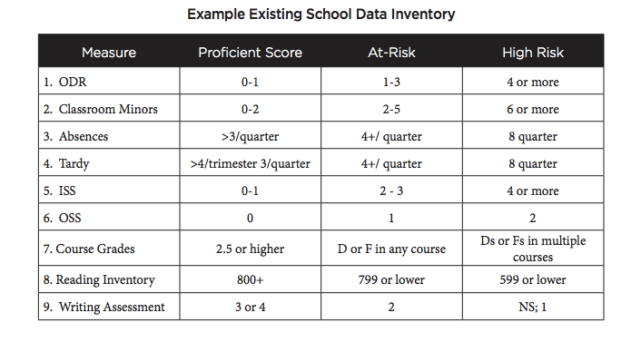
How do we use the data for decision making?
Step 1a: establish what your team considers proficient and at risk for your schoolwide and standardized screener data.
Example from PBIS Missouri
Notes:
Question #7: how do we use the data for decision making?
Okay, so you have created a screening process that includes multiple sources of data and developed a schedule for collection/review. Now, you are wondering… what do we do with this data? How do we respond when the data indicates a need? The following process is based on the Social-Emotional and Behavioral Assessment Model (SEBA) developed by Stephen Kilgus and Katie Eklund, who recommend the following steps when reviewing your data. (A link to the SEBA model website can be found on the resources slide).
Begin by establishing needs. Define proficient, at risk and high-risk markers for the data you have prioritized as capturing your SEB and academic priorities. This may also include defining “advancing” markers to identify those students who are exceeding expectations in specific areas. Some teams may choose to only use on target or at risk rather than the 3 levels shown above. Remember teams will not review all data sources at one time and should set up a schedule. This means, your team will undergo a review of screening data at different times throughout the year, but the process will remain the same.
The sample above may be a helpful starting point.

Slide 18
Step 1a. with Office Discipline Referrals:
Outline the purpose of the data source and define non-response:
Purpose: ODRs help to determine which students are not responding to our school-wide behavior supports. Non-response defined: 1-3 ODRs in a single marking period
Adapted from Kilgus & Eklund, 2016
Notes:
Here is an example of step 1a using one source of schoolwide data (Office discipline data). I chose this, because most schools are familiar with this piece of data but may not be using it for screening in the way we’ve discussed. The team has determined the purpose of ODR is to identify students who are not responding to school-wide behavioral supports. They have defined risk as: 1-3 ODRs in a single marking period.

Slide 19
How do we use the data for decision making?
Step 1a: establish what your team considers proficient and at risk for your schoolwide and standardized screener data.
Step 1b: Outline supports aligned to your screener sources for ALL
Example from PBIS Missouri
Notes:
Next in step 1b. outline the supports you plan to use in response to screening data at the Tier 1 school and classroom level.

Slide 20
Step 1b. with Office Discipline Referrals:
If the data show a need for all what actions can you take?
System Supports (Tier 1): Ensure integrity to implementation of Tier 1 practices; reevaluate Tier 1 plan Classroom Supports (Tier 1): Ensure teacher use of Tier 1 practices; implement class-wide or student level contingency
Adapted from Kilgus & Eklund, 2016
Notes:
Continuing with our previous example, the team chose to use ODRs as a measure of student response to Tier 1 behavior supports. Assuming their Tier 1 practices, include school wide expectations, an acknowledgement system and discipline policies, their response actions should provide more support in these areas if the data shows a need. Just remember, teams should begin this mapping before reviewing screener data. In other words, have the supports up and running before you begin screening. You can always add more if you find there is a need. A big take away: your screening process will be most effective if you have clear Tier 1 practices at the school and classroom level.

Slide 21
How do we use the data for decision making?
Step 1a: establish what your team considers proficient and at risk for your schoolwide and standardized screener data.
Step 1b: Outline supports aligned to your screener sources for ALL
Step 1c: Outline supports aligned to your screener for SOME
Example from PBIS Missouri
Notes:
Next in step 1c. you should outline the supports you plan to use for Tier 2 interventions. Tier 2 intervention should be readily available and match a broad scope of student needs.

Slide 22
Step 1c. with Office Discipline Referrals
If the data show a need for some what actions will you take?
Team reviews multiple sources of the student’s universal screening data (e.g. course grades, attendance) to prioritize their primary need(s) Team reviews IN rules for available interventions Team makes a match based on student needs and IN rules
Notes:
The general actions teams will take in step 1c. are shown above. Multiple sources of data are reviewed to determine which available Tier 2 intervention(s) address the student’s need. Remember the key to MTSS is integration. Teams need to look at the SEB data in conjunction with academic data to see the whole picture and address the whole child.
To efficiently do this, teams should map out Tier 2 interventions (that align with their Tier 1 supports) but add an additional layer of support. For example, students who show a need for additional behavior supports would benefit from a Tier 2 intervention that provides them with additional teaching, feedback and practice with school-wide or classroom expectations.
To make decisions efficiently, it is helpful to begin by creating “IN” rules for each available Tier 2 support. IN rules are specific data points that indicate a student requires a specific support. In other words, if you determine a student requires more support beyond Tier 1 based on your decision rules, IN rules can help determine WHICH support best meets their needs. An example is shown on the next slide.

Slide 23
“In Rules” Using ODR Data
Name of Intervention: Check in/Check Out
Purpose of Intervention: Best for students who demonstrate difficulties following schoolwide and classroom expectations; provides additional teaching, feedback and positive acknowledgement with these expectations via a daily progress report and check in with staff member.
In Rules:
Behavior: 2 or more ODRs in a marking period; student enjoys adult attention
Academic: Student has several not handed in assignments in one or more classes
Notes:
Above are hypothetical IN rules for Check In/Check Out. Check in/check out is an intervention that layers additional teaching, feedback and acknowledgement of Tier 1 expectations for students who need more through a daily progress report. Office discipline data and academic data (related to student work habits) are helpful hints a student would benefit from this type of support.

Slide 24
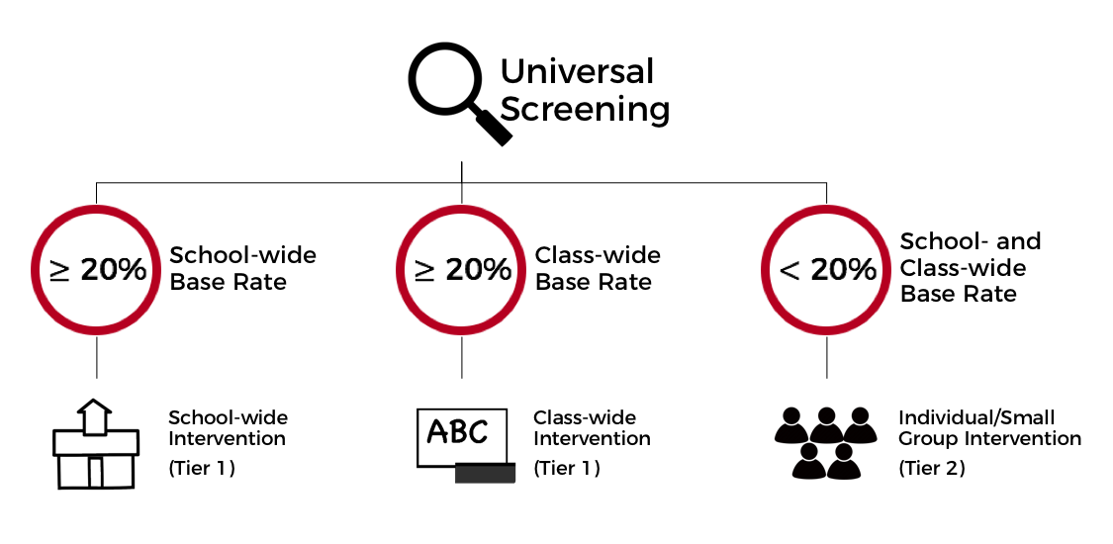
Step 2: Screen and Problem Solve (using decision rules and a resource map)
See: SEBA Website
Notes:
Once you have defined risk for each screening source AND outlined the actions you will take for response, it’s time to move on to analyzing the screening data. Each time you review a screening source (whether a screening tool or a schoolwide data source) this process is always the same. We will continue using ODR as our screening source exemplar.
The general data review process is as follows:
Step 1: Compile and review disaggregated data (e.g. race, gender, disability). At this point you are not looking at individual student data. You are scanning your entire school to determine the response of different groups to your Tier 1 behavior supports. If your data over-represents risk (typically equal to or greater than 20% in any one population of interest) address Tier 1 supports. This will require you to revisit your overall Tier 1 action plan.
Step 2: If the school-wide risk is low but individual classrooms are high address Tier 1 classroom supports. In other words, perhaps your schoolwide data looks good. It shows that your Tier 1 behaviors supports are working for most students. However, there are individual classrooms with a high number of students showing a lack of response. In these cases, it’s best to provide support at the classroom level rather than providing support to individual students in these classrooms.
Step 3: Finally, if schoolwide and classroom risk is low you can move forward with providing the least intensive (but effective) support that matches a students need. This means that although an entire classroom of students might be responding positively to the Tier 1 behavioral supports a few students may show a need for more. For students who are not already receiving support, it’s important to start with a quick and efficient support using establish IN rules.

Slide 25
Schoolwide data show greater than 20% of student population at risk for social behavior problems (based on ODR data)
Ensure fidelity to Tier 1 instruction and acknowledgement plan
Schoolwide data are less than 20% but 3 classrooms identified more than 20% of students at risk for social behavior problems
Develop a class wide group contingency linked to classroom expectations
Schoolwide data are less than 20%, the classroom is less than 20% but 2 students are at risk for social behavior problems (based on ODR data)
Enroll 1 student in CICO
Develop a classroom (Tier 1) independent contingency for 1 student
Notes:
To walk us through the next three steps, let me use screening for SEB needs using ODR data with the previous supports as an example. The above example are supports determined appropriate by the team at each step.
Your Tier 1 team has decided to review schoolwide data monthly using the three steps above. They have identified a staff members who has access to discipline data, which they’ve prioritized to review this year. They review this data monthly. The staff member compiles this data and presents the team with a graphic display of disaggregated data for each data source for race, gender and disability status.
The percentage of at risk and not at-risk students is reviewed at the schoolwide level. If the %age of risk is over 20% for any demographic they drill deeper into the data to better understand the problem for Tier 1 school-wide decision making. A precision problem statement and their Tier 1 school-wide action plan is revisited.
Next, the team looks at the data at the classroom level. For those classrooms with more than 20% of the students falling in the at-risk category, the team plans to collaborate with the classroom teacher or work with the grade level teams (e.g. PLCs) to develop a classroom intervention.
Finally, for classrooms exhibiting levels of risk below 20%, the team begins to identify individual students who may require some additional support. They compile a list of students who may be eligible for Tier 2 supports and a team member who also attends grade level PLC plans to discuss each student at their next Tier 2 meeting. The Tier 2 team reviews the information and what is known about the student to decide next steps based on available Tier 2 interventions and IN rules. For a few students, the Tier 2 team decided CICO is a match. For other students, they determine a classroom intervention makes more sense.

Slide 26
Notes:
Just a quick reminder about student level problem solving before we move on. In some cases, your team will have enough information from your screening to quickly link a student to an adjustment to Tier 1 classroom support or to a standard Tier 2 intervention like CICO. However, in some cases additional problem solving may be required. You may realize a student has not responded to multiple attempts to intervene and continues to need support. In these cases, some additional gate 2 data collection might be indicated. The visual above shows some common gate 2 types of data that are used to refine a student’s linkage to support. The key takeaway is to remember: only a few number of students indicated in your screening process should require this level of problem solving.

Slide 27
Will screening data lead to more students identified as needing support or evaluation? Yes, but…
Universal screening data signal that more information (not necessarily more intervention) is needed to understand and support your staff and students.
If a high percentage of students show risk at the school or classroom level, your interventions should address those needs before individual student needs.
As the effectiveness of your school and classroom support increases, the number of students requiring additional support should decrease.
Screening data are intended to provide an efficient linkage to the available classroom, Tier 2 and Tier 3 supports. Teams should proactively develop and outline each available support before screening.
Notes:
Question #9 will screening data lead to more students identified as needing support or evaluation.
I hope after listening through this webinar you are prepared to respond to these types of questions. However, let’s review a few key ideas to keep in mind:
Universal screening data signals that more information (not necessarily more intervention) is needed to understand and support your staff and students.
If a high percentage of students show risk at the school or classroom level your interventions should address those needs before individual student needs.
As the effectiveness of your school and classroom support increases, the number of students requiring additional support should decrease.
Screening data is intended to provide an efficient linkage to the available classroom, Tier 2 and Tier 3 supports. Teams should proactively develop and outline available supports before screening. Or, plan to use screening data to develop these supports before identifying individual student needs.

Slide 28
Do you have a list of recommended screening tools? We do but let’s talk readiness...
District Actions | School Readiness
Teaming: as part of your MTSS leadership team’s work, create an action plan to install a universal screener as part of your larger screening expectations within the district Plan for school readiness: establish data based decision making guidance for existing screening data (e.g. ODRs) and provide training/coaching support to school teams resource map existing and expected core practices to be coached/supported district wide (T1, 2 and 3) Explore and respond to the need for new tools: explore existing data sources and identify gaps explore screening tools that address the gap | Teaming: establish a team that will support the development and implementation of your universal screening process Practices: complete a resource map and gap analysis based on the behaviors prioritized by screening data (e.g. social behavior, academic behavior, emotional behavior) Data Practices: using existing data (e.g. ODRs) engage in screening via data based decision making guidelines established by your district
Notes:
Question #10: do you have a list of recommended screening tools? we do, but let’s talk readiness...
We recommend schools work with their district-level MTSS leadership team to engage in a process inclusive of exploring the use of existing screening data to select and add a screener (if needed) that supports the core instructional and SEB approach of the larger district. District support is especially important because adopting a new screening tool requires stakeholder support, legal guidance, financial resources and coaching. The visual above shows the relationship between district actions supporting school readiness for screening.
Our team at the DE-PBS Project is working with partner districts through the Project DelAWARE grant to develop a process for district leadership teams interested in selecting and installing a new screening measure. We have also developed a screener installation coaching guide to help your leadership team progress through the process.

Slide 29
Next Steps? Keep Learning with these Links:
The Delaware Department of Education MTSS Page
The Delaware PBS Project Universal Screening Page
The Social Emotional Behavior Assessment Model Page
Ci3T Systematic Screening Page
Hexagon Tool from the National Implementation Research Network
Or get in touch….
Niki Kendall, Instructional Coach
The Delaware PBS Project
Robertsn@udel.edu
www.delawarepbs.org

Slide 30
References:
Connections Surveying with Teachers. (2014). Retrieved from
http://www.delawarepbs.org/wp-content/uploads/2011/06/1-pg-Connections-Survey-Strategy-to-Identify-Disconnected-Students-updated-10.14.14.docx
District Planning Guide: Installing a Universal Screening Tool. (2020). Retrieved from http://www.delawarepbs.org/wp-content/uploads/2020/06/Tool-2-Coaching-Guide.docx
Kligus, S. P., & Eklund, K. R. (2016). Consideration of Base Rates within Universal Screening for Behavioral and Emotional Risk: A Novel Procedural Framework. School Psychology Forum, 10, 120-130.
McIntosh, K., & Goodman, S. (2016). The Guilford practical intervention in the schools series. Integrated multi-tiered systems of support: Blending RTI and PBIS (The Guilford Practical Intervention in the Schools Series). Guilford Press.
Mitchell, B., Guffey, T., &amp; Powers, L. (n.d.). Systems for Screening: Keeping it Simple During Remote Learning. Retrieved from https://pbismissouri.org/event-directory/pbis_in_a_virtual_environment/
National Center on Intensive Intervention at American Institutes of Research. (n.d.). Defining, measuring and monitoring behaviors. Retrieved
January 14, 2020, from https://intensiveintervention.org/defining-measuring-and-monitoring-behaviors-behavior-course#Module6Intro
School-Wide Expectations as Behavioral Screening. (2020). Retrieved from http://www.delawarepbs.org/wp-content/uploads/2020/06/schoolwide-expectations-as-behavioral-screening.docx
Tier 2 Workbook &amp; Resources. (n.d.). Retrieved from https://pbismissouri.org/tier-2-workbook-resources/
Universal Screening. (n.d.). Retrieved from https://sebasuccess.weebly.com/universal-screening.html

