Slide 1
School Climate
Data Workshop
Delaware Positive Behavior Support Project
May 11, 2017
George Bear
University of Delaware

Slide 2
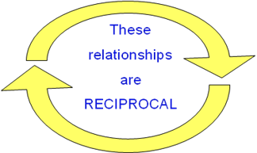
Why is school climate important?
School Climate is linked to a wide range of academic, behavioral, and socio-emotional outcomes for students and teachers:
          Academic achievement
          Student academic, social, and personal attitudes and motives
          Student attendance and school avoidance
          Student behavior problems, delinquency, victimization
          Student and teacher emotional well-being
          Teachers’ greater implementation fidelity
          of new curriculum and interventions

Slide 3
Why is school climate important?
The Every Student Succeeds Act (ESSA) explicitly recognizes the strong relationship between positive school climate and student learning and success.
Law requires states to include data related to school climate and safety in annual school report cards

Slide 4
How are we doing?
DE School Climate Longitudinal Study
2012-2016
Examined changes in students’ perceptions of school climate using the DSCS-Student version
Guiding question:
  Did students’ perceptions of school climate improve from 2012 to 2016 in elementary, middle, and high schools?
  If so, were improvements found across all seven aspects of school climate measured by the Delaware School Climate Scale-Student?

Slide 5
Major Findings
Total school climate score:
  Students’ perceptions quite favorable; especially in elementary schools
  Improved significantly from 2012 to 2016
All seven subscales:
  Scores improved significantly (elementary, middle, and high schools)
  Exception: Bullying School-wide subscale scores in middle schools.
Most impressive:
  Improvements in School Safety and Bullying (elementary & high schools)

Slide 6
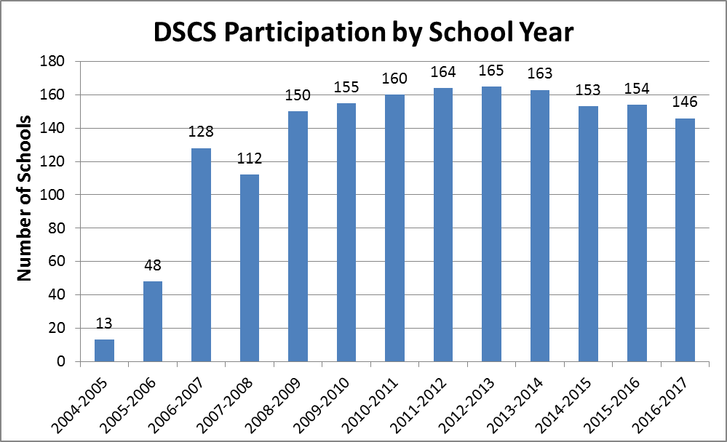
Participation Continues To Be High
Number of Participating Schools
School Years

Slide 7
2016-17 Survey Sample
 |  | Student Survey | Teacher Survey | Home Survey
Elementary | Schools | 57 | 77 | 59
 | Respondents | 12674 | 2888 | 7464
Middle | Schools | 22 | 26 | 21
 | Respondents | 11072 | 1447 | 3184
High | Schools | 17 | 22 | 13
 | Respondents | 5791 | 1154 | 838
Alternative | Schools | 2 | 4 | 0
 | Respondents | 55 | 56 | 0
Special | Schools | 1 | 8 | 4
 | Respondents | 23 | 367 | 205
Early Childhood | Schools | N/A | 5 | 4
 | Respondents | N/A | 208 | 448
Other | Schools | 5 | 5 | 5
 | Respondents | 2429 | 262 | 1059
 |  | 32,044 | 6,382 | 13,198

Slide 8
Delaware School Survey Scales
(Note: School Climate is 1 of the 5 Scales)
Student Scales
School Climate
Techniques (School Discipline)
Teacher/Staff Scales
School Climate
Home Scales
School Climate
Bullying Victimization
Student Engagement
Student Social and Emotional Competencies
Techniques (School Discipline)
Bullying Victimization
Student Engagement

Slide 9
Delaware School Climate Scale and Subscales
Student | Teacher/Staff | Home
Teacher-Student Relations | Teacher-Student Relations | Teacher-Student Relations
Student-Student Relations | Student-Student Relations | Student-Student Relations
Clarity of Expectations | Clarity of Expectations | Clarity of Expectations
Fairness of Rules | Fairness of Rules | Fairness of Rules
School Safety | School Safety | School Safety
Student Engagement School-wide | Student Engagement School-wide
Bullying School-wide | Bullying School-wide
 | Teacher-Home Communications | Teacher-Home Communications
 | Staff Relations
Total School Climate | Total School Climate | Total School Climate
 |  | Satisfaction with School

Slide 10
Item Examples
  Teacher-Student Relations
    “Teachers care about their students.”
  Student Engagement School-wide
    “Most students try their best.”
Fairness of Rules
    “The school rules are fair.”
  Bullying School-wide
(Note: A high score for this subscale is unfavorable)
    “Students threaten and bully others.”
  Staff Relations
  “Teachers, staff, and administrators work well together.”

Slide 11
Delaware Positive, Punitive, and SEL Techniques Scale and Subscales
Student Survey | Teacher/Staff Survey | Home Survey
Positive Behavior Techniques | Positive Behavior Techniques
Punitive Techniques | Punitive Techniques
Social Emotional Learning Techniques | Social Emotional Learning Techniques

Slide 12
Item Examples
Use of Positive Techniques
  “Students are praised often.”
Use of Punitive Techniques
(Note: A high score for this subscale is unfavorable)
  “Students are punished a lot.”
Use of Social Emotional Learning (SEL) Techniques
  “Students are taught to feel responsible for how they act.”

Slide 13
Bullying Victimization Scale and Subscales
Student |  | Teacher/Staff | Home
Bullying Victimization¹ | Verbal Bullying |  | Verbal Bullying
 | Physical Bullying |  | Physical Bullying
 | Social/Relational Bullying |  | Social/Relational Bullying
 | Cyberbullying² |  | Cyberbullying²
¹ Grades 6-12 only for the printed version. Optional for grades 4-5 with computer version. ² Grades 6-12 only.

Slide 14
Item Examples
Verbal Bullying
  “A student said mean things to me.”
Physical Bullying
  “I was pushed or shoved on purpose.”
Social/Relational Bullying
  “A student told or got others to not like me.”
Cyberbullying (grades 6-12)
  “A student sent me a mean or hurtful message about me using email, text messaging, instant messaging, or similar electronic messaging.”

Slide 15
Student Engagement Scale and Subscales
Student |  | Teacher/Staff | Home
Student Engagement | Behavioral |  | Behavioral
 | Cognitive |  | Cognitive
 | Emotional |  | Emotional
¹ Grades 6-12 only for the printed version. Optional for grades 4-5 with computer version. ² Grades 6-12 only.

Slide 16
Item Examples
  Behavioral Engagement
    “I pay attention in class.”
    “I follow the rules at school.”
  Cognitive Engagement
    “I try my best in school.”
  Emotional Engagement
    “I feel happy in school.”

Slide 17
Social and Emotional Competencies Scale
Student Survey | Teacher/Staff Survey | Home Survey
Responsible Decision-making/Responsibility
Understanding how others Think and Feel/Social Awareness
Self-management of Emotions and Behavior
Relationship Skills

Slide 18
Item Examples
Responsible Decision-making/Responsibility
  “I feel responsible for how I act.”
Understanding how others think and feel/Social Awareness
  “I think about how others feel.”
Self-management of emotions and behavior
  “I can control how I behave.”
Relationship skills
  “I am good at solving conflicts with others.”

Slide 19
Evidence of Reliability and Validity
Reliability:
Are the scores consistent or stable?
Validity:
Does the test yield the factors predicted?
Are the scores related to other variables as one might predict (e.g., grade level, sex and race, academic achievement, suspensions)?

Slide 20
School Climate and Techniques: Reliability (alpha coefficients)
Subscale | Student | Teacher/Staff | Home
Teacher-Student Relations | .88 | .87 | .92
Student-Student Relations | .87 | .91 | .94
School Safety | .76 | .86 | .91
Clarity of Expectations | .78 | .89 | .93
Fairness of Rules | .80 | .82 | .91
Student Engagement School-wide | .81 | .87 | N/A
Bullying School-wide | .74 | .87 | N/A
Teacher-Home Communications | N/A | .89 | .91
Staff Relations | N/A | .95 | N/A
Total Climate | .91 | .94 | .98
Parent Satisfaction | N/A | N/A | .88
Use of Positive Behavioral Techniques | .84 | .83 | N/A
Use of Punitive Techniques | .75 | .81 | N/A
Use of Social Emotional Learning Techniques | .84 | .90 | N/A

Slide 21
School Climate: Student Reliability (alpha coefficients) by Grade
Grade | Teacher Student Relations | Student Relations | School Safety | Clarity of Expect-ations | Fairness of Rules | Student Engagement School-wide | Bullying School-wide | Total Score
Third | .76 | .82 | .63 | .65 | .64 | .71 | .65 | .86
Fourth | .80 | .84 | .67 | .71 | .72 | .74 | .74 | .86
Fifth | .85 | .85 | .70 | .75 | .77 | .76 | .76 | .88
Sixth | .88 | .86 | .77 | .79 | .81 | .80 | .78 | .90
Seventh | .87 | .86 | .75 | .81 | .82 | .80 | .80 | .90
Eighth | .86 | .86 | .81 | .80 | .81 | .81 | .80 | .90
Ninth | .87 | .87 | .82 | .80 | .83 | .80 | .80 | .90
Tenth | .87 | .88 | .82 | .82 | .84 | .81 | .80 | .91
Eleventh | .87 | .88 | .85 | .82 | .84 | .84 | .81 | .92
Twelfth | .88 | .90 | .87 | .83 | .83 | .86 | .82 | .92

Slide 22
Student Engagement and Bullying Victimization: Reliability (alpha coefficients)
Subscale | Student | Home
Behavioral Engagement | .80 | .86
Cognitive Engagement | .75 | .86
Emotional Engagement | .85 | .91
Verbal Bullying | .91 | .91
Physical Bullying | .84 | .79
Social/Relational Bullying | .90 | .90
Total Bullying | .95 | .93
Cyberbullying | .89 | .89

Slide 23
See Technical Manual on Delaware PBS website
Bear, G., Yang, C., Harris, A., Mantz, L., Hearn, S., & Boyer, D. (2016). Technical Manual for 2016 Delaware School Survey: Scales of School Climate; Bullying Victimization; Student Engagement; Positive, Punitive, and Social Emotional Learning Techniques; and the Delaware Social and Emotional Competencies Scale. Newark, DE: Center for Disabilities Studies.
http://wh1.oet.udel.edu/pbs/technical-manual-for-school-climate surveys/

Slide 24
Peer-Reviewed Journals:
Bear, G. G., Gaskins, C., Blank, J. , & Chen, F. F. (2011). Delaware School Climate Survey-Student: Its factor structure, concurrent validity, and reliability. Journal of School Psychology.
Bear, G., Yang, C., Pell, M., & Gaskin, C. (2014).Validation of a brief measure of teachers' perceptions of school climate: Relations to student achievement and suspensions. Learning Environments Research.
Bear, G.G., Yang, C., & Pasipanodya, E. (2015). Assessing school climate: Validation of a brief measure of the perceptions of parents. Journal of Psychoeducational Assessment.
Yang, C., Bear, G. G., Chen, F.F., Zhang, W., Blank, J.C., & Huang, X.S. (2013). Students‘perceptions of school climate in the U.S. and China. School Psychology Quarterly.
Bear, G.G., Mantz, L., Glutting, J., Yang, C., & Boyer, D. (2015). Differences in bullying victimization between students with and without disabilities. School Psychology Review.

Slide 25
Peer-Reviewed Journals:
Bear, G.G., Holst, B., Lisboa, C., Chen, D., Yang, C., & Chen, F.F. (2016). A Brazilian Portuguese survey of school climate: Evidence of validity and reliability. International Journal of School and Educational Psychology, 4, 165-178.
Bear, G.G., Chen, D.D., Mantz, L., Yang, C., Huang, X., & Shiomi, K. (2016). Differences in classroom removals and use of praise and rewards in American, Chinese, and Japanese schools. Teaching and Teacher Education, 53(1), 41-50.
Bear, G.G., Yang, C., Mantz, L., & Harris, A. (2017). School-wide practices associated with school climate in elementary, middle, and high school. Teaching and Teacher Education, 63, 372-383.
Mantz, L. S., Bear, G. G., Yang, C., & Harris, A. (in press). The Delaware Social-Emotional Competency Scale (DSECS-S): Evidence of Validity and Reliability. Child Indicators Research.

Slide 26
Validity Screening Items on Student Survey
Items:
SC-31. “I am lying on this survey.”
E-13. “I am telling the truth in this survey.”
Results:
9.8% (3,540) noted lying on item SC-31 and/or E-13 and thus were deleted
1% (351) did not respond to items SC-31 and E-13 and were deleted

Slide 27
2017 State-wide Results
Caution in Comparisons:
Schools (and Students) Differ

Slide 28
For example: “I like this school.” | Percent who Agreed or Agreed a lot
 | Elem School | Middle School | High School
Teachers/Staff | 97% | 92% | 93%
Home | 96% | 90% | 91%
Students | 98% | 75% | 69%

Slide 29
School Climate Scale
Student Survey Results

Slide 30
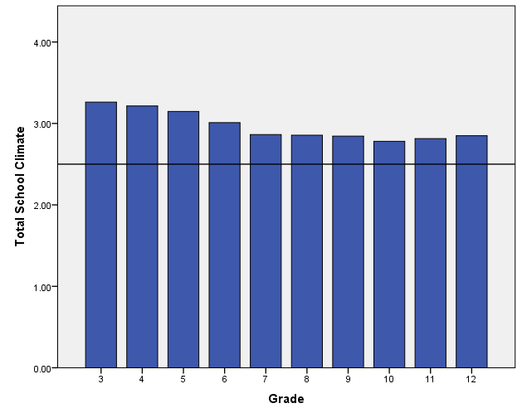
Total School Climate by Student Grade
  Student perceptions tend to decrease, especially from elementary to middle school

Slide 31
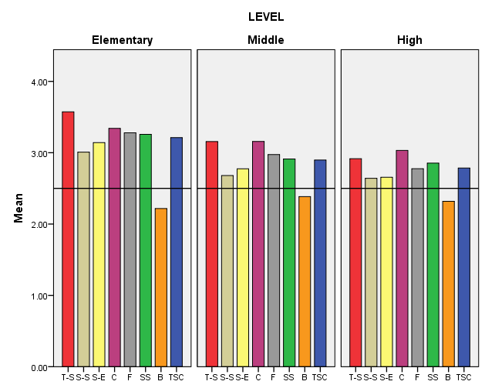
Grade Level Differences: Student Survey 2017
Scores tend to decrease as students get older, especially from ES to MS
Student-student relations and student engagement SW tend to be low compared to other scores across all levels
Teacher-student relations and clarity of expectations tend to be high compared to other scores across all levels
Teacher-Student
Relations
Student Engagement
School-wide
Fairness of Rules
Bullying School-wide
Student Relations
Clarity of Expectations
School Safety
Total School Climate
Fairness of Rules

Slide 32
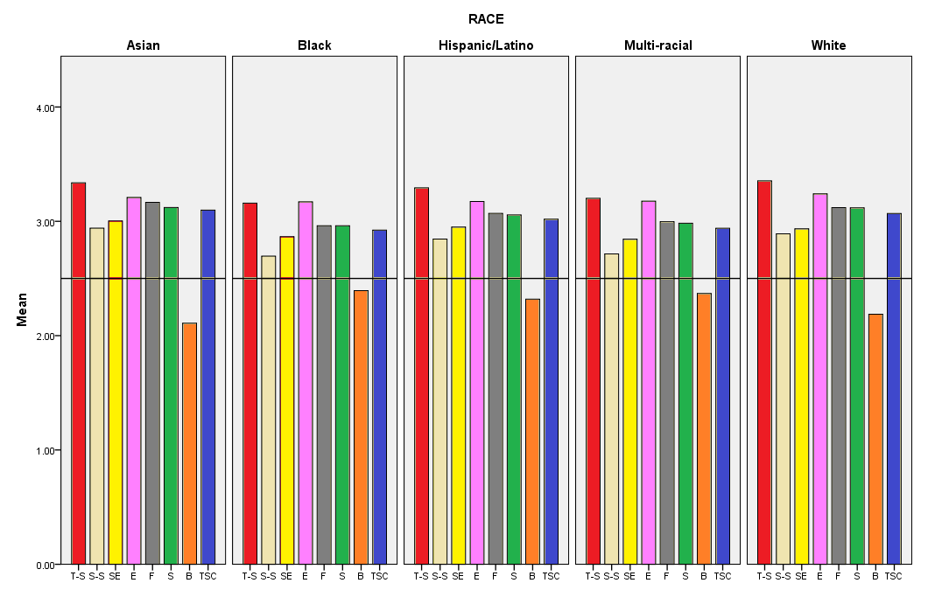
Race Differences: Student Survey 2017
Teacher-Student
Relations
Student Engagement
School-wide
Fairness of Rules
Bullying School-wide
Student Relations
Clarity of Expectations
School Safety
Total School Climate

Slide 33
Sample subscale responses associated with student scores (School Climate) | Percent who Agreed or Agreed a lot
 | Elem School | Middle School | High School
Teacher-Student Relations 7. Teachers care about their students. | 95.9 | 88.5 | 80.9
Student–Student Relations 11. Students are friendly with each other. | 77.4 | 65.5 | 68.1
Student Engagement School-wide 28. Most students work hard to get good grades. | 92.2 | 78.8 | 72.9
Clarity of Expectations 10. Students know how they are expected to act. | 89.8 | 86.3 | 85.7
Bullying School-wide* 9. Students threaten and bully others. | 32.7 | 43.2 | 40.2
Fairness of Rules 18. The school’s Code of Conduct is fair. | 90.5 | 79.5 | 70.4
School Safety 13. Students feel safe. | 91.6 | 82.8 | 79.7
* = A high score on this subscale is negative because items are negatively worded.

Slide 34
School Climate Scale
Teacher/Staff Survey Results

Slide 35
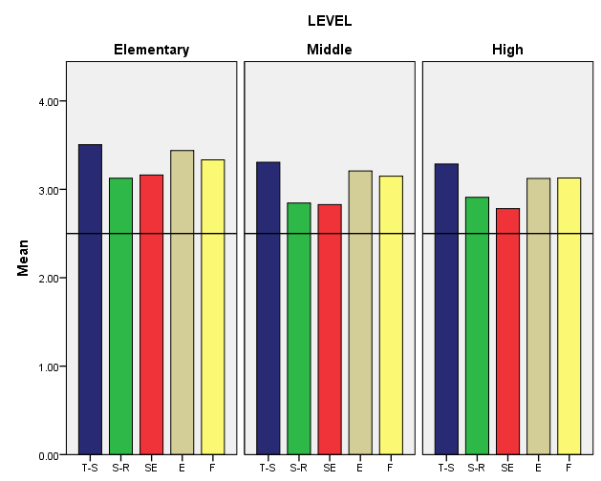
2017 Teacher Survey Results, K-12
Teachers/staff across grade levels tend to perceive student engagement SW and student relations least favorably and teacher-student relations most favorably.
Generally, perceptions decrease from elementary to middle school
Teacher-Student
Relations
Student Engagement
School-wide
Student Relations
Clarity of Expectations
Fairness of Rules

Slide 36
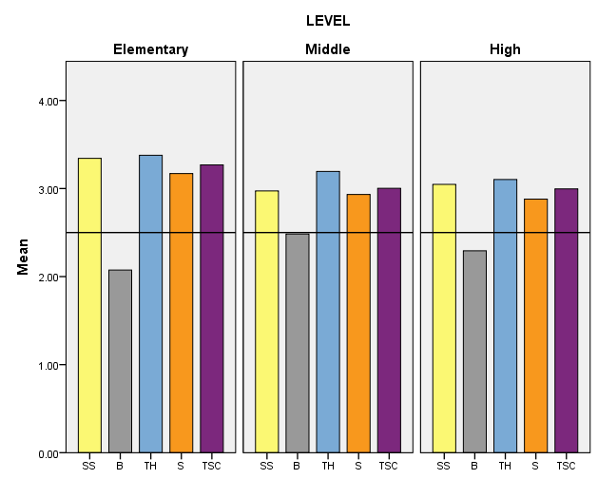
2017 Teacher Survey Results, K-12
Teacher-home communication tends to be viewed favorably across grade levels
Bullying SW tends to be viewed least favorably by middle school teachers/staff
School Safety
Teacher-Home
Communication
Total School Climate
Bullying School-wide
Staff Relations

Slide 37
Sample subscale responses associated with teacher/staff scores (School Climate) | Percent who Agreed or Agreed a lot
 | Elem School | Middle School | High School
Teacher-Student Relations 7. Teachers care about their students. | 99.3 | 97.9 | 98.5
Student–Student Relations 11. Students are friendly with each other. | 93.8 | 84.8 | 88.3
Student Engagement School-wide 28. Most students work hard to get good grades. | 89.1 | 71.7 | 63.9
Clarity of Expectations 10. Students know how they are expected to act. | 97.6 | 90.7 | 88.7
Bullying School-wide* 9. Students threaten and bully others. | 26.5 | 50.3 | 39.9
School Safety 13. Students feel safe. | 97.1 | 86.2 | 89.0
* = A high score on this subscale is negative because items are negatively worded.

Slide 38
Sample subscale responses associated with teacher/staff scores (School Climate) | Percent who Agreed or Agreed a lot
 | Elem School | Middle School | High School
Fairness of Rules 18. The school’s Code of Conduct is fair. | 93.5 | 89.7 | 91.6
Teacher-Home Communications 33. Teachers do a good job communicating with parents. | 97.5 | 90.9 | 87.0
Staff Relations 32. Teachers, staff, and administrators function as a good team. | 88.0 | 78.0 | 76.4

Slide 39
School Climate Scale
Home Survey Results

Slide 40
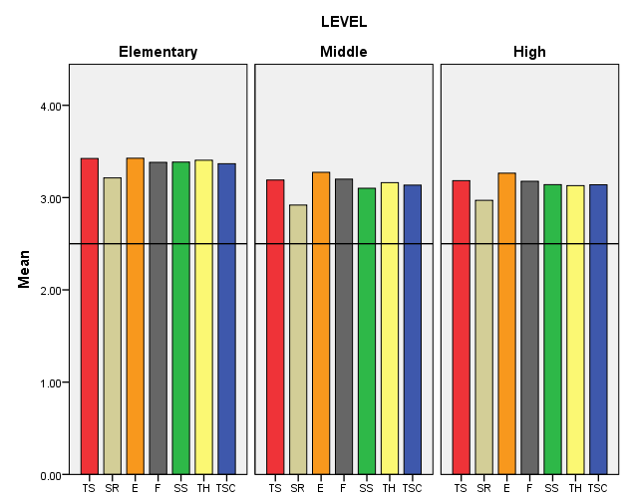
Grade Level Differences: Home Survey 2016-17
Clarity of expectations tends to be viewed most favorably across grade levels, while student relations is viewed least favorably.
Generally, perceptions decrease from elementary to high school, but positive perceptions overall.
Clarity of Expectations
School Safety
Total School Climate
Teacher-Student
Relations
Student Relations
Fairness of Rules
Teacher-Home Communication
Fairness of Rules

Slide 41
Sample subscale responses associated with home scores (School Climate) | Percent who Agreed or Agreed a lot
 | Elem School | Middle School | High School
Teacher-Student Relations 7. Teachers care about their students. | 97.8 | 93.7 | 93.0
Student–Student Relations 11. Students are friendly with each other. | 91.0 | 77.9 | 85.1
Clarity of Expectations 10. Students know how they are expected to act. | 98.2 | 95.9 | 94.1
Teacher-Home Communication 24. Teachers work closely with parents to help students when they have problems. | 94.4 | 86.6 | 84.9

Slide 42
Sample subscale responses associated with home scores (School Climate) | Percent who Agreed or Agreed a lot
 | Elem School | Middle School | High School
School Safety 13. Students feel safe. | 96.6 | 88.9 | 89.5
Fairness of Rules 18. The school’s Code of Conduct is fair. | 97.8 | 94.0 | 92.5
Parent Satisfaction 9. I am satisfied with the education students get in this school. | 94.1 | 89.7 | 88.8

Slide 43
Positive, Punitive and
Social-Emotional Learning Techniques Scale
Student Responses

Slide 44
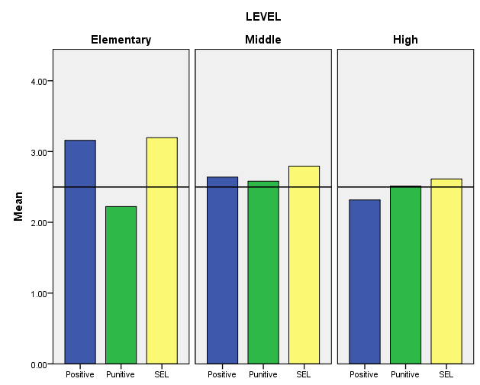
Disciplinary Techniques by Student Grade Level
Students in middle and high school tend to perceive less use of positive and SEL techniques and greater use of punitive techniques than elementary students.
Positive Techniques Punitive Techniques SEL Techniques

Slide 45
Sample subscale responses associated with student scores (Techniques) | Percent who Agreed or Agreed a lot
 | Elem School | Middle School | High School
Use of Positive Behavioral Techniques 2. Students are praised often. 5. Students are often given rewards for being good. | 81.4 80.5 | 57.9 57.8 | 43.5 33.2
Use of Punitive Techniques* 4. Students are often sent out of class for breaking rules. 13. Students are punished too much for minor things. | 49.1 29.3 | 69.6 49.1 | 57.1 53.5
Use of SEL Techniques 3. Students are taught to feel responsible for how they act. 12. Students are taught how to solve conflicts with others. | 91.1 87.1 | 83.7 67.1 | 78.3 52.7
* = A high score on this subscale is negative because items are negatively worded.

Slide 46
Techniques
Teacher/Staff Results

Slide 47
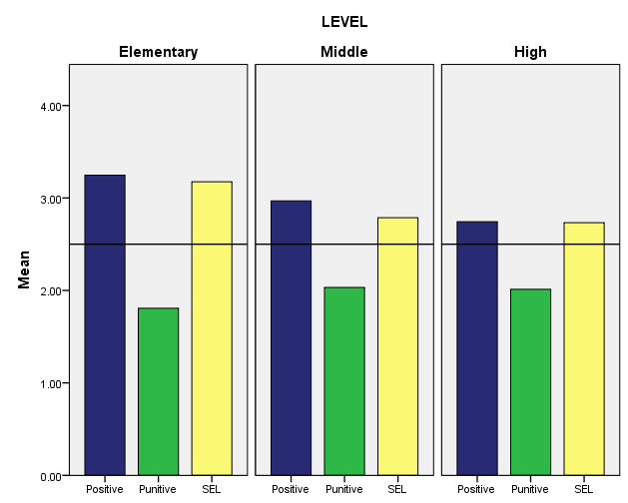
Techniques by Teacher Grade Level
In contrast to students, teachers/staff consistently report low use of punitive techniques & high use of positive and SEL techniques.
Use of positive techniques decreases from elementary to high school.
Positive Techniques Punitive Techniques SEL Techniques

Slide 48
Sample subscale responses associated with staff/teacher scores (Techniques) | Percent who Agreed or Agreed a lot
 | Elem School | Middle School | High School
Use of Positive Behavioral Techniques 2. Students are praised often. 11. Classes get rewards for good behavior | 97.8 90.1 | 89.6 77.2 | 82.7 51.7
Use of Punitive Techniques* 7. Students are often yelled at by adults. 10. Many students are sent to the office for breaking rules. | 8.2 14.3 | 16.3 23.4 | 11.5 23.9
Use of SEL Techniques 3. Students are taught to feel responsible for how they act. 15. Students are taught they should care about how others feel. | 93.1 96.0 | 77.2 77.6 | 73.4 75.3
* = A high score on this subscale is negative because items are negatively worded.

Slide 49
Bullying Victimization Scale
Student Results

Slide 50
Bullying Victimization Scale
Students asked to respond to 12 statements about the extent to which he/she was bullied, including:
  4 physical statements
  4 verbal statements
  4 social bullying statements
Students in grades 6-12 also given 4 statements about cyber bullying
Students responded on a 6-point scale:
  1 = Never
  2 = Less than once a month
  3 = Once or twice a month
  4 = Once a week
  5 = Several times a month
  6 = Every day

Slide 51
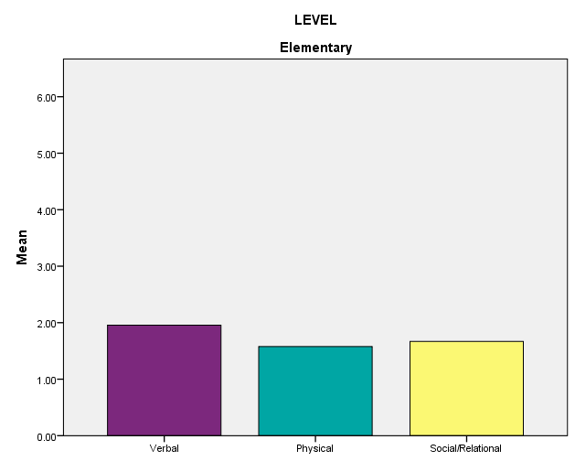
Bullying Victimization by Student Grade Level
Elementary students tend to view verbal bullying as occurring more frequently than other types of bullying.
Overall, students perceive little bullying occurring in elementary school.
Verbal Bullying Physical Bullying Social/Relational Bullying

Slide 52
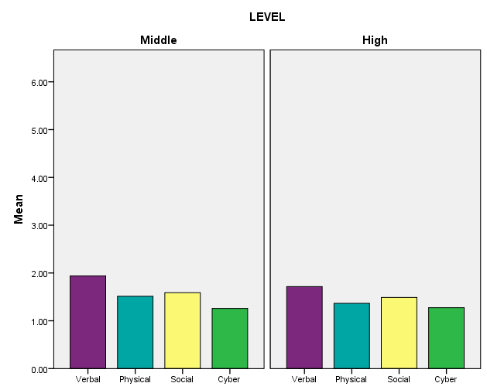
Bullying Victimization by Student Grade Level
As in elementary school, students tend to view verbal bullying as occurring most frequently in middle and high school.
Overall, students view bullying as occurring rather infrequently (never – less than once a month range).
Verbal Bullying Physical Bullying Social/Relational Bullying Cyberbullying

Slide 53
Sample subscale responses associated with student scores (Bullying Victimization*) | Percent who are bullied once a month or more
 | Elem School | Middle School | High School
Verbal Bullying 4. A student said mean things to me. | 27.8 | 27.4 | 20.3
Physical Bullying 5. I was hit or kicked and it hurt. | 12.9 | 10.4 | 6.9
Social/Relational Bullying 6. A student told/got others not to like me. | 15.9 | 15.2 | 12.8
Cyberbullying 14. A student sent me a mean or hurtful message about me using email, text messaging, instant messaging, or similar electronic messaging. | N/A | 6.6 | 7.4
* = A high score on this subscale is negative because items are negatively worded.

Slide 54
Bullying Victimization Scale
Home Results

Slide 55
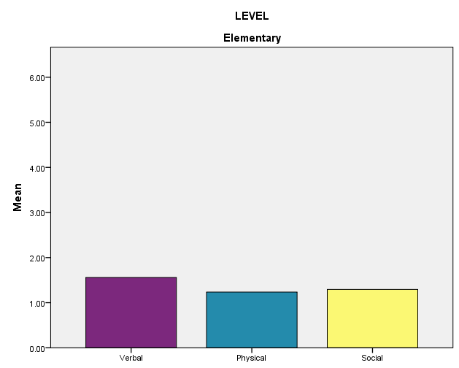
Bullying Victimization by Student Grade Level
Parents tend to view verbal bullying as occurring more frequently than other types of bullying in elementary school.
Overall, parents perceive little bullying occurring in elementary school.
Verbal Bullying Physical Bullying Social/Relational Bullying

Slide 56
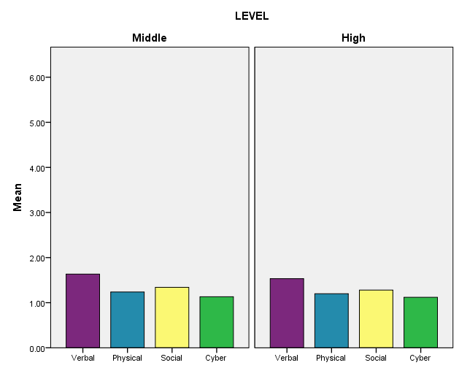
Bullying Victimization by Student Grade Level
As in elementary school, parents tend to view verbal bullying as occurring most frequently in middle and high school.
Overall, parents view bullying as occurring rather infrequently (never – less than once a month range).
Verbal Bullying Physical Bullying Social/Relational Bullying Cyberbullying

Slide 57
Sample subscale responses associated with home scores (Bullying Victimization*) | Percent who are bullied once a month or more
 | Elem School | Middle School | High School
Verbal Bullying 7. My child was called names he/she didn’t like. | 10.7 | 15.2 | 11.8
Physical Bullying 11. A student threatened to harm my child. | 3.0 | 5.7 | 5.4
Social/Relational Bullying 9. A student got others to say mean things about my child. | 5.6 | 8.8 | 7.6
Cyberbullying* 13. Another student sent my child a mean or hurtful message about him/her using email, text messaging, or other electronic messaging. | N/A | 3.4 | 4.7
A high score on this subscale is negative because items are negatively worded. *For grades 6-12 only

Slide 58
Student Engagement Scale
Student Results

Slide 59
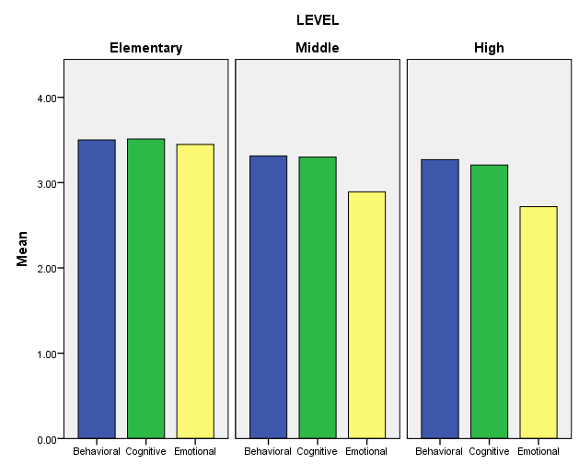
Student Engagement Grade Level Differences: Student Survey
In middle school and high school, students tend to view themselves as being less emotionally engaged than in elementary school.
Overall, across grade levels students tend to perceive themselves as being engaged in school.
Behavioral Engagement Cognitive Engagement Emotional Engagement

Slide 60
Sample subscale responses associated with student scores (Student Engagement ) | Percent who Agreed or Agreed a lot
 | Elem School | Middle School | High School
Behavioral 1. I pay attention in class. 4. I follow the rules at school. | 94.9 96.9 | 93.2 93.2 | 93.4 93.6
Cognitive 2. I try my best in school. 5. I turn in my homework on time. | 98.6 88.3 | 95.2 79.8 | 91.1 77.7
Emotional 3. I feel happy in school 9. I like students who go to this school | 86.6 91.8 | 72.4 82.8 | 65.4 74.1

Slide 61
Student Engagement Scale
Home Results

Slide 62
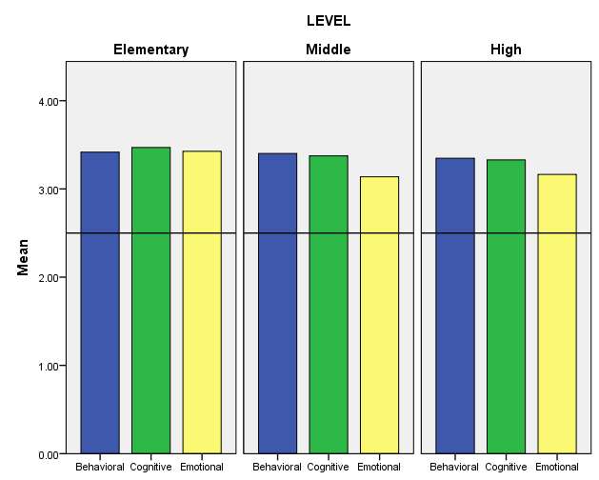
Student Engagement Grade Level Differences: Home Survey
In middle school and high school, parents tend to view their children as being less emotionally engaged than in elementary school.
Overall, across grade levels, parents perceive their children as being engaged in school.
Behavioral Engagement Cognitive Engagement Emotional Engagement

Slide 63
Sample subscale responses associated with home scores (Student Engagement ) | Percent who Agreed or Agreed a lot
 | Elem School | Middle School | High School
Behavioral 4. My child follows the rules at school. | 97.7 | 97.4 | 97.0
Cognitive 2. My child tries his/her best in school. | 96.4 | 92.9 | 91.7
Emotional 3. My child feels happy in this school | 94.7 | 86.2 | 87.7

Slide 64
Student Social and Emotional Competencies Scale
Student Results

Slide 65
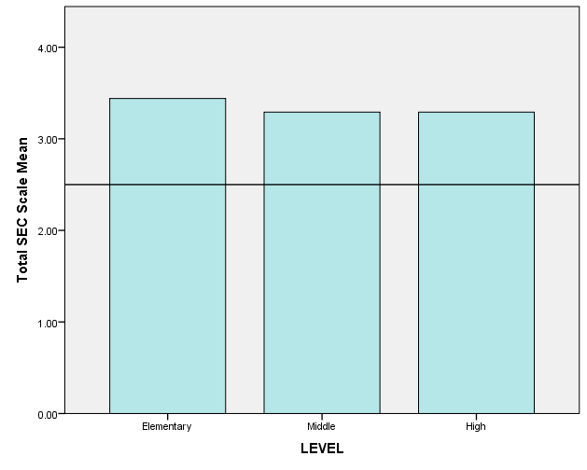
Total Student Social and Emotional Competencies Scores by Student Grade Level
Students across grade levels tend to perceive themselves as possessing social and emotional competence.

Slide 66
Sample subscale responses associated with student scores (Student Social and Emotional Competencies Scale) | Percent who indicated this was somewhat or very much like them
 | Elem School | Middle School | High School
Responsible Decision-making/Responsibility 5. I feel responsible for how I act. | 94.5 | 92.9 | 94.6
Understanding how others think and feel/Social Awareness 6. I care about how others feel. | 93.3 | 87.8 | 86.6
Self-management of emotions and behavior 7. I think before I act. | 86.4 | 81.5 | 86.0
Relationship Skills 4. I am good at solving conflicts with others. | 83.0 | 79.9 | 85.3

Slide 67
How do school climate scores relate to other measures?
Caution: Correlation does not mean causation. ☺ Direction of influence is likely to be bidirectional.

Slide 68
Evidence of Concurrent Validity
Student Survey and School-level Data: School Climate Scale
Subscales | Elementary Schools |  |  | Middle Schools |  |  | High Schools
 | ELA | Math | S/E | ELA | Math | S/E | ELA | Math | S/E
Teacher–Student Relations | .540** | .485** | -.420** | .714** | .715** | -.583** | -.041 | .108 | -.565*
Student–Student Relations | .691** | .649** | -.682** | .751** | .755** | -.740** | .286 | .526* | -.837**
Engagement School-wide | .531** | .530** | -.585** | .663** | .644** | -.623** | .355 | .546** | -.819**
Clarity of Expectations | .463** | .445** | -.316** | .605** | .614** | -.408* | -.021 | .077 | -.432*
Fairness of Rules | .500** | .463** | -.366** | .690** | .616** | -.772** | -.431* | -.296 | -.135
School Safety | .558** | .500** | -.512** | .657** | .669** | -.579** | .451* | .528* | -.691**
Bullying School-wide | -.782** | -.687** | .574** | -.708** | -.760** | .676** | -.381 | -.510* | -.686**
Total School Climate | .694** | .639** | -.598** | .746* | .743** | -.698** | .223 | .393 | -.749**
Note. ELA= English–Language Arts. S/E = Suspensions and Expulsions. ELA = % passing ELA. Math = % passing math. 77 Elementary Schools, 28 Middle Schools, 17 High Schools. *p < .05. **p < .01, ***p < .001 One tailed.

Slide 69
Evidence of Concurrent Validity
Teacher Survey and School-level Data: School Climate Scale
Subscale | Elementary Schools |  |  | Middle Schools |  |  | High Schools
 | ELA | Math | S/E | ELA | Math | S/E | ELA | Math | S/E
Teacher–Student Relations | .522** | .648** | -.574** | .577** | .590** | -.463** | .353 | .431* | -.661**
Student–Student Relations | .716** | .746** | -.753** | .683** | .635** | -.586** | .629** | .704** | -.668**
Schoolwide Engagement | .743** | .816** | -.734** | .727** | .746** | -.683** | .731** | .775** | -.774**
Clarity of Expectations | .498** | .624** | -.541** | .444* | .396* | -.246 | .420* | .397* | -.424*
Fairness of Rules | .559** | .611** | -.566** | .506** | .468** | -.400* | .559** | .461* | -.419*
School Safety | .591** | .683** | -.696** | .590** | .543** | -.486** | .574** | .590** | -.580**
Bullying Schoolwide | -.687** | -.700** | .690** | -.660** | -.612** | .463* | -.534** | -.547** | .500*
Teacher-Home Communications | .604** | .698** | -.555** | .551** | .614** | -.530** | .330 | .547** | -.700**
Staff Relations | .307** | .270** | -.211* | .214 | .259 | -.198 | .230 | .222 | -.360
Total School Climate | .655** | .622** | -.527** | .617** | .603** | -.508** | .587** | .613** | -.676*
Note. ELA= English–Language Arts. S/E = Suspensions and Expulsions. ELA = % passing ELA. Math = % passing math. 75 Elementary Schools, 27 Middle Schools, 20 High Schools. *p < .05. **p < .01, One tailed.

Slide 70
Evidence of Concurrent Validity
Student Survey: Techniques Scale
Subscale | Elementary Schools |  |  | Middle Schools |  |  | High Schools
 | ELA | Math | S/E | ELA | Math | S/E | ELA | Math | S/E
Punitive Techniques | -.764** | -.714** | .634** | -.790** | -.822** | .735** | -.147* | -.473* | .726**
Positive Techniques | -.033 | -.030 | -.016 | .113 | .102 | -.118 | -.460 | -.332 | -.262
SEL Techniques | .374** | .325** | -.325** | .580** | .610** | -.619** | -.199 | -.181 | -.151
Note. ELA= English–Language Arts. S/E = Suspensions and Expulsions. ELA = % passing ELA. Math = % passing math. 76 Elementary Schools, 28 Middle Schools, 18 High Schools. *p < .05. **p < .01, **p <.001. One tailed.

Slide 71
Evidence of Concurrent Validity
Teacher Survey: Techniques Scale
Subscale | Elementary Schools |  |  | Middle Schools |  |  | High Schools
 | ELA | Math | S/E | ELA | Math | S/E | ELA | Math | S/E
Positive Techniques | .319** | .347** | -.244* | .258 | .278 | -.234 | .137 | .261 | -.542**
Punitive Techniques | .692** | .688** | -.672** | .655** | .649** | -.674** | .396* | .483* | -.627**
SEL Techniques | .544** | .540** | -.415** | .390* | .386* | -.288 | .607** | .529** | -.619**
Note. ELA= English–Language Arts. S/E = Suspensions and Expulsions. ELA = % passing ELA. Math = % passing math. 75 Elementary Schools, 27 Middle Schools, 20 High Schools. *p < .05. **p < .01, One tailed.

Slide 72
Summary
Delaware has developed a reliable and valid measure of school climate.
Scores on the surveys are reliable and related to important outcomes, particularly academic achievement and suspensions/expulsions.
Improvements continue to be made.

