Slide 1
Delaware PBS Cadre Meeting
Thursday, December 2, 2010

Slide 2
2011 School Climate Survey
159 Schools from 18 Districts & Charters
2010 Survey in 2011
Piloting School Engagement Items
  Online survey for students grade 5+
SC Survey Timeline
Invite & Reminder: | 10/13/10 & 10/29/10
Registration Due: | 11/12/10
Deliver Materials: | By 1/7/11
Return from Schools: | 2/25/11
Reports Delivered: | May 2011
SC Workshop: | 5/24/11
Notes:
Process:
Registration closed and confirmation send on 11/16.
Materials being ordered and prepared.
Materials delivered to district offices for distribution to the schools by 1/7 (exact date notice will be sent)
Return via state mail (NO DISTRICT PICK UP), or through coaches – 2/25
Communication plan: School contacts, coaches & district SC people on all communication
If you have a different need/want – let’s discuss
Feedback on Spanish Student survey option idea
Board presentation on SC

Slide 3
Discipline Data Reporting Tool - DDRT
2 Templates
  09-10 and 10-11 data (2 yr)
  07-08 through 10-11 (4 yr)
Distributed September 2010
Support in use of DDRT available – Sarah at skhearn@udel.edu
DDRT Submission
District Coaches & Sandi Bradford - sandi@udel.edu
December 31st &
June 30th
Notes:
Data collection for District & State level review
Looking to consider:
How does my school referral rate compare to other schools within the district (by grade level if applicable)?
How does my school referral rate compare to other schools within the state?
Do schools experience similar trends in disciplinary referrals throughout the year as my school?
Other?

Slide 4
School-wide PBS – Supporting Tiers 1-2-3
 | SWPBS 1: Basic SW Tier 1 | SWPBS 2: Advanced SW Tier 1 | SWPBS 3: Basic Targeted Tier 2 | SWPBS 4: Advanced Targeted Tier 2 | SWPBS 5: Intensive Tier 3
Strengths & Needs Assess | Prevention & Evaluation sections | Self-Discipline & Correction sections | Targeted & Intensive Sections
Phase/Recognition | Phase 1 | Phase 2 | Phase 3 | Phase 4 | Phase 5
External Evaluation |  | SWPBS Key Features Eval |  | Future: Tier 2&3 Key Features Eval
PD | SW Team Training | Developing Self-Discipline Family-School Collaboration | Targeted Team Training | Advanced Targeted Team Training | FBA/BSP Person-Centered Planning

Slide 5
DE Assessment of Strengths and Needs For PBS
2010 user feedback via electronic & phone survey gathered
2010-2011 Revisions:
  Needs Assessment
  Presentation of Data
  Data Guide
Coaches as Needs Assessment Ambassadors
2010-2011 Participation Process
  Invitation Options
Notes:
Feedback:
Electronic survey & phone survey
Educator feedback to address item clarity and conciseness
2010-2011 Revisions: Will continue to look at w/ Cadre today
NA – split into 2 sections
Presentation of Data
Data Guide
2010-2011 participation process
3 Options: December/prior to break; January (w/ SC), Feb/March

Slide 6
DE Assessment of Strengths and Needs For PBS
Survey Review Activity
For your NA Survey section:
  Review the NA section making note of confusing language, excess info, etc.
    Which examples do you feel are needed to support the item, and which can be eliminated?
    Any other areas to explore/questions to add or break out?
    Do you have suggestions for clarifying items?
  Discuss in group & provide summary of section feedback
Notes:
Small groups activity
Divide into 4 groups for review of 1-3, 5.

Slide 7
DE Assessment of Strengths and Needs For PBS
Data Activity
Materials:
Task:
NA data set; 2 sections
Data Guides
NA summary worksheets
Review the NA data summary & complete the worksheet
Discuss in group & provide feedback on the utility of worksheets
Review guide; is additional/less information is needed?
Notes:
Small groups activity

Slide 8

Targeted Team Planning
Targeted Team PD – January 11, 2010
Targeted PD will have two levels
  Level 1 focuses on team development and implementing BEP
Questions to Consider
  What are Targeted Interventions?
  Which schools are ready to attend?
  Who should be on a team?

Slide 9
What is Targeted?
A process to support students with needs not fully addressed by the school-wide (universal) program.
May be conducted in small groups or with individual students.
Matched to hypothesized functions.
Readily available, requires little assessment, requires less than 10 minutes of classroom teacher’s time per day
Notes:
Linda
This is the purpose section.
We want to clarify here that there IS an assessment process but it is not as detailed as it might have to be later. Also, some targeted level interventions might already exist in the school, while others will have to be developed.
From the McIntosh et al (2009) Differential Effects of a Tier Two Behavior Intervention Based on Function of Problem BehaviorKent McIntosh, Amy L. Campbell, Deborah Russell Carter and Celeste Rossetto Dickey Journal of Positive Behavior Interventions 2009 11: 82 originally published online 30 June 2008 DOI: 10.1177/1098300708319127

Slide 10
Overview of Training
Overview of targeted process
Fit between RTI, IST, and PBS - Targeted
Developing the targeted team
Process for identifying students in need
Introduction to skill building and
relationship building interventions
Notes:
Linda
Let me start by saying, we will probably disappoint you because we are not going to give them a laundry list of interventions .. This is more about the system and the approach to problem solving, and that this it would not be appropriate to just give them a laundry list … the interventions will be “discovered” in the process. We will give some broad based interventions that you will be able to use, but we are not going to give you a list of 100 most used.
The main components we will be covering. You will get enough information to begin, but this is not an exhaustive training, and there will be additional information and resources needed for your team depending on where your team is starting and what experiences your team members already have.
There is a 2 day workshop that covers the process in more detail and offers a more advanced way to identify and intervene with students through consultation; we also can give more attention to interventions

Slide 11
Targeted Team - Collaborate and Simplify
A member of the school-wide team to facilitate communication
Targeted team facilitator should not be the same person as the school-wide team leader
Don’t create separate problem solving teams for academics and behavior.
Consider experience in consultation or interest in developing consultative skills
Consider size and membership needs of related school teams
Consider energy, interest, and commitment of team members
Notes:
Linda
Re-emphasize that there is ONE targeted team that addresses both behavior and academics.

Slide 12
Daily Progress Report
Notes:
Debby
Here are three different examples.
This first one has Periods (block schedule) along the top
Goals (along the side) are the school-wide expectations (may need to be individualized for some students)
Rankings – 2 = followed expectation, 1 = so- so, 0 = did not meet expectation

Slide 13
Targeted Team Data Support
Excel – Targeted Gradebook
I-Tracker – Point Card Entry
Demo – Mike Lewis
  DE-PBS Graduate Assistant
Point Card Data:
  By student Data & graph
  Weekly summary & comparisons
  Group trends
Demo - Katey Semmel
  Director of Operations
  Data Service Center
I-Tracker Pro Users:
Appoquinimink Capital Colonial Indian River Red Clay Lake Forest Caesar Rodney Laurel (2011)
Notes:
The following districts are currently using I-Tracker Pro:
Colonial
Red Clay
Appoquinimink
Capital
CR
Indian River
Lake Forest
Laurel (new 2011 implementation)
Family Foundations Charter (new 2011 implementation)
We are anticipating Christina and Smyrna to also begin using the application this school year but are awaiting confirmation.

Slide 14
Networking- Tier 2 & 3: Targeted & Individual Behavioral Supports
Secondary and Tertiary Systems of Support
Prevent, Teach, Reinforce Presentation

Slide 15
PBIS Leadership Forum 2010
A5 Sheri Luecking & Ami Flammini, Illinois PBIS Network; Sara Teeter & Abbey Wacaser, Springfield School District Building Capacity at the State, District, and Building for Wraparound at Tier 3
C6 Cynthia Anderson, University of Oregon; Lucille Eber, Illinois PBIS Network Secondary/Tertiary Systems Development, Part 1: District and School Levels
http://www.pbis.org/presentations/chicago_forum_10.aspx

Slide 16

Positive Behavior Supports and Intervention: Tiered Assessment and Intervention
Tier 1/Universal
School-Wide Assessment
School-Wide Prevention Systems
ODRs,
Attendance,
Tardies, Grades,
DIBELS, etc.
Tier 2/
Secondary
Tier 3/
Tertiary
Check-in/ Check-out
Assessment
Intervention
Social/Academic Instructional Groups
Daily Progress
Report (DPR)
(Behavior and
Academic Goals)
Individualized Check-In/Check-Out, Groups & Mentoring (ex. CnC)
Competing Behavior
Pathway, Functional
Assessment Interview,
Scatter Plots, etc.
Brief Functional Behavioral Assessment/
Behavior Intervention Planning (FBA/BIP)
Complex FBA/BIP
SIMEO Tools:
HSC-T, RD-T, EI-T
Wraparound
Illinois PBIS Network, Revised May 2009
Adapted from T. Scott, 2004
Notes:
Use this slide to talk about each intervention…focusing on tier 3
When writing a plan, it could be useful to have this in front of the team members; this will help us create plans using our lower level interventions. Point out: we believe there are six types of interventions (point out on triangle); This is our new structure for our training.

Slide 17
3-Tiered System of Support
Necessary Conversations (Teams)
Universal
Team
Secondary Systems Team
Problem Solving Team
Tertiary Systems Team
Uses Process data; determines overall intervention effectiveness
Uses Process data; determines overall intervention effectiveness
Plans SW & Class-wide supports
Standing team; uses FBA/BIP process for one youth at a time
Universal Support
CICO
Brief
FBA/BIP
SAIG
Complex
FBA/BIP
WRAP
Group w. individual
feature
Brief FBA/BIP
Sept. 1, 2009
Notes:
17
17
The abbreviations in yellow are spelled out on the previous inverted triangle slide

Slide 18
Teaming at Tier 2
Secondary Systems Planning ‘conversation’
  Monitors effectiveness of CICO, S/AIG, Mentoring, and Brief FBA/BIP supports
  Review data in aggregate to make decisions on improvements to the interventions themselves
  Students are NOT discussed
Problem Solving Team ‘conversation’
  Develops plans for one student at a time
  Every school has this type of meeting
  Teachers and family are typically invited

Slide 19
Secondary Systems Team Roles
Team Leader: responsible for agenda & overall facilitation
Intervention Coordinators (CICO, S/AIG etc.): report out on aggregate student data from interventions they facilitate (ex. “50 youth in CICO, 40 are responding”)
Action Plan Recorder: a.k.a. note taker
Time Keeper: help team to set time limits and stay within allotted time for each agenda item
Notes:
Remind teams that at each level, Univ, Sec, Tert, there should be a division of duties among team members to avoid one person being the “expert” or carrying all of the PBIS responsibilities.

Slide 20
Data Used to Identify Youth in Need of CICO
Student outcome data:
  Office Discipline Referrals
  Suspensions
  Attendance
  Tardies
Universal Screeners (SSBD, BESS etc.)
Requests for Assistance made by teachers, family members and/or students
Notes:
We are beginning with description/examples of ways we will identify students who are in need of Secondary Support/s

Slide 21
Teaming at Tier 3
Tertiary Systems Planning ‘conversation’
  Monitors effectiveness of Complex FBA/BIP & Wraparound supports
  Review data in aggregate to make decisions on improvements to the interventions themselves
  Students are NOT discussed
Individual Student Teams
  FBA/BIP Team per student
  Wraparound Team per student
Notes:
Be ready…this is probably a new message; Two types of teams or conversations at the tertiary level. The first type of team is a systems team and individual student teams. Every child who you are thinking about at the tertiary level will have an individual team. This is not the IEP team. This is people who know and interact with the student. Like a wrap around team, but slightly less comprehensive because talking about school behaviors.

Slide 22
Tertiary System
Planning Team
Supported by Tertiary Coach
Review/assess effectiveness of interventions themselves
Work on improving/creating intervention systems, data, practices
Support Complex FBA/BIP & Wraparound facilitators
Notes:
Without the context of where fba/bip fits the practices won’t matter; They are not allowed to name individual kids; they talk about the whole school (their unit of analysis); what you trouble shoot around are the tertiary level interventions in your building. (have them take out their tier 2/tier 3 tracking tool). This is the main tool the tertiary system planning team uses to guide their work.

Slide 23
Student-Specific Teams
Wraparound Team:
  Family of child and all relevant stakeholders invited by family. Wrap facilitators are trained to effectively engage families so that they will see that these teams are created by and for the family, and therefore will want to have a team and actively participate. School staff involved are informed that their presence is uniquely important for this youth and invited to participate.
Individual Youth FBA/BIP Team:
  This team is uniquely created for each individual child in need of comprehensive planning and the families are critical members of the team. All relevant individuals/staff are invited.
Notes:
Point out not just for wrap around, but for tertiary level fba/bip. The team is going to figure it out, rather than an expert coming in and pulling ideas from a generic menu. Good news: this is only for about 3% of building population.

Slide 24
Identifying Who Needs a FBA/BIP
Kids are referred to an individual problem solving team by the Secondary Systems Team typically when lower-level, Simple Secondary, interventions do not result in adequate progress.
  Any student not responding adequately to CICO, S/AIG and/or Mentoring etc. (CnC etc.).
  Request for Assistance made:
    Data identifies student as in need (# of ODRs, suspensions, absences, etc..).
    Exception to the system: Adult perceives youth as in urgent need (lower-level support not seen
    as adequate)
Notes:
Kids who get a brief fba/bip didn’t respond to layeriing of interventions; kids who get a complex fba/bip are kids who didn’t respond to a brief fba/bip. If you don’t have a rule, you can’t have an exception…it would just be how you do business.

Slide 25
Brief vs. Complex FBA/BIP
Brief
Generic Individual Problem solving Team
Meeting time/day usually already determined
Plan developed quickly/easily
Complex
Individualized Youth FBA/BIP Team
Meeting time/day decided by individualized team
Interventions are highly individualized
Notes:
If you are sitting with a generic team, you are doing secondary work; focused one behavior and one setting with brief fba/bip.

Slide 26
Brief vs. Complex FBA/BIP
Brief
SWIS data, Daily Progress Report (DPR) points, Functional Assessment interviews
Effectiveness of system monitored by Secondary Systems Planning Team
Data reviewed at least every other week
Complex
SWIS data, Daily Progress Report (DPR) points, Functional Assessment interviews, SIMEO Data, direct observation data, additional tools as needed
Effectiveness of system monitored by Tertiary Systems Planning Team
Data reviewed at least weekly
Notes:
Dean Fixen “kids can’t benefit from interventions they don’t’ receive”; this is relevant because the more conversations we have early on in the process the fewer kids we are going to be able to get to serve. If you talk about function too soon, you aren’t going to be able to get to all the kids who need interventions. Any kid you are considering for tertiary, put in cico immediately. For both types you use some very basic forms of data. All data points don’t have to be highly individualized. You don’t want to say “all of these tools have to be completed” for an fba/bip. You use the tools to answer questions that aren’t answered.

Slide 27
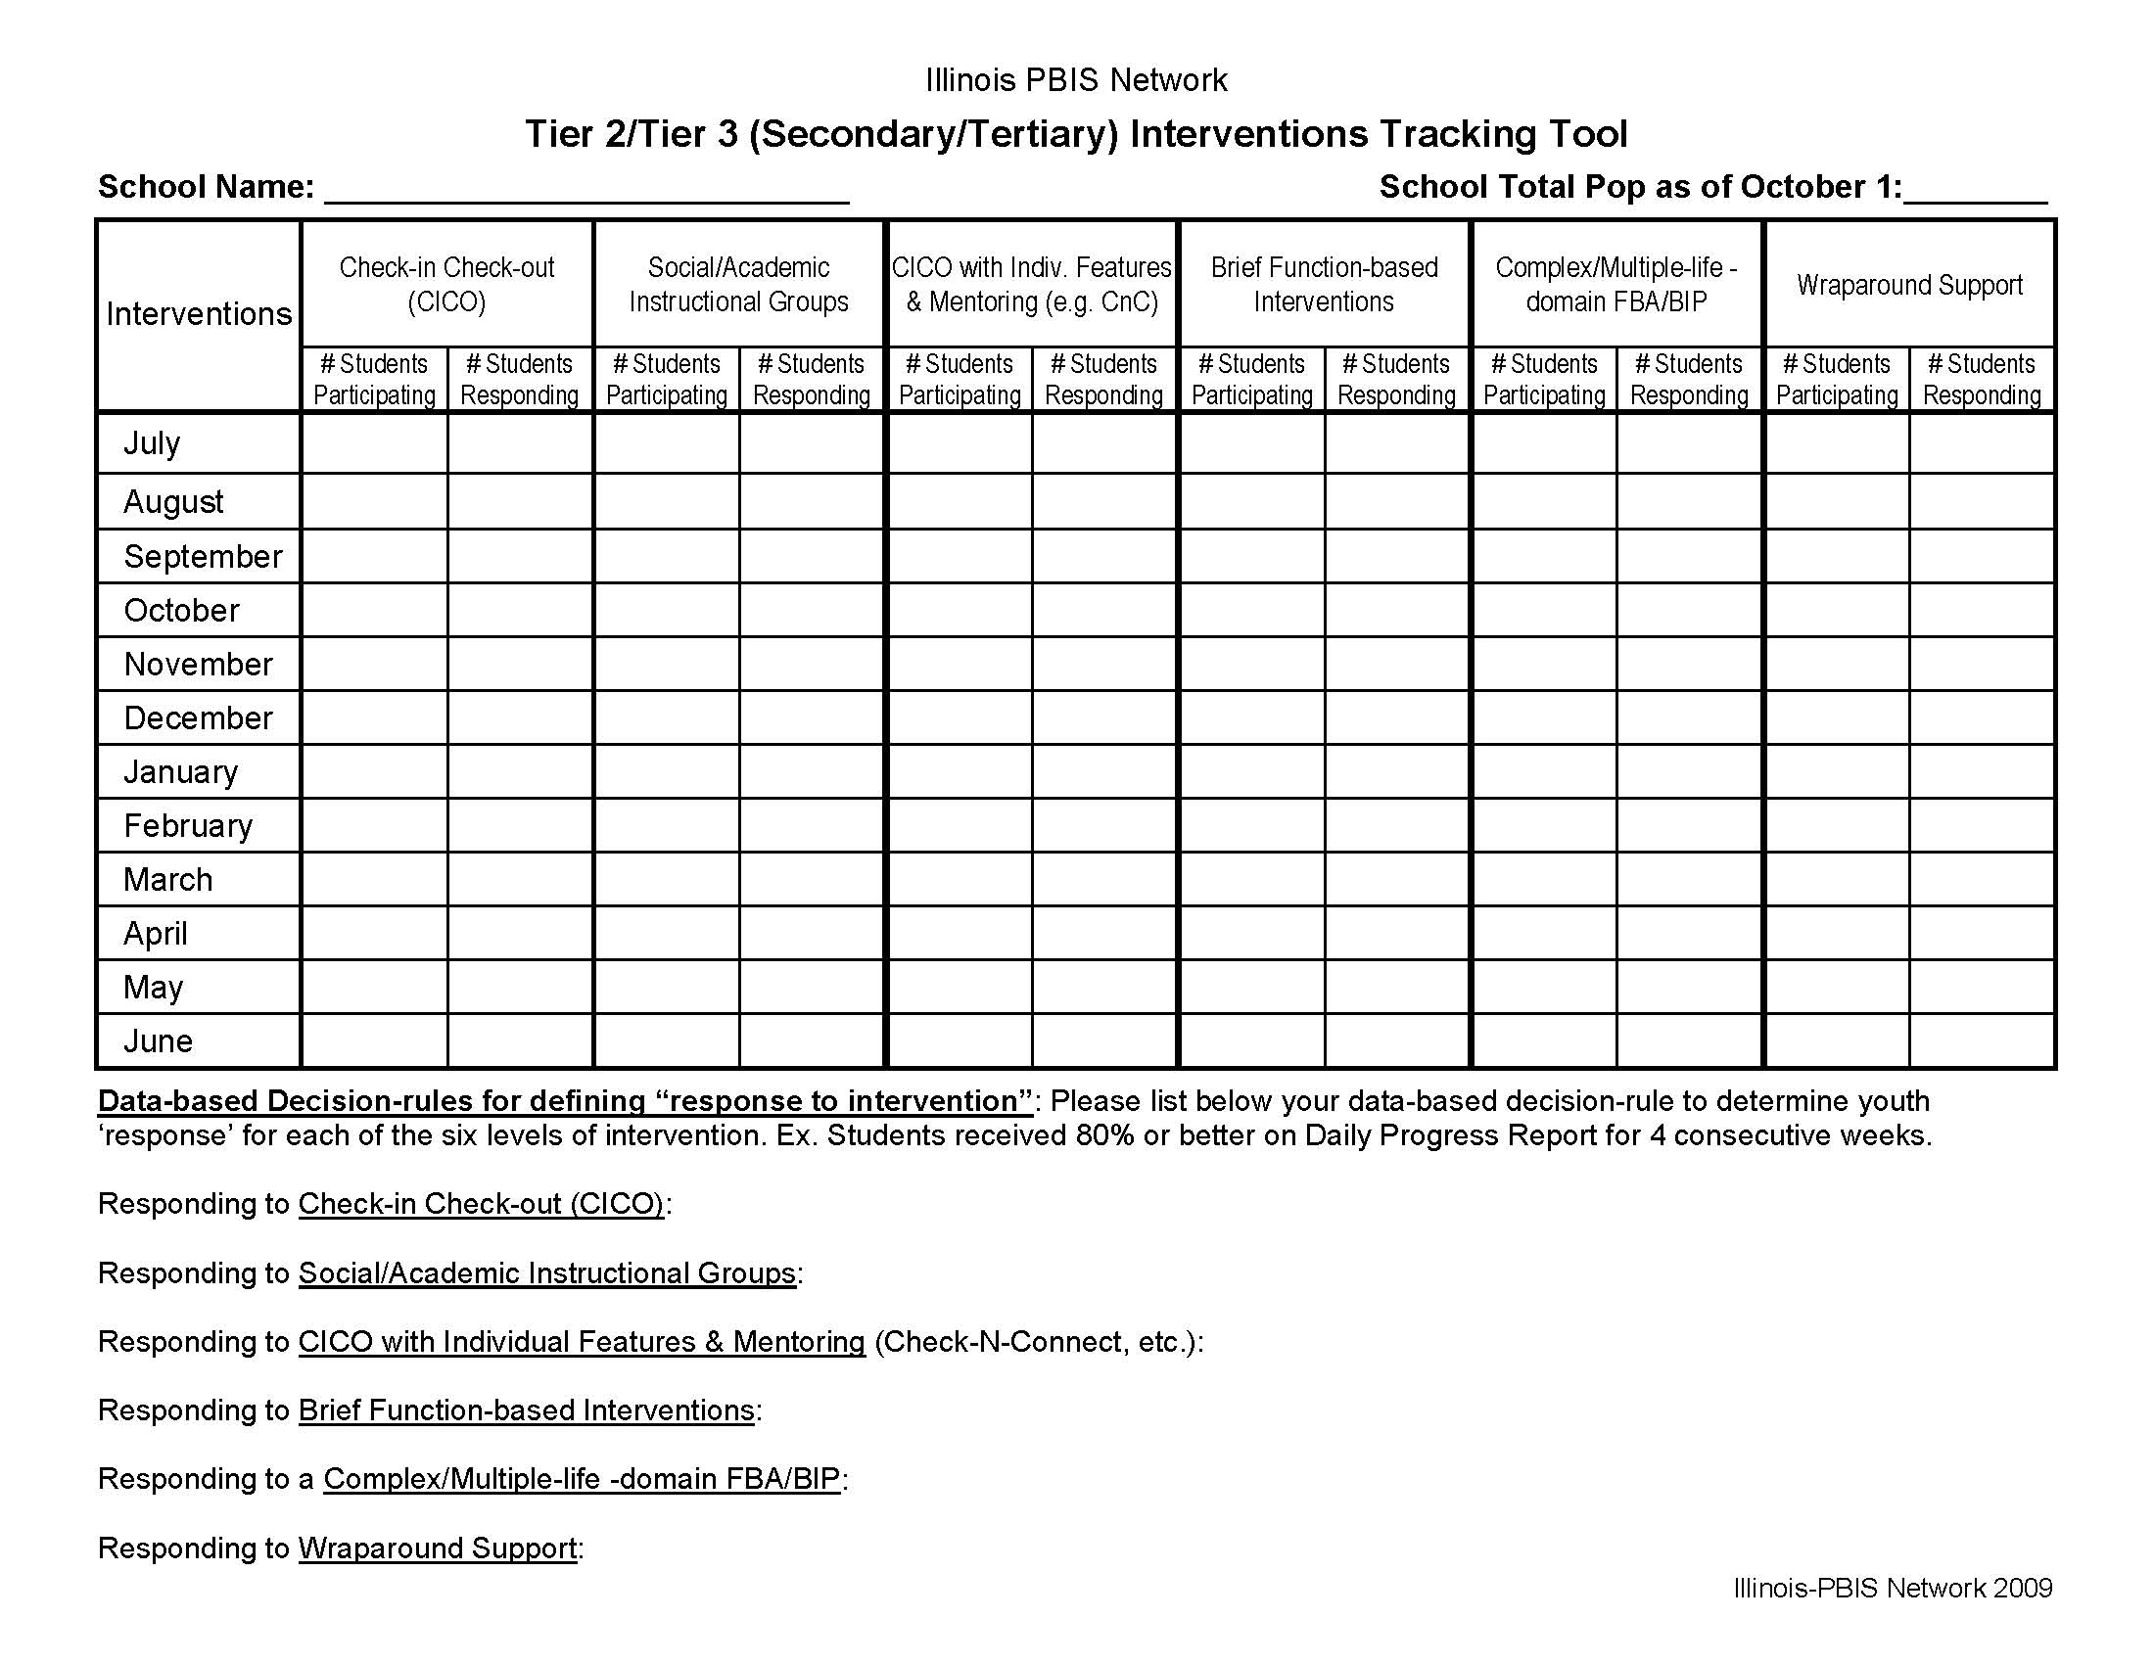
Notes:
The tracking tool is the agenda in a different format

Slide 28
2011 DE-PBS Recognition: Phases 1 &2
Phase 1 Application
Distribute Options
What’s new?
Expanded FAQ Document
NA Survey – 2 sections
Phase 2 Application
Provide feedback on requirements
Determine Distribution Timeline
Notes:
2011 Recognition
Phase 1 in good shape; we made minor tweaks to review and confirm with cadre; Quick turnaround to resend to schools before winter break.
FAQ – Additions include: Additional NA guidance, Data for schools serving students w/ significant intellectual disabilities, and family sharing/feedback
NA: Staff completed “Delaware Assessment of Strengths and Needs for Positive Behavior Supports” Sections 1 and 5 are required for 1st time applicants. All other schools complete 2 sections chosen by team based on data.
When schools are completing the needs assessment for the first time, sections 1 and 5 are required. In subsequent years schools should select sections to complete each year based on the areas of focus.
Phase 2 – in progress
Discussed draft of phase 2, Linda will try to read over, SH will share with DB. Discuss on the 18th if we want to get it ready to discuss w/ cadre in any form. Susan Corey first since she was part of workgroup.
Jessica or Mike look at Illinois recognition system. Have on hand to share when reviewing our recognition applications for comparison purposes.

Slide 29
DE-PBS Annual Celebration
School Highlights
  Panel Presentations
  Across grade level representation
  Sharing done by school staff, coaches, project staff, video
Possible Topics & Initial Ideas
  Character Education – Social-Emotional Learning
  Correction Strategies – System Supports
  Use of Students in Programming
  Staff Recognition
  Sustainability
  Others?
Notes:
PBS Celebration –
Aim for 5 topics that would be spotlight topics (current ideas: character ed, correction strategies, teaching strategies, student involvement, staff recognition or sustainability)
Panel format – cross grade representation per topic if possible, as well as coaches and staff to share
Develop an example for the coaches, so they get an idea of what we’re looking for and can help recruit
April 14, 2011 – Dover, DE
PBS Celebration –
Aim for 5 topics that would be spotlight topics (current ideas: character ed, correction strategies, teaching strategies, student involvement, staff recognition or sustainability)
Panel format – cross grade representation per topic if possible, as well as coaches and staff to share
Develop an example for the coaches, so they get an idea of what we’re looking for and can help recruit

Slide 30
Thank you!
Next meeting: February 15, 2011
Happy Holidays!

