Slide 1
A Brief Overview of Prevent, Teach, Reinforce
A School based model of individualized positive behavior support
Selected slides based on presentation from the 2010 PBIS Leadership Forum
Chicago, IL
Rose Iovannone, Ph.D., BCBA-D
University of South Florida

Slide 2

  Dunlap, G., Iovannone, R., English, C., Kincaid, D., Wilson, K., Christiansen, K., & Strain, P. (2010). Prevent-Teach-Reinforce: A school-based model of individualized positive behavior support. Baltimore:Paul H. Brookes

Slide 3
Objectives
Participants will:
  Describe the 5-step PTR Tier 3 support model
  Identify the critical components that enhance the success of Tier 3 behavior supports

Slide 4
Step 1: teaming
Purpose:
  Evaluate strengths and weaknesses of team functioning
  Outline roles and responsibilities- transdisciplinary
  Determine a consensus-making process
Members (desired)
  Person with knowledge of student (e.g., Classroom teacher, parent, related service provider, paraeducator,)
  Someone with expertise in functional assessment, behavioral principles (school psychologist, behavior specialist, counselor, etc.)
  Someone with knowledge of context/resources (administrator or designee)
Tools
  Classroom Team Survey
  Work Style Survey (teacher and paraeducator)

Slide 5
Step 2:
Goal Setting
Purpose:
  Identify behaviors of greatest concern to the team and possible replacement behaviors (teach)
  Prioritize and operationalize behaviors
  Develop teacher friendly baseline data collection system
Targeted Areas:
  Problem behaviors
  Social skills
  Academic behaviors
Tools
  Goal-Setting Form

Slide 6
Example: Operational Definitions
Problem behaviors
  Screaming—loud, high pitched noise heard outside the classroom
  Hitting—anytime Mike touches peers or adults with an open hand, fist, foot, or object while screaming or protesting
Replacement/Appropriate Behaviors
  Express frustration appropriately using Dynamite, pictures, or signs to ask for a break or attention
  Transition to non-preferred activities: Moving to non-preferred activity and engaging with appropriate verbal expression

Slide 7
Example: Goal Setting
Behavior
Social
Academic
Broad
Johnny will communicate his wants and needs in an age-appropriate manner | Johnny will demonstrate age-appropriate social skills to maintain friends | Johnny will increase task engagement time during academic activities
Johnny will decrease screaming, kicking furniture, and /or people, and throwing objects to express his wants and needs | Johnny will reduce the number of times he screams at and/or throws objects toward other children during group assignments | Johnny will decrease screaming and throwing work materials during academic instruction
Johnny will verbally express his wants and needs in the classroom by using an inside voice and calm body | Johnny will use a calm, normal tone of voice when interacting with his peers during academic work groups | Johnny will increase the amount of time he remains in his seat with eyes focused on the teacher and/or work materials during academic assignments
Decrease
Increase

Slide 8
Step 2 Part 2: Data Collection System
Behavior Rating Scale
  Direct Behavior Rating (DBR)—Hybrid assessment combining features of systematic direct observations and rating scales
  Efficient and feasible for teacher use
  Provides data for decisions
  Prioritized and defined behaviors measured
  Can be used as a perceptual scale or to collect actual direct observational data
  Can collect frequency, duration, and/or intensity data all on one form
  Visually displays information

Slide 9
Example: Behavior Rating Scale
Behavior
Tantrum (combination of yell/scream, throw obj., and/or kick/hit) | 9+ times 7-8 times 5-6 times 3-4 times 0-2 times | 5 4 3 2 1 | 5 4 3 2 1 | 5 4 3 2 1 | 5 4 3 2 1 | 5 4 3 2 1 | 5 4 3 2 1 | 5 4 3 2 1 | 5 4 3 2 1 | 5 4 3 2 1 | 5 4 3 2 1 | 5 4 3 2 1 | 5 4 3 2 1
Screaming | Ear-piercing Louder than playground Playground voice Louder than inside voice Soft whimper/squeal | 5 4 3 2 1 | 5 4 3 2 1 | 5 4 3 2 1 | 5 4 3 2 1 | 5 4 3 2 1 | 5 4 3 2 1 | 5 4 3 2 1 | 5 4 3 2 1 | 5 4 3 2 1 | 5 4 3 2 1 | 5 4 3 2 1 | 5 4 3 2 1
Verbally Expresses wants and needs | 40%+ 30-40% 20-30% 10-20% 0-10% | 5 4 3 2 1 | 5 4 3 2 1 | 5 4 3 2 1 | 5 4 3 2 1 | 5 4 3 2 1 | 5 4 3 2 1 | 5 4 3 2 1 | 5 4 3 2 1 | 5 4 3 2 1 | 5 4 3 2 1 | 5 4 3 2 1 | 5 4 3 2 1
Task Engagement | >10 min 8-10 min 5-7 min 2-4 min 0-1 min | 5 4 3 2 1 | 5 4 3 2 1 | 5 4 3 2 1 | 5 4 3 2 1 | 5 4 3 2 1 | 5 4 3 2 1 | 5 4 3 2 1 | 5 4 3 2 1 | 5 4 3 2 1 | 5 4 3 2 1 | 5 4 3 2 1 | 5 4 3 2 1
Date

Slide 10
Step 3: PTR Assessment (FBA)
PTR Assessment (FBA)
  Each team member independently answers a series of questions (5+ pages for EACH target) related to:
    Observed antecedents/triggers of problem behaviors
    Functions of the problem behaviors
    Consequences ordinarily associated with the problem behaviors
  PTR facilitator summarizes input and develops draft hypothesis- based on patterns of response
  Team reaches consensus
Tools
  Functional Behavior Assessment Checklist
  Functional Behavior Assessment Summary Table

Slide 11
Step 3: Example
Assessment Summary Table of Problem Behavior
 | Prevention Data (Setting/Antecedent Events) | Teach Data (Perceived Function) | Reinforce Data (Actual Consequences)
 | Reading, Math Independent activities Group activities Seatwork Transition from preferred activity End of recess, art, music Told “no” | To escape, delay, or avoid To obtain attention from adult | Sent to time out Allowed to stay in art and music class Delay in upcoming activities Sent to behavior specialist
Tantrum- yell, scream, throw obj., hit

Slide 12
Step 3: Example
Assessment of Appropriate Behavior
 | Prevention Data (Not likely to occur) | Teach Data (Alternative Responses) | Reinforce Data (Known Reinforcers)
 | Science Recess, art, music When engaged in computer | Communicating Seeking attention Requesting wants/needs Transitioning appropriately Expressing emotions | Enjoys time with behavior specialist Computer Recess, art, music
Prosocial

Slide 13
Step 3: Example Hypotheses
 | When…. | Then… | As a result…
 | Johnny is required to end preferred activities (i.e. recess, art, or music) and begin independent work activities in reading and math | Yell, scream, throw objects, and/or hit (tantrum) | Able to 1) delay or escape the independent work activities when he is sent to time-out or to the behavior specialist’s office or allowed to stay in art and music classes, and 2) obtain attention from the behavior specialist.
 | Johnny is required to end preferred activities (i.e. recess, art, or music) and begin independent work activities in reading and math | Ask for a break | Allowed to delay or escape the independent work activities or allowed to stay in art or music, or obtain attention from the behavior specialist
Inappropriate
Appropriate

Slide 14
Step 4: Behavior Support Plan
Team selects supports/interventions from each component (P-T-R)
Detailed behavior plan developed
PTR Facilitator provides training and assistance with plan implementation
Implementation fidelity evaluated
Tools
  Intervention Checklist
  Intervention Scoring Table
  Behavior Intervention Plan Hypothesis
  Behavior Intervention Plan

Slide 15
STEP 4: EXAMPLE– Johnny’s BSP
Prevent Strategies | Specific Strategy steps
Environmental Support | Johnny’s will be given a visual schedule so that he can monitor progress throughout his day toward both preferred and non-preferred activities and to help support him during transitions. His schedule should be set up so that non-preferred activities are not clustered together. 1. In the morning and after lunch, Johnny should review the visual schedule so he knows what to expect 2. As Johnny completes an activity, he should X off the activity or remove the picture icon
Curricular Modification | Johnny will be given an easy, independent activity, such as a worksheet, to complete upon transitioning to a non-preferred activity or an activity that requires him to wait, such as group activities

Slide 16
Teach Strategies | Specific Strategy Steps
Replacement Behavior | Johnny will be taught to communicate his emotions and use a variety of self-calming techniques. Accessing these supports may be referred to as “requesting break” Steps: Prior to transitioning to a non-preferred activity or at the end of a preferred activity, an adult may prompt Johnny by saying “If you start to get upset, you can choose to calm down.” As soon as Johnny starts to get upset, prompt him to communicate by saying “I need to calm down.” Johnny will then be presented with the choice board of calming strategies and the adult will ask him, “What do you want?” Johnny will have access to chosen strategy for a short period of time (until calm for 1 min) As soon as he is calm, praise him (e.g., “You made a good choice.”. Once he is calm, reference his visual schedule and remind him of what he can earn/access once he completes the non-preferred task to aid in the transition back to the previous activity

Slide 17
Reinforce Strategies | Specific Strategy Steps
Replacement Behavior | Anytime Johnny “says” “I need to calm down”, his choice/break board should be given immediately 1. Praise Mike for communicating (“thank you for telling me what you need.”) 2. Provide his choice/break board 3. Allow him access to supports until calm for 1 minute 4. Praise him for calming 5. Praise him for returning to the group

Slide 18
Reinforce Strategies | Specific Strategy Steps
Transition | Johnny will earn stars during independent reading and math activities if he transitions and completes his work without tantruming. A social story will be reviewed periodically with Johnny at home and school to remind him that he can earn stars. An adult will check in with Johnny immediately after he successfully transitions to the activity and begins working, every 2-3 minutes during the activity, and when the activity is complete to review Johnny’s behavior and ask him if he earned his stars. Stars will be provided and paired with praise when earned and will be stored on his “star chart”. At a specified time of day, allow Johnny access to his chosen activity (i.e. computer, visiting favorite adult, extra music/art class) if he earned his stars.

Slide 19
Step 4: Part 2- PTR Intervention
Coaching/fidelity
Provide training to practice the plan without student (30-90 min.)
PTR facilitator present first day of implementation with student
Provide support in the classroom
  Model the plan
  Provide feedback
  Discuss need for modifications if applicable
Tools
  Training Checklist
  Fidelity of Implementation

Slide 20
Example: Sample Coaching Checklist/Fidelity for Mike

Slide 21
Step 5: Evaluation
Is it working?
  Daily ratings of behavior
  Continuous progress monitoring
    BRS
    Other data collection forms
Is it being implemented consistently and accurately?
  Fidelity ratings
Do we need more data?
Does the plan need to be modified or expanded?
Plan for generalization and maintenance

Slide 22
STEP 5: JOHNNY EVALUATION

Slide 23
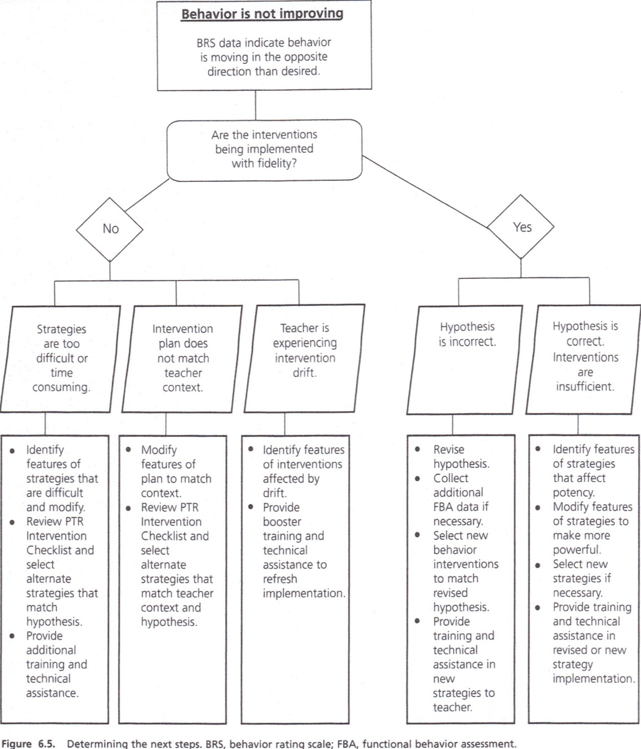

Slide 24
Matching Triggers and Functions to Interventions and Supports
Not an exhaustive list but based on components of behavior support plans from PTR chapter 5
A possible resource or starting point when choosing interventions and supports
A support for ensuring that we are linking what is learned in the FBA process to choices made in the BSP
Notes:
Share “matching triggers and functions to interventions and supports”

