Slide 1
DE-PBS Cadre Meeting
Thursday, September 22, 2011

Slide 2

WELCOME!
DE-PBS Staff Introductions & Updates
Cadre Introductions & Updates
What is the role of the Cadre?

Slide 3

Logistics
Cadre contact information
Active school update
Team leader & administrator information

Slide 4
2010-2011
Phase 1 & 2 Recognition
2010-2011 Phase 1 & 2 Recipients
Applications & FAQ documents will be sent out (approximately mid-year) to team leaders, coaches, and administrators
  10-11 documents available on the website under “DE-PBS Schools/Phases” for school reference
Will share Phase 3 draft with Cadre in December for feedback

Slide 5
What Ideas Do you Have for the banner?
Banner
Yearly recognition Flags

Slide 6
Summer Update
Cadre Workshop Session w/ Susan Barrett
Targeted Technical Assistance (TA) Sessions
Social Skills Workshops w/ Jill Kuzma
  Educator (Dover & Newark)
  Parent (Dover & Newark)
School-wide Data Workshop

Slide 7
DE-PBS Professional Development
PD Invitation Process
  Notice sent to PBS School Administrator, Team leader(s), and Coaches *
2011-2012 Events
TA Model Roll-out
  Continuation of Targeted TA
  Developing Self-Discipline
  Data Support
Coach Participation

Slide 8
Targeted Support Process
Cohort 1 – Non-TA Participants
  September- Confirm current list of Targeted contacts
    Send email to all trained teams general check in and helpful prompts for start of school year
  November – send survey to Cohort 1 schools (remove previous TA attendees); those who meet basic implementation criteria will receive invitation for January TA session.
  January – 1/26/12 – ½ day AM in Dover
  Spring – Final follow up to non-responders.
    Are you implementing at the Targeted level? If not, they would be expected to start back at initial team training if they want to move forward.
Cohort 2 –
  Summer 2012 – Offer initial training again to new cohort

Slide 9
Prevent-Teach-Reinforce: PTR
Intervention teams given manual and assigned PTR consultant
Five step process (aligned with problem solving process):
  Teaming
  Goal Setting (Identification of Problem)
  Functional Assessment (Problem Analysis)
  Intervention (Intervention Implementation)
    Coaching and fidelity
  Evaluation (Monitoring and Evaluation of RtI)

Slide 10
Tier 3 Function-Based Behavior Interventions in Schools
Current Issues
  Absence of uniform policies & practices
  Form versus a process
  Expert driven versus collaborative effort
  Occasionally contextual fit considered
  Limited support/follow-up/training for teacher provided
  Teachers may not be the personnel to facilitate FBAs in schools
    Increased focus on school psychologists (Scott & Kamps, 2007) and other school-based behavioral consultants or “coaches”

Slide 11
PTR Facilitators will be selected
Four to six professionals/”facilitators” (e.g., school psychologists, social workers, counselors) will be trained and coached to facilitate the PTR process with fidelity with a minimum of one student-centered campus-based team.
The facilitators will increase their skills in collaborative consulting with school-based teams.
The facilitators will increase the state’s capacity by becoming trainer-of-trainers and coach other professionals to implement PTR with school-based teams.

Slide 12
PTR Facilitators will Receive Ongoing coaching and support
Coaching will be conducted at a distance using technology (e.g. Adobe Connect, Webinars, Skype). For each professional, the following coaching activities will occur:
  Three to five individual coaching meetings to include:
    reviewing the process to be used prior to meeting with the team,
    reviewing products and brief video clips,
    debriefing meeting activities.
  Facilitators will provide brief video clips (i.e., 5-10 minutes) of specific activities implemented with teams
Bimonthly meetings will be held with the facilitators (60-90 minutes each) to discuss implementation issues.
One face-to-face interactive presentation at the end of the year to debrief with facilitators, disseminate outcomes to other professionals, and provide advanced training in FBA processes related to multi-tiered supports.

Slide 13

DE-PBS Annual Celebration
Save the Date: Wednesday, April 25, 2012
Keynote Presenter:
Dr. Laura Riffle (www.behaviordoctor.org)
Call for posters & presentations

Slide 14
Classroom management with Laura riffle
April 26, 2012
Focus on classroom teachers

Slide 15
Continued Focus on Sustainability
Need expressed by many
  Sustaining momentum is challenging
Key Feature #8
  …schools demonstrate sustained commitment, participation, and implementation with fidelity
  …a shared approach to the dynamic and evolving PBS process.

Slide 16
Identify 10 Best Practices to Promote Evidence Based Practices
Focus on Data

Slide 17
6. Help your teams become organized and efficient
The Planning Tools
Monthly Calendar
Minutes Forms
Courtesy of S. Barrett – PBIS TA Ctr.

Slide 18
Revise review activity
Monthly Calendar
Example
Activity
Discuss utility of calendar tool
Revised to reflect DE Practices
Questions?
Divide group
Divide months per group
Groups provide feedback
Share/Debrief

Slide 19
1. Get honest about issues or concerns in your building
Administrator is key!!
Establish a kind of “haven”- place that individuals can get feel safe about reporting concerns
Supported by school community and empowered to be a part of the decision making process- “Community of Practice”
Use Data!
Courtesy of S. Barrett – PBIS TA Ctr.

Slide 20
Tools to Use
Tools:
  Self Assessment - DASNPBS
  Fidelity Checks and Evaluations
  ODRs – DDRT Summaries
  DE School Climate Surveys
  Satisfaction Surveys
Provide data summaries within a week of return – decide best approach to deliver feedback
Adapted slide from S. Barrett – PBIS TA Ctr.

Slide 21
2. Develop precision statements
Key to being efficient with limited resources
Adapted slide from S. Barrett – PBIS TA Ctr.

Slide 22
From primary to precise
Primary statements are vague and leave us with more questions than answers
Precise statements include information about the 5 “Wh” questions:
  What is the problem and how often is it happening?
  Where is it happening?
  Who is engaging in the behavior?
  When is the problem most likely to occur?
  Why is the problem sustaining?
Adapted slide from S. Barrett – PBIS TA Ctr.
Notes:
Debby
A primary statement may sound like: “There is too much fighting at our school”
Precise statements may sound like: “There are more ODRs for aggression on the playground than last year, and these are most likely to occur during the first recess because there is a large number of students, and the aggression is related to getting access to the new playground equipment. “
Another example of a primary statement is: “ODRs during December were higher than any month”
A precise statement may sound like: “Minor disrespect and disruption are increasing over time and are most likely to occur during the last 15-minutes of our classes when students are engaged in independent seat work. This pattern is most common in 7th and 8th grades, involve many students, and appears to be maintained by work avoidance/escape. Attention may also be a function of the behavior- we’re not sure.

Slide 23
From primary to precise:
An example
Primary statement:
  “There is too much fighting at our school”
Precise statement
  There were 30 more ODRs for aggression on the playground than last year, and these are most likely to occur from 12:00-12:30 during
  fifth grade’s recess because there is a large number of students, and the aggression is related to getting access to the new playground equipment. “
Adapted slide from S. Barrett – PBIS TA Ctr.
Notes:
Debby
A primary statement- What questions do you still have?? Who is fighting? Where are they fighting? When? And most importantly, Why?
While this precise statement still may not answer ALL of your questions, it is certainly more precise than “There is too much fighting at our school.”
Another example of a primary statement is: “ODRs during December were higher than any month”
A precise statement may sound like: “Minor disrespect and disruption are increasing over time and are most likely to occur during the last 15-minutes of our classes when students are engaged in independent seat work. This pattern is most common in 7th and 8th grades, involve many students, and appears to be maintained by work avoidance/escape. Attention may also be a function of the behavior- we’re not sure.

Slide 24
From primary to precise:
An example
Precise statement:
Minor disrespect and disruption are increasing and are most likely to occur during the last 15-minutes of our classes when students are engaged in
independent seat work. This pattern is most common in 7th and 8th grades, involve many students, and appears to be maintained by work avoidance/escape. Attention may also be a function of the behavior- we’re not sure.
Primary statement:
  “ODRs during December were higher than any month”
Adapted slide from S. Barrett – PBIS TA Ctr.
Notes:
Debby
Another example of a primary statement is: “ODRs during December were higher than any month”
What questions do you have?
A precise statement may sound like
What questions do you have?

Slide 25
3. Elements to the data process
A. Establish A Coherent Process for Discipline
  Behavior definitions
  Minor vs. Major
  Written procedures for staff
  Flow chart showing process
  Office referral form ( includes possible motivation)
    Other tracking forms
  Time during staff meetings to get agreement, learn about process and follow through all year!!
Courtesy of S. Barrett – PBIS TA Ctr.

Slide 26
Discipline Data Reporting Tool - DDRT
Excel Sheet: 2 or 4 year data tracking
Includes:
  Average referral rate/month and per year
  Year to year comparison
  Referrals by Student – Triangle Graph
  2010-2011 National Average Comparison
  2010-2011 DELAWARE Average Comparison ****
Distribution
  Email to coaches, team leaders & administration
  Available for download from DE-PBS Website
Data Collection
  DDRT due dates
    January 13th (August – December)
    June 29th (August – June)

Slide 27
DE comparison data for Referrals is now Available

Slide 28
DE Strengths and Needs Assessment for PBS
Part A (Tier 1) has 4 sections:
  Program Development and Evaluation
  SW and Classroom-wide Systems
  Developing Self-Discipline
  Correcting Problem Behavior
Available throughout the school year
Information will be distributed to Team Leaders, Coaches, and Administrators

Slide 29
Purpose of the Needs Assessment
Self Assessment of both Schoolwide and Classroom Practices
Reflection on Practice
Action Planning
  Target needs and actions for improvement
  Continue to emphasize strengths
  Include in school improvement plan
  Use in combination with other data:
    ODRs, School Climate
Professional Development Planning
Notes:
29

Slide 30
Supporting Team with DASNPBS Data
View example DASNPBS summary data & worksheet
Follow up after data is received to see if there are questions/thoughts about the data
Prompt schools to make a plan to share with staff and USE at a team planning meeting

Slide 31
School Climate
Participation for 2011
  160 Schools State-wide
    Teacher = 6757 respondents
    Home= 15838 respondents
    Student= 42066 respondents
2011-2012 Timeline
  Invitation to enroll in early October
  Registration due in early November
  Materials distributed in early January
  Surveys due in early March
  Reports returned in May

Slide 32
Survey Updates
Engagement
  15 items that we pilot tested last
  Three distinct aspects of Engagement: Behavioral, Cognitive, and Emotional.
Bullying a separate factor
Exploring Hope

Slide 33
How are you using your School Climate results?
How many have reviewed 2010-2011 SC data?
Identified areas to highlight and address?
Shared the results with the school community?

Slide 34
Putting Data to Work for You
Working smarter NOT harder by using data-based decision making!

Slide 35
“Informed decision-making comes from a long tradition of guessing and then blaming others for inadequate results.”
-Scott Adams

Slide 36
When do teams look at data?
Data Summaries reviewed monthly with team
Designate a data person from team (and a back up) to pull data summaries monthly before meeting
Can utilize a subgroup to review and present summary to team

Slide 37
How do we look at data?
Data
Sources
Subgroups
Analysis
Identify Trends
Prioritize Needs
Action Plan
Set Goals
Plan Strategies
Monitor Progress

Slide 38

Three Steps for Using Data for On-Going Problem Solving
Use data in steps
Is there a problem?
What “system(s)” are problematic?
Are there units (grade levels or classrooms) or individuals experiencing more problems?
It’s “OK” to be doing well
Step 2. What systems are problematic?
Referrals by problem behavior?
What problem behaviors are most common?
Referrals by location?
Are there specific problem locations?
Referrals by student?
Are there many students receiving referrals or only a small number of students with many referrals?
Referrals by time of day?
Are there specific times when problems occur?
Step 1. Is there a problem?
ODR Average Summary/Triangle
Attendance
Faculty Reports
School Climate Data
Needs Assessment
Trends
Peaks before breaks?
Gradual increasing trend across year
Compare levels to last year
Improvement?
Step 3. Are there units or individuals experiencing more problems?
Detailed Data Sources:
Individual student data
Grade level data (discipline and climate data)
Classroom data
Direct observation
Faculty/Staff report

Slide 39
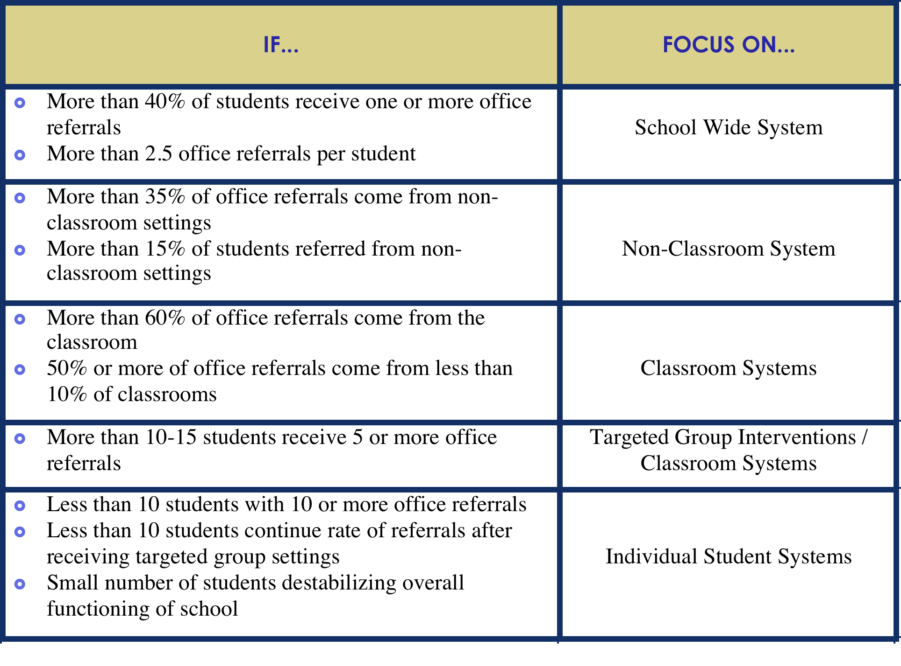
Notes:
39

Slide 40
+ If many students are making same mistake, consider
changing systems ...not students
+ START by teaching, monitoring & recognizing success
…before increasing PUNISHMENT

Slide 41
Key Features Evaluation
New external evaluation to replace SET-D
Aligned with DE-PBS key features to be a more comprehensive tool
Questions piloted in 4 schools, and full tool piloted in 2 schools in Spring 2011
Roll out of full tool in 2011-12

Slide 42
Key Features Evaluation Summary
Four sections covered within a rubric (scores range from 0-3)
  Schoolwide TIER 1 Program Devlopment
  Implementing Schoolwide Programs
  Developing Self Discipline
  Correcting Behavior Problems
  ** Data gathered from TL interview, Admin interview, SC surveys, Needs Assessment, Student and Staff Interviews and Observations of school and materials

Slide 43

DE-PBS Cadre Schedule 2011-2012
September 22,2011 – Del Tech Educational Technology Building (ETB) - Room 741
December 1,2011 – Del Tech ETB 741
February 9,2012 – Del Tech ETB 741
May 9, 2012– Collette ERC room B
Please mark your
Calendars and hold
these days!!

