Slide 1
Building Solutions that Promote and Sustain Evidence Based Practices
Susan Barrett
Technical Assistance Center on PBIS
www.pbis.org

Slide 2

www.pbis.org

Slide 3
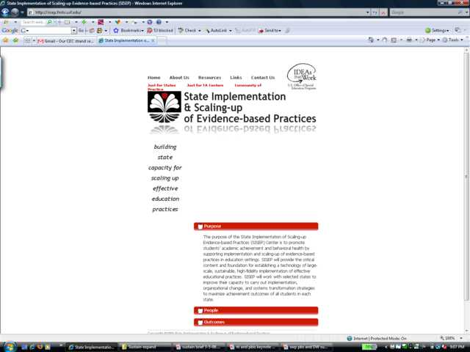
www.scalingup.org

Slide 4

School-wide PBIS
This two-day forum for state, district and regional Leadership Teams has been designed to help increase the effectiveness of School-wide PBIS Implementation. Sessions have been developed for all levels of implementation and have been organized into 8 specialized strands, including:
  PBIS Foundations
  Enhanced Implementation
  Building Training & Coaching Capacity
  Evaluation & Policy
  High Schools
  Tier 2/Tier 3 Supports
  Integrated Systems
  Disproportionality, Bully Prevention, and
  other special topics
For more information, visit www.pbis.org.
Sponsored by the OSEP Center on Positive Behavioral Interventions & Supports with support from the Illinois PBIS Network.
Save the Date
October 27-28, 2011
Implementing Innovation for a Lasting Effect
2011 National PBIS Leadership Forum | Hyatt Regency O’Hare | Rosemont, Illinois

Slide 5
Goals for Today
Review PBIS Basics
Identify 10 Best Practices to promote Evidence Based Practices
“Your Turn” Slides- when you see slide in red, it means you will have small amount of time to discuss item with your shoulder partner
Let’s Practice!

Slide 6
PBIS Defined
IS a decision making framework that guides selection, integration, and implementation of the best evidence-based academic and behavioral practices for improving important academic and behavior outcomes for all students

Slide 7
TIER I: Core, Universal
GOAL: 100% of students achieve
at high levels
Tier I: Implementing well researched programs and practices demonstrated to produce good outcomes for the majority of students.
Tier I: Effective if at least 80% are meeting benchmarks with access to Core/Universal Instruction.
Tier I: Begins with clear goals:
What exactly do we expect all students to learn ?
How will we know if and when they’ve learned it?
How you we respond when some students don’t learn?
How will we respond when some students have already learned?
Questions 1 and 2 help us ensure a guaranteed and viable core curriculum
7
Notes:
7
ADAPTED FROM PASCO- florida pbs
District facilitates discussions among schools on curriculum standards preschool through12th grade.
Systematic process for monitoring, evaluating, reviewing curriculum.
7

Slide 8
TIER II: Supplemental, Targeted
Tier II
For approx. 20% of students
Core
+
Supplemental
…to achieve benchmarks
Tier II Effective if at least 70-80% of students improve performance (i.e., gap is closing towards benchmark and/or progress monitoring standards).
Where are the students performing now?
Where do we want them to be?
How long do we have to get them there?
How much do they have to grow per year/monthly to get there?
What resources will move them at that rate?
8
Notes:
8
ADAPTED FROM PASCO
District facilitates discussions among schools on curriculum standards preschool through12th grade.
Systematic process for monitoring, evaluating, reviewing curriculum.
8

Slide 9
Tier III
For Approx 5% of Students
Core
+
Supplemental
+
Intensive Individual Instruction
…to achieve benchmarks
Where is the student performing now?
Where do we want him to be?
How long do we have to get him there?
What supports has he received?
What resources will move him at that rate?
Tier III Effective if there is progress (i.e., gap closing) towards benchmark and/or progress monitoring goals.
TIER III:
Intensive, Individualized
9
Notes:
9
ADAPTED FROM PASCO
District facilitates discussions among schools on curriculum standards preschool through12th grade.
Systematic process for monitoring, evaluating, reviewing curriculum.
9

Slide 10
Schools adopting SWPBIS by year
14,325 Schools Adopting
School-wide PBIS

Slide 11
Schools use SWPBIS (Feb, 2011)
11 states with over 500 schools
3 states with over 1000 schools
Illinois
Florida
Maryland
Texas
Delaware

Slide 12
Percentage of Schools using SWPBIS by State
1 state > 60%
5 states > 40%
7 states > 30%
Delaware
Illinois
Maryland

Slide 13
65 million kids
6 million teachers and staff
100,000 schools
3,143 counties
60 states & U.S. jurisdictions
Notes:
(c) Dean Fixsen and Karen Blase, 2008
13

Slide 14
Start with the end in mind…
What will it take to have 100,000 replications that produce increasingly effective outcomes for 100 years?
  Fixsen

Slide 15
Educational Initiatives
Guiding Principles (Coyne, 2008)
  Promoting evidence based practices
  Supporting change at the systems level (feasible, consistent and relevant to local needs)
  Developing local capacity to sustain effective practices over time

Slide 16
Training Outcomes Related to Training Components
 | Training Outcomes
Training Components | Knowledge of Content | Skill Implementation | Classroom Application
Presentation/ Lecture
Plus Demonstration
Plus Practice
Plus Coaching/ Admin Support Data Feedback
10% 5% 0%
30% 20% 0%
60% 60% 5%
95% 95% 95%
Joyce & Showers, 2002

Slide 17
Overall Organizers
Stages of Implementation
Implementation Blueprint
DATA, SYSTEMS, PRACTICES= OUTCOMES
Tiered Logic

Slide 18
Notes:
New version

Slide 19
Phases of Implementation
Exploration
Installation
Initial Implementation
Full Implementation
Innovation
Sustainability
2 – 4 Years
Fixsen, Naoom, Blase, Friedman, & Wallace, 2005

Slide 20
Exploration Stage
Need for change identified, possible solutions are explored, learning about what it takes to implement the innovation effectively, stakeholders are identified and developed, and decision is made to move forward
Installation
Resources needed to implement innovation with fidelity and desired outcomes are in place
Initial Implementation
Innovation is in place in schools, implementation largely guided by external TA providers
Full Implementation
Innovation is implemented and sustained by local stakeholders and is well-integrated into policy/written documentation
Innovation and Sustainability
Innovation is adapted to fit local context, innovation becomes more efficient and is integrated with other initiatives

Slide 21
Stages of Implementation
Exploration/Adoption
Installation
Development Commitment
Initial Implementation
Establish Leadership Teams, Set Up Data Systems
Full Implementation
Provide Significant Support to Implementers
Innovation and Sustainability
Embedding within Standard Practice
Should we do it?
Improvements: Increase Efficiency and Effectiveness
Doing it right
Doing it better

Slide 22
Exploration Adoption
Exploration Adoption
Scale-Up Schools
Targeted/Intensive Supports
Continuous Improvement
District
Installation
Continuous Improvement
Installation
Continuous Improvement
Initial Implementation
Exploration Adoption
Initial Implementation
Elaboration
Elaboration
Scale-Up Schools
Universal
Supports
Elaboration
Exploration Adoption
Initial Implementation
Installation
Continuous Improvement
Installation
Model Schools
Universal
Supports
Exploration Adoption
Initial Implementation
Elaboration
Continuous Improvement
Installation
Model Schools
Targeted/Intensive Supports
Embedded Stages within District Implementation of RtI
Initial Implementation
Elaboration
Notes:
Thanks to Steve Goodman

Slide 23
Your Turn
With your “shoulder partner”, discuss how you might use the phases of implementation in your work?
Which phase are you in?

Slide 24
PBIS
Creating the Conditions for Learning
Social Competence &
Academic Achievement
OUTCOMES
Systems Supporting Staff Behavior
Team Approach
Administrator participation
Community of Practice (Skill development and performance feedback)
Data Supporting Decision Making
office discipline referrals
academic progress
Attendance, truancy
direct observation
school improvement goal progress
Process tools (fidelity)
SYSTEMS
DATA
PRACTICES
Practices Supporting Student Behavior
Define behaviors, expectations, and rules
Teach, model, and acknowledge behaviors, expectations, and rules
Correct behaviors
Consensus/collaboration
Notes:
24
The triangle is a graphic organizer of the practices we are working towards implementing. We will talk about data later today. The big part of this is the systems. Your job as a coach is to work with the team, administrator, and division coordinator to build a system of support for teachers to implement these practices school-wide, in the classroom and non-classroom settings
Ask: Which part of this do you find the most challenging within your schools?

Slide 25

Building Coaching Capacity
Occurs at ALL Levels
Systems
Conditions that support skill development
for staff
Policy and Procedures alignment
Budget Re-allocation
Recruitment and Selection of Coaches
Supervision of Coaching within Organization
Training Curriculum and Scope and Sequence
Access to certification
Facilitative Administrator Supports
Practices/Skills
The technical skill set required to achieve fidelity
Problem Solving (Team, Classroom, Staff, Student)
Team Building/Collaboration
Delivering Feedback
Behavioral Consultation
State
Regional
District
Building
Classroom
Staff
Student
Family
Data
Information required to guide skill development process
Action Plan with short/long term measurable goals
Self Assessment
Process Measures/Fidelity Checks
Performance Feedback Measure
Progress Monitoring Tools
Evaluation Tools
Student Outcomes
Data used for continuous regeneration (PEP/PIP)
Notes:
25
Graphic organizer for coaching functions
What are the necessary conditions that support skill development?

Slide 26
Outcomes of Coaching
Fluency with trained skills
Adaptation of trained concepts/skills to local contexts and challenges
    And new challenges that arise
Rapid redirection from miss-applications
Increased fidelity of overall implementation
Improved sustainability
    Most often due to ability to increase coaching
    intensity at critical points in time. Horner 2009

Slide 27
Creating Implementation Capacity
Start with too many overqualified people
“Generation 1” practitioners become:
  Generation 2 interviewers, trainers, coaches, evaluators
  Generation 3 administrators, directors, and leaders
  Generation 4 state and federal officials
  Fixsen (2008)

Slide 28
“Implementation Cascade”
Building Capacity and Sustainability
  Project Leadership Team
  Training and Technical Assistance Centers
  District Coordinators
  Coaches
Team Leaders
  Problem-Solving Teams
  School Staff, Families, Transportation, Communities
Notes:
We will be working through exploration to build this system of support

Slide 29
10 Ways You Can Promote Sustain Evidence Based Practices

Slide 30
1. Get honest about issues or concerns in your building
Administrator is key!! Establish a kind of “haven”- place that individuals can get feel safe about reporting concerns, supported by school community and empowered to be a part of the decision making process- “Community of Practice”
  Tools: Self Assessment, Fidelity Checks, ODRs, climate surveys, satisfaction surveys
  Provide data summaries within a week of return – decide best approach to deliver feedback
Notes:
Tools: Climate Survey (recommended, but needed to be completed by the school without our support)
***** Working Conditions Survey (select items relative to behavior may be appropriate to consider; data available in each building)

Slide 31
Worry #1
Do we live in a punishing work environment ?
How do we create systems that support staff?

Slide 32
Need to Know
Cultural fit
Building on “What works”
Focus on the Staff

Slide 33
Predictable work environments are places where employees:
Know what is expected
Have materials & equipment to do job correctly
Receive recognition each week for good work
Have supervisor who cares & pays attention
Receive encouragement to contribute & improve
Can identify person at work who is “best friend”
Feels mission of organization makes them feel like their jobs are important
See people around them committed to doing good job
Feel like they are learning new things
Have opportunity to do the job well
(Buckingham & Coffman 2002, Gallup)

Slide 34
Many Begin, Many Leave
Adelman and Taylor
Preparing All Education Personnel to Address Barriers to
Learning and Teaching (2008)
Predictions of shortages of 2 million educators
over the next decade…
Data in the U.S. indicate about
15% of new teachers leave in the first year,
30% within three years and
40-50% within the first five years.
(Smith and Ingersoll, 2003)

Slide 35
On school reform…
Kauffman states “…attempts to reform education will make little difference until reformers understand that schools must exist as much for teachers as for student. Put another way, schools will be successful in nurturing the intellectual, social, and moral development of children only to the extent that they also nurture such development of teachers.” (1993, p. 7).
Notes:
35

Slide 36
Principal’s Role
Maintaining standards regarding which innovations their school would employ,
Making a public statement of support once the faculty selected an innovation,
Establishing a representative leadership team to lead the process of implementing the innovation,
Supporting the team members to have the time and resources to accomplish the task,
Guiding rather than dictating decision-making,
Taking a leadership role to model and reinforce implementing the innovation with fidelity,
Regularly attending and participating in team meetings,
Providing recognition to faculty and the team for their hard work,
Serving as the spokesperson to community stakeholders about the worth and importance of the innovations, and
Establishing objective means to monitor and provide feedback to all staff about the effect of the innovation. (Colvin & Sprick, 1999)

Slide 37
Do Principals Make a Difference?
All staff rate principals leadership with respect to managing behavior as important
Statistically significant differences between SWPBS and non-SWPBS schools on staffs perceptions of:
  Principals involvement related to behavior management
  Overall effectiveness of behavior supports
  Job satisfaction

Slide 38
Have to see the connection!
Are there other ways in which implementing PBIS will support your strategic plan?

Slide 39
Prepare for Working Smarter
(Not Harder)
Allows schools to identify the multiple committees within their school
Helps in identifying purposes, outcomes, target groups, and staff
Assists schools in addressing, evaluating, and restructuring committees and initiatives to address school improvement plan
Important for schools to identify that school-wide PBIS is integrated into existing committees and initiatives
Notes:
Our next activity is designed to identify committees in your school.
Is there overlap or duplication of effort?
Are many of the same people serving on different committees?
Working smarter not harder; how can we make this happen?
During the activity we’ll outline the committees on campus and identify the purpose of those committees
Who do they address?
Can some of these committees be collapsed, so that we have fewer committees but the same needs are addressed?
Are there committees that deserve added support?

Slide 40
Use Worksheet to Organize Your Teams Responsible for ALL Programs/Initiatives
  Step 1: Identify Current Teams (discipline, instruction, climate, school improvement, parent support, etc)
  Step 2: Complete the Working Smarter document
  Step 3: Based on your results, what committees/teams can you:
  (a) align and integrate to support everyone’s efforts towards the school strategic plan and mission?
  Determine your next steps …

Slide 41
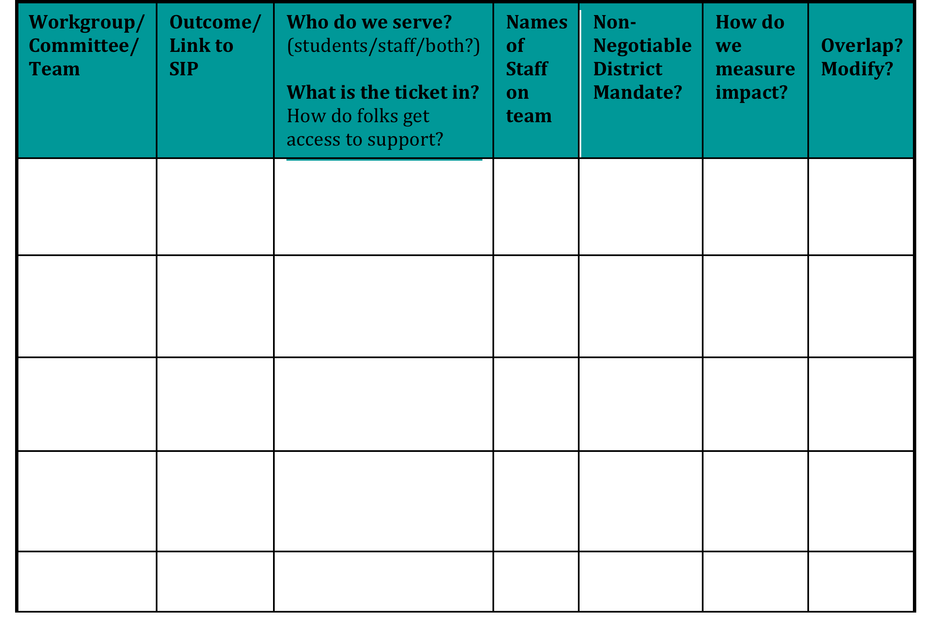

Slide 42
Workgroup/ Committee/ Team | Outcome/Link to SIP | Who do we serve? What is the ticket in? | Names of Staff | Non-negotiable District Mandate? | How do we measure impact? | Overlap? Modify?
Attendance Committee |  | students | Junebug, Leo, Tom | yes | Attendance records | Yes-fold to SW PBS
SW PBS Team |  | Students staff | Ben, Tom, Lou | no | Office Referrals Attend, MIR, Nursing log ,climate | Yes- continue
Safety Committee |  | Students staff | Toni, Barb, Tom | no | Office Referrals BIG 5, climate | Yes-fold into SW PBS
School Spirit Committee |  | students | Tom | no | No | Yes-fold into SW PBS
Discipline Committee |  | students | Tom, Lou | no | Office Referrals | Yes-fold into SW PBS
Student Support Team/Problem Solving Team |  | students | Steve, Sue,Jon, Tom | yes | Discipline, DIBELS, FACTS… | No- continue
School Improvement |  | 1,2,3 | Bill, Jon, Lou, Tom | yes | All of the above | Yes- continue
Notes:
42
This will be even more important as we move into advanced tiers.
List teams, complete chart- start with just making list- but use this as a guide for reviewing overlap, progress monitoring, overall organization of teaming structure- can we get same impact meeting less, using data to guide use of minutes- collapse groups ?
This is a consideration for us to

Slide 43
2. Develop precision statements
Key to being efficient with limited resources
Notes:
Please emphasize that this is a skill that needs to be practiced since most aren’t used to working with data.

Slide 44
From primary to precise
Primary statements are vague and leave us with more questions than answers
Precise statements include information about the 5 “Wh” questions:
  What is the problem and how often is it happening?
  Where is it happening
  Who is engaging in the behavior?
  When is the problem most likely to occur?
  Why is the problem sustaining?
Notes:
A primary statement may sound like: “There is too much fighting at our school”
Precise statements may sound like: “There are more ODRs for aggression on the playground than last year, and these are most likely to occur during the first recess because there is a large number of students, and the aggression is related to getting access to the new playground equipment. “
Another example of a primary statement is: “ODRs during December were higher than any month”
A precise statement may sound like: “Minor disrespect and disruption are increasing over time and are most likely to occur during the last 15-minutes of our classes when students are engaged in independent seat work. This pattern is most common in 7th and 8th grades, involve many students, and appears to be maintained by work avoidance/escape. Attention may also be a function of the behavior- we’re not sure.

Slide 45
From primary to precise:
An example
Primary statement:
  “There is too much fighting at our school”
Precise statement
  There were 30 more ODRs for aggression on the playground than last year, and these are most likely to occur from 12:00-12:30 during
  fifth grade’s recess because there is a large number of students, and the aggression is related to getting access to the new playground equipment. “
Notes:
A primary statement- What questions do you still have?? Who is fighting? Where are they fighting? When? And most importantly, Why?
While this precise statement still may not answer ALL of your questions, it is certainly more precise than “There is too much fighting at our school.”
Another example of a primary statement is: “ODRs during December were higher than any month”
A precise statement may sound like: “Minor disrespect and disruption are increasing over time and are most likely to occur during the last 15-minutes of our classes when students are engaged in independent seat work. This pattern is most common in 7th and 8th grades, involve many students, and appears to be maintained by work avoidance/escape. Attention may also be a function of the behavior- we’re not sure.

Slide 46
From primary to precise:
An example
Precise statement:
Minor disrespect and disruption are increasing and are most likely to occur during the last 15-minutes of our classes when students are engaged in
independent seat work. This pattern is most common in 7th and 8th grades, involve many students, and appears to be maintained by work avoidance/escape. Attention may also be a function of the behavior- we’re not sure.
Primary statement:
  “ODRs during December were higher than any month”
Notes:
Another example of a primary statement is: “ODRs during December were higher than any month”
What questions do you have?
A precise statement may sound like
What questions do you have?

Slide 47
3. Elements to the data process
A. Establish A Coherent Process for Discipline
  Behavior definitions
  Minor vs. Major
  Written procedures for staff
  Flow chart showing process
  Office referral form ( includes possible motivation)
    Other tracking forms
  Time during staff meetings to get agreement, learn about process and follow through all year!!
Notes:
Please be aware that there has been a major drift from including motivation on ODRs. I don’t think teams understood how later in the process this may help with an FBA and a targeted intervention.

Slide 49
B. Computer Application
  Easy, efficient
  No more than 30 seconds to enter
  Able to generate reports quickly
  Available in picture form (bar graphs)
  Custom Reports
Notes:
This is a tough one given that FCPS has SASI as a procedure. We do have more principals going to their own Excel files.
You can emphasize that schools need to get their data entry person SASI/PBS training.

Slide 50
C. Data For Decision Making
Generate reports for various meetings
  Action Plan
Build Precision Statements
Determine Intervention
Track Data, Continue, Modify, Terminate
Share with Faculty
Celebrate!!!!!
Notes:
.

Slide 51
Feed them the data!!
Continuous feedback to staff- always provide data summaries –monitor progress of selected intervention, modify if necessary and celebrate successes
  Indian Head ES

Slide 52
4. Recommit each year!!
Develop and recommit to team process and PBIS process with staff- ask for buy- in each year- showcase results and form a plan that addresses trends seen from this school year- if you can predict it, you can prevent it….
Notes:
Link to strategic plan –use resource mapping activity
Need Example

Slide 53
Make SWPBS Adaptive to change
Collection and use of data for decision-making
    Are we implementing SWPBS with fidelity?
        Fidelity Checks
    Are students benefiting behaviorally, emotionally, academically?
      www.swis.org
        SWIS (ODR, Suspensions, Referrals to SPED)
        School Safety Survey
        Standardized tests, Oral Reading Fluency
    Are the systems and practices efficient?
        Faculty/staff time; Student academic engagement; Cost benefit
Satisfaction (student, faculty, family)

Slide 54
Make it “Scale-worthy”
Not Effective
Traditional
Promising
Scale Worthy
Oregon Department of Education
Proposed Policy on Scale-worthy Practices
Dr. Dianna Carrizales-Englemann

Slide 55
Oregon Department of Education
Proposed Policy on Scale-worthy Practices
  Practice addresses a core educational outcomes (e.g. reading, math, writing, graduation, social behavior)
  Practice is operationally defined
  Practice includes formal systems/ strategies for professional development.
  Practice includes formal system for measuring both fidelity and impact on student outcomes.
  Practice includes strategies for sustainability and continuous improvement
  Practices has been proven feasible, socially acceptable and effective in at least 50 schools in Oregon.
  Practice is documented as evidence-based
Dr. Dianna Carrizales-Englemann

Slide 56


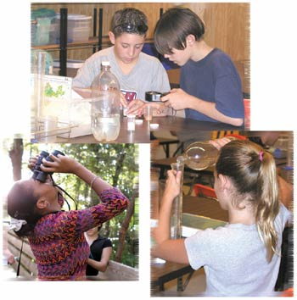
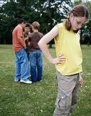




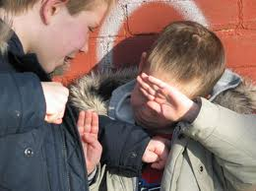
Schools

Slide 57
5. Develop marketing plan
Develop marketing plan to renew commitment- how will you keep it novel new and a priority in school and community? Continue to make it a priority- admin crucial- needs to continue to be a top school improvement goal- always with the design that as it becomes standard practice it will be easier each year-
Notes:
Need example

Slide 58
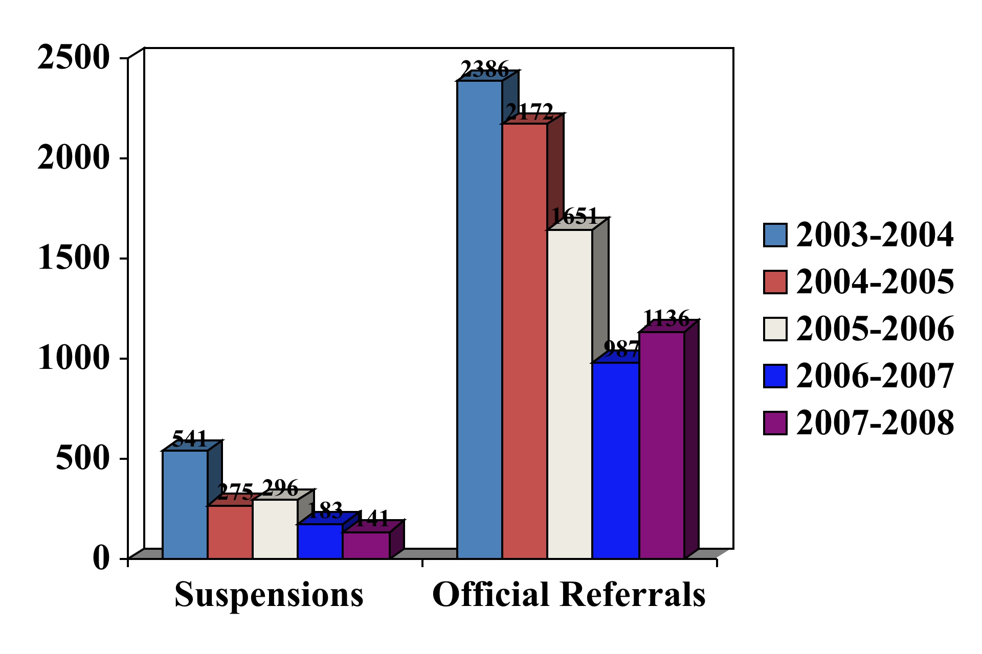
West Potomac HS
PBS Data: 2003-2008
52% decrease in office referrals
74% decrease in suspensions/expulsions

Slide 59
Paradigm Shifts we’re seeing…
We’ve noticed a gradual change in focus from:
Aggressive disrespect to an appreciation of manners, respect and excellence.
“Us against them” to shared, thoughtful collaborative relationships between students and staff.
Emphasis on teaching to an emphasis on learning.
“Do what I say” to “understand why it is important for you to do this.”
“It’s someone else’s fault” to assumption of responsibility.

Slide 61
Group Cost Benefit
Office Referral Reduction
Across 12 PBIS Schools =5,606
If students miss 45 minutes of instruction for each Office Referral, 5,606 X 45=
252,270 minutes
4204.50 hours or
700 days
of instructional time recovered!!!!!

Slide 62
Cost-Benefit Analysis

Slide 63
What does a reduction of 850 office referrals and 25 suspensions mean?
Kennedy Middle School
Savings in Administrative time
ODR = 15 min
Suspension = 45 min
13,875 minutes
231 hours
29, 8-hour days
Savings in Student Instructional time
ODR = 45 min
Suspension = 216 min
43,650 minutes
728 hours
121 6-hour school days

Slide 64
Your Turn
How would you use Cost Benefit and other data points to help Market PBIS?
Remember to tell a personal story too!!

Slide 65
6. Help your teams become organized and efficient
The Planning Tools
Resource Mapping
Implementation Snapshots
Practice Profiles
BOQ Team Action Plan
Year at A Glance Planner
Monthly Calendar
Big 5 Generator

Slide 66
Overall Organizing Framework
Need for a framework, the anchor, for all school improvement efforts
Common language, Common logic
  Resource Mapping
    Use it as initial activity to organize
    Use for ongoing planning
  Always link to goals on strategic plan

Slide 67
Triangle Activity:
Applying the Three-Tiered Logic to Your School
Tier 3
Practices, Initiatives,
Programs for a FEW
Tier 2
Practices, Initiatives,
Programs for SOME
Tier 1
Practices, Initiatives,
Programs for ALL
Notes:
See workbook
What do you have in place for behavior interventions for all, some, and a few? Think about this on a school-wide level and maybe think about it around one of the top behaviors in your school. Say disrespect or disruption. Think about kids down the road too-who do not respond to universal.
Be sure to make the connections to the pyramid for academics and you will always look to both –the connections. Our work will be looking at what we have, what can we tweak, and what are we missing.
What are the EBPs? How are you monitoring effectiveness with data? Are there any that are really getting significant outcomes?
How will you take your staff through this process?

Slide 68
Resource Mapping
What are the practices in place at each tier of the triangle?
Are they evidence-based practices?
How are you measuring effectiveness of practices (data)?
Who are the service delivery teams/personnel (e.g., graduation coach, PALS teacher, Math Coach)
Notes:
Conversation starter: This is not to be completed, just to get them started and then they can take back.
Materials: Lamenated triangle poster, removable stickers, list of ebp and resources for identifying ebps

Slide 69
Activity 1
Step 1: Identify all programs/initiatives/common practices by tier
  Tier I- How do you support all children? Core Curriculum- “everyone gets”
  Tier II, III How do you support students who need more support? How do you build on the foundation so that all Tier II, III activities are a natural extension of core curriculum?
Step 2: Identify outcome for each practice. How do you measure effectiveness?(Staff performance) How do monitor progress? (student impact) How do you support teachers? (staff support)How are they linked to School Improvement? (integrated approach)
Notes:
Social emotional programs at each tier inventory. Do both steps. Use the workbook for the recording of these activities.

Slide 70
Who are the staff supporting all of these practices?
What “support teams or staff” support these practices?
What are their roles and responsibilities?
Is there any duplication or overlap?
What communication loops and /or progress monitoring exists among all of these support personnel?
What’s working and how do we know, got data?

Slide 71
Schools need to be clear about what interventions they have (and don’t have) in place
Service Delivery Personnel
Tier 3/Tertiary Interventions 1-5%
_____________________
_____________________
_____________________
Tier 2/Secondary Interventions 5-15%
___________________________
___________________________
___________________________
___________________________
___________________________
___________________________
Tier 1/Universal Interventions 80-90%
________________________
________________________
________________________
________________________
________________________
________________________
Adapted from Illinois PBIS Network, Revised May 15, 2008. Adapted from “What is school-wide PBS?” OSEP Technical Assistance Center on Positive Behavioral Interventions and Supports. Accessed at http://pbis.org/school-wide.htm
Notes:
71
Poster paper:
Draw this framework on your poster. We are going to go through taking inventory for each part, once piece at a time.
Let’s do ESD together all the way through (ESD SW practice, ESD Team, ODRs, Attendance)
(4: schools need to flush out their own triangle) So…first thing you want to do when you go back to school tomorrow…is to think about “what interventions do we actually have at each tier”. List them out..plug them in where you think they belong based on what you know about the 3 tiers. If you’ve done this before, do it again : ) you want to make sure you’re capturing everything..including any new interventions you may have developed recently. If you haven’t done this…you may find the “crack” that children are falling thru…you may find (as many of our schools have) that the ‘gap’ we need to close is actually the yellow part of this triangle… Most schools do not have enough secondary interventions (both in quantity and type/quality) needed to support their student body. Think about it…can your Secondary system hold 15-20% of the youth in your school? (school of 1,000 is 200 kids, 500 is 100 kids)?? Everyone needs to know what this completed triangle looks like for your school: your teachers, clinicians, administrators, families…

Slide 72

Got data?
Take inventory of current data
  Office Referrals- BIG 5
  Expulsion and Suspension
  Attendance
  Nursing Logs
  Counselor Logs
  Minor incident reports
  Benchmark Assessments
  GPA
  Homework Completion
  At-risk factors and other trajectory data for prevention
Notes:
Think about all the data sources you have now-these can be used to assess how much support you provide for each student?
What other info do you need? How do you use this data to guide teams to decide which kids get support- do you intervene early on before the problem become bigger?

Slide 73
Schools need to be clear about what interventions they have (and don’t have) in place
Data to measure effectiveness
1-5% Tier 3/Tertiary Interventions
        ___________________________
        ___________________________
        ___________________________
5-15% Tier 2/Secondary Interventions
        ____________________________
        ____________________________
        ____________________________
        ____________________________
        ____________________________
        ____________________________
80-90% Tier 1/Universal Interventions
        ____________________________
        ____________________________
        ____________________________
        ____________________________
        ____________________________
Adapted from Illinois PBIS Network, Revised May 15, 2008. Adapted from “What is school-wide PBS?” OSEP Technical Assistance Center on Positive Behavioral Interventions and Supports. Accessed at http://pbis.org/school-wide.htm
Notes:
73
Poster paper:
Draw this framework on your poster. We are going to go through taking inventory for each part, once piece at a time.
Let’s do ESD together all the way through (ESD SW practice, ESD Team, ODRs, Attendance)
(4: schools need to flush out their own triangle) So…first thing you want to do when you go back to school tomorrow…is to think about “what interventions do we actually have at each tier”. List them out..plug them in where you think they belong based on what you know about the 3 tiers. If you’ve done this before, do it again : ) you want to make sure you’re capturing everything..including any new interventions you may have developed recently. If you haven’t done this…you may find the “crack” that children are falling thru…you may find (as many of our schools have) that the ‘gap’ we need to close is actually the yellow part of this triangle… Most schools do not have enough secondary interventions (both in quantity and type/quality) needed to support their student body. Think about it…can your Secondary system hold 15-20% of the youth in your school? (school of 1,000 is 200 kids, 500 is 100 kids)?? Everyone needs to know what this completed triangle looks like for your school: your teachers, clinicians, administrators, families…

Slide 74
Schools need to be clear about what interventions they have (and don’t have) in place
Service Delivery Personnel
Data to measure effectiveness
Tier 3/Tertiary Interventions 1-5%
_____________________
_____________________
_____________________
1-5% Tier 3/Tertiary Interventions
        ___________________________
        ___________________________
        ___________________________
Tier 2/Secondary Interventions 5-15%
___________________________
___________________________
___________________________
___________________________
___________________________
___________________________
5-15% Tier 2/Secondary Interventions
        ____________________________
        ____________________________
        ____________________________
        ____________________________
        ____________________________
        ____________________________
Tier 1/Universal Interventions 80-90%
________________________
________________________
________________________
________________________
________________________
________________________
80-90% Tier 1/Universal Interventions
        ____________________________
        ____________________________
        ____________________________
        ____________________________
        ____________________________
Adapted from Illinois PBIS Network, Revised May 15, 2008. Adapted from “What is school-wide PBS?” OSEP Technical Assistance Center on Positive Behavioral Interventions and Supports. Accessed at http://pbis.org/school-wide.htm
Notes:
74
Poster paper:
Draw this framework on your poster. We are going to go through taking inventory for each part, once piece at a time.
Let’s do PBIS together all the way through (ESD SW practice, ESD Team, ODRs, Attendance)
(4: schools need to flush out their own triangle) So…first thing you want to do when you go back to school tomorrow…is to think about “what interventions do we actually have at each tier”. List them out..plug them in where you think they belong based on what you know about the 3 tiers. If you’ve done this before, do it again : ) you want to make sure you’re capturing everything..including any new interventions you may have developed recently. If you haven’t done this…you may find the “crack” that children are falling thru…you may find (as many of our schools have) that the ‘gap’ we need to close is actually the yellow part of this triangle… Most schools do not have enough secondary interventions (both in quantity and type/quality) needed to support their student body. Think about it…can your Secondary system hold 15-20% of the youth in your school? (school of 1,000 is 200 kids, 500 is 100 kids)?? Everyone needs to know what this completed triangle looks like for your school: your teachers, clinicians, administrators, families…

Slide 75

Applying the Logic to Families
Tier 3: Intensive, Individual Interventions
Family Liaison-matched with family, needs matched with community resources
Individual Skill Building Sessions-
1-5%
Tier 2: Targeted Group Interventions
Support Groups (Military Families, Newcomer Group)
Skill Building Sessions (Academic and Behavior)
5-10%
Tier 1: Universal Interventions
Self Assessments: Family Engagement Checklist, Surveys
Skill Building Series Guest Speaker (Topics Vary- Survey Families)
Newsletter, Resource Library , “Shout Outs”
Volunteer Opportunities (DOGS- Dads of Great Students)
Teacher Conferences- Goal Setting, Family Vision, Strengths Discovery
Family Fun Nights throughout the year
School Handbook (Description, Teaching Matrix – promote common language between school and home)
80-90%
Notes:
Tier 1 – For All
Tier 2- increase frequency, more specific to group, more involvement in development of feedback forms

Slide 76
Critical Elements | Sample Implementation Product/Outcome
PBIS Team | Problem-solving, planning team
Faculty Commitment | Shared understanding and language around discipline
Effective procedures for Dealing with Discipline | Flowchart, Office Referral Form, Minor Incident Form, Time out of Class Form
Data Entry & Analysis Plan Established | Data system and analysis to guide intentional interventions
Develop Expectations & Rules | Teaching matrix of social/behavioral skills (core curriculum), a tool for providing behavior specific feedback/acknowledgement/praise/ reinforcement
Notes:
Display sample implementation products, poster sessions
Make connections, show where classroom practices will fit in
Make this a cloz activity of sorts

Slide 77
Critical Elements | Implementation Product
Establish Acknowledgement Program | Consistency with feedback, focus on what we want students and adults to do in the building vs what we don’t want them to do, evidence-based practice for teaching academic and behavioral skills
Develop Lesson Plans for Teaching Expectations/Rules | Consistency, explicit and situational instructional tools
Plan for Implementation | Systematic approach to supporting students and adults, procedures for new students, staff, substitutes, family involvement
Classroom Systems | Classroom Rules map onto SW expectations
Evaluation | Data- for decision making, planning, marketing, buy in

Slide 78
Practice Profiles
Each critical component is a heading
Each level of implementation becomes a dimension on the rubric associated with that critical component.
Critical Component (non-negotiable) | Define how does this Critical Component contributes to the Outcome? | Ideal “Gold Standard” of the Critical Component | Acceptable Variation of the Critical Component | Unacceptable Variation of the Critical Component
Adapted from work of the
Heartland Area Education Agency 11, Iowa
Notes:
Drowning frog example

Slide 79
Your Turn
How would you use Resource Mapping, Practice Profile?
How would you hope this would change/improve?

Slide 80
Implementation Snapshots
Used in Training
Supporting Implementation
  Clearly defined roles for:
    District Coordinator
    Coach
    Administrator
    Team
    Student, Family, Community

Slide 81
Year at a Glance Planner
Team Planner

Slide 82
Each month has team activities for:
Information (Data)
  E.g., review ODR graphs, suspension, ethnicity, attendance & academic data
  E.g., review results surveys, checklists
Planning (Systems)
  E.g., develop needed Cool Tool lesson(s) & schedule time to teach
Implementation (Practices)
  E.g., conduct grade level celebrations
Communication with Staff
  E.g., present results of evaluation
Notes:
82
As a coach, how can you assist your team with calendar tasks? Where does your action plan come in? What are your priorities to accomplish?

Slide 83
Your Turn
How would Snapshot and “Year at a Glance” help move your team forward?

Slide 84
7. Facilitate Effective Meetings:
Use Team Initiated Problem Solving
Need to conduct Team Training
  Team includes all members and a coach
  Define Roles and Responsibilities is critical
    Plan for absences (have back up people)
Coaching is critical
Training critical skills to facilitator, minute taker, and data analyst
  Keep people on track,
  document relevant information for progress monitoring and evaluation
  Launch the meeting with a data summary
Documenting decisions, actions, timelines, evaluation plan is critical for sustainability

Slide 85
Organizing for an effective problem solving conversation
A key to collective problem solving is to provide a visual context that allows everyone to follow and contribute
Problem
Use Data
Out of Time
Solution
Notes:
Animated slide telling a well too known story.

Slide 86
Define roles for effective meetings
Core roles
  Facilitator
  Minute taker
  Data analyst
  Active team member
  Administrator
Backup for each role
Typically NOT the administrator
Can one person serve multiple roles?
Are there other roles needed?
Notes:
We need primary people with a back up person for each role needed. It is encouraged to NOT have the administrator play a primary role for facilitator, data analyst, or minute taker. Administrators need to be flexible with what might come up and it is unpredictable when a situation causes administrator absence from a planned meeting. Since we know that this might occur, let’s avoid problems and set up the roles so that the team is not dependent on administrators being at the full meetings 100% of the time.

Slide 87
Data Analyst
Role & Responsibilities
Role
  To create data summaries that will facilitate the team in (quick big 5 or other custom reports)
    determining if there are problems
    jump starting a problem solving discussion, and
    evaluating the impact of solutions and fidelity of implementation
General Responsibilities
  Prepares a brief written summary for distribution at meetings using each of the data sources needed for problem solving and decision making
  Help to generate reports during the meeting as questions of the data arise

Slide 88
Launch the meeting with a data summary that helps define the problem with precision
How?
  Establish the role of a data analyst (and backup person)
  Teach data analyst to develop data summary
    Oakes, DIBELS, SWIS…. Etc
  Start meeting with defining the problem with precision
  Refine precision of problem statement through inferences and hypothesis
    Have data accessible for custom report generation during the meeting

Slide 89
Meeting Foundations Elements
Define purpose of the team
  Decisions to be made, cycle of decision making, and data source(s) to use
Define roles & responsibilities
Define team agreements about meeting processes
      Inform facilitator of absence/tardy before meeting
      Be prepared for meeting by completing previously assigned tasks
      Avoid side talk: Remind each other to stay focused
      Start and end on time
      Be an active participant
      Use electronic meeting minutes
Notes:
Basic Meeting Foundations Elements are essential no matter what type of meeting is being conducted. Teams need to know the purpose and expected outcomes of their group, they need to establish operating agreements (always start with something nice, avoid side talk, be on time, etc), and they need to establish roles and the expected responsibilities .

Slide 90
Using Meeting Minutes
Documentation of
  Logistics of meeting (date, time, location, roles)
  Agenda items for today’s meeting ( and next meeting)
  Discussion items, decisions made, tasks and timelines assigned
  Problem statements, solutions/decisions/tasks, people assigned to implement with timelines assigned, and an evaluation plan to determine the effect on student behavior
Reviewing Meeting minutes
  An effective strategy for getting a snapshot of what happened at the previous meeting and what needs to be reviewed during the upcoming meeting
    What was the issue/problem?, What were we going to do?, Who was going to do it and by When?, and How are we measuring progress toward the goal?
Visual tracking of focus topics during and after meetings
  Prevents side conversations
  Prevents repetition
  Encourages completion of tasks
Notes:
Help people understand what needs to be documented and why. If someone talks the entire meeting and there is no discussion, that is a memo, not a meeting! No need to document irrelevant anecdotes like: ‘ Jason yawned after Debbie explained her problem’, or ‘Debbie rolled her eyes and sighed when we talked about the testing schedule’

Slide 91
Langley Elementary PBIS Team Meeting Minutes and Problem-Solving Action Plan Form
Today’s Meeting: Date, time, location: Facilitator: Minute Taker: Data Analyst:
Where in the Form would you place:
Planning for next PTA meeting?
Too many students in the “intensive support” for literacy
Schedule for hallway monitoring for next month
There have been five fights on playground in last month.
Next meeting report on lunch-room status.
Next Meeting: Date, time, location: Facilitator: Minute Taker: Data Analyst:
Team Members (bold are present today)
Today’s Agenda Items Next Meeting Agenda Items
01. 02. 03.
Administrative/General Information and Issues
Information for Team, or Issue for Team to Address | Discussion/Decision/Task (if applicable) | Who? | By When?
Problem-Solving Action Plan
 |  | Implementation and Evaluation
Precise Problem Statement, based on review of data (What, When, Where, Who, Why) | Solution Actions (e.g., Prevent, Teach, Prompt, Reward, Correction, Extinction, Safety) | Who? | By When? | Goal, Timeline, Decision Rule, & Updates
 | Our Rating
 | Yes | So-So | No
1. Was today’s meeting a good use of our time?
2. In general, did we do a good job of tracking whether we’re completing the tasks we agreed on at previous meetings?
3. In general, have we done a good job of actually completing the tasks we agreed on at previous meetings?
4. In general, are the completed tasks having the desired effects on student behavior?
Evaluation of Team Meeting (Mark your ratings with an “X”)
Notes:
This slide is animated to teach the different parts of the meeting minute form each click adds the next section
Most schools have the title at the top and write/type as the meeting progresses
Make a point that we don’t need to document everything that happened (i.e., NM rolled her eyes KJ entered the room, SW continued to repeat the same issue, we took at 5 minute bathroom break)

Slide 92
Problem-Solving Action Plan
 |  | Implementation and Evaluation
Precise Problem Statement, based on review of data (What, When, Where, Who, Why) | Solution Actions (e.g., Prevent, Teach, Prompt, Reward, Correction, Extinction, Safety) | Who? | By When? | Goal, Timeline, Decision Rule, & Updates
October : We have way too many ODRs and we have a problem with aggression/fighting and disrespect on the playground during K,1,2 morning and lunch recess | BB talked about the 3 students who are starting CICO system. AT is skeptical about parent involvement. TP saw the program work fine without parent involvement at the previous school. AA walked in and asked if another student could be on CICO. JJ asked if the supervisors were moving around, he had seen them talking together in the middle of the playground once last week. We should plan to reteach playground expectations .Older students could teach primary students basketball game rules – contingent on D.C. coming to school on time | Cico team LL analyze referral data | 11/16/2009
This month’s precise problem statement: We have three high fliers, K-2 and a 6th grader on the playground, at 10:00 and 11:45/12:00 46/69 number of total major and minor referrals on the playground | -Reteaching game and playground rules -Reinforce proper lining up -Reinforce exiting and entering building | -MM will ask MA if she can reinforce/teach playground rules
Last month’s example: We are above the national average of ODR’s and we have a problem with aggression/fighting and disrespect on the playground during K,1,2 morning and lunch recess with 4 students. | 3 students are starting CICO system Older students teach primary students basketball game rules – contingent on D.C. coming to school on time Reteach playground expectations | Cico team LL analyze referral data NN/MM | 11/16/2009 January PBS meeting 11/16/09 | CICO Team check-in every two weeks to see if students are meeting 80% of their goal. Decrease of playground referrals by 25% by January PBS meeting. CICO team will report Decrease of playground referrals by K-2 students and D.C. defiance/disruption referrals

Slide 93
8. Educate staff about evidence-based practice
“Staff as consumers” of evidence based practices- with an average of 14 initiatives going at any one time in schools, educators must be able to say no to new practices that are unnecessary
Best practices should not go away with when we get new leadership- with data, we can make informed decisions about effective and ineffective practices that fit into each school’s culture- when we use data, we can make decisions that reflect the needs of our individual building

Slide 94
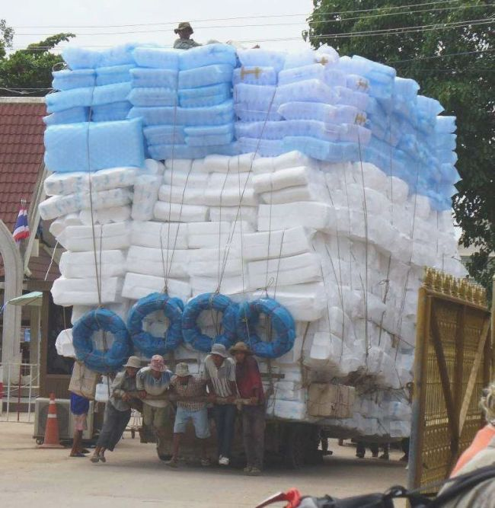
Before you add one more thing….
www.safetycenter.navy.mil
Notes:
We plan for systems to support top two tiers .Creating foundations to support the maintenance of those behaviors.

Slide 95
Memo
To: School Administrators
From: District Administrators
In keeping with the new state initiative, this fall we will be implementing an exciting new district initiative of SNI in place of LYI. All in-service days previously scheduled for LYI will be rescheduled as staff development for SNI. The $500 for release time and materials for LYI will be discontinued and provided instead for SNI. By the way, you will need to create local SNI teams that meet weekly. The former members of your LYI team would be perfect for this new team. Your new SNI binders will be coming next week. Have a great year!!!

Slide 96
9. Adjusting along the way
(adapted from Situational Leadership
Blanchard and Hersey)
Team needs to adjust to situation (teams skill set, knowledge and commitment to change)
C1- Teaching/Transfer of new skill set: Define the roles and tasks (BOQ, BAT) of the ‘follower’ or team and supervise them closely. Decisions are made by the coach/facilitator and announced, so communication is largely one-way. Team will lack fluency who but are enthusiastic and committed. They need direction and supervision to get them started.
C2 – Coaching – High task focus, high relationship focus – coach still define roles and tasks, but seeks ideas and suggestions from the team. communication is much more two-way. For people who have some competence but can lack commitment. They need direction and supervision because they are still relatively inexperienced. They also need support and praise to build their self-esteem, and involvement in decision-making to restore their commitment.
C3 – Participating / Supporting – Low task focus, high relationship focus – coach pass day-to-day decisions, such as task allocation and processes, to the team. The leader facilitates and takes part in decisions, but control is with the team. For people who have competence, but lack confidence or motivation. They do not need much direction because of their skills, but support is necessary to bolster their confidence and motivation.
C4 – Delegating – Low task focus, low relationship focus – coach still involved in decisions and problem-solving, but control is with the team. The team decides when and how the coach will be involved. For people who have both competence and commitment-they are able and willing to work on a project by themselves with little supervision or support.

Slide 97
Development of the Team/Staff
T4 – High Competence, High Commitment – Fluent and experienced with innovation, and comfortable with their own ability to do it well. May even be more skilled than the coach .
T3 – High Competence, Variable Commitment – Experienced and capable, but may lack the confidence to go it alone, or the motivation to do it well / quickly.
T2 – Some Competence, Low Commitment – May have some relevant skills, but won’t be able to do the job without help. The task or the situation may be new to them.
T1 – Low Competence, High Commitment – Generally lacking the specific skills required for the job in hand, but has the confidence and / or motivation to tackle it.

Slide 98
10. Empower staff also make it easy to do….
Give them a voice, communication mechanism – referral process for tier 2,3- respond to requests in 24 hours, provide support within 48 hours- system must be there before kids are identified- make them part of the process when designing supports-
Notes:
Can we say establish a targeted intervention is your school like CICO

Slide 99
Make SWPBS Easier to do
Handbook
    Description of SW-PBS core ideas
    School-wide Behavioral Expectations
    Teaching matrix
    Teaching plans and teaching schedule
    Reward system
    Continuum of consequences for problem behavior
Teaming System
    Regular meeting schedule and process
    Regular schedule for annual planning/training
Annual Calendar of Activities
On-going coaching support for teachers
(isolate skills, performance feedback, professional learning community)
Request for Assistance- easy to ask for help

Slide 100
When you empower staff, you start to see high fidelity- when they know their behavior has a direct impact on student outcomes and better school environment, fidelity increases…

