Slide 1
Building the Foundation for Advanced Tiers
Susan Barrett
sbarrett@pbismaryland.org
Special thanks to the IL PBIS Network

Slide 2
Description
Positive outcomes for students are achieved when evidence-based interventions are implemented within effective systems and data are used to guide decision-making. We describe the ways data can be used at Tiers 2 and 3 (e.g., for individual students, for a system) and share tools for using data effectively and efficiently.

Slide 3
Positive outcomes for students are achieved when…

Slide 4
…evidence-based interventions are implemented…
Provide guidance on selection of EBP
Organize Evidence Based Practices into a framework that makes sense to all stakeholders

Slide 5

Positive Behavior Interventions & Supports:
A Response to Intervention (RtI) Model
Tier 1/Universal
School-Wide Assessment
School-Wide Prevention Systems
ODRs,
Attendance,
Tardies, Grades,
DIBELS, etc.
Tier 2/
Secondary
Tier 3/
Tertiary
Check-in/ Check-out
Assessment
Intervention
Social/Academic Instructional Groups
Daily Progress
Report (DPR)
(Behavior and
Academic Goals)
Individualized Check-In/Check-Out, Groups & Mentoring (ex. CnC)
Competing Behavior
Pathway, Functional
Assessment Interview,
Scatter Plots, etc.
Brief Functional Behavioral Assessment/
Behavior Intervention Planning (FBA/BIP)
Complex FBA/BIP
SIMEO Tools:
HSC-T, RD-T, EI-T
Illinois PBIS Network, Revised May 2009
Adapted from T. Scott, 2004
Wraparound

Slide 6
Universal
Targeted
Intensive
Continuum of Support for ALL
Math
Science
Spanish
Reading
Soc skills
Soc Studies
Basketball
Label behavior…not people
Notes:
NOTICE GREEN GOES IS FOR “ALL”

Slide 7
Are you ready?
  Are you ready for Tier 2?
  Using Check-In/Check-Out (CICO) as the foundation for Advance Tier development

Slide 8
How do I know if I am ready?
Gap Analysis: Student or System?
What does your data say?
Are students getting access to T1?
Fidelity for Tier 1?
How many referrals are coming from Classroom? Are students getting access to best practice in the classroom?
Do you have buy in?
Examine current teaming process
Are you flexible?

Slide 9
Your Turn
Are you ready?
Discuss current conditions
How many kids have you discussed in your problem solving team so far this year?
How are kids getting access? (data point in)
How are you progress monitoring students?
How are you fading your support?

Slide 10
3-Tiered System of Support
Necessary Conversations (Teams)
Universal
Team
Secondary Systems Team
Problem Solving Team
Tertiary Systems Team
Uses Process data; determines overall intervention effectiveness
Uses Process data; determines overall intervention effectiveness
Plans SW & Class-wide supports
Standing team; uses FBA/BIP process for one youth at a time
Universal Support
CICO
Brief
FBA/BIP
SAIG
Complex
FBA/BIP
WRAP
Group w. individual
feature
Brief FBA/BIP
Illinois PBIS (9/1/09)
Notes:
10
10

Slide 11
Teaming at Tier 2
Secondary Systems Planning ‘conversation’
  Monitors effectiveness of CICO, S/AIG, Mentoring, and Brief FBA/BIP supports
  Review data in aggregate to make decisions on improvements to the interventions themselves
  Students are NOT discussed
Problem Solving Team (‘conversation’)
  Develops plans for one student at a time
  Every school has this type of meeting
  Teachers and family are typically invited

Slide 12
Getting Ready for Advanced Tiers
Foundations
  Teaming Structures, RFA
  Communication Loops
  Using Team Time Effectively: “Necessary Conversations”
  Not ready for that- What about Check In/Check Out?

Slide 13
RFA
ODR (SWPBS Team)
Parent recommendation
Administrator recommendation
Student Recommended for CICO
CICO Coordinator
CICO is Implemented
Morning
check-in
CICO Coordinator
summarizes data
for decision making
Parent
feedback
Regular teacher
feedback
Bi-weekly coordination
Meeting to assess student
progress
Afternoon
check-out
Revise
program
Exit
program
home
Notes:
Student recommended for CICO by Teacher, parent, other school personnel?
Prior to CICO implementation- meeting with Counselor, parent and student
Go over expectations for each party (parent, school, and student)
Set goal
Sometimes contract is signed (I don’t know if you this was ever used Kelly)
3) CICO Implemented
4) Morning check-in
What did you check for? Pencil, binder, agenda, CICO form from day before
Gave students supplies if they did not have them to help them be successful
CICO Daily progress report given (can flip to next slide to show)
Teacher Feedback
Student carries card to teachers
Teachers have been trained to provide some sort of positive interaction upon receiving the card
-Teachers have also been trained not to use the system as punishment- no nagging
Afternoon check-out
CICO coordinator checks for goal
Reinforcement for checking out (High 5)
Bigger reinforcement for checking out and meeting goal (snack)
Parent Feedback
Send home- student gets feedback from parent
Student brings back form signed the next day
CICO Coordinator Summarizes Data for Decision Making
Using Quattro pro Spread sheet program- graphs data
Weekly CICO Meeting
½ hour to assess progress
who attends meeting
decisions made in meeting

Slide 14
Tier 2- Basic
Using CICO as the “Organizer”
Intervention
Screening Tool
Data Collection
Teacher Support
Formal Documentation
Outcomes:

Slide 15
Positive Behavior Interventions & Supports:
A Response to Intervention (RtI) Model
Tier 1/Universal
School-Wide Assessment
School-Wide Prevention Systems
ODRs,
Attendance,
Tardies, Grades,
DIBELS, etc.
Tier 2/
Secondary
Tier 3/
Tertiary
Check-in/ Check-out
Assessment
Intervention
Social/Academic Instructional Groups
Daily Progress
Report (DPR)
(Behavior and
Academic Goals)
Individualized Check-In/Check-Out, Groups & Mentoring (ex. CnC)
Competing Behavior
Pathway, Functional
Assessment Interview,
Scatter Plots, etc.
Brief Functional Behavioral Assessment/
Behavior Intervention Planning (FBA/BIP)
Complex FBA/BIP
SIMEO Tools:
HSC-T, RD-T, EI-T
Illinois PBIS Network, Revised May 2009
Adapted from T. Scott, 2004
Wraparound

Slide 16
Sample: Daily Progress Report
Check-In/Check-Out
EXPECTATIONS | 1 st block | 2 nd block | 3 rd block | 4 th block
Be Safe | 2 1 0 | 2 1 0 | 2 1 0 | 2 1 0
Be Respectful | 2 1 0 | 2 1 0 | 2 1 0 | 2 1 0
Be Responsible | 2 1 0 | 2 1 0 | 2 1 0 | 2 1 0
Total Points
Teacher Initials
Consistent with School Wide Expectations
Adapted from Responding to Problem Behavior in Schools: The Behavior Education Program by Crone, Horner, and Hawken
Notes:
16

Slide 17
Sample: Daily Progress Report
for GROUP Intervention
EXPECTATIONS | 1 st block | 2 nd block | 3 rd block | 4 th block
Be Safe Use your words Use deep breathing | 2 1 0 | 2 1 0 | 2 1 0 | 2 1 0
Be Respectful Keep arm’s distance Use #2 voice level when upset | 2 1 0 | 2 1 0 | 2 1 0 | 2 1 0
Be Responsible Ask for breaks Self-monitor with DPR | 2 1 0 | 2 1 0 | 2 1 0 | 2 1 0
Total Points
Teacher Initials
Adapted from Grant Middle School STAR CLUB
Adapted from Responding to Problem Behavior in Schools: The Behavior Education Program by Crone, Horner, and Hawken
Notes:
17

Slide 18
Sample: Daily Progress Report
Behavior Intervention Plan
0 = Try again 1 = Good 2 = Excellent! | Be Safe | Be Respectful | Be Responsible
 | * Rip recycled paper * Only tap pencils (not pens) | * Use “voice level #1” while teacher is speaking (whisper) | * Say “I need help getting started” when having difficulty
Class | 0 1 2 | 0 1 2 | 0 1 2
Recess | 0 1 2 | 0 1 2 | 0 1 2
Class | 0 1 2 | 0 1 2 | 0 1 2
Lunch | 0 1 2 | 0 1 2 | 0 1 2
Class | 0 1 2 | 0 1 2 | 0 1 2
Class | 0 1 2 | 0 1 2 | 0 1 2
Total Points = _____ Points Possible = __36___ |  | Date: ________________ Today ______________%

Slide 19
Decision Rules for Access to Advanced Tiers
(and decision rules for prevention-if we can predict the trajectories , then we can prevent it from occurring)
Youth has 2 Major ODRs
Youth has 1 Suspension
Youth experiences more than ? minutes out of instruction
Youth misses more than ? days unexcused absences
Youth drops GPA by more than ??
Youth – benchmark testing- McIntosh
Youth- incomplete class work/homework
Attendance (look at predictors for drop-out and school completion)
Admin Referral
Teacher/Staff Referral
Family Referral
Other:
Notes:
Flags for discussion
Data Dashboard
Multiple places to get access
data we've used in a couple of
districts. As far as academics go, they're not 100% predictors (i.e.,
not all students with academic deficits end up with behavior
challenges), but people have been using them as flags for discussion. So
if a student is flagged as "at risk" (aka deficit, tier III, red zone),
their name gets raised as a possible student requiring behavior support
as well. Because some students have academic problems but won't ever
need behavior support, it's ok for a team/teacher to veto the need for
behavior support.

Slide 20
and data are used to guide decision-making
  Progress-monitoring of the actual EBPs
    Systematized stakeholder input/feedback
    Progress-monitoring of the actual interventions
    Progress-monitoring of the system
  Progress-monitoring of youth response

Slide 21
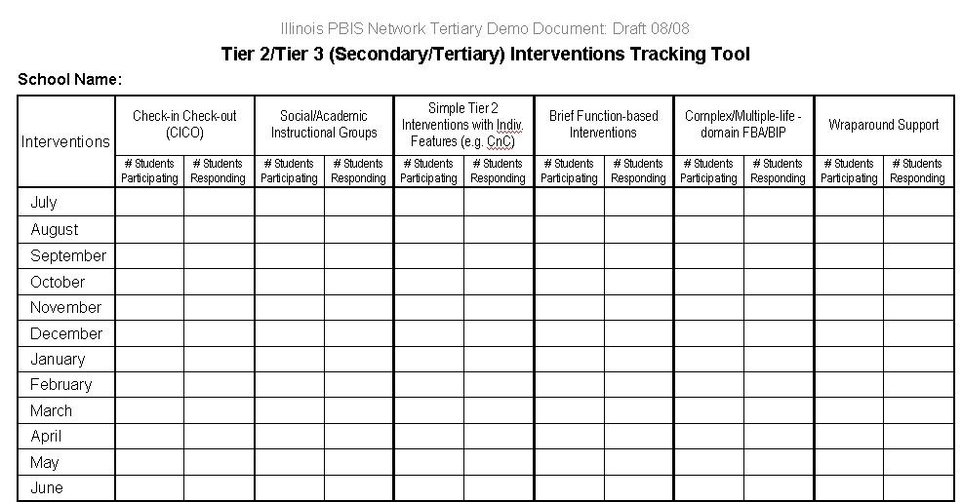
Please list below how your school defines “responding” at each of the six levels:
Responding to CICO:
Responding to Social/Academic instructional groups:
Responding to Simple Tier 2 with Individualized Features (i.e. CNC):
Responding to Brief Function-Based Interventions:
Responding to Complex Function-based Interventions:
Responding to Wraparound Plans:

Slide 22
Tier 2/3 Tracking Tool
Structured to follow 6 levels/types of interventions from Secondary through Tertiary
Increases accountability
  Schools have to count # of kids in interventions
  Data-based decision-rules are necessary (Identify, Progress-monitor, Exit)
  Must define ‘response’ to each intervention type/level
  Shows % of kids who responded to each intervention
…..the tool assesses the success rate, or effectiveness of the interventions themselves
Connects each level of intervention to the next level

Slide 23
Systems-Response Tool
“Finding” Students in Need of Tertiary Supports
Records the “system’s response” to youth behavior/circumstance
Administrators and team members need to find the #s of youth that meet each criteria
  Using the tool IS engaging in a ‘systems-reflection’
  Prevents the hiding or mis-labeling of youth (ex. “We don’t have any kids that need Wraparound”)

Slide 24
Systems-Response Tool
System Response Options | Total # of Students in Category for Time Period: List date at top of column & total # of youth in each box
 | Date: | Date: | Date: | Date: | Date: | Date:
A. Students being monitored by Secondary Systems Team (ex. CICO, CnC, FBA/BIP)
B. Students being monitored by Tertiary Systems Team (ex. Complex FBA/BIP, Wraparound)
C. Students being considered for Special Education Testing
D. Students with Special Education process in progress (being tested, placement being considered, etc.)
E. Students that were tested and did not qualify for Special Education
F. Students suspended on one occasion
G. Students suspended on two or more separate occasions
H. Students placed (or at risk of placed) in separate setting or “Safe School” (ex. Alternative to suspension program)
I. Students in Special Education setting, out-of-home school
J. Students in “short-term” restrictive placement in clinical setting (hospitalization)
K. Students with expulsion hearing in progress
L. Students expelled

Slide 25
Necessary Teaming Functions and Evaluation Tools
in a 3-Tiered System of Support
Universal
Team
Secondary Systems Team
Problem Solving Team
Tertiary Systems Team
Uses Process data; determines overall intervention effectiveness
Uses Process data; determines overall intervention effectiveness
Plans SW & Class-wide supports
Standing team; uses FBA/BIP process for one youth at a time
BOQ
Universal Screening
Decision Rules for Access
SWIS
BAT ISSET
PIC
Behavior Pathway
FACTS
ISIS
BAT
ISSET
ISIS
SRT
Home/School/Community Ed Info Tool
WIT
SIMEO
Tracking Tool
Reverse RFA
SRT
CICO SWIS/
ISIS
Illinois PBIS 9/1/09
Notes:
25
25

