Slide 1

Constructing the
Functional Behavior Assessment,
Behavior Support Plan and Individual Education Program to be Congruent
March 5, 2014
Eileen Baker
Melissa Ebling
Karen Jones
Lynn Moss

Slide 2
Our Agenda
8:30 – 9:00 Welcome & Overview
9:00 – 9:30 Review Robbie’s FBA-BSP
9:30 – 9:50 Purpose of IEPs
9:50 – 10:15 IEP Sections 1-3
  Unique Educational Needs & Characteristics of the Student
  Statement of Special Education & Related Services & Supplementary Aids and Services
  Services, Aids & Modifications
10:15 – 10:30 Break
10:30 – 10:45 IEP Sections 1-3, continued
10:45 – 11:45 IEP Sections 4-5
  PLEP (Present Level of Education Performance)
  Annual Goal with Benchmarks to Reach Goal
11:45 – 12:00 Wrap-up & Evaluation

Slide 3
Select a role and take corresponding role card
    Facilitator - Guides the case study activity; remains objective
    Timekeeper - Keeps track of time spent on issue; prompts group when allotted time is up
    Recorder/Note taker - Takes notes; keeps track of decisions made
    Reporter - Uses recorder’s notes to share with the group

Slide 4
Student’s
IEP
Team
Student
Regular
Education
Teacher(s)
School
System
Rep.
Transition
Serv. Agency
Rep.
Parents
Others w/
knowledge or
special
expertise
Person who
can interpret
test results
Special
Education
Teacher(s)

Slide 5
Demonstrating Congruency
Behavior Support Plan
Individual Education Program
Functional Behavior Assessment

Slide 6

Information shared with permission, source used:
Tips for Better IEPs
How to develop legally correct and educationally useful programs.
Bateman, Barbara D. and Linden, M.A. Verona, Wisconsin: Attainment Company, 2012, 5th Edition.

Slide 7
Functional Behavior Assessment
Describe Observable Behavior, collect data
Determine the conditions that trigger & reinforce behavior
Behavior Support Plan
Individual Education Program
Describe behaviors in unique needs
Determine Services to meet those unique needs (conditions needed or goal for improved performance)
Specify the intervention strategies
Teach/Support appropriate, positive behaviors

Slide 8
Demonstrating Congruency
Functional Behavior Assessment
Behavior Support Plan
Individual Education Program

Slide 9
Competing Pathway
Competing Pathway
For Robbie
Desired Alternative Behavior
Complete work independently
Stay in the classroom
Typical Consequence
Grades improve
Positive relationship with mother
Setting Events
Mood disorder
Anxiety
Single parent family
Delayed social
skills
Difficulty expressing
emotions
Trigger Antecedents
Writing Assignment
Test taking
Desired Alternative Behavior
Complete work independently
Stay in the classroom
Typical Consequence
Grades improve
Positive relationship with mother
Setting Events
Mood disorder
Anxiety
Single parent family
Delayed social
skills
Difficulty expressing
emotions
Trigger Antecedents
Writing Assignment
Test taking
Maintaining Consequence
1:1 attention from nursevoid work
Avoid writing tasks
Avoid tests
Maintaining Consequence
1:1 attention from nurse
Avoid work
Avoid writing tasks
Avoid tests
Target Behavior
Asking to go to the nurse (Elopes)
Target Behavior
Leaves classroom without permission (Elopes)
Acceptable Alternative/
Replacement Behavior
Asking for a specified amount of breaks
Asking for help with certain items
Avoiding certain items
Acceptable Alternative/ Replacement Behavior
Asking for a specified amount of breaks
Asking for help with certain items
Avoiding certain items

Slide 10
Demonstrating Congruency
Behavior Support Plan
Individual Education Program
Functional Behavior Assessment

Slide 11
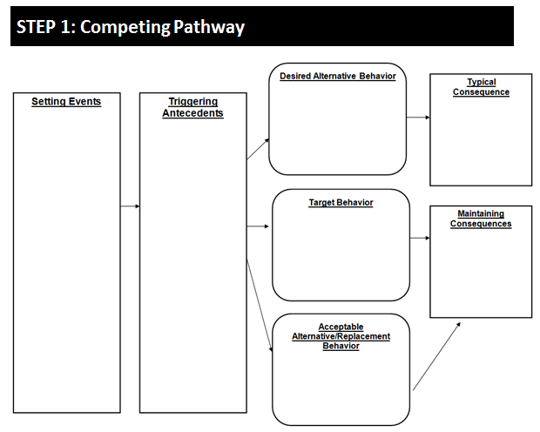
Behavior Support Plan
Behavior Intervention Plan/Positive Behavior Support Plan (Form G)
Hypothesis:
PREVENT Intervention
TEACH Intervention
REINFORCE Intervention
When this happens… | Student does this… | In order to….
Intervention Strategy | Description and Steps | Comments
Intervention Strategy | Description and Steps | Comments
Intervention Strategy | Description and Steps | Comments

Slide 12
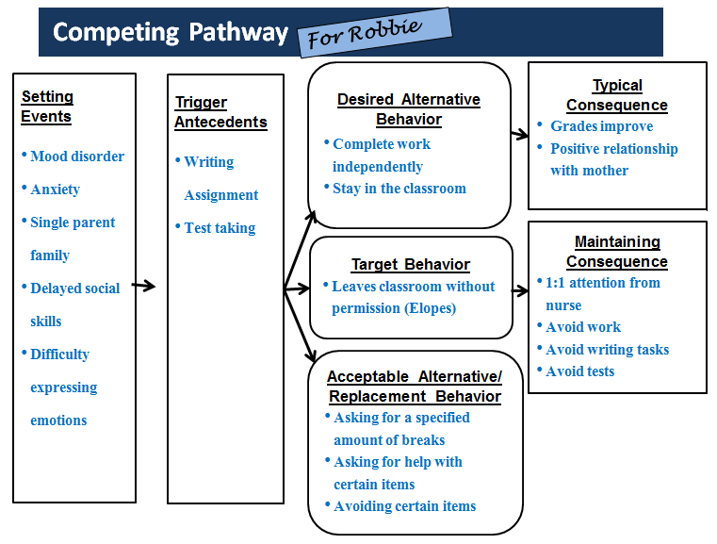
Behavior Support Plan
Behavior Intervention Plan/Positive Behavior Support Plan (From G)
Hypothesis:
When this happens… | Student does this… | In order to….
A writing task is presented
A test is occurring
Avoid the task
Get 1:1 help
Leaves classroom

Slide 13

Attention Reporters:
Student Case Study Summary (Yellow)
Throughout the IEP goal development process, each step will be crafted for your student.
Schools are to submit 1 clean copy prior to leaving.
Feedback will be provided electronically for your team’s use.

Slide 14
Student Case – HYPOTHESIS
 | When this happens… | Student does this… | In order to….
Target Behavior

Slide 15
You have the….
Hypothesis:
For Robbie
When this happens… | Student does this… | In order to….
Triggering antecedents | Target behavior | Maintaining consequences
When this happens… | Student does this… | In order to….
A writing task is presented A test is occurring | Leaves classroom | Avoid the task Get 1:1 help
Now, we need to write out….
    PREVENT Interventions
    TEACH Interventions
    REINFORCE Interventions
…for him based on your data!

Slide 16
Behavior Support Plan
For Robbie
Hypothesis:
When this happens… | Student does this… | In order to….
A writing task is presented A test is occurring | Leaves classroom | Avoid the task Get 1:1 help
PREVENT Interventions
Intervention Strategy | Description and Steps | Comments
Environmental Supports | Nurse pass – Robbie will be given a max of 3 passes to go to the nurse each day; Each day, and as needed, Mrs. Moss will remind Robbie about using them and his chance to trade them in for basketball time if he does not use them all. (see reinforce).

Slide 17
Behavior Support Plan
For Robbie
PREVENT Interventions
Intervention Strategy | Description and Steps | Comments
Chunking of writing tasks | Chunk writing assignment by using scaffolding techniques to initially reduce the amount of writing required. In assignments requiring multiple paragraphs, allow a 1 minute break between paragraphs. Upon completion of the first paragraph, allow Robbie to choose an upcoming section that he wants help with. In short answer essay assignments, allow Robbie to select two out of 10 that he does not have to answer. If Robbie completes additional work independently, he may earn minutes toward a weekly reward (basketball). | Allows opportunity to avoid and/or get 1:1 help with some non-preferred assignments.

Slide 18
Behavior Support Plan
For Robbie
PREVENT Interventions
Intervention Strategy | Description and Steps | Comments
Test taking preparation | - Provide 5 days notice and reminders for tests Provide choice of location to take tests – “Robbie, would you like to go to the Guidance office or Ms. Brown’s classroom to take the test?” | Choices, some control over test taking.

Slide 19
Behavior Support Plan
For Robbie
Hypothesis:
When this happens… | Student does this… | In order to….
A writing task is presented A test is occurring | Leaves classroom | Avoid the task Get 1:1 help
TEACH Interventions
Intervention Strategy | Description and Steps | Comments
Break Cards | Robbie may signal the need for a break by holding up a red card to get teacher permission to move to the quiet area to practice calming techniques/review calming checklists. Consider the use of a stop-watch to track time spent in quiet area daily..

Slide 20
Behavior Support Plan
For Robbie
TEACH Interventions
Intervention Strategy | Description and Steps | Comments
Self-Monitoring of Anxiety | Anxiety Rater– Will be developed with Robbie (Allow Robbie to choose style of this rating scale – clip art from internet?) Create a visual rating scale of how Robbie is feeling in regards to his anxiety: 5=out of control; head is spinning, need to take a break 4= fast breathing, heart beating, but can visualize playing basketball, the beach to calm 3 = thoughts are moving fast, but can take deep breaths to slow them, count to 10 2 = butterflies in stomach, body is shaking, but think about basketball and my stomach settles 1 = thoughts go in one ear and out the other and flow through my head, I do not give my worry thoughts too much energy Robbie’s scale will be laminated and kept on the inside cover of his agenda. If he takes a break to the nurse, he will need to take his agenda. He will have a sheet he has to complete at the nurse that will have a spot where he has to mark what level he was at (1-5) and what he did to calm himself down (what strategy he used). | Dr. Baker and Robbie will develop the Anxiety Rater levels together Dr. Baker and Robbie together will review with Mrs. Moss Copy of the Anxiety Rater will be sent home and explained to mom.

Slide 21
Behavior Support Plan
For Robbie
TEACH Interventions
Intervention Strategy | Description and Steps | Comments
Test-Taking Strategies | Utilize a checklist of “test ready behaviors - test preparation and strategies/process When Robbie has his 5 day reminder that a test is coming that will involve writing, he will be given a premade sheet that has his “test ready behavior checklist” -- make flashcards for vocabulary test -- make flashcards for spelling test -- come up with 3 questions about the chapter -- make a story map about the chapter with a topic sentence and 3 supporting details.

Slide 22
Behavior Support Plan
For Robbie
Hypothesis:
When this happens… | Student does this… | In order to….
A writing task is presented A test is occurring | Leaves classroom | Avoid the task Get 1:1 help
REINFORCE Interventions
Intervention Strategy | Description and Steps | Comments
Checklist tracking minutes earned. | Daily checklist to track minutes earned for weekly basketball time with a staff member/mentor. Minutes are earned for: turning in unused nurse passes (1 min/pass) independent completion of more than (his) required writing assignments (1min/writing assignment) staying in class for the whole period (1 min/class) | This reinforcement strategy encourages Robbie to earn basketball 1:1 time by staying in class and completing non-preferred tasks.

Slide 23
Demonstrating Congruency
Functional Behavior Assessment
Behavior Support Plan
Individual Education Program

Slide 24

Purpose of an IEP is to identify services that meet the unique needs of the learner
Special education
Related services
Supplementary aids and services
Accommodations and modifications
Personnel support
… based upon the unique needs, not availability of services or category of disability.
The IEP progress determines if what has been provided is working
Bateman, Barbara D. and Linden, M.A., 2012

Slide 25
Steps to convert behaviors into IEP components (Sugai & Colvin 1990)
Problem Behavior
Problem Context
Desired Behavior
Current Level of Functioning (PLEP)
Desired Level of Functioning (Annual Goal)
Intervention Strategies (Services)
Evaluation Measurement (Goal, Benchmark)
Evaluation Schedule (Benchmark)
Adapted from Sugai, G., & Colvin, G. (1990). From assessment to development: Writing Behavior IEPs. The Oregon Conference Monograph, 125-179. Eugene, OR: University of Oregon.

Slide 26
Specifically…
Problem Behavior: Behavior displayed by student that is observed (recorded, graphed) and determined to be problematic (e.g. student does not follow adult directions the first time).
Problem Context: Setting(s) or condition(s) in which behavior is most problematic (e.g. when in 45 minute, large group math or reading lessons).
Desired Behavior: Replacement behavior selected for the problem behavior (e.g. student follow adult directions within five seconds without comment or inappropriate facial expression).
Sugai & Colvin 1990

Slide 27
Current Level of Functioning: How often or long occurrences of the problem and replacement behavior are desired (e.g. student follows teacher directions within five seconds in 45% of the opportunities). (PLEP)
Desired Level of Functioning: How often or long occurrences of the problem and replacement behaviors are desired (e.g. student follow teacher directions within five seconds in 90% of the opportunities for five consecutive days). (Goal)
Sugai & Colvin 1990

Slide 28
Intervention Strategies: The names of possible strategies for achieving the desired level of functioning (List in “Statement of the special education and related services +/or modifications”)
Evaluation Measurement: Type of measurement strategy for assessing student progress and intervention effectiveness (e.g. frequency counts of following and not following teacher directions).
Evaluation Schedule: Schedule for how often measurements should be conducted (e.g. frequency counts will be daily for 45 minutes during math and reading groups).
Sugai & Colvin 1990

Slide 29
Unique Needs
What are the student’s needs in relation to the grade level general education curriculum and functional behavior in addition to what all students will receive?
Needs define what portions or aspects of the child’s education need to be individualized, taught, supported.
Academic and Functional (deficit needs around core content and e.g., social skills, mobility, behavior, employment and skills to increase independence).
What are the needs makes this student unique, that differ from that of peers, that interfere with learning?
How do these unique needs keep this student from accessing and progressing in their education?

Slide 30
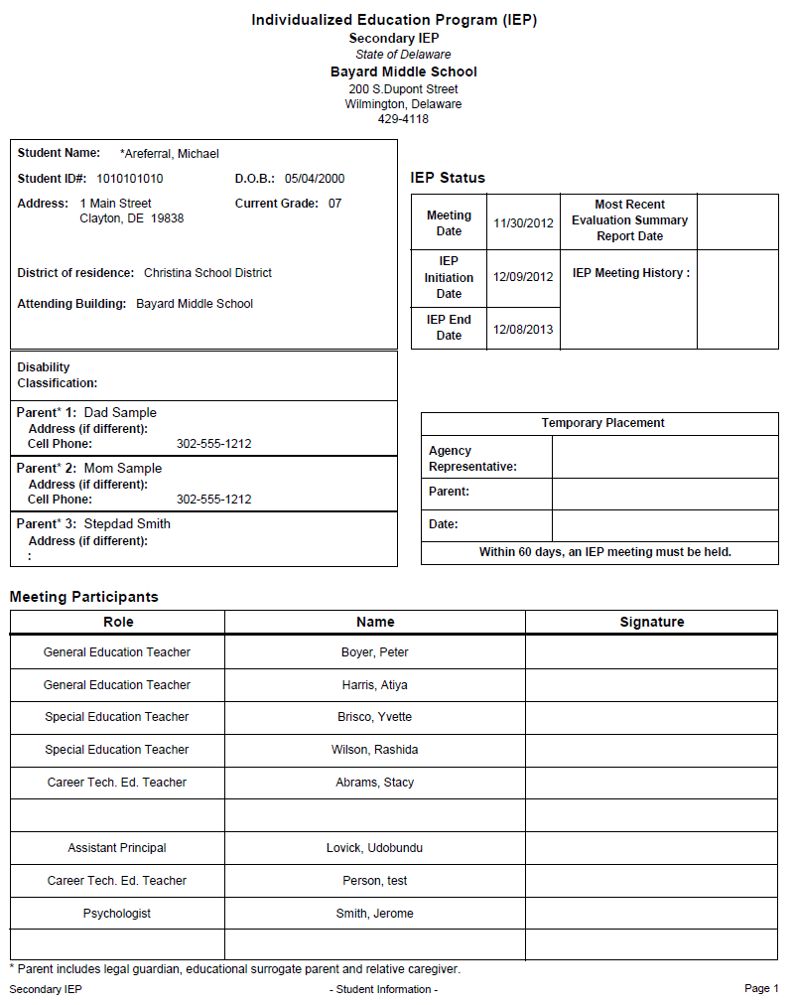

Slide 31
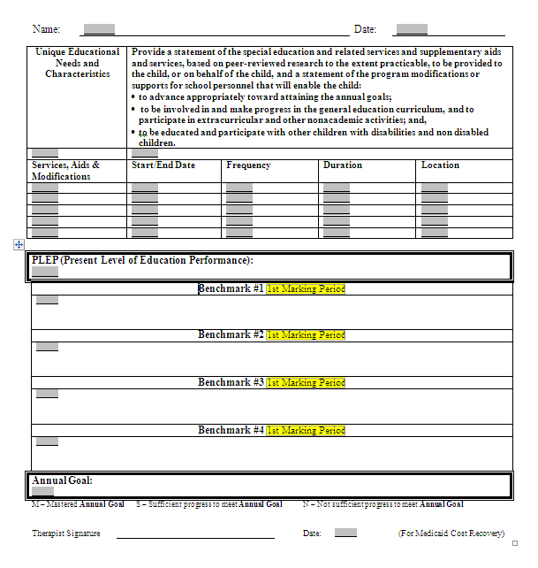
Creating IEP Goals
Unique Educational Needs & Characteristics of the Student
Statement of Special Education & Related Services & Supplementary Aids and Services
Services, Aids & Modifications
PLEP (Present Level of Education Performance
Annual Goal with Benchmarks to Reach Goal

Slide 32
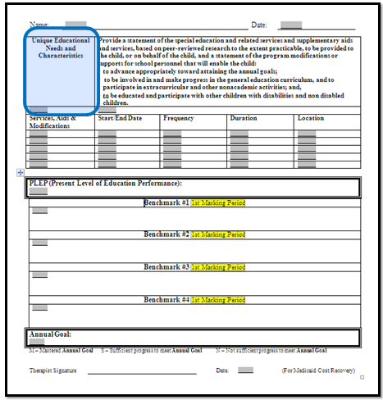
Creating IEP Goals - SECTION 1:
Unique Educational Needs & Characteristics of the Student
Unique Educational Needs and Characteristics
Unique Educational Needs and Characteristics
Robbie needs to learn : Self-control Anxiety reducing strategies Request break Complete assignments Remain in the classroom
Use Your Existing Documents
FBA
Data Collected
Competing Pathways
Behavior Support Plan
For Robbie

Slide 33
Creating IEP Goals - SECTION 1:
Unique Educational Needs & Characteristics of the Student
Unique Educational Needs and Characteristics
Unique Educational Needs and Characteristics
Use Your Existing Documents
FBA
Data Collected
Competing Pathways
Behavior Support Plan
For Case Study Student

Slide 34
From the IEP Form:
Needs, Services and Annual Goals
A statement of the special education and related services and supplementary aids and services, based on peer-reviewed research to the extent practicable, to be provided to the child, or on behalf of the child, and a statement of the program modifications or supports for school personnel that will enable the child:
  to advance appropriately toward attaining the annual goals;
  to be involved in and make progress in the general education curriculum, and to participate in extracurricular and other nonacademic activities; and,
  to be educated and participate with other children with disabilities and non disabled children.

Slide 35
Examples of Specific Descriptors of
Supplementary Aids and Services
What kind of staff support and for what purpose?
Name specialized equipment needs, adaptive tools, AT, behavioral charts, checklists, reinforcements
Pacing of instruction, need for breaks, movement
Flexible presentation of instruction (e.g. via tape, sign language, peer assisted reading, computer aided instruction or practice)
Presentation of Materials (shared note taking, accessible formats)

Slide 36
Examples of Specific Descriptors of
Supplementary Aids and Services (cont.)
Explanation of assignment adaptations of modifications
Flexible demonstration of skills (project based, DI, varied product choices)
Testing adaptations – oral, taped responses, 1:1, chunking test, in a different room,
Planning Consultation time (needed by staff to meet student’s individualized program)
Personnel Training – in taking data, teaching calming skills, coping mechanisms, safety precautions

Slide 37
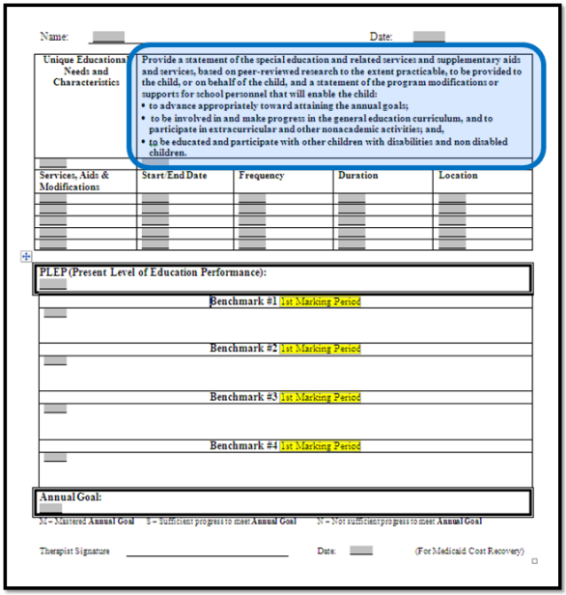
Creating IEP Goals- SECTION 2: Statement of Special Education &
Related Services & Supplementary Aids and Services
Provide a statement of the special education and related services and supplementary aides and services, based on peer-reviewed research to the extent practicable, to be provided to the child, or on behalf of the child, and a statement of the program modifications or supports for school personnel that will enable the child: to advance appropriately toward attaining the annual goals; to be involved in and making profess in the general education curriculum, and to participate in extracurricular and other nonacademic activities; and, to be educated and participate with other children with disabilities and non-disabled children
Use Your Existing Documents
FBA
Data Collected
Competing Pathways
Behavior Support Plan
Follow Behavior Support Plan, which includes interventions in the areas of Prevent, Teach and Reinforce: Prevent: Environmental Supports (nurse passes). Chunking and scaffolding of writing tasks. Teach: Self-monitoring of anxiety. Calming strategies. Use of break cards and nurse cardtaking strategies (preparation and process). Reinforce: Daily cheklist to track minutes earned for weekly basketball time with

Slide 38
Creating IEP Goals- SECTION 2: Statement of Special Education &
Related Services & Supplementary Aids and Services
Provide a statement of the special education and related services and supplementary aides and services, based on peer-reviewed research to the extent practicable, to be provided to the child, or on behalf of the child, and a statement of the program modifications or supports for school personnel that will enable the child: to advance appropriately toward attaining the annual goals; to be involved in and making profess in the general education curriculum, and to participate in extracurricular and other nonacademic activities; and, to be educated and participate with other children with disabilities and non-disabled children
Use Your Existing Documents
FBA
Data Collected
Competing Pathways
Behavior Support Plan
Behavior Support Plan, which includes interventions in the areas of Prevent, Teach and Reinforce: Environmental Supports (nurse passes). Chunking and scaffolding of writing tasks. Test taking preparation and design. Designated quiet area in the classroom for daily strategy review/warm up and cool down. Self-monitoring of anxiety. Calming strategies. Use of break cards and nurse cards. Test taking strategies (preparation and process). Daily checklist to track minutes earned for weekly basketball time with a staff member/mentor. Minutes are earned for: Turning in unused nurse passes, Independent completion of more than (his) required writing assignments, Staying in class for the whole period.
For Robbie

Slide 39
Creating IEP Goals- SECTION 2: Statement of Special Education &
Related Services & Supplementary Aids and Services
Provide a statement of the special education and related services and supplementary aides and services, based on peer-reviewed research to the extent practicable, to be provided to the child, or on behalf of the child, and a statement of the program modifications or supports for school personnel that will enable the child: to advance appropriately toward attaining the annual goals; to be involved in and making profess in the general education curriculum, and to participate in extracurricular and other nonacademic activities; and, to be educated and participate with other children with disabilities and non-disabled children
Use Your Existing Documents
FBA
Data Collected
Competing Pathways
Behavior Support Plan
For Case Study Student

Slide 40
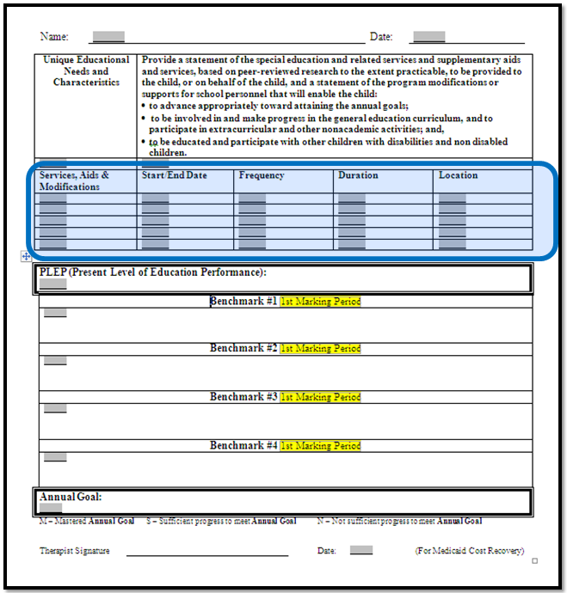
Creating IEP Goals- SECTION 3: Services, Aids & Modifications
Use Your Existing Documents:
TEACH interventions from BSP
What level of frequency/duration is needed to learn and maintain the skill taught?
For Robbie
Services , Aids and Mod. | Start/ End Dates | Frequency | Duration | Location
Teaching sessions with teacher/guidance/mentor to focus on practice of self-monitoring, development of self-calming strategies, anger control strategies, test-taking strategies and the use of break cards and nurse cards. | 3/3/14 – 3/14/14 | Daily | 10 minutes | Classroom
Teacher/para-directed warm up activities to review strategies taught. | 3/17/14 – end of 1st reporting period. | Daily | 5 minutes | Classroom
Teaching sessions with teacher/guidance/mentor to focus on practice of self-monitoring, development of self-calming strategies, test-taking strategies and the use of break cards and nurse cards. | 3/3/14 – 3/14/14 | Daily | 10 minutes | General Classroom
Teacher/para-directed warm up activities to review strategies taught. | 3/17/14 – end of 1st reporting period. | Daily | 5 minutes | General Classroom

Slide 41
Creating IEP Goals- SECTION 3: Services, Aids & Modifications
Use Your Existing Documents:
TEACH interventions from BSP
What level of frequency/duration is needed to learn and maintain the skill taught?
For Case Study Student
Services , Aids and Mod. | Start/ End Dates | Frequency | Duration | Location
Teaching sessions with teacher/guidance/mentor to focus on practice of self-monitoring, development of self-calming strat | 3/3/14 – 3/14/14 | Daily | 10 minutes | Classroom
Teacher/para-directed warm up activities to review strategies taught. | 3/17/14 – end of 1st reporting period. | Daily | 5 minutes | Classroom

Slide 42
Present Level Aligned to Unique Need
Needs should focus on the skill sets the student requires to access and make progress in general education curriculum.
  The student’s need for interventions will inform the IEP team which measurable annual goals to develop.
  If the need is well defined in the present levels, it will form the basis for the measurable annual goal - have similar unit of measurement

Slide 43
Present Level of Academic and Functional Performance
PLOP, PLEP, PLAAFP is based on the unique needs related to the child's disability
Must be current, accurate, and specific to that student and targeted behavior need
Is the point from which future progress will be measured
Includes Baseline data that can be used to monitor the students progress toward the IEP goals

Slide 44
Present Level of Academic
and Functional Performance
The unit of measurement used in the PLEP must match that used in the annual goal and benchmarks
May be determined by activity-based and timed measures, data from Behavior Support Plan
If using Behavior Rating Scale, ensure scores are self-explanatory or include an explanation of the score

Slide 45
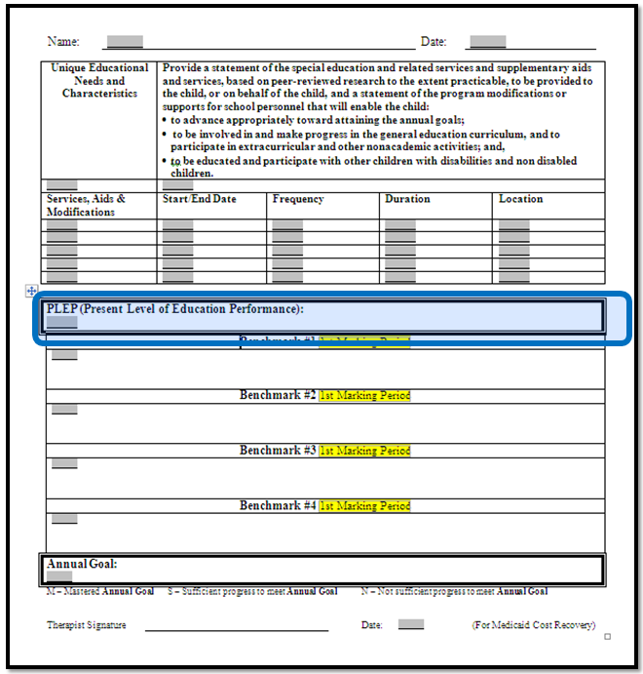
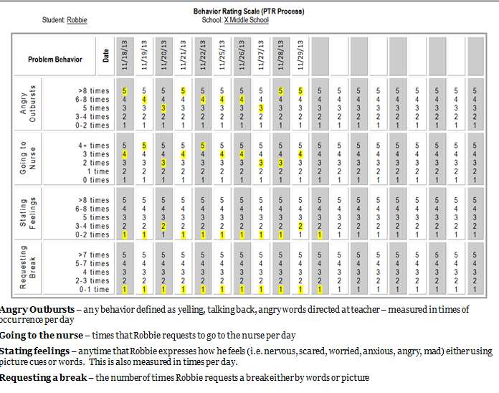
Creating IEP Goals
SECTION 4: Present Level of Education Performance
Use Your Existing Documents
From Baseline Behavior Rating Scale
For Robbie
PLEP (Present Level of Education Performance
Given any test situation or writing task, Robbie leaves the classroom without permission and goes to the nurse for up to 45 minutes at a time an average of 4 times a day in 10 consecutive days as measured by his individualized Behavior Rating Scale (BRS).

Slide 46
Creating IEP Goals
SECTION 4: Present Level of Education Performance
Use Your Existing Documents
From Baseline Behavior Rating Scale
For Case
Study Student
PLEP (Present Level of Education Performance

Slide 47
Creating IEP Goals
For Robbie
Unique Educational Needs and Characteristics
Robbie needs to learn : -Self-control -Anxiety reducing -strategies -Request break -Complete assignments -Remain in the classroom
Provide a statement of the special education and related services and supplementary aides and services, based on peer-reviewed research to the extent practicable, to be provided to the child, or on behalf of the child, and a statement of the program modifications or supports for school personnel that will enable the child: to advance appropriately toward attaining the annual goals; to be involved in and making profess in the general education curriculum, and to participate in extracurricular and other nonacademic activities; and, to be educated and participate with other children with disabilities and non-disabled children
Follow Behavior Support Plan (attached), which includes interventions in the areas of Prevent, Teach and Reinforce: Environmental Supports (nurse passes). Chunking and scaffolding of writing tasks. Test taking preparation and design. Designated quiet area in the classroom for daily strategy review/warm up and cool down. Self-monitoring of anxiety. Calming strategies. Use of break cards and nurse cards. Test taking strategies (preparation and process). Daily checklist to track minutes earned for weekly basketball time with a staff member/mentor. Minutes are earned for: Turning in unused nurse passes, Independent completion of more than (his) required writing assignments, Staying in class for the whole period .
1
2
3
Services , Aids and Mod. | Start/ End Dates | Frequency | Duration | Location
Teaching sessions with teacher/guidance/mentor to focus on practice of self-monitoring, development of self-calming strategies, anxiety control strategies, test-taking strategies and the use of break cards and nurse cards. | 3/3/14 – 3/14/14 | Daily | 10 minutes | Classroom
Teacher/para-directed warm up activities to review strategies taught. | 3/17/14 – end of 1st reporting period. | Daily | 5 minutes | Classroom
4
PLEP (Present Level of Education Performance
Given any test situation or writing task, Robbie leaves the classroom without permission and goes to the nurse for up to 45 minutes at a time an average of 4 times a day in 10 consecutive days as measured by his individualized Behavior Rating Scale (BRS).

Slide 48
Purposes of Goals and Benchmarks
Determine the appropriateness of the special services and/or accommodations and modifications
Monitor the student’s progress from the PLOP to the present, to the next benchmark, etc. toward annual goal
Use data and team decision-making process to evaluate whether to continue as written or make revisions
Revisit BSP if needed to make revisions
Bateman, Barbara D. and Linden, M.A., 2012

Slide 49

Creating IEP Goals- SECTION 5:
Creating the ANNUAL GOAL (Replacement Behavior)
For Robbie
Hypothesis Statement:
Present Level of Performance:
Given any test situation or writing task, Robbie leaves the classroom without permission and goes to the nurse for up to 45 minutes at a time an average of 4 times a day in 10 consecutive days as measured by his individualized Behavior Rating Scale (BRS).
When a writing task is presented or a test is occurring, Robbie goes to the nurse in order to avoid the task and get 1:1 help.
The Annual Goal:
Given any test situation or writing task, Robbie will use self-control strategies taught (i.e. calm down checklist, anxiety rater), at his desk or in his designated quiet area in order to remain in the classroom for greater than 80% of the day for 9 out of 10 consecutive days as measured by the behavior rating scale.
STEP 5: Creating IEP Goals

Slide 50
Creating IEP Goals- SECTION 5:
Creating the ANNUAL GOAL (Replacement Behavior)
For Robbie
Hypothesis Statement:
Present Level of Performance:
Given any test situation or writing task, Robbie leaves the classroom without permission and goes to the nurse for up to 45 minutes at a time an average of 4 times a day in 10 consecutive days as measured by his individualized Behavior Rating Scale (BRS).
When a writing task is presented or a test is occurring, Robbie goes to the nurse in order to avoid the task and get 1:1 help.
The Annual Goal:
Given any test situation or writing task, Robbie will use self-control strategies taught (i.e. calm down checklist, anxiety rater), at his desk or in his designated quiet area in order to remain in the classroom for greater than 80% of the day for 9 out of 10 consecutive days as measured by the behavior rating scale.
STEP 5: Creating IEP Goals

Slide 51
Creating IEP Goals- SECTION 5:
Creating the ANNUAL GOAL (Replacement Behavior)
For Robbie
Under what conditions | Who | Will Do What | At What Level | As Measured | By When
[Given …..] | [Student] | [Desired Behavior] | [Proficiency] | [by Whom & Measurement Method & Materials] | [Benchmark increment]
Under what conditions | Who | Will Do What | At What Level | As Measured | By When
Given any test situation or writing task, | Robbie | will use self-control strategies taught (i.e. calm down checklist, anxiety rater) at his desk or in his designated quiet area in the classroom | for greater than 80% of the day for 9 out of 10 consecutive days | as measured by the behavior rating scale. | [End date of the IEP]
Format adapted from Diana Browning Wright, Behavior/Discipline Trainings, 2005

Slide 52
Creating IEP Goals- SECTION 5:
Creating the ANNUAL GOAL (Replacement Behavior)
For Case Study Student
Under what conditions | Who | Will Do What | At What Level | As Measured | By When
[Given …..] | [Student] | [Desired Behavior] | [Proficiency] | [by Whom & Measurement Method & Materials] | [Benchmark increment]
Under what conditions | Who | Will Do What | At What Level | As Measured | By When
Format adapted from Diana Browning Wright, Behavior/Discipline Trainings, 2005

Slide 53
Creating IEP Goals- SECTION 5:
Creating the Benchmarks
For Robbie
Benchmark 1:
Under what conditions | Who | Will Do What | At What Level | As Measured | By When
Given any test situation or writing task, | Robbie | will use self-control strategies taught (i.e. calm down checklist, anxiety rater) at his desk or in his designated quiet area in order to remain in the classroom. | for greater than 50% of the day for 8 out of 10 consecutive days | as measured by the behavior rating scale. | End of the 3rd MP
Annual Goal:
Given any test situation or writing task, Robbie will use self-control strategies taught (i.e. calm down checklist, anxiety rater), at his desk or in his designated quiet area in order to remain in the classroom for greater than 80% of the day for 9 out of 10 consecutive days as measured by the behavior rating scale.
Format adapted from Diana Browning Wright, Behavior/Discipline Trainings, 2005

Slide 54
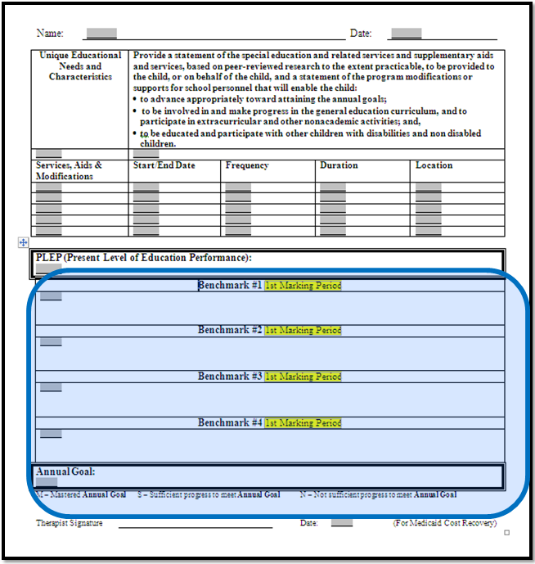
Creating IEP Goals- SECTION 5:
Creating the Benchmarks
For Robbie
Benchmark 1:
Given any test situation or writing task, Robbie will use self-control strategies taught (i.e. calm down checklist, anxiety rater), at his desk or in his designated quiet area in order to remain in the classroom for greater than 50% of the day for 8 out of 10 consecutive days as measured by the behavior rating scale.
Annual Goal:
Given any test situation or writing task, Robbie will use self-control strategies taught (i.e. calm down checklist, anxiety rater), at his desk or in his designated quiet area in order to remain in the classroom for greater than 80% of the day for 9 out of 10 consecutive days as measured by the behavior rating scale.
Format adapted from Diana Browning Wright, Behavior/Discipline Trainings, 2005

Slide 55
In determining the measurement
(At What Level)….
be certain to take into consideration where the Start Date of the IEP falls in terms of the Marking Period.
Unless the IEP Start Date is exactly that of the beginning of the MP, then you will need to adjust your projected expectation (At What Level) accordingly.
For example, if there are only 5 weeks left in the Marking Period, you would not expect the same amount of growth as in a 9-week Marking Period.

Slide 56
Creating IEP Goals- SECTION 5:
Creating the Benchmarks
For Robbie
Benchmark 2:
Under what conditions | Who | Will Do What | At What Level | As Measured | By When
Given any test situation or writing task, | Robbie | will use self-control strategies taught (i.e. calm down checklist, anxiety rater), at his desk or in his designated quiet area in order to remain in the classroom. | for greater than 60% of the day for 8 out of 10 consecutive days | as measured by his teacher on his individualized Behavior Rating Scale. (BRS) | End of the 4th MP
Annual Goal:
Given any test situation or writing task, Robbie will use self-control strategies taught (i.e. calm down checklist, anxiety rater), at his desk or in his designated quiet area in order to remain in the classroom for greater than 80% of the day for 9 out of 10 consecutive days as measured by the behavior rating scale.
Format adapted from Diana Browning Wright, Behavior/Discipline Trainings, 2005

Slide 57
Creating IEP Goals- SECTION 5:
Creating the Benchmarks
For Robbie
Benchmark 3:
Under what conditions | Who | Will Do What | At What Level | As Measured | By When
Given any test situation or writing task, | Robbie | will use self-control strategies taught (i.e. calm down checklist, anxiety rater), at his desk or in his designated quiet area in order to remain in the classroom. | for greater than 70% of the day for 9 out of 10 consecutive days | as measured by his teacher on his individualized Behavior Rating Scale. (BRS) | End of the 1st MP (2014-15)
Annual Goal:
Given any test situation or writing task, Robbie will use self-control strategies taught (i.e. calm down checklist, anxiety rater), at his desk or in his designated quiet area in order to remain in the classroom for greater than 80% of the day for 9 out of 10 consecutive days as measured by the behavior rating scale.
Format adapted from Diana Browning Wright, Behavior/Discipline Trainings, 2005

Slide 58
Creating IEP Goals- SECTION 5:
Creating the Benchmarks
For Robbie
Benchmark 4:
Under what conditions | Who | Will Do What | At What Level | As Measured | By When
Given any test situation or writing task, | Robbie | will use self-control strategies taught (i.e. calm down checklist, anxiety rater), at his desk or in his designated quiet area in order to remain in the classroom. | for greater than 80% of the day for 9 out of 10 consecutive days | as measured by his teacher on his individualized Behavior Rating Scale. (BRS) | End of the 2nd MP (2014-15)
Annual Goal:
Given any test situation or writing task, Robbie will use self-control strategies taught (i.e. calm down checklist, anxiety rater), at his desk or in his designated quiet area in order to remain in the classroom for greater than 80% of the day for 9 out of 10 consecutive days as measured by the behavior rating scale.
Format adapted from Diana Browning Wright, Behavior/Discipline Trainings, 2005

Slide 59
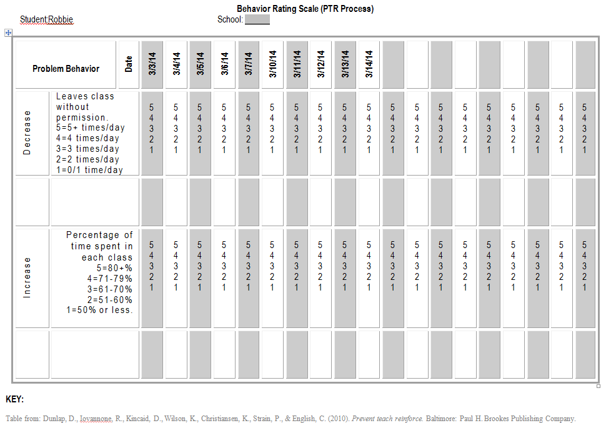

Slide 60
Creating IEP Goals- SECTION 5:
Creating the Benchmarks
For Case Study Student
Benchmark #:
Under what conditions | Who | Will Do What | At What Level | As Measured | By When
Annual Goal:
Format adapted from Diana Browning Wright, Behavior/Discipline Trainings, 2005

Slide 61
Demonstrating Congruency
Functional Behavior Assessment
Behavior Support Plan
Individual Education Program

Slide 62
Student Case Study Summary
Please be sure each area is filled out for your case study student.
Include school and contact name & email on last page.
Feedback will be provided electronically for your team’s use.

Slide 63
Thank you!
Please turn in Case Study form to project staff.
We appreciate your evaluation feedback.

