Slide 1

Tier 2 Networking
October 18, 2016
Agenda
Welcome
Big Picture Review of MTSS
Tier 2 Conversations
Tiered Fidelity Inventory
  Team
  Intervention
  Evaluation
Team Time and Action Planning

Slide 2
School-Wide Systems for Student Success:
A Response to Intervention (RtI) Model
Academic Systems
Behavioral Systems
Tier 3/Tertiary Interventions 1-5%
Individual students
Assessment-based
High intensity
1-5% Tier 3/Tertiary Interventions
        Individual students
        Assessment-based
        Intense, durable procedures
Tier 2/Secondary Interventions 5-15%
Some students (at-risk)
High efficiency
Rapid response
Small group interventions
Some individualizing
5-15% Tier 2/Secondary Interventions
        Some students (at-risk)
        High efficiency
        Rapid response
        Small group interventions
        Some individualizing
Tier 1/Universal Interventions 80-90%
All students
Preventive, proactive
80-90% Tier 1/Universal Interventions
        All settings, all students
        Preventive, proactive
Illinois PBIS Network, Revised May 15, 2008. Adapted from “What is school-wide PBS?” OSEP Technical Assistance Center on Positive Behavioral Interventions and Supports. Accessed at http://pbis.org/schoolwide.htm
Notes:
2

Slide 3
Teams Lead the Systems within a MTSS
School-wide
Team
Tier 2 Team(s)
Tier 3 Team
Identifies targeted student needs, selects relevant interventions; implements & evaluates interventions’ use
Uses Process data; determines overall intervention effectiveness
Plans SW & Class-wide supports
Universal Support through SW Program
Relationship-Building Interventions
Skill-Building Interventions
FBA/BSP
PTR
Person Centered Planning
Notes:
3
3

Slide 4
Teams Lead the Systems within a MTSS
Tier 2 Team(s)
Identifies targeted student needs, selects relevant interventions; implements & evaluates interventions’ use
System Conversations
Uses process data; evaluates overall effectiveness; does NOT involve discussion of individual students
Problem Solving Conversations
Matches students to interventions and monitors progress, making adjustments as needed
Problem-Solving
Systems
Notes:
4
4

Slide 5
Systems Development is KEY
Fixsen, Blase, Horner, & Sugai (2008)
To scale up interventions we must first scale up implementation capacity
Building implementation capacity is essential to maximizing the use of Positive Behavior Support and other innovations
Adapted from the Illinois PBIS Network

Slide 6
Recognition Process
Phase I- Developing a SWPBS System
Phase II- Establishing an Advanced SWPBS System
Phase III- Developing a Tier 2 Problem Solving Team with Tier 2 Interventions
Phase IV- Developing a Strong Tier 2 System

Slide 7
2015-16 Phase 3 Recipients
Phase III- Developing a Tier 2 Problem Solving Team with Tier 2 Interventions
School District | School Name
Brandywine | Carrcroft Elementary
Capital | Dover High
Christina | Wilson Elementary Gallaher Elementary Keene Elementary
Friend of Family | Brandywine Community
Milford | Lulu Ross Elementary
Red Clay | Marbrook Elementary

Slide 8
2015-16 Phase 4 Recipients
Phase IV- Developing a Strong Tier 2 System
School District | School Name
Appoquinimink | Brick Mill Elementary

Slide 9
16-17 SY Phase Recognition
Reminders
Distribution typically in January/February
Application entails end of the year program reflection
Recognition reflects CURRENT year effort; schools maintaining or advancing levels should apply yearly
Process should be a team effort
Application review - May

Slide 10


SWPBIS Tiered Fidelity Inventory
Self-Assessment Tool
  External coach/evaluator can help you to complete the tool
Tiers 1, 2, 3
30-60 min per tier
Facilitates action planning
Online portal to data summaries
  Total Score
  Subscale Scores
  Graphs
www.pbis.org/Common/Cms/files/pbisresources/2015_10_7_SWPBIS_Tiered_Fidelity_Inventory.pdf
Notes:
10

Slide 11
Tier 2 Sections:
Teams
Interventions
Evaluation

Slide 12
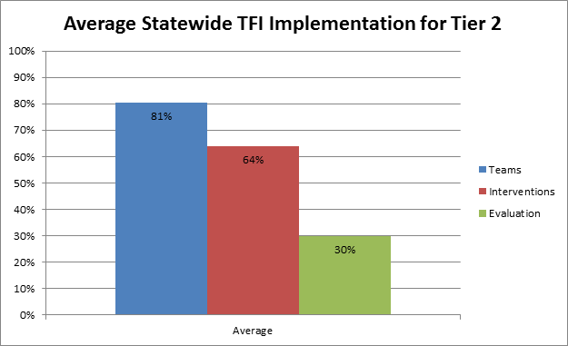
Current TFI Results – Aggregate Average Across 14 Schools Participants

Slide 13
Tier 2 System Conversation
Outcomes
Systems
Examining & addressing gaps in available Tier 2 interventions
Identifying interventions for implementation and that need refinement *
Determining percent of students successful in group interventions*
Identifying students for problem solving conversations*
* Data will guide yours systems team in these activities.

Slide 14
Tier 2 System Conversation
Logistics, Set Up and Monitoring
Systems
Team Operating Procedures (Logistics)
    Monthly meeting schedule
    Agenda, minutes, and use of meeting roles
System Set up Activities
    Develop process for identifying students for Tier 2 support
      Request for assistance
      Forms & data rules
Staffing
    Identification of coordinators & facilitators of existing interventions
    Identification of coordinators & facilitators of new interventions
Your Interventions
    Relationship- and Skill-Building
Communication:
    With staff, student, families
Ongoing Monitoring
    Develop system to monitor overall intervention effectiveness

Slide 15
TFI
Section 1: Teams
2.1 Team Composition
2.2 Team Operating Procedures
2.3 Screening
2.4 Request for Assistance

Slide 16
TFI Reflection - Teams
How are you identifying students for interventions?
What are your team structures?
  How are you having the two types of conversation?
What is going well and what are you looking to tweak?

Slide 17
Team Meeting Structure
Elementary Example
Team Leaders organize ahead of time:
All data
Meeting agenda
  Cumulative chart (tracker with dates, intervention type and designated staff)
Monthly meeting combines Tier 1 and 2
  Small # of students

Slide 18
Interventions

Slide 19
10 Critical Features of Tier 2 Interventions
Intervention linked directly to school wide expectations and/or academic goals.
Intervention can be modified based on assessment and/or outcome data
Intervention includes structured prompts for what to do in relevant situations.
Intervention results in students receiving positive and corrective feedback from staff (with emphasis on positive).
Intervention includes a school-home communication exchange system at least weekly.

Slide 20
10 Critical Features of Tier 2 Interventions
Orientation process and introduction to materials is provided for students as they begin the intervention
Orientation to and materials provided for staff/sub’s/volunteers who have students using the intervention. Ongoing information shared with staff.
Systematic attention to generalization and fading of supports.
Intervention continuously available for student participation.
Intervention is implemented within a few school days of determining the student is in need of the intervention.

Slide 21
How is academic success being addressed?
Relationship-Building Interventions
  For students:
    whose behavior is a function of seeking adult attention
    who “can do” appropriate behavior but typically “don’t do”
  Goal: to provide greater reinforcement for desired behaviors than is currently provided for undesired behavior
  If the student does not experience the interactions as positive and supportive, the intervention will not work!

Slide 22
Skill-Building Interventions
How is academic success being addressed?
Key features of successful relationship-building Interventions:
  Ongoing mentor training with structured activities
  Clear expectations regarding contact frequency
  Involvement of parents by communicating student goals (DuBois et al, 2002; cited in Hawken et al.)

Slide 23
Tier 2 Intervention – Big Ideas
  Interventions are efficient
    Continuously available so students can receive support quickly (within 2-3 days optimally)
  Minimal time commitment required from classroom teachers
  Required skill sets needed by teachers easily learned
  Aligned with school-wide expectations
  Emphasis on intervention designed to support multiple students simultaneously (e.g. Check-In/Check-Out, Social Skills Groups, etc.)
  Consistently implemented with most students, there can be some flexibility if needed (“Tier 2 plus”)
  Intervention selected matched to function of student behavior
Problem-Solving
Systems

Slide 24

Your Tier 2 Interventions
 |  |  | Decision Rules:
Intervention Name | Contact Name | Type (S/R) | In | On | Out
Notes:
24

Slide 25

Tell us about 1 intervention you feel is going well.
TFI Reflection - Interventions
What has been 1
successful intervention?

Slide 26
TFI
Section 2: Interventions
2.5 Options for Tier II
Interventions
2.6 Tier II Critical Features
2.7 Practice Matched to
Student Need
2.8 Access to Tier 1
Supports
2.9 Professional
Development

Slide 27
TFI Reflection - Interventions
What is…
1 strength
1 challenge
…you currently have?

Slide 28
Evaluation and data tracking

Slide 29
Tier 2 Problem-Solving Conversation
Individual Student Discussions
Problem-Solving
Discussing individual students identified for supports
  Review request for assistance from staff & home
  Review students identified via school-wide student outcome data
Matching students to existing interventions (examine function of behavior)
Individual Success Monitoring
  Identify need for increased supports
  Identify readiness for decreased supports
  Identify readiness for graduating from intervention

Slide 30
Tier 2 Problem-Solving Conversation
Logistics and Set Up
Problem-Solving
Meeting Schedules
  Meeting Monthly? Biweekly?
Problem-Solving Conversation Set Up
  Using meeting agenda? Norms?
Communication
  Talking with teachers? With Student? With Family?
Monitoring (On-Going)
  Establishing cycles?
Data-Based Decision-Making
  Looking at trends (and for how long)?
Individual Data Tracking
  Using data tracking system(s)?

Slide 31
TFI
Section 3: Evaluation
2.10 Level of Use
2.11 Student Performance Data
2.12 Fidelity Data
2.13 Annual Evaluation

Slide 32
TFI Reflection - Evaluation
What is…
1 strength
1 challenge
…you currently have?

Slide 33
Tracking Success of Targeted Interventions
  Define the goal(s) of the intervention
    If this intervention is successful for this group of students, what will they be doing that they are not doing now?
    Make these statements as behavioral, objective, and observable as possible
  Utilize a simple rating scale
    5 - Student’s behavior is well above expectations
    4 - Student’s behavior is above expectations
    3 - Student’s behavior meets expectations
    2 - Student’s behavior is below expectations
    1 - Student’s behavior is well below expectations
  Create a simple tracking sheet (see example)
Problem-Solving
Systems

Slide 34
Tracking Success of Targeted Interventions
Example: Lunch Bunch
  Define the goal(s) of the intervention
    Students will speak to each other in a conversational tone (”inside voice”)
    Students will listen to each other
      Eye contact with speaker
      Remain quiet until speaker has finished
    Students will take turns in games
    Students will show self-management of emotions
      Demonstrate calm when disappointed
      Express own needs appropriately
  The Lunch Bunch time should include active teaching of each of these skills (e.g., teaching “This is how we play games together.”)
Problem-Solving
Systems

Slide 35
Tracking Success of Targeted Interventions
Example: Lunch Bunch
Week 1
Student | Inside Voice | Listening | Taking Turns | Managing Emotions
Kirk | 1 | 3 | 3 | 1
Spock | 5 | 5 | 5 | 5
Uhura | 3 | 4 | 3 | 4
Sulu | 2 | 4 | 5 | 3
    5 - Student’s behavior is well above expectations
    4 - Student’s behavior is above expectations
    3 - Student’s behavior meets expectations
    2 - Student’s behavior is below expectations
    1 - Student’s behavior is well below expectations
Problem-Solving
Systems

Slide 36
Test of Adolescent Social Skills Knowledge (TAASK): Student Assessment
Tracking Success of Targeted Interventions
Example: PEERS Social Skills
Used to assess student’s social skill knowledge that is taught in the curriculum
Items derived from key elements in the didactic lessons
26 questions and takes approximately 5 minutes to complete

Slide 37
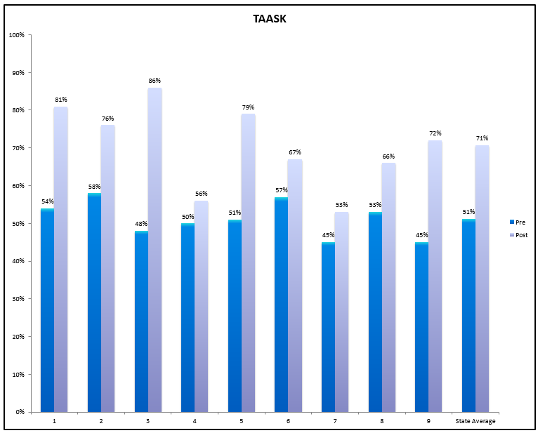
Tracking Success of Targeted Interventions
Example: PEERS ®
Test of Adolescent Social Skills Knowledge

Slide 38
PEERS Teacher Rating Scale
1 = The child almost never uses the skill
2 = The child seldom uses the skill
3 = The child sometimes uses the skill
4 = The child often uses the skill.
5 = The child almost always uses the skill
Skill | 1 | 2 | 3 | 4 | 5
Trades information with peers (e.g. asks the other person questions, answers their own question)
Has get togethers with peers
Conversation is two way
Chooses appropriate friends
Uses humor appropriately
Starts a conversation appropriately
Enters a group conversation appropriately
Exits a group conversation appropriately
Has good sportsmanship
Interacts with peers (e.g. talks to them, shares interests)
Handles arguments with others well
Maintains eye contact while talking with others

Slide 39


Additional Resources for Mentoring Programs
http://educationnorthwest.org/sites/default/files/resources/peer_book.pdf
http://educationnorthwest.org/sites/default/files/foundations.pdf

Slide 40


Thank You
for attending today’s PD Session!
Please finish and submit
your PD evaluation
before leaving today!
Project staff are available to talk
if you have any additional questions.

