Slide 1
DE-PBS Cadre Meeting
December 1, 2011

Slide 2
Overview of Meeting
School Climate Survey Updates
Organizational Tools
  Review PBS Notebook tool
  Working Smarter
  Team Problem Solving
Key Features Evaluation
Updates on Indicator 4 of the APR– Rates of Suspension and Expulsion
Memorandum of Understanding
Targeted Survey
Prevent Teach Reinforce and Self-Discipline follow up

Slide 3
2011-12 School Climate Participation
Total of 164 Schools Participating
From 18 School Districts and 4 Charter Schools
Student Survey: 151 Schools
Staff Survey: 161 Schools
Home Survey: 144 Schools

Slide 4
Notes:
Share new surveys – highlight the changes

Slide 5
Theme for the Day:
Help your teams become organized and efficient
The Planning Tools
Notebook Outline
Working Smarter
Monthly Calendar
DDRT Template
Meeting Minutes/Action Plan Form
Courtesy of S. Barrett – PBIS TA Ctr.
Notes:
We are not going to go over the DDRT again, but if anyone needs more help with it, let us know
Focus on items in teal blue
Big 5 Generator (Prompt to assign have data person on team that knows how and will pull this info)
Looking at tool to make improvements to our DDRT

Slide 6
SW PBS Team Notebook
Permanent Products Notebook
Working Notebook
Notes:
Review draft on website
Break into groups of three and review outline and site. Record on group form any recommended changes

Slide 7
Prepare for Working Smarter
(Not Harder)
Allows schools to identify the multiple committees within their school
Helps in identifying purposes, outcomes, target groups, and staff
Assists schools in addressing, evaluating, and restructuring committees and initiatives to address school improvement plan
Important for schools to identify that school-wide PBS is integrated into existing committees and initiatives
Courtesy of S. Barrett – PBIS TA Ctr.
Notes:
Linda
Our next activity is designed to identify committees in your school.
Is there overlap or duplication of effort?
Are many of the same people serving on different committees?
Working smarter not harder; how can we make this happen?
During the activity we’ll outline the committees on campus and identify the purpose of those committees
Who do they address?
Can some of these committees be collapsed, so that we have fewer committees but the same needs are addressed?
Are there committees that deserve added support?

Slide 8
Workgroup/ Committee/ Team | Outcome/Link to SIP | Who do we serve? What is the ticket in? | Names of Staff | Non-negotiable District Mandate? | How do we measure impact? | Overlap? Modify?
Attendance Committee |  | students | Junebug, Leo, Tom | yes | Attendance records | Yes-fold to SW PBS
SW PBS Team |  | Students staff | Ben, Tom, Lou | no | Office Referrals Attend, MIR, Nursing log ,climate | Yes- continue
Safety Committee |  | Students staff | Toni, Barb, Tom | no | Office Referrals BIG 5, climate | Yes-fold into SW PBS
School Spirit Committee |  | students | Tom | no | No | Yes-fold into SW PBS
Discipline Committee |  | students | Tom, Lou | no | Office Referrals | Yes-fold into SW PBS
Student Support Team/Problem Solving Team |  | students | Steve, Sue,Jon, Tom | yes | Discipline, DIBELS, FACTS… | No- continue
School Improvement |  | 1,2,3 | Bill, Jon, Lou, Tom | yes | All of the above | Yes- continue
Courtesy of S. Barrett – PBIS TA Ctr.
Notes:
8
We will have blank of this on the website under forms and tools in case you have any schools that can benefit

Slide 9
Being an Efficient PBS Team

Slide 10
Facilitate Effective Meetings:
Use Team Initiated Problem Solving
Need to conduct Team Training
  Team includes all members and a coach
  Define Roles and Responsibilities is critical
    Plan for absences (have back up people)
Coaching is critical
Training critical skills to facilitator, minute taker, and data analyst
  Keep people on track,
  document relevant information for progress monitoring and evaluation
  Launch the meeting with a data summary
Documenting decisions, actions, timelines, evaluation plan is critical for sustainability
Courtesy of S. Barrett – PBIS TA Ctr.

Slide 11
TIPS: Team Initiated Problem Solving using office discipline referral data
National Leadership Forum
Chicago, Illinois
October 2010
presented by Anne Todd & Katie Conley, UO
Developed by
Steve Newton, Anne Todd, Rob Horner, UO
Bob Algozzine, & Kate Algozzine, University of NC at Charlotte

Slide 12
Achieving a Precise Problem Statement for Fictional Trevor Test School
Middle School – Grades 6, 7, & 8
565 students

Slide 13
Trevor Test Middle School
Is there a problem? If so, what is it?

Slide 14
Trevor Test Middle School
Identified Problem
Identified problem
  for last 4 mos., Major ODRs per day higher than national avg.
  increasing trend across all 5 mos.

Slide 15
Trevor Test Middle School 11/01/2007 through 01/31/2008 (last 3 mos.)

Slide 16
Trevor Test
Logical Inferences Based on Big 4
Most Disruptions occur in Cafeteria
Most Disruptions occur in Cafeteria between 11:30 AM and 12:00 PM
Most instances Inappropriate Language occur in Cafeteria between 11:30 AM and 12:00 AM
Now…use a Custom Graph to confirm (or disconfirm) your inferences, starting with Disruptions, by grade level

Slide 17
Trevor Test
Precise Problem Statement
Many instances of disruption (what)…
occurring in cafeteria (where)…
between 11:30 AM and 12:00 PM (when)…
with large majority involving 6th graders (who)…
particularly Student #10 (who)

Slide 18
Beginning to Develop a Problem-Solving Action Plan
Write your precise Problem Statement as one element of your “Minutes and Problem-Solving Action Plan Form”
The P-S Action Plan is simply a record of
  team decisions and
  actions needed to implement the decisions
Here’s Problem Statement section of P-S Action Plan for Trevor Test Middle School

Slide 19
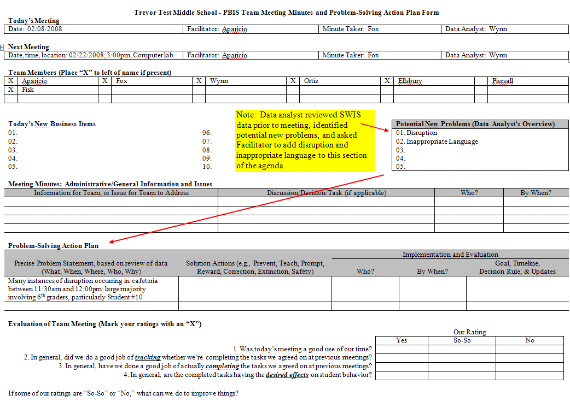

Slide 20
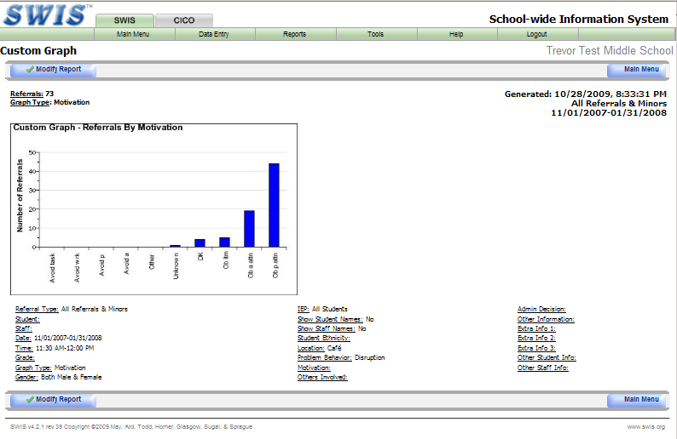

Slide 21
Trevor Test
Hypothesis Statement
Many instances of disruption occurring in cafeteria between 11:30 AM and 12:00 PM; large majority involving 6th graders, particularly Student #10…
because (a) cafeteria overcrowded at that time, (b) 6th graders have received insufficient instruction in cafeteria expectations, and (c) disruption results in attention from adults and peers
Here’s hypothesis statement incorporated into P-S Action Plan

Slide 22
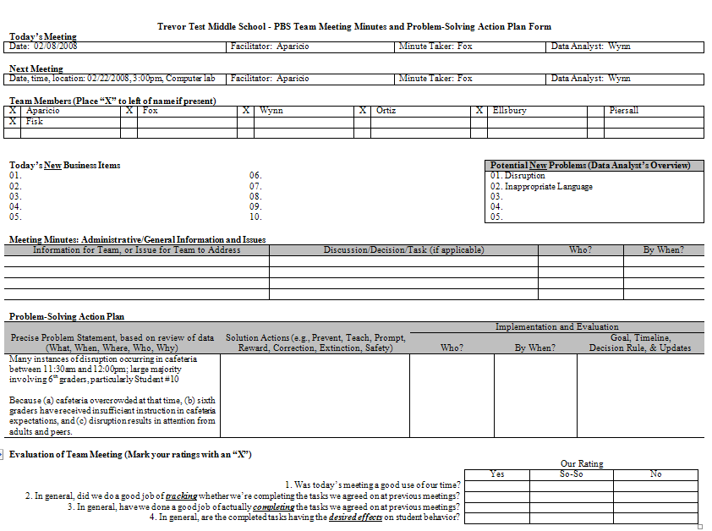
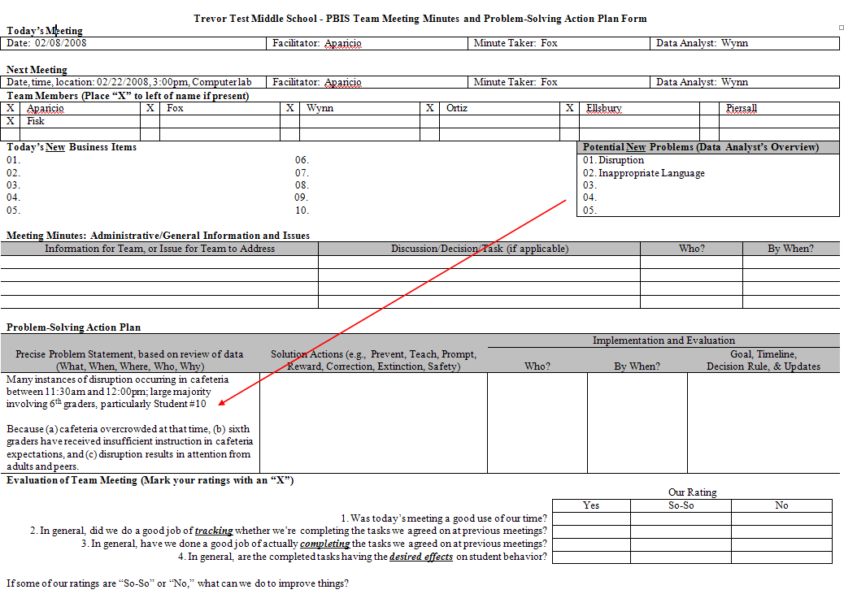

Slide 23
Hypothesis
Is best explanation for what the data and your experience tell you
Provides a possible “why” for other Ws you discovered
AND guides you toward possible solutions

Slide 24
Solutions – Generic Strategies
Prevent – Remove or alter “trigger” for problem behavior
Define & Teach – Define behavioral expectations; provide demonstration/instruction in expected behavior (alternative to problem behavior
Reward/reinforce – The expected/alternative behavior when it occurs; prompt for it, as necessary
Withhold reward/reinforcement – For the problem behavior, if possible (“Extinction”)
Use non-rewarding/non-reinforcing corrective consequences – When problem behavior occurs
Consider Safety issues

Slide 25
Trevor Test Middle School
Hypothesis - cafeteria overcrowded; 6th graders with insufficient instruction in cafeteria expectations; attention from adults and peers rewarding disruption
Prevent “Trigger”
Define & Teach
Reward/Reinforce
Withhold Reward
Corrective consequence
Other
Safety

Slide 26
Trevor Test Middle School
Hypothesis - cafeteria overcrowded; 6th graders with insufficient instruction in cafeteria expectations; attention from adults and peers rewarding disruption
Prevent “Trigger” | Change lunch schedule so fewer students are eating between 11:30 AM & 12:00 PM?
Define & Teach | Focus on 6th graders; define cafeteria expectations; develop and post expectation signage in cafeteria; demonstrate/teach expectations in class periods occurring just prior to lunch
Reward/Reinforce | Set up “Friday 5” (extra 5 mins. of lunch time on Friday, if no ODRs occur in cafeteria during lunch time)
Withhold Reward | Ensure staff don’t argue back and forth with student if instance of disruption occurs (may be an inadvertent reward); remind students that paying attention to a disruptive student can mess up Friday 5
Corrective consequence | Ensure active supervision during lunch (add one supervisor between 11:30 AM and 12:00 PM?); ensure quick corrective consequence, per our handbook
Other | Determine whether Behavior Support Program has been initiated for Student #10; if it has, make sure it includes focus on disruption in cafeteria
Safety

Slide 27
Monitoring and Evaluation
Fidelity
  Did we do what we said we would do?
    Make it simple
Student Outcomes
  Did our intervention produce the outcomes we were expecting
    Use the right data to answer the questions you are asking

Slide 28
DE-PBS Key Features Evaluation
School-wide Tier 1 - Program Development and Evaluation
  Data/problem solving
  Professional Development
  Resources
Implementing Schoolwide & Classroom Systems
  Prevention
  Expectations
  Acknowledgment
  SC & Safety
  Home School Collaboration
Developing Self-Discipline
Correcting Problem Behavior

Slide 29
Indicator 4

Slide 30
Memorandum of Understanding
Creates clear set of expectations
Ensures commitment before time and resources are committed

Slide 31
Targeted Survey and TA Session
  Survey to Cohort 1 schools (remove previous TA attendees)
  Those who meet basic implementation criteria will receive invitation for January TA session.
  January – 1/26/12 – ½ day AM in Dover

Slide 32
Prevent Teach Reinforce
Feedback from workshop
Plans for 6 facilitators
Idea for half day workshop on April 18th, 2012

Slide 33
Developing Self-Discipline Follow Up
Review of Action plans
Creation of online sharing platform
Part 2 - March 21 , 2012

Slide 34
Next Cadre Meeting
February 9th, 2012

