Slide 1
Understanding Office Discipline Referral Data

Slide 2
Steps of Data Collection, Analysis, and Use
Identify sources of information and data
Summarize/Organize Data
Continual Data Analysis
Build action plan based on data trends
Sources
Organize
Analysis
Action Plan
Notes:
Data isn’t a 4 letter word, though that may be our initial response.
Be careful of Need vs Want, though if you have too much you can always dissect it, but you cannot with too little………..
4 guiding principles:
-Use it for decision making
-Emphasize simplicity and efficiency
-Use it locally (the people who gather it in schools should use it, or see it used, on a regular basis)
-Design repeating cycles of data use (Ex: Teacher support team meets weekly, so should be weekly). Quarterly? Then at least quarterly.
Focus on a few key outcomes. Keep it simple.
Summarize it for decision makers, don’t let them summarize it for you, or at least not ALL of it.
-In general, data should generate questions. Large number of kids getting referrals in setting or with behavior – look at system.
-Few kids with a lot of referrals, look at kids.
Ask the crowd to ask questions about each slide to emphasize asking questions and seeking additional data
3 –
Identify areas of strength and progress
Identify areas for problem-solving and planning
4 –
Teaching issues? Need boosters, reteaching, cool – tools??
Reinforcement schedule? Check frequency, intensity, applicability
Type of Acknowledgements? Tangilble, verbal, internal, external
(elem prin lunch vs HS prin & lunch as reward)
Real root/function of the problem identified???

Slide 3
The Big Five
Sources
Average Referral/Day/Month
# of Referrals by Behavior
# of Referrals by Location
# of Referrals by Time of Day
# of Referrals by Student

Slide 4
The Big Five
Sources
Average Referral/Day/Month
# of Referrals by Behavior
# of Referrals by Location
# of Referrals by Time of Day
# of Referrals by Student

Slide 5
Average Referral Rate per Month
Organize
Notes:
- Change can be sustainable
- Harlan Elementary
- Shows sustainability over time

Slide 6
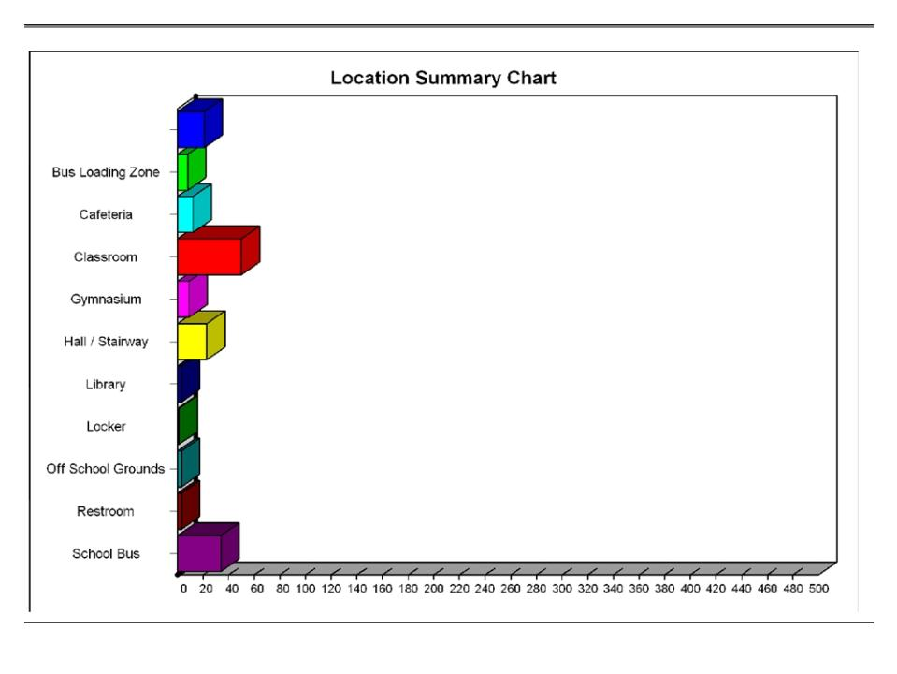
Organize

Slide 7
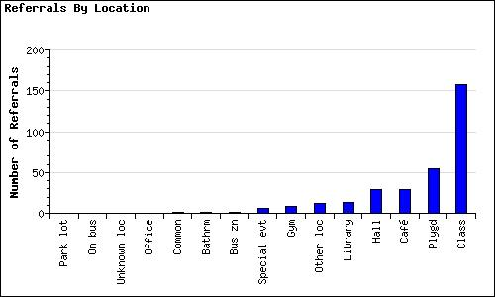
Organize
Notes:
Of course class is highest location – someone wanted to look at it as compared to amount of time students spend in each setting

Slide 8
Comparison by Location
Organize
Notes:
Look at the y-axis – can see what location they are having the most success in

Slide 9
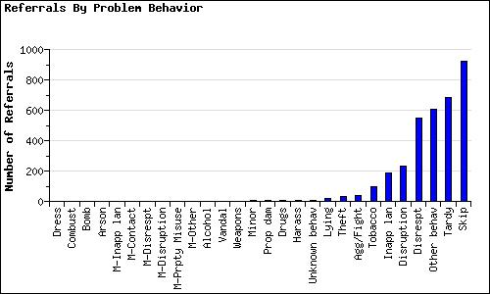
Organize
Notes:
Why so many “other behaviors”?
Do we need to re-teach definitions and come to agreement as staff?
Is “other behavior” being used for a special category?

Slide 10
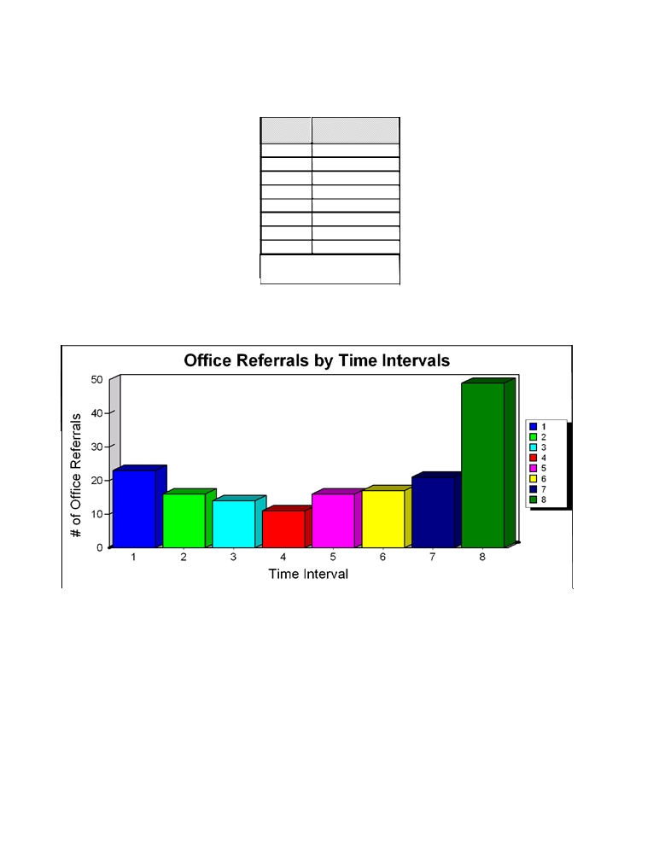
Organize
Incident
Count for
Time Code
Incident Code Time
1
23
2
16
3
14
4
11
5
16
6
17
7
21
8
49
Total: 167
Time Intervals:
0 = Time missing
1 = 07:00 - 07:59
2 = 08:00 - 08:59
3 = 09:00 - 09:59
4 = 10:00 - 10:59
5 = 11:00 - 11:59
6 = 12:00 - 12:59
7 = 13:00 - 13:59
8 = 14:00 - 14:59
9 = 15:00 - 15:59
10 = 16:00 - 16:59
11 = 17:00 - 17:59
12 = 18:00 - 18:59
13 = 19:00 - 19:59
14 = 20:00 - 20:59
15 = 21:00 - 21:59
16 = 22:00 - 22:59
17 = 23:00 - 23:59

Slide 11
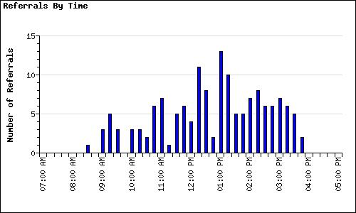
Organize

Slide 12
Referrals by Student
Organize
Total Enrollment | 327
# of Students with 0-1 | 247 | 76%
# of Students with 2-4 | 68 | 21%
# of Students with 6+ | 12 | 4%

Slide 13
Other Referral Information
Sources
# of referrals per Day of the Week
# of Suspensions (In-School and Out-of-School)
# of Referrals by Classroom
# of Referrals by Staff
# of Referrals compared to # of acknowledgments
Others?

Slide 14
Organize
Notes:
Extra graphs

Slide 15
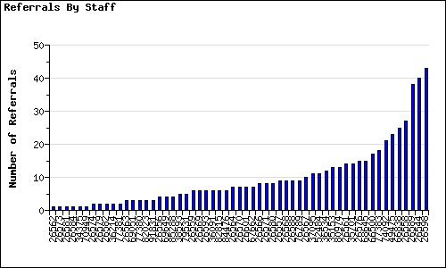
Organize
Notes:
Just as we look at the number of referrals per student, we can look at the number of referrals submitted per staff member.
What questions might you ask of the staff persons at the high end?
What role do they have in the school?
Who’s in their class? Do they have the red level students?
Data may indicate a staff member may need some assistance, professional development, mentoring, etc.
Careful with this one when sharing. Staff can be very sensitive, but there is valuable information here and can lead to good questions and discussions.

Slide 16
Organize
Notes:
This is another illustration on how you can choose to look at data.
This suspension data illustrates the number of events that resulted in out of school suspension and in school suspension, as well as the number of students that contributed to these events.

Slide 17
Organize
Notes:
Comparison of number of Acknowledgements given to number of level one’s
- Always look at 3 data points before making assumptions and decisions

Slide 18
Why Collect Data
Decision making
Professional accountability
Decisions made with data (information) are more likely to be (a) implemented, and (b) be effective
You won’t just be relying on a “hunch” to know if you are effective
Adapted from “Using Data for Decision-making”
Rob H. Horner, George Sugai, Teri Lewis-Palmer, & Anne W. Todd

Slide 19
Key Features of Data Systems That Work
The data are accurate
The data are easy to collect
Data are used for decision-making
The data must be available when decisions need to be made
The people who collect the data must see the information used for decision-making
Adapted from “Using Data for Decision-making”
Rob H. Horner, George Sugai, Teri Lewis-Palmer, & Anne W. Todd

Slide 20
What Data to Collect for Decision-Making
USE WHAT YOU HAVE
Office Discipline Referrals/Detentions - Measure of overall environment
Referrals are affected by:
  (a) student behavior
  (b) staff behavior
  (c) administrative context
Suspensions/Expulsions
Other Sources
Adapted from “Using Data for Decision-making”
Rob H. Horner, George Sugai, Teri Lewis-Palmer, & Anne W. Todd

