Slide 1
DE-PBS Cadre Meeting
Wednesday, May 9, 2012
Notes:
Linda or Sarah
Welcome
Solicit any updates from districts
Updates from project –
Staff
-welcome Melissa back to work – Congrats on the arrival of baby Elyse
-Megan – finishing work as graduate student this spring
-Kristin & Lindsey returning next year
Presented at NASP Conference and will present at Northeast PBIS Network Leadership Forum

Slide 2

DE-PBS Key Feature Evaluation
Notes:
Sarah
DE-PBS Key Feature Evaluation update
1. Instrument Review:
Share Evaluation – Show rubrics 1 & 3 (to illustrate structure and build understanding- 2&4 still have some questions to be worked out)
Share all of the interview questions
Score sheet for 1 & 3
Goal is to increase their understanding of the rubrics, questions, and scoring process

Slide 3
DE-PBS Key Feature Evaluation Summary
Aligned with Delaware’s Key Features of PBS
Goes beyond the basic SWPBS implementation
Focus is on highlighting areas of strength and providing feedback on areas for improvement; not on getting a “high score”
Provides qualitative information in combination with quantitative
Notes:
Sarah
In the summary, some highlights about our new evaluation tool.
Questions go beyond Yes-No responses
With finalization of the tool, we are looking to explore the use of Ipads to gather the data on site

Slide 4
DE-PBS Key Feature Evaluation Structure
SW PBS Tier 1: Program Development & Evaluation | Prevention: Implementing SW & CR Systems
Data Problem-Solving Teams Professional Development & Resources | Positive Relations Inclusive Planning & Implementation Expectations/Teaching
Correcting Problem Behavior | Developing Self Discipline
Notes:
Sarah
Initial development of a rubrics to flesh out each of the 10 DE-PBS Key Features
To better align with existing materials, we rearranged items from 10 rubrics to fall under 4 rubrics with the main categories from Part A – DASNPBS.
2 sections are more multifaceted and therefore have sub-headings

Slide 5
Evaluation Process
On-site Evaluation (approx. 3-4 hours)
Sources of Information:
Interviews with administrator, DE-PBS team leader, teachers/staff, and students
Review of documents
Schoolwide observations
Existing data: School Climate Surveys, DASNPBS, ODR
Notes:
Sarah
Discuss the sources of information & then how the rubrics are used
Approach & some items similar to SET process – a little longer (process is new + TL interview)
Interviewing staff and students during lunch hours (non-instructional time)
HANDOUT – interview questions
Review coding on questions

Slide 6
Products
SW PBS Tier 1: Program Development & Evaluation | Prevention: Implementing SW & CR Systems
List of PBS school team members and their roles Any materials delivered to all staff that include an overview of School-wide DE-PBS, and specifics of your school’s PBS program | School Improvement Plan – specifically goals related to PBS, reduced discipline referrals, suspension, improved school climate, etc. School Crisis Plan – Lockdown procedure Materials/plans used for teaching expectations to students Written Description of Acknowledgement System (Acknowledgement matrix model) Information about the SW PBS Program distributed to parents/families
Correcting Problem Behavior | Developing Self-Discipline
Documentation of Major (office managed) vs. Minor (classroom managed) Behavior Infractions Office Discipline Referral Form | The school's mission statement Schoolwide Behavioral Expectations
Notes:
Sarah
Product review – list of products we look at are shared ahead of time (encourage schools to have these ready)
Other products reviewed such as data, mission statement, expectations, etc.
Existing data – taking a look at cross comparing data sources for a school

Slide 7
Rubric 1: SW Tier 1-Program Development & Evaluation
Office Discipline Referral data are pulled by a designated person, reviewed monthly by the School-wide team, and shared with entire staff.
Source: Team Leader Interview - Q-3, 4, 5
3 | 2 | 1 | 0
Team Leader reports all of the following are done: Team has a designated data person to pull ODR data monthly. ODR data are reviewed monthly by team, and ODR data are shared at least 3 times with staff during the school year. | Team Leader reports 2 of 3 items listed in Column 1 are done. | Team Leader reports 1 of 3 items listed in Column 1 are done. | Team Leader reports none of the items listed in Column 1 are done.
1.4
Notes:
Sarah
Gather information through all these sources – get summarized across the rubrics
Look at Rubric 1
See Rubric 1 –
Orient to rubric structure –
ITEM summary → 3-2-1-0 → Source
This item is similar to the SET, but combines areas and adds in designated data person.

Slide 8
Rubric 2: Prevention: Implementing School-wide & Classroom Systems
Students are recognized for their good behavior (e.g., verbal praise, coupon, privilege), and can state the reason for the recognition.
Source: Student Interview – Q-2
3 | 2 | 1 | 0
90% or more of students interviewed stated they were recognized during the last week and why. | 80-89% of students interviewed. | 50-79% of students interviewed | Less than 50% of students interviewed
2.12
Notes:
Sarah
Example for Rubric 2 – not sharing rubric 2 because still under revision
This question also stems from Key Feature 3. Similar to SET, but includes the “WHY” component which we feel is very important that the students receive that message with their acknowledgement.

Slide 9
Rubric 3: Correcting Behavior Problems
Correction is viewed not just as use of punishment or consequences but also as opportunity to help develop social problem solving/decision making skills of self-discipline and prosocial behavior.
Source: Staff Interviews – Q – 8a
3 | 2 | 1 | 0
90% or more of teachers/staff interviewed respond that when a student is corrected for a behavior problem, the intervention includes (in addition to any punitive consequence or reinforcement system) strategies/techniques designed specifically to develop social problem solving/decision making skills | 80%-89% of teachers/staff interviewed | 60%-79% of teachers/staff interviewed | Less than 60% of teachers/staff interviewed
3.3
Notes:
Sarah
See rubric 3 handout
KF5. Correction is viewed not just as use of punishment or consequences but also as opportunity to help develop social problem solving/decision making skills of self-discipline and prosocial behavior.
*May or not be an ODR
When correcting misbehavior, what strategies or techniques do you use most often?
a. What are the most common strategies that you use to prevent the behavior from reoccurring? (looking for 3-5)

Slide 10
Rubric 4: Developing Self-Discipline
Social Emotional Lessons are infused throughout the school curriculum.
Source: Staff Question – Q - 6
3 | 2 | 1 | 0
90-100% of staff state that self-discipline concepts are part of lessons/curriculum and provide good examples. -OR- 90-100% cite a specific curriculum program (e.g. Second Step, Bullyproofing) that is used in the school in which self-discipline is developed and how/when teaching occurs. | 80-89% of staff state. | 60-79% of staff state. | Less than 60% of staff state.
4.2
Notes:
Sarah
See example, but rubric not shared
This area is not reflected on the SET, but an are of focus for DE.
Key Feature 4:
Staff Q: Q6(R4-F4) - Do teachers or other staff teach lessons that are intended to help develop social and emotional competencies such as empathy, perspective taking, respecting others, and social problem solving? If so, how is this done? When and where in the curriculum?

Slide 11
Scoring - Essential Items
The “Essential Item” scoring method was inspired by the ADOS scoring method
Schools will receive an overall score that falls within 3 range categories:
Not yet meeting criteria, Meeting criteria, Exceeding criteria
Scores will also be reflected in the four heading areas, thus, helping teams target areas for improvement and action planning.
Notes:
Sarah
Finalization of scoring still in process
ADOS: Autism Diagnostic Observation Schedule
No % score – no 100% - overall want to illustrate need & encourage room for program growth
Good to understand and emphasize that “Meeting criteria” is a good thing.

Slide 12
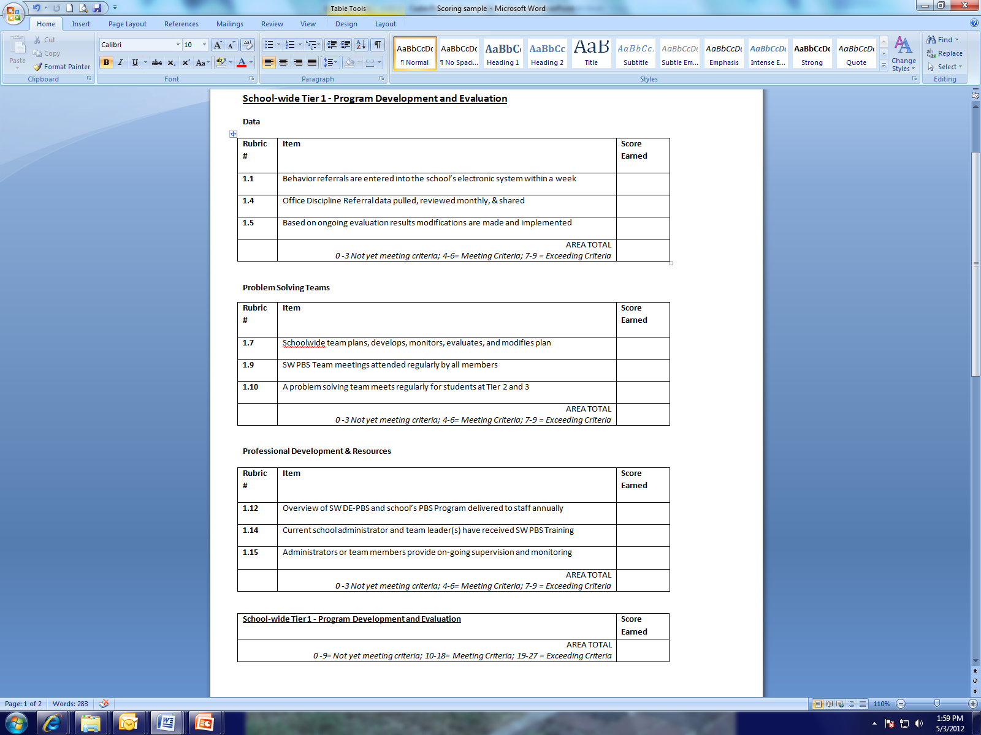
Notes:
Sarah
Receive numerical scores on Essential Items, but feedback on all questions asked.

Slide 13
Summary Report
School receives overall score, and score summary on essential items in 4 categories
Graph (future will include multiple years)
Narrative summary of evaluation information gathered
Highlight strengths
Note areas for improvement
Include recommendations for program improvements, professional development opportunities, and resources
Provided to school and district coach
Notes:
Sarah
Areas scoring a 3 (EI and non-EI) receive comment under strengths
Areas scoring 2-1-0 (EI & Non-EI) receive improvement notes
Playing with data component of report

Slide 14
Evaluation Schedule
Spring 2012 -- Contact with 11 schools
6 scheduled visits!
3 Winter Reponses
2 no response
2012-2013 SY
Late fall, winter, spring
Coaches’ role in process
Notes:
Sarah
Debby & Linda (help with 12-13 discussion)
2. Spring 2012 Review
Explain to group that we used their recommendations this spring
The pass process – what if a school does not respond?
This summer will explore number of evaluations possible and how to prioritize schools to visit
3. Discussion of coach role in process
Coaches may participate in the evaluation process as observers.
If the coach is present for the evaluation - appreciate support in connecting evaluators with education staff
Role in report review/support? Idea – plan to review at least 1 report with coach and team, then encourage coach to do the same for others; also willing to help for difficult cases

Slide 15
Professional Development
Notes:
Linda

Slide 16
April Event Debrief
Prevent Teach Reinforce – Part 2
DE-PBS Celebration
175 Attendees
4 school presentations
11 poster presentations
Classroom Management
130 Attendees
Notes:
Linda
NOTE: This slide repeats after PTR section so you can talk about Celebration and CM
PTR –
Refresh all on what this tier 3 training is, and how the coaching was done
Discuss plans for next year
Celebration –
Thanks to those schools presenting
Great evaluations of the day
Promote schools applying next year for oral and poster presentations
Share bookmarks & extra packets
Your thoughts for next year?
Classroom Management
How many coaches able to attend?
Thoughts about turn around of materials
Thinking about highlighting resources and sharing (distribute few ideas at a time)
Share extra booklets

Slide 17
Prevent-Teach-Reinforce: PTR
Intervention teams given manual and assigned PTR consultant – Rose Iovannone, Ph D
Five step process (aligned with problem solving process):
Teaming
Goal Setting (Identification of Problem)
Functional Assessment (Problem Analysis)
Intervention (Intervention Implementation)
Coaching and fidelity
Evaluation (Monitoring and Evaluation of RtI)
Notes:
Linda –
Research project funded by U.S. Department of Education, Institute of Education Sciences
University of South Florida
Three central Florida school districts
University of Colorado, Denver
Two Colorado school districts

Slide 18
Tier 3 Function-Based Behavior Interventions in Schools
Current Issues
Absence of uniform policies & practices
Form versus a process
Expert driven versus collaborative effort
Occasionally contextual fit considered
Limited support/follow-up/training for teacher provided
Teachers may not be the personnel to facilitate FBAs in schools
Increased focus on school psychologists (Scott & Kamps, 2007) and other school-based behavioral consultants or “coaches”
Notes:
Linda
Components of behavior support missing – function basis, instruction of replacement skills, progress monitoring and evaluation data

Slide 19
PTR Facilitator Coaching Process
Six ”facilitators” nominated by Special Ed Directors
Participated in PD sessions
November – PTR full day
April – ½ day interventions/ ½ day PTR Case Debrief
Coached to facilitate the PTR process with fidelity with a minimum of one student-centered campus-based team
Focus on collaborative consulting with school-based teams
Facilitators can increase the state’s capacity by becoming trainer-of-trainers and coaching other professionals to implement PTR with school-based teams
Notes:
Linda

Slide 20
PTR Facilitator Coaching Process
Coaching conducted at a distance using technology
Coaching activities:
Three to five individual coaching meetings:
Review process to be used prior to meeting with the team,
Review products
Debriefing meeting activities.
Bimonthly meetings (60-90 minutes each) to discuss implementation issues
Interactive presentation at the end of the year to debrief with facilitators, disseminate outcomes to other professionals, and provide advanced training in FBA processes related to multi-tiered supports
Notes:
Linda
The videos will show steps of the process (e.g., setting up a behavior progress monitoring tool, coming to consensus on a hypothesis, developing an intervention strategy). The videos will be used to determine use of collaborative skills as well as fidelity of implementation.

Slide 21
PTR Coaching Process Year 2
Plan to support current facilitators through Brief PTR process & Networking
Solicit additional facilitators for PD & Coaching
Provide resources to facilitators and teams
Boardmaker
Intervention supplies
Provide PTR professional development to additional participants
Notes:
May 14 Special Ed Leadership will solicit additional facilitators/ teams

Slide 22
April Event Debrief
Prevent Teach Reinforce – Part 2
DE-PBS Celebration
175 Attendees
4 school presentations
11 poster presentations
Classroom Management
130 Attendees
Notes:
Linda
PTR –
Refresh all on what this tier 3 training is, and how the coaching was done
Discuss plans for next year
Celebration –
Thanks to those schools presenting
Great evaluations of the day
Promote schools applying next year for oral and poster presentations
Share bookmarks & extra packets
Your thoughts for next year?
Classroom Management
How many coaches able to attend?
Thoughts about turn around of materials
Thinking about highlighting resources and sharing (distribute few ideas at a time)
Share extra booklets

Slide 23
School Climate Update
Participation for 2012
165 Schools State-wide
Teacher = 7225 respondents
Home= 15896 respondents
Student= 43520 respondents
Workshop on Understanding and Interpreting your School Climate data on May 23, 2012 in Dover
Recommend 2 staff from a participating school
Notes:
Linda
Surveys were updated this year, and reports are therefore different.
If schools cannot make the workshop, we send data electronically and by mail.
Coaches – great for you to attend to support your schools that are present, and especially to help your schools that are unable to send representation.
Have current attendance list on hand for review.

Slide 24
School-wide Team Training
June 18-19, 2012
Del-tech – Dover, DE
Required: representative team with administrator participation
Administrative commitment
Notes:
Linda
Teams can be previously trained, but are looking to regroup and revamp as a TEAM. Still plan to hold 1 day session in the fall.
If admin retreat effects attendance, admin must attend at least 1 day.
If you have not participating in 2 day training, or have teams attending, we encourage you to attend.
Handout: Share admin/school commitment draft

Slide 25
Future Professional Development
Looking at DASNPBS & other data for planning
Coaches continue to share feedback regarding school interest
Notes:
Linda

Slide 26

Reminders
Notes:
Sarah (or Debby)

Slide 27
Discipline Data Reporting Tool - DDRT
Excel Sheet: 2 or 4 year data tracking
Includes:
Average referral rate/month and per year
Year to year comparison
Referrals by Student – Triangle Graph
2010-2011 National Average Comparison
2010-2011 DELAWARE Average Comparison
DE-PBS Website- “Forms & Tools – Tier 1”
Data Collection
Year end data due June 29, 2012
Notes:
Sarah (or Debby)
We hope that the DDRT provides a quick way to gather summary data for use at the team and school-wide levels.
At the district and state levels, we would also like to use this information to guide professional development and technical assistance efforts.
Looking at state-wide data to provide summaries of DE-PBS schools so that you will be able to compare how your school is doing compared to other similar schools in DE.
Hope to answer the questions:
How does my school referral rate compare to other schools within the state? (by grade level is applicable)
Do schools experience similar trends in disciplinary referrals throughout the year as my school?
Please encourage schools to use and share. We want to collect again so that we can develop the 11-12 DE comparison table again.

Slide 28
DDRT
Notes:
Sarah (or Debby)
Screen shots incorporated to highlight what DDRT provides

Slide 29
DDRT
Notes:
Sarah (or Debby)
% of students with 0-1
% of students with 2-5
% of students with 6 +

Slide 30
DDRT
Notes:
Sarah (or Debby)
Tab 9
Check out your school's 2010-2011 Average Referral Rate per Month as compared to schools serving similar grades.
We can’t do this with out DDRT submissions

Slide 31
DE Assessment of Strengths and Needs for PBS (DASNPBS)
Part A (Tier 1) has 4 sections:
Program Development and Evaluation
SW and Classroom-wide Systems
Developing Self-Discipline
Correcting Problem Behavior
Available through end of school year
DE-PBS Website: “Forms and Tools-Tier 1”
Notes:
Sarah (or Debby)
Have list of schools participating this year to date
This is part of recognition
Option at Phase 1 (DASNPBS Or School Climate Staff Survey)
Required at Phase 2 (at least 1 section)
Coaches are cc’d on results being sent back to school. We recommend you follow up with a school shortly after receiving results to see if they need support understanding and using the data.

Slide 32
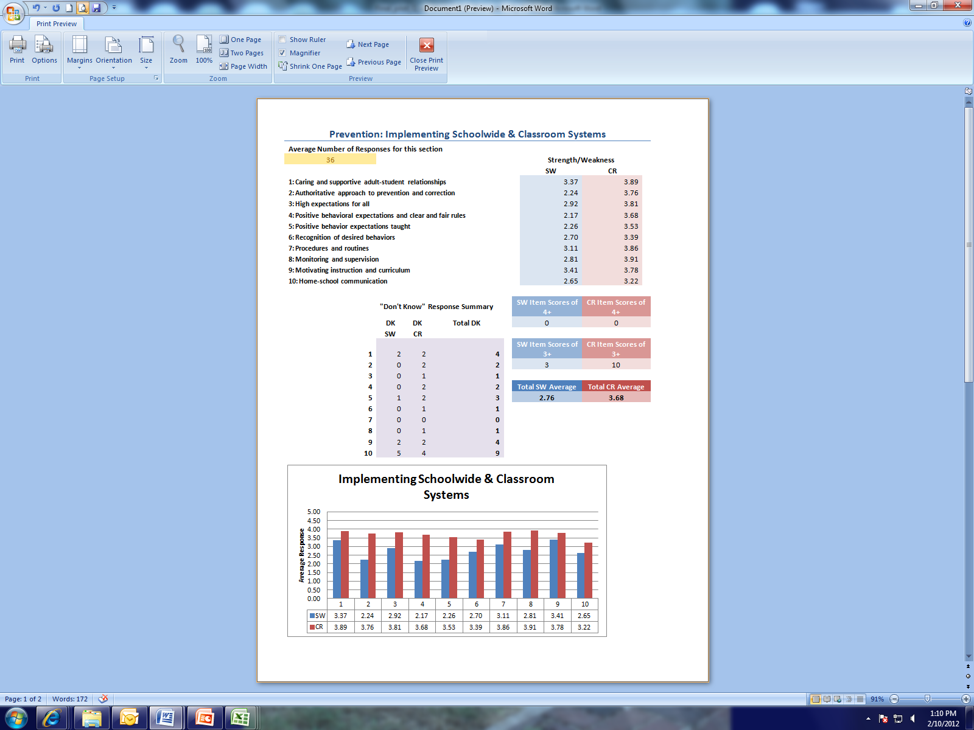
Notes:
Sarah (or Debby)
Summarize data for each participating school participating online
Provide data summaries & charts for each section completed
Compile summary of written comments
Excel summary provided with documents to support excel understanding and data interpretation

Slide 33
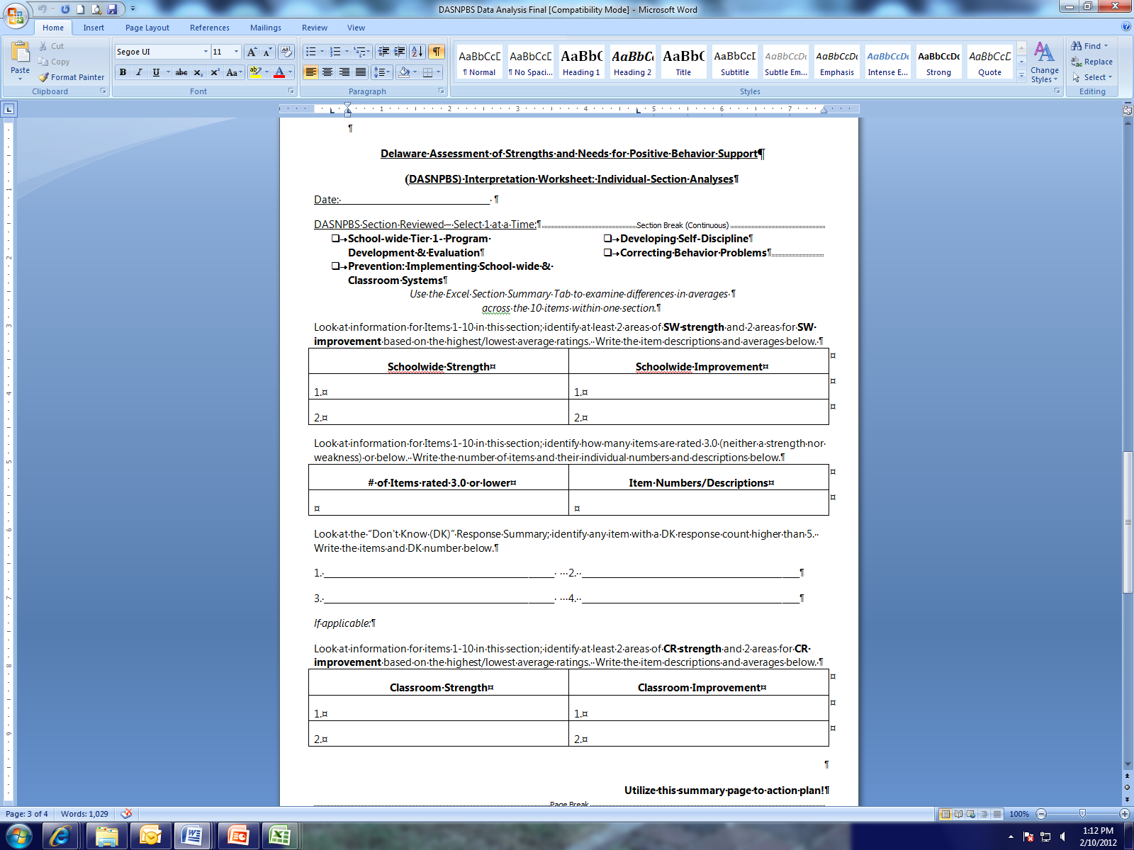
Notes:
Sarah (or Debby)
Example of data analysis worksheet to walk teams through pulling out strengths and areas for improvement to help focus their conversations and planning.

Slide 34

Phase 1 & 2 Recognition
Team process
Due June 29, 2012
DE-PBS Website: Recognition
Application
FAQ document
Reflection Question Guide
Banner addition discussion
Phase SWPBS 3: Basic Targeted Tier 2
Notes:
Sarah (or Debby)
We encourage your participation in the application process
Team process that should be started now, so it does not come down to 1 person completing the application on June 28th.
The reflection question guide is what our group uses when reviewing essays – encourage schools to use, and you can use if looking over a school’s responses
VIEW guide sheet (phase 1 & phase 2 – double sided purple sheet)
Great way to get information for the celebration
Bring banner & visuals for yearly additions
Discuss and get feedback on ideas for adding years at bottom
Discuss hold on phase 3 this year, plan to roll out phase 3 next year
-NA for Tier 2 & 3 not ready, and would be a part of moving into phase 3
-Wanted to see how PTR and Targeted cohort rolled out
-Overall didn’t want to rush to have phase 3 for this year, and then need to redo in future
SWPBS 1:
Basic SW Tier 1
SWPBS 2:
Advanced SW Tier 1
SWPBS 3:
Basic Targeted Tier 2
SWPBS 4:
Advanced Targeted Tier 2
SWPBS 5:
Intensive Tier 3

Slide 35
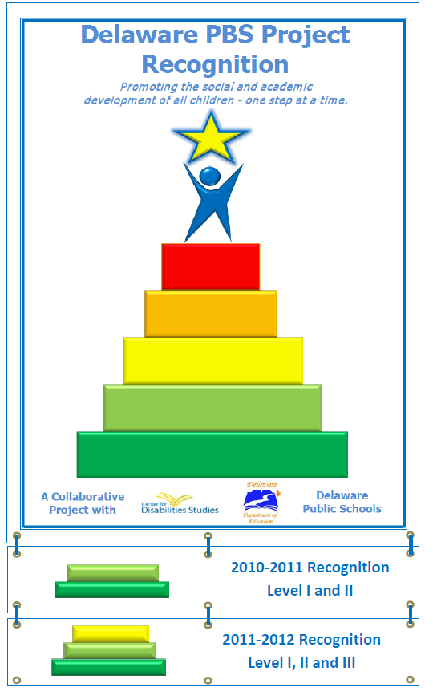
Notes:
Sarah (or Debby)
Feedback
SWPBS 1:
Basic SW Tier 1
SWPBS 2:
Advanced SW Tier 1
SWPBS 3:
Basic Targeted Tier 2
SWPBS 4:
Advanced Targeted Tier 2
SWPBS 5:
Intensive Tier 3

Slide 36
Bullying Prevention
Notes:
Sarah
District-wide efforts –
Brandywine
Christina
Share some materials (PBIS materials & BSD specifics)
Solicit info on what other districts are doing
Share this is a focus for the summer

Slide 37

Notes:
Sarah
PBIS Resources (Elem and Middle) are currently posted:
Forms & Tools
Tier 1
Additional Resources

Slide 38


Slide 39

Anti-Bullying Powerpoints
Detailed Anti-Bullying Presentations:
Identify DE DOE policies, procedures, and resources related to bullying
Provide a wealth of practical information for school personnel, including how to:
1) measure & identify bullying behaviors,
2) select the most appropriate anti-bullying programs for your school, and
3) coordinate anti-bullying efforts with students and parents
Educate students about bullying , specifically how to:
1) define a range of bullying behaviors, and
2) notify the school about bullying incidents they have witnessed and/or
experienced.
Notes:
Brandywine School District's Anti-Bullying Committee has developed plans to be implemented at the elementary, middle and high schools to empower our students to take a stand against bullying.
Materials on district site (also linked from school sites) for Students, Parents, and Staff
This slide represents Staff resources including powerpoints & policies & teaching materials

Slide 40
Anti-Bullying Documents
Age-appropriate posters for school hallways
Templates for staff and student reports of bullying
Anti-bullying contracts and pledges
Clear definitions of positive vs. negative behaviors
Tattling vs. telling
Sexual harassment vs. Flirting
Straight thinking vs. crooked thinking
Training documents for staff PD
Signs and symptoms of bullying to look for
Bully prevention matrices
Bully Prevention and Positive Behavior Support (Free ES and MS level text by Ross, Horner, and Stiller go to www.delawarepbs.org to download)

Slide 41
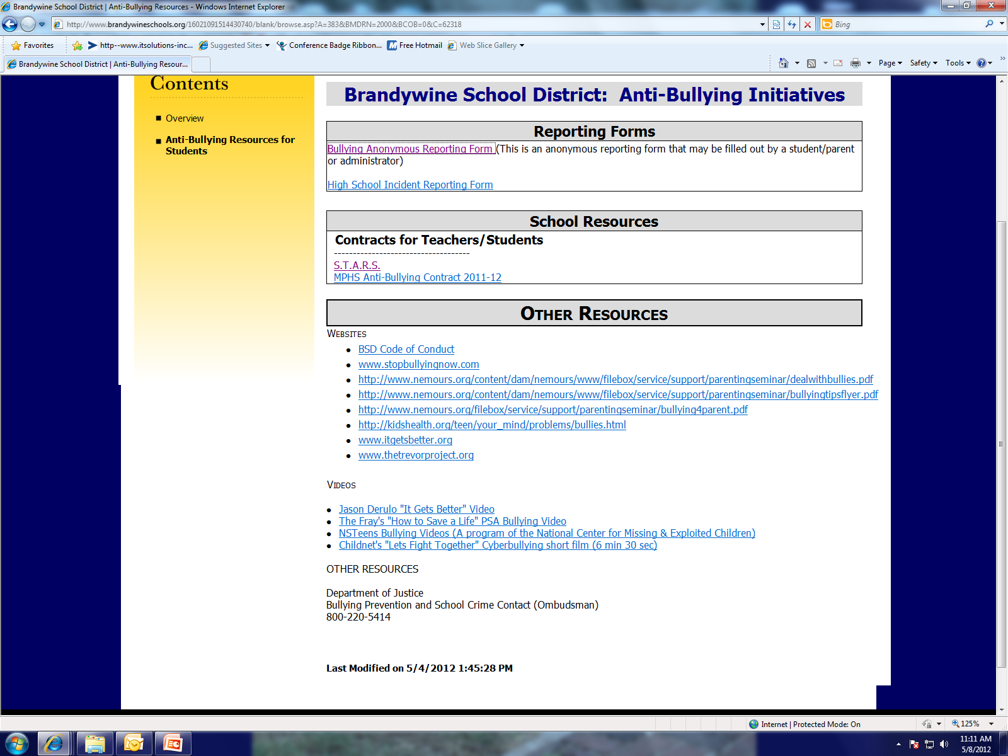
Notes:
Materials on district site for Students – including Bullying Anonymous Reporting Form
School we visited also had paper forms and drop box available to report bullying

Slide 42

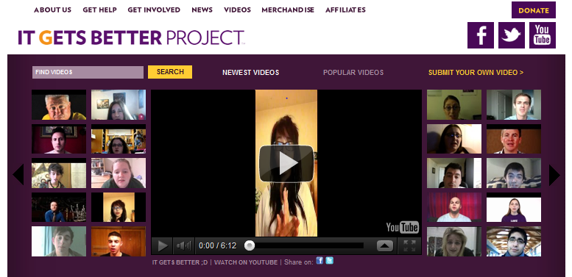

Links to Anti-Bullying Internet Resources
National Anti-Bullying Campaigns
Stop Bullying Now
The Trevor Project (for LGBTQ)
It Gets Better Project
Multi-Media Presentations

Slide 43

Notes:
http://www.christina.k12.de.us/BullyFreeSchools/index.htm
At school level – book study/PLC work on bully prevention

Slide 44
What’s going on in your district?
Notes:
District wide efforts?
School level efforts?

Slide 45
Coaching
End of the Year & Summer
Notes:
Sarah
Reminder of 4 areas discussed in February (PD, TA, Data, Sustainability) – note some end of the year/summer activities that fall under these categories for coaches
Share table again

Slide 46
Professional Development
Technical Assistance
Communicates (by personal email) scheduled statewide PD to team leaders
Coordinates substitutes for PD with DOE,
Attends PD sessions
Attends cadre meetings, shares information with team leaders, and follows up with required tasks
Meets with team leaders and/or building teams
Notes:
Sarah
PD:
What PD are your schools looking for?
Communicate about SW PBS
Not all involved in substitute paperwork in district but if so:
The Department of Education will provide substitute reimbursement. Please work closely with your Business Office, ask that they generate PFA and DPR007 forms, and forward them electronically to Beth Draper bdraper@doe.k12.de.us prior to June 1, 2012.
TA
Updates from today can be shared with your Team Leaders
End of the year or summer is a recommended time to meet with teams to discuss successes from the year, and plan for next SY
Ask if anyone would want to provide Feedback on project efforts on support tools – team implementation checklist? Calendar? Binder? Tier 2 & 3 needs assessment

Slide 47
Data
Sustainability
Communicates with teams regarding data
Needs Assessment
DDRT
School Climate
Knows how access data
Reviews monthly DDRT spreadsheets
Determines which schools are fully functioning PBS schools
Encourages PBS schools to continue to attend PD, to rotate roles within building teams
Provides feedback to DE-PBS Project about concerns, successes, and ideas
Notes:
Sarah
Data –
Lots of year end data to process
Support review, understanding and use of data
Sustainability –
Though contact get a sense of how schools are functioning
Encourages and supports school participation in new PBS external evaluation
Team leader turn over – help team talk about it
Plans to meet over the summer

Slide 48
THANK YOU!
Notes:
Linda
End of the SY thoughts – Maybe have all share something that has gone well for them in their coach role this year?
Wrap up
evals

