Slide 1



Building State or District Capacity for Evidence-Based FBA/BIP Process: Prevent-Teach-Reinforce
Rose Iovannone, USF
Linda marie smith-Delaware department of education
Tracy long neugebauer, Delaware department of education
Deborah boyer, Delaware positive behavior support project
The contents of this training were developed under grant H324P04003 from the Department of Education

Slide 2
Maximizing Your Session Participation
When Working In Your Team
Consider 4 questions:
Where are we in our implementation?
What do I hope to learn?
What did I learn?
What will I do with what I learned?

Slide 3
Where are you in the implementation process?
Adapted from Fixsen & Blase, 2005
Exploration & Adoption
Installation
Initial Implementation
We think we know what we need so we are planning to move forward (evidence-based)
Let’s make sure we’re ready to implement (capacity infrastructure)
Let’s give it a try & evaluate (demonstration)
Full Implementation
That worked, let’s do it for real and implement all tiers across all schools (investment)
Let’s make it our way of doing business & sustain implementation (institutionalized use)

Slide 4
Leadership Team Action Planning
Worksheets: Steps
  Self-Assessment: Accomplishments & Priorities
Leadership Team Action Planning Worksheet
  Session Assignments & Notes: High Priorities
Team Member Note-Taking Worksheet
  Action Planning: Enhancements & Improvements
Leadership Team Action Planning Worksheet

Slide 5
What is Prevent-Teach-Reinforce (PTR)?
  A standardized FBA/BIP process
  Subjected to a randomized controlled trial 2005-2009
  Compared to students who received “services as usual”
  Outcomes showed that PTR was more effective (significant and moderate effect size) than services as usual in:
    Decreasing problem behavior
    Increasing appropriate/replacement behaviors
    Increasing academic engaged time (see Iovannone et al., 2009)
  Teachers implemented behavior plans with high fidelity (>80%)
  Teachers rated PTR social validity as high (4.2 out of 5 point Likert Scale)
  Another RCT for PTR Young Children finishing up-same outcomes as PTR
  Two IES grants submitted—PTR Family and PTR Secondary

Slide 6
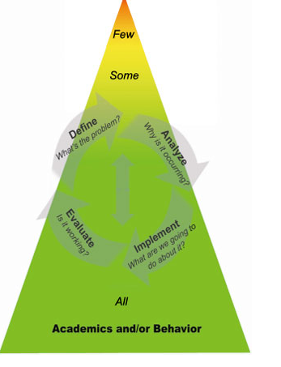
Where is PTR in a Multi-tiered System of Supports (MTSS)?

Slide 7
PTR Process
Intervention teams given manual and assigned PTR consultant
Four step process (aligned with problem solving process):
  Goal Setting (Identification of Problem)
  Functional Assessment (Problem Analysis)
  Intervention (Intervention Implementation)
    Coaching and fidelity
  Evaluation (Monitoring and Evaluation of RtI)

Slide 8
How is PTR Different?
Collaborative approach
  Facilitated by person with expertise in ABA principles and FBA/BIPs
Input systematically gathered from all team members
Behavior interventions selected from menu with facilitator ensuring link to hypothesis
Behavior interventions task analyzed and matched to teacher feasibility and skill
Coaching teacher to implement support plan part of process
Fidelity measures developed and collected
Problem-solving/decision-making based on data guidelines

Slide 9
Training Others
Facilitators/coaches
  Training is a job-embedded approach
  PTR overview provided to districts/states
  When possible, trainer provides an example of a PTR process with a real team in a district
  Districts/states select key people to be trained as facilitators/coaches
  Facilitators/coaches take a minimum of one team through the PTR process
  Facilitators/coaches receive TA from PTR researchers (e.g., Rose Iovannone, Don Kincaid, Glen Dunlap, Phil Strain)
Master Facilitators/Master Coaches
  Subset of individuals trained as facilitators selected
  Master Facilitators/Master Coaches select a peer/professional in district to train as a facilitator by using a modified behavioral skill training approach (provide content, model, observe facilitator/coach practice, provide feedback)
  Master Facilitator/Master Coaches receive TA from PTR researchers
  For more information on the tools used for MaFs and MCs, go to SESSION
  Or contact us to provide you with more information, forms
  Intensive PBIS-website coming in future

Slide 10
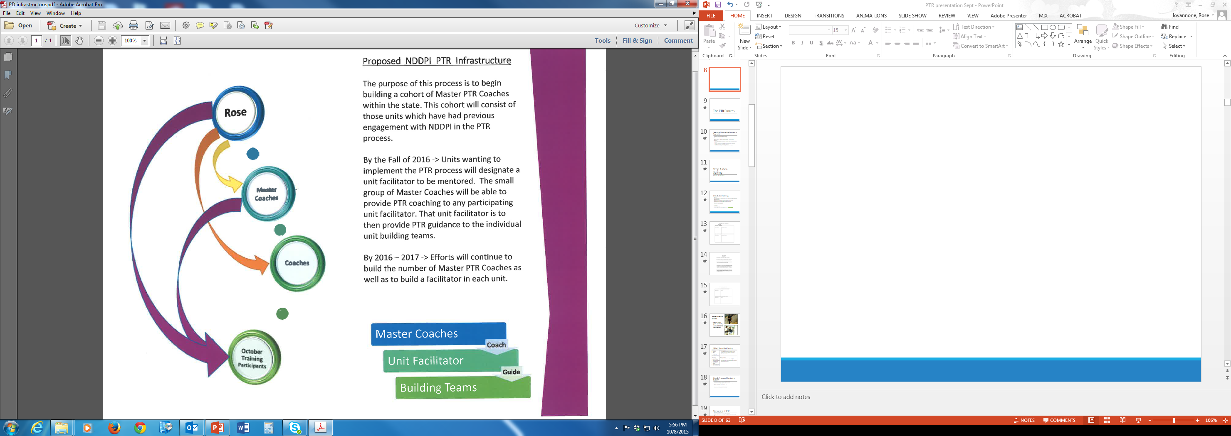

Slide 11
The PTR Process

Slide 12
Teaming (Before the Process is Started)
Teaming: A collaborative process
Determine relevant team members
Suggestions—3 levels of knowledge represented:
  Members
    Person with knowledge of student (e.g., Classroom teacher, instructional assistant, parent)
    Facilitator—Someone with knowledge of functional assessment, behavioral principles (PTR consultant, school-based consultant)
    Someone with knowledge of context (e.g., administrator or designee)

Slide 13
Step 1-Goal Setting
Identify the problem

Slide 14
Step 1: Goal Setting
Purpose:
  Identify behaviors of greatest concern to the team and possible replacement behaviors (teach)
  Prioritize and operationalize behaviors targeted for intervention
  Develop teacher friendly baseline data collection system
Areas that can be targeted:
  Problem behaviors
  Social skills
  Academic behaviors

Slide 15


Slide 16
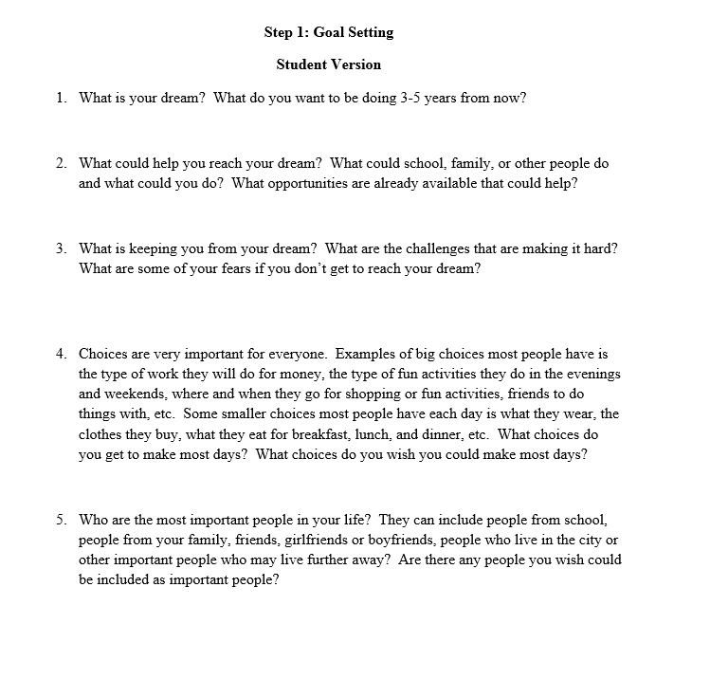

Slide 17
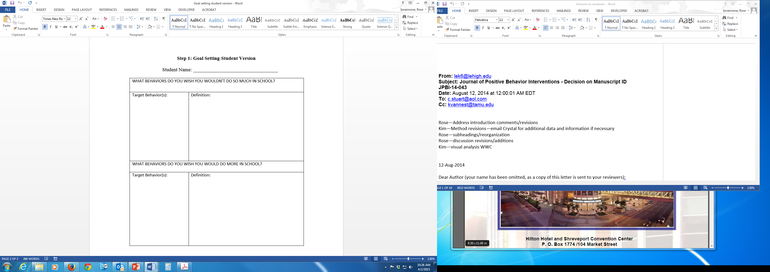

Slide 18
Mike’s Team-Goal Setting
BEHAVIORS TO DECREASE
Target Behavior: Screaming Hitting Getting out of seat Bossing peers | Operational Definition: Loud, high pitched noise heard outside the classroom Touching peers or adults with open hand, fist, foot, or object while screaming
BEHAVIORS TO INCREASE
Target Behavior: Transition from preferred to non-preferred activities Express frustration using his communication Ask for a break or attention Initiate peer interactions using communication | Operational Definition: Moving to non-preferred activity and engaging in communication at inside voice volume and pitch Use communication (voice output device, signs, pictures) to request a break or attention

Slide 19
Step 1: Progress Monitoring System
Individualized Behavior Rating Scale Tool – IBRST
  Direct Behavior Rating (DBR)—Hybrid assessment combining features of systematic direct observations and rating scales
  Efficient and feasible for teacher use
  Provides data for decisions
  Prioritized and defined behaviors measured
  Requires minimum of 1 appropriate and 1 inappropriate behavior

Slide 20
Components of IBRST
Scale—5 point foundation
  Can be flexible and add or subtract Likert scale points
  Can be creative and use columns/rows for different time periods/people, etc.
Key—Vital for teacher
  Definition of behavior
  Directions—over what time period of day will they be rating the behavior? What do each of the anchor points represent as perceptual estimates?
Practice
  After setting up, ask teacher to rate student’s behavior from earlier in the day or previous day
  Adjust if necessary

Slide 21
Case Study 1- Mike: Behavior Rating Scale
Behavior
Screaming | 9+ times 7-8 times 5-6 times 3-4 times 0-2 times | 5 4 3 2 1 | 5 4 3 2 1 | 5 4 3 2 1 | 5 4 3 2 1 | 5 4 3 2 1 | 5 4 3 2 1 | 5 4 3 2 1 | 5 4 3 2 1 | 5 4 3 2 1 | 5 4 3 2 1 | 5 4 3 2 1 | 5 4 3 2 1
Hitting | 8+ times 6-7 times 4-5 times 2-3 times 0-1 times | 5 4 3 2 1 | 5 4 3 2 1 | 5 4 3 2 1 | 5 4 3 2 1 | 5 4 3 2 1 | 5 4 3 2 1 | 5 4 3 2 1 | 5 4 3 2 1 | 5 4 3 2 1 | 5 4 3 2 1 | 5 4 3 2 1 | 5 4 3 2 1
Expressing Frustration | 40%+ 30-40% 20-30% 10-20% 0-10% | 5 4 3 2 1 | 5 4 3 2 1 | 5 4 3 2 1 | 5 4 3 2 1 | 5 4 3 2 1 | 5 4 3 2 1 | 5 4 3 2 1 | 5 4 3 2 1 | 5 4 3 2 1 | 5 4 3 2 1 | 5 4 3 2 1 | 5 4 3 2 1
Transition to Non-preferred | Whimper or squeal Louder than indoor voice Outdoor play voice Louder than outdoor play Ear penetrating | 5 4 3 2 1 | 5 4 3 2 1 | 5 4 3 2 1 | 5 4 3 2 1 | 5 4 3 2 1 | 5 4 3 2 1 | 5 4 3 2 1 | 5 4 3 2 1 | 5 4 3 2 1 | 5 4 3 2 1 | 5 4 3 2 1 | 5 4 3 2 1
01/15

Slide 22
IBRST—Key for Mike
Screaming: Loud, high-pitched noise heard outside the classroom. Rate your perception of Mike’s screaming episodes over the entire day. 5 = Terrible day; 4 = Typical bad day; 3 = So-So day; 2 = Good day; 1 = Fantastic day.
Hitting: Touching peers or adults with open hand, fist, foot, or object while screaming. Rate your perception of Mike’s hitting episodes over the entire day. 5 = Terrible day; 4 = Typical bad day; 3 = So-So day; 2 = Good day; 1 = Fantastic day.
Expressing frustration: Using communication (voice output device, signs, pictures) to request a break or attention. Rate your perception of the percentage of opportunities Mike used appropriate communication 5 = Fantastic day; 4 = Good day; 3 = So-so day; 2 = Typical bad day; 1 = Terrible day
Transition to non-preferred: Moving to non-preferred activity and engaging in communication at inside voice volume and pitch. Rate your perception of the overall intensity of Mike’s transitioning behaviors. 5 = Fantastic day; 4 = Good day; 3 = So-so day; 2 = Typical bad day; 1 = Terrible day

Slide 23
IBRST Psychometrics
Kappa coefficients of:
  Problem Behavior 1 (n = 105): .82
  Problem Behavior 2 (n = 90) : .77
  Appropriate Behavior 1 (n = 103): .65
  Appropriate Behavior 2 (n = 56): .76 (Iovannone, Greebaum, Wang, Kincaid, & Dunlap, 2014)
Convergent Validity
  In recent multiple baseline study,
    Problem Behavior-74% of ratings in exact agreement, 16% within one scaled score
    Appropriate Behavior-75% exact agreement, 14% within one scaled score.
  Cohen’s Kappa = 0.70 (p<0.001)
  Barnes, 2015

Slide 24
Step 2:
Functional behavior assessment
Analyze the Problem

Slide 25
Step 2: PTR Assessment (FBA)
Problem Analysis
PTR Assessment (FBA)
  Prevent: Antecedents/triggers of problem behavior
  Teach: Function(s) of problem behavior, possible replacement behaviors
  Reinforce: Consequences associated with problem behavior, possible reinforcers
Assessment form completed by each team member
Facilitator summarizes input on Assessment Summary Table and develops draft hypothesis
Team reaches consensus
Facilitator has conducted at least ONE direct observation of student and context prior to this step
25

Slide 26
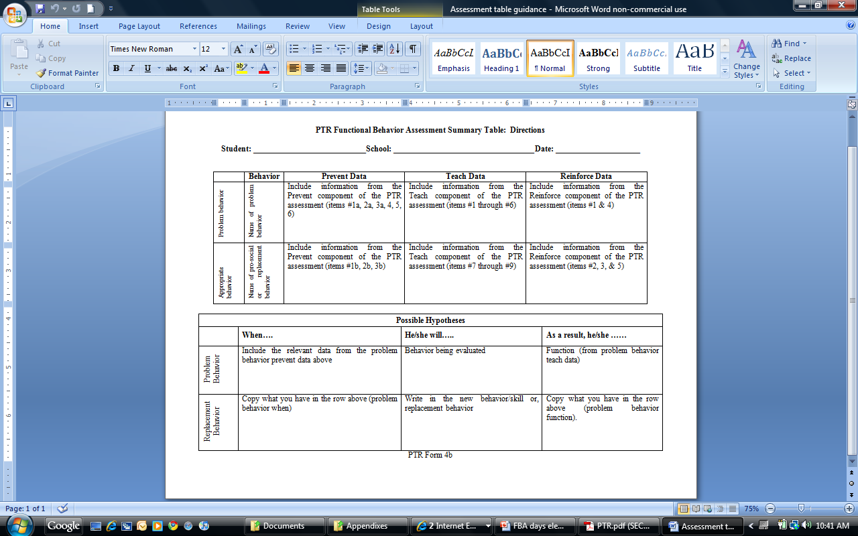
Completing the PTR Assessment Organization Table and Hypothesis

Slide 27
Step 2: Case Study – Mike
Assessment Summary Table of Problem Behavior
 | Antecedent/Prevention Data | Teach/Function Data | Consequences/ Reinforce Data
 | Non-preferred tasks Reading, Math—when in a group Other students upset/mad Teacher attending to others Transition Preferred (one-one) to non-preferred (group reading/math) Change in schedule Denied item, told no, or to fix something | Gain attention Peers, adults Delay Access to items | Redirected Reprimanded Calm/soothe Personal space Later must complete task Loss of or delay in reinforcement
Screaming, Hitting

Slide 28
Step 2: Case Study – Mike
Assessment Summary Table of Absence of Problem Behavior
 | Antecedent/ Prevention Data | Teach Data | Reinforce Data
 | Independent work One-on-one attention Specials | Peer interaction Getting attention Raising hand Sharing attention Conversation skills Taking turns Waiting Self-management Asking for break Expressing emotions | Treasure box Movie Attention Helping teacher Going to media center Going outside Walk Food
Absence of Screaming, HItting

Slide 29
Mike’s Hypotheses
 | When…. | he will | As a result…
 | 1. Mike is (a) asked to complete non-preferred tasks in small groups (Reading, Math), stop a preferred one-one activity or transition to a non-preferred group activity, or fix an error, or 2. When the teacher is attending to other students, | scream and hit. scream and hit | Mike (a) delays the transition or non-preferred activity and (b) gets attention from teachers and peers Mike gets attention from teachers and peers
 | 1. Mike is (a) asked to complete non-preferred tasks in small groups (Reading, Math), stop a preferred one-one activity or transition to a non-preferred group activity, or fix an error, or 2. When the teacher is attending to other students, | (a) express his frustration appropriately and (b) transition from preferred to non-preferred tasks Ask for attention | Mike (a) delays the transition or non-preferred activity and (b) gets attention from teachers and peers Mike gets attention from teachers and peers
Inappropriate
Appropriate

Slide 30
Step 3: PTR Intervention Plan
Developing and implementing an intervention

Slide 31
Behavior Intervention Plan Development: Essential Features
Behavior interventions selected by team from PTR Menu
Team/teacher provides description on how interventions will look in classroom setting
Facilitator guides the team/teacher by using ABA principles to develop most effective intervention that matches the team/teacher context
Each intervention selected is described in detail by task-analyzing steps, providing scripts, describing adult behaviors, NOT student behaviors
After plan developed, time is scheduled to train the team/teacher the strategies prior to implementation
Plans for training students and other relevant individuals
Support provided once plan is implemented

Slide 32
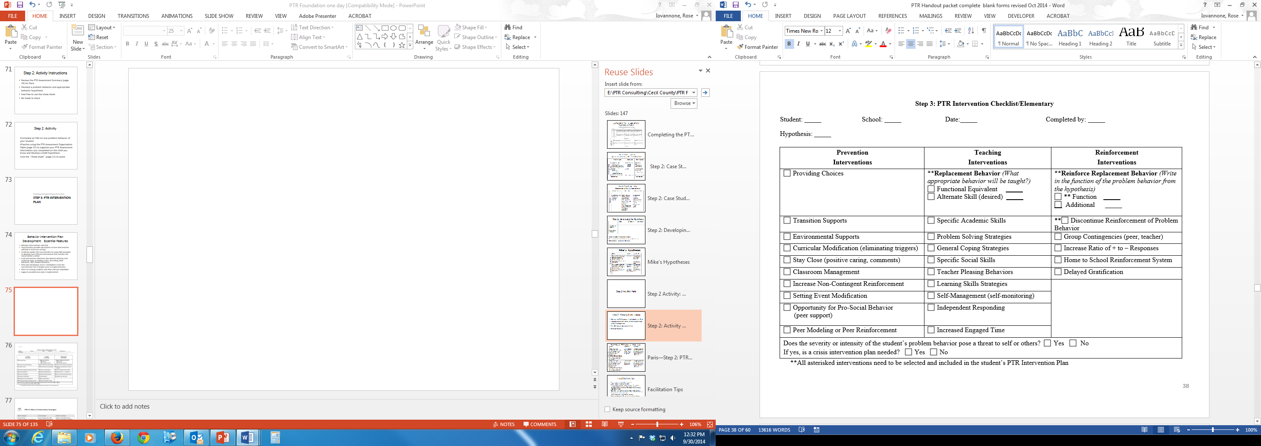

Slide 33
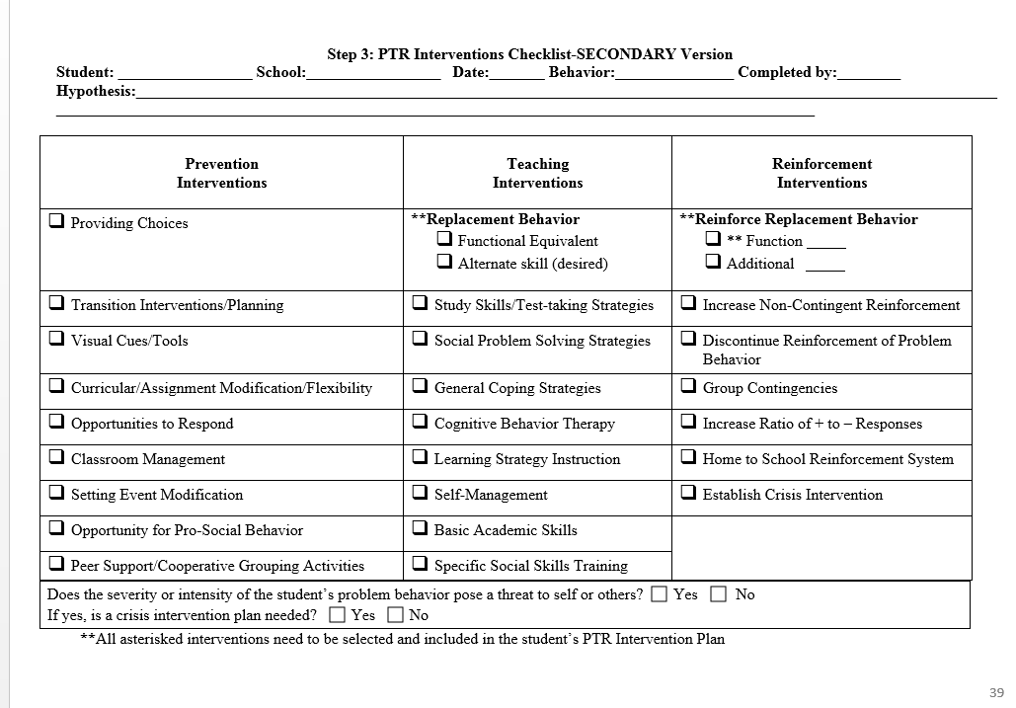

Slide 34
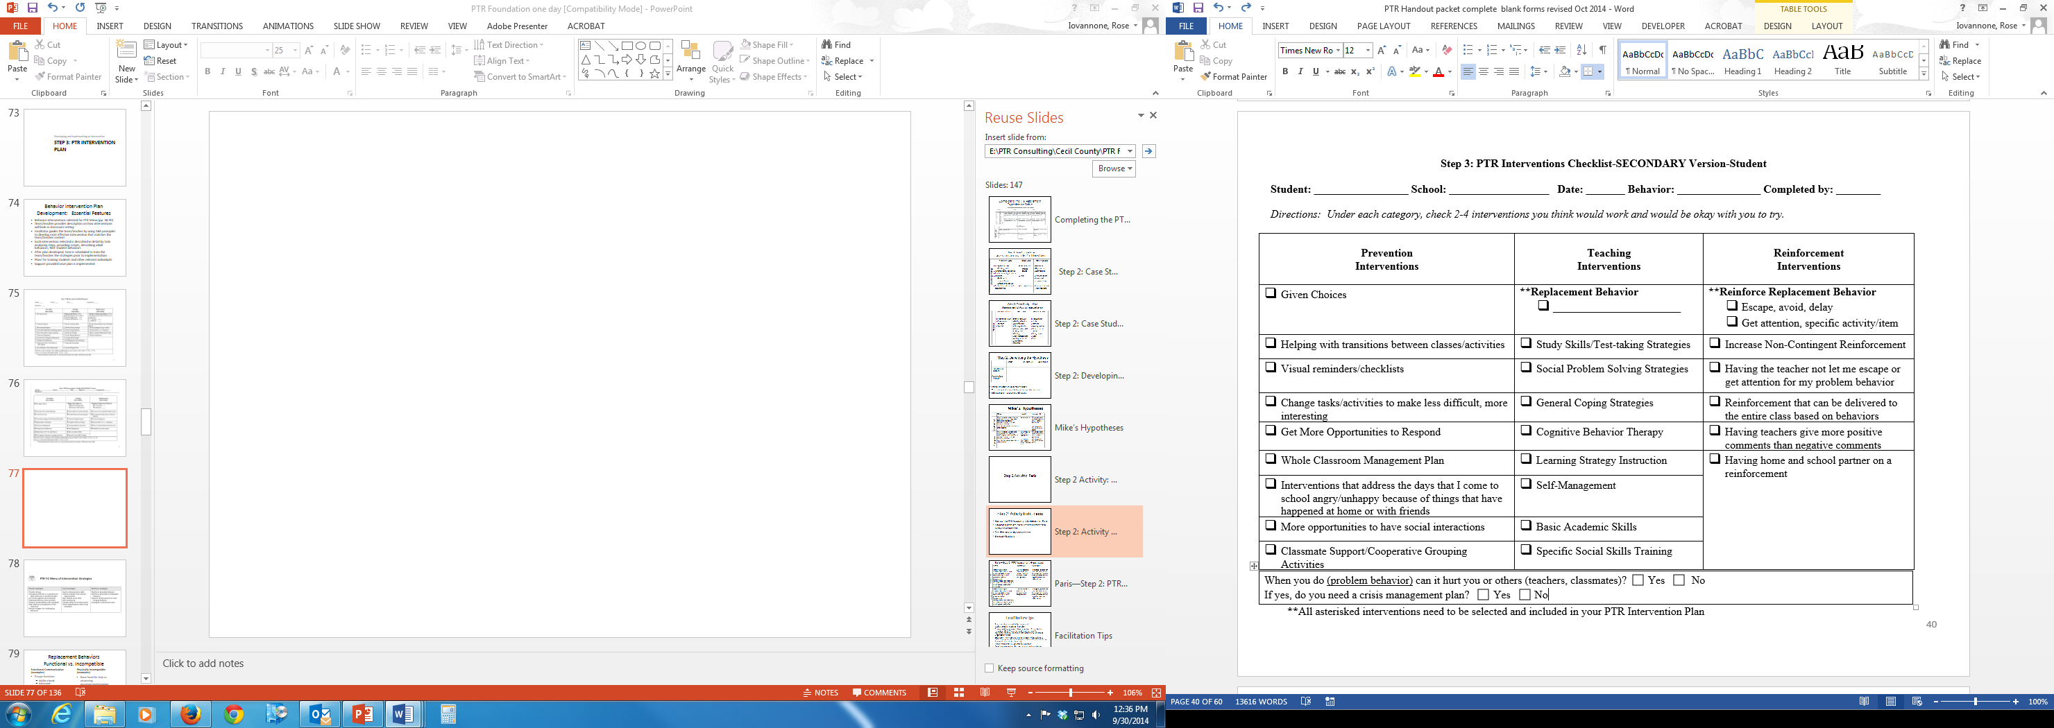

Slide 35
Writing the Intervention Plan
Task analyze each step of the plan
  Non-Example: Give student choices
  Example:
    Prior to the start of independent reading, tell the student, “We have 2 worksheets today.”
    Show student both worksheets
    Say, “Which worksheet would you like to do first?”
Teachers need to know exactly what to do or the intervention may not be implemented as intended.

Slide 36
Which One Will More Likely be Consistently Implemented?
BIP-Prevention Strategies
BIP-Prevention Strategies
OR
Provide choices of where to sit
Provide Choices: The teacher will provide Don with a choice immediately after assigning him independent work in class. Choice options are: (a) materials to use for assignment; choice of leadership activities; (b) where to sit; (c) who to do the assignment with
Steps for Provide Choices:
Immediately after giving the class the independent math assignment, go over to Don and present him with a choice option.
When presenting him with a choice, say “Don, where do you want to sit? X or X?”
After Don makes his choice, say, “Thanks for making a great choice” and release him to his choice.

Slide 37
Mike’s Intervention Plan
Prevent Strategies | Specific Strategy steps
Environmental Support | Mike’s visual schedule will be modified to detail the number of and type of activities he is to complete during non-preferred activities. For example, if math involves listening to a lesson, doing a hands-on activity, and completing a worksheet, his visual schedule will list each activity under math using either a picture of the type of activity or using numbers that correspond to a number on the worksheet. Environmental Support Steps: Each week, an adult will review Mike’s schedule and activities and ensure that the visual schedule matches the activities. Before a non-preferred activity, the teacher will review the visual schedule with Mike and the tasks he will do by reviewing the visual schedule and pointing to each task while describing it. After reviewing the schedule, the teacher will ask Mike some questions to make sure he knows the order of activities. The teacher will remind Mike that after he finishes each activity, he will put an X over it to show it is finished. After Mike completes each activity, the teacher (initially) will prompt Mike to place an X over the activity on his schedule.

Slide 38
Mike’s Intervention Plan
Prevent Strategies | Specific Strategy steps
Curricular Modification | Mike will be given an easy, independent activity, such as a worksheet, to complete upon transitioning to a non-preferred activity or an activity that requires him to wait, such as group activities. Curricular modification steps: At the beginning of each week, the teacher will identify the transitions that would be appropriate for the curricular modification strategy. Immediately after the transition signal for the specified transitions, the teacher will say “Mike, how about doing this __ first before going to __?” Wait for Mike to complete the activity. During this time, provide minimum attention (e.g., limited talking, eye contact) At the end of the activity, prompt Mike to transition (if he does not transition) or prompt him to use his replacement behavior (I need to calm down).

Slide 39
Mike’s Intervention Plan
Teach Strategies | Specific Steps
Replacement Behavior: Appropriately express his need to calm down | Mike will be taught to use his Dynamite to express his need to calm down. Replacement Behavior Steps: An adult will program Mike’s AAT device to say “I need to calm down.” A choice board will be built into the device by identifying 3-4 options from which Mike can select as his activity to calm down and identifying buttons to represent those choices. One minute before transitioning from a preferred to a non-preferred activity or at the end of a preferred activity (if the timer has not gone off), the teacher/adult will remind Mike to use his replacement behavior. “Remember, If you start to get mad when you go to X, you can tell us you need to calm down.” At the first sign of Mike beginning his screaming behavior (initial squeal), redirect Mike to use his replacement behavior by prompting him (most-to-least hierarchy) while saying “What do you need?” For example, initially the teacher will use physical prompting (hand-over-hand) to guide Mike in telling the adults that he needs to calm down. Once Mike communicates “I need to calm down”, present him with the choice board of calming strategies and ask him, “What do you want?” As soon as he is calm, praise him by saying “thank you for telling us what you need to calm down.”. Allow Mike to engage in his choice until he is calm for 1-min. If Mike does not return to his area, then start having a fun time in that area with those students present

Slide 40
Mike’s Intervention Plan
Reinforce Strategies | Specific Steps
Replacement Behavior: Appropriately express his need to calm down | Whenever Mike ‘says’, “I need to calm down”, give him the choice board, praise him for using his communication, and release him to his choice. Immediately after Mike indicates he needs to calm down, ask him “What do you want?” while showing the choices. Immediately after Mike makes his choice, say “Thank you for telling us what you need.” Depending upon his choice, release him or provide him with the selection. When he makes his transition, praise him (with a warm tone) for returning to the group; “thank you for coming over.”
Discontinue reinforcing problem behavior | Minimal attention will be provided to Mike when he is calming down and when he is starting to scream. Steps: As soon as Mike begins to show signs for screaming, the adult will immediately prompt Mike to say he needs to calm down by presenting the device and saying “What do you need?”. If necessary, provide physical or partial physical prompting to have Mike say what he needs. Immediately after Mike says “I need to calm down”, present the choice board and ask him “What do you want?”. Provide positive praise for Mike saying what he needs, “thank you for telling us what you need.” Allow him to engage in his choice for one minute.

Slide 41
Coaching/Fidelity

Slide 42
Teacher Coaching
Teacher and Staff Training
  Initial training with no students present
    30 -90 minutes
  Model, Role Play,
  Q & A, Discussion
Coaching/Fidelity Checklist
  Used by PTR Consultant for training evaluation
  Evaluate teacher accuracy on each step prior to implementation with student
  Comfort and competence measured
  Can also be used as fidelity measure after intervention is implemented

Slide 43
Mike: Coaching/Fidelity

Slide 44
Step 3: In-Class Support
Provide support to teacher in implementation
  Be present on first day of implementation
  Determine when to debrief
  Measure fidelity
  Discuss and modify if necessary

Slide 45
Step 4: Progress Monitoring

Slide 46
Step 4: Evaluation
Progress Monitoring
Data-Based Problem-Solving
  What is working? What is not working?
  What changes need to be made?
  Is more data needed? (additional data collection measures)
Implementation Fidelity Data
  Is the plan being implemented consistently and accurately?
Student outcome data
  Is the problem behavior decreasing? Is the replacement behavior increasing?
Next step decisions based on data-Decisions may include:
  Expand the plan/generalize
  Intensify the plan
  Fade components of the plan
  Identify another behavior to address
  Gather more information to analyze the problem

Slide 47


Slide 48
Step 5: Mike Evaluation
Intervention changed

Slide 49
Step 5: Evaluation

Slide 50
Step 5: Evaluation

Slide 51
Step 5: Evaluation

Slide 52
PTR Publications
PTR Manual
  Dunlap, G., Iovannone, R., Kincaid, D., Wilson, K., Christiansen, K., Strain, P., & English, C., 2010. Prevent-Teach-Reinforce: The School-Based Model of Individualized Positive Behavior Support. Baltimore: Paul H. Brookes.
Journal Articles
  Iovannone, R., Greenbaum, P., Wei, W., Kincaid, D., Dunlap, G., & Strain, P. (2009). Randomized controlled trial of a tertiary behavior intervention for students with problem behaviors: Preliminary outcomes. Journal of Emotional and Behavioral Disorders, 17, 213-225.
  Dunlap, G., Iovannone, R., Wilson, K., Strain, P., & Kincaid, D. (2010). Prevent-Teach-Reinforce: A standardized model of school-based behavioral intervention. Journal of Positive Behavior Interventions, 12, 9-22
  Strain, P. S., Wilson, K., & Dunlap, G. (2011). Prevent-Teach-Reinforce: Addressing problem behaviors of students with autism in general education classroom. Behavior Disorders, 36, 160-171.
  Iovannone, R., Greenbaum, P., Wang, W., Kincaid, D, & Dunlap, G. (2014). Inter-rater agreement of the Individualized Behavior Rating Scale Tool (IBRS-T). Effective Assessment for Intervention, 39, 195-207.
  Sears, K. M., Blair, K. S. C., Iovannone, R. & Crosland, K., (2013). Using the Prevent-Teach-Reinforce model with families of young children with ASD. Journal of Autism and Developmental Disabilities, 43, 1005-1016.
  Iovannone, R., Anderson, C., & Scott, T. (2013). Power and control: Useful functions or explanatory fictions? Beyond Behavior, 22, 3-6.

Slide 53


Building Delaware’s Capacity for
Evidence-based FBA/BIP Process: Prevent-Teach-Reinforce
Debby Boyer and Linda Marie Smith
DE-PBS Project Co-Directors
University of Delaware’s Center for Disabilities Studies
DE Department of Education
October 23, 2015

Slide 54

DE-PBS Recycles!
PTR materials used with permission of
Rose Iovannone, Ph.D.

Slide 55
DE-PBS Project
DE-PBS Project is a collaborative partnership between the
Delaware Department of Education,
University of Delaware’s Center for Disabilities Studies, and
Delaware Public Schools

Slide 56
Delaware’s strategies

Slide 57
PTR in Delaware
Piloted through DE-PBS Project
Adopted by DE DOE as Tier 3 intervention for districts/ schools with noncompliance
Expanded through DE DOE’s State Personnel Development Grant (SPDG)
DE-PBS Project Coaches use PTR process with Delaware adaptations

Slide 58


Step 1: Identify the Problem
High rates of student suspension with significant discrepancy between general and special ed
Noncompliance issues with special education regulations
Lack of systemized, tiered behavior supports
Ineffective practices across general and special education
Difficulty with/ inadequate data collection and progress monitoring processes
Perspectives
DE DOE
DE-PBS Project
Districts
Schools
Families
Students

Slide 59
Step 1: Identify the Problem
Perspectives
DE DOE
DE-PBS Project
Districts
Schools
Families
Students
Expert model contributed to lack of teacher buy in or difficulty with implementation
Interventions not meaningful or effective – lack of student buy in
Inadequate resources and organizational support
Struggles with sustainability

Slide 60
Step 1: Goal Setting
Through professional development, coaching, and technical assistance, build DE educators’ knowledge and skills in a team-based problem solving process, leading to development of effective, function-based intervention plans, implemented with fidelity, within multi-tiered systems of support.

Slide 61



Overview of PTR Process
What we like about it!
Teacher, parent and team driven
Prescriptive/manualized process
Four-step team-based process
  Optional pre-step regarding teaming
Every intervention plan includes 3 components
  Prevent
  Teach
  Reinforce
Plans are task analyzed
Attention to supports for teacher/team to implement interventions

Slide 62

Step 2: Problem Analysis
Getting to the root
of the problem…
Need for….
Problem-solving process
Collaborative teams
Identified predictors
Progress monitoring
Data-based decisions
Intervention plan linked to hypothesis
Clearly defined behaviors
Fidelity measurement
Changed responses to behaviors

Slide 63

Step 3: PD and Coaching Plan
Facilitators (and their team) participate in full day workshop on PTR process in fall
Coaching for at least one student case by Dr. Rose Iovannone
Coaching support includes:
  Review of documents completed in the process
  Written feedback
  Individual coaching calls to discuss and plan for next steps
  Group conference calls for sharing experiences and problem-solve any challenges in implementation
Second, half-day workshop in spring focused on interventions
Afternoon networking session where facilitators share cases

Slide 64
Why Practice-Based Coaching?
Focuses on mentoring/teaching skills to other professionals
Develops ongoing coaching relationship to:
  Build and refine existing skills and/or acquire new skills (individual and group)
  Support person or group’s ability to apply new knowledge
Uses problem solving method with focus on data to inform practice (individual and group)
Continuous improvement: encourage, recognize, shape
Goal is to build capacity of other FBA/BIP facilitators to conduct an evidence-based team-driven process
Note: It is not a fix for professionals with performance issues

Slide 65
Step 3 Teacher Coaching:
Often a missing link
Teacher and Staff Training on plan
  Initial training with no students present Model, Role Play, Q & A, Discussion
Fidelity Checklist
Used by PTR Consultant for training evaluation
  Evaluate teacher accuracy on each step prior to implementation with student
  Comfort and competence measured

Slide 66
Teacher Coaching Steps
Facilitator introduces coaching form,
  e.g., “We’re going to go over the steps of the behavior plan strategies to make sure they are still making sense to you and are things that can be done by you in your classroom. If there is anything that you feel isn’t going to work, we can make changes today.”
Several methods for coaching the teacher. Can choose one method, combination of two, or all three:
  Discussion—facilitator asks teacher to verbally describe (in his or her own words) each of the interventions.
    Ensures teacher describes each step of the intervention
    Teacher can refer to coaching form to cue core steps
  Q & A—facilitator asks teacher questions about strategies.
    For example, choice-making “When are you going to offer the choices to X?”; “What kind of choices will you offer X?”; etc.
  Role Play (preferred method)-facilitator plays role of student and asks teacher to perform plan steps as they would with student.

Slide 67
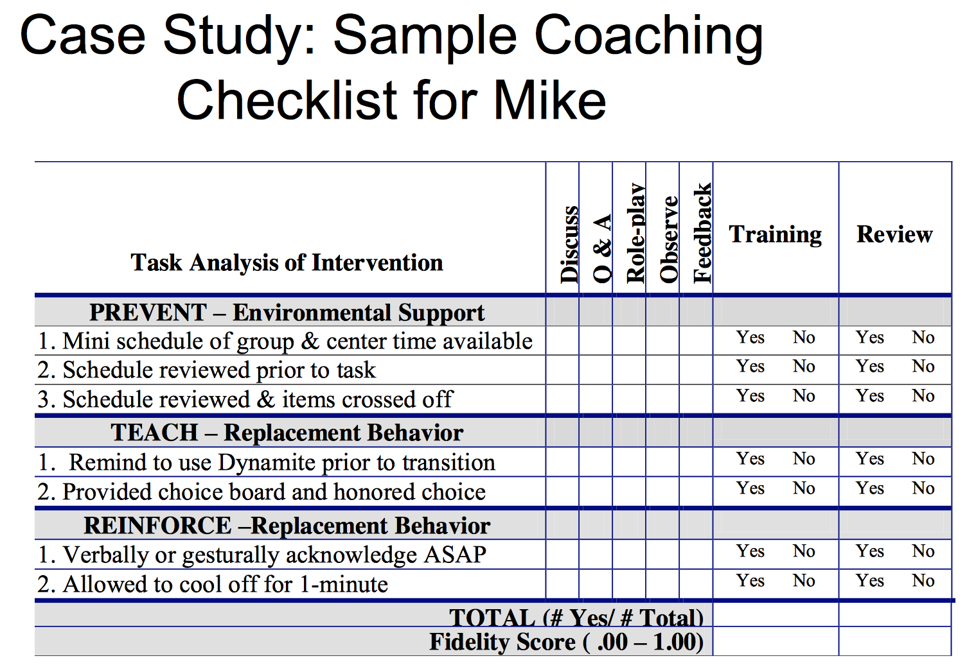

Slide 68
Delaware’s Experiences

Slide 69

Expanding PTR Capacity
Established Memorandum of Understanding to ensure organizational support
2 PBS Project Staff assigned to coach
Adaptation of forms to fit district requirements as well as preferences of facilitators
Select facilitators receive both external consultant coaching and internal project coaching

Slide 70
Expanding PTR Capacity
R+
Trained school psychologists invited to be “Master Facilitators” annually
Master Facilitators (MFs) identify one professional who conducts FBA and BSP process in their district to provide coaching
Master Facilitators receive coaching support in how to coach others

Slide 71

Master Facilitator Coaching
Master Facilitators receive technical assistance in evaluating their coachee’s behavior plans using forms created by the PTR process.
Master Facilitators receive tools to provide feedback to their coachee.

Slide 72
Tools for Coaching Process
FBA/BIP Technical Adequacy Tool for Evaluation (TATE)
Fidelity of Coach implementing PTR Process Steps using Coach/Coachee Form and Checklist
Coached Case Product Fidelity Review
FBA/BIP Innovative Configuration Maps

Slide 73
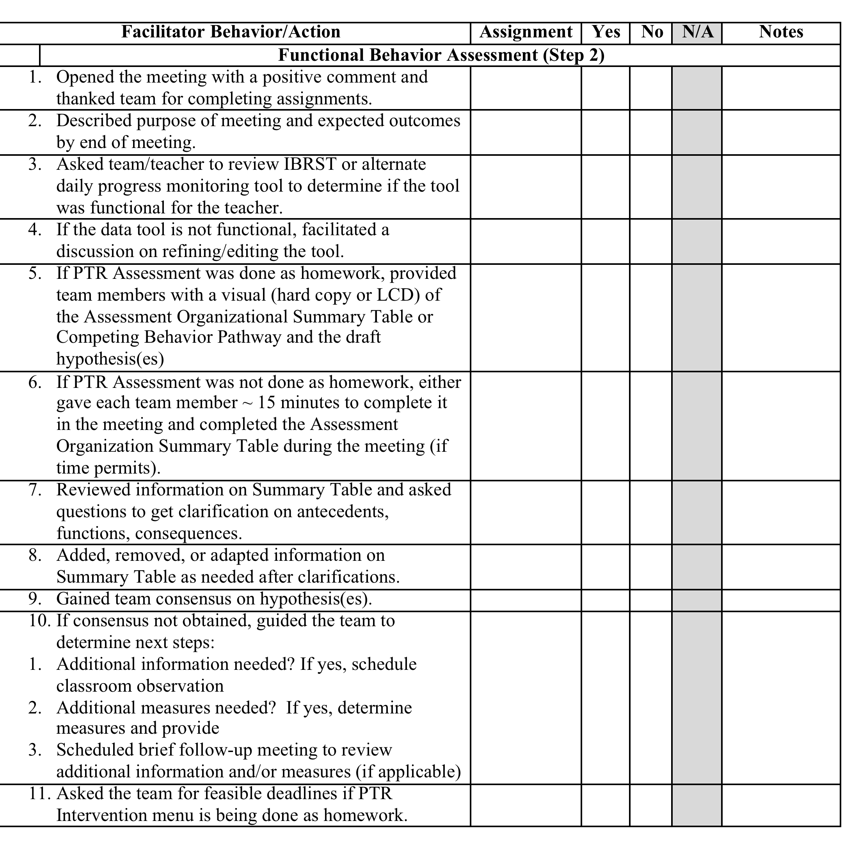
Coach/Coachee Checklist

Slide 74
Step 4: Delaware Outcome Data to Date
Insert % of student goal attainment
Bullet level 1
  Bullet level 2
Fidelity
Bullet level 1
  Bullet level 2
Social Validity

Slide 75
Step 4: Systems Data Outcomes
Increased technical adequacy of FBAs/BSPs completed school professionals
Teachers implementing technically adequate FBA/BIPs with high fidelity
Data-systems evaluating the effectiveness of plans on student behavior(s) used consistently
High teacher ratings of the social validity of the PTR process

Slide 76
Delaware perspectives

Slide 77
Delaware Perspectives
“The PTR process allowed me to develop a more effective Behavior Intervention Plan (BIP) which in turn improved the classroom environment. This led to an increase of effective academic time in the classroom.”
“I really enjoy the PTR process as opposed to the previous FBA/BIP format that we used. Our meetings are much more efficient and effective now that we use this format. Our data collection also improved.”

Slide 78
Building Delaware’s Capacity
Expanded Plans
Add new cohort of PTR facilitators annually
Continue to support Master Facilitators to expand coaching within their district
Model PTR process for facilitators
Add site visits by Project coaches to review data collection and provide additional assistance to facilitators with greater need

Slide 79

Questions?

Slide 80
Contact Us:
Rose Iovannone, iovannone@usf.edu
Linda Marie Smith, linda.smith@doe.k12.de.us
Deborah Boyer, dboyer@udel.edu

Slide 81
Maximizing Your Session Participation
When Working In Your Team
Consider 4 questions:
Where are we in our implementation?
What do I hope to learn?
What did I learn?
What will I do with what I learned?

Slide 82
Where are you in the implementation process?
Adapted from Fixsen & Blase, 2005
Exploration & Adoption
Installation
Initial Implementation
We think we know what we need so we are planning to move forward (evidence-based)
Let’s make sure we’re ready to implement (capacity infrastructure)
Let’s give it a try & evaluate (demonstration)
Full Implementation
That worked, let’s do it for real and implement all tiers across all schools (investment)
Let’s make it our way of doing business & sustain implementation (institutionalized use)

Slide 83
Leadership Team Action Planning
Worksheets: Steps
  Self-Assessment: Accomplishments & Priorities
Leadership Team Action Planning Worksheet
  Session Assignments & Notes: High Priorities
Team Member Note-Taking Worksheet
  Action Planning: Enhancements & Improvements
Leadership Team Action Planning Worksheet

