Slide 1
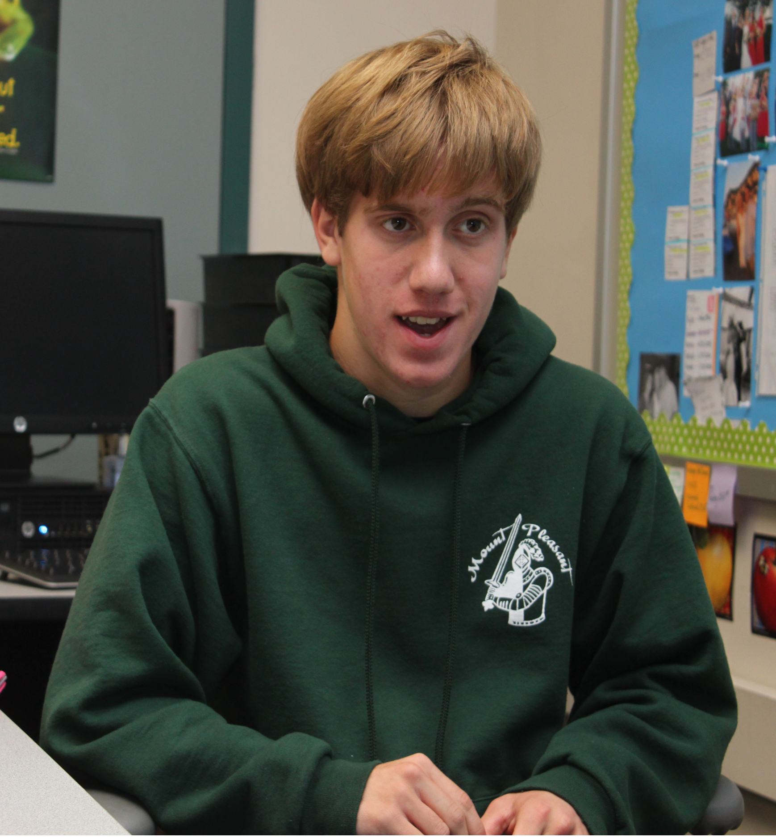
Implementation of PEERS®
(Program for the Education and Enrichment of Relational Skills)
at a Secondary Level
Susan Veenema & Debby Boyer
University of Delaware Center for Disabilities Studies
Delaware Positive Behavior Support Project
What is PEERS®?
The PEERS® Curriculum for School-Based Professionals:
Is an evidence-based secondary social skills curriculum developed by Dr. Elizabeth Laugeson of UCLA
Has the goal of teaching students to make and keep friends using ecologically valid social skills
Includes an easy to follow scripted manual
Uses a variety of techniques including didactic lessons, role-plays, perspective-taking questions and behavior rehearsal
Includes homework to generalize skill use
Results
Data Collection
TAASK (Test of Adolescent Skills Knowledge)
- Included in the PEERS® curriculum
- Assesses social skill knowledge of teens
2. Teacher Rating Scale
- Created by the University of Delaware
- Assesses applied knowledge of the skills
taught
3. Facilitator Fidelity of Implementation
- Observation by Project Coach using the
curriculum to ensure that lesson components
are followed
Conclusions
Fidelity was high and quickly achieved
Students increased their social knowledge
Most teachers found increases in use of social skills
PEERS was shown to be an effective Tier 2 Social Skills intervention
“At our school, we found that the PEERS social skills based curriculum stimulated students to self reflect on their social behaviors during interactions with their peers. It assisted them in stepping out of their comfort zone to start conversations. Students showed interest in being more social and began having get-togethers during school and outside of school.”
“We were all a little skeptical about using
a scripted curriculum…but as the weeks unfolded, we realized just how much the carefully structured, step-by-step lessons and role plays allowed our students to first learn specific things to do and say and then gave them the time and opportunity to practice these new skills. The ongoing, predictable format of the lessons, role plays, review and homework appeared to decrease the uncomfortableness… allowing them to build their confidence to interact successfully with their peers.”
Skills Taught
Engaging in two-way conversations
Entering and exiting conversations
Choosing appropriate friends
Using humor appropriately
Having successful get-togethers
Managing arguments with friends and handling teasing
Handling bullying
Implementation
Dr. Elizabeth Laugeson came to Delaware and trained over 50 educators to implement PEERS®
Facilitators included teachers, psychologists, speech-therapists and building administrators
Cohort 1 consisted of 9 groups across 5 school districts
Cohort 1 received follow-up technical assistance from the Delaware Positive Behavior Support Project Coach.
Project Coach conducted observations to measure fidelity of implementation and assisted with data
“I have experienced changes of my self-confidence to an extent. I got into sports more and got to know more people. I also learned some new social skills from PEERS. Like how to use humor appropriately, how to handle teasing and most importantly, how to make and keep friends.”
-Special Education Coordinator, Charter School
-Facilitator, Brandywine School District
-High School Student

