Slide 1
BUILDING STATEWIDE CAPACITY AT THE TIER 3 LEVEL: THE COACHING PROCESS USING THE PREVENT TEACH AND REINFORCE (PTR) MODEL
Eileen Baker
Debby Boyer
Susan Veenema

Slide 2



PTR in Delaware
Initially piloted through DE-PBS Project
Expanded through Delaware Department of Education’s State Personnel Development Grant
DE-PBS Project Coaches use PTR process, Delaware adaptations

Slide 3

Special Thanks to
Dr. Rose Iovannone
Materials are used and adapted from
Dr. Iovannone with permission

Slide 4

Overview
PTR overview
Coaching model and process
Capacity building
Outcomes
Next steps

Slide 5
School-Wide Systems for Student Success
Multi-tiered System of Support
Academic Systems
Behavioral Systems
Tier 3/Tertiary Interventions 1-5%
Individual students
Assessment-based
High intensity
1-5% Tier 3/Tertiary Interventions
        Individual students
        Assessment-based
        Intense, durable procedures
Tier 2/Secondary Interventions 5-15%
Some students (at-risk)
High efficiency
Rapid response
Small group interventions
Some individualizing
5-15% Tier 2/Secondary Interventions
        Some students (at-risk)
        High efficiency
        Rapid response
        Small group interventions
        Some individualizing
Tier 1/Universal Interventions 80-90%
All students
Preventive, proactive
80-90% Tier 1/Universal Interventions
        All settings, all students
        Preventive, proactive
Illinois PBIS Network, Revised May 15, 2008. Adapted from “What is school-wide PBS?” OSEP Technical Assistance Center on Positive Behavioral Interventions and Supports. Accessed at http://pbis.org/schoolwide.htm
Notes:
5

Slide 6
3-Tiered System of Support
Necessary Conversations (Teams)
School-wide
Team
Tier 2 Team
Tier 3 Team
Plans SW & Class-wide supports
System
Conversations
Uses process data; evaluates overall effectiveness; does not involve discussion of individual students
Problem Solving Conversations
Matches students to interventions and monitors progress, making adjustments as needed
Uses Process data; determines overall intervention effectiveness
Universal Support through SW Program
CICO
FBA/BSP
PTR
Group interventions
Group w. individual
features
Brief
FBA/BSP
Adapted from the Illinois PBIS Network
Notes:
6
6

Slide 7
What should Tier 3 include?
Team formed, includes those who have knowledge of student
Systematic problem solving process is foundation
Target behaviors identified and defined
Antecedents (predictors) of problem behavior occurrence
Consequences/responses of others following problem behavior
Hypothesis generated by data
Function-based understanding of behavior
Multi-component intervention plan built and linked with hypothesis
Progress monitoring plan established
Fidelity measurement of intervention implementation developed and scheduled
Follow-up meeting to make data-based decisions

Slide 8
What is Prevent-Teach-Reinforce (PTR)?
Research project funded by U.S. Department of Education, Institute of Education Sciences in partnership with:
University of South Florida
Three central Florida school districts
University of Colorado, Denver
Two Colorado school districts
Purposes:
Answer the call for rigorous research
Evaluate effectiveness of PTR vs. “services as usual” using randomized controlled trial
Evaluate effectiveness of “standardized “ approach

Slide 9
Results of Study
Shown to be efficacious through a randomized controlled trial with more than 200 students in grades K-8 (Iovannone, Greenbaum, Wang, Kincaid, Dunlap, & Strain, 2009 )
  Improved behavioral outcomes
  Majority of teachers were able to implement plans with fidelity
  Teachers reported liking the procedures and willingness to carry out plans on Social Validity measures

Slide 10
Overview of PTR Process
Teacher, parent and team driven
Prescriptive/manualized process
Four-step team-based process
  Optional pre-step regarding teaming
Every intervention plan includes 3 components
  Prevent
  Teach
  Reinforce
Plans are task analyzed
Attention to supports for teacher/team to implement interventions

Slide 11
Prevent Teach Reinforce (PTR)
Four step process for completing an FBA/BSP (aligned with problem solving process):
  Goal Setting (Identification of Problem)
  Functional Assessment (Problem Analysis)
  Intervention (Behavior Support Plan Implementation)
    includes Coaching of plan and fidelity check
  Evaluation (Progress Monitoring and Social Validity)

Slide 12
Collaborative Facilitation is Key
Take off the “expert” hat
Avoid direct confrontation or “fixing” issues
  Purpose is for team to recognize potential issues that enhance and inhibit problem solving process
Less talk, more listening and facilitating
Provide visual summary while facilitating—allow reflection and discussion by team
  Ask them to review the results and reflect
  Ask for their ideas, reactions, input
  Facilitate the discussion
  Guide them to use “science” in making decisions

Slide 13
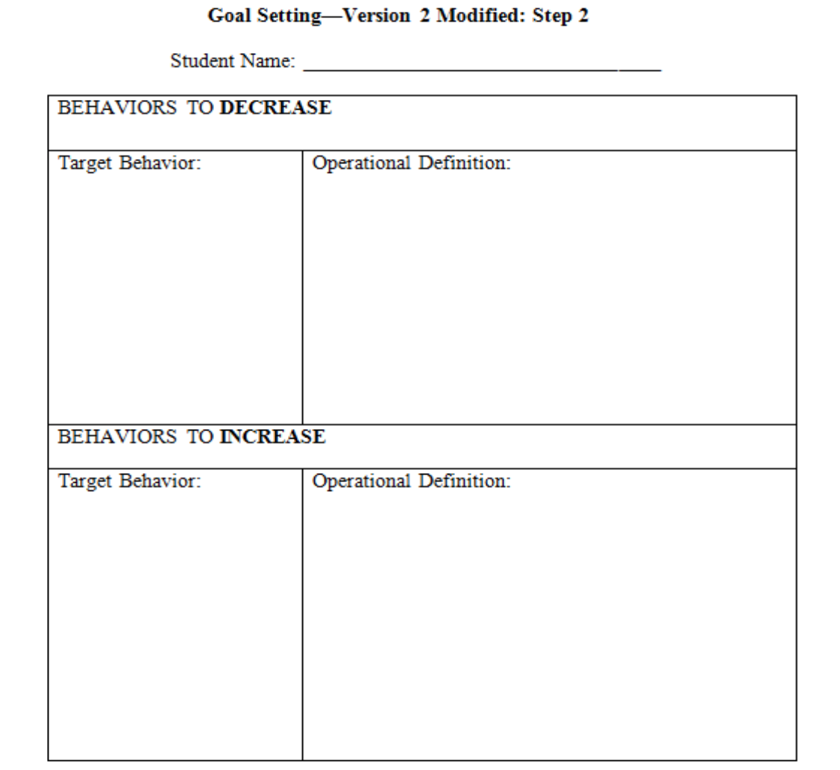
￼
￼
￼

Slide 14
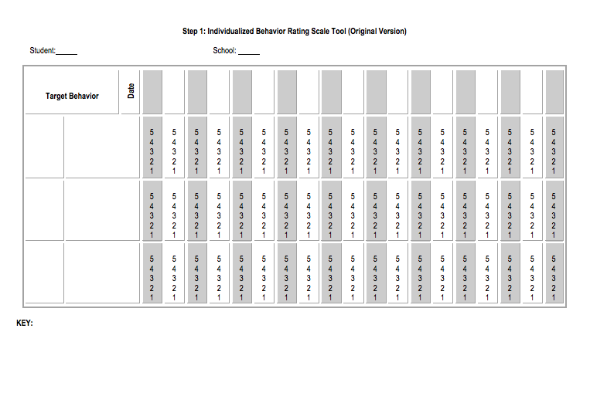
Data Collection: Individualized Behavior Rating Scale Tool (IBRST)

Slide 15
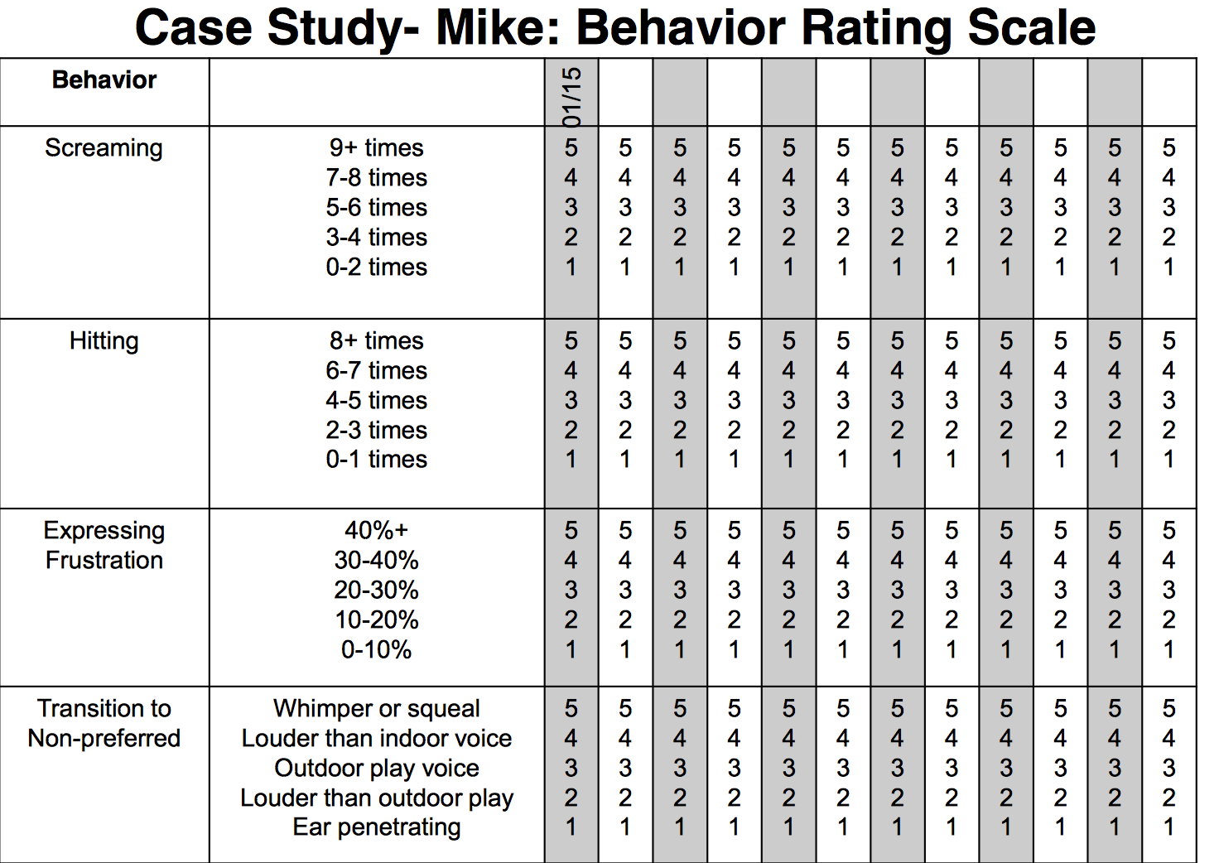
￼
￼

Slide 16
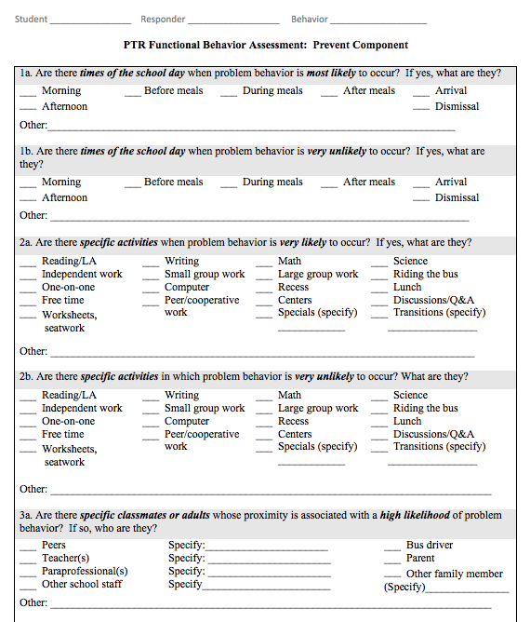

Slide 17
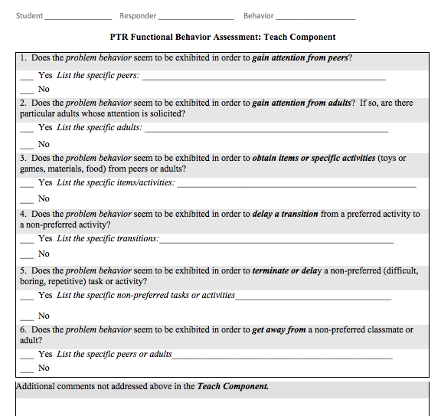

Slide 18
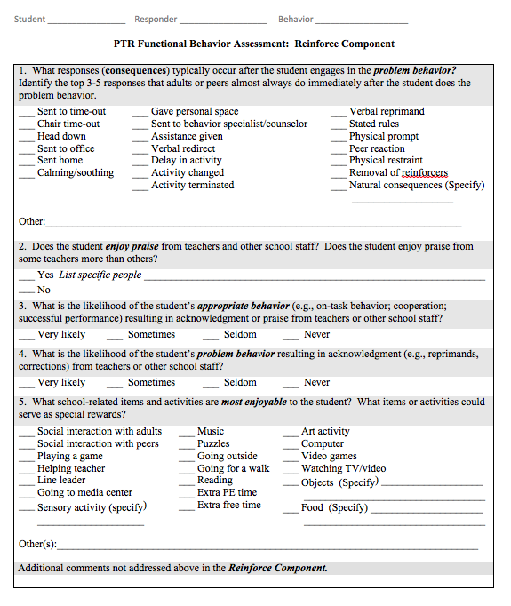

Slide 19
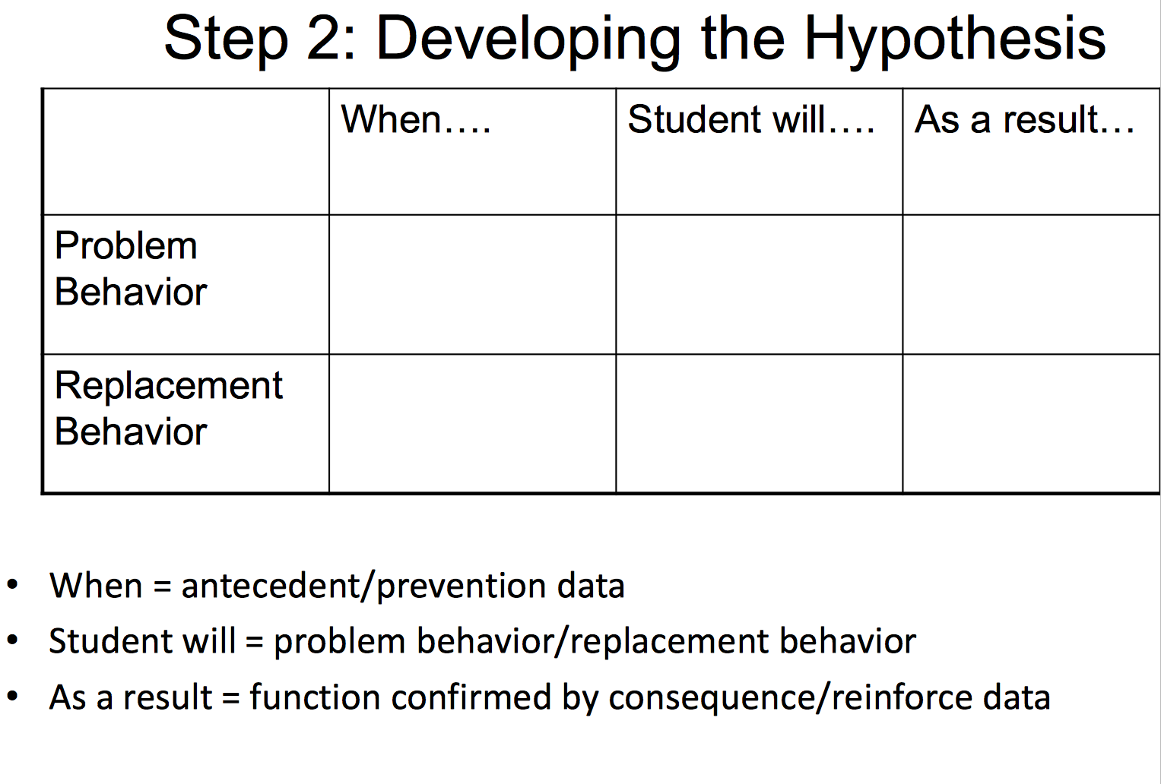

Slide 20
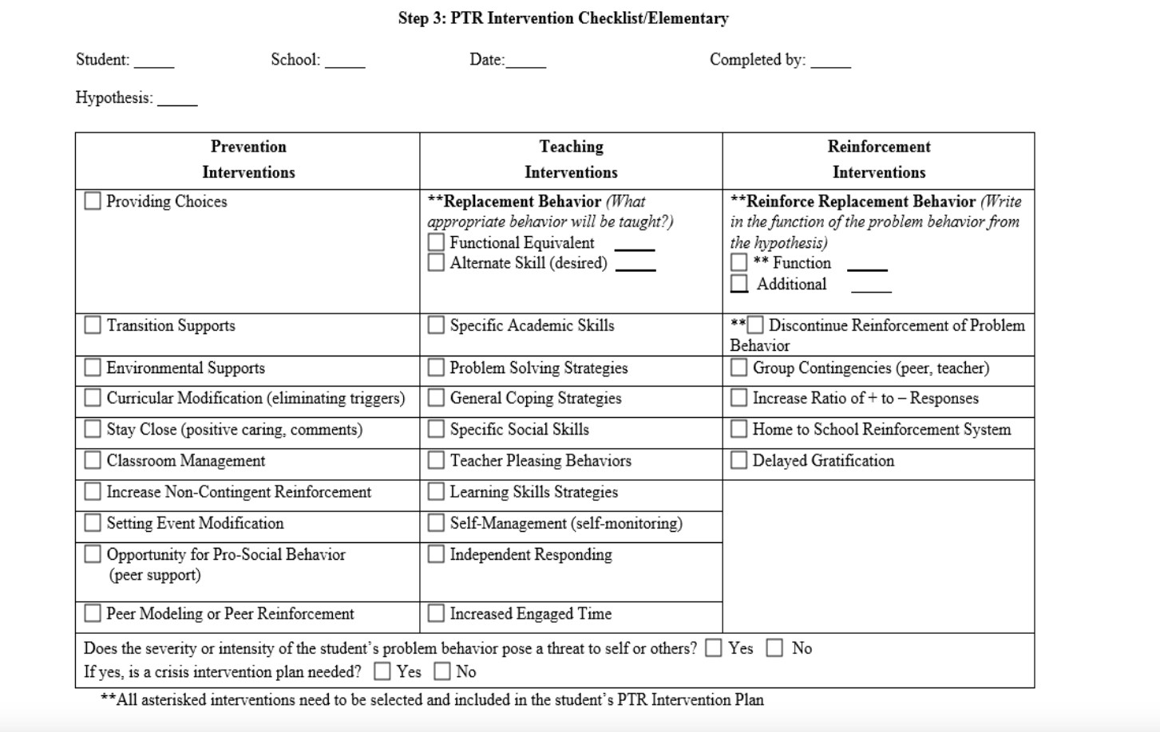

Slide 21
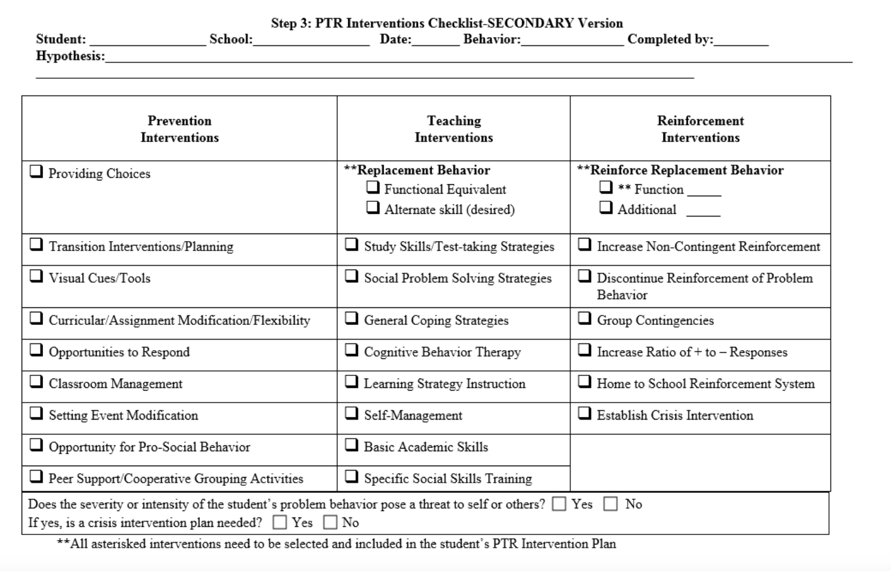

Slide 22
Mike’s Intervention Plan
Reinforce Strategies | Specific Steps
Replacement Behavior: Appropriately express his need to calm down | Whenever Mike ‘says’, “I need to calm down”, give him the choice board, praise him for using his communication, and release him to his choice. Immediately after Mike indicates he needs to calm down, ask him “What do you want?” while showing the choices. Immediately after Mike makes his choice, say “Thank you for telling us what you need.” Depending upon his choice, release him or provide him with the selection. When he makes his transition, praise him (with a warm tone) for returning to the group; “thank you for coming over.”
Discontinue reinforcing problem behavior | Minimal attention will be provided to Mike when he is calming down and when he is starting to scream. Steps: As soon as Mike begins to show signs for screaming, the adult will immediately prompt Mike to say he needs to calm down by presenting the device and saying “What do you need?”. If necessary, provide physical or partial physical prompting to have Mike say what he needs. Immediately after Mike says “I need to calm down”, present the choice board and ask him “What do you want?”. Provide positive praise for Mike saying what he needs, “thank you for telling us what you need.” Allow him to engage in his choice for one minute.
Notes:
22

Slide 23

Step 3 Teacher Coaching:
Often a missing link
Teacher and Staff Training on plan
  Initial training with no students present Model, Role Play, Q & A, Discussion
Fidelity Checklist
Used by PTR Consultant for training evaluation
  Evaluate teacher accuracy on each step prior to implementation with student
  Comfort and competence measured

Slide 24
Teacher Coaching Steps
Facilitator introduces coaching form,
  e.g., “We’re going to go over the steps of the behavior plan strategies to make sure they are still making sense to you and are things that can be done by you in your classroom. If there is anything that you feel isn’t going to work, we can make changes today.”
Several methods for coaching the teacher. Can choose one method, combination of two, or all three:
  Discussion—facilitator asks teacher to verbally describe (in his or her own words) each of the interventions.
    Ensures teacher describes each step of the intervention
    Teacher can refer to coaching form to cue core steps
  Q & A—facilitator asks teacher questions about strategies.
    For example, choice-making “When are you going to offer the choices to X?”; “What kind of choices will you offer X?”; etc.
  Role Play (preferred method)-facilitator plays role of student and asks teacher to perform plan steps as they would with student.

Slide 25
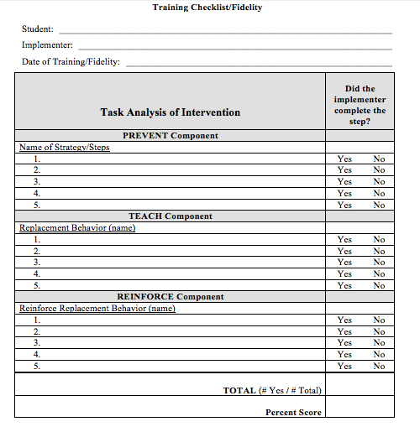

Slide 26
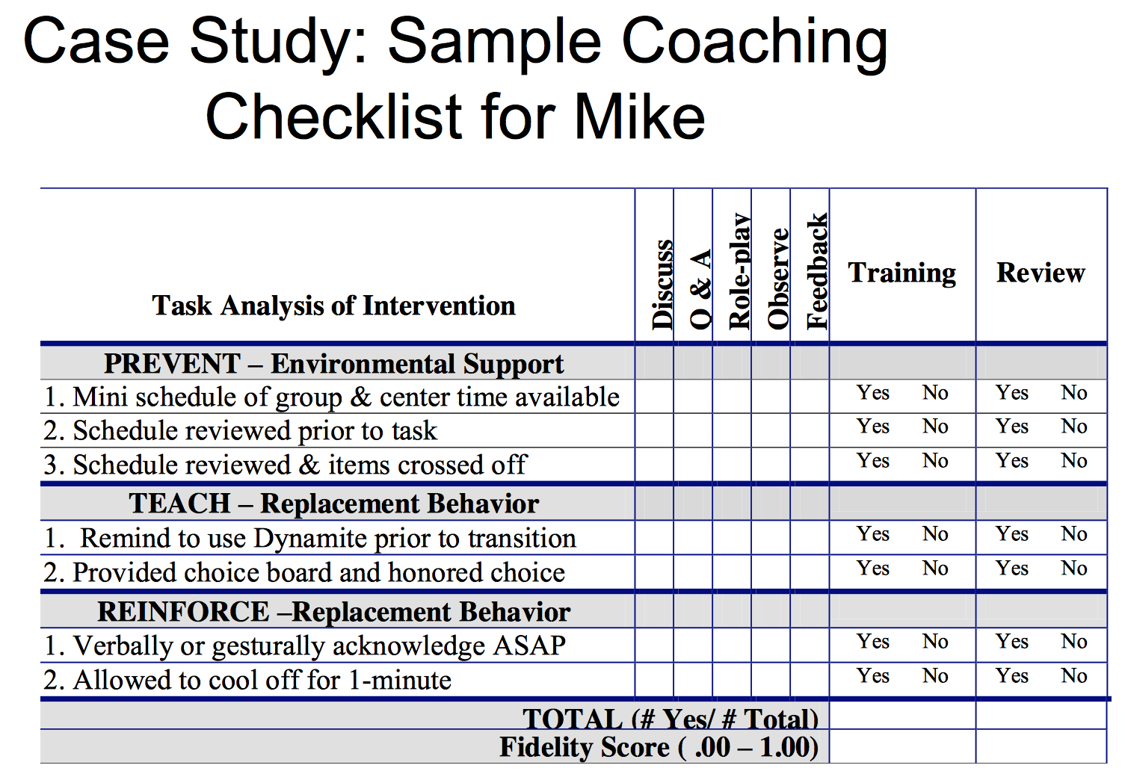

Slide 27
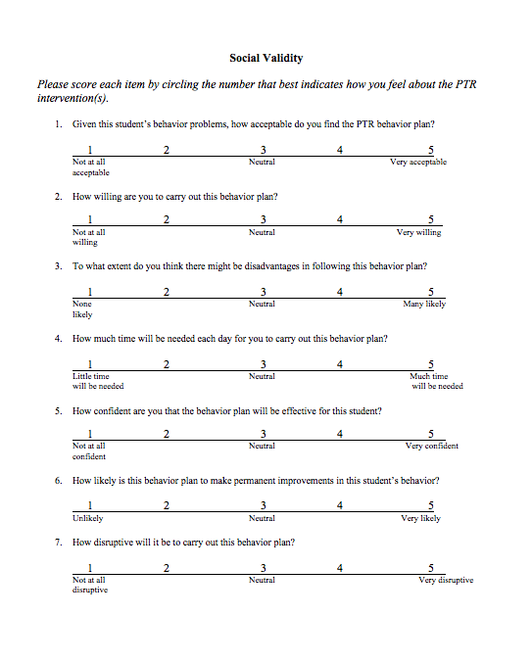

Slide 28
What is Practice-Based Coaching?
Focuses on mentoring/teaching skills to other professionals
Ongoing coaching relationship is used to:
  Build and refine existing skills and/or acquire new skills (individual and group)
  Support person or group’s ability to apply new knowledge
Use of problem solving method with focus on data to inform practice (individual and group)
Continuous improvement – encourage, recognize and shape
End goal is to build capacity of other FBA/BIP facilitators to conduct an evidence-based team-driven process
Not a fix for professionals with performance issues

Slide 29
Overview of Professional Development and Coaching
Facilitators receive full day of PD on PTR process in fall
Coaching for at least one student case by Dr. Rose Iovannone
Coaching support includes:
  review of documents completed in the process
  Written feedback
  Individual coaching calls to discuss and plan for next steps
  Group conference calls for sharing experiences and problem-solved any challenges in implementation
Second half day workshop in spring focused on inventions
Afternoon networking session where facilitators share cases

Slide 30
Expanding PTR Capacity
3 PBS Project Staff assigned to coach
Adaptation of forms to fit district requirements as well as preferences of facilitators
Select facilitators received both external consultant coaching and internal project coaching

Slide 31
Expanding PTR Capacity
3 of the trained school psychologists were asked to be “Master Facilitators”
Master Facilitators (MFs) were asked to pick 1 professional that conducts FBA and BSP in their district to provide coaching to this professional (special ed coordinator, school psych, school counselor)
Coaching was provided to the MFs in how coach others

Slide 32
Master Facilitator Coaching
Master Facilitators received technical assistance in evaluating their coachee’s behavior plans using forms created by the PTR process.
Master Facilitators were given tools to provide feedback to their coachee.

Slide 33
Tools for Coaching Process
FBA/BIP Technical Adequacy Tool for Evaluation (TATE)
Fidelity of Coach implementing PTR Process Steps using Coach/Coachee Form and Checklist
Coach Case Product Fidelity Review
FBA/BIP Innovative Configuration Maps

Slide 34
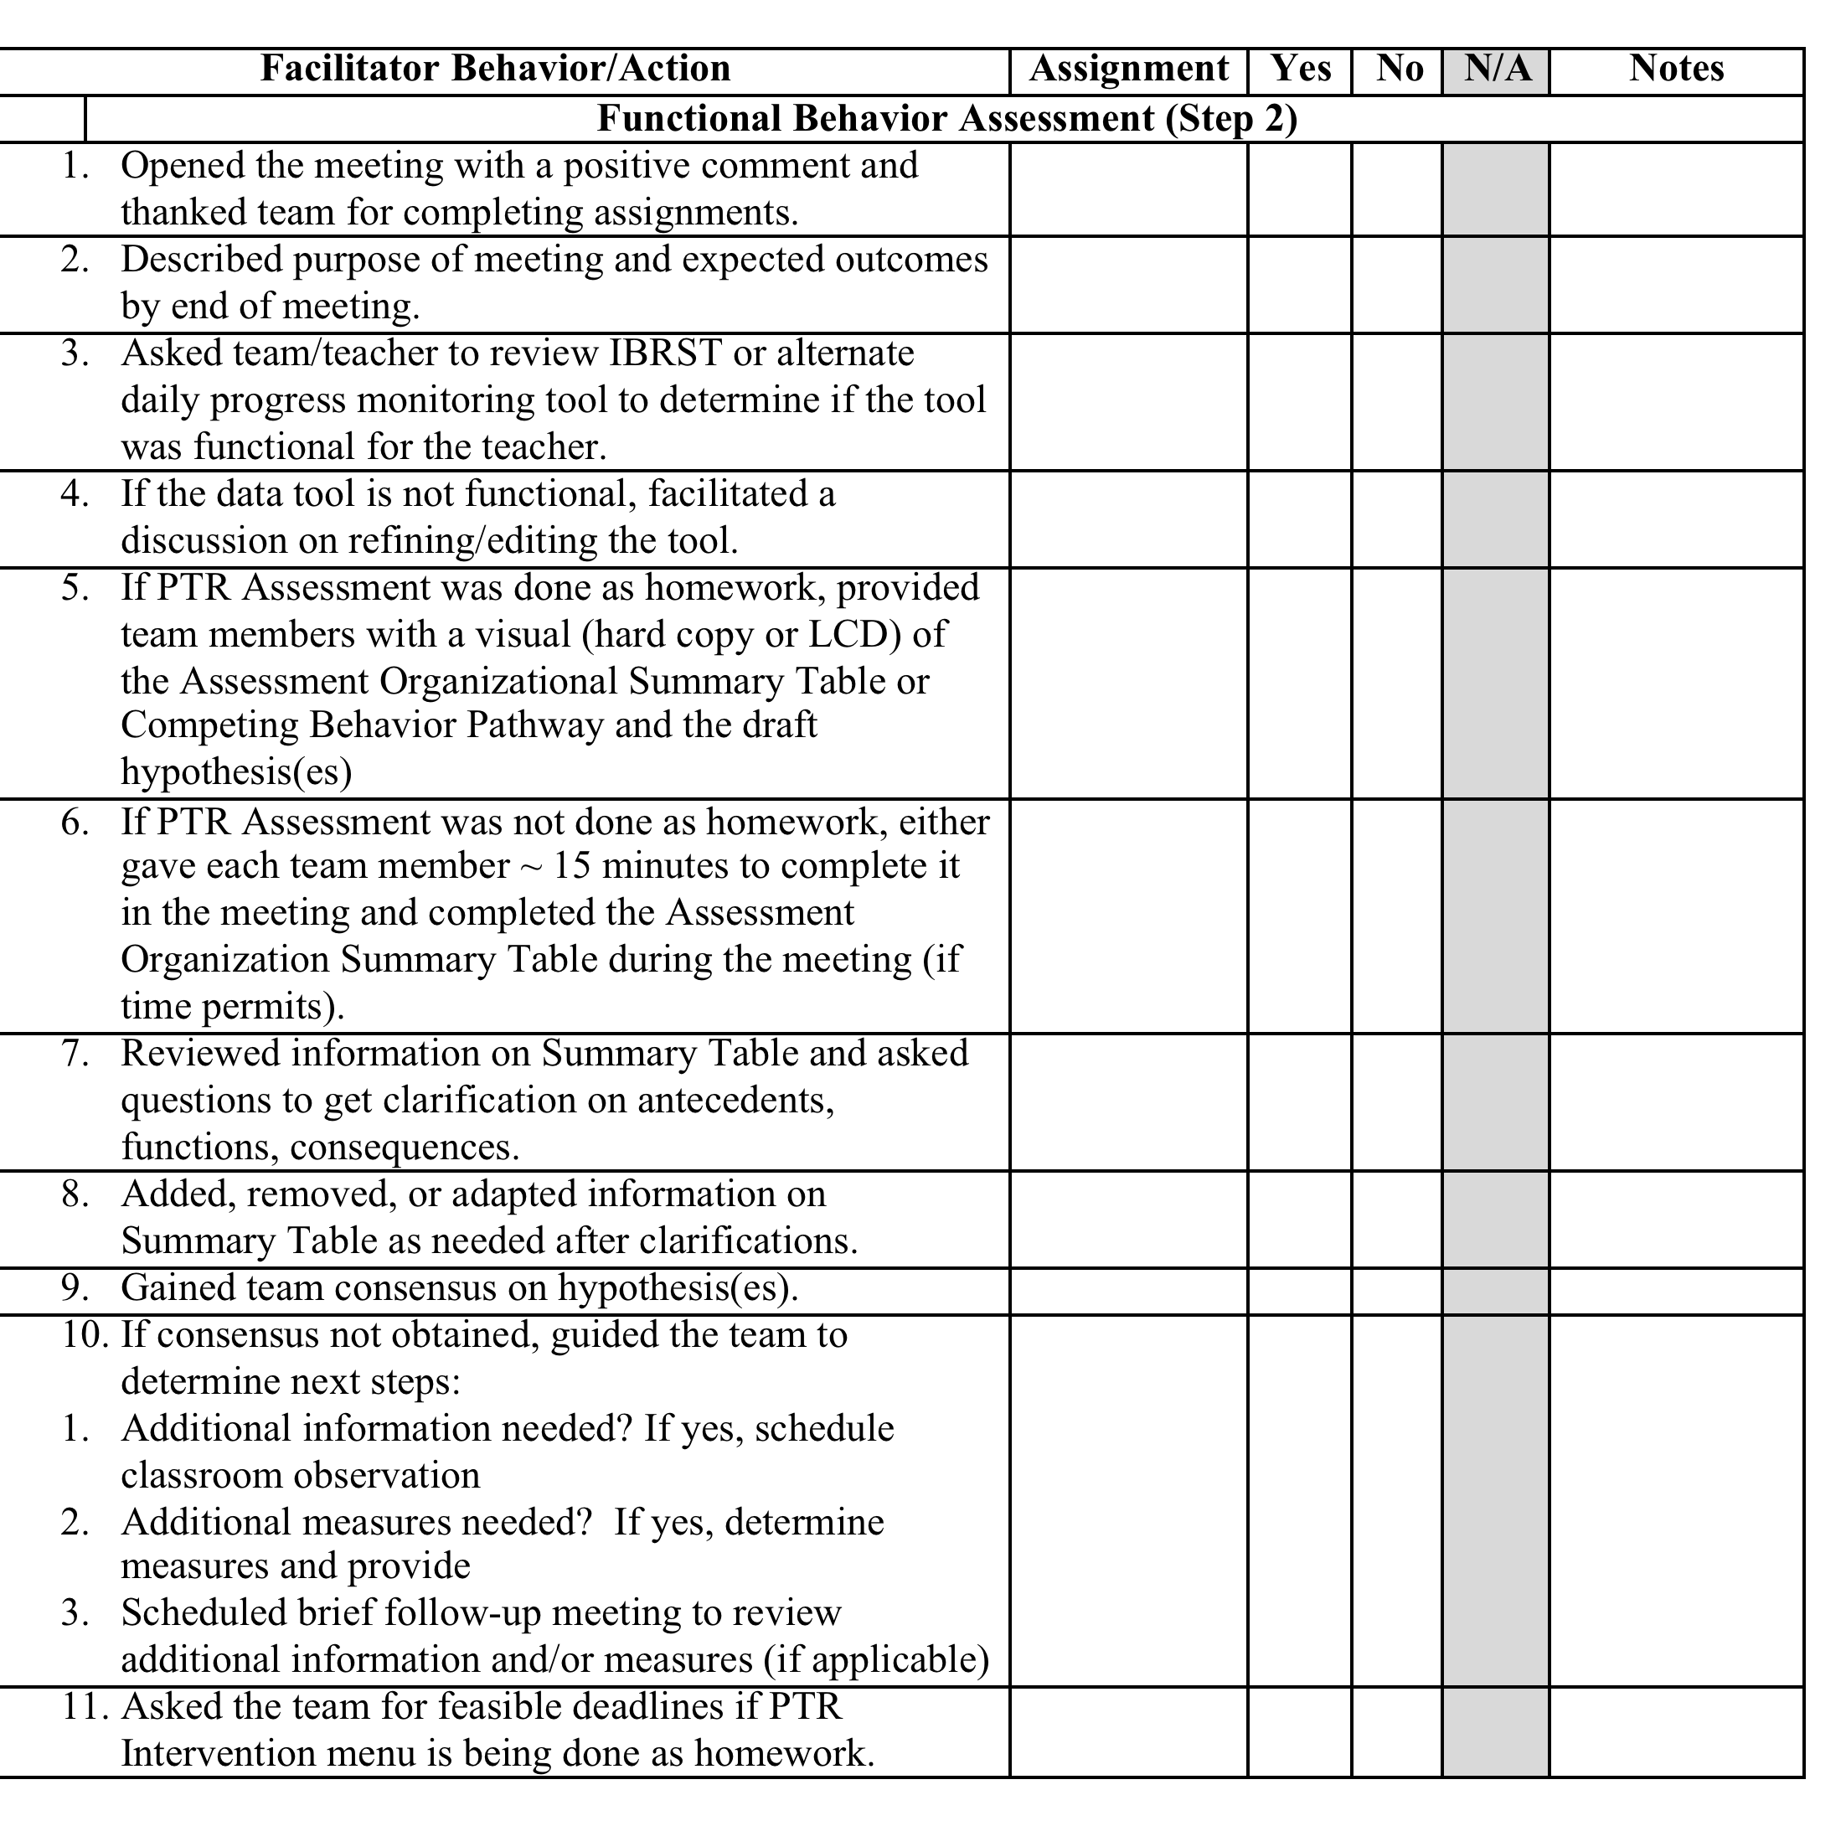
Coach/Coachee Form and Checklist

Slide 35
Student Data Outcomes
Decrease in behavior of concern/target behavior
Increase in replacement behaviors identified as important to family and educators
Improvements in overall behavior (e.g. looking at ODRs or other existing behavior data)
Academic improvements

Slide 36
Systems Data Outcomes
Increased technical adequacy of FBAs/BSPs completed school professionals
Teachers implementing technically adequate FBA/BIPs with high fidelity
Data-systems evaluating the effectiveness of plans on student behavior(s) used consistently
High teacher ratings of the social validity of the PTR process

Slide 37
Testimonies from Facilitators
The PTR process allowed me to develop a more effective Behavior Intervention Plan (BIP) which in turn improved the classroom environment. This led to an increase of effective academic time in the classroom.
I really enjoy the PTR process as opposed to the previous FBA/BIP format that we used. Our meetings are much more efficient and effective now that we use this format. Our data collection also improved.

Slide 38
Where do we go from here?
Continue to support a new cohort PTR facilitators
Continue with support to Master Facilitators to expand coaching within districts
Model PTR process for facilitators
Add site visits by project coaches to check data and provide additional assistance to facilitators with greater need

Slide 39
CONTACT
De-PBS Project Staff:
Susan Veenema – susanv@udel.edu
Debby Boyer – dboyer@udel.edu
Eileen Baker – emmnova@udel.edu
PTR Consultant from University of South Florida:
Rose Iovannone - iovannone@usf.edu

