Slide 1
Turn the Team Around
Sarah Schmittinger Kashner, Red Clay Consolidated School District, Wilmington, DE
Melissa Ebling, Center for Disability Studies, University of Delaware

Slide 2

District-wide Multi-Tiered System of Support
Evaluated current MTSS status
  Tier 1- School-wide
  Tier 2/3- Problem Solving teams
  Why did we need a district-wide process?
    Every building operating in silos
    Continuity for students

Slide 3
  How did we determine what the process would look like?
    Response to Intervention (RTI) under the IDEA
    State Administrative Code
      Problem Solving in General Education and Instructional Support Teams
      Response to Intervention Procedures

Slide 4
How did we determine what the process would look like?
    Researched programs throughout the nation
    Data collection/form development
      Pre-referral
      Referral
      Staff input forms
      Intervention log

Slide 6
Pre-Referral
Identification of Need
  Classroom Management
  Teacher
  Student
    Academic
    Behavior
    Wellness
    Anything else that impacts school success
  PBIS school-wide

Slide 7
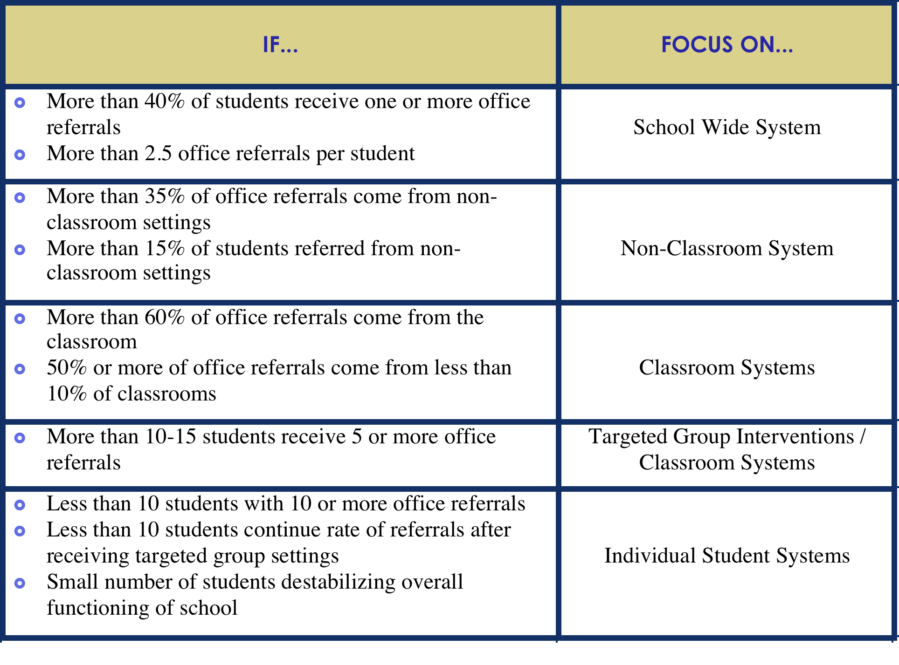

Slide 8
Referral Form-Student Identification

Slide 9
Referral form-Connecting with Outside Agencies

Slide 10
Referral form- Current Intervention details

Slide 11
Referral Form- Data Sources

Slide 12
    District/ State Collaboration
      State initiatives- PBIS, IST
      Cadre membership
      Technical Assistance
      Compliance agreement
      Grant partnership

Slide 13
  How Did We Implement the Process?
    Team development
      Name submission from Principals yearly for team leader
      Team membership- 6-8 people, representative teams
    Training- PST process
      Administration
      Team Leaders
      Building Staff and faculty
      District office

Slide 14
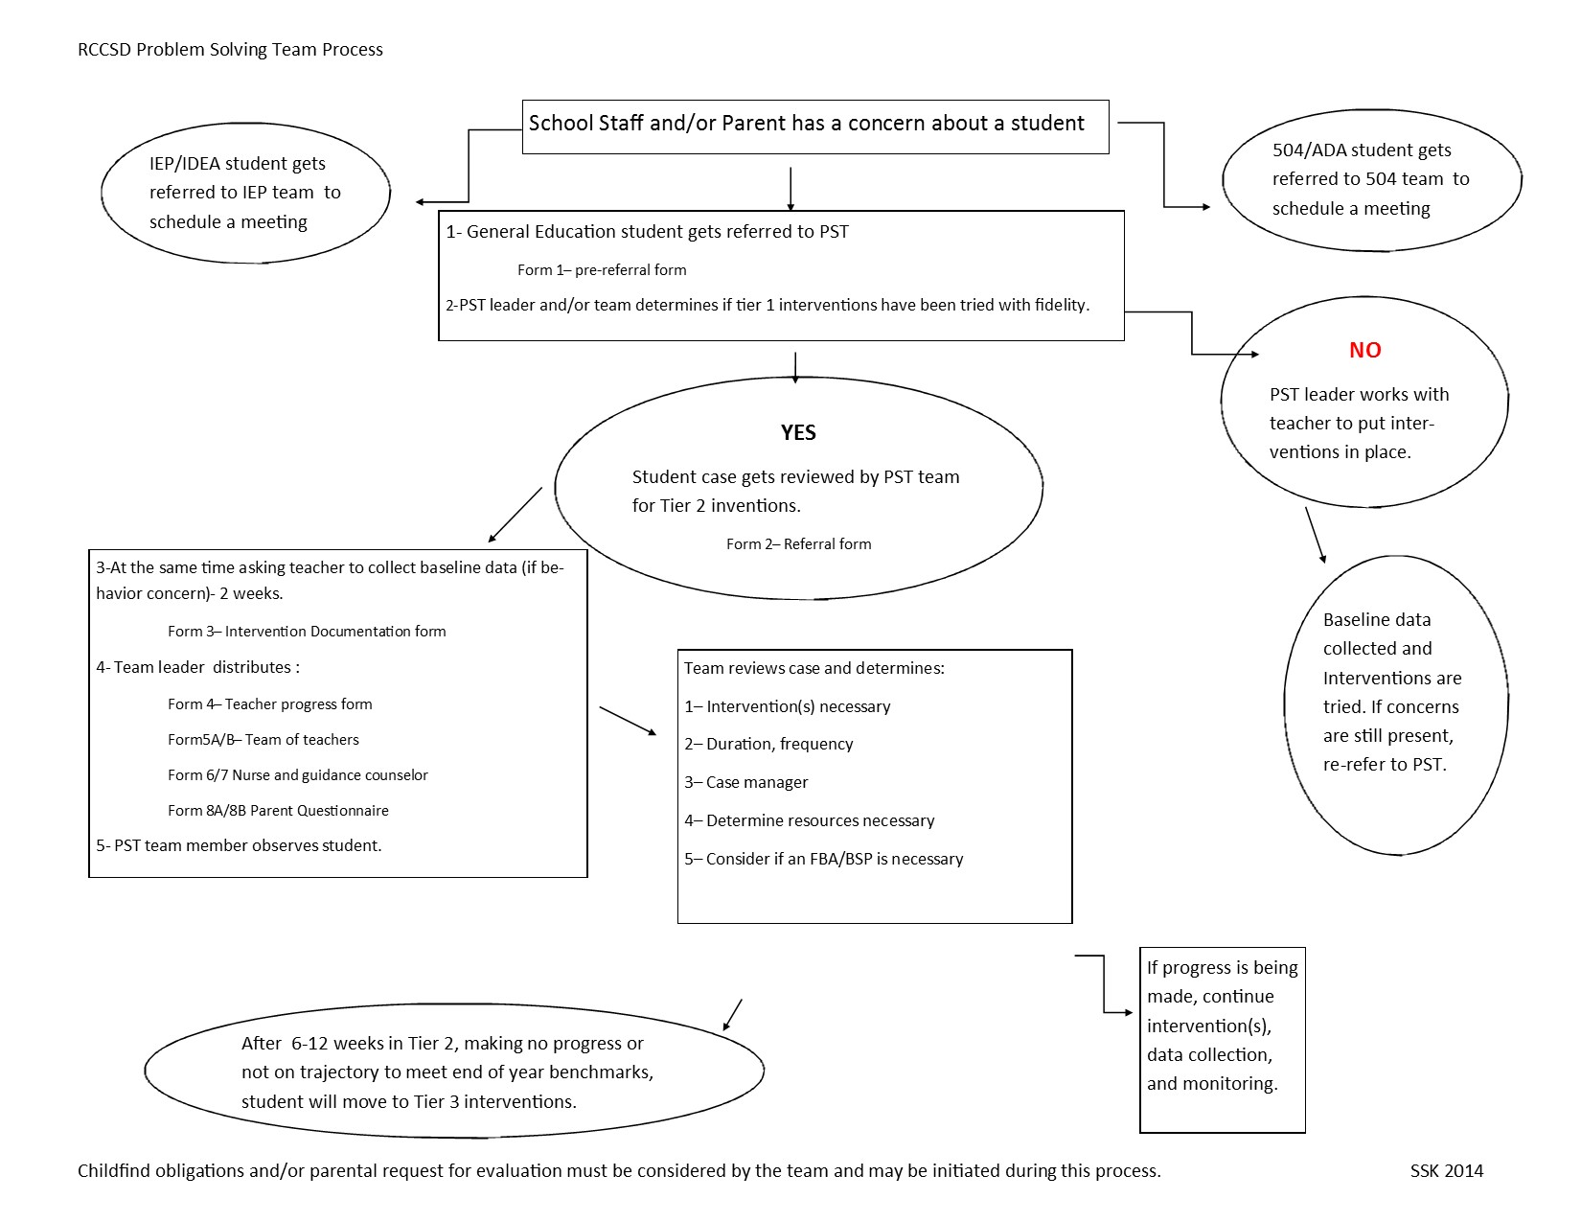

Slide 15
Team Leader Networking and Training
  District Coach trains team leaders – on the following schedule:
    PST team leaders meet 4 times a year
    PBIS team leaders meet every other month
    PST and PBIS team leaders as well as suspending building administrators meet two times a year.
    PST and PBIS teams- Ongoing collaboration within schools (shared members)
    District coach supports building level custom PD
    How to maintain- District coach meets individually with building admin and team leader every spring.

Slide 16
District Coach- Spring Maintenance Meeting- Sample Agenda
Strengths of the PBIS program (current year)
Areas of Growth
Goals for the (next) school year
Using Big 5 data in faculty and PBIS meetings?
  What data sources?
  How often?
Review triangle data. Reflections.
Survey Monkey: Strength and Needs Assessment or KFE?
Summer planning meetings/PD?
How can the district provide support next year?
Other school questions/concerns?

Slide 17
MTSS and Tiered Behavioral Interventions
  Not all schools implement PBS
    PBIS school-wide Buildings- 12
    Non-PBIS school-wide buildings- 15
    Behavioral expectations in all buildings
  PST Tier 2/3 Interventions
    CICO
    Mentoring
    Second Step
  Training----District meetings

Slide 18
Sample Agenda topics from District meetings
Thinking CAP Discussion- In quads, discuss possible alternatives to external suspensions that you think might work to decrease student misbehaviors. Make a short list of the interventions and be ready to give a brief description of the two three interventions you came up with as a group. Be ready to share out in 6 minutes.
Clint Smith- “The Danger of Silence” https://www.ted.com/talks/clint_smith_the_danger_of_silence?language=en
Disciplinary Alternatives to Suspensions - Hanover
Video- The Behavior Education Program: a check-in, check-out intervention for students at risk
Cause I Ain’t Got a Pencil (Poem)
Student Scenarios- what would YOU recommend for any two of the four students?
School Climate & Youth Development (Handout: Discuss @ school)
Discipline: Effective School Practices (Handout: small group discussion)
How to use school climate data (staff)- Large Group Discussion
PST Brainteaser
Childfind Regulations and questions

Slide 19
Multi-Tiered System of Support
PBiS School-wide
Team
PST Tier 2 Team
Tier 3 Team
Plans SW & Class-wide supports
System
Conversations
Uses process data; evaluates overall effectiveness; does not involve discussion of individual students
Problem Solving Conversations
Matches students to interventions and monitors progress, making adjustments as needed
Uses Process data; determines overall intervention effectiveness
Universal Support through SW Program
CICO
FBA/BSP
PTR
Person Centered Planning
Group interventions
Group w. individual
features
Brief
FBA/BSP
DE-PBS Project March 2015
Adapted from the Illinois PBIS Network

Slide 20
How Does the District Support This?
Building level meetings
  PBIS (School –wide), one hour per month, 6-8 team members
  PST (Tier 2/3), two meetings per month, one hour each, 6-8 members
      Systems Meeting
      Student Cases
District level team leader meetings
  Substitute coverage for PBS Team Leader meetings every other month
  Substitute coverage for PST Team Leader meetings quarterly
  PST and PBS Team leader stipends yearly

Slide 21
How Does the District and State Support This?
  Monthly building level meetings
  Enhanced student supports
    Behavior Specialists/District behavior team
  State FBA/ BSP training in PTR process
  State developed targeted tier 2 training
  State supported substitutes

Slide 22
Looking forward
Assessed and identified current areas of need
  Increase social-emotional learning curricula district wide
  Additional training in basic FBA/BSP development
  Additional training in data collection and goal setting
  Increase support for students with highest needs
  Increasing district partnership to get mental health supports to students
  Continuing to build MTSS in every building
District behavior team creation
Increasing Tier 1 PBIS buildings district wide

Slide 23
Questions?
Sarah.kashner-schmittinger@redclay.k12.de.us
Mebling@udel.edu

