Slide 1
Delaware Assessment of Strengths and Needs for Positive Behavior Supports (Bear, Burwell, Baker, Blank, & Boyer, 2010)
Data Analysis Tutorial
The Delaware Positive Behavior Support Project www.delawarepbs.org
Notes:
Welcome to the Data Analysis Tutorial for the Delaware Assessment of Strengths and Needs for Positive Behavior Supports. This tutorial will walk you through the steps to interpreting your Needs Assessment Report using the Data interpretation worksheet. Let’s begin by reviewing the tools and documents that you will need to complete your analysis.

Slide 2
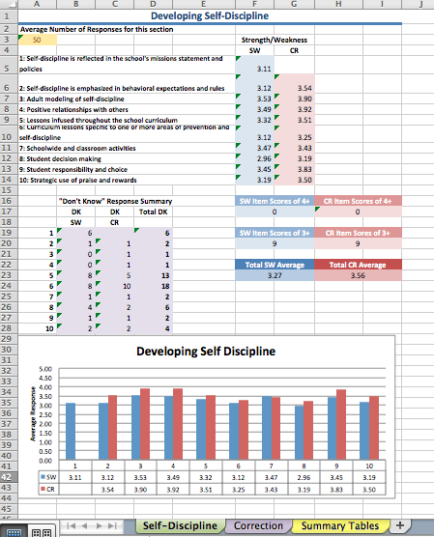
You will need :
Your school’s excel data report
Includes the sections your school completed
Includes Summary Report
Notes:
First, you will need your school’s excel data report. You will receive this report from PBS Project Staff after your staff has completed the Needs Assessment Survey. The Excel report, which we will review more in depth shortly, includes a report tab for each section that your school completed, a summary report. You will refer primarily to this document while doing your analysis. You may also find it helpful to print the report. Each tab will print on its own page.

Slide 3
You will need:
Your School’s Comment Summary Report
Includes the comments for each section
Notes:
Next, you will also have received your School’s Comment Summary Report from the PBS Staff with your Excel Report. For each section, your staff had the opportunity to provide a comment for each item rated as a 3 or lower.This Word document compiles all of the written comments in an easy-to-read format. A review of your staff’s comments provides for more qualitative information regarding your school’s strengths and needs.

Slide 4
You will need :
Needs Assessment - Excel Data Guide.doc
Explains the content and format the Excel report and technical aspects of how to navigate the report
Notes:
You may also want to refer to the Needs Assessment Excel Data Guide word document, which was included in the email from the PBS Staff. This document explains the content and format of the Excel Data Report. We will review its contents during this tutorial when we discuss the ins and outs of the Excel Data Report. However, you will find this as a handy quick reference guide later if you have any questions about the excel report.

Slide 5
You will need :
“DASNPBS Data Analysis.doc”
Includes:
A checklist of what to do once you have your data
Data Interpretation Worksheets
Notes:
Also included in your email from the PBS Staff, is the DASNPBS Data Analysis in a word document. This document includes a checklist that documents the process from receiving your data to sharing results with the team.
**CLICK**
This document also includes the Data interpretation worksheets which will guide you through your data analysis. There are two parts to the Data analysis worksheet. The first worksheet is used to analyze data from each individual section. This may require you to print out more than one copy of this worksheet so that one can be completed for each section in which your school collected data. The second part is a multi-section analysis, where you will look across all your sections to determine strengths and weaknesses overall. You will complete the multi-section analysis only once.

Slide 6
You will need :
NA Questions document for your section (PDF labeled by its section)
Notes:
You may also need the NA Questions document. This document outlines the actual questions for each section. The PBS Staff will have sent you a question document for each section that your school completed. The titles of the documents can be seen in the lower left hand of the screen. We recommend referencing this document as you dig deeper into your analysis. While the excel report includes the general item descriptors, the question document provides additional detail to the question the staff responded to for each item.

Slide 7
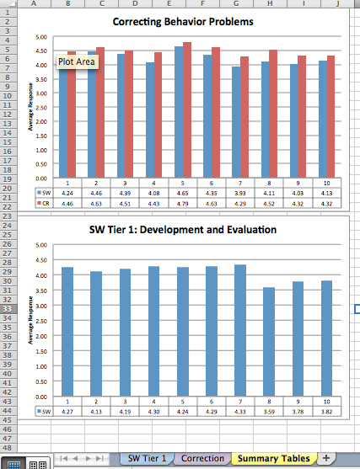
Excel Data Report- By Tab
Notes:
So now that you have all your documents, lets take a closer look at the Excel Data Report layout. The following information can also be found in the “Needs Assessment 2011-2012-Excel Data Guide” if you need a quick reference later.
The Excel spreadsheet is organized by “worksheets” that are visually represented by colored tabs that appear along the bottom of the Excel window. You can click on a tab to bring up the corresponding worksheet. Each worksheet is named after the section(s) of the Needs Assessment your school completed. In this example, the school completed two sections, School Wide Program Development & Evaluation and Correction. In addition to section summary worksheets, all files will have a “Summary Tables” worksheet.

Slide 8
Excel Data Report: Section Report
Average Number of Respondents for this section
Notes:
Let’s take a closer look at the individual section report tab. Data from each completed section are collected and organized in worksheets labeled with the section name. For example, if your school completed the “Correcting Behavior Problems ” section, the resulting data are summarized and displayed on the “Correction” worksheet.
On the top left of the sheet in the shaded orange cell (A3), you will find the average number of respondents who completed this section. Remember, the recommendation is that at least 50% of staff complete the survey.

Slide 9
Excel Data Report: Section Report
Average Item Score.
Blue: Schoolwide Score
Red: Classroom Score
Notes:
Next, each item is listed with the average item scores in the columns to the right. The items are briefly listed. However, if you would like to see the full questions, you can refer to the NA Questions document for your section.
The average scores for the Schoolwide level are in the blue shaded cells, and the scores for the Classroom level are in the red shaded cells. Keep in mind that if you are looking at results for the “Schoolwide Tier 1: Program Development and Evaluation” section, it does not include a Classroom level scores, so there will only be a blue column with scores and no red column of scores.

Slide 10
Excel Data Report: Section Report
“Don’t Know (DK)” Response Summary
Notes:
Next we have the “Don’t Know” (DK) response summary. These cells summarize the number of “Don’t Know” responses for each item and level. This is useful information to know – for example, if 8 staff members answered DK to a specific question, this may be an area to address in future staff development sessions.
The first column is the number of DKs to the SchoolWide items. The second column is the number “Don’t Know” responses to Classroom items. The Third column is the Total of Schoolwide and Classroom “Don’t Know” responses.

Slide 11
Excel Data Report: Section Report
Count Summary and Total Averages
Notes:
To the right of the DK Summary, is a Count Summary which includes a count of the number of items with average scores above 4 in the top row. The second row is a count of items with average scores above 3. The bottom row includes a Total Average of all items. As with the individual items scores, this summary is color-coded with Schoolwide scores in blue and Classroom scores in red.

Slide 12
Excel Data Report: Section Report
Graph representing the average item scores for the selected section
Notes:
At the bottom of the individual section report worksheet, is a graph of the average item scores per item which allows you to visualize your school’s data. The blue bars represent the schoolwide responses while the red represents the classroom responses. The actual average scores are in the data table below the bar graph.

Slide 13
Excel Data Report: Summary Report
Notes:
After the individual report worksheets you will find a worksheet with the Summary report. The Summary report graphs the average item scores from each completed section formatted and arranged to print on 8 ½” x 11” paper in portrait format.

Slide 14
Interpretation Worksheet: Individual-Section Analyses
Notes:
Ok, now that we have reviewed the layout of the report, let’s move onto the data analysis using the “DASNPBS Interpretation Worksheets” . Open the document “DASNPBS Data Analysis.doc”. The first few pages provide the steps of how to work with your team on data analysis and some questions to discuss once you have reviewed your data. Starting on page 4 is the “DASNPBS Interpretation Worksheets”.
The first step of the worksheet is to fill out the data and indicate which section you are analyzing by checking off the corresponding box. As this is an individual section analysis, you will complete this worksheet once for each section that you school has done.

Slide 15
Interpretation Worksheet: Individual-Section Analyses
Notes:
Next we will begin by examining the differences in averages across the 10 items within one section. We are going to look at the averages for Items 1-10 in this section and identify at least 2 areas of SW strength and 2 areas for SW improvement based on the highest/lowest average ratings. We will then write the item descriptions and averages in the table provided on the worksheet. For example, in this data set we see that the highest Schoolwide averages are items 5 and 2. The lowest Schoolwide Averages are items 7 and 9. We can refer back to the individual summary report tabs to find the item descriptions for these item numbers. Strengths for this school are Nondiscriminatory correction and Awareness of Rules and Policies, while improvement areas are Self-discipline in correction and parent collaboration.

Slide 16
Interpretation Worksheet: Individual-Section Analyses
Notes:
Next we want to look at the item averages to identify how many items are rated 3.0 which is neither a strength or weakness or below 3.0. In the table of the worksheet you will fill in the quantity of items 3 or below in the first column and the actual item description and average in the second column. In this example, there are no items that are 3.0 or below.

Slide 17
Interpretation Worksheet: Individual-Section Analyses
Notes:
Next we will look at the individual report tab for that section and refer to the “Don't Know (DK)” Response Summary; identify any item with a DK response count higher than 5 and write the items and DK number in the table on the worksheet.
In this data, item 5, Nondiscriminatory, has 5 DKs total. This is less concerning if it was 5 DKs for just Schoolwide or Classroom, but it is still relevant to note. When an item has more than 5 DKs in a specific area, this is an area that should be looked into further so as to better understand why staff is unable to provide a response.

Slide 18
Interpretation Worksheet: Individual-Section Analyses
Notes:
Next, you have done sections 2, 3, or 4 you will complete the same strengths and weakness analysis for the Classroom scores as you did for the Schoolwide Scores.
This completes the individual section analysis. You should complete this worksheet for each individual section.

Slide 19
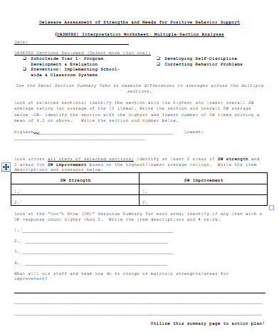
Interpretation Worksheet: Multiple-Section Analyses
Notes:
The next worksheet is for multiple-section analyses. Begin by filling out the date of your analysis and indicating the sections that your school has completed.

Slide 20
Interpretation Worksheet: Multiple-Section Analyses
Notes:
Next you look to identify which sections are the strongest and weakest overall for your school. There are two ways that you can determine this. One way is to compare the overall SchoolWide average for each section and identify the section with the highest and lowest overall SW average rating. Using this method, we see that this school’s highest section is Correction and its lowest section is Program Development and Evaluation. Once you identify your highest and lowest section, write the section name and the corresponding average on the space provided in the worksheet as shown on this slide.

Slide 21
Interpretation Worksheet: Multiple-Section Analyses
Notes:
The second way to look at your highest and lowest section is to look at the number of SchoolWide items scoring a mean of 4.0 or above. The section with the highest count is the strongest section and visa versa for the lowest section. In this data we see that the Correction section is highest as it has 9 items at 4.0 or above and the Program Evaluation and Development only has 7, making it it the lowest section. Record the highest and lowest section as well as the count on the space provided on the worksheet.
This information allows you to compare aspects of your schools performance against each other and may help with decisions on which areas you need to prioritize resources.

Slide 22
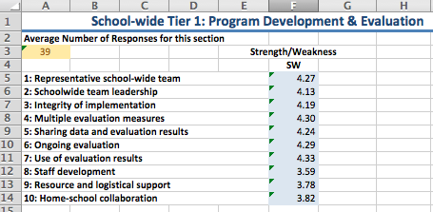
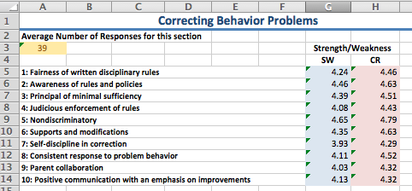
Interpretation Worksheet: Multiple-Section Analyses
Notes:
Now lets look at more specific areas of strengths or improvements across all sections. Look across all items of selected sections; Identify at least 2 areas of SchoolWide strength and 2 areas for SchoolWide improvement based on the highest and lowest average ratings. Then write the item descriptions and averages in the table of the worksheet.
In the data here, we look across all 20 SchoolWide items and find that the highest average is 4.65 Nondiscriminatory and the second highest is Awareness of Rules and Polices (4.46). The lowest averages are 3.69, Staff Development, and 3.78, Resource and Logistical Support.

Slide 23
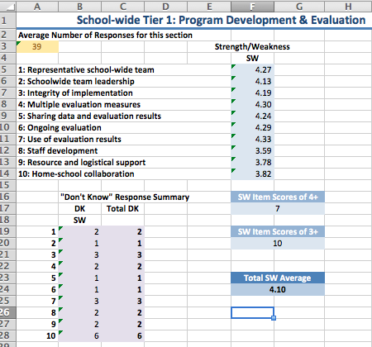
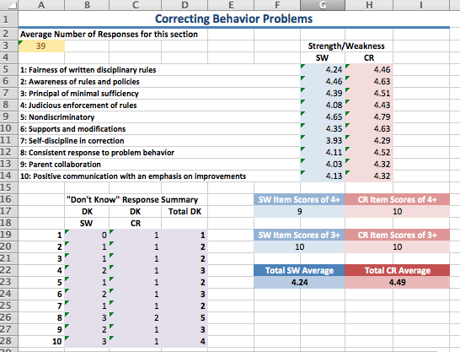
Interpretation Worksheet: Multiple-Section Analyses
Notes:
Now let’s look at the “Don't Know (DK)” Response Summary for each area. Identify if any item with a DK response count higher than 5 and write the item descriptions and # in the space provided on the worksheet. These are areas in which it would be good to understand why some staff feel uninformed.
In this data we see that there are 6 DKs about Home-school collaboration in relation to correction. Also there are 5 DKs total about consistent response to correction. This may be because staff are unaware of what others are doing in regards to these areas. This may be an opportunity for discussion among staff regarding how they respond to behavior and how they collaborate with the home.

Slide 24
Qualitative Analysis
Notes:
Its important to also look at the qualitative responses. You can find the comments in the Comment Report word document. For each section, your staff had the opportunity to provide a comment for each item rated as a 3 or lower. We recommend that you read through the comments for each section and see how they complete your quantitative data. Do your comments support your data? Are you seeing a trend in the comments that is not captured by your quantitative data?
While there is not a space on the worksheet to discuss comments, we recommend reviewing the comments after completing the worksheet and adding any notes that may be helpful for your team discussion.
For example, in this data we saw that “Consistent Response to Behavior Problems” had a higher level of DKs, and when looking at the comments, we see that several staff are concerned about consistency. While this may not be a weakness when looking at the numerical results, it is an area in which the team can delve further into by talking to the staff. Additionally, we also see comments in section 1 support the data in saying that Staff Development is an area of improvement for this school.

Slide 25
Interpretation Worksheet: Multiple-Section Analyses
Guiding questions for reflection/discussion:
Do scores accurately reflect strengths and needs for the school?
What might account for variability across raters?
What might account for any discrepancy between ratings of strength/weakness?
What changes might address identified needs?
Notes:
The section at the bottom of the Multiple-Section Worksheet- provides a place for your team to discuss action planning based on your results. What will your team do to change areas for improvement and maintain areas of strength?
The data Analysis document includes other questions to help guide discussion, some of which we have included here: Do scores accurately reflect strengths and needs for the school?
What might account for variability across raters?
What might account for any discrepancy between ratings of strength/weakness?
What changes might address identified needs?

Slide 26
Action Planning Recommendations
Use the summary results and staff responses to results to determine which components/items require immediate attention.
Target needs and actions for improvement
In planning, consider who will do what by when?
Continue to celebrate and emphasize strengths
Include in school improvement plan
Use in combination with other data: ODRs, School Climate
Notes:
Now that you have completed your data analysis and discuss action planning as a team. Keep these recommendations in mind as you proceed.
Use the results to determine which areas need immediate attention. Determine what will be done and by whom and when. Don’t forget to continue to celebrate and emphasize your school’s strengths. And finally, use this data in combination with your other data such as Office Discipline Referrals and School Climate Survey results to provide additional information about your schools strengths and needs.

Slide 27
Questions? Please Contact our DE-PBS Staff
www.delawarepbs.org
Sarah Hearn: skhearn@udel.edu
Notes:
Thank you for listening to our tutorial on the Delaware Assessments of Strengths and Needs for PBS.
Feel free to contact our staff if you have additional questions.

