Slide 1

A Step-By-Step Tutorial for the Discipline Data Reporting Tool
The Delaware Positive Behavior Support Project www.delawarepbs.org
Notes:
Slide 1:
Welcome to the tutorial for the Discipline Data Reporting Tool, also known as the DDRT, produced by the Delaware Positive Behavior Support Staff. This tutorial will take you through how to complete the DDRT step-by-step.
The DDRT templates can be downloaded from the Delaware PBS Website. They are located under “Forms & Tools-Tier1: Universal Tools”

Slide 2
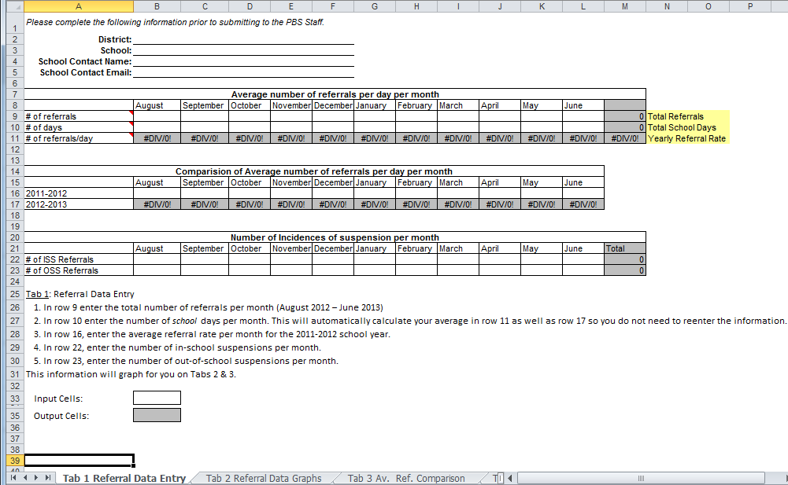
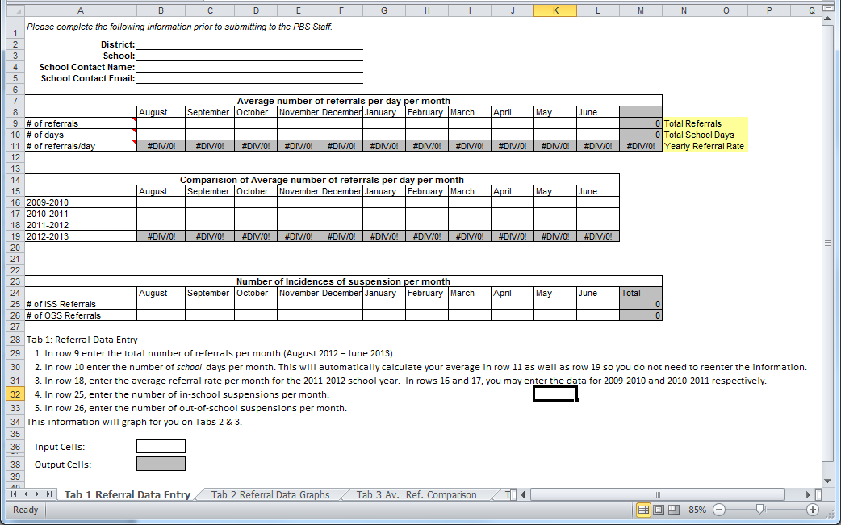
Choose the 2-year or 4-Year Template
2-Year Template
2 Year Template requires data from current and previous year (row 16-17).
4-Year Template
4 Year Template requires data from current and past 3 years (row 16-18).
Notes:
Slide 2:
There are two versions of the DDRT template: the 2-year template and the 4-year template.
*CLICK*
The 2-year template will require discipline data for the current year and previous year.
*CLICK*
The 4-year template will require discipline data for the current year and the past 3 years. You may choose which template to use based on the amount of previous data available to you. If you have 3 previous years of data available, it is recommended that you complete the 4-year template. While it may require additional work to compile the data, it will be helpful when looking for trends in your school’s referrals and may provide you with a better understanding of areas of need.

Slide 3
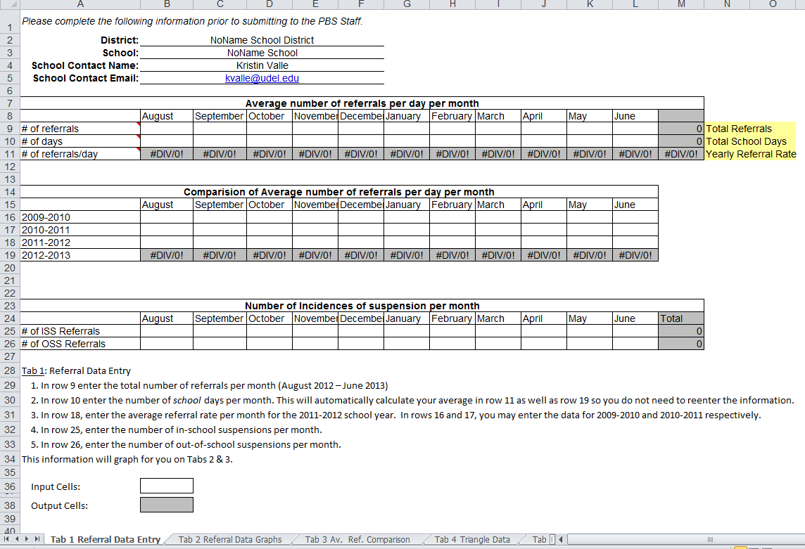
Step 1: Complete school and contact information on Tab 1
Notes:
Slide 3:
Let’s begin by opening the DRRT to “Tab 1 Referral Data Entry”. Tab 1 is the primary tab for data entry in this tool.
*CLICK*
First, begin by filling out your district name, school name, and your contact information in rows 2-5. Please be sure to complete this section prior to submitting your DDRT to Delaware PBS Staff and your district PBS Coach.

Slide 4
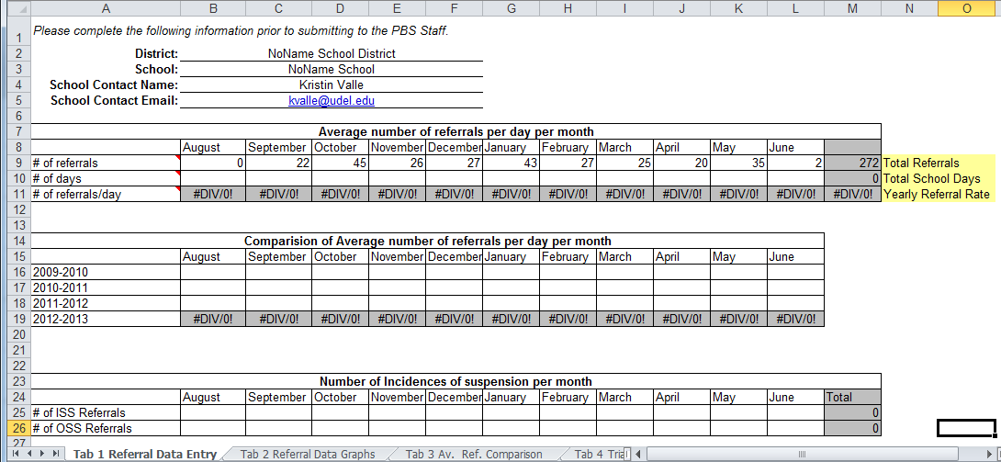
Data Entry
Output Cells
Input Cells
Notes:
Slide 4:
Now is time to begin entering your school’s referral data. Throughout this tool, data should be entered into white cells only. Do not enter data into grey cells, which are for formula output only.

Slide 5
Step 2: For each month, enter the number of referrals in row 9
Notes:
Slide 5:
In row 9, enter your school’s number of referrals for each month.
*CLICK*
Cell M9 will automatically provide a total number of referrals for the year based on your monthly entries.

Slide 6
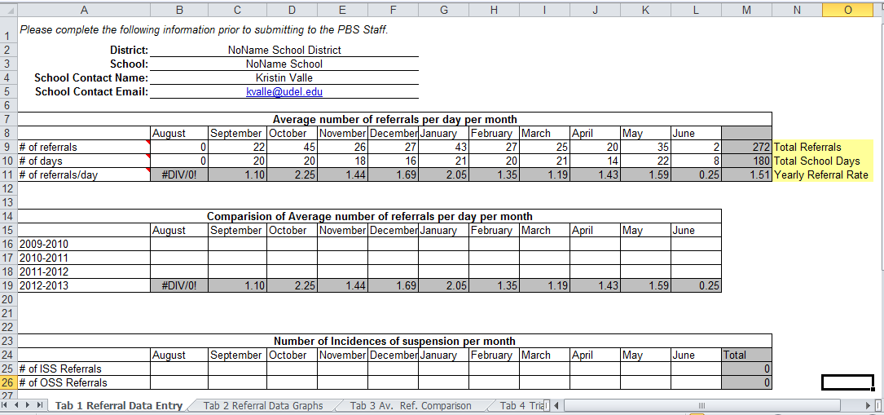
Step 3: For each month, enter the number of school days in row 10
This will automatically calculate your average in row 11 as well as row 19.
Notes:
Slide 6:
Step 3, for each month, enter the number of school days in row 10. Keep in mind that this is the number of school days and not calendar days. Weekends and holidays in which the school is closed should not be counted.
*CLICK*
Cell M10 will calculate the total number of school days for the year based on your entries.
*CLICK*
Once you have completed rows 9 and 10, the average number of referrals per school day will be produced in row 11 and also in 19 for the 4-year Template or 17 for the 2-year template.

Slide 7
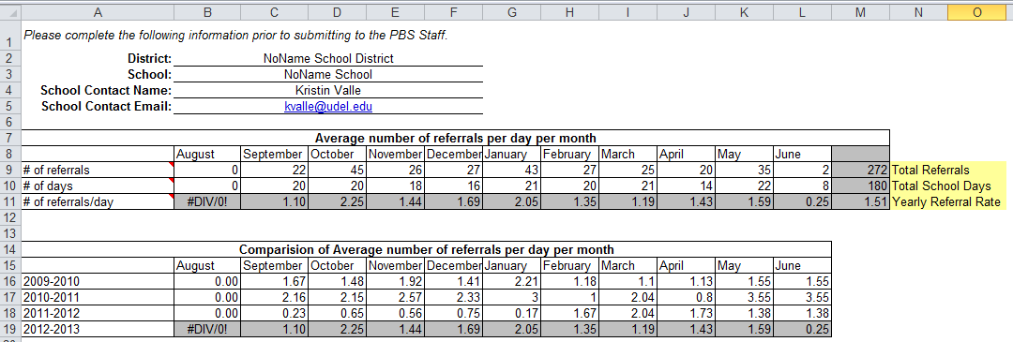
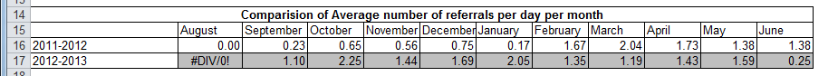
Step 4: For each month, enter the average referral rate from the previous year(s)
4-Year Template
2-Year Template
Notes:
Slide 7:
In Step 4, you will be entering data from previous years. For each month, enter the average referral rate for the previous school year in row 16 on the 2-year template or row 18 on the 4-year template.
The average referral rate for the previous school year can be copied over from last year’s DDRT or it can be calculated by dividing the number of referrals for each month by the number of school days in that month. On the 4-year template, enter the average referral rate for the previous 3 years in their corresponding rows.

Slide 8
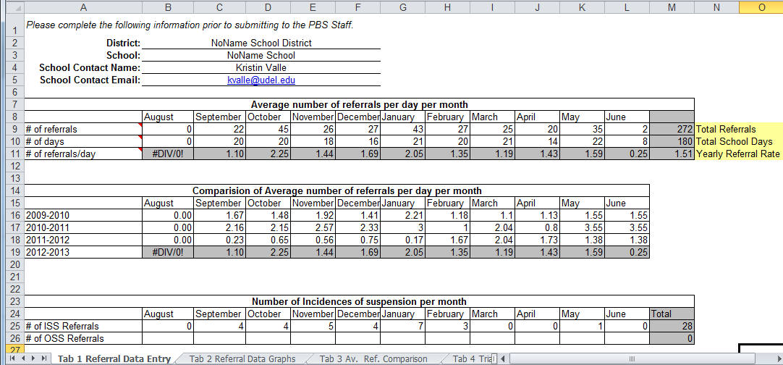
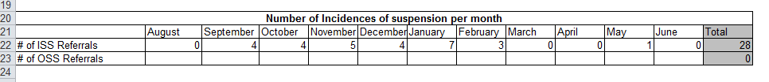
Step 5: For each month, enter the number of in-school suspensions in row 25 (4-year) or row 22 (2-year)
4-Year Template
2-Year Template
Notes:
Slide 8:
Step 5, for each month, enter the number of in-school suspension referrals in row 25 (4-year) or row 22 (2-year). If it is more useful to the team, you can record days of suspension per month. This data will graph in tab 2.
*CLICK*
The grey cell at the end of the row will automatically calculate the yearly total based on your monthly entries.

Slide 9

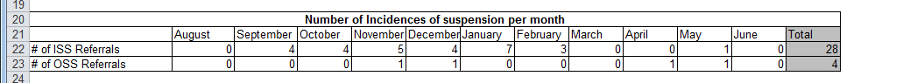
Step 6: For each month, enter the number of out-school suspensions in row 26 (4-year) or row 23 (2-year).
4-Year Template
2-Year Template
Notes:
Slide 9:
Similarly in Step 6, you will need to enter the number of out-school suspension referrals for each month in row 26 (4-year) or row 23 (2-year). Again you may choose to record days of suspension if this is helpful to the team.
*CLICK*
The grey cell at the end of the row will automatically calculate the yearly total based on your monthly entries. You have now completed the data entry on Tab 1. Let’s move on to Tab 2.

Slide 10
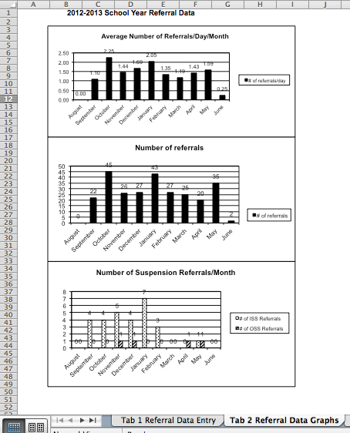
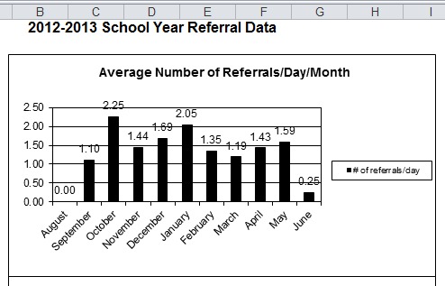
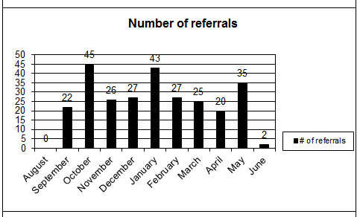
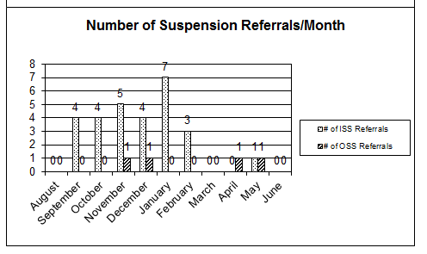
Tab 2: Referral Data Graph
Notes:
Slide 10:
On “Tab 2 Data Referral Graphs”, you will find 3 graphs that illustrate the data you have entered on Tab 1.
*CLICK*
The first graph charts the Average Rate of Referrals by month. As the referral rate is per day, each month can be compared directly regardless of the number of schools days in that month. This graph can be used to identify months with higher referral rates, which may be useful for program planning.
*CLICK*
The second graph is the number of referrals. This graph provides an understanding of the referral volume by month; keep in mind it does not take into account the number of school days per month.
*CLICK*
The third graph is the number of in-school and out-of-school suspensions. Here you can visually see your schools level of suspension by type across the year. Keep in mind that this graph is based on volume alone and does not take into account the number of school days in a month.

Slide 11
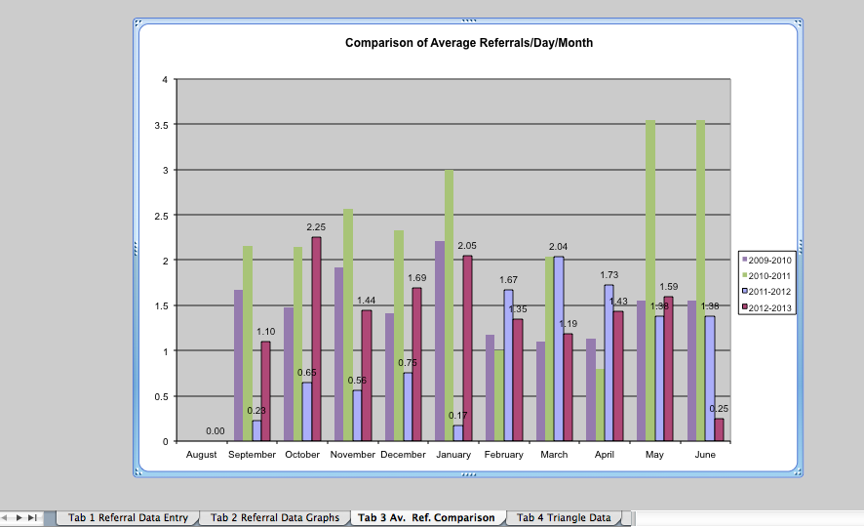
Tab 3: Comparison of Average Referrals
Notes:
Slide 11
Now let’s move to Tab 3 which includes a comparison graph of the average referrals per day per month across the previous years. Depending on which template you chose to use, you will be able to see 2 to 4 years of data. This graph is helpful for looking at trends throughout the year. For example- which months do referrals tend to be highest.
In this school’s graph it appears that January tends to be a time of higher referrals.
Or you might also look to see how referrals have change from year to year as a result of changes in school policy. For example, in this school’s chart they appear to have a strong decline in referrals from 2010-2011 to the first half of 2011-2012, but in the second half of 2011-2012 referrals increased.
After noting observations about the data, be sure to discuss as a team some hypotheses for reasons the data looks a certain way so that you can also come up with data-driven solutions.

Slide 12
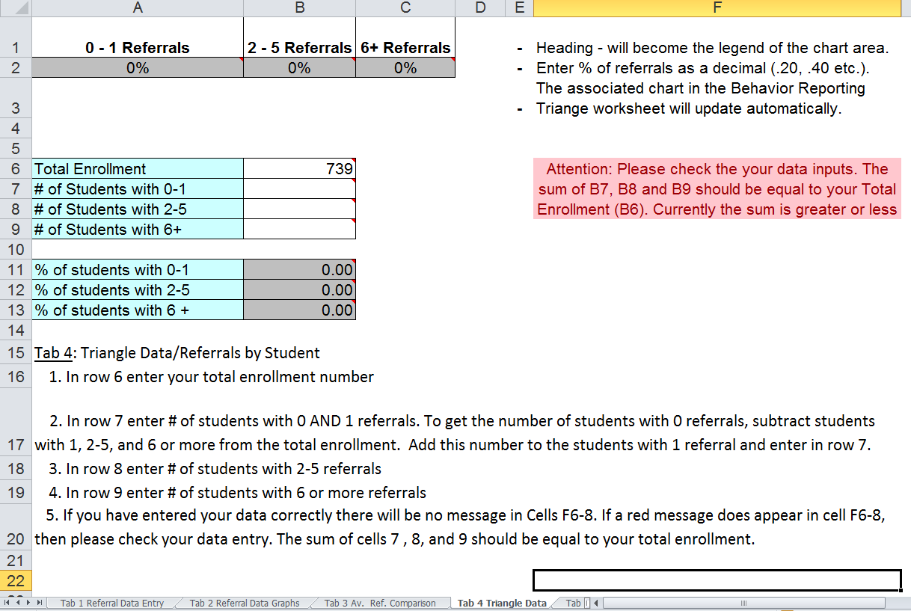
Step 7: On “Tab 4: Triangle Data”, Enter Total Student Enrollment in cell B6
Notes:
Slide 12
Ok so now we have reviewed the first 3 tabs, which primarily focus on understanding the volume and rate of referrals for your school throughout the year. The next two tabs help provide a snapshot of a school looks in terms of the level of intensity of the referrals using the Behavior Triangle. So let’s begin by first entering our data on tab 4.
*CLICK*
In step 7 of data entry, you will enter the total enrollment number of student in your school in cell B6.
*CLICK*
Once you have entered a number here you will see a red warning pop up in column F. For now, you can ignore that warning since you have not finished entering your data in this section. I’ll talk further about the meaning of this warning in just a minute.

Slide 13
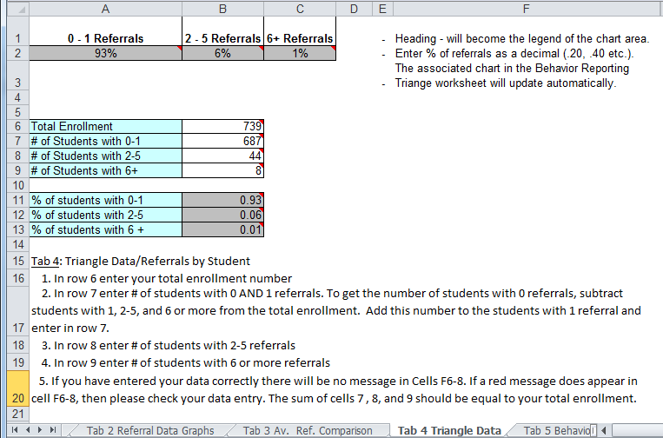
Step 8: Enter the number of students with 0-1 referrals in cell B7, 2-5 referrals in cell B8 and 6+ in cell B9.
Notes:
Slide 13:
The next step for data entry, step 8, requires you to enter data on the number of students that have a certain number of referrals.
*CLICK*
In cell B7, enter the number of students in your school with 0 or 1 referral this school year.
*CLICK*
In cell B8, enter the number of students in your school that have between 2-5 referrals this school year.
*CLICK*
Finally in cell B9, enter the number of students that have 6 or more referrals this school year.

Slide 14
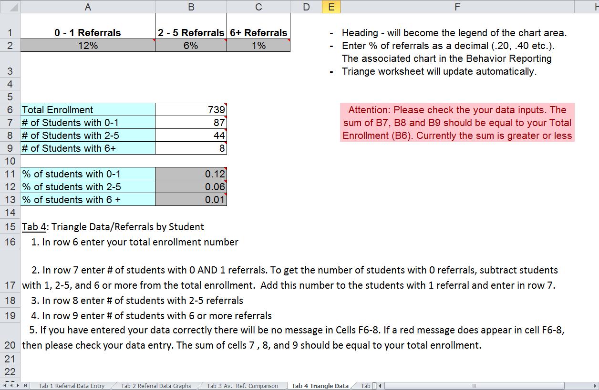
Be sure to include the number of students with 0 referrals in B7.
Notes:
Slide 14:
Do not forget about the students with zero referrals. A common mistake on this tab is entering only the students with 1 referral in cell B7.
If you have entered your data into cells B6, B7, B8 and B9 and you still see the red warning box in column F, then one of the data entries is incorrect. The sum of students in cells B7, B8 and B9 should be equal to the total enrollment because we are accounting for each student with these parameters.
If you have entered in your data and the red warning box in column F is not there, then your data has been entered correctly.

Slide 15
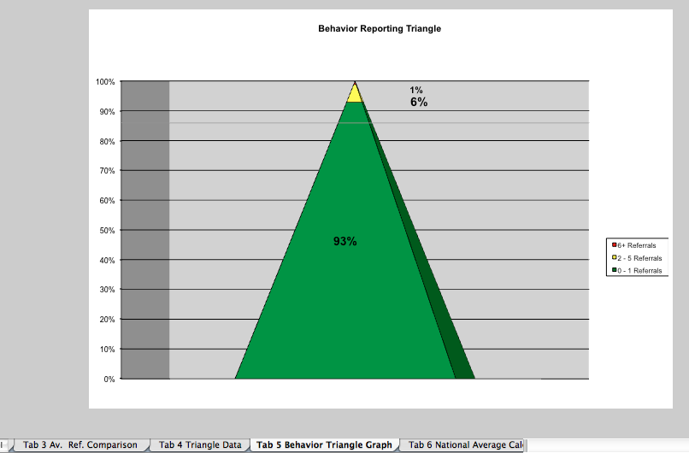
Tab 5 Graphs the Triangle Data from Tab 4
Notes:
Slide 15:
Now let’s take a look at Tab 5 where the data you have just entered is graphed in to the Behavior Triangle. As the Behavior Triangle is in fact a triangle, we would expect to see that the majority of students fall into the green area with 0-1 referrals, while students with a greater number referrals are fewer and make up the top of the triangle. In the sample Triangle, 93% of students have 0 or 1 referral, 6% have 2-5, and 1% have greater than 6 referrals.
Your triangle data may look similar or completely different depending on the population of student’s your school serves. The purpose of the Triangle is to help the staff identify the intensity of the referrals, so they may be matched equally with intensity of services.
Since this data is a snapshot in time, you may wonder how often it should be updated. We asked that at a minimum you update this tab at least quarterly. However, you may update this tab as often as you find it helpful throughout the year.

Slide 16
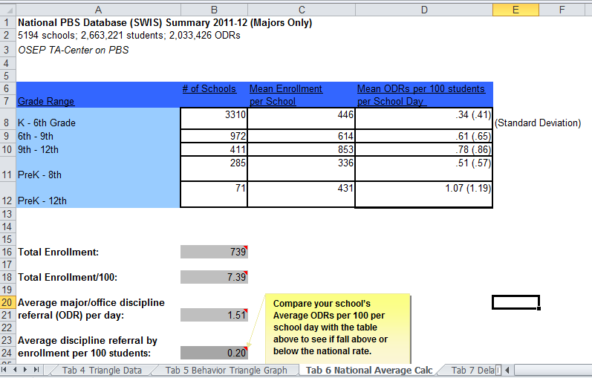
Tab 6: National Average Calculation
Notes:
Slide 16:
You have now completed the data entry portion of this template. The next 4 tabs will compare your school’s data to nationwide and statewide averages in order to provide perspective on your school’s discipline data.
Let’s take a look at Tab 6-“National Average Calc”. Tab 6 calculates the average referral rate per 100 students, so you can compare year to year without the bias of enrollment changes. The table contains a summary of national results that allows you to compare your average to other similar schools nationwide.
*Click*
Cell B16 contains your Total Enrollment, which is carried over from Tab 4.
*Click*
Cell B18 calculates your enrollment per 100 students by dividing your Total Enrollment by 100.
*Click*
Cell C21 carries over your office referral rate per day from Tab 1.
*Click*
Finally, the average discipline referral by enrollment per 100 students in calculated in B24, by dividing referral rate (C21) by the total enrollment per 100 students (C18).
*Click*
The next step for the team to take is to compare your school’s average discipline referral rate by enrollment per 100 students in cell C24 to the National Mean for your corresponding grade level which can be found in column D.
Let’s assume that the school’s data we are looking as in an elementary school. Their rate of .20 is just below the National Mean of .34 for Elementary schools in 2011-2012 and within the standard deviation range. So this school’s referral rate is on par with national referral rates.

Slide 17
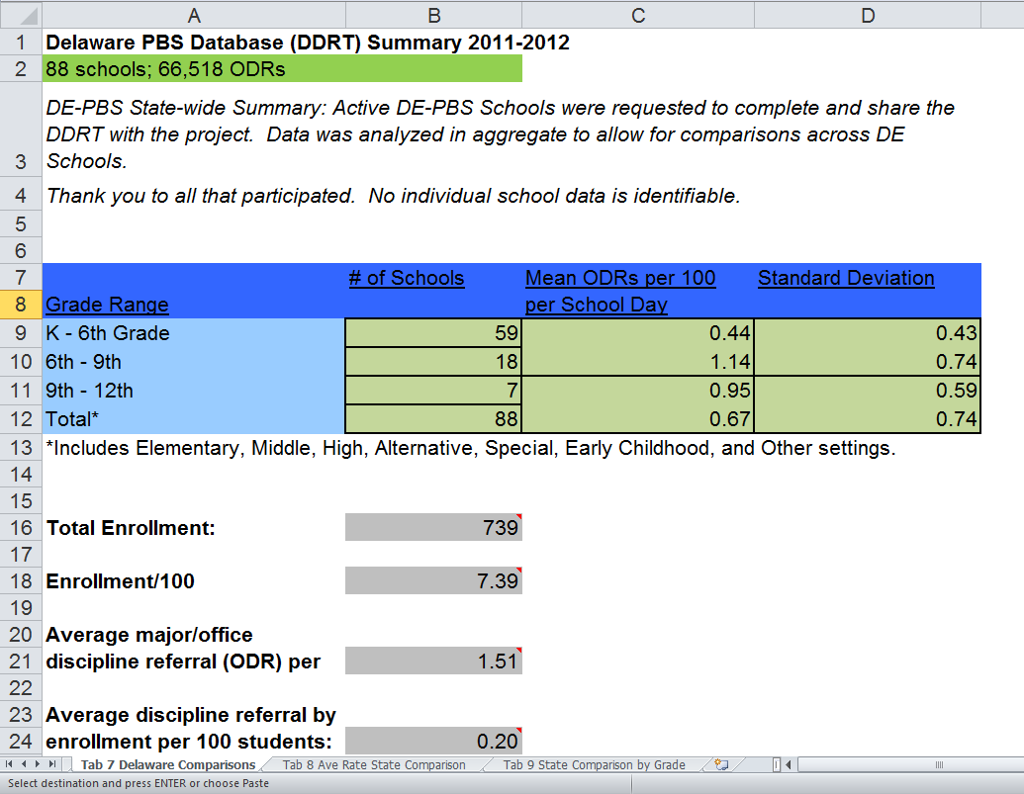
Tab 7: Delaware Comparison
Notes:
Slide 17:
Let’s take a look at Tab 7 “Delaware Comparisons”. Tab 7 calculates your school’s average discipline referral by enrollment per 100 students in cell C25 using the same method as on Tab 6.
*Click*
Cell B16 contains your Total Enrollment, which is carried over from Tab 4.
*Click*
Cell B18 calculates your enrollment per 100 students by dividing your Total Enrollment by 100.
*Click*
Cell C21 carries over your office referral rate per day from Tab 1.
*Click*
The average discipline referral by enrollment per 100 students in calculated in B24.
*Click*
As with Tab 6, use the Table at the Top of the Tab to compare your school’s referral rate to that of the Delaware PBS State Mean for schools of the similar grade level. If your school does not fit into one of the grade levels, compare your referral rate to the Total Mean.
For example, using the data on this page, you would compare this Elementary school’s rate of .20 in cell C25 to that of the Delaware PBS Elementary Schools Mean of .44. This school would conclude that there referrals are somewhat lower than the average for the state, but within the standard error of measure.

Slide 18
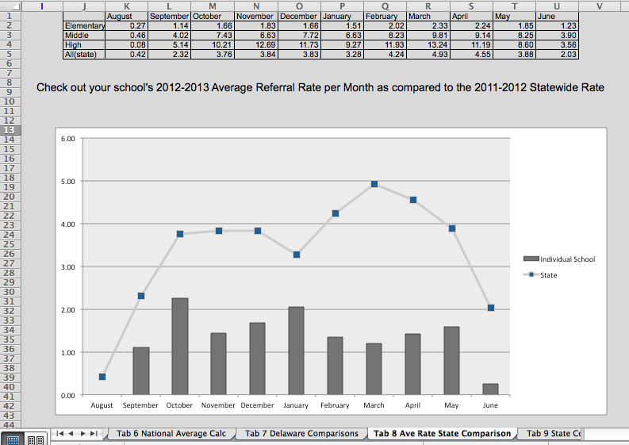
Tab 8: Ave Rate State Comparison
Notes:
Slide 18:
On the next tab, Tab 8, you will be able to see how your school compares to the state averages for each month. The data table at the top of the tab includes the state averages per month by grade population served and the statewide total. The graph below it shows how your school’s referral rate per month compares to the total state average per month. The line represents the monthly average referral rates for the state. Your school’s rates are represented by the grey bars.
Here, you can see that this school’s average rates are below the state average throughout the whole year.

Slide 19
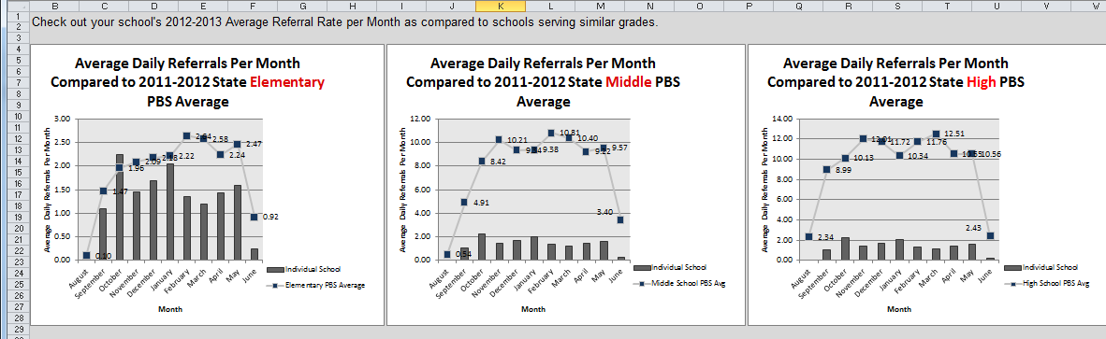
Tab 9: State Comparison by Grade
Elementary School
Middle School
High School
Notes:
Slide 19:
On the final tab, Tab 9, you will see a similar graphs to the one on Tab 8. These three graphs will chart your school’s referral rate in the grey bars and the state averages by grade population served with the line. The first chart is the elementary state averages, the second is Middle, and the third graph is High School. Here you will only need to look at the graph that matches the grade level of your school.
For example, this school is an elementary school, so we will examine the first graph only. Although this school had a total referral rate that was lower than the state Elementary average, we see here on the graph that in the months of October and January the referral rate is higher than the state average.

Slide 20
Additional Questions?
Contact one of the PBS Staff:
  Kristin Valle: kvalle@udel.edu
  Sarah Hearn: skhearn@udel.edu
  You can find the DDRT Templates and other resources on our website:
    www.delawarepbs.org
Notes:
Slide 20:
This completes the Step by Step Tutorial of the Delaware DDRT. If you have any questions please feel free to the PBS Staff.
We hope that your School-wide PBS Team will utilize this tool in addition to other data summaries for making data-based decisions and action plans.

