Slide 1
DE-PBS Cadre
May 8, 2013

Slide 2

Appreciation
“Gratitude makes sense of our past, brings peace for today, and creates a vision for tomorrow”
-Melody Beattie

Slide 3
Secondary Celebration
Debriefing
Lights! Camera! Next Action Steps!
Film debrief
Secondary Panel Presentations
Student Session – Dream School
RENEW interest

Slide 4
Secondary Panel Presentations
Lake Forest High Promoting SW-PBS Expectations through a Student Fashion Show
Newark High Students Promoting Teacher & Student Buy-In for SW-PBS
Redding Middle SW-PBS Student Leadership at the MS Level: The FISHES Student Group
Dover High SW-PBS Student Leadership at the HS Level: Dover High’s Rap Group

Slide 5

School Connectedness
Body of research indicates students’ emotional connectedness to school is directly related to their choices about activities involving drugs and violence
EVERY student has a need for recognition, acknowledgement, purpose, belonging, and competence
National Center on Inclusive Education
www.inclusiveed.org

Slide 6
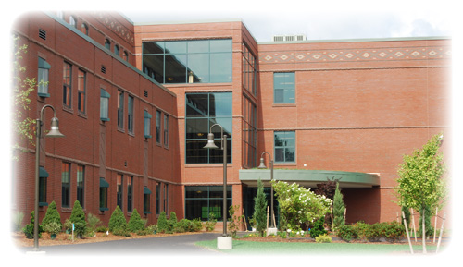
Planning Your Ideal School
What are some of the problems/ challenges in schools?
What would an ideal school look like?
How would students behave?
What would exist to engage all students?
National Center on Inclusive Education
www.inclusiveed.org

Slide 7

What Works and Doesn’t Work
Purpose: Identify situations that are helpful and detrimental.
There are two columns. For the first, tell us what works in school that is successful. The second column is for the situations and things that don’t work.
National Center on Inclusive Education
www.inclusiveed.org

Slide 8
In groups of 4:
Choose 1 facilitator, who will record answers on the flipchart paper
Discuss with your group what works/ Doesn’t work in your school regarding the following topics: communication/ relationships, learning environment
What Works!!!
What Doesn’t Work!!!
National Center on Inclusive Education
www.inclusiveed.org

Slide 9
D R E A M
S C H O O L
MY
The sky is the limit! You have just been put in charge of creating the ideal school.
In your groups of 4, Choose 1 facilitator, who will record answers on the flip chart paper.
Discuss with your group what your ideal school would be like ?
National Center on Inclusive Education
www.inclusiveed.org

Slide 10
? Questions to Consider ?
What would the expectations for students/ teachers be?
How would expectations be communicated and reinforced?
Would you attend for shorter days year round or have longer days with less summer vacation?
How would different types of learners be engaged in school/ academics?
How would all students be challenged to think creatively, and be prepared for the world of work and adult life beyond high school?
What else would you need to consider in creating your ideal school?
National Center on Inclusive Education
www.inclusiveed.org
Notes:
Some of the questions on slide – full list from presentation below
What would the expectations for students/ teachers be?
How would expectations be communicated and reinforced?
Would you attend for shorter days year round or have longer days with less summer vacation?
How would different types of learners be engaged in school/ academics?
How would all students be challenged to think creatively, and be prepared for the world of work and adult life beyond high school?
What would students and teachers interactions look like?
What would the culture be like?
What beliefs and attitude would be prevalent/ mainstream?
What kinds of activities, schedules would be in your school?
What else would you need to consider in creating your ideal school?

Slide 11

Next Steps
Purpose: To brainstorm ways to achieve a particular goal. What is needed to reach that goal?
Activity: Choose one goal from your “Dream School”
Group will brainstorm steps in achieving the goal– 5 Minutes
The group will develop an action plan for next steps.
National Center on Inclusive Education
www.inclusiveed.org

Slide 12

My Goal:
Action Item | Who Responsible | Due Date
My Action Plan
National Center on Inclusive Education
www.inclusiveed.org

Slide 13
Debrief
Share your ideal school with the larger group
How does your ideal school differ from your current or previous school?
What would need to change/happen for your school to look more like your ideal school?
What can YOU do to help make that happen?
National Center on Inclusive Education
www.inclusiveed.org

Slide 14

RENEW
School-to-career transition planning program and individualized wraparound process
Developed for students with emotional and behavioral challenges
Focused upon supporting youth to design and pursue a plan for the transition from school to adult life

Slide 15
RENEW
Increased high school completion and post-secondary education participation rates
Reduction of behavior problems in school and community
Increased employment rates
Increased youth self-determination and self-efficacy skills
High youth satisfaction rates

Slide 16

DE-PBS Phase Recognition
2012-2013 Phase 1 & 2 Available
Due in full by Friday, June 28, 2013
Confirmation of application receipt by July 8, 2013; schools to contact Sandi if they do not receive confirmation
Materials:
  Application
  Frequently Asked Questions
  Reflection Question Guide

Slide 17
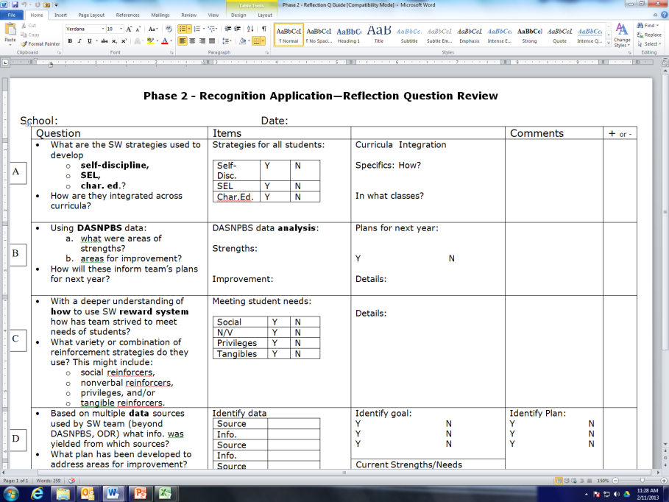
Remind schools to use the Reflection Question Review sheet when teams are selecting, creating, and reviewing their reflection questions.

Slide 18
Phase 3: Establishing Tier 2: Problem Solving Team PILOT
Phase 3 Application – Pilot
Offered to 7 schools
Previously awarded Phase 2 Recognition
Expressed interest in Phase 3 and/or strong Key Feature Evaluation performance

Slide 19
Data & Survey Support
School Climate Data
Key Feature Evaluation
DE Survey table sharing
DDRTs – August 2012 – June 2013 due June 28

Slide 20
Key Feature Evaluation Updates
28 completed across 8 districts
Finalize level scores this summer using the data from these schools
Supporting schools with using report for action planning
KF Tracker – use as self-assessment or coach check in
Selecting Schools for next year

Slide 21
Key Feature Status Tracker
Checklist #1: School-wide PBS Tier 1: Program Development and Evaluation
 |  | Status: In Place, Partially in Place, Not in Place
Date: (MM/DD/YY)
Data 1. Behavior referrals are entered into the school’s electronic system within a week. | Status:
2. School participates in “DE School Climate Survey”: Staff, Student, Home (w/in past year). This data is used by team to plan in planning and evaluating the PBS program. | Status:

Slide 22
2013-2014
KFE Evaluation Planning
Schools that have participated in the KFE:
School | Dated Trained in SW-PBS | KFE Date
DE-PBS High School | June/05 | 11/11/2012
Schools that have not participated in the KFE:
School | Dated Trained in SW-PBS | Is School Ready for KFE? | If "No," why?
DE-PBS Elementary | Fall 2007

Slide 23
Summer PD for 2013
SW PBS Team Training June 18 & 19 (Tuesday and Wednesday) with Late Fall 2013 follow up
Jill Kuzma – August 7
  Strategies to Support Executive Function Skills in Students with Planning, Organization, Emotional Control, Working Memory and Attention Needs

Slide 24
Summer Work Groups
Classroom Management
Resource Reviews

Slide 25
Planning for Next year
Prevent – Teach – Reinforce (PTR)
  New Facilitators for 2013-14
  Networking with year 1 & 2 Facilitators
  Creating a website with completed PTR tools (without identifying information)

Slide 26
2013-2014 Cadre Planning
2012-2013
2013-2014
4 Meetings - 1/2 day sessions
Theme of recognition
Project coach contacts
Project updates
Feedback opportunities
Networking
For consideration:
Number of meetings
Timing of meetings
Topics

Slide 27

District Reflection & Sharing
Reflect on 12-13 School Year
Plans for 13-14 School year

