Slide 1
DE-PBS Cadre Summer Retreat
Thursday, August 1, 2013

Slide 2

Aloha!
How long have you been involved with DE-PBS?
How long have you had a coaching role?
What words come to mind when you think about coaching?

Slide 3
Materials
Parking lot/Future topics
Agenda
Materials

Slide 4

Goals
Network among coaches
Share ideas
Share resources
Gather topics/ideas for future cadre meetings
Others?

Slide 5
Tier 2 & 3 Reflections
1. What Tier 2/3 interventions did your school(s) try this year?
  How successful were these interventions?
2. What are the areas in which you/schools still think additional supports are needed?

Slide 6


Tiers 2 & 3

Slide 7
System Development is Key!
Dean Fixsen, Karen Blase, Robert Horner, George Sugai, 2008
To scale up interventions we must first scale up implementation capacity
Building implementation capacity is essential to maximizing the use of EBPs and other innovations
★ Slides are from presentations of the Illinois PBIS Network
Notes:
(6: Systems need tending to) We’ve all spent too much time chasing practices we’ve heard of or read about, without realizing that if we don’t have a system to support those practices…then they are limited in their usefulness. So we have modified our training curriculum to focus on system-development at all tiers.

Slide 8
Schools/districts need to reflect on the system of support they are using
Is your Tier 2 designed to support 7-15% of your student population?
Can Tier 2 interventions be delivered within 72hrs of identification of need?
Do your SpEd & GenEd systems work together? Hand-off? or Compete?
Does everyone know how the system works?
Is it simple and easy?

Slide 9
Schools need to be clear about what interventions they have (and don’t have) in place
Data and Support Staff
Tiered Supports / Practices
Tier 3/Tertiary Interventions 1-5%
_____________________
_____________________
_____________________
1-5% Tier 3/Tertiary Interventions
        ___________________________
        ___________________________
        ___________________________
Tier 2/Secondary Interventions 5-15%
___________________________
___________________________
___________________________
___________________________
___________________________
___________________________
5-15% Tier 2/Secondary Interventions
        ____________________________
        ____________________________
        ____________________________
        ____________________________
        ____________________________
        ____________________________
Tier 1/Universal Interventions 80-90%
________________________
________________________
________________________
________________________
80-90% Tier 1/Universal Interventions
        ____________________________
        ____________________________
        ____________________________
        ____________________________
        ____________________________
Adapted from Illinois PBIS Network, Revised May 15, 2008. Adapted from “What is school-wide PBS?” OSEP Technical Assistance Center on Positive Behavioral Interventions and Supports. Accessed at http://pbis.org/school-wide.htm
Notes:
9
(4: schools need to flush out their own triangle) So…first thing you want to do when you go back to school tomorrow…is to think about “what interventions do we actually have at each tier”. List them out..plug them in where you think they belong based on what you know about the 3 tiers. If you’ve done this before, do it again : ) you want to make sure you’re capturing everything..including any new interventions you may have developed recently. If you haven’t done this…you may find the “crack” that children are falling thru…you may find (as many of our schools have) that the ‘gap’ we need to close is actually the yellow part of this triangle… Most schools do not have enough secondary interventions (both in quantity and type/quality) needed to support their student body. Think about it…can your Secondary system hold 15-20% of the youth in your school? (school of 1,000 is 200 kids, 500 is 100 kids)?? Everyone needs to know what this completed triangle looks like for your school: your teachers, clinicians, administrators, families…

Slide 10
3-Tiered System of Support
Necessary Conversations (Teams)
Universal
Team
Secondary Systems Team
Problem Solving Team
Tertiary Systems Team
Uses Process data; determines overall intervention effectiveness
Uses Process data; determines overall intervention effectiveness
Plans SW & Class-wide supports
Standing team; uses FBA/BIP process for one youth at a time
Universal Support
CICO
Brief
FBA/BIP
SAIG
Complex
FBA/BIP
WRAP
Group w. individual
feature
Brief FBA/BIP
Sept. 1, 2009
Notes:
10
10

Slide 11

Teaming at Tier 2
Secondary Systems Planning “conversation”
  Monitors effectiveness of CICO, S/AIG, Mentoring, and Brief FBA/BIP supports
  Review data to make decisions on improvements to the interventions
  Individual students are NOT discussed
Problem Solving Team “conversation”
  Develops plans for one student at a time
  Every school has this type of meeting
  Teachers and family are typically invited

Slide 12
Secondary Systems Planning Team
Meeting Agenda
Number of students in CICO (record on Tracking Tool)?
  Number of students responding (record on Tracking Tool)?
  * Send Reverse Request for Assistance to teachers of all youth not responding
  Number of new students potentially entering intervention (share # of RFAs or # of students who met the data-based decision-rule)?
Repeat for S/AIG, Mentoring & Brief FBA/BIP
If less than 70% of students are responding to any of the interventions, the Secondary Systems team should review the integrity of the intervention and make adjustments as needed.
Notes:
12

Slide 13
Numbers to Keep in Mind
7-15%: Percent of total population expected to need and be supported by Tier 2 interventions
1-5%: Percent of total population expected to need and be supported by Tier 3 interventions
70%: Percent of youth (receiving intervention “X”)that should be responding to intervention
Data-based Decision-Rules for determining response must be defined
  Data sources defining response are efficient
    Ex. Daily Progress Report (DPR) cards

Slide 14
Tier 2/Tier 3 Interventions
Tracking Tool Activity (20 mins)
1) What is your total building population?
2) What would 5% of your building population be? What would 15% be? Consider these two numbers for a range of students who should be receiving Secondary Interventions
3) What would 1% of your building population be? 5%? Consider these two numbers for a range of students who should be receiving Tertiary Interventions.
4) Using these calculations, what are the potential number of students your building could be serving at each Tier 2 and Tier 3 intervention?
5) What are some steps can your building take to prepare to serve these students?

Slide 15
Your “Model” of Support
List official teams/meetings in 1st row, team/mtg. purpose 2nd row & use bottom cluster of boxes for student interventions.
Use arrows to indicate “direction of intervention layering” (If youth don’t respond to intervention ‘X’, what do they get next?)
Notes:
15
15

Slide 16
Tier 2/Tier 3 Tracking Tool
Structured to follow all levels/types of interventions from Secondary through Tertiary
Increases accountability
  Teams have to count # of students in interventions
  Data-based decision-rules are necessary (Identify, Progress-monitor, Exit)
  Must define “response” to each intervention type/level
  Shows % of students who responded to each intervention
Assesses the success rate, or effectiveness, of the interventions themselves
Connects each level of intervention to the next level

Slide 17
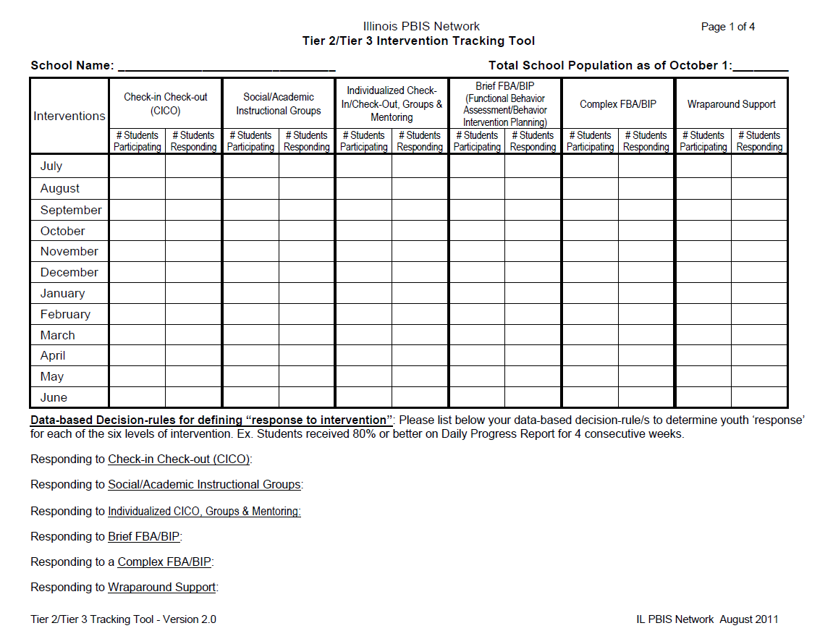

Slide 18
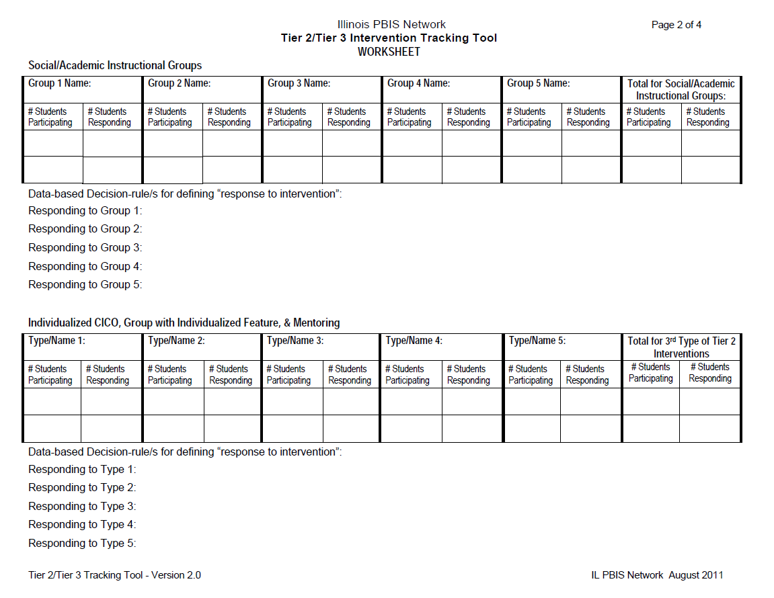

Slide 19
Data-Based Decision-Making
Outcome and Process Data
Student outcome data is used to:
  Identify youth in need of support and to identify appropriate interventions
  Progress-monitor youth response to intervention
  Exit or transition youth off of interventions
Intervention process data is used to:
  Assess intervention fidelity
  Monitor the effectiveness of the intervention itself
  Make decisions regarding the continuum/menu of interventions/supports

Slide 20
Tier 2/3 Guiding Questions
(a Coaches’ assistant)
Efficient: teams plan ahead, discuss components of the system
Open ended: encourages teams to think about what they currently do
Guides teams to develop ‘decision rules’
Documentation: can be shared with new team members, new staff, families, district leaders etc.
Tool is completed in parts, teams develop their intervention systems as they approach each level
Revisited only when reviewing/modifying system
Notes:
Take a look at pages 3 and 4 and think about how you could help your teams use these questions to enhance existing interventions or develop new needed interventions

Slide 21

Tier 2
Coach Intervention Idea
Sharing & Discussion

Slide 22
Tier 2 Project Resource Sharing
Organizational Check-up
Behavior Education Program
Check and Connect

Slide 23

HS-BEP
Tier 2 Intervention:
The High School – Behavior Education Program
(An Example of An Academic Seminar in Oregon)
DE-PBS Cadre
2013 Retreat

Slide 24

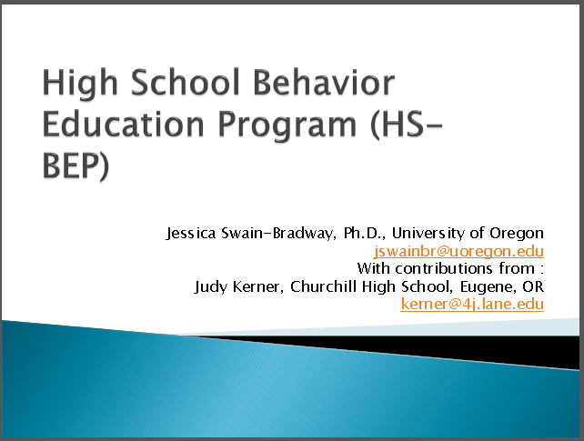
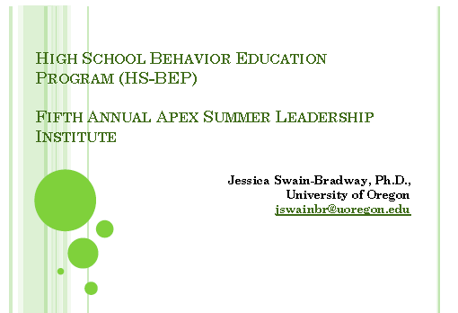
HS-BEP: An Academic
Seminar with PRIDE
Materials Come From Multiple Resources From:
  Jessica Swain-Bradway
    Ph.D., University of Oregon
    jswainbr@uoregon.edu
  Judy Kerner
    Churchill High School, Eugene, OR
    kerner@4j.lane.edu
  Melanie Morrison
      Churchill High School, Eugene, OR

Slide 25
HS-BEP: An Academic
Seminar with PRIDE
CRITERIA:
“Academic Seminar Plus PRIDE targets freshman and sophomore students who meet the following criteria:
Student is engaging in problem behavior, but no “crisis” behaviors.
Improved structure would help student succeed.
Student may lack organizational skills.
Student is placed at appropriate instructional level for academic courses (math, reading, history, etc).
Student is not achieving at least a C in core classes due to lack of, or poor quality completion of: class/ homework, tests, or class projects.”
                (Excerpt from Handbook, pg. 4)

Slide 26
HS-BEP: An Academic
Seminar with PRIDE
COMPONENTS:
The Academic Seminar Plus PRIDE Card intervention is a secondary level intervention for high school students designed to:
Decrease the difficulty of academic task by providing:
  explicit instruction in organizational and self-management skills, and homework completion assistance
Increase positive adult interaction and specific behavioral prompts through use of the PRIDE Card, a daily behavior report card.
                (Handbook, pg. 4)
The overarching goal of the class is for students to become fluent in the organizational and self-management skills required for successful completion of class work, homework, tests, and projects. The relevance and applicability of the organizational skills extend past high school to post-secondary, real-world settings.
            (Excerpt from Handbook, pg. 7)

Slide 27
HS-BEP: An Academic
Seminar with PRIDE
COMPONENTS:
Academic Seminar is a 45-minute period designed to decrease the difficulty of academic tasks through explicit teaching of academic skills and supported homework completion.
As much as possible the scope and sequence of the specific academic skills are organized to mirror Small Learning Community (SLC) academic demand so the skills learned in Academic Seminar can be applied to general content assignments.
      (Excerpt from Handbook, pg. 7)

Slide 28
HS-BEP: An Academic
Seminar with PRIDE
COMPONENTS:
45 minute class
  5 minutes: Entry Task, Check-In
  15 minutes skill building: foundational organizational skills
  25 minutes supported homework completion: application of organizational skills to homework activities
Daily class
  First period of the day
Student participates in CICO cycle
  First period HS-BEP class serves as morning check-in period
  HS-BEP teacher coordinates CICO
      (Excerpt from Swain-Bradway, 2010 slide)

Slide 29
HS-BEP: An Academic
Seminar with PRIDE
CURRICULUM SCOPE:
  Identification of school-wide expectations, Lancer PRIDE
  Goal setting for academic and social behaviors
  Use and maintenance of a planner or assignment sheet
  Organization and maintenance of notebooks, backpack
  Test taking / study strategies
  Creation of a Graduation Plan
  Use of school based technology (emails, web pages, etc)
  Tracking assignment completion and grades
      (Excerpt from Handbook, pg. 7)

Slide 30
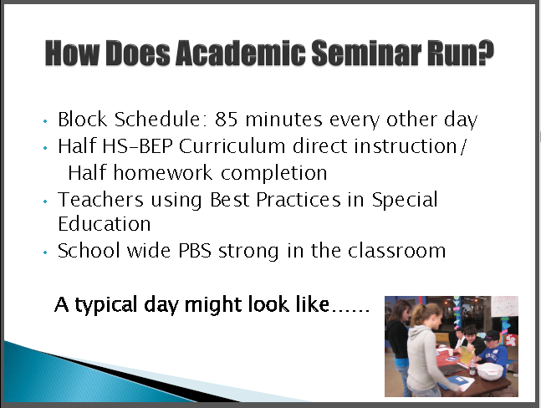
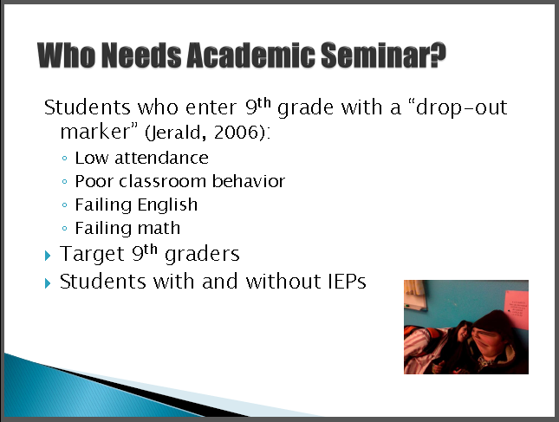
HS-BEP: An Academic
Seminar with PRIDE
COMPONENTS MAY NEED TO CHANGE:
      (Excerpt from Swain-Bradway and Kerner, 2009 slide)

Slide 31
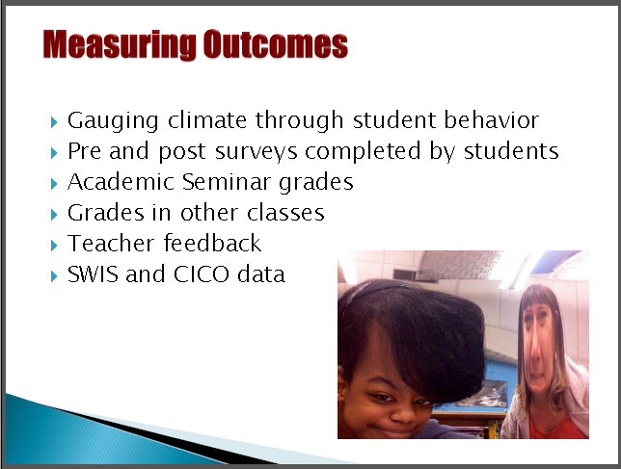
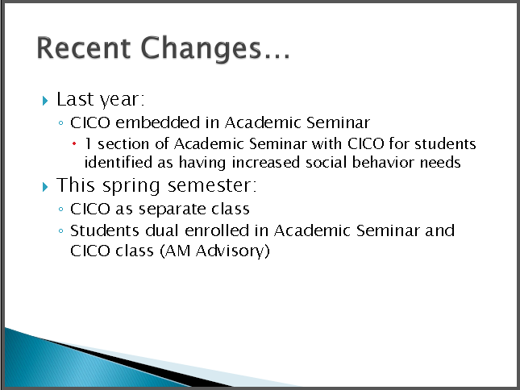
HS-BEP: An Academic
Seminar with PRIDE
USE DATA TO DETERMINE SEMINAR EFFECTIVENESS :
      (Excerpt from Swain-Bradway and Kerner, 2009 slides)

Slide 32
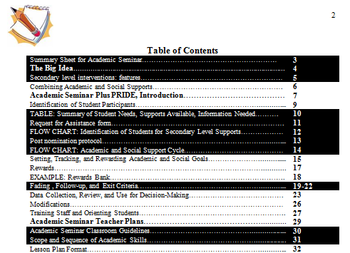
HS-BEP: An Academic
Seminar with PRIDE
ADDITIONAL RESOURCES IN HANDBOOK:
      (Excerpt from Handbook, pg. 72)

Slide 33
Check and Connect
Tier 2 intervention
Designed to increase student engagement
Role of “monitor”
  Checks in with student regularly to discuss progress
  Provides feedback
  Intervenes when problem occurs
  Coordinates services

Slide 34
Tier 3
Coach Intervention Idea
Sharing & Discussion
Notes:
Kittie & Mike

Slide 35
Tier 3 Project Resource Sharing
FBA/BSP – Technical Assistance Flow Chart
FBA/BSP - Fidelity-Check/Monitoring Form
Key Intervention Strategies at Tier 3

Slide 36
Tier 2 & 3 Reflections
3. What goal(s) do you have for your district regarding Tier 2/3 interventions in 2013-2014?
  What is your first step when you get back home?

Slide 37
Self-Discipline &
Student Relationships Reflections
4. What strategies did your school(s) try this year to encourage self-discipline and improve student-to-student relationships?
  How successful were these interventions?
5. What are the areas in which you/schools still think additional supports are needed?

Slide 38
Self-Discipline and DE-PBS Overview
DE-PBS Key Feature
Schools recognize the importance of developing self- discipline, implementing evidence based programs in character education and social and emotional learning, and/or infusing lessons throughout the curriculum that teach social-emotional competencies

Slide 39
DE’s approach to SWPBS
Although similar to the SWPBS approach found in many other states, Delaware’s approach (DE-PBS) places much greater emphasis on integrating common features of SWPBS with those of the Social and Emotional Learning approach (SEL; see www.CASEL.org). In integrating these two popular approaches, the primary goal of DE-PBS is to create safe and caring learning environments that promote the social-emotional and academic development of all children.

Slide 40
 | Approach
Components of Comprehensive School Discipline | Traditional SWPBS | SEL
Developing the social and emotional competencies of self-discipline | Weakness | Strength
Preventing behavior problems | Strength (more so for immediate environment) | Strength (more lasting effects)
Correcting behavior problems (short-term goal) | Strength | Weakness
Addressing Tier 2 and 3 Needs | Strength | Weakness
Notes:
Both aims are critically important.
Both approaches have strengths and weaknesses.
A blend of the two approaches would be consistent with best practices of the most effective teachers.

Slide 41
What does the research say regarding integrating the two approaches?
In the areas of school discipline, classroom management, and childrearing, the best approach is that of Authoritative Discipline (combination of structure and support), which blends strategies of SEL and SWPBIS
  Best for achieving compliance
  Best for promoting self-discipline and resilience
  Best for effective prevention and correction
  Best for school climate
  Best for preventing bullying

Slide 42
What is Self-Discipline?
Consists of 5 key Social and Emotional Learning skills:
Self-management skills
Social awareness and empathy
Social connectedness and relationship skills
Responsible decision making
Positive sense of self

Slide 43
What is Self-Discipline?
Consists of each of the social and emotional skills, but especially:
  Responsible decision making at school, home, and in the community
  Self-management of emotions and behavior, and doing so under one’s own volition.
Connotes the critical notion of internalization, as seen in
  Committed compliance or willing compliance

Slide 44
Often used interchangeably with:
  Autonomy
  Self-determination
  Responsibility
  Self-regulation
  Self-control
  Used to remind educators that there is more to school discipline than the use of discipline.
  LONG-TERM goal!
Notes:
Children internalize the values, standards, beliefs, and attitudes of their parents and others in society, and in the process of doing so they actively transform them and endorse them as their own.

Slide 45
It’s not just what you see (observed behaviors), but about how children:
How children behave in your absence is more important than how they behave in your presence or when punishment and rewards are not highly salient.
Think
Feel
Act

Slide 46
Incorporating Self-Discipline in Your SW PBS Framework
  Relationship building
  Schoolwide policies and activities
  Student decision making
  Corrective Procedures
  Social and Emotional Curriculum
  Strategic Use of Praise and Rewards

Slide 47
1. Positive Relationships
Not only do students like teachers who are caring, respectful, and provide emotional support, but when those qualities are found students also show increased:
school completion, academic engagement, and academic achievement
peer acceptance
motivation to act responsibly and prosocially
subjective well-being

Slide 48
Student-Student Relationships
Students with positive peer relationships experience greater:
  academic initiative and achievement
  liking of school
  school completion
  self-esteem
They experience less:
  school avoidance
  depression
  delinquent and aggressive behaviors
  bullying
Notes:
Supporting key skills of :
Social connectedness and relationship skills
Positive sense of self

Slide 49

Student-Student Relationship Building
Positive relationships with others. Positive relations with others are expected, taught, and encouraged and planned opportunities (e.g., extracurricular activities, class meetings, structured recess activities) are provided to develop positive relationships.

Slide 51
2. Schoolwide policies and activities
Mission Statement & SW behavioral expectations include the goal of developing self-discipline (character education, social & emotional learning, caring, or social responsibility)
In community service or service learning activities that involved students in multiple classes (e.g., food drive, visits to senior citizen center)
School assemblies
Morning announcements & public displays of information
Notes:
Supporting key skills of :
Social awareness and empathy
Social connectedness and relationship skills
Positive sense of self

Slide 52
3. Student Involvement in
Decision Making
The school principal meets regularly with students to discuss current schoolwide issues and involves them in decisions about the welfare of the school.
  Student council/government, SWPBS student group, other groups representing the student body
Teachers across grade levels create opportunities for students to be active decision makers
Notes:
Supporting key skills of :
Self-management skills
Social connectedness
Responsible decision making

Slide 53
4. Corrective Procedures
Administration AND Staff views correction not just as use of punishment but also as opportunity to help develop social & emotional problem solving/decision making skills of self-discipline.
Systematic behavioral reflection including impact of behavior on self/others & action planning for positive change with discussion of supports needed for positive choice making
Notes:
Supporting key skills of :
Self-management skills
Social awareness and empathy
Responsible decision making

Slide 54
5. Social and Emotional Curriculum
Social Emotional Lessons are infused throughout the school curriculum to promote the development of thoughts, feelings, and behaviors associated with responsible behavior.
  E.g., specific SEL lessons are regularly provided to all students (e.g., Second Step, www.casel.org)
  E.g., curriculum activities in language arts and social studies highlight the general importance of empathy, perspective taking, and social and moral problem solving.
Notes:
Supporting key skills of :
Self-management skills
Social awareness and empathy
Social connectedness and relationship skills
Responsible decision making
Positive sense of self

Slide 55
6. Strategic Use of Praise and Rewards
Praise and rewards are used strategically to recognize and reinforce social and emotional competencies that underlie prosocial behavior. For example, students are routinely recognized with praise and rewards for demonstrating empathy, caring, responsibility, and respect.

Slide 56
Effective Ways to Praise and Acknowledge
Focus on the message
  Emphasize the informative rather than controlling function of praise and rewards
Highlight the student’s specific achievement demonstrated toward the achievement
Link the behaviors to underlying thoughts, emotions, and dispositions
  These may include: feelings of pride, empathy, autonomy, responsibility, caring, kindness, trustworthiness, etc.
Highlight the future value or usefulness of the behavior

Slide 57

Developing Self-Discipline & Student Relationship Coach Intervention Idea Sharing & Discussion

Slide 58
Developing Self-Discipline & Student Relationship Project Resource Sharing
Restorative Practices & PBS
Effective Use of Praise & Rewards
Good Behavior Game
Morning Meetings

Slide 59
Restorative Practices
Practices to Support DE-PBS Initiatives in School
DE-PBS Cadre
2013 Retreat

Slide 60

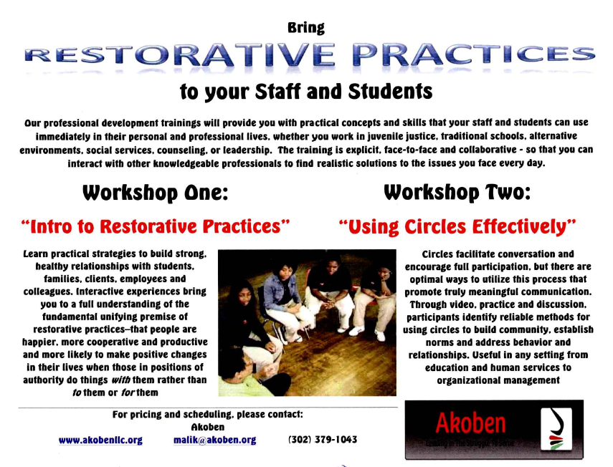
Recent DEDOE PD
Facilitators: Malik Mohammed, State Director of Providence Service Corporation in DE & Corie Strand, Teacher
Notes:
Definition of what restorative practices are from the leading institution in this new area of study – the International Institute for Restorative Practices’ website- http://www.iirp.edu/what-is-restorative-practices.php:
“The IIRP's definition of restorative practices also includes the use of informal and formal processes that precede wrongdoing, those that proactively build relationships and a sense of community to prevent conflict and wrongdoing.”
“The fundamental premise of restorative practices is that people are happier, more cooperative and productive, and more likely to make positive changes when those in authority do things with them, rather than to them or for them.”

Slide 61
Restorative Practices
Source: Douglas, D., St. Rose, D., & Lieberman, K. (2011). Integrating restorative practices Into a positive behavior support framework. Presentation at 2011 International PBIS Conference.
Traditional Discipline
  School rules violated
  Justice focuses on establishing guilt
  Accountability=Punishment
  Action focuses on offender
  Victim is often ignored
  Rules and intent outweigh outcomes
  No opportunities for remorse or amends
Restorative Practices
  People and relationships violated
  Justice identifies needs and obligations
  Accountability=understanding impact and repairing harm
  Offender, victim, and school all have direct roles
  Offender is responsible for behavior and repairing harm
  Allows for amends and expression of remorse
Notes:
“Emphasizes harms and resulting obligations
Keeps the victims’ needs/interests central
Encourages offenders to understand and take responsibility for harm
Involves dialogue and the community
Promotes individual and societal healing and growth”

Slide 62
Restorative Practices
Source: Douglas, D., St. Rose, D., & Lieberman, K. (2011). Integrating restorative practices Into a positive behavior support framework. Presentation at 2011 International PBIS Conference.
Restorative Practices
ARE
Victim centered and victim sensitive
A vehicle for victims to have a voice
An opportunity for taking responsibility for your actions
A vehicle for offenders to listen to those affected by their actions
An opportunity to learn how to start changing behavior
Restorative Practices
ARE NOT
Soft on offenders
A way for the offender to avoid consequences
Only for juveniles or less serious offenses
New processes
The opposite of or substitute for an existing system
Notes:
“Emphasizes harms and resulting obligations
Keeps the victims’ needs/interests central
Encourages offenders to understand and take responsibility for harm
Involves dialogue and the community
Promotes individual and societal healing and growth”

Slide 63
Linking SWPBS to RJP
Source: Sprague, J. & Mooimanm, L. (2011). PBIS and restorative discipline in schools: Challenges and opportunities. Presentation at 2011 International PBIS Conference.
SWPBIS | Restorative Justice/Discipline [Practices]
Assumptions/Theory
Applied Behavior Analysis Implementation Science (Finsen, Naomi, Blasé, Friedman, & Wallace, 2005) Human Performance (Gilbert, 1996) Host Environment (Jones et al., 2009) | A restorative environment provides the context for restorative practices Control Theory (Li & Mustanski, 2012)
Practices
Building-level PBIS team established to guide needs assessment, planning and integration with school improvement Consistent school wide expectations that are taught and followed by all students and staff Students are acknowledged for their success in meeting expectations Decisions regarding interventions are based on data collected on student behavior A continuum of responses to rule infractions is used consistently by all staff Routine collection and summary of discipline data to identify school wide, classroom and individual student needs System improvement decisions based on outcome data Firm but fair consequences for misbehavior are clearly defined | Whole school prevention Educators are models of restorative practice Physical environment promotes an ethos of care Emotional environment promotes an ethos of care School policies and practices focus on restoration Conflict resolution Flexible policies Differentiated discipline Restorative Responses to Problem Behavior Reintegration following office referrals or suspension Conferencing Class meetings Circles Mediation Conflict Resolution
Research Base
Two randomized control trials in elementary schools (C.P. Bradshaw, Koth, Thornton, & Leaf, 2009; Lynne-Landsman, Bradshaw, & Ialongo) One completed randomized control trial in middle schools (Sprague et al.,) Multiple single subject studies and evaluation studies documenting positive effects (C. P. Bradshaw & Garbarino, 2004) | Multiple case study reports in U.S. and Canada (Leff, Kupersmidt, Patterson, & Power, 1999; Lewis, 2009; Marini, Dane, Bosacki, & YLC-CURA., 2006; Sumner, et al., 2010)
Notes:
This comes from a more comprehensive PPW. Nationally, we are seeing that states are combing their SWPBIS and Restorative Practices. These are not separate initiatives but rather complementary activities. Restorative practices can be used effectively within the PBS framework. The next slide further explains how the two compliment one another.

Slide 64
Linking SWPBS & RJP
Modified From: Douglas, D., St. Rose, D., & Lieberman, K. (2011). Integrating restorative practices Into a positive behavior support framework. Presentation at 2011 International PBIS Conference.
INTENSIVE
REPAIRING HARM
w/Conferencing
TARGETED GROUP INTERVENTION
TAKING RESPONSIBILITY
w/Problem Solving Circles
UNIVERSAL PRACTICES
DEVELOPING SOCIAL/EMOTIONAL CAPACITY
w/Circles
Notes:
Douglas et al. notes:
“Circles
Circles are used throughout RP in a variety of forms and for numerous purposes.
At the Universal Practices level, circles typically focus on increasing community and social/emotional understanding.
Purposes might include community building, developing understanding, celebration, support, community problem solving, checking in and checking out, etc.
Problem Solving Circles
Focus is on taking responsibility
Can be on-going or time limited
Identify potential members using PBS data
Interview members to ensure understanding and willingness to participate
Topics or concerns to address might include: attendance issues, failing grades, non-compliance, girls groups, bullying, reintegration etc.
Conferencing
Conferencing is the most formal restorative process and can be used to supplement or supplant other traditional remedies such as suspension.
Involves all parties directly involved, their respective supporters and others in the community who have been affected.
Seeks to identify and repair harm caused in a relationship and prevent recurrence.
Participation is voluntary and based on parties willingness and readiness.
Agreements are consensus-based.”

Slide 65
Linking SWPBS & RJP
Multiple Sources: Currently there are efforts in California, Illinois, Michigan, & Minnesota to make links between Positive Behavior Support and Restorative Justice/Practices.
Almeida County School Health Services Coalition (2011):
  “[Restorative Justice] is a philosophy, a way of being and relating. It does not replace current initiatives.
  Promising and evidence-based programs such as: Positive Behavior Intervention and Support (PBIS), Responsive Classroom, Second Step, Too Good for Violence, Too Good for Drugs, Tribes, and other initiatives assist in building a foundation and culture of caring. These kinds of programs and initiatives complement restorative practices.” (p.9)

Slide 66
Linking SWPBS & RJP
Multiple Sources: Currently there are efforts in California, Illinois, Michigan, & Minnesota to make links between Positive Behavior Support and Restorative Justice/Practices.
Others:
  Restorative Justice Practices are tools to be used within the PBIS framework
  They are both schoolwide procedures/processes that can have differing tiers of support based on student needs and school data.
  “Restorative Practices can enhance Positive Behavior Support by building a focus on respect and relationships into the system” (Douglas et al., 2011).
Notes:
The DE training that MP attended did not make these links; therefore, it may be important for cadre members to find out which of their schools attended the trainings and/or want to attempt the implementation of these programs and help them make these links.
The last bullet point is a quote from: Douglas, D., St. Rose, D., & Lieberman, K. (2011). Integrating restorative practices Into a positive behavior support framework. Presentation at 2011 International PBIS Conference.

Slide 67
Linking SWPBS & RJP
Modified From: Douglas, D., St. Rose, D., & Lieberman, K. (2011). Integrating restorative practices Into a positive behavior support framework. Presentation at 2011 International PBIS Conference.
Positive Behavior Support
Supports and reinforces positive academic and social behavior through comprehensive systems
Focuses on teaching children positive pro- social skills directly in real context
Supports positive relationships between students, teachers, staff and parents.
When used in a comprehensive manner, combines classroom, school, home and community efforts
Restorative Practices
Involves dialogue and the community
Promotes individual and societal healing and growth
Encourages offenders to understand and take responsibility for harm
Emphasizes harms and resulting obligations
Keeps the victims’ needs/interests central
Notes:
This is the last slide explaining the links between the PBS framework and the set of restorative practices.

Slide 68
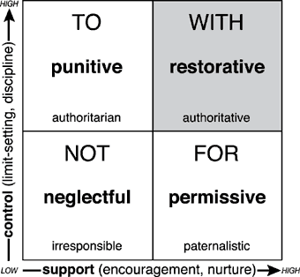
RJP Vocabulary
From: Costello, B., Wachtel, J. & Wachtel, T. (2009). The Restorative Practices Handbook for Teachers, Disciplinarians and Administrators.
Social Discipline Window
Notes:
This is an explanatory slide showing one of the activities that staff participating in restorative practices engage in. This is a metacognitive chart to help them understand their discipline style and the potential problems and common vocabulary related to each.

Slide 69
RJP Vocabulary
From: Costello, B., Wachtel, J. & Wachtel, T. (2009). The Restorative Practices Handbook for Teachers, Disciplinarians and Administrators.
Restorative Practices Continuum
Informal |  |  |  | Formal
Affective statements | Affective questions | Small, impromptu conference | Group or circle | Formal conference

Slide 70
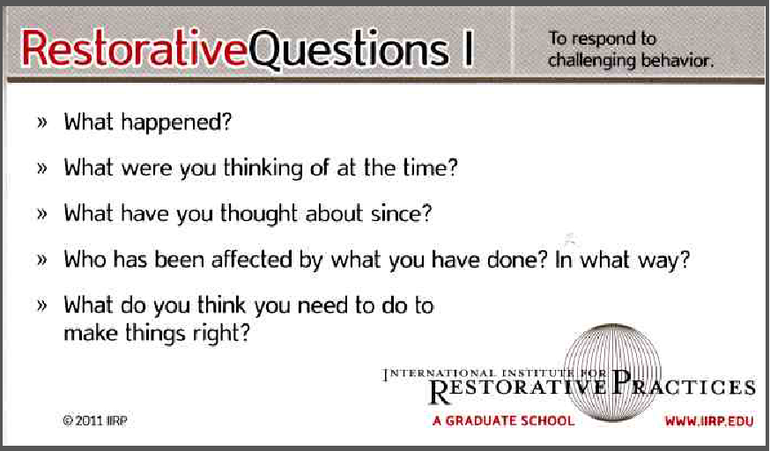
RJP Vocabulary
From: Costello, B., Wachtel, J. & Wachtel, T. (2009). The Restorative Practices Handbook for Teachers, Disciplinarians and Administrators.
Restorative Questions – For Challenging Behavior
Notes:
This is an explanatory slide showing questions used in circles during restorative practices. These are the questions that the student who has exhibited negative behavior is asked to answer.

Slide 71
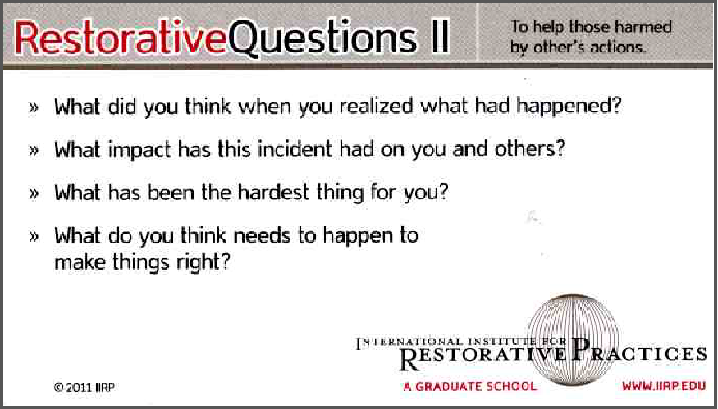
RJP Vocabulary
From: Costello, B., Wachtel, J. & Wachtel, T. (2009). The Restorative Practices Handbook for Teachers, Disciplinarians and Administrators.
Restorative Questions – For Those Harmed by Behavior
Notes:
This is an explanatory slide showing questions used in circles during restorative practices. These are the questions that the individuals impacted by the negative behavior are asked to answer.

Slide 72

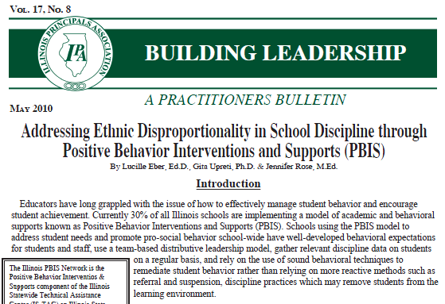
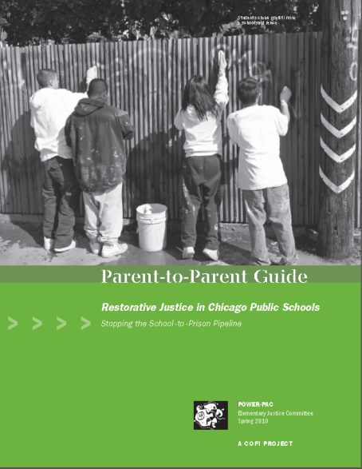
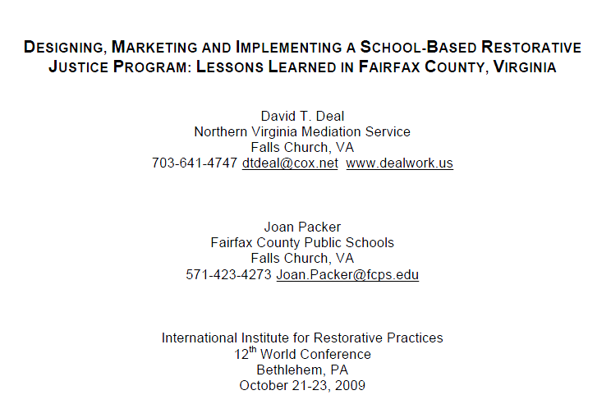
Implementation
Additional
Resources Available:
Research – Success Stories
Chapter 3 of Text
Parental Considerations
Cautionary Tales
Notes:
This is slide that shows that next steps in DE are unknown (at least to our our project as of 7/2013); however, restorative practices are being utilized elsewhere in the country so educators can start researching it more. Other states that have implemented restorative practices include California, Illinois, Maryland (Baltimore city), Michigan, Minnesota, Pennsylvania (Philadelphia), & Virginia.

Slide 73
6. Strategic Use of Praise and Rewards
Praise and rewards are used strategically to recognize and reinforce social and emotional competencies that underlie prosocial behavior. For example, students are routinely recognized with praise and rewards for demonstrating empathy, caring, responsibility, and respect.

Slide 74
Effective Ways to Praise and Acknowledge
Focus on the message
  Emphasize the informative rather than controlling function of praise and rewards
Highlight the student’s specific achievement demonstrated toward the achievement
Link the behaviors to underlying thoughts, emotions, and dispositions
  These may include: feelings of pride, empathy, autonomy, responsibility, caring, kindness, trustworthiness, etc.
Highlight the future value or usefulness of the behavior

Slide 75
The Good Behavior Game
Classroom Management Intervention
Led to reductions in student’s off-task, aggressive, and antisocial behaviors.
Uses an interdependent group contingency technique.
  Group of students earns points based on the group’s performance as a whole.
  These points are recorded on the board and can later be exchanged for privileges or rewards.
  Teams may compete with one another, but all teams can earn the total number of predetermined points for following the rules.
  The particular rules and number of points to be earned can vary depending on teacher preference and the behaviors he or she wants to target.
8 Simple steps outline the implementation

Slide 76
Morning Meeting
Morning Meeting is a strategy that merges social, emotional and academic learning. Educators can support classroom community building with Morning Meetings where students gather and work through four components.
  Greeting - each child is greeted face to face with a smile.
  Sharing – students learn how to give a short new message, ask for details, and practice active listening.
  Group Activity – fun active group activity (can support an academic subject).
  Morning Message – news and announcements from the teacher to the students

Slide 77
Self-Discipline &
Student Relationships Reflections
6. What goal(s) do you have for your district regarding self-discipline and student relationships?
      What is your first step when you get back home?

Slide 78

Action Planning & Closing

