Slide 1

Delaware PBS Cadre Meeting
September 24, 2013
WELCOME!

Slide 2

DE-PBS Phase Recognition

Slide 3
DE-PBS Phase 1 Recognition
2012-2013
School District | School Name
Appoquinimink School District | Appoquinimink High Old State Elementary
Brandywine School District | Harlan Elementary Springer Middle
Cape Henlopen School District | H. O. Brittingham Elementary
Capital School District | Dover High Fairview Elementary Hartly Elementary North Dover Elementary South Dover Elementary
Christina School District | Marshall Elementary

Slide 4
DE-PBS Phase 1 Recognition
2012-2013
School District | School Name
Colonial | New Castle Elementary
Lake Forest School District | Lake Forest Central Elementary Lake Forest East Elementary
Red Clay | The Central School Shortlidge Academy Stanton Middle Richardson Park Learning Center
Woodbridge | Woodbridge High

Slide 5
DE-PBS Phase 2 Recognition
2012-2013
School District | School Name
Brandywine School District | Brandywine Community School
Cape Henlopen School District | Rehoboth Elementary
Christina School District | Keene Elementary Gallaher Elementary
Lake Forest School District | Lake Forest South Elementary
Milford School District | Ross Elementary
Red Clay | Meadowood Program
Woodbridge | Woodbridge Elementary

Slide 6
DE-PBS Phase 3 Recognition
2012-2013
School District | School Name
Appoquinimink School District | Brick Mill Elementary
Christina School District | Wilson Elementary
Milford School District | Morris Early Childhood Center

Slide 7
Public Notices
Letters to district superintendents and board presidents,
DOE governors report,
Website highlights
Other thoughts? Feedback from schools?

Slide 8
13-14 SY Phase Recognition Logistics
Phase 1 - 3 Materials
  Application
  Frequently Asked Questions
  Reflection Question Review Guide
Due June 27, 2014

Slide 9
13-14 SY Phase Recognition
Notes
Application entails end of the year program reflection
Recognition reflects CURRENT year effort; schools maintaining or advancing levels should apply yearly
Process should be a team effort
Application review - May

Slide 10
Project Coach Support & Contact Information
Project Coaches
  Contact process & support
District SWPBS School List Review

Slide 11
IM 40 – Guest Presentation
Nicole Freeman from YMCA
Daneya Jacobs from Children and Families First
Karen Johnston from 4-H
Peggy Geisler from Sussex County Health Promotion Coalition

Slide 12





Community partners working together to build asset rich environments

Slide 13
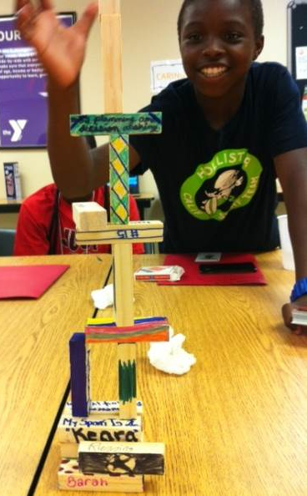
Objectives
Learn about the IM40 Young Health Program
Identify opportunities and benefits to aligning your efforts with the IM40 movement

Slide 14

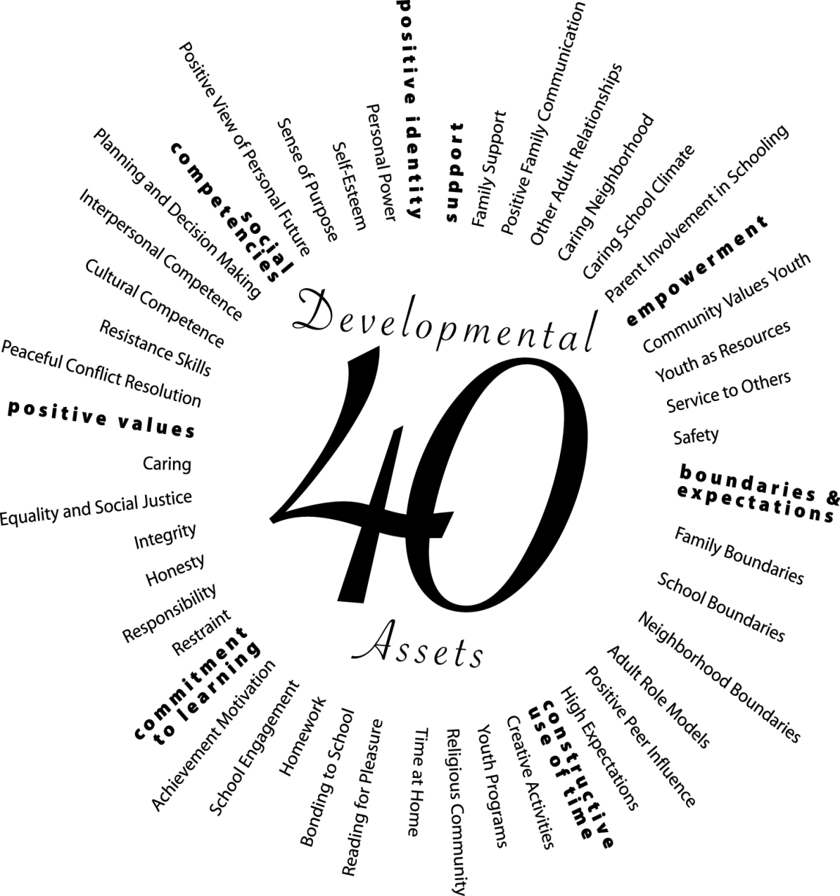


Launched in January 2012, IM40 is a movement based on the evidence-based framework of the
Provides the resources necessary for youth to reduce risk behaviors, and improve academic success.
Overview
4

Slide 15
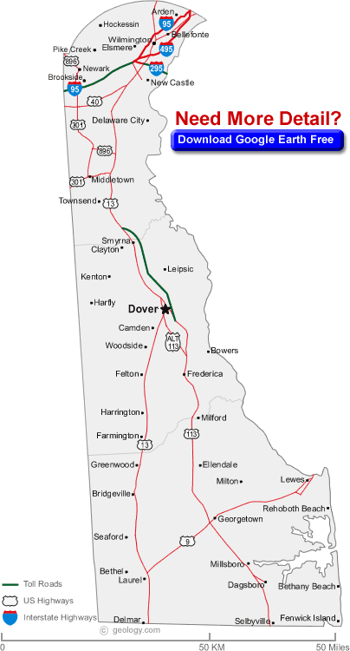


5

Slide 16
40 Developmental Assets
External Assets
Support
Empowerment
Boundaries and Expectations
Constructive Use of Time
Internal Assets
Commitment to Learning
Positive Values
Social Competencies
Positive Identity

Slide 17
Benefits and Opportunities to aligning with IM40 movement
  Gain support for the PBS initiatives
  Initiate positive conversations via social media
  Access to tools and community partners to sustain your PBS Peer Leadership Team (both adults and youth)
  IM40 workshops to help your school support an asset rich environment.
    Youth workshops to identify sparks and become familiar with concept
    Parent/family workshops
    Youth serving professionals workshop

Slide 18
Benefits and Opportunities cont…
Access to an online Tool Kit which contains:
  40 Developmental Asset Checklist
  IM40 logo
  Asset Contract
  Asset Empowerment Contract
  Calendar of events featuring local and statewide asset building opportunities
  Contact information for targeted asset building opportunities such as:
        Y’s Peer Leader and Bully Prevention trainings
        4-H’s Health Rocks, Up for the Challenge
        Youth in Government
        Life Map Workshops

Slide 19
IM40 Asset Champion tools, cont…
Developmental Asset Profile (DAP) survey tool to scientifically measure increase in assets using a pre/post method.
Suitable for grades 4 – 12
Costs $150 for a one-time start up fee and $2 per youth. United Way of DE will cover this cost with IM40 funds.

Slide 20
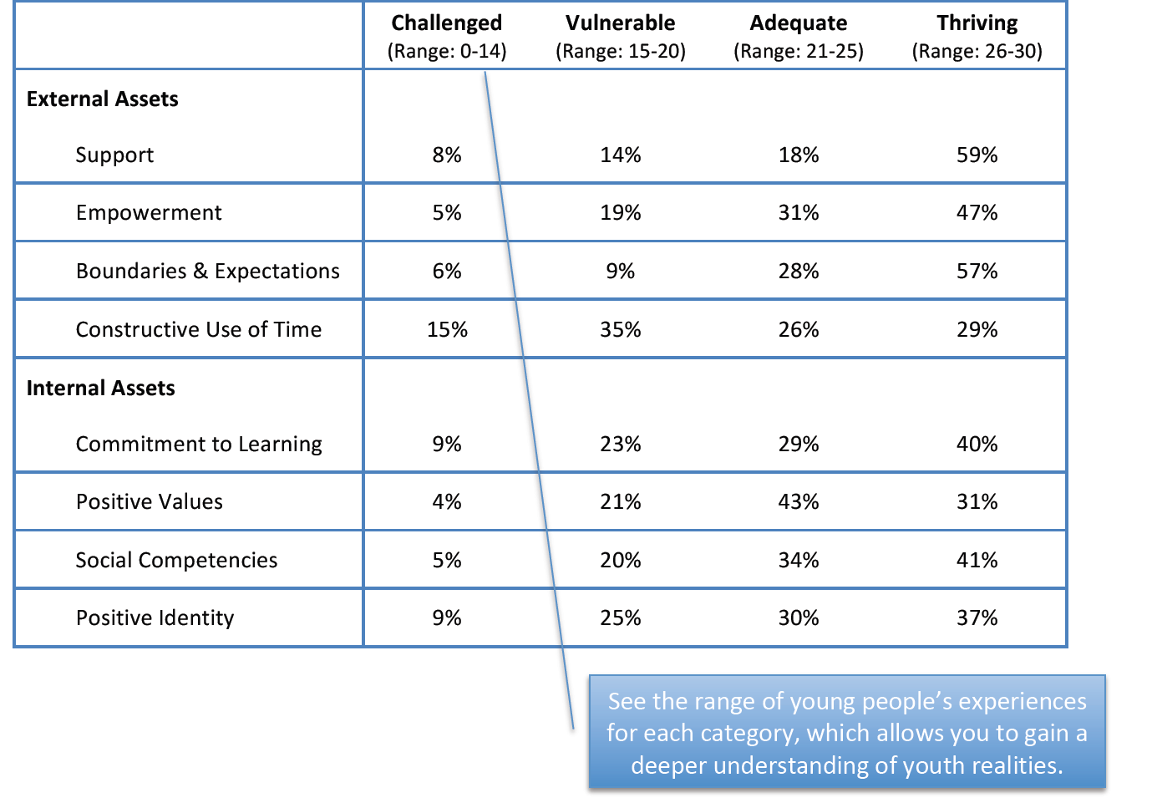
It is typical to see between 5% and 15% scoring in the “challenged” and the “thriving” range with most scoring in the “vulnerable” or “adequate” ranges. This data could then help identify opportunities for further exploration and action.

Slide 21
The Power of Assets to Protect
Copyright © 2012 by Search Institute

Slide 22
The Power of Assets to Promote
T5
Copyright © 2012 by Search Institute

Slide 23
Three Levels of Involvement
Individual
  Attitudes
  Behavior
Organizational
  Relationships
  Climate
  Programs and Practices
Community-wide Coalition
  Awareness Building
  Prioritizing
  Conducting Community-wide Events
  Communication
  Coordination
  Celebration
Clay Roberts, used with permission

Slide 24
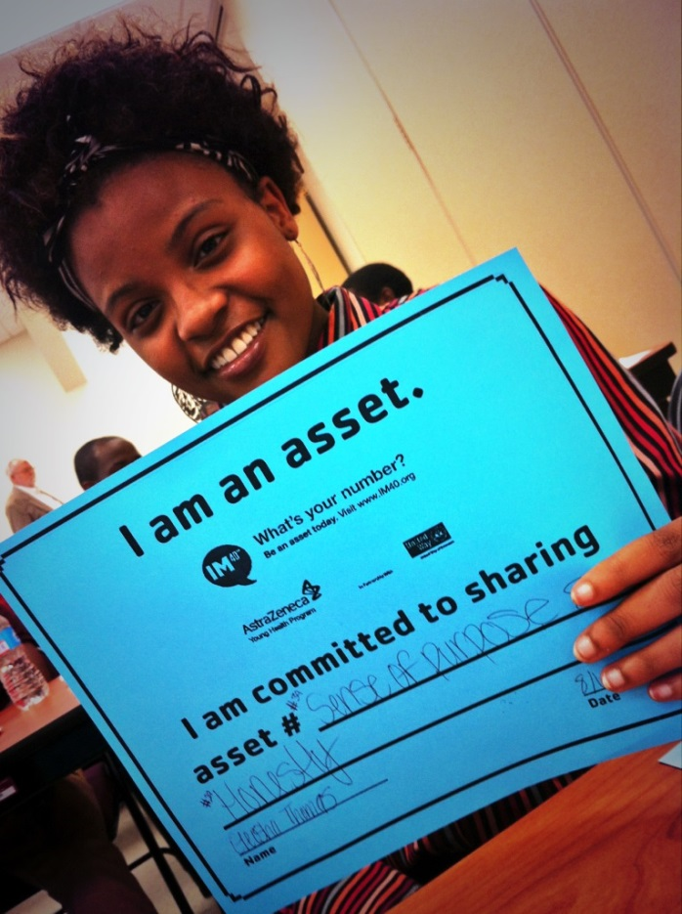
What are your assets?
How do you and how can you personally build assets?

Slide 25

Assets offered by
PBS and IM40 partnership
#3 Other Adult Relationships
#5 Caring School Climate
#7 Community Values Youth
#8 Youth as Resources
#12 School Boundaries
#14 Adult Role Models
#15 Positive Peer Influence
#16 High Expectations
#18 Youth Programs
#22 School Engagement
#24 Bonding to School
#33 Interpersonal Competence
#35 Resistance Skills
#36 Peaceful Conflict Resolution Skills

Slide 26
“Our deepest fear is not that we are inadequate. Our deepest fear is that we are powerful beyond measure. It is our light, not our darkness that most frightens us.' We ask ourselves, Who am I to be brilliant, gorgeous, talented, fabulous? Actually, who are you not to be? You are a child of God. Your playing small does not serve the world. There's nothing enlightened about shrinking so that other people won't feel insecure around you. We are all meant to shine, as children do. We were born to make manifest the glory of God that is within us. It's not just in some of us; it's in everyone. And as we let our own light shine, we unconsciously give other people permission to do the same. As we're liberated from our own fear, our presence automatically liberates others.”
(By Marianne Williamson, author of A Return to Love:

Slide 27
www.im40.org
For materials visit the Search Institute website at www.search-institute.org or call 1-800-888-7828
Tweet @im40yhp and #40assets
Facebook – Young Health Program: IM40
Nicole Freedman, YMCA of Delaware, Statewide nfreedman@ymcade.org
Daneya Jacobs, Children and Families First, Eastside
Daneya.Jacobs@cffde.org
Karen Johnston, 4-H, Dover
krjohn@udel.edu
Peggy Geisler, Sussex County Health Promotion Coalition,
Seaford, Bridgeville, Laurel
pgeisler@pmgconsulting.net

Slide 28


Slide 29
DE-PBS and Self-Discipline
DE-PBS Key Feature
Schools recognize the importance of developing self- discipline, implementing evidence based programs in character education and social and emotional learning, and/or infusing lessons throughout the curriculum that teach social-emotional competencies

Slide 30
What is Self-Discipline?
Consists of 5 key Social and Emotional Learning skills:
Self-management skills
Social awareness and empathy
Social connectedness and relationship skills
Responsible decision making
Positive sense of self

Slide 31

Incorporating Self-Discipline in Your SW PBS Framework
  Relationship building
  Schoolwide policies and activities
  Student decision making
  Corrective Procedures
  Social and Emotional Curriculum
  Strategic Use of Praise and Rewards

Slide 32
3. Student Involvement in
Decision Making
The school principal meets regularly with students to discuss current schoolwide issues and involves them in decisions about the welfare of the school.
  Student council/government, SWPBS student group, other groups representing the student body
Teachers across grade levels create opportunities for students to be active decision makers

Slide 33
Student Activities & Resource Sharing
Activity 1: What works and what doesn’t
Activity 2: Dream School
Youth Leadership Resources

Slide 34
DE-PBS Key Feature Evaluation

Slide 35
Levels of Implementation
Exploration:
  Few elements of implementation
Developing:
  Early phase of implementation; some elements adequately in place
Proficient:
  Elements in place and implemented
Exemplary:
  Implementation shows evidence of innovation and sustainability

Slide 36
Essential Item Scoring
Level | Parameters | Level | Definition
1 | 1 – 12 items earned 2s & 3s on Essential Items (EIs) out of 23 total EIs | Exploring | Few elements of implementation
2 | 13-17 items earned 2s & 3s on EIs out of 23 total EIs | Developing | Early phase of implementation; some elements adequately in place
3 | 18-20 items earned 2s & 3s on EIs out of 23 total EIs; One 0 allowed (but plan must be made to correct this failed item) | Proficient | Elements in place and implemented
4 | 21-23 items earned 2s & 3s on EIs out of 23 total EIs ; No 0s | Exemplary | Implementation shows evidence of innovation and sustainability

Slide 39
Implementation Level Information Distribution & Support
DE-PBS Key Feature Evaluation Scoring Summary
  Overall summary & criteria
  Per section criteria
Narrative report distribution
Technical assistance
Determine steps for support

Slide 40
DE-PBS Key Feature Status Tracker
Purpose: To support teams to assess implementation in four main program categories & plan next steps
Broken into four evaluation sections
  SWPBS Tier 1, Prevention, Correcting Problem Behaviors, and Developing Self-Discipline
Tracker includes:
  Key program components for each section
    Teams can use these to assess their program and identify areas to modify or build upon
  Action plan to develop steps towards improving or modifying program components
Can be used for ongoing monitoring

Slide 41
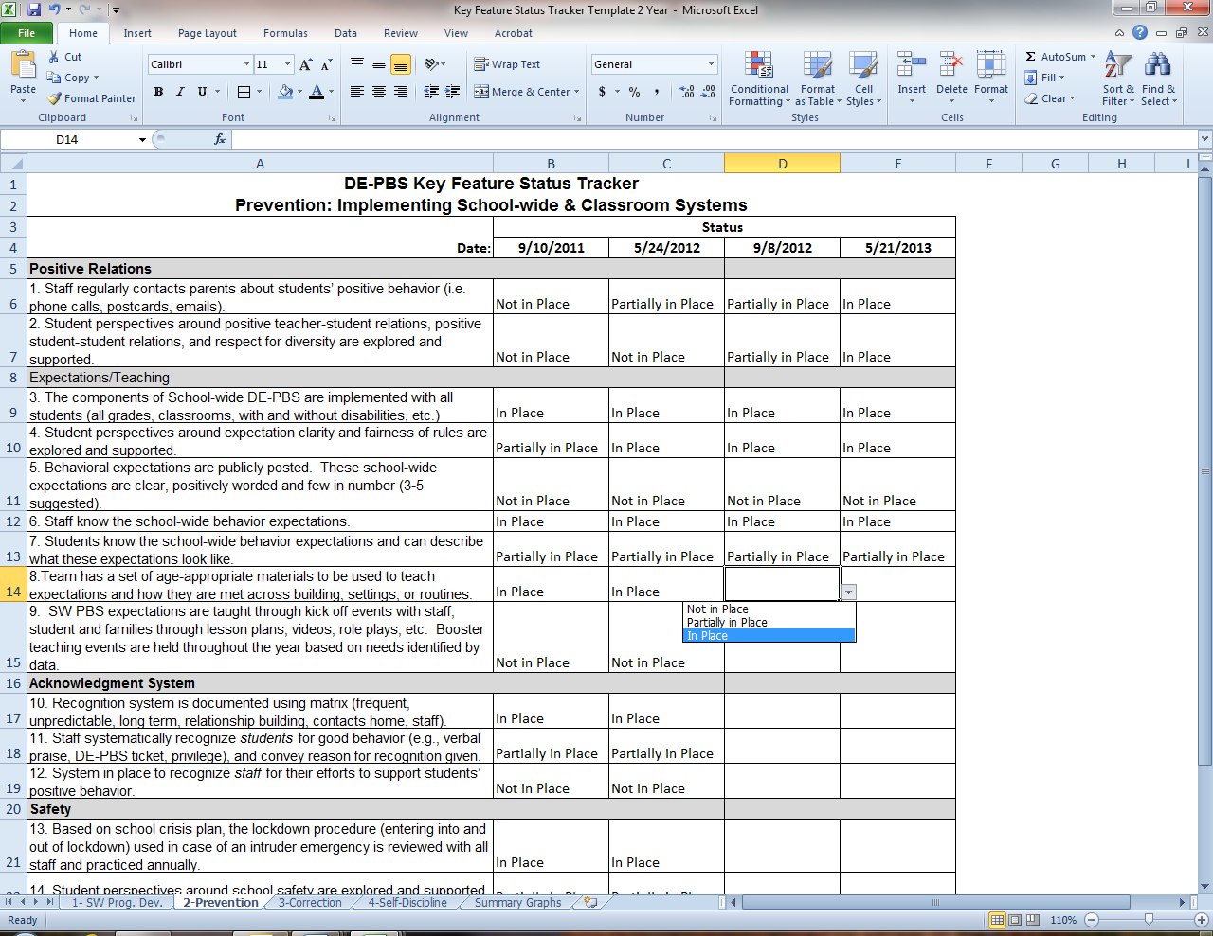

Slide 42
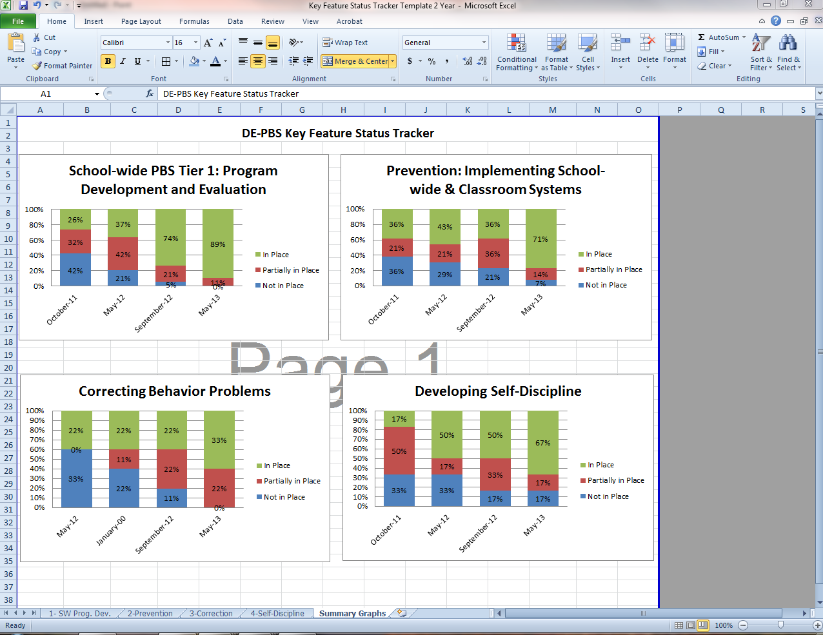

Slide 43
Key Feature Evaluation Review Guide/Action Plan
Tool to be used after receiving evaluation feedback
Review noted strengths for each evaluation section
  Identify strategies for maintaining strengths and develop an action plan
Review noted recommendations for each section
  Prioritize recommendations and develop an action plan
This tool supports continued implementation planning

Slide 44
KFE Evaluation Planning
KFE visits for 13-14 SY
For future consideration & discussion
  Overall cycle of evaluations
  Targeted re-evaluation

Slide 45
Let’s chat Key Feature Evaluation!
Melissa - New Castle
A Friend of the Family
Appoquinimink
Brandywine
Christina
Colonial
Red Clay
Susan Corey - Kent
Caesar Rodney
Capital
Lake Forest
Smyrna
Eileen Baker - Sussex
Cape Henlopen
Milford
Seaford
Woodbridge
In your groups, please share and discuss thoughts on the following:
DE-PBS KFE Scoring Summary (Purple sheet)
Providing Technical Assistance &
determining steps for support
Use of KFE Status Tracker & KFE Review Guide & Action Plan (Pink & Yellow sheets)
Evaluations for 13-14

Slide 46
DE-PBS Professional Development Calendar

Slide 47
School-wide PBS Overview Template
Presentation that could be used in school to provide program information to staff
Contains general information on SWPBS components
Schools also asked to insert information specific to their program
  i.e. their school-wide expectations, teaching plan, and acknowledgment system

Slide 48
1 Day School-wide PBS
Tuesday, October 22– 9-3:30
DelTech Dover Campus (Room 400 A&B)
Who should attend?
  New PBS Team members to existing teams
  New coaches
  New Administrators

Slide 49
Administrator Roundtable
Brownbag lunch during 1 Day SWPBS Workshop
Agenda:
  Expectations of the Administrator on the SWPBS Team
  New School Year Administrator Resolutions
  Supporting Staff
  Resource Sharing
  Discussion: Strengths & Challenges

Slide 50
School-wide PBS Training: Correcting Problem Behavior and Developing Self-Discipline
Friday, November 15 – 9-3:30
DelTech Dover Campus (Room 727)
Continuation from 2-day summer training
Open to active schools
  Reflect on Key Features Evaluation results
The focus of this workshop is on systems to support correction of problem behaviors and developing self-discipline as part of the SWPBS framework.

Slide 51
Prevent Teach Reinforce
Part I:
  Tuesday, October 15 – 9-3:30
  DelTech Dover Campus (Room 400 A & B)
Part II:
  Tuesday, April 15 – 9-3:30
  DelTech Dover Campus (Room 400 A & B)
The Prevent-Teach-Reinforce (PTR) model is a Tier 3 behavior intervention process. Participants will learn the 5-step, teacher/team driven model as well as how to identify the critical components that enhance the success of Tier 3 interventions.

Slide 52
FBA/BSP
Part I:
  Tuesday, December 10 – 9-3:30
  DelTech Dover Campus (Room 727)
Part II:
  Wednesday, January 8 – 9-3:30
  DelTech Dover Campus (Room 727)
Half day sessions 1/28 & 3/5 based on need related to specific topics
  Data collection, IEP goal development, interventions

Slide 53
DE-PBS Secondary Forum
Tuesday, February 4 – 9-12
Location to be determined
This is a collaborative meeting of secondary schools implementing DE-PBS at various levels. Members of secondary school PBS teams meet together to share resources and ideas to support implementation of SWPBS in middle and high school settings.

Slide 54
PD To Be Scheduled
Targeted Team Technical Assistance
DE-PBS Celebration (Spring 2014)
School Climate Data Workshop (May 2014)

Slide 55
DE-PBS Related Data

Slide 56
DDRT & DASNPBS
Discipline Data Reporting Tool (DDRT)
  Template available on website
  Submission 2x per year
DE Assessment of Strengths and Needs
  10 question survey per implementation area
  Staff perspective on program strength/weakness for use in planning

Slide 57
School Climate Survey 13-14
Enrollment: 10/1/13-11/1/13
Survey window:
  Staff: 11/11/13 - 12/13/13
  Student and Home: 1/10/14 - 3/1/14
Results: May 2014
Timeline
Logistics
Student, Staff, Home Versions
Paper & Online Options
Survey Contact per school

Slide 58
December 5, 2013
February 25, 2014
May 9, 2014
Mark your calendars for Cadre meetings:

