Slide 1
Delaware PBS Cadre Meeting
December 5, 2013

Slide 2
Agenda/Topics
Professional Development Updates
  Fall PD
  Correcting Problem Behaviors & Developing Self-Discipline
  Upcoming PD
Tier 2 & 3 System Support & Discussion
DE-PBS Key Feature Evaluation
DE-PBS Related Data
DE-PBS & IM 40

Slide 3
Reminder - Project Coach Support & Contact Information
School
Team leader or administrator email District Coach
District
Contact Project Coach as needed
District Coach respond to school
DE-PBS
Project Coach support District Coach
Project Coach in contact with DE-PBS staff team as needed

Slide 4
DE-PBS Professional Development Updates

Slide 5
PD-General Process
General calendar shared in September
PD Specific invitation distributed to DE-PBS Schools: Administrators, Team Leaders, Coaches
  1 month prior to event with deadline included
  Registration required
    Substitute coverage
PD pertaining to PBS supports for individual students open to broader audience (e.g., PTR, FBA/BSP)
PD- registration process & deadlines

Slide 6
Fall Professional Development
Prevent-Teach-Reinforce- Part 1
1 Day School-wide PBS & Administrator Roundtable
SWPBS: Correcting Problem Behavior and Developing Self-Discipline

Slide 7
Correcting Problem Behaviors & Developing Self-Discipline
PD Debrief & Activity Sharing

Slide 8
Correcting Problem Behaviors
  Referral system
    ODR form is clear – defines specific behavior problem, location, time (WHY – think about big 5)
    Data entered in school system w/in 24 hours – ideal goal
  Consistent and clear procedures
    Major vs. minor
    Defining behaviors
  Disciplinary encounters used as learning opportunities to teach problem solving strategies
    Administrative response (major)
    Staff response (minor)

Slide 9
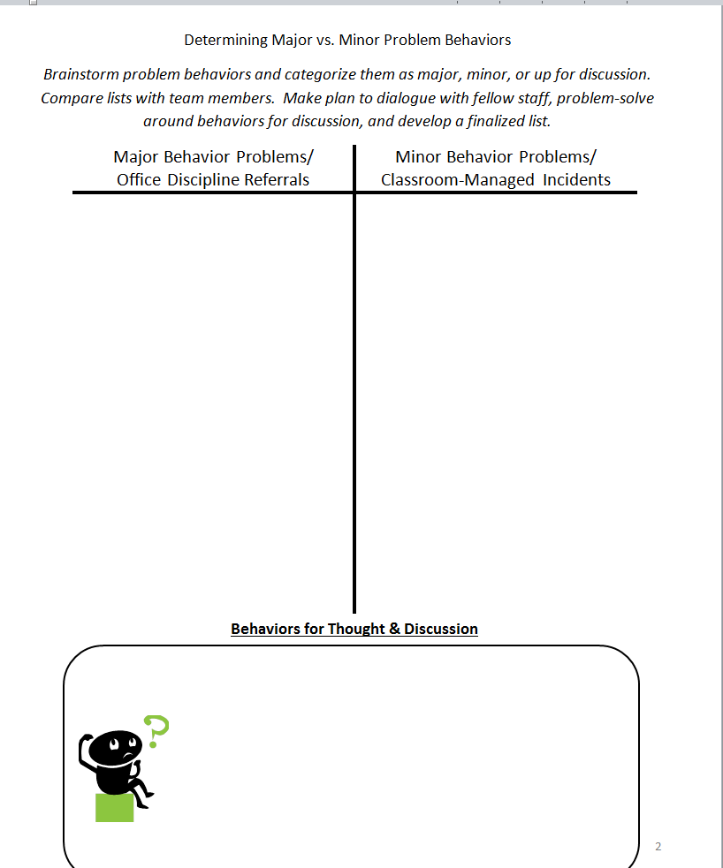
Activity: Determining
Major vs. Minor Behavior
Individually, brainstorm problem behaviors place them in a category.
  Major
  Minor
  Need more Thought & Discussion
Compare lists with team members. How do you differ? Why do you differ? Are you on the same page?
Make plan to dialogue with fellow staff, problem-solve around behaviors for discussion, and develop a finalized list.

Slide 10
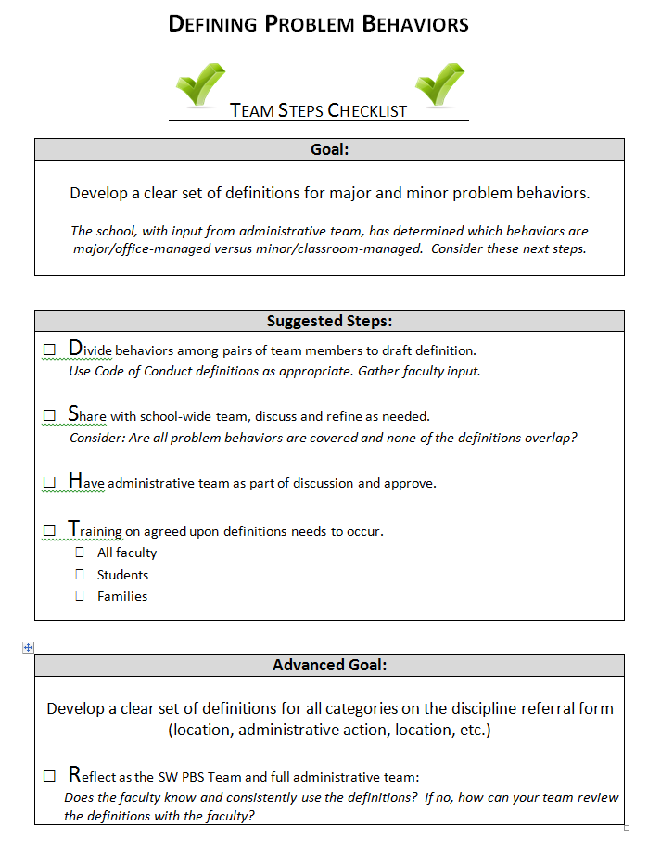
Activity: Defining Behaviors
Make a group of 2-3 team members
Pick a problem behavior (subjective in nature) from your ODR form, or a behavior for discussion
Operationally define the problem behavior
When cued, pass the draft to another group at your table
Revise, or ask questions if something is not clear

Slide 11
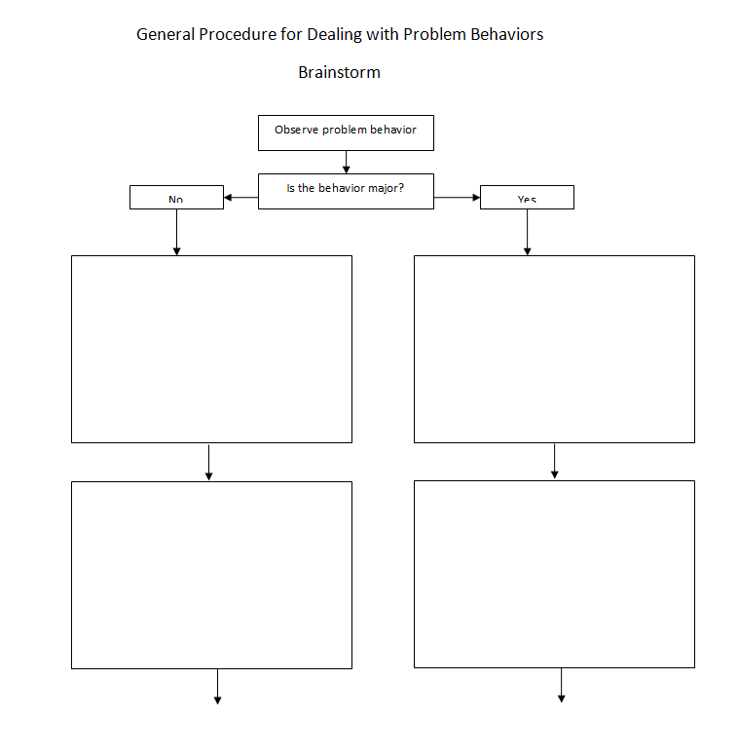
Activity: Response Procedures
Individually, draft your current response procedures based on your experience (e.g, as teacher, as administrator, etc.)
When cued, please share with other team/table mates to look for consistency & differing procedures/responses
Discuss steps for developing school-wide systems for response

Slide 12
Managing and Responding to Minor Problem Behavior
Managing Minor Behavior | Responding to Inappropriate Behavior
Proximity Nonverbal cue Ignore/Attend/Praise Restitution Review routine Change activity | Re-direct Re-teach Provide Choice Student conference Increase Group/Individual teaching Home contact Arrange for role/play practice Restrict privileges (seating arrangement, etc.) Behavior planning, contract

Slide 13
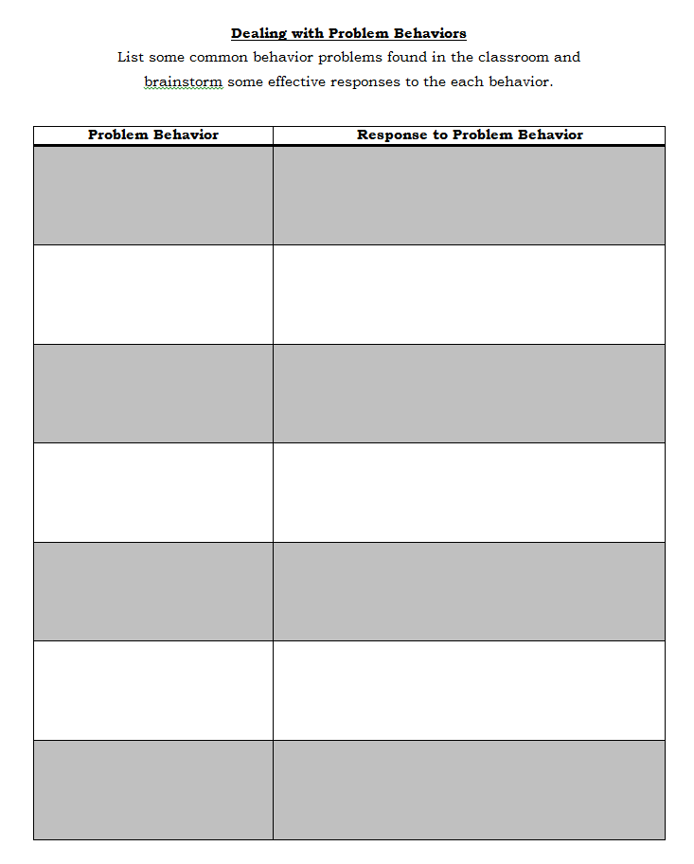
Activity – Classroom Behavior Strategies
List common behavior problems occurring in your classroom (left column) and brainstorm strategies to respond to these problem behaviors

Slide 14
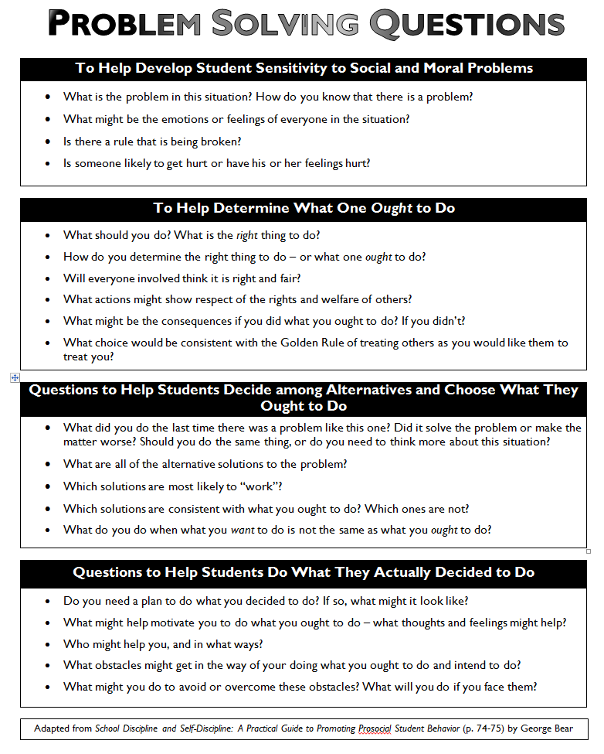
Activity: Problem Solving Practice
Divide into groups of 2-3
Determine the following roles
  Educator
  Student
  Observer (if team has 3)
Select index card with behavior scenario
Educator to facilitate discussion with student using resources
Reference:
  “Problem Solving Questions”

Slide 15
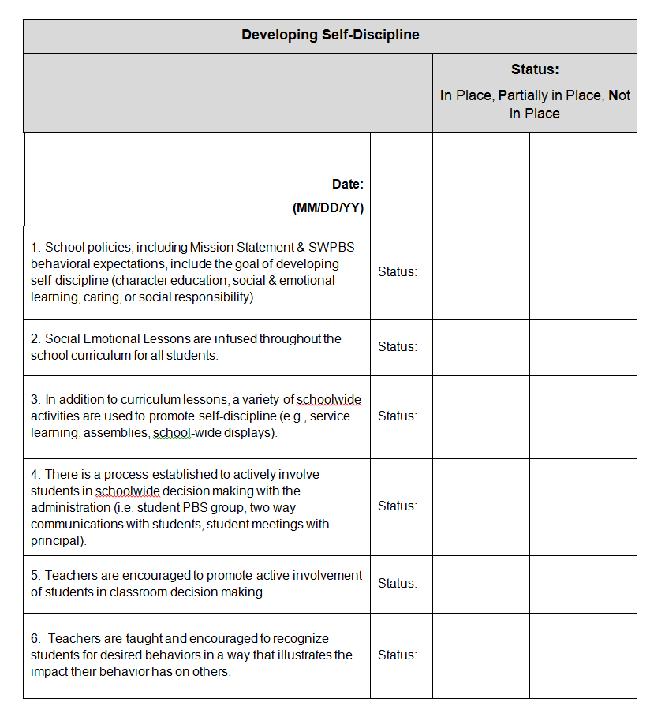
Activity- DE-PBS Status Tracker
Correcting Behavior Problems
Developing Self-Discipline
  School focus areas included #4 and #6.

Slide 16
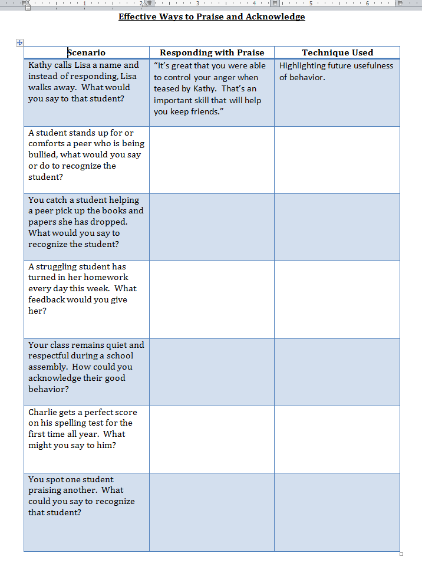
Effective Ways to Praise and Acknowledge – Activity Feedback
Have teams review scenarios
Draft possible praise response
Identify praise technique being utilized

Slide 17
Upcoming Workshops

Slide 18
Functional Behavior Assessment & Behavior Support Plans
Part I:
  Wednesday, January 8 – 9-3:30
  DelTech Dover Campus (Room 727)
Part II:
  Wednesday, January 28 – 9-3:30
  DelTech Dover Campus (Room 727)
Half day sessions 3/5 based on need related to specific topics
  Data collection, IEP goal development, interventions

Slide 19
DE-PBS Secondary Forum
Tuesday, February 4 – 9-12
Location to be determined
This is a collaborative meeting of secondary schools implementing DE-PBS at various levels. Members of secondary school PBS teams meet together to share resources and ideas to support implementation of SWPBS in middle and high school settings.

Slide 20
DE-PBS Annual Celebration
April 29, 2014
Keynote guest - Dr. Chad Rose
School-based presentations

Slide 21
Tier 2 & 3 System Support

Slide 22
System Development is Key!
Dean Fixsen, Karen Blase, Robert Horner, George Sugai, 2008
To scale up interventions we must first scale up implementation capacity
Building implementation capacity is essential to maximizing the use of EBPs and other innovations
★ Slides are from presentations of the Illinois PBIS Network

Slide 23
Schools/districts need to reflect on the system of support they are using
Is your Tier 2 designed to support 7-15% of your student population?
Can Tier 2 interventions be delivered within 72hrs of identification of need?
Do your SpEd & GenEd systems work together? Hand-off? or Compete?
Does everyone know how the system works?
Is it simple and easy?
★ Slides are from presentations of the Illinois PBIS Network

Slide 24
Schools need to be clear about what interventions they have (and don’t have) in place
Data and Support Staff
Tiered Supports / Practices
Tier 3/Tertiary Interventions 1-5%
_____________________
_____________________
_____________________
1-5% Tier 3/Tertiary Interventions
        ___________________________
        ___________________________
        ___________________________
Tier 2/Secondary Interventions 5-15%
___________________________
___________________________
___________________________
___________________________
___________________________
___________________________
5-15% Tier 2/Secondary Interventions
        ____________________________
        ____________________________
        ____________________________
        ____________________________
        ____________________________
        ____________________________
Tier 1/Universal Interventions 80-90%
________________________
________________________
________________________
________________________
80-90% Tier 1/Universal Interventions
        ____________________________
        ____________________________
        ____________________________
        ____________________________
        ____________________________
Adapted from Illinois PBIS Network, Revised May 15, 2008. Adapted from “What is school-wide PBS?” OSEP Technical Assistance Center on Positive Behavioral Interventions and Supports. Accessed at http://pbis.org/school-wide.htm

Slide 25
3-Tiered System of Support
Necessary Conversations (Teams)
Universal
Team
Secondary Systems Team
Problem Solving Team
Tertiary Systems Team
Uses Process data; determines overall intervention effectiveness
Uses Process data; determines overall intervention effectiveness
Plans SW & Class-wide supports
Standing team; uses FBA/BIP process for one youth at a time
Universal Support
CICO
Brief
FBA/BIP
SAIG
Complex
FBA/BIP
WRAP
Group w. individual
feature
Brief FBA/BIP
Sept. 1, 2009

Slide 26
Teaming at Tier 2
Secondary Systems Planning “conversation”
  Monitors effectiveness of CICO, S/AIG, Mentoring, and Brief FBA/BIP supports
  Review data to make decisions on improvements to the interventions
  Individual students are NOT discussed
Problem Solving Team “conversation”
  Develops plans for one student at a time
  Every school has this type of meeting
  Teachers and family are typically invited
★ Slides are from presentations of the Illinois PBIS Network

Slide 27
Secondary Systems Planning Team
Meeting Agenda
Number of students in CICO (record on Tracking Tool)?
  Number of students responding (record on Tracking Tool)?
  * Send Reverse Request for Assistance to teachers of all youth not responding
  Number of new students potentially entering intervention (share # of RFAs or # of students who met the data-based decision-rule)?
Repeat for S/AIG, Mentoring & Brief FBA/BIP
If less than 70% of students are responding to any of the interventions, the Secondary Systems team should review the integrity of the intervention and make adjustments as needed.
★ Slides are from presentations of the Illinois PBIS Network

Slide 28
Numbers to Keep in Mind
7-15%: Percent of total population expected to need and be supported by Tier 2 interventions
1-5%: Percent of total population expected to need and be supported by Tier 3 interventions
70%: Percent of youth (receiving intervention “X”)that should be responding to intervention
Data-based Decision-Rules for determining response must be defined
  Data sources defining response are efficient
    Ex. Daily Progress Report (DPR) cards
★ Slides are from presentations of the Illinois PBIS Network

Slide 29
Tier 2/Tier 3 Interventions
Tracking Tool Activity
1) What is your total building population?
2) What would 5% of your building population be? What would 15% be? Consider these two numbers for a range of students who should be receiving Secondary Interventions
3) What would 1% of your building population be? 5%? Consider these two numbers for a range of students who should be receiving Tertiary Interventions.
4) Using these calculations, what are the potential number of students your building could be serving at each Tier 2 and Tier 3 intervention?
5) What are some steps can your building take to prepare to serve these students?
★ Slides are from presentations of the Illinois PBIS Network

Slide 30
Your “Model” of Support
List official teams/meetings in 1st row, team/mtg. purpose 2nd row & use bottom cluster of boxes for student interventions.
Use arrows to indicate “direction of intervention layering” (If youth don’t respond to intervention ‘X’, what do they get next?)
★ Slides are from presentations of the Illinois PBIS Network

Slide 31
Tier 2/Tier 3 Tracking Tool
Structured to follow all levels/types of interventions from Secondary through Tertiary
Increases accountability
  Teams have to count # of students in interventions
  Data-based decision-rules are necessary (Identify, Progress-monitor, Exit)
  Must define “response” to each intervention type/level
  Shows % of students who responded to each intervention
Assesses the success rate, or effectiveness, of the interventions themselves
Connects each level of intervention to the next level
★ Slides are from presentations of the Illinois PBIS Network

Slide 32
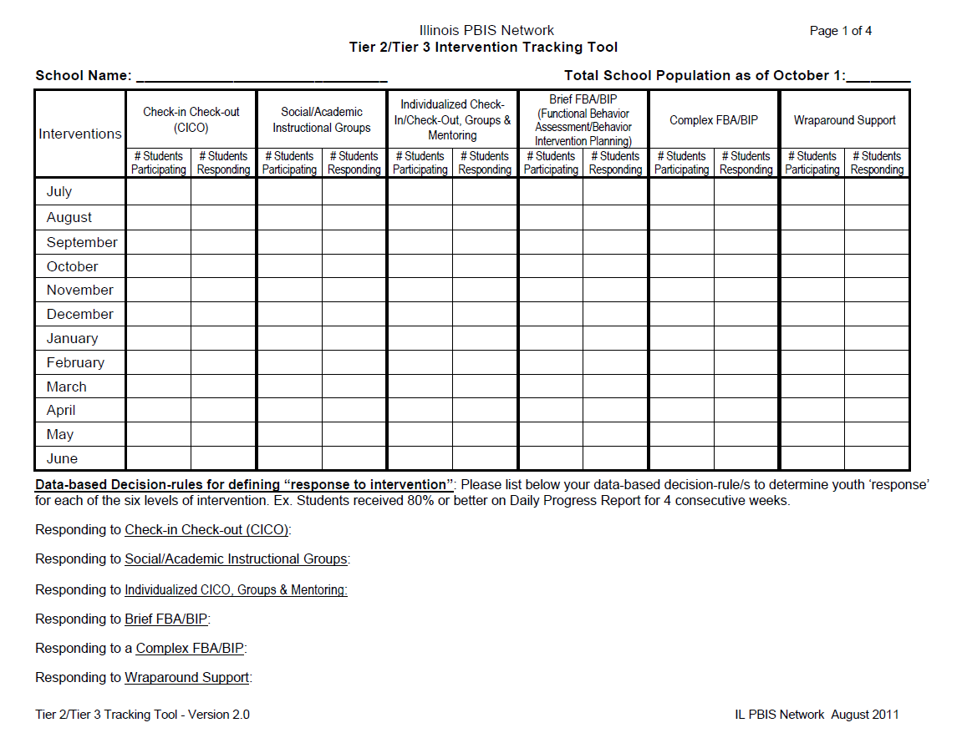

Slide 33
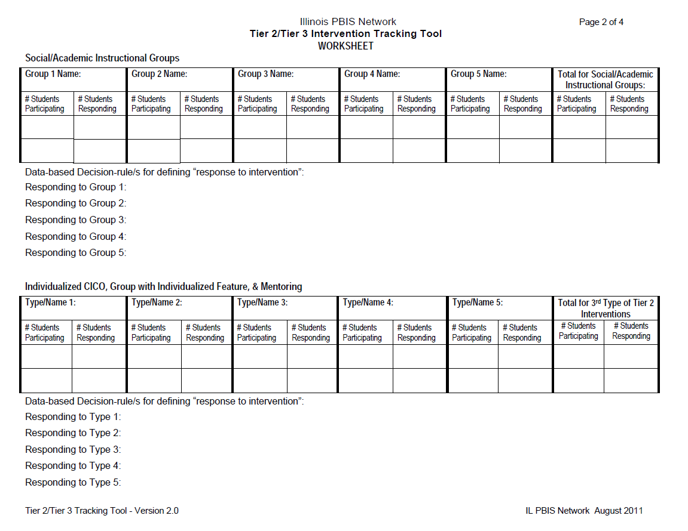

Slide 34
Data-Based Decision-Making
Outcome and Process Data
Student outcome data is used to:
  Identify youth in need of support and to identify appropriate interventions
  Progress-monitor youth response to intervention
  Exit or transition youth off of interventions
Intervention process data is used to:
  Assess intervention fidelity
  Monitor the effectiveness of the intervention itself
  Make decisions regarding the continuum/menu of interventions/supports
★ Slides are from presentations of the Illinois PBIS Network

Slide 35
Tier 2/3 Guiding Questions
(a coaches’ assistant)
Efficient: teams plan ahead, discuss components of the system
Open ended: encourages teams to think about what they currently do
Guides teams to develop ‘decision rules’
Documentation: can be shared with new team members, new staff, families, district leaders etc.
Tool is completed in parts, teams develop their intervention systems as they approach each level
Revisited only when reviewing/modifying system
★ Slides are from presentations of the Illinois PBIS Network

Slide 36
Tier 2/3 Overview from Rose Iovannone from PTR
  Interventions are efficient
    Continuously available so students can receive support quickly (optimally-within 2-3 days)
  Minimal time commitment required from classroom teachers
  Required skill sets needed by teachers easily learned
  Aligned with school-wide expectations
  Emphasis on intervention designed to support multiple students simultaneously (e.g. Check-In/Check-Out/BEP, Social Skills Groups, etc.)
    Consistently implemented with most students, some flexibility
  Intervention selected matched to function of student behavior

Slide 37
Multiple Levels of Tier 3
Tier 3
  Emphasis is on individual supports that require more intensity than Tier 2
To have efficiency in Tier 3, FBA process will be a continuum of progressively more formal and intensive procedures/practices

Slide 38
Features of FBA across all levels
Team formed (minimum 2 people with at least one having knowledge of student)
Systematic problem solving process is foundation
Problem behaviors identified and defined
Antecedents (predictors) of problem behavior occurrence
Consequences/responses of others following problem behavior
Hypothesis generated by data
Multi-component intervention plan built and linked with hypothesis
Progress monitoring plan established
Fidelity measurement of intervention implementation developed and scheduled
Follow-up meeting to make data-based decisions

Slide 39
Continuum of FBA (Scott, Alter, Rosenberg, & Borgmeier, 2010)
Level 1: Consultation-based functional assessment (e.g. PTR-brief; ERASE)
Level 2: Team based functional assessment (e.g., PTR-full)
Level 3: Wraparound-based functional assessment
All of the above are based on the principles of FBA
(features from previous slide)

Slide 40
Tier 3 Level 1: Consultation-Based Functional Thinking
Consultant and teacher
  Consultant is skilled in behavioral principles and can guide the teacher in developing a hypothesis and intervention plan
  Best done with structured process (e.g., brief PTR, ERASE)
    Run through strategic questions to understand functional relationship of problem behavior and environment
    Process is simpler, less intense, less formal, and far less comprehensive than Level 2 or Level 3.
    Still uses functional behavior assessment principles/features and problem solving process

Slide 41
Tier 3 Level 1: Consultation-Based Functional Thinking - Continued
  Uses only indirect methods (informal yet structured interview)
  Most effective for use with students having mild level of problem behaviors (e.g., mild off-task behaviors, mild non-compliant behaviors) or behaviors that have precise (few) antecedents and one primary function that is clear
  Not effective for use with students having multiple behavior problems that may serve multiple functions under multiple contexts or student with intensive, chronic, durable problem behaviors
This level can become the foundation for Level 2 (team-based) if intervention plan not effective

Slide 42
Tier 3 Level 2: Team-Based Functional Assessment
Steps are same as Level 1 but complexity is greater
  Expanded team (beyond teacher and consultant)
  Consultant role becomes facilitator role (guiding the team)
  Assessment process more formal and comprehensive, includes direct and indirect methods
  Hypothesis may be informally confirmed through observations under variety of naturally occurring conditions
  Consensus process established for behaviors selected, hypothesis developed, behavior intervention plan built; responsibilities may be shared across team

Slide 43
Tier 3 Level 3: Wraparound-Based Functional Assessment
Process uses same steps and features as previous levels
Efficiency secondary
Team greatly expands from school environment to other areas of student’s life (school, family, community)
Process considered to be last chance to break escalating chain of failures (Scott et al., 2010)
Intervention options include full range (not just those limited to school setting and resources)

Slide 44
Tier 3 Level 3: Wraparound-Based Functional Assessment - Continued
Additional features of wraparound (Burns et al., 2000):
  Strength-needs assessment
  Child/family/school teaming with collective vision
  Related goals that reflect the voice and culture of youth and family
  Measurable outcomes monitored on consistent basis
  Systemic structures necessary to lead and manage implementation across services identified and coordinated
  Clearly defined targets
  Flexibility across disciplines (e.g. role release)
Primary question is not how to identify and provide support but how much resources will be necessary if we are committed to supporting students with the most serious and challenging problem behaviors

Slide 45
Discussion
Where are your schools in having a SYSTEM in place for monitoring Tier 2 and 3 interventions?
  Illinois distinguishes between the roles of “coordinator” for the system and “facilitator” of the interventions
  System coordinator should lead meetings in which DATA not individual students are discussed (see sample forms)
Have schools completed asset mapping activities?
  Mapping available in school resource personnel and the services provided
  Mapping in school services against functions these services address
  Mapping community services for potential sources of help with more involved students

Slide 46
Discussion
What supports are needed to improve the systems aspect of your Tier 2 and 3 program?
  Clearer roles?
  Administrative support?
  Better data?
  Better forms and structures?
  Other?
What are the strengths and weaknesses you see with respect to existing Tier 2 and Tier 3 interventions? What supports do you need to make these more effective?

Slide 47
DE-PBS Key Feature Evaluation

Slide 48
DE-PBS Key Feature Evaluation
Scoring summaries & report
re-distribution
Draft schedule for winter-spring
Coach role in scheduling
Use of KFE data & status tracker

Slide 49
Level | Parameters | Definition
Exploring | 1 – 12 items earned 2s & 3s on Essential Items (EIs) out of 23 total EIs | Few elements of implementation
Developing | 13-17 items earned 2s & 3s on EIs out of 23 total EIs | Early phase of implementation; some elements adequately in place
Proficient | 18-20 items earned 2s & 3s on EIs out of 23 total EIs; One 0 allowed (but plan must be made to correct this failed item) | Elements in place and implemented
Exemplary | 21-23 items earned 2s & 3s on EIs out of 23 total EIs ; No 0s | Implementation shows evidence of innovation and sustainability

Slide 50
2013-2014 Key Feature Evaluation – Draft Schedule
Schools trained between 2005-2007
District Coach readiness feedback considered
2012-13 passes

Slide 51
District Coach role in scheduling & evaluation
Inform schools of projected evaluation month
Follow up with school following scheduling email from project; especially if you see a second email
Prior to evaluation, helpful to check in with school to see if they have any concerns
Report review & action planning with school
Ongoing monitoring (Status Tracker)

Slide 52
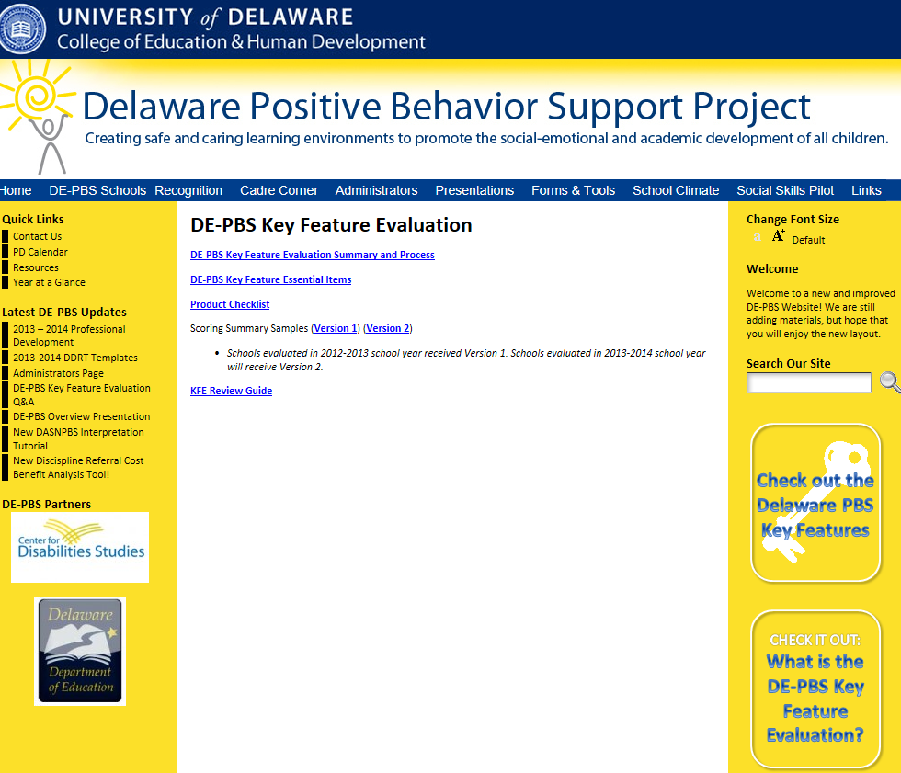
http://wordpress.oet.udel.edu/pbs/de-pbs-key-feature-evaluation/

Slide 53
DE-PBS Related Data

Slide 54
DDRT & DASNPBS
Discipline Data Reporting Tool (DDRT)
  Template & tutorial available on website
  Submission 2x per year to coaches & DE-PBS Project
  1/17/14 & 6/27/14
DE Assessment of Strengths and Needs
  January email distribution; support teams to consider areas to explore
  10 question survey per implementation area
  Staff perspective on program strength/weakness for use in planning

Slide 55
School Climate Survey 13-14
Timeline
Logistics
Survey window:
  Staff: 11/11/13 - 12/13/13
  Student and Home: 1/10/14 - 3/1/14
Results: May 2014
Student, Staff, Home Versions
Paper & Online Options
Survey Contact per school
Coach role – How do you support your schools?

Slide 56
DE-PBS & IM 40

Slide 57
40 Developmental Assets
External Assets
Support
Empowerment
Boundaries and Expectations
Constructive Use of Time
Internal Assets
Commitment to Learning
Positive Values
Social Competencies
Positive Identity

Slide 58
Benefits and Opportunities to aligning with IM40 movement
  Gain support for the PBS initiatives
  Initiate positive conversations via social media
  Access to tools and community partners to sustain your PBS Peer Leadership Team (both adults and youth)
  IM40 workshops to help your school support an asset rich environment.
    Youth workshops to identify sparks and become familiar with concept
    Parent/family workshops
    Youth serving professionals workshop

Slide 59
Benefits and Opportunities cont…
Access to an online Tool Kit which contains:
  40 Developmental Asset Checklist
  IM40 logo
  Asset Contract
  Asset Empowerment Contract
  Calendar of events featuring local and statewide asset building opportunities
  Contact information for targeted asset building opportunities such as:
        Y’s Peer Leader and Bully Prevention trainings
        4-H’s Health Rocks, Up for the Challenge
        Youth in Government
        Life Map Workshops

Slide 60

Assets offered by
PBS and IM40 partnership
#3 Other Adult Relationships
#5 Caring School Climate
#7 Community Values Youth
#8 Youth as Resources
#12 School Boundaries
#14 Adult Role Models
#15 Positive Peer Influence
#16 High Expectations
#18 Youth Programs
#22 School Engagement
#24 Bonding to School
#33 Interpersonal Competence
#35 Resistance Skills
#36 Peaceful Conflict Resolution Skills

Slide 61

Discussion
How can we help schools integrate IM 40 into their SWPBS framework?

Slide 62
February 25, 2014
May 9, 2014
Please mark your calendars for Cadre meetings.
Thank you for completing your evaluation!

