Slide 1
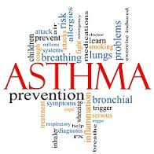
Creating An Asthma Friendly School
Sheelagh Stewart MPH, RN, AE-C
Nemours Health and Prevention Services

Slide 2
Acknowledgement and Disclaimer
The project described was made possible by Grant 1C1CMS331017 from the Department of Health and Human Services, Centers for Medicare and Medicaid Services.
“The contents of this Power Point presentation are solely the responsibility of the authors and do not necessarily represent the views of the views of the Department of Health and Human Services or any of its agencies.”
Notes:
Requisite disclaimer
Read

Slide 3
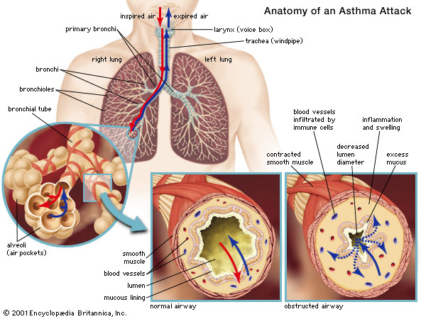
Normal and asthmatic bronchiole
Notes:
During an “asthma episode,” muscles around the airways tighten, linings of the airways (bronchioles) become inflamed, and mucus clogs the tiny airways, making breathing difficult.
The airways become overly responsive (twitchy) to environmental changes, sometimes resulting in wheezing, coughing, breathlessness, or tightness in the chest.
During an asthma episode a child may feel he/she can't inhale enough air, but actually, the child’s lungs are having trouble exhaling. Continued exposure and/or lack of treating the inflammation results in preventing O2/CO2 exchange.
Untreated, the inflammation can cause recurrent episodes of wheezing, coughing, breathlessness, and chest tightness, especially at night / early morning
Potentially, airway remodeling (a type of lung scarring which is permanent) can occur when asthma goes untreated.

Slide 4
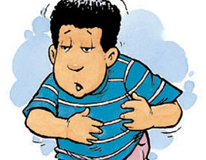
Cough
Shortness of breath
Mild wheeze
Tight chest
Night time symptoms
Exposure to a known trigger
Notes:
Asthma often looks like this but may have other symptoms. Sometimes manifests as behavior, lethargy, headache, stomach ache
Cough
•Shortness of breath
•Mild wheeze
•Tight chest
Night time symptoms
•Exposure to a known trigger

Slide 5
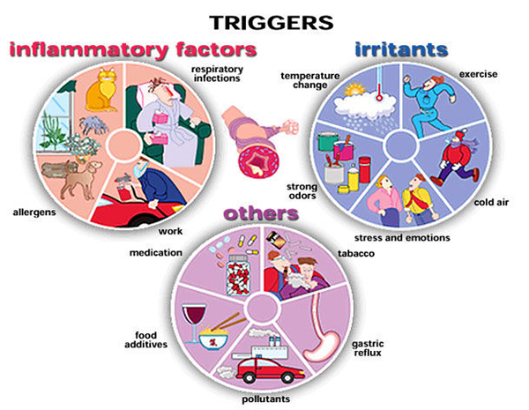
Notes:
Allergies account for approx 70% of asthma
Respiratory infections particulary RSV, FLU,
Occupational asthma

Slide 6
Medication: Two types What is the difference? Rescue / reliever medications
Rescue inhalers are typically Albuterol products
(Proventil, Ventolin, ProAir, Xopenex)
Are taken when asthma symptoms are appearing (asthma flare up)
Work by relaxing the muscles surrounding the airways
Are taken 10-15 minutes before strenuous exercise/activity by people with Exercise Induced Asthma
Do NOT reduce or prevent swelling from developing in the lungs
Patients/parents have often been noted to be giving the wrong medicine at the wrong time.
Notes:
Rescue medications- examples are Albuterol & Xopenex which are beta2-agonists. Inhaler form of these medications ideally should always be used WITH a spacer or younger patients will have these medicines in a nebulizer. ( Compressed air) . These are used to prevent exercise induced asthma or to treat an emerging asthma episode (attack). These medication work by relaxing the contracting muscles of the airways.
A child may carry their own inhaler ONLY with the signed permission of their doctor or medical care provider, their parent or guardian and in most districts (depending on school board policy) with the evaluation and approval of the school nurse.
Oral corticosteroids (pills) can be used as a rescue medication but generally not as a replacement for a rescue inhaler since onset isn’t immediate.

Slide 7
Medication: Two types What is the difference? Controller medications
Keeps swelling and mucus in the airways
Must be taken EVERY day even when not having symptoms
Inhaled corticosteroids (ICS’s) are the most common and effective way to control asthma Flovent, Pulmicort, QVAR, Advair
Also may have other medications like Singulair in a pill
Help prevent asthma flare ups from developing!
Notes:
An example of typical “controller” medications may be Inhaled Corticosteroids such as Pulmicort, Flovent, Advair, Qvar, Symbicort, Singulair etc.
Controller medications are NOT used when having an asthma attack –
These medications must be taken every day, regardless if there are symptoms or not. Typically, it can take up to 3 weeks before the inflammation in the lungs is reduced- a asthmatic may or may not notice in the short term but long term- the frequency of their episodes is reduced greatly.
Oral corticosteroids (pills) can be taken by people with severe and difficult to control asthma on a daily basis. These are NOT the same steroids used by athletes to bulk up muscle.

Slide 8
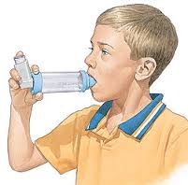
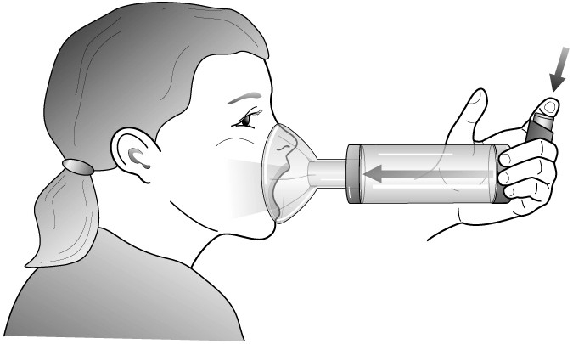
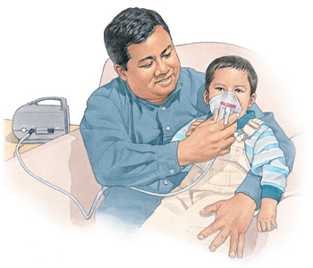
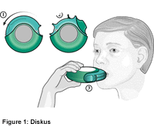

Slide 9
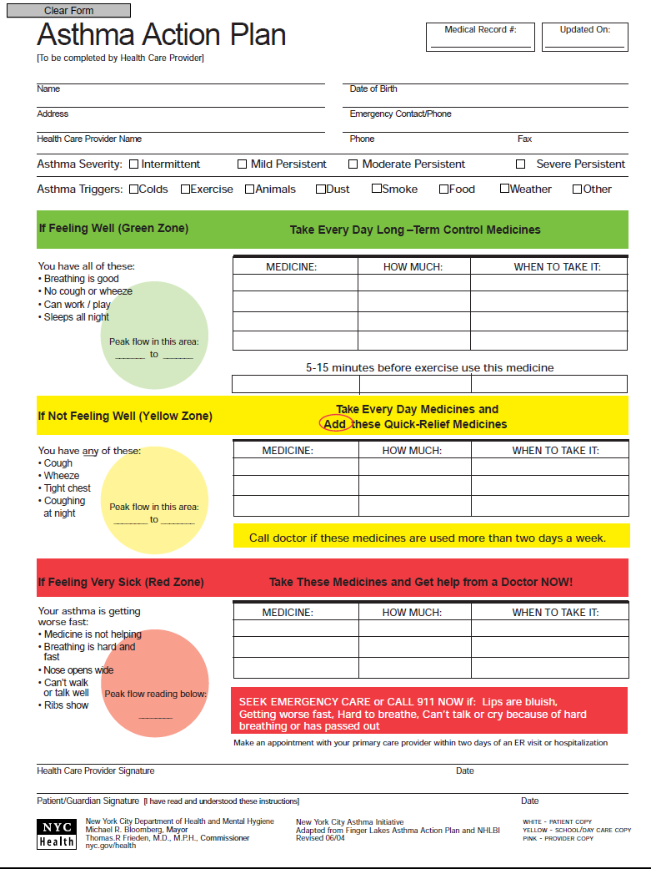
Asthma Action Plan Uses Colors To Help Manage Asthma
Green Zone: All Clear/Breathing Good/Go
No asthma symptoms and/or
Peak flow 80-100%
Yellow Zone: Caution/Slow Down
Some asthma symptoms and/or
Peak flow 50-80%
Red Zone: Medical Alert/Stop
Severe asthma symptoms and/or
Peak flow < 50%

Slide 10
CALL 911!!!
Rescue medications are not working (symptoms are getting worse, not better) or, meds are unavailable – or
The person’s lips or fingernails are BLUE – or
The individual is having difficulty talking, walking, or drinking liquids –
The person’s nostrils are flaring out – or
You see neck, throat or chest muscle retractions – or
The person is in obvious distress, there is a change in level of consciousness, or the individual is showing signs of confusion – or the individual’s condition is deteriorating

Slide 11
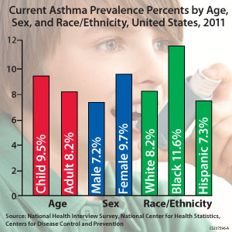

Slide 12
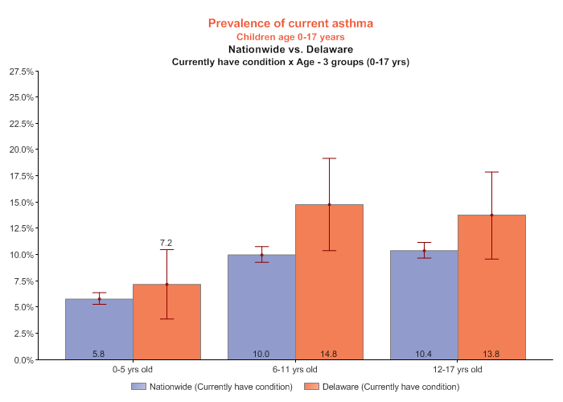
2011/12 National Survey of Children's Health

Slide 13
Children are not just “little adults”
– Biologically more vulnerable
– Different exposures: hand to mouth, floor time
– Cannot identify hazards or protect themselves
– Cannot articulate exposures or health effects
– Children with special health or learning needs may be even more exposed and more vulnerable (IDD 2010)
– Compelled to attend school by states; children with special needs may be placed in 12-month school programs
– Out number adults in schools by ~ 8:1 (NCES)

Slide 14
Schools are not just “little offices”
– 95% of all school occupants are women and children (NCES)
– 98% of all school age children attend schools (55m; NASN)
– Schools more densely occupied than homes or offices
– Multiple processes and chemical uses in one school facility (EPA)
– Record of poor facility management: no consistent facility measures; inconsistent funding; no oversight; decades of deferred repairs and facility neglect (GAO, EPA, 21CSF)
– US EPA: est. ~ 50% schools do not have Indoor Air Programs

Slide 15
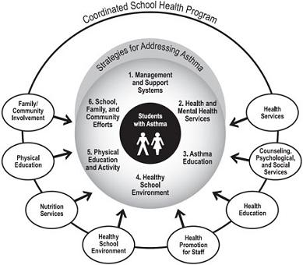

Slide 18
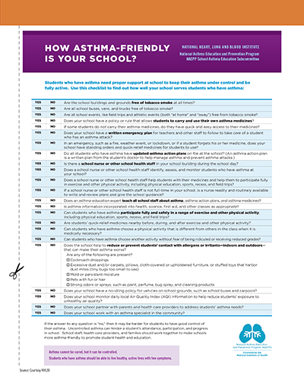

Slide 21
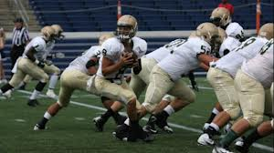
Coach’s Asthma Clipboard Program

Slide 22
These Kids With Asthma…….

Slide 23
Became Superstar Athletes!!

Slide 26
Acknowledgements and Questions
Sheelagh.stewart@nemours.org

