Slide 1

Healthy Eating and
School Nutrition Programs
Aimee F. Beam, RD, LDN
3/5/14

Slide 2
USDA Child Nutrition Programs
Goal:
  Make available a nutritious meal to all students

Slide 3
USDA Child Nutrition Programs
School Breakfast Program
National School Lunch Program
Afterschool Snack Program
Fresh Fruit and Vegetable Program
Special Milk Program

Slide 4
School Breakfast Program
Why is this important?
  Lower rates of absences and tardiness
  Improved academic performance
    Higher test scores
    Better grades
  Decreased visits to the nurses office
  Likelihood of improved attentiveness
  Decreased behavior problems
  Source: http://frac.org/federal-foodnutrition-programs/school-breakfast-program/
  Accessed 3/5/14

Slide 5
School Breakfast Program
Requirements
  Grains
  Fruit/Vegetable
  Milk
Targets for:
  Calorie ranges (daily average)
  Saturated fat
  Sodium
  Trans fat

Slide 6
School Breakfast Program
Logistics
  Pricing vs. non-pricing
  Cafeteria
  Grab and Go
  Breakfast in the classroom
  Breakfast after the bell

Slide 7
School Breakfast Program
Key Players
  Nutrition Supervisor/Manager
  Superintendent
  Principal
  Teacher
  Custodians

Slide 8
National School Lunch Program
Why it is important?
  Provides students with access to a nutritious lunch
  Healthy meals can lead to:
    Increased academic performance
    Improved concentration
    Decreased behavioral problems
  Can lead to improved eating habits for life
  Source: http://frac.org/federal-foodnutrition-programs/national-school-lunch-program/
  Accessed 3/5/14

Slide 9
National School Lunch Program
Logistics
  Cafeteria
  Pricing vs. Non-pricing

Slide 10
National School Lunch Program
Requirements:
  Meat/Meat Alternate
  Grain
    Whole Grain-Rich
  Fruit
  Milk
    1% white, FF Flavored, FF White
  Vegetable
    Vegetable subgroups

Slide 11
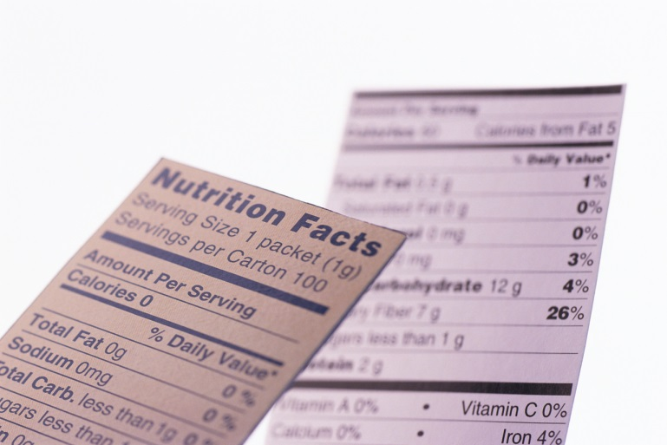
National School Lunch Program
Targets for:
  Calories
  Saturated fat
  Sodium

Slide 12
SMART Snacks
Effective July 1, 2014
Purpose:
  To reinforce healthy eating options throughout the school environment during the school day

Slide 13
SMART Snacks
Intended to build on healthy meal changes by ensuring that all snacks and beverages that are sold to students are nutritious
Applies only to foods sold to students during the school day
Will contribute to improving the overall school health environment

Slide 14
SMART Snacks
Any food sold in schools must:
  Be a “whole grain-rich” grain product; or
  Have as the first ingredient a fruit, a vegetable, a dairy product, or a protein food; or
  Be a combination food that contains at least ¼ cup of fruit and/or vegetable; or
  Contains 10% of the Daily Value (DV) of one of the nutrients of public health concern in the 2010 Dietary Guidelines for Americans (Calcium, potassium, vitamin D, or dietary fiber)

Slide 15
SMART Snacks
Calorie limits
  Snacks ≤ 200 calories
  Entrée ≤ 350 calories
Sodium limits
  Snacks ≤ 230 mg
  Entrée ≤ 480 mg

Slide 16
SMART Snacks
Fat limits
  Total fat ≤ 35 % calories
  Saturated fat ≤ 10 % calories
  Trans fat: Zero grams
Sugar limit
  ≤ 35 % of weight from total sugars in food

Slide 17
SMART Snacks
Beverages
  Plain water (with or without carbonation)
  Unflavored 1% milk
  Unflavored or flavored fat free milk (and permitted alternatives)
  100% fruit or vegetable juice
  100% fruit or vegetable juice diluted with water (with or without carbonation), and no added sweeteners

Slide 18
SMART Snacks
Beverages
  Elementary school up to 8 ounce portion
  Middle and High schools up to 12 ounce portion
  No portion size limit for water
  No calorie and lower calorie beverage options for high school students only

Slide 19
SMART Snacks
Fundraisers
  No limits on foods that meet the nutrition requirements
  Does not apply to non-school hours and off campus events

Slide 20
SMART Snacks
Key Players:
  Nutrition staff
  Fundraiser groups
  Teachers
  Administrators
  Students
  Parents

Slide 21
Healthy Eating and School Nutrition
Meal Pattern
Captive audience
Opportunity to teach
Might be only meal

Slide 22

How can you help?
Take action!!
  Advocate
  Role Model
  Facilitator
  Leader
  Wellness Committee

