Slide 1
CREATING TRAUMA SENSITIVE SCHOOLS
SUPPORTS FOR STUDENTS AND STAFF

Slide 2
ovERVIEW
TRAUMA DEFINED
PREVALENCE OF TRAUMA
IMPACT OF TRAUMA
STEPS TO CREATING TRAUMA SENSITIVE SCHOOLS

Slide 3
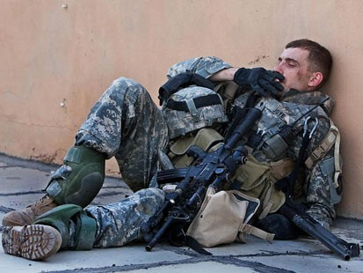
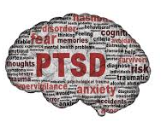
TRAUMA DEFINED
TYPE I: SINGLE EVENT
TYPE II: REPEATED, CHRONIC OR COMPLEX TRAUMA
PTSD

Slide 4
Adverse childhood experiences (aces) study
ADVERSE CHILDHOOD EXPERIENCES ARE
VERY COMMON
STRONG PREDICTORS OF HEALTH RISKS
STRONG PREDICTORS OF DISEASE
THIS MAKES ACEs ONE OF THE LEADING, IF NOT THE LEADING, DETERMINANT OF THE HEALTH AND SOCIAL WELL BEING OF OUR NATION
NATIONAL DATA: WWW.CDC.GOV/ACE/INDEX/HTM
DELAWARE DATA: WWW.CHILDHEALTHDATA.ORG

Slide 5
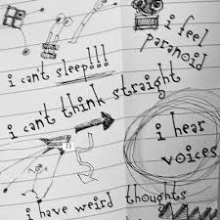
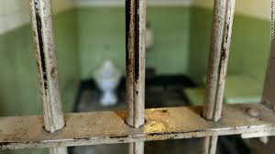
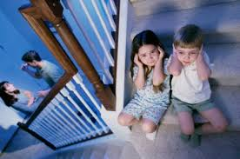
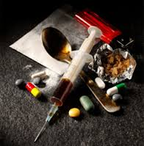
PREVALENCE ADVERSE CHILDHOOD EXPERIENCE (aces) STUDY CENTERS FOR DISEASE CONTROL AND PREVENTION (cdc)
Household dysfunction
Substance abuse 27%
Parental separation/divorce 23%
Mental illness 19%
Battered mother 13%
Incarcerated household member 5%
Abuse
Psychological 11%
Physical 28%
Sexual 21%
Neglect
Emotional 15%
Physical 10%
Notes:
In Delaware, The greatest numbers were around access to basic needs, separation/divorce and substance abuse (2011) 1803 participants
Urban ACE and more recent data sets have included questions about community violence and racial/ethnic discrimination

Slide 6
HEALTH RISKS ASSOCIATED WITH ACEs
BEHAVIORS
SCHOOL ABSENTEEISM, TARDIES, TRUANCY
DYSREGULATED EATING
SMOKING
SUICIDE ATTEMPTS
ILLICIT DRUG USE AND SUBSTANCE ABUSE
MULTIPLE SEXUAL PARTNERS
SELF-INJURIOUS BEHAVIORS
OUTCOMES
AUTOIMMUNE DISORDERS
OBESITY AND EATING DISORDERS
SUBSTANCE USE DISORDERS
CHRONIC OBSTRUCTIVE PULMONARY DISEASE (COPD)
DEPRESSION
FETAL DEATH
LIVER DISEASE
SEXUALLY TRANSMITTED INFECTIONS

Slide 7
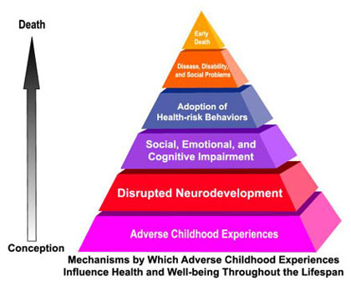
IMPACT OF TRAUMA OVER THE LIFE SPAN
EFFECTS OF CHILDHOOD ADVERSE EXPERIENCES
NEUROLOGICAL
BIOLOGICAL
PSYCHOLOGICAL
SOCIAL
Notes:
ACE leads to levels of toxic stress which make the rest of pyramid more likely
Brain development impacted: learning new info, focus, memory and regulation of strong emotions

Slide 8
ACES INFOGRAPHIC
http://vetoviolence.cdc.gov/childmaltreatment/phl/resource_center_infographic.html

Slide 9
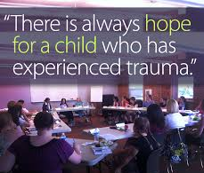
Trauma sensitive schools

Slide 10
TRAUMA SPECIFIC THERAPY V. TRAUMA SENSITIVE SCHOOL
THERAPY
LICENSED CLINICAL MENTAL HEALTH PROFESSIONALS
INTERVENTION OCCURS IN THERAPIST’S OFFICE 1:1 OR IN SMALL GROUP SESSIONS
FOCUS IS ON ADDRESSING TRAUMA REACTIONS AND REDUCING SYMPTOMS
SCHOOL
LICENSED EDUCATORS AND PUPIL SERVICES PROFESSIONALS WITH VARIED MENTAL HEALTH TRAINING
SENSITIVITY AND ACCOMMODATIONS OCCUR THROUGHOUT THE SCHOOL
FOCUS IS ON STUDENTS’ EDUCATIONAL SUCCESS THROUGH EMOTIONAL AND PHYSICAL SAFETY, EMPOWERMENT, TRUST, CHOICE AND COLLABORATION

Slide 11
DO WE SERVE STUDENTS WHO….
WITNESS DOMESTIC VIOLENCE?
ARE PHYSICALLY, EMOTIONALLY OR SEXUALLY ABUSED?
ARE NEGLECTED?
ARE HOMELESS?
HAVE FAMILY MEMBERS IN THE MILITARY?
HAVE BEEN IN A SERIOUS ACCIDENT?
LIVE IN HOMES WITH FAMLY MEMBERS WHO ABUSE ALCOHOL OR OTHER DRUGS?
LIVE IN HOMES WITH FAMILY MEMBERS WITH UNTREATED MENTAL ILLNESS?
HAVE LOST A LOVED ONE?
LACK CONSISTENT ACCESS TO BASIC NECESSITIES?

Slide 12
How do we see these students?
UNINFORMED VIEW
ANGER MANAGEMENT PROBLEMS
ADHD
STUDENT CHOOSING TO ACT OUT
UNCONTROLLABLE
DESTRUCTIVE
NON-RESPONSIVE
UNINFORMED RESPONSE:
STUDENT NEEDS CONSEQUENCES OR ADHD EVALUATION
TRAUMA-INFORMED VIEW
DIFFICULTY REGULATING EMOTIONS
DIFFICULTY MAINTAINING FOCUS
LACKING NECESSARY SKILLS/ IMPACTED NEUROBIOLOGY
DIFFICULTY TRUSTING ADULTS
TRAUMA RESPONSE WAS TRIGGERED
TRAUMA-INFORMED RESPONSE:
WE NEED TO PROVIDE THE SUPPORTS NECESSARY FOR THE CHILD TO LEARN TO MEET WITH SUCCESS

Slide 13
TRAUMA AFFECTS SCHOOL PERFORMANCE
LOWER SCORES ON STANDARDIZED ACHIEVEMENT TESTS (GOODMAN ET AL, 2011)
SUBSTANTIAL DECREMENTS IN IQ, READING ACHIEVEMENT AND LANGUAGE (DELANEY-BLACK ET AL, 2002)
TWO AND A HALF TIMES MORE LIKELY TO BE RETAINED (GREVSTAD, 2007; SANGER ET AL, 2000; SHONK ET AL, 2001)
SUSPENDED AND EXPELLED MORE OFTEN (SANGER ET AL, 2000)
MORE LIKELY TO HAVE STRUGGLES IN RECEPTIVE AND EXPRESSIVE LANGUAGE (DELANEY-BLACK ET ALL, 2002)

Slide 14
TRAUMA AFFECTS LEARNING
ADVERSELY AFFECTS ABILITY TO….
ORGANIZE NARRATIVE MATERIAL
UNDERSTAND CAUSE AND EFFECT
TAKE ANOTHER PERSON’S PERSPECTIVE
ATTEND TO CLASSROOM INSTRUCTION
REGULATE EMOTIONS
ENGAGE THE CURRICULUM
UTILIZE EXECUTIVE FUNCTIONS
MAKE PLANS
ORGANIZE WORK
FOLLOW CLASSROOM RULES

Slide 15
Six core components of trauma sensitive schools
SAFETY
SELF-REGULATION
SELF-REFLECTION
INTEGRATE TRAUMATIC EXPERIENCES
RELATIONAL ENGAGEMENT
POSITIVE SELF-IMAGE
(COOK, VAN DER KOLK, ET. AL., 2005)

Slide 16
Attributes of a trauma sensitive school
LEADERSHIP AND STAFF SHARE AN UNDERSTANDING OF TRAUMA’S IMPACT ON LEARNING
THE SCHOOL SUPPORTS ALL STUDENTS TO FEEL SAFE PHYSICALLY, SOCIALLY, EMOTIONALLY, AND ACADEMICALLY
THE SCHOOL ADDRESSES STUDENT NEEDS IN HOLISTIC WAYS
THE SCHOOL EXPLICITLY CONNECTS STUDENTS TO THE SCHOOL COMMUNITY
THE SCHOOL EMBRACES TEAMWORK AND STAFF SHARE RESPONSIBILITY FOR ALL STUDENTS
LEADERSHIP AND STAFF ANTICIPATE AND ADAPT TO THE EVER-CHANGING NEEDS OF STUDENTS

Slide 17
TEN TIPS FOR BUILDING RESILIENCE
MAKE CONNECTIONS
HAVE THE CHILD HELP OTHERS
MAINTAIN A DAILY ROUTINE
TAKE A BREAK
TEACH CHILDREN SELF-CARE
PRACTICE GOALS SETTING
NURTURE A POSITIVE SELF-VIEW
KEEP THINGS IN PERSPECTIVE AND MAINTAIN A HOPEFUL OUTOLLOK
LOOK FOR OPPORTUNITIES FOR SELF-DISCOVERY
ACCEPT THAT CHANGE IS A PART OF LIVING

Slide 18
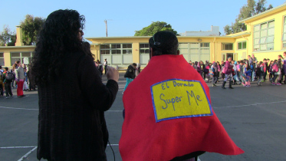
Seeing positive results
Lincoln High School in Walla Walla, WA, tries new approach to school discipline — suspensions drop 85%
At Reedley (CA) High School, suspensions drop 40%, expulsions 80% in two years with PBIS, restorative justice
San Francisco’s El Dorado Elementary uses trauma-informed practices; suspensions drop 89%

Slide 19
RESOURCES
Resiliency:
The Center for The Developing Child at Harvard University-has good information on the impact of toxic stress on the developing brain and building resiliency
http://developingchild.harvard.edu/topics/foundations_of_lifelong_health/
Search Institute: Focuses on developmental assets research has shown are associated with success in life:
http://www.search-institute.org/
Collaborative for Academic, Social, and Emotional Learning
http://www.casel.org/
Trauma informed schools:
Massachusetts Advocates for Children
http://traumasensitiveschools.org/tlpi-publications/
Washington State The Heart of Learning and Teaching
http://k12.wa.us/CompassionateSchools/HeartofLearning.aspx
Child Trauma Toolkit for Educators
http://www.nctsnet.org/nctsn_assets/pdfs/Child_Trauma_Toolkit_Final.pdf

