Slide 1

DE-PBS Cadre Meeting
October 1, 2014
WELCOME!

Slide 2

Welcome
Introductions
Tell me something good, cause that’s what I want to hear:
  What’s something fun you did this summer or an interest or hobby that others may not know about you?

Slide 3
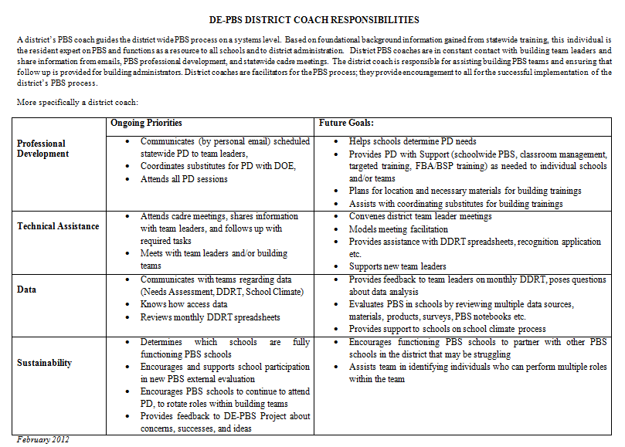

Slide 4

DE-PBS Phase Recognition

Slide 5
2013-14 Phase 1 Recipients
School District | School Name
Cape Henlopen School District | H. O. Brittingham Elementary Rehoboth Elementary
Capital School District | East Dover Elementary Fairview Elementary Hartly Elementary North Dover Elementary Towne Point Elementary William Henry Middle
Caesar Rodney School District | W. Reily Brown Elementary

Slide 6
2013-14 Phase 1 Recipients
School District | School Name
Christina School District | Leasure Elementary McVey Elementary Jennie Smith Elementary
Lake Forest School District | Lake Forest East Elementary
Milford School District | Banneker Elementary
Red Clay School District | Lewis Dual Language Elementary Richardson Park Learning Center Warner Elementary

Slide 7
2013-14 Phase 2 Recipients
School District | School Name
Brandywine School District | Brandywine Community School
Cape Henlopen School District | Shields Elementary
Christina School District | Marshall Elementary

Slide 8
2013-14 Phase 3 Recipients
School District | School Name
Appoquinimink School District | Brick Mill Elementary
Christina School District | Gallaher Elementary Keene Elementary
Milford School District | Morris Early Childhood Center

Slide 9
Public Notices
Letters to district superintendents and board presidents,
DOE governors report,
Website highlights

Slide 10
14-15 SY Phase Recognition
Reminders
Distribution typically in January
Application entails end of the year program reflection
Recognition reflects CURRENT year effort; schools maintaining or advancing levels should apply yearly
Process should be a team effort
Application review - May

Slide 11
Sustainability

Slide 12
Ensuring Sustainability of SWPBS
SUBSIST PBIS Sustainability Checklist: Overcoming Barriers
To overcome shifting priorities, the team and school administrators review new initiatives and identify how PBIS can contribute to/be integrated with those initiatives
To address general school turnover, the PBIS team is representative and communicates with groups across the school (e.g., administration, grade-level teachers, specialists, staff, students)
To address “champion” turnover, the leadership and expertise for implementing PBIS is shared among a number of school personnel
SUBSIST Checklist1 McIntosh, K., Doolittle, J.D., Vincent, C. G., Horner, R. H., & Ervin, R. A. (2013). SUBSIST PBIS Sustainability Checklist (Version 1.1). Eugene, OR: Educational and Community Supports, University of Oregon

Slide 13
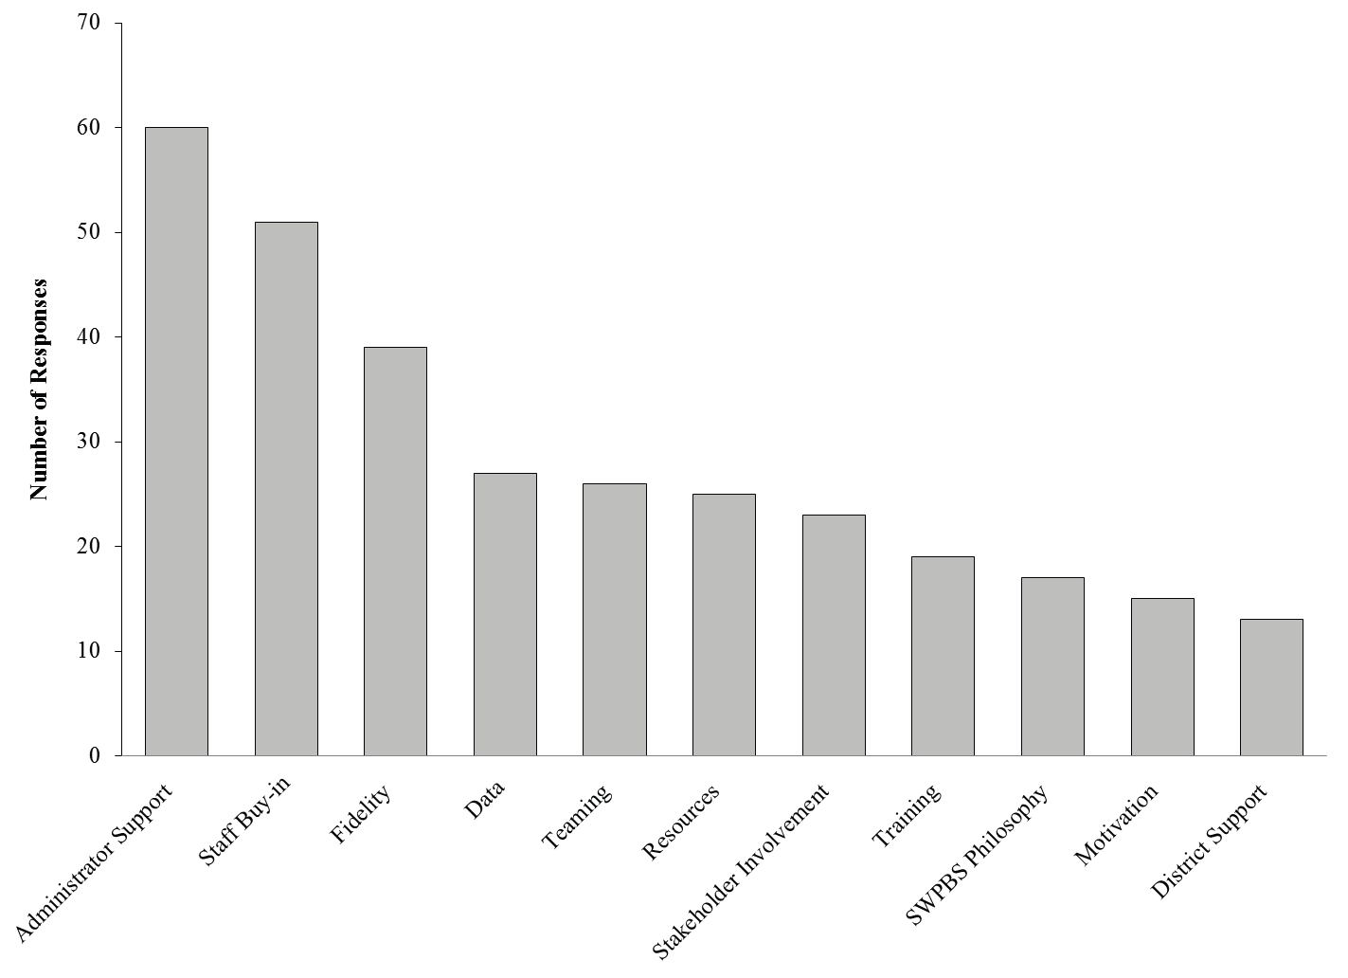
Enablers of Sustainability

Slide 14
Sustainability-Enhancing Strategies for School Team Members in face Principal Turnover
Ensure teams are representative of the whole school
Plan proactively for sustainability
  Many individuals have skills to maintain when key members leave
Create a practice handbook
Meet with incoming administrator
  Determine best way to present current practices as they relate to high-priority initiatives
  Share outcome data that aligns with goals
  Consider how new administrator goals might fit within existing practices
Recruit district support
  Provide district teams/leadership with updates related to valued outcomes
  District policies that support effective practices
  Increase visibility by sharing both within and outside of district
Strickland-Cohen, McIntosh & Horner, 2014. Effective Practices in the Face of Principal Turnover. Teaching Exceptional Children, vol 46, No. 3, pp. 19-25

Slide 15
Summer 2014 Update
Grant
SW Team Training
PEERS
1 Day School-wide PBS

Slide 16

School Climate and Student Success Grant
Component 1: Expanded Evidence-Based PD and Data Integration Tools
  All existing DE-PBS LEAs and schools
  Any new LEAs and/or schools that start DE-PBS
  over the course of the grant
Component 2: Increased Quantity and Quality of Existing TA
  3 priority LEAs, and particularly 9 focus schools, identified as having the greatest needs
    Red Clay
    Brandywine
    Capital

Slide 17
School-wide Team Training
2 sessions (June & July)
Total 6 new schools; 2 revamping team
1 group-based training; 1 follow up session with Project Coach
June Session | July Session
Campus Community | Stokes Elementary
Gunning Bedford Middle | Seaford Central Elementary
Marbrook Elementary | Seaford High
Stubbs Elementary* | North Laurel Elementary*

Slide 18

PEERS Curriculum for Schools
PEERS is an evidence-based curriculum developed for higher functioning adolescents without significant intellectual disabilities
Developed at UCLA by Dr. Elizabeth Laugeson
Focuses on making and keeping friends
Lessons include topics such as:
  having two-way conversations
  electronic forms of communication
  choosing appropriate friends
  managing arguments with friends
  handling teasing and bullying
PEERS teaches ecologically valid social skills using concrete rules and systematic steps of social behavior.
Curriculum utilizes the Socratic method, role-play demonstrations, perspective taking questions, coaching with feedback, and homework assignments.

Slide 19
PEERS
Program for the Education and Enrichment of Relational Skills
(Laugeson, 2014)
Treatment for middle and high school students with ASD
16-week curriculum
Small group format
  7-10 group members
30-60 minute daily lesson plans
Teacher-facilitated in the classroom
Includes weekly comprehensive parent handouts

Slide 20
Long-term Follow-up Study
(Mandelberg, Laugeson, Cunningham, Ellingsen, Bates, & Frankel, 2013)
Data was collected 1-5 years post-treatment
No significant differences between participants and non-participants at baseline
Mean age at follow-up
  17.5 years old
  11.4 grade level
Significant improvements found 1-5 years post-treatment in domains including Social Skills, Problem Behaviors, Cooperation, Assertiveness, Empathy, Self-Control, Internalizing and Externalizing Behaviors, and Social Responsiveness
Total Get Togethers also significantly improved based on parent and teen report at follow-up 1-5 years later

Slide 21
1 day School-wide PBS Debrief
Tuesday, September 23
94 attendees (39 school/15 district represented)
Top 10 areas of need on KFE (the first being the lowest item):
1. Involving Students in SW Decision Making
2. Students knowing the expectations
3. Supporting SEL through recognition of students
4. School staff developing self-discipline
5. Staff consistency with ODR
6. Ongoing staff development
7. Staff receiving recognition
8. Teacher-student relationships
9. Peer relationships
10. Representative SW team

Slide 22
DE-PBS Professional Development Calendar

Slide 23
Registration & Substitute Process
Invitation & reminder distributed to DE-PBS identified administrators, team leaders, and district coaches
Registration update prior to closing sent to district coaches
Attendance summary to coaches following PD event
The Department of Education will provide substitute reimbursement.
PFA or IV need to be completed within 30 days after the training. If training occurs after April 1, PFA or IV need to be completed as soon as possible. Please send completed PFA or IV electronically to Beth Draper (beth.draper@doe.k12.de.us).

Slide 24
Prevent Teach Reinforce
Part I:
  Wednesday, October 15 – 8-4
  DelTech Dover Campus (Room 400 A & B)
Part II:
  Thursday, April 30 – 8-4
  DelTech Dover Campus (Room 400 A & B)
The Prevent-Teach-Reinforce (PTR) model is a Tier 3 behavior intervention process. Participants will learn the 5-step, teacher/team driven model as well as how to identify the critical components that enhance the success of Tier 3 interventions.

Slide 25

PTR - Master Facilitators
Building district capacity:
  Colonial
  Capital
  Red Clay

Slide 26

DE-PBS Secondary Forum
The Logistics:
Date: Wednesday, October 22, 2014 (8:30-12:30)
Location: DelTech (Terry Campus) – Room 400A
Why: Team members and project coaches can share materials, ideas, obstacles and strengths in implementation efforts to help strength their current DEPBS programming.
Please remind your HS and MS administrators and
team members to RSVP by October 13

Slide 27

DE-PBS Secondary Forum
The Topics:
Student Involvement in SWPBS Programming
Bullying
Minor vs. Major Behaviors
Social Emotional Learning
Updates from the DEPBS Project

Slide 28
School-wide PBS Training: Correcting Problem Behavior and Developing Self-Discipline
Tuesday, December 9 – 8-4
DelTech Dover Campus (Room 727)
Continuation from 2-day summer training
Open to active schools
  Reflect on Key Features Evaluation results
The focus of this workshop is on systems to support correction of problem behaviors and developing self-discipline as part of the SWPBS framework.

Slide 29
Administrator Roundtable
Tuesday, December 9 – Lunch Hour
DelTech Dover Campus (Room 727)
Brownbag discussion
Invite included in Correcting Problem Behavior & Developing Self-Discipline distribution
Additional invite distributed to administrator list

Slide 30
SSIP planning update

Slide 31
DE-PBS & Bullying Prevention/Response

Slide 32
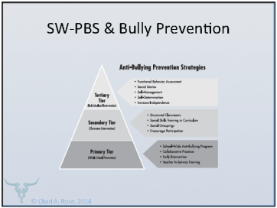
  Bullying Prevention for All Students with a Multi-tiered Systems of Support
Develop a SW-PBS Bully Prevention Plan by looking at school data:
  Is bullying a problem?
  What types of bullying are occurring?
  Where is the bullying occurring
  Where and how do the students seek help?
  Where do staff feel students should or could seek help?
  Are staff aware of district/school bully policy and procedures?
  What are the parent perceptions of issues and school interventions?
  (Lewis, 2011)
Promote SEL Learning at all Tiers including:
Self-Awareness
Social Awareness
Self-Management
Relationship Skills
Responsible Decision Making
(Casel, 2003)

Slide 33
Bullying Prevention:
Your DSCS Data Can Help Set Priorities
13-14 DSCS Part III: Bullying
Climate Subscale | Student Survey Results Report | Home Survey Results Report
Bullying SW* | School-Wide (Pgs. 1, 2, 7, 11) | N/A
Bullying Victimization | Physical Bullying (Pgs. 4-5, 8, 12) | Physical Bullying (Pgs. 2, 4-5)
 | Verbal Bullying (Pgs. 4-5, 8, 12) | Verbal Bullying (Pgs. 2, 4-5)
 | Social/Relational Bullying (Pgs. 4-5, 8, 12) | Social/Relational Bullying (Pgs. 2, 4-5)
 | Cyberbullying (Pgs. 4-5, 8, 12) | N/A
* A higher score represents an unfavorable response to items on the Bullying School-Wide subscale and the Use of Punitive Techniques subscale.

Slide 34

Bullying Prevention:
Initial Steps
Confirm the definition of “bullying” for your school
Outline your school’s plan for teaching the definition & establish clear reporting protocol
Outline your school’s protocol for responding to bullying reports.
Describe how your school’s School-Wide Expectations relate to bullying prevention in your school.

Slide 35
Bullying & Students with Disabilities
Compared to children without disabilities, and looking at bullying occurrences of at least once or twice a month or more, we found that students with disabilities are:
  1.45 times more likely to experience bullying in general
  1.44 times more likely to experience physical bullying
  1.32 times more likely to experience verbal bullying
  1.31 times more likely to experience social/relational bullying

Slide 36
Bullying & Students with Disabilities
 | Verbal Bullying | Social/ Relational Bullying | Physical Bullying | Bullying in general
Children with Emotional Disturbance | 75%, | 41.7 | 45.5%, | 66.7%,
Children with Blindness/Visual Impairments | 36.4%, | 36.4%, | 10.0%, | 10.0%,
Children with Hearing Impairments | 28.6%, | 18.2%, | 4.5%, | 8.7%,
Children with Mild Intellectual Impairments | 21.7% | 18.2% | 8.7% | 17.4%

Slide 37
Let’s chat?
How are schools integrating bullying prevention in their SWPBS Program?
If they are not, how can we support them?

Slide 38

Resource
1 per district

Slide 39

Incorporating multiple initiatives within
DE-PBS Framework
  Grit/SEL/MAG, etc.
  Trauma-sensitive practices
  Restorative practices
  Bullying prevention
  Others?

Slide 40
DE-PBS Related Data

Slide 41
DDRT & DASNPBS
Discipline Data Reporting Tool (DDRT)
  Template available on website
  Submission 2x per year
DE Assessment of Strengths and Needs
  10 question survey per implementation area
  Staff perspective on program strength/weakness for use in planning

Slide 42
School Climate Survey 2014-2015
Enrollment: mid-October -11/7/14
Survey window:
  Staff: 11/17/14 - 12/23/14
  Student and Home: 1/12/15-3/2/15
Results: May 2015
Timeline
Logistics
Student, Staff, Home Versions
Paper & Online Options
Survey Contact per school

Slide 43
DE-PBS Key Feature Evaluation

Slide 44
Key Feature Evaluation Process
On-site Evaluation (approx. 3-4 hours)
Sources of Information:
  Interviews with administrator, DE-PBS team leader, teachers/staff, students
  Review of documents
  Schoolwide observations
  Existing data: School Climate Surveys, DASNPBS, ODR
DE-PBS Key Feature Evaluation Structure
SW PBS Tier 1: Program Development & Evaluation | Prevention: Implementing SW & CR Systems
Correcting Problem Behavior | Developing Self Discipline

Slide 45
Levels of Implementation
Exploration:
  Few elements of implementation
Developing:
  Early phase of implementation; some elements adequately in place
Proficient:
  Elements in place and implemented
Exemplary:
  Implementation shows evidence of innovation and sustainability

Slide 46
Implementation Level Information Distribution & Support
DE-PBS Key Feature Evaluation Scoring Summary
  Overall summary & criteria
  Per section criteria
Narrative report distribution
Technical assistance
Determine steps for support
Level | Description
Exploration: | Few elements of implementation
Developing: | Early phase of implementation; some elements adequately in place
Proficient: | Elements in place and implemented
Exemplary: | Implementation shows evidence of innovation and sustainability

Slide 47
Percentage of Schools by Implementation Level – 2 years

Slide 48
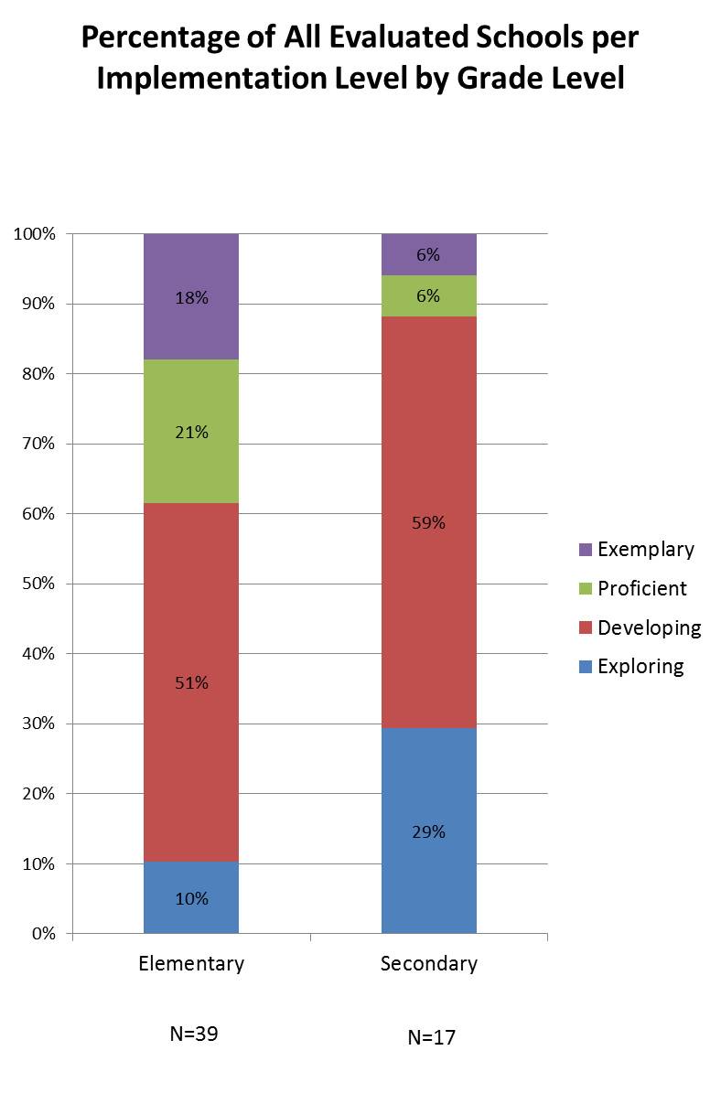
Percentage of Schools by Implementation Level
Elementary vs. Secondary

Slide 49
Key Feature Evaluation Review Guide/Action Plan
Tool to be used after receiving evaluation feedback
Review noted strengths for each evaluation section
  Identify strategies for maintaining strengths and develop an action plan
Review noted recommendations for each section
  Prioritize recommendations and develop an action plan
This tool supports continued implementation planning

Slide 50
2014-15 KFE School Visits
New KFEs
  Next cohort of schools not yet evaluated with KFE
  Draft schedule plan will be shared with coaches
Focused re-evaluations
  Recognition
  Schools receiving extra support

Slide 51
DE-PBS Key Feature Status Tracker
Purpose: To support teams to assess implementation in four main program categories & plan next steps
Broken into four evaluation sections
  SWPBS Tier 1, Prevention, Correcting Problem Behaviors, and Developing Self-Discipline
Tracker includes:
  Key program components for each section
    Teams can use these to assess their program and identify areas to modify or build upon
  Action plan to develop steps towards improving or modifying program components
Can be used for ongoing monitoring

Slide 52
Key Feature Status Tracker
Checklist #1: School-wide PBS Tier 1: Program Development and Evaluation
 |  | Status: In Place, Partially in Place, Not in Place
Date: (MM/DD/YY)
Data 1. Behavior referrals are entered into the school’s electronic system within a week. | Status:
2. School participates in “DE School Climate Survey”: Staff, Student, Home (w/in past year). This data is used by team to plan in planning and evaluating the PBS program. | Status:

Slide 53
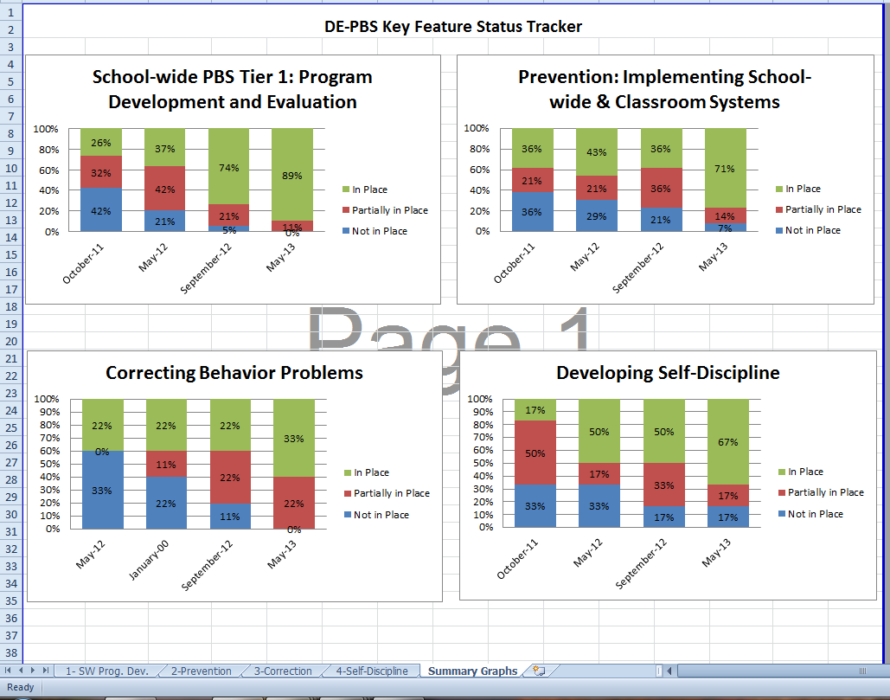

Slide 54
School Climate Data Highlights
Techniques as predictors of climate:
  Positive techniques improve climate.
  Positive techniques predict increases in climate the next year.
    No significant interactions by race or level. When examined by gender, males have a steeper slope than females.
  Punitive techniques decrease climate.
    Punitive techniques predict decreases in climate the next year. No significant interactions by race, or gender.
  SEL increases climate
    SEL predicts increases in climate the next year.
    There are no interactions by level.

Slide 55

School Climate Data
Highlights continued
Predicting student engagement (cognitive-behavioral and emotional engagement)
  Increases in positive techniques predict increases in engagement.
  Increases in climate predict increases in student engagement.
  Increases in SEL predict increases in engagement the following year.

Slide 56

Please mark & protect your calendars for DE-PBS Cadre Meetings on. . .
Tuesday, January 13, 2015
Tuesday, March 24, 2015

Slide 57
State Systemic Improvement Plan (SSIP) Overview
&
Indicators 4A & 4B
Significant Discrepancy
Rates of Suspension & Expulsion
DE-PBS Cadre
October 1, 2014
Tracy Neugebauer

Slide 58


State Systemic Improvement Plan
Overview

Slide 59
The Office of Special Education Programs (OSEP) is revising how it holds States accountable for educating children with disabilities.
In the past, OSEP has focused most of its monitoring and on compliance-related requirements of the Individuals with IDEA.
OSEP is now expanding its focus to include improved achievement for children with disabilities. However, the State is still responsible for monitoring compliance.
Results
Driven
Accountability

Slide 60
SPP/APR
Indicator | Focus
1/2 | Graduation/Dropout Rates
3 | DCAS Participation/Achievement
4 | Disproportionality/Suspension & Expulsion
5/6 | LRE
7 | Early Childhood Outcomes
8 | Parent Involvement in IEP Process
9 & 10 | Disproportionate Representation re: Identification
11 | Part C State Systemic Improvement Plan (RDA)
12 | Transition from Part C to Part B
13/14 | Secondary Transition
15/16 | Mediations/Due Process
17 | Part B State Systemic Improvement Plan (RDA)

Slide 61
Indicator 17
INDICATOR: The State’s SPP/APR includes a State Systemic Improvement Plan that meets the requirements set forth for this indicator.
MEASUREMENT: The State’s SPP/APR includes a comprehensive, multi-year State Systemic Improvement Plan, focused on improving results for children and youth with disabilities and their families.

Slide 62
SPP/APR:
Predetermined Targets
Indicator | Focus | Target
1 | Graduation Rate | ESEA Waiver
3 | DCAS Participation/Achievement | ESEA Waiver
4b | Disproportionality/Suspension & Expulsion (race & ethnicity) | 0%
9 & 10 | Disproportionate Representation re: Identification | 0%
11 | Evaluation Timelines | 100%
12 & 13 | Secondary Transition | 100%

Slide 63
SPP/APR
Targets to be Determined with Stakeholders
Indicator | Focus
2 | Dropout Rate
4a | Disproportionality/Suspension & Expulsion (SWD > 10 days)
5 & 6 | LRE
7 | Early Childhood Outcomes
8 | Parent Involvement
14 | Secondary Transition

Slide 64
Improving Results for Students with Disabilities
State Systemic Improvement Plan (SSIP)
5 year plan
Phase 1 |  | Phase 2 |  | Phase 3
Analysis | Plan |  | Implement | Evaluation
✓ Data Analysis
✓ State-Identified Measurable Target
✓ Infrastructure Analysis
✓ Root Cause Analysis
✓ Theory of Action
✓ Develop Plan

Slide 65
Improving Results for Students with Disabilities
State Systemic Improvement Plan (SSIP)
Phase 1 Advisory Council
GACEC
DD Council
AGEC
Parent Information Center
PTA
619 Coordinators (Preschool)
English Language Learners Advisory Group
Parents representing each county
Special Education Directors representing each county
State Board of Education
Transition Cadre/Council
PBS Cadre/Regional Council
DOE: Assessment, K-12 Initiatives, Early Learning, Title I

Slide 66
June 1 – October 30, 2014
SSP/APR
Stakeholder Groups
Set Targets
for 2015 – 2020
Indicator 2
Indicator 4a
Indicators 5 & 6
Indicator 7
Indicator 8
Indicator 14
Indicator 17 Advisory Council
Phase 1
Data Analysis
Focus for Improvement
Infrastructure Analysis
Root Cause Analysis
Theory of Action
Develop Implementation Plan

Slide 67
Indicator 4
Rates of Suspension and Expulsion
4A
Percent of Local Education Agencies
(LEAs) identified by the State as having a
significant discrepancy in the rates of
suspensions and expulsions of children with
disabilities for greater than 10 days in the
school year.
  Considered a results driven indicator with stakeholders setting targets.

Slide 68
4B
Percent of LEAs identified by the State as having a significant discrepancy in the rates of suspensions and expulsions for greater than 10 days in a school year of children with disabilities by race and ethnicity.
Considered a Compliance Driven indicator with OSEP setting the target.

Slide 69
*2007-2008: A. 36.8% of districts (7 districts) are identified by the state as having a significant discrepancy in the rates of suspensions and expulsions of children with disabilities for greater than 10 days in a school year.
2008-2009: A. 26.3% of districts (5 districts) are identified by the state as having a significant discrepancy in the rates of suspensions and expulsions of children with disabilities for greater than 10 days in a school year.
2009-2010: A. 15.7% of districts (3 districts) are identified by the state as having a significant discrepancy in the rates of suspensions and expulsions of children with disabilities for greater than 10 days in a school year.
2010-2011: A. 0% of districts (0 districts) are identified by the state as having a significant discrepancy in the rates of suspensions and expulsions of children with disabilities for greater than 10 days in a school year.
2011-2012: A. 0% of districts (0 districts) are identified by the state as having a significant discrepancy in the rates of suspensions and expulsions of children with disabilities for greater than 10 days in a school year.
2012-2013: A. 0% of districts (0 districts) are identified by the state as having a significant discrepancy in the rates of suspensions and expulsions of children with disabilities for greater than 10 days in a school year.
Annual Targets
4A
*These targets were set using 2004-2005 data, and dropped by two districts every year to 0…..

Slide 70
New Targets need to be set..
Indicator 4 Stakeholder groups to set new measurable and rigorous targets for Indicator 4A
  Set target for percentage of LEAs identified with significant discrepancy
  Identify rate ratio to compare general education and special education rates of long term expulsions and suspension
Previous SPP Target – 0% of LEAs
Rate ratio for 2012-2013 data – 1.26

Slide 71
4B Measurable and Rigorous Target
Percent of districts that have: (a) a significant discrepancy, by race or ethnicity, in the rate of suspensions and expulsions of greater than 10 days in a school year for children with IEPs; and
(b) policies, procedures or practices that contribute to the significant discrepancy and do not comply
with requirements relating to the development and implementation of IEPs, the use of positive behavioral interventions and supports, and procedural safeguards.
Target = 0% of LEAs
This is set by OSEP

Slide 72
Significant Discrepancy Definition
Rate Ratio Method
An LEA has a significant discrepancy when the rate of long term suspension/ expulsions for students with disabilities compared to the rate for students without disabilities is greater than the “state bar.”

Slide 73
Significant Discrepancy Definition
Rate Ratio Method – State Bar
Define Significant Discrepancy:
4A - LEAs with Rate Ratio above “Bar” and
15 or more students in cell
4B - LEAs with Rate Ratio above “Bar” and
10 or more students in cell

Slide 74
Significant Discrepancy Definition
Rate Ratio Method
Indicator 4A
Step 1: Calculate Rate Ratio
  LEA % of SWD Suspended > 10 days
  LEA % of SWOD Suspended > 10 days
Step 2: Compare LEA Rate Ratio to “Bar”
  FFY 2011 - 1.30; FFY 2012 – 1.28
  FFY 2013 - 1.26 (based on 2012-2103 data)
Step 3: Examine Cell Size
  4A - > 15 SWD Suspended/ Expelled > 10 days
Step 4: Define Significant Discrepancy
  4A - LEAs with Rate Ratio above “Bar” and
  15 or more students in cell

Slide 75
District example 4A
Step 1:Calculate LEA % of Students with Disabilities (SWD)
47 Special Ed Students Suspended > 10 days = 3.7%
1287 Special Ed Students in LEA
Step 2: Calculate LEA % of Students without Disabilities (SWOD)
46 General Ed Students Suspended > 10 days = 0.9%
5322 General Ed Students in LEA
Step 3: Calculate Rate Ratio
3.7 LEA % of SWD Suspended > 10 days = 4.1
0.9 LEA % of SWOD Suspended > 10 days
Step 4: Compare LEA Rate Ratio to “Bar”
4.1 (LEA Rate Ratio) compared to State “Bar”

Slide 76
Significant Discrepancy Definition
Rate Ratio Method
Indicator 4B
Step 1: Calculate Rate Ratio
  LEA % of Black SWD Suspended > 10 days
  LEA % of SWOD Suspended > 10 days
Step 2: Repeat 1 – 3 for Each Race Category
American Indian/Alaskan Native; Asian; Black or African American; Hispanic/Latino; Native Hawaiian/Pacific Islander; White; Two or More Races
Step 3: Compare LEA Rate Ratio for Each Race Category to “Bar”

Slide 77
Significant Discrepancy Definition
Rate Ratio Method
Indicator 4B
Step 4: Examine Cell Size
4B - > 10 SWD Suspended/ Expelled > 10 days
Step 5: Define Significant Discrepancy:
4B - LEAs with Rate Ratio above “Bar” and
10 or more students in cell for any Race/ Ethnicity Category

Slide 78
District example 4B
Step 1: Calculate LEA % of Students with Disabilities (SWD) - Each Racial Category
28 Black SWD Suspended > 10 days = 3.9%
710 Black SWD in LEA
Step 2: Calculate LEA % of Students without Disabilities (SWOD)
46 General Ed Students Suspended > 10 days = 0.9%
5322 General Ed Students in LEA
Step 3: Calculate Rate Ratio
3.9 LEA % of Black SWD Suspended > 10 days = 4.3
0.9 LEA % of SWOD Suspended > 10 days
Step 4: Compare LEA Rate Ratio to “Bar”
4.3 (LEA Rate Ratio) > State “Bar”

Slide 79
Actual Target Data
FFY 2011 (10-11 data)
4A – 12.2% of LEAs (5 LEAs)
4B – 12.2% of LEAs (5 LEAs)
FFY 2012 (11-12 data)
4A – 9.75% of LEAs (4 LEAs)
4B -- 9.75% of LEAs (4 LEAs)
FFY 2013 (12-13 data)
4A – 2.56 % of LEAs (1 LEA)
4B – 12.8 % of LEAs (5 LEAs)
* Note the base number of LEAs vary year to year as charter
schools open and close

Slide 80
State’s Monitoring Responsibilities
FFY 2012 – Feb 2014 APR
Indicator 4A - Rate Ratio > 1.28 & n > 15
Indicator 4B - Rate Ratio > 1.28 & n > 10
Local Education Agency | 2011 – 2012 SWD compared to S w/o D | 2011 – 2012 4B Black Students | 2011- 2012 4B Hispanic Students
LEA 1 | 1.34 (n = 36 ) | 1.92 (n = 29 )
LEA 2 | 1.47 (n = 49) | 2.72 (n = 42)
LEA 3 | 1.58 (n = 32) | 1.88 (n = 18)
LEA 4 | 1.69 (n= 46 ) | 3.17 (n = 31) | 1.57 (n= 10 )

Slide 81
State’s Monitoring Responsibilities
FFY 2013 – Feb 2015 APR
Indicator 4A - Rate Ratio > 1.26 & n > 15
Indicator 4B - Rate Ratio > 1.26 & n > 10
Local Education Agency | 2012 – 2013 CWD compared to C w/o D | 2012 – 2013 4B Black Students
LEA 1 |  | 1.50 (n = 10)
LEA 2 | 2.88 (n = 44 ) | 1.33 (n = 33 )
LEA 3 |  | 1.96 (n = 32)
LEA 4 |  | 1.69 (n = 12)
LEA 5 |  | 2.02 (n = 19)

Slide 82
New Target…
Input from Cadre on new target for 2015-2020
Thoughts??
Use baseline data from this year?
If we use 0% we won’t meet target because we are using lag data-can we deal with that?
We also have other stakeholder groups to weigh in on this
Set target for percentage of LEAs identified with significant discrepancy
  Previous SPP Target – 0% of LEAs
Identify rate ratio to compare general education and special education rates of long term expulsions and suspension
  Rate ratio for 2012-2013 data – 1.26

Slide 83

Questions?
Tracy Neugebauer
Tracy.Neugebauer@doe.k12.de.us

