Slide 1
DE-PBS Cadre Meeting
January 13, 2015

Slide 2


Welcome & Happy New Year
Please share name & district.
Think of something you are looking forward to in this 2nd half of the school year? Or think about a job related resolution?

Slide 3

DE-PBS Professional Development Update

Slide 4
Prevent Teach Reinforce – 10/15/14
PTR Day 1 - Total participants - 112
  Districts 15
  Schools 55
Reminder of Day 2 – 4/30/15
Master Facilitator Update
  4 Master Facilitators
    Capital, Colonial, Milford, Red Clay

Slide 5
PEERS – Secondary Social Skills Training
4 districts, 1 charter school and 9 groups
(Brandywine, Capital, Seaford, Appoquinimink, Gateway Charter)
Looking for….
  Fidelity of implementation
  Pre & Post Intervention data
  Student Outcome data
  Are teachers seeing changes?

Slide 6


DE-PBS Secondary Forum
October 22, 2014 - Overview
Attendees
41 total
12 districts
19 schools
(PBS & non-PBS)
Attendees
41 total
12 districts
19 schools
(PBS & non-PBS)
Topics
Student Involvement in SWPBS Programming (Schools Sharing)
Bullying
Minor vs. Major Behaviors
Social Emotional Learning
Updates from the DEPBS Project
  Trauma-Sensitive Schools
  PEERS
  Achievement Mentoring (DHS)
Topics
Student Involvement in SWPBS Programming (Schools Sharing)
Bullying
Minor vs. Major Behaviors
Social Emotional Learning
(including CASEL & evidence-based resources)
Updates from the DEPBS Project
  Trauma-Sensitive Schools
  PEERS
  Achievement Mentoring (DHS)

Slide 7
DE-PBS Secondary Forum
October 22, 2014 - Highlights
Schools’ Identified
“Next Steps”
Create a bullying committee and/or action plan at school
Re-examine minors vs. majors
Revamp and/or expand SEL programming to SW level
Improve student involvement in PBS
Schools’ Identified
“Next Steps”
Create a bullying committee and/or action plan at school
Re-examine minors vs. majors
Revamp and/or expand SEL programming to SW level
Improve student involvement in PBS
  Spring Forum
Resources Shared
Time to Share Real-Life Peer Perspectives ☺
How to Calm an Agitated Student (InterventionCentral.org)
DE-PBS Bully Prevention Action Plan - Guiding Questions (Chad Rose)
Relevance Writing Exercise (Hulleman et al., 2009)
  Self-Affirmation Writing (Cohen et al., 2009)
Time to Share Real-Life Peer Perspectives ☺
How to Calm an Agitated Student (InterventionCentral.org)
DE-PBS Bully Prevention Action Plan - Guiding Questions (Chad Rose)
Relevance Writing Exercise (Hulleman et al., 2009)
  Self-Affirmation Writing (Cohen et al., 2009)

Slide 8
School-wide Day 3 – 12/9/14:
Correcting Problem Behavior & Developing Self-Discipline
Total Participants - 84
  Districts 14
  Schools 34
Agenda -
  SW success sharing
  Correcting Problem Behavior
  Developing Self-Discipline
Administrator Roundtable Discussion (lunch hour)

Slide 9
SW Day 3 – Action Items
Correcting Problem Behavior
Developing Self-Discipline
Modify current referral process
Decide major vs. minor behaviors, terms to define them, response procedures
Work on flow chart for managing classroom & office behaviors
Implement reflection forms with students
Weekly social skills curriculum
Enhance cool tools (SW expectation lessons) to incorporate more SEL
Create student-led data review monthly
Create a PBS student team
  Implement student-run teacher of the week nomination

Slide 10
Upcoming Events
Tier 2: Targeted/Problem-solving Team Training – 2/10/15
DE-PBS Celebration Conference (Date TBD)
DE School Climate Data Workshop (Date TBD)
SWPBS New Team Training (Summer 2015)
Delaware Inclusion Conference – 3/9/15
  Trauma-Sensitive Schools

Slide 11


Addressing Trauma
Identifying 6 middle schools to receive on going PD in Compassionate Schools
  Appoquinimink
  Brandywine
  Caesar Rodney
  Christina
  Colonial
  Woodbridge
Highlight connections to DE-PBS
Additionally, looking at how to integrate understanding the impact of trauma on students in all DE-PBS PD sessions

Slide 12
Ten Strategies of a Compassionate School
Focus on culture and climate in the school and community.
Train and support all staff regarding trauma and learning.
Encourage and sustain open and regular communication for all.
Develop a strengths based approach in working with students and peers.
Ensure discipline policies are both compassionate and effective (Restorative Practices).
Weave compassionate strategies into school improvement planning.
Provide tiered support for all students based on what they need.
Create flexible accommodations for diverse learners.
Provide access, voice, and ownership for staff, students and community.
Use data to identify vulnerable students and to determine outcomes and strategies for continuous improvement

Slide 13

Alternatives to Suspension

Slide 14
Alternatives to Suspension
October Cadre discussion included Indicator 4 review and concerns about school community’s view on use of alternatives to suspension.
How can we support you in fostering understanding among school personnel & families that alternatives to suspension are beneficial?

Slide 15
3 Summary Sheets for Review
Using Current SWPBS Systems
Restorative Practices
10 Alternatives To Suspension – by Reese Peterson

Slide 16
Visual Intent
User friendly
Quick reference to support discussion
Easy to share
Visually appealing (not a research article)

Slide 17
Overall thoughts…..
What did you think of the format of the documents? Does the format support you to have a conversation with someone?
Would these be usable for your schools?
Is there enough information?
Were they helpful? Did they give you new ideas?
What other alternatives might you like to see highlighted?

Slide 18

DE-PBS Related Data

Slide 19
DDRT & DASNPBS
Discipline Data Reporting Tool (DDRT)
  Template available on website
  Submission 2x per year – DE-PBS Project & Coaches
    January 16, 2015
    June 2015
DE Assessment of Strengths and Needs
  10 question survey per implementation area
  Staff perspective on program strength/weakness for use in planning

Slide 20
School Climate Survey Update
Staff survey – now closed
  Approximately 6, 200 responses
Student & Home Survey - 1/12/15-3/2/15
  Materials delivered to district offices for distribution to schools
  Online survey now open
Weekly online completion updates
May 2015 – Reports distributed & Workshop to be scheduled

Slide 21
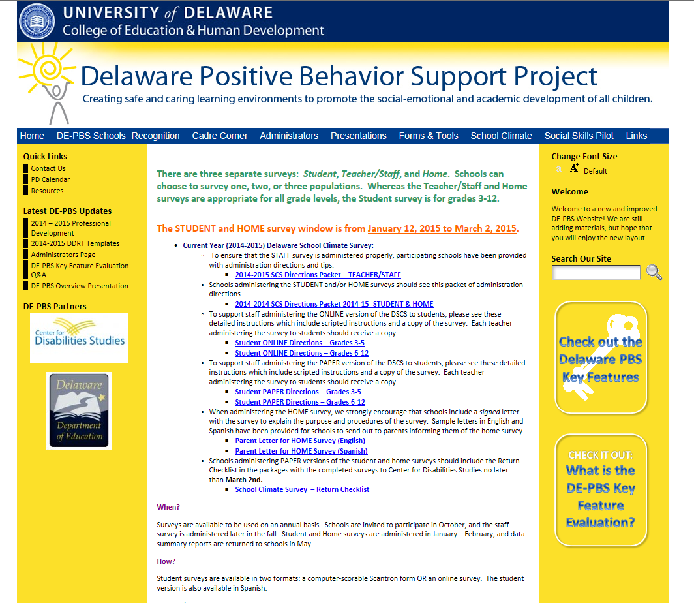

Slide 22
2015 DSCS Report Enhancements
Report data tables:
  Color coding to highlight favorable and unfavorable scores
Report graphs:
  Include 3 years data
  Graphs for each population report (Only student in 2014)
Other:
  Revision of interpretation worksheets
  PowerPoint template to support teams in sharing data results with school community

Slide 23
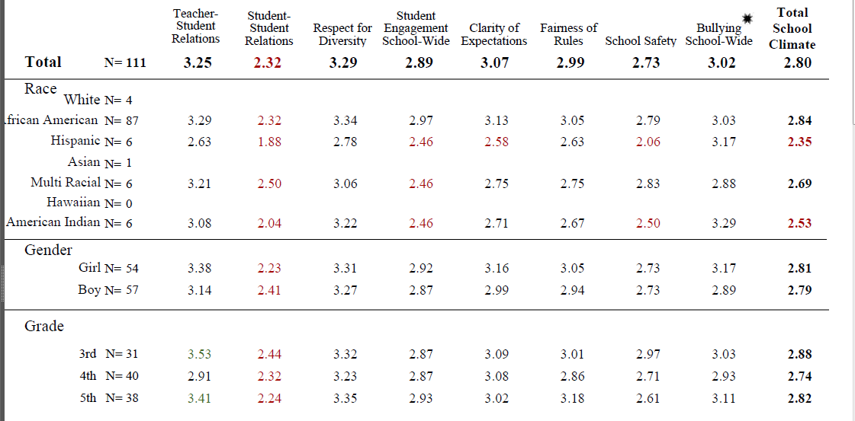
Report Data Tables – Color coding

Slide 24
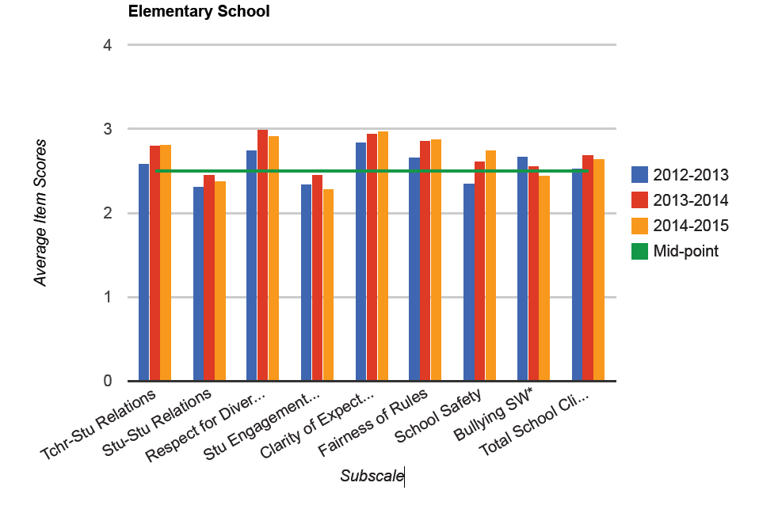
Report Data Graphs – Multi-year, Color

Slide 25
Key Feature Evaluation Overview
On-site External Evaluation of SWPBS Programs by DE-PBS Staff
KFE will be conducted with all schools active with DE-PBS Project over course of a few years
DE-PBS Key Feature Evaluation Structure
SW PBS Tier 1: Program Development & Evaluation | Prevention: Implementing SW & CR Systems
Correcting Problem Behavior | Developing Self Discipline

Slide 26
Implementation Level Information
Level | Description
Exploration: | Few elements of implementation
Developing: | Early phase of implementation; some elements adequately in place
Proficient: | Elements in place and implemented
Exemplary: | Implementation shows evidence of innovation and sustainability

Slide 27
DE-PBS Key Feature Evaluation Summary
7 School visits – Fall 2014
  3 Exemplary, 2 Proficient, 2 Developing
6 KFEs scheduled – January 2015
Reminder – DE-PBS Phase 2 Recognition requires a Proficient or Exemplary KFE Status
  Schools may request to schedule KFE or KF Re-Evaluation
To date 23 schools earning Proficient or Exemplary levels of implementation!

Slide 28

Anonymous statewide survey of licensed school-based educators to assess teaching conditions at the school, district and state level
Survey previously administered in Winter 2013
The 2015 TELL Delaware Survey will be administered in spring of 2015.
http://www.telldelaware.org/

Slide 29
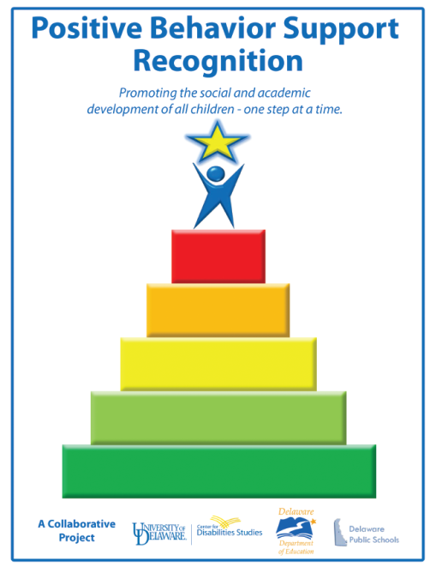
DE-PBS Phase Recognition

Slide 30
Option A:
Phase 1 – Application w/ no changes
Phase 2 –
  Exemplary KFE implementation level
    No application needed
  Proficient KFE implementation level
    Application revised to only include essay question
Phase 3 – Application w/ no changes; Phase 2 is a prerequisite

Slide 31
Option B:
Recognition only tied to KFE status
  Schools receive banner for advanced PBS implementation based on Exemplary KFE level
  No Phase 1 or 3
Future: Tier 2-3 external evaluation can be used to award schools for strong implementation

Slide 32
Option C:
No DE-PBS Phase Recognition System
No KFE implementation awards
OR
Other Ideas

Slide 33

Break

Slide 34

Tier 2: Targeted Team Training & Resources

Slide 35
Targeted Team Training – 2/10/15
Invitation based on readiness as determined by KFE
Coaches, please attend if possible:
Tier 2 - Targeted Problem-Solving System Development Tuesday, February 10, 2014 9:00 – 3:30 (Registration 8:45) DelTech – Room 400 A&B

Slide 36
Multi-Tiered System of Support
The Tiers are not set and not constant. Students can move back and forth through these Tiers, and the Tiers each have growing levels of intensity within themselves.
(Red Clay and DE-PBS Project)
Tier 1, School-wide
Supports
Tier 2, Targeted Supports
Tier 3, Intensive Supports
Tier 1, School-wide
Team
Tier 2, Targeted
Team
Tier 3, Intensive
Team

Slide 37
Multi-Tiered System of Support
Interventions Under the Teams
Tier 1 Team
Tier 2 Team
Tier 3 Team
Universal Support through SW Program
Group interventions
FBA/BSP
PTR
Person Centered Planning
Group w. individual
Features
Brief
FBA/BSP
Adapted from the Illinois PBIS Network

Slide 38
Multi-Tiered System of Support
Necessary Conversations within Teams
School-wide
Team
Tier 2 Team
Tier 3 Team
Plans SW & Class-wide supports
System
Conversations
Uses process data; evaluates overall effectiveness; does not involve discussion of individual students
Problem Solving Conversations
Matches students to interventions and monitors progress, making adjustments as needed
Uses Process data; determines overall intervention effectiveness
Universal Support through SW Program
CICO
FBA/BSP
PTR
Person Centered Planning
Group interventions
Group w. individual
features
Brief
FBA/BSP
Adapted from the Illinois PBIS Network

Slide 39
Tier 2 Team: 2 Types of Conversations
Tier 2 Team
System
Conversations
Uses process data; evaluates overall effectiveness; does not involve discussion of individual students
Problem Solving Conversations
Matches students to interventions and monitors progress, making adjustments as needed
Problem-Solving
Systems

Slide 40
Tier 2 – Why 2 Conversations?
  Ensure interventions are efficient
    Continuously available so students can receive support quickly (within 2-3 days optimally)
  Use minimal time commitment required from classroom teachers
  The required skill sets needed by teachers are easily learned
  Interventions should be aligned with school-wide expectations
  Allows for an emphasis on intervention designed to support multiple students simultaneously
    Consistently implemented with most students, some flexibility
  Ensure intervention selected matched to function of
  student behavior
Adapted from Rose Iovannone, Brief PTR

Slide 41
Tier 2 System Conversation
Monitoring (On-Going)
Systems
Per intervention determine:
  Types of student progress data used
  Rules of effectiveness
  Rules for intervention fading & transition
Identify how student progress data will be recorded and brought to system meeting
Develop system to monitor overall intervention effectiveness
Based on data identify gaps in types of interventions needed to support student body

Slide 42
Tier 2 System Conversation:
Overall Intervention Effectiveness
Systems
If less than 70% of students are responding to any of the interventions, the Tier 2 Team should have a systems conversation to review the fidelity of the intervention and make adjustments as needed.
For each intervention a plan for progress monitoring will be established. As part of a system conversation, the team will collect and summarize intervention data to assess overall response.

Slide 43
Tier 2 System Conversation:
Intervention Tracking Tool
& Effectiveness Monitoring
Systems
Based on data sources identified to monitor progress for a given intervention, the team will define how they measure student success.
  Example: Responding to Check-in Check-out:
    After 4 weeks, student has earned 80% or more of their Daily Progress Report (DPR) points.
  Example: Responding to Anger Management Group:
    After 4 weeks, student has no major office discipline referrals for aggression related behaviors (e.g., fighting, offensive touching).

Slide 44
Tier 2 System Conversation:
Intervention Tracking Tool
& Effectiveness Monitoring
Systems
# of total students participating = add together all students participating in a particular group intervention and record. If there are multiple groups of a given intervention, add those students together.
# of students responding = Based on pre-determined definition of response, record number of students responding to given intervention.
% of students responding = Calculate the # of students responding divided by # of students responding and record.
(Continued….)

Slide 45
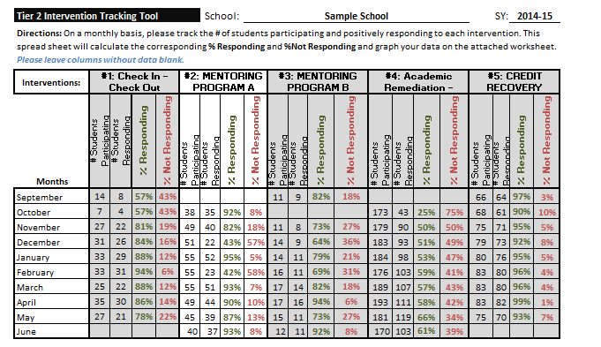
Tier 2 System Conversation:
Intervention Tracking Tool (Excel and Word)
& Effectiveness Monitoring
Systems

Slide 46
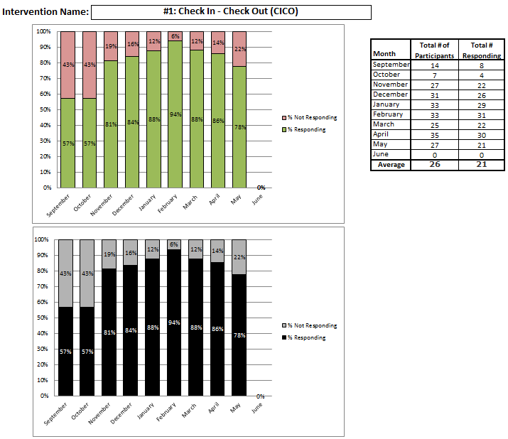
Tier 2 System Conversation:
Intervention Tracking Tool (Excel Only)
Systems

Slide 47
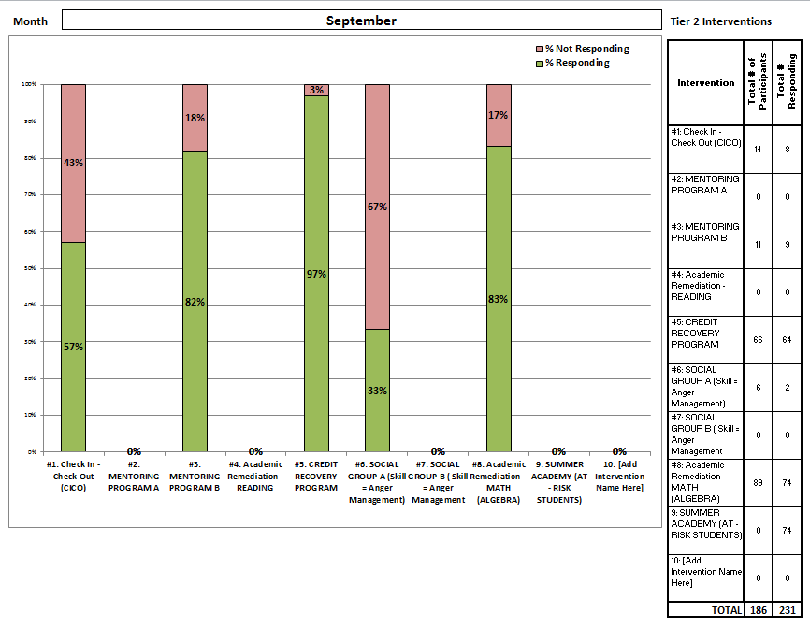
Tier 2 System Conversation:
Intervention Tracking Tool (Excel Only)
Systems

Slide 48
Tier 2 System Conversation:
Intervention Tracking Tool
& Effectiveness Monitoring
Systems
Intervention effectiveness = Note if intervention is effective for a given month. If less than 70% of students are responding to any interventions, mark No.
  If NO, the Tier 2 Systems team should review the fidelity of the intervention and make adjustments as needed.
    Are mentors and mentees meeting regularly?
      If not – Is there an issue regarding the schedule? – This a systems conversation
      If so but seems isolated to a particular mentor – This is a problem-solving conversation
    Do mentor, student and teacher(s) know what the behavior definitions mean?

Slide 49
Tier 2 System Conversation:
Intervention Tracking Tool (Excel and Word)
& Effectiveness Monitoring
Systems

Slide 50
Tier 2 System Conversation:
Intervention Tracking Tool
& Effectiveness Monitoring
Systems
  If NO and fidelity is strong, flag for problem-solving discussion for individual students.
    This is becomes a problem-solving discussion
Problem-Solving
Systems

Slide 51
Tier 2 Problem-Solving Conversation
Monitoring (On-Going)
Problem-Solving
Team to review currently data regarding specific students and intervention effectiveness and problem solve as needed
    Identify need for increased supports
    Identify need for use of different supports
      Interventions Change (form)
    Identify readiness for decreased supports
    Identify readiness for graduating from intervention

Slide 52
Tier 2 Problem-Solving Conversation
Individual Data Tracking
Problem-Solving
Points earned on Daily Progress Report (DPR)
Reduction in ODRs
Attendance improvement
Reduction in In School Suspensions
Improvement in grades
Reduction of tardies
Improved homework completion
Group specific skill tracking

Slide 53
Tier 2 is about Data-Based Decision-Making
Problem-Solving
Identify Students
“In”
Progress Monitor
“On”
Transition
“Out”
Systems

Slide 54
Targeted/Problem-Solving
Team Benchmarks
T2 Team established & trained
T2 Team members with leader meeting at least monthly
  [With System and Problem-Solving Conversations evident]
Data-based decision rule(s) established to identify students in need
Request for assistance forms developed for staff & families
At least 2 Tier 2 research-based & function-based interventions established and ready to access
Tier 2 interventions have established facilitator, progress monitoring, and fading/graduation criteria
Tier 2 - Targeted Problem-Solving System Development 2/10/15 9:00 – 3:30 (Registration 8:45) DelTech -Room 400 A&B

Slide 55



DE-PBS & Social Emotional Learning

Slide 56
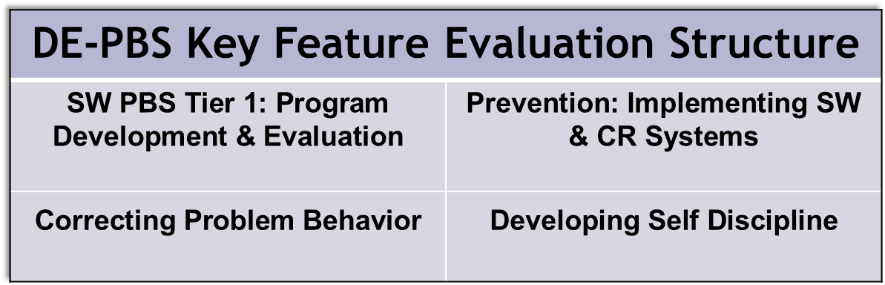
How is SEL integrated in School-wide PBS?

Slide 57
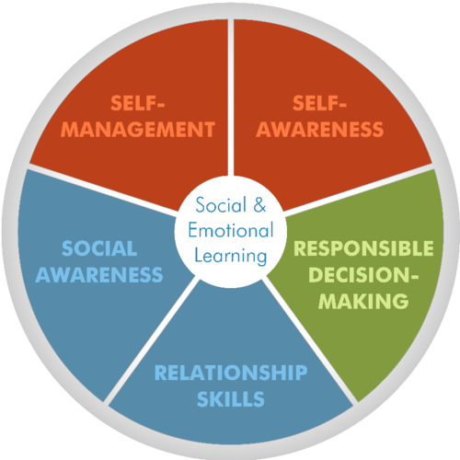
What is Self-Discipline?
The CASEL Model
Consists of 5 key Social and Emotional Learning skills:
Self-management skills
Social awareness and empathy
Social connectedness and relationship skills
Responsible decision making
Positive sense of self
http://www.casel.org/

Slide 58
Social-Emotional Learning Curriculum
3 main avenues
  Package program (not infused)
  Package program (infused)
  Infused in curriculum without package program
What’s currently happening in your schools?
  Think & list to self
  Share in small group of neighbors
  Share with full group

Slide 59

Bullying Prevention

Slide 60
DOE Press Release and “Dear Colleague” Letter issued October, 2014 with additional guidance
“If a student with a disability is being bullied, federal law requires schools to take immediate and appropriate action to investigate the issue and, as necessary, take steps to stop the bullying and prevent it from recurring.”
Bullying of a student with a disability on any basis can similarly result in a denial of FAPE
Protections in place for students with an IEP or a 504 plan
Resource for evidence-based Practices
Fact sheet for families (also available in Spanish)
http://www.ed.gov/news/press-releases/bullying-students-disabilities-addressed-guidance-america’s-schools

Slide 61
Effective Evidence-based Practices for Preventing and Addressing Bullying
Use a comprehensive multi-tiered behavioral framework
Teach appropriate behaviors & how to respond
Provide active adult supervision
Train & provide ongoing support for staff & students
Develop & implement clear policies to address bullying
Monitor & track bullying behaviors
Notify parents when bullying occurs
Address ongoing concerns
Sustain bullying prevention efforts over time
https://www2.ed.gov/policy/speced/guid/idea/memosdcltrs/bullyingdclenclosure-8-20-13.pdf

Slide 62

Bullying Prevention:
Initial Steps
Confirm the definition of “bullying” for your school
Outline your school’s plan for teaching the definition & establish clear reporting protocol
Outline your school’s protocol for responding to bullying reports.
Describe how your school’s School-Wide Expectations relate to bullying prevention in your school.

Slide 63

PD for Team Leaders

Slide 64
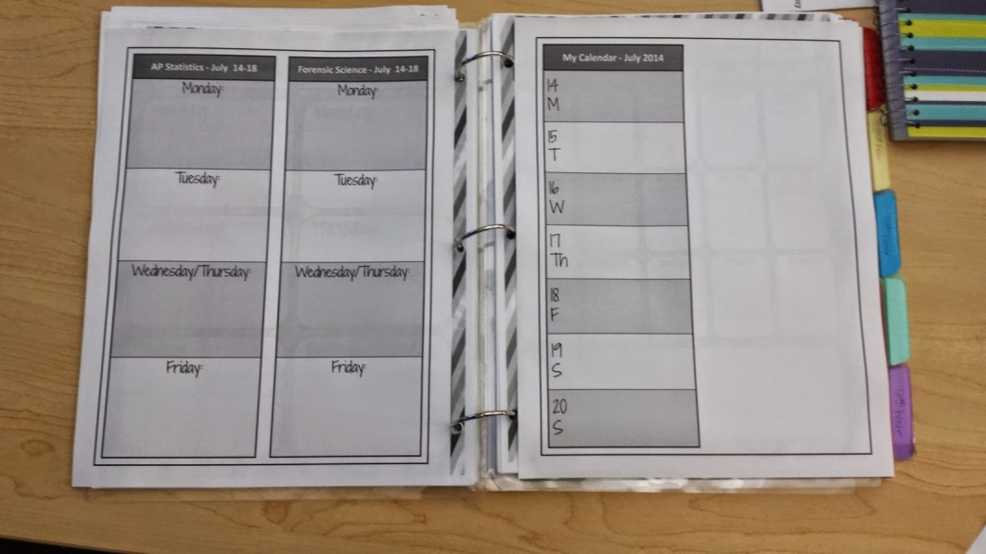
SWPBS Products

Slide 65
DE-PBS School-wide Team Product Guide
FAQs
Working Products: Outline of the monthly meeting materials SWPBS teams may use and reference such as minutes and data reports.
Permanent Products: Outline of the program materials a SWPBS team creates when it develops and implements a SWPBS program.

Slide 66

Thank you!
Please complete the evaluation. We appreciate your feedback.
NEXT MEETING: March 24, 2015

