Slide 1
ALLEN PARK COMMUNITY SCHOOL
Penguins R.U.L.E.

Slide 2
Allen Park Community School Demographics
Alternative high school
Lower enrollment
High Risk learners
Small staff (12 full time, 1 part time)
Over 75% of the students are in their 3rd and 4th year of high school.
High turnover of students

Slide 3
Class Demographics
APCS offers 5 classes a day.
1st hour is remedial, test prep or graduation needed
Remainder of the day - 80 minutes per class
No homework policy - supervised assignments
Accelerated credit

Slide 4
PBIS AT APCS
PBIS was started in January 2009 - need from level of acting out behaviors
Launching of tiers - learn from our mistake.
Our matrix is an acronym: R.U.L.E.
Tier 2 should be around 15%, tends to be more 30%
Alternatives to suspension
Notes:
During the first semester, the PBIS team launched all three tiers. We started with defining the goals that we wanted our students to achieve, teach those expectations, as well as create a process to support those students who were not able to meet those expectations becuase of our concerns Allterantives → detention, mediation, consult, convference, etc.

Slide 5
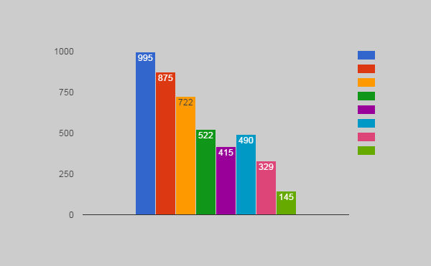
OFFICE DISCIPLINE REFERRAL YEAR TO YEAR COMPARISON
2007
2008
2009
2010
2011
2012
2013
2014

Slide 6
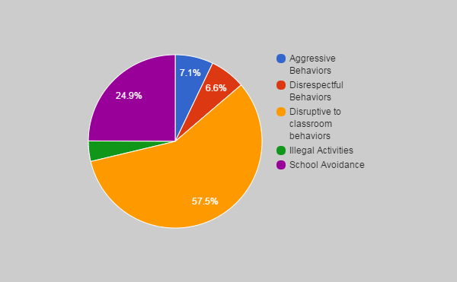
Type of Referrals

Slide 7
CLASSROOM INTERVENTIONS (TIER 1): PREPARE FOR HIGH RISK LEARNERS
Books studies, PLC’s, SIP
Weekly Bulletin and Monthly Newsletter regarding interventions sites and ideas
Multimodal learning strategies
Supervised Classroom work
Relationship Building priority
Staff trained in verbal de-escalation technique
Interviews with guardians and applicants for enrollment
New student orientation with peer mentors
Notes:
“Failure is not an option” – Alan M. Blankstein , “Lost at School” – Ross Greene, PhD, “Getting to got it” – Betty K. Garn

Slide 8
CLASSROOM INTERVENTIONS (TIER 1): MANAGE ALL RISK LEARNERS
Behavioral matrix R.U.L.E. is taught for four days two times a year.
Each letter of the matrix (R.U.L.E.) is taught for one class period for one day.
Advisory classes RULE
Posting top 5 students of each class.
Every week there are awards during assembly
Weekly grade sheets
Quarterly rewards for grades, absences and discipline
Notes:
The staff nominates the awards [student of, most impoved, 212] based on behaviors and grades they see in the classroom. The teachers give a fast presentation

Slide 9
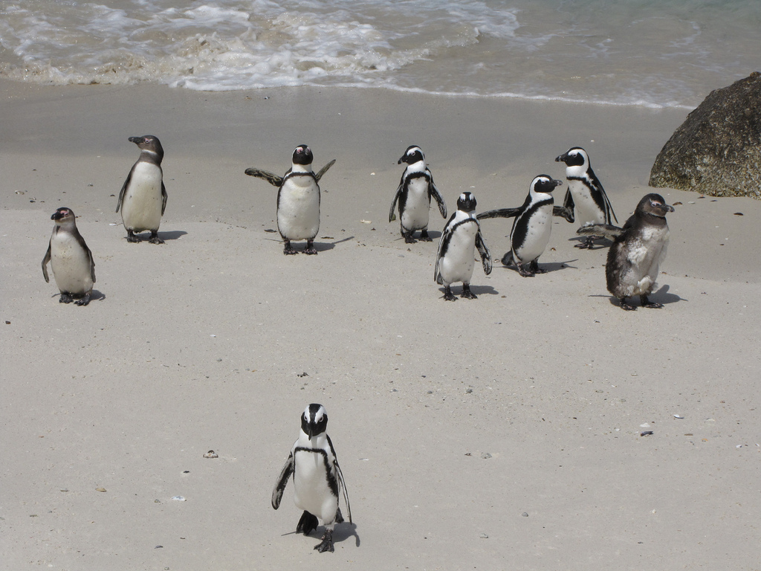
Make it Right Steps
Verbal warning/redirection (positive language)
Pass for break or movement or remove from environment for a few minutes
Think it out Sheet
Intervention staff referral
Referral to front office for discipline

Slide 10
CLASSROOM INTERVENTIONS (TIER 1): MANAGE ALL RISK LEARNERS
Movement breaks (passes)
Music/headphones
Positive contacts
Active Supervision - Teacher monitoring
Peer tutoring
Advisory (monthly) Based on RULE
Make it Right steps for behaviors
After school support supervised
Ticket Economy
Notes:
postcards, emails, rewards, praise

Slide 11
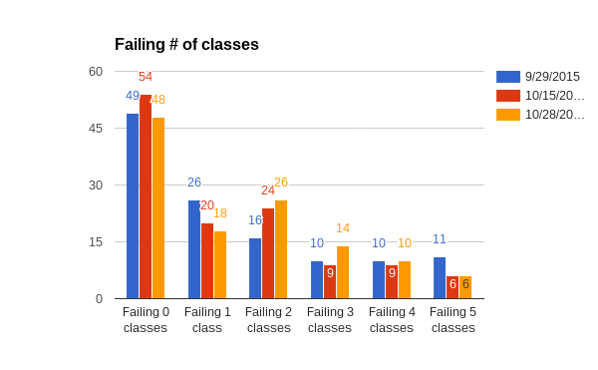

Slide 12
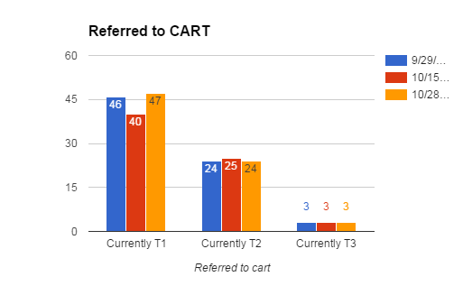

Slide 13
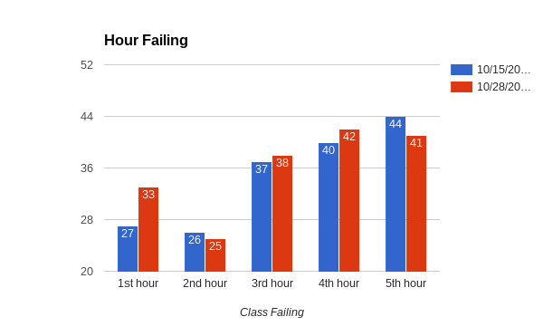

Slide 14
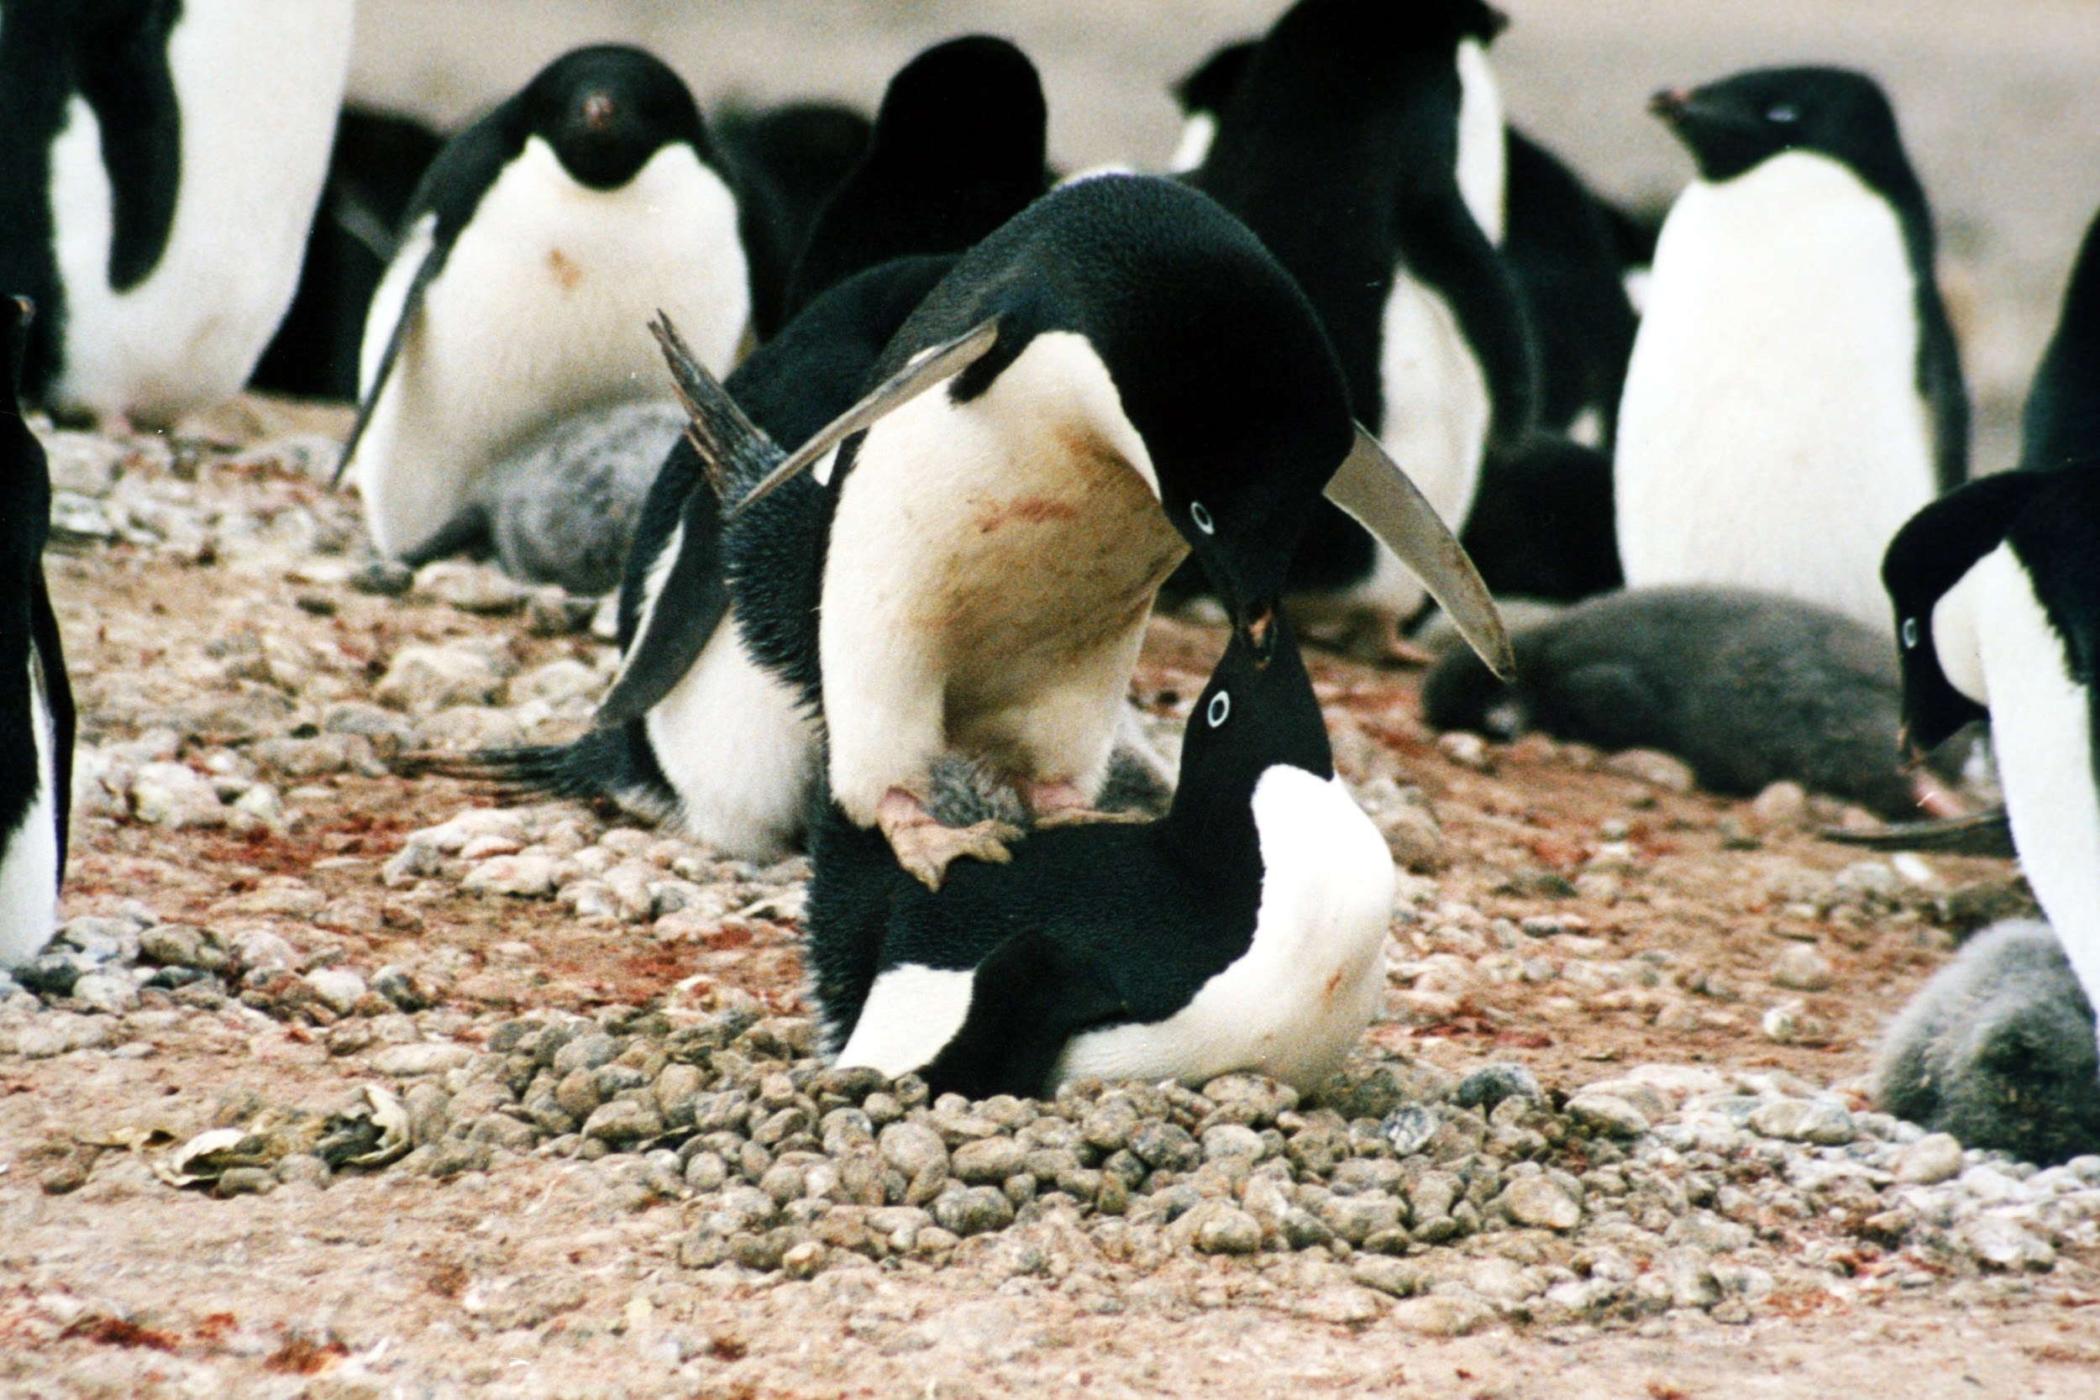
PROGRAM INTERVENTIONS: SUPPORTING STUDENTS WHO STRUGGLE
Intervention team meets regularly, 3 referral sources
Student completes paperwork
There are several levels of tier 2 (about 40% of the population is referred to Tier 2).
Notes:
instructional aide (grant funded position works from 10am to 3pm) or resource room teacher (full time staff member) for additional support, during to fix low scores, re take tests and quizzes, and complete absent work (teachers stipend position two days a week for one hour each time).

Slide 15
PROGRAM INTERVENTIONS (TIER 2): SUPPORTING STUDENTS WHO STRUGGLE
Weekly monitoring system -->
Incentive plan with SSW or IA sessions
Reviewed at every intervention meeting →
Management groups with SSW
Parent Contact -->
Referred to REED for 504 or Special Ed
Re-Enrollment/Review quarterly
Notes:
goal area (improving attendance, improving assignment completion, improving behavior), Tier 2 includes a second level of increased support services outside of the classroom - Instructional aid, SSW

Slide 16
PROGRAM INTERVENTIONS (TIER 3): SUPPORTING STUDENTS WHO STRUGGLE
Tier 3 involves increasing # of services and supports - including review for Special education or Section 504 services.
Once frequency and duration standards have been meet and there is limited progress in the student’s behaviors, including academics, an exit plan is created with the family.
The emphasis is always on supporting the student to manage and control their own education. We strongly support this by using the skills to be respective, have unstopping choices, leadership skills and empathetic choices.

Slide 17
Final Thoughts
What we have learned and are continuing to learn….
Behavior has meaning… what is the meaning?
Our attitude matters, how to we help ourselves?
Working with others does make a difference.
If there is Respect then there is Safety. if there is safety, then there is Trust. If there is trust then there is Cooperation. If there is Cooperation, there is a way to Self-Regulate. If a student can self-regulate, then Learning happens.

Slide 18
APCS Staff 313-827-2660
Sean Laura, general education teacher
lauras@appublicschools.com
Kendra Payette-Linn LMSW SSW
payette-linn@appublicschools.com
Rebecca Westrate, Director
westrate@appublicschools.com
Thank you!

