Slide 1

Welcome!
Secondary Forum - DE-PBS Project
2/23/16
Please complete the BEFORE items on your
evaluation form in your folder (yes, the pink one ☺)

Slide 2
Welcome!
Your Name
School Name
Please share with the group:
  1 PBS-Related Challenge/Question
  1 PBS-Related Success/Tip

Slide 3
"Top 10 Ideas for Rebooting " Reinvigorating PBS at the Secondary Level

Slide 4


Reboot your team!
Have co-leaders for your PBS team
Do a +/delta with your team to see what has worked in the past and what areas could use some strengthening
Form committees for your teams to even the workload

Slide 5
Use your data
Take this “rebooting” time to check in with your staff
  Try the Delaware Assessment of Strengths and Needs
  Have you had a Key Feature evaluation recently done?
  Try a Key Feature Status Tracker to check in to where your PBS team is

Slide 6
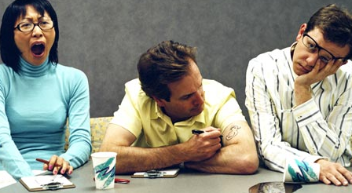
Start with Staff!
Begin a staff reinforcement system (keep it simple)
  Ideas:
    Staff journal that is passed around with compliments
    Pay it forward
    Sub for a sub
    Caught you being good
    Parking spot
    Make data relevant to staff

Slide 7
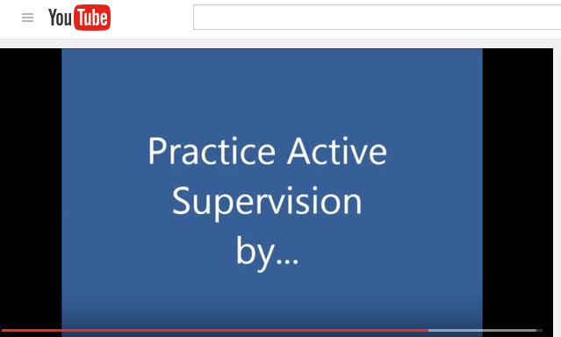
Active SUPERvision
https://www.youtube.com/watch?v=u1fLgxW4E7c

Slide 8
Steps Toward Check in – Check out
At your next faculty meeting, list all the students of the building and give each teacher a sheet of dot stickers.
Ask each teacher to put a dot next to each student’s name that they consider themselves to have a connection with (i.e. talks to them in the hallway, on a team, homeroom, advisory, case manager, etc.).

Slide 9
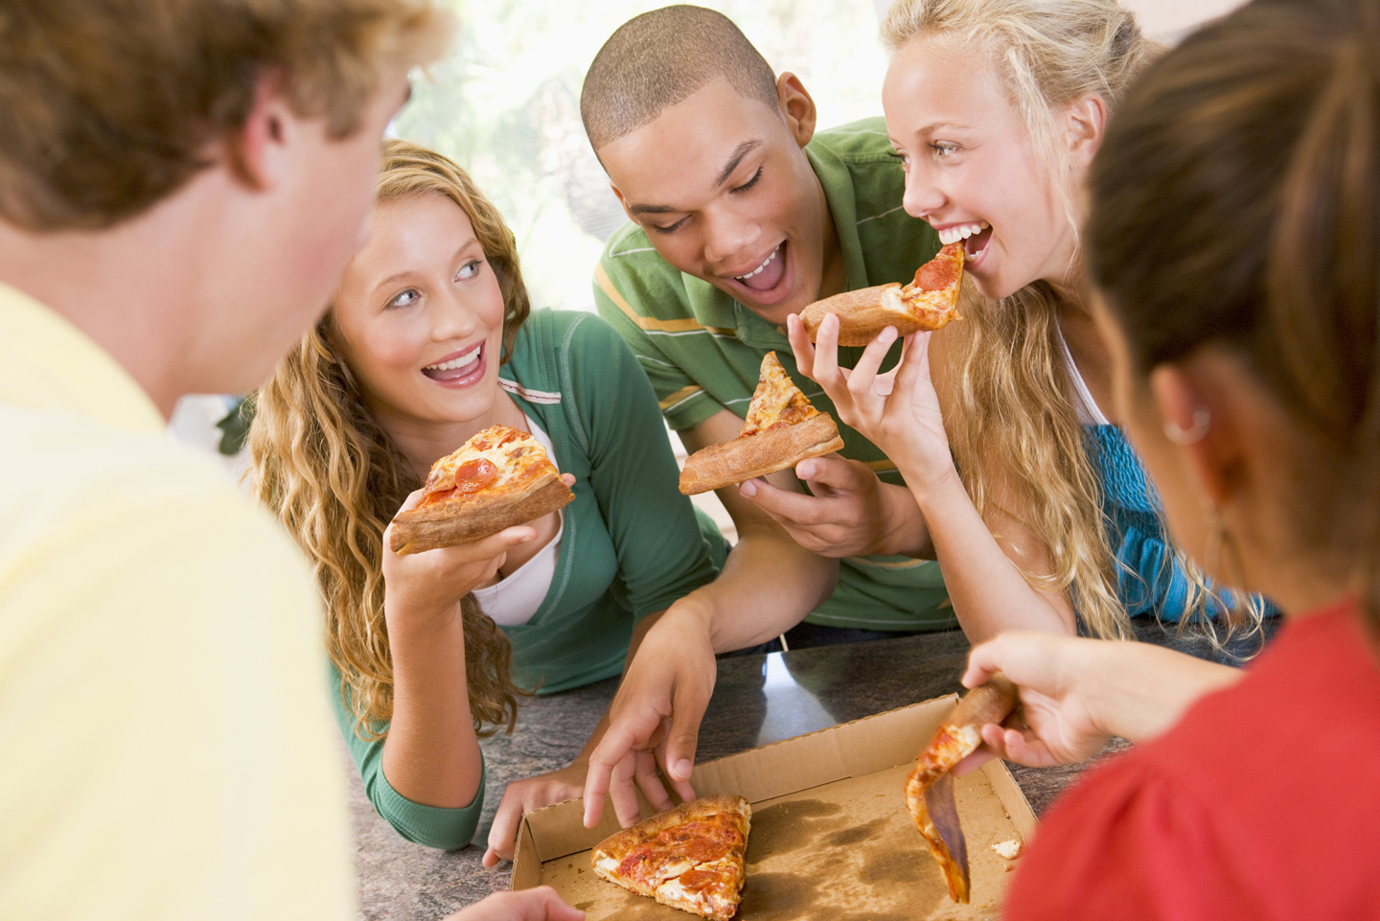
Nominate a classroom of the week/month
Have teachers simply nominate a class of the week or month to the PBS team
The PBS team then selects the winning class and reads why they have won on the announcements
The winning class receives a class-wide prize (i.e. Surf Bagel party, music, free HW pass)
This begins a culture of positivity

Slide 10
Tardy intervention
Have a random call into a class to see if everyone is on-time
If the teacher reports that 100% of students are on-time that classroom gets reinforcement
Use your data to pick what time of day to make the call in (i.e. 1st period, etc.)

Slide 11
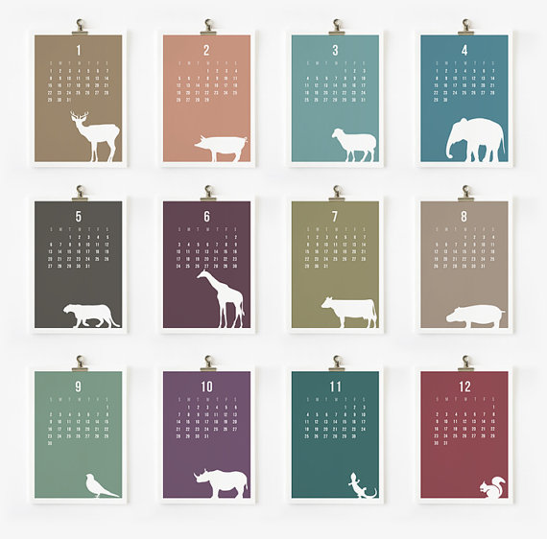
Have a monthly theme
Pay it forward
Millions acts of kindness
Sweet tweets
Community service (food drive, sock drive, penny wars)
Homeroom discussions on respecting diversity
Class-wide reading of a book (one book, one school)

Slide 12
Positive Behavior Referrals
Think about how you could easily implement positive behavior referrals
  Could be student designed
  Challenge staff to have a certain amount of positive referrals completed versus true behavioral referrals
  Encourage the school population with a goal and a level of reinforcement when that goal is reached

Slide 13
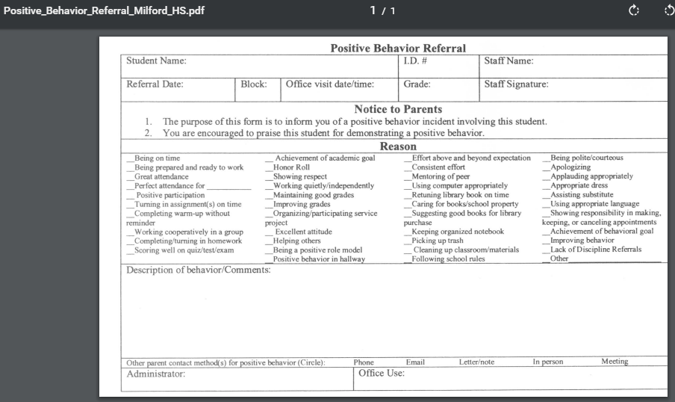
Milford High Example on delawarepbs.org

Slide 14

Get the students “plugged in”
Have a student run PBS component of your team
Have the students survey the other students to see what is working what could work better
Gather ideas for reinforcement
Gather concrete ideas from the students for building a more positive school climate
Let the students run the meetings!

Slide 15
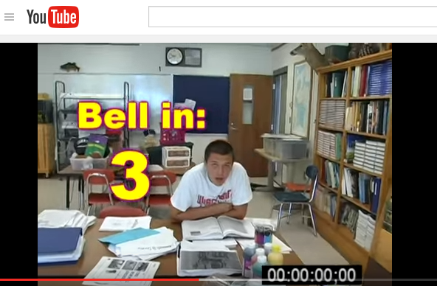
https://www.youtube.com/watch?v=5C-Wyy_lPNk
Students Sharing Positive Messages

Slide 16
Growth Mindset
How can you imped “growth mindset” ideals within your school wide culture –
  Trying again
  Making a mistake
  Asking for help
  Rising to a challenge
  Taking risks academically
  **essay contest, poster contest, schoolwide themes

Slide 17

Your Tips for
Restarting & Re-Energizing
Your School’s Positive Culture

Slide 18
REBOOTING THE SYSTEM
Start small
  What is one thing you can do for the rest of this year to improve your school climate?
Note to self…

Slide 19
Demystifying the DE Key Feature Evaluation

Slide 20
The KFE: What is it?
A tool…
for DE PBS schools to use to measure the fidelity and comprehensiveness of your SWPBS program and implementation.
to help your SWPBS team to action plan around improving or expanding specific areas of your SWPBS programming.
to help your school and district to understand and acknowledge your PBS efforts.
to help the DE-PBS Project more responsive to your SWPBS needs and those of schools throughout DE.

Slide 21
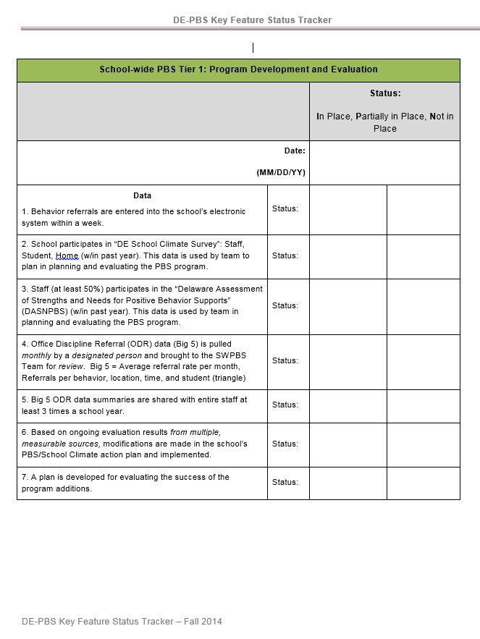
The KFE: How Do You Prepare for It?
http://wordpress.oet.udel.edu/pbs/program-development-and-evaluation/
Self-study on the four components of SWPBS:
  Tier 1: Program Development and Evaluation
  Prevention: Implementing Schoolwide & Classroom Systems
  Correcting Behavior Problems
  Developing Self-Discipline

Slide 22
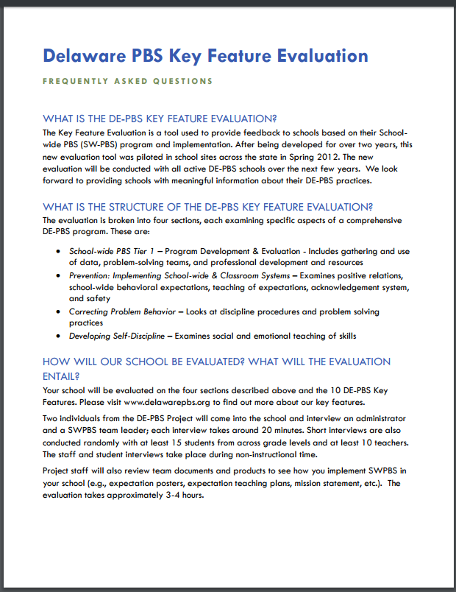
The KFE: FAQ
http://wordpress.oet.udel.edu/pbs/wp-content/uploads/2013/01/KFE-QA.pdf

Slide 23
The KFE: The Day Of
Hello staff and students. This is a reminder that we have visitors in the building today who may ask you some questions. They thank everyone in advance for your time and cooperation!
Team leader interview
Administrator interview
Brief student interviews
Brief staff interviews
Product review

Slide 24
Multi-Tiered Systems of Support (MTSS)
Tier 2 Interventions

Slide 25
What Tier 2 Interventions and Resources are Out There?
CICO
Achievement Mentoring
Twilight/Daylight Programming
Why Try?
Social Groups
Attendance intervention
Mental health/life event groups
PEERS
Skill building or relationship building?

Slide 26
Structuring your Tier 2 Team Discussions
Systems AND Problem-Solving Discussions
Data Collection – baseline, during intervention, after intervention
  Tracker at delawarepbs.org
Tiered Fidelity Inventory
  National database of Tier 2 implementation
  Contact Project for log-in information for data entry

Slide 27

Your Team,
Your Interventions,
Your Tools

Slide 28
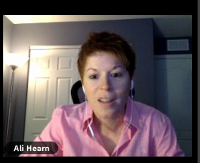
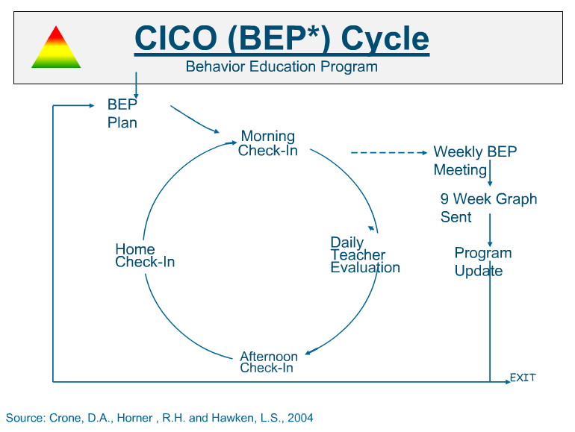
Check-In/Check-Out
    Midwest PBIS Webinar (2hr)
    Ali Hearn, Midwest PBIS Network
https://midwestpbis.adobeconnect.com/p2e6kstk7hn/?launcher=false&fcsContent=true&pbMode=normal

Slide 29

Tiered Fidelity Inventory
2.1 Team Composition 2.2 Team Operating Procedures 2.3 Screening 2.4 Request for Assistance 2.5 Options for Tier II Interventions 2.6 Tier II Critical Features 2.7 Practice Matched to Student Need 2.8 Access to Tier 1 Supports 2.9 Professional Development | 2.10 Level of Use 2.11 Student Performance Data 2.12 Fidelity Data 2.13 Annual Evaluation

Slide 30
Supporting Positive and Trauma-Sensitive School Community Conversations

Slide 31

The ACES Study

Slide 32
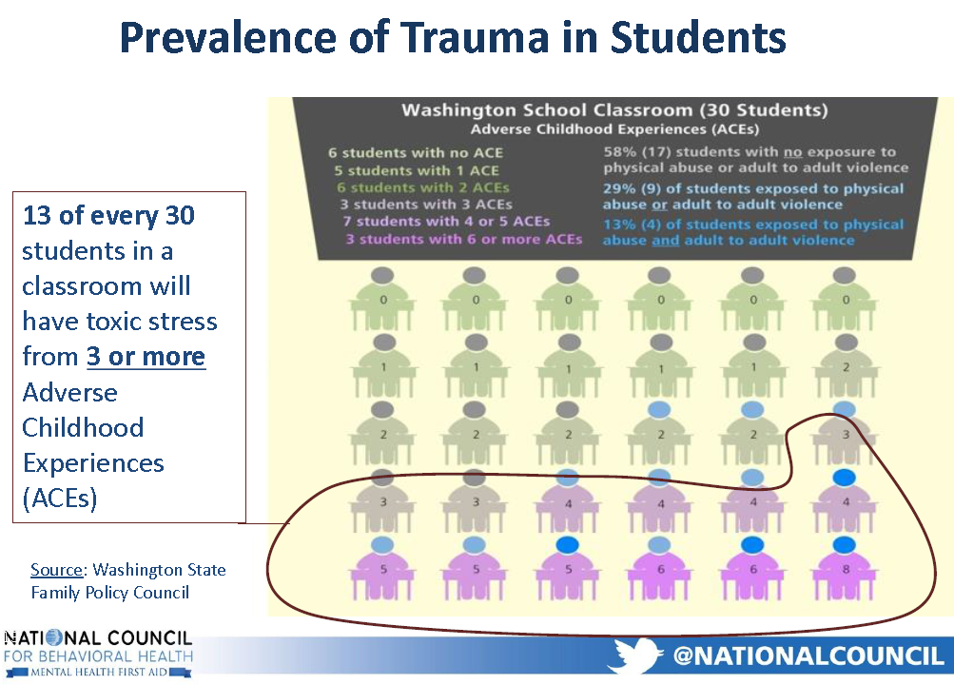
MTSS: Helping to Build Student Resilience

Slide 33

Schools can be a protective factor for students who have experienced trauma and can help these students to become more resilient. Staff need support, too!

Slide 34

PBS and Trauma-Informed Practices
Compliment Each Other
Trauma-informed practices bring these additional attributes to PBS schools:
  the incorporation of mindfulness in schools
  the promotion of resilience among all community members
  mindfulness in avoiding re-traumatization of students.
But both help schools
to develop MTSS that are:
  Consistent
  Inclusive
  Culturally Relevant & Responsive
  Building Positive Relationships
www.delawarepbs.org
Notes:
34

Slide 35
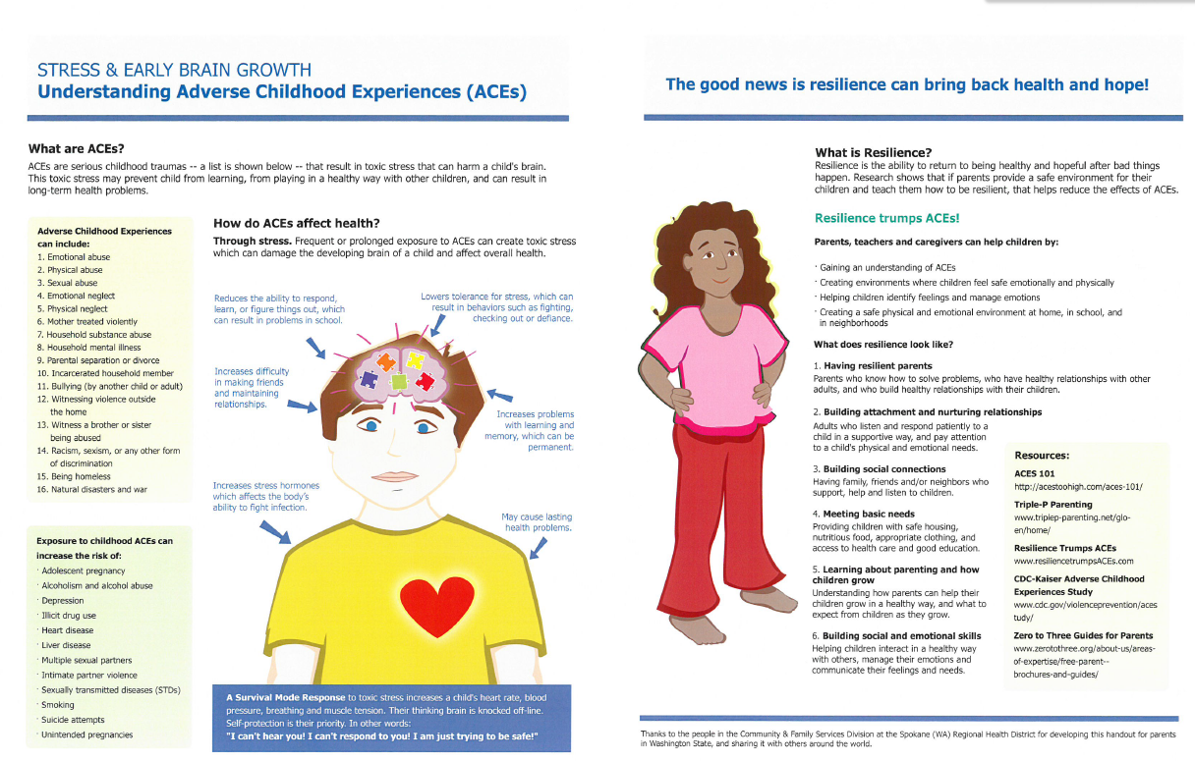
Resilience and Growth Mindset

Slide 36
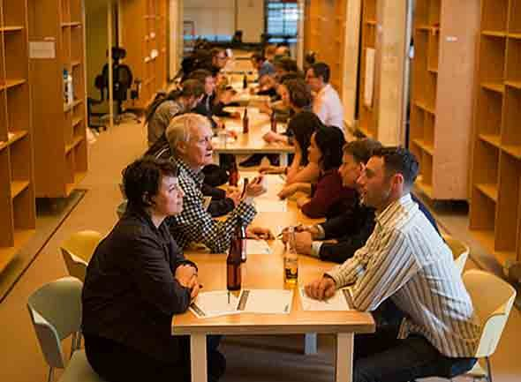
Debrief/Sharing Time:
Additional thoughts/recommendations about…

Slide 37
Thank You for your attendance!
Please use this time to:
To Network More
Complete Your Evaluation
Action Plan

