Slide 1

DE-PBS Cadre
May 12, 2015

Slide 2
Website Orientation
www.delawarepbs.org

Slide 3
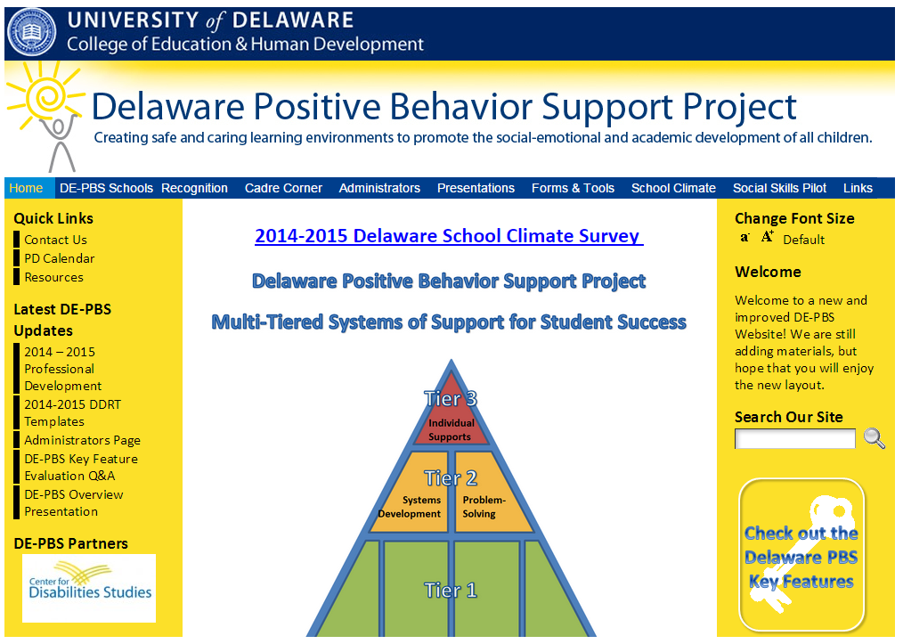
Home Page

Slide 4
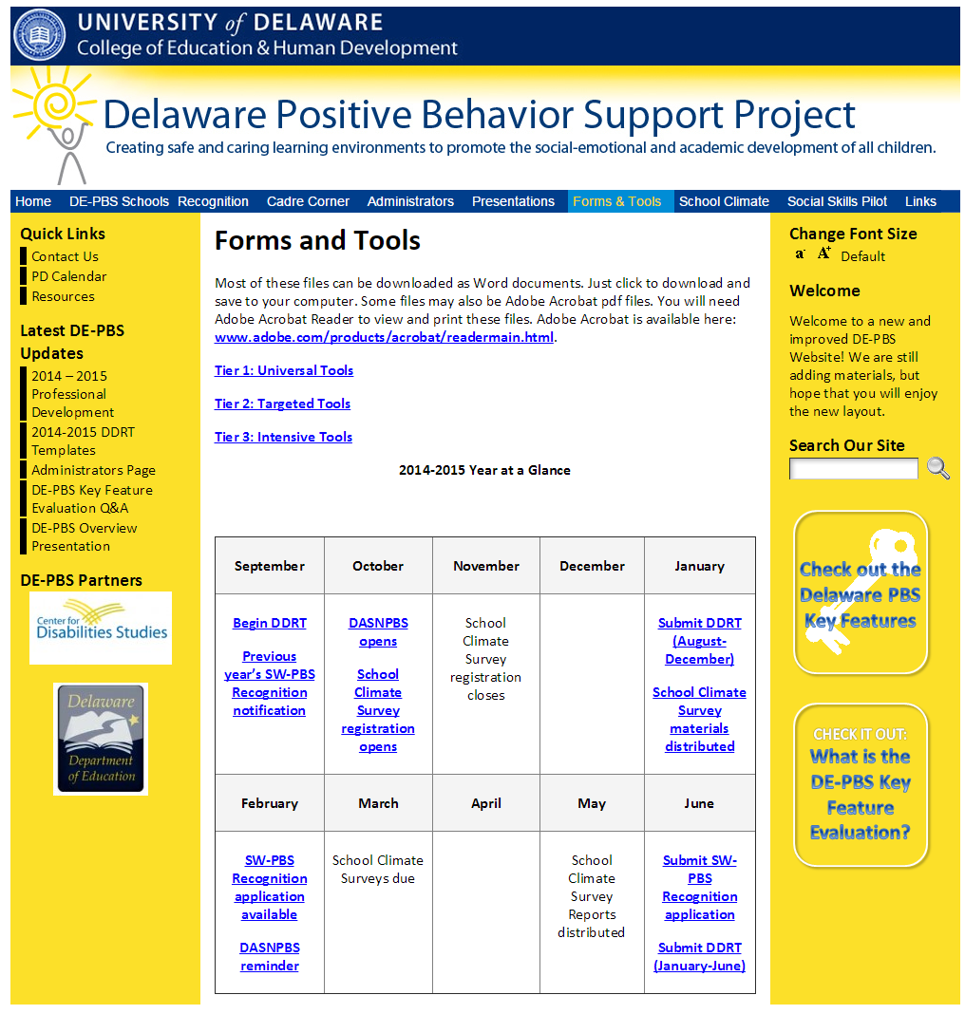
Forms & Tools

Slide 5
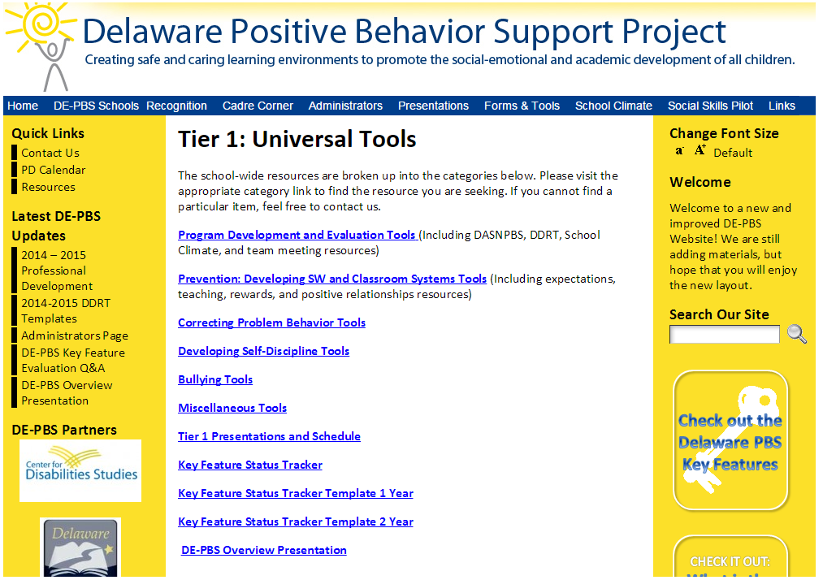
Tier 1 Tools

Slide 6
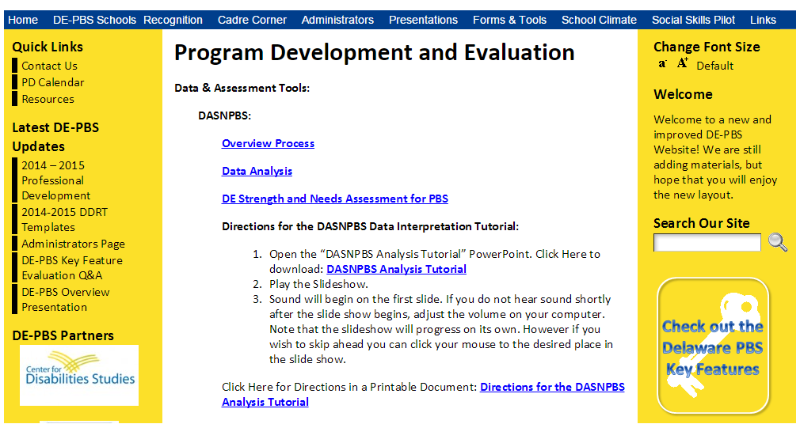
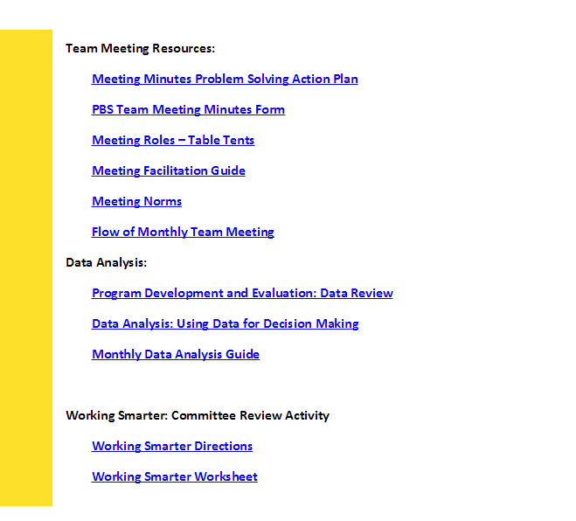
Program Development & Evaluation

Slide 7
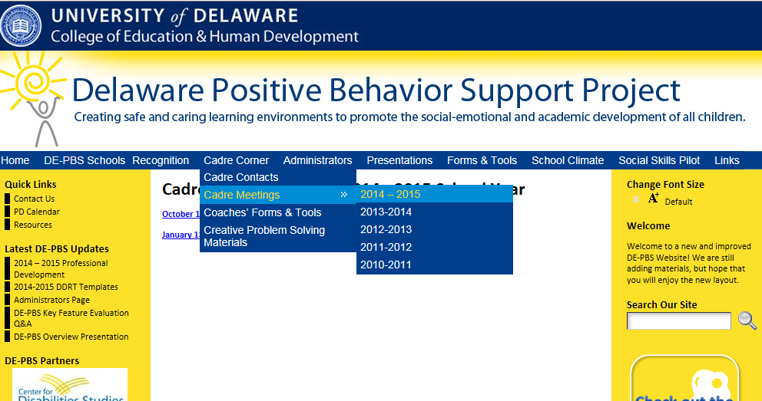
Cadre Corner

Slide 8
DE-PBS Topics of Interest
Alternatives to Suspension
Social-Emotional Learning
Team Leader Professional Development
Phase Recognition

Slide 9
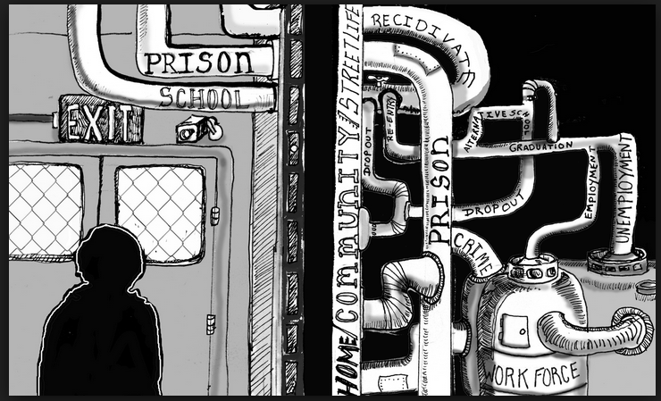
Alternatives to Suspensions
Informational Overview for Administrators
  Dangers of Zero Tolerance Policies
Informational Handouts About Existing Alternative Activities including:
  Effective In-School Suspension
  Restorative (Justice Practices)
POC: Megan Pell

Slide 10

Social Emotional Learning
Thank You for Sharing What You’re Seeing!
Resources To Help Others Understand These SEL Programs and Their Links to PB(I)S
  Program Descriptions
  2nd Step & PBS
  Restorative Practices & PBS
Any Programs to Add?
POC: Megan Pell

Slide 11

Team Leader Professional Development
Format ideas
  3 part series
  1-1.5 hour segments
Topics covered through series
  Data/Information sources
  Leadership strategies
  Communication
POC: Sarah Hearn

Slide 12

DE-PBS Phase Recognition
2014-2015 Phase 1, 2, 3 Available
Due in full by Friday, June 26, 2015
Confirmation of application receipt by July 17, 2015; schools to contact Sandi if they do not receive confirmation
Notification of award: Week of September 14, 2015
Materials:
  Application
  Frequently Asked Questions
  Reflection Question Guide

Slide 13
Recognition Reminders
Application based on the current 14-15 School Year.
  Teams should reflect on current practices and select Phase accordingly
  This may mean a team re-applies for Phase 1 because it best reflects this year’s efforts.
Don’t wait to start the application; discuss & divide efforts now at team meetings.
For Phase 2 and 3, schools must have earned an overall implementation of PROFICIENT or EXEMPLARY on the DE-PBS Key Feature Evaluation.

Slide 14
Future Recognition Plans
Option A
Option B
Phase 1 – Application w/ no changes
Phase 2 –
  Exemplary KFE implementation level
    No application needed
  Proficient KFE implementation level
    Application revised to only include essay question
Phase 3 – Application w/ no changes; Phase 2 is a prerequisite
Recognition only tied to KFE status
  Schools receive banner for advanced PBS implementation based on Exemplary KFE level
  No Phase 1 or 3
Future: Tier 2-3 external evaluation can be used to award schools for strong implementation

Slide 15
Thinking about recognition…
If overall Exemplary, but 1 area with Exploring, should there be a required action plan or a Key Feature Re-Evaluation in that area?
Do you as coaches keep track of which schools apply?
What questions would our coaches have for the schools around recognition?

Slide 16
Professional development
Targeted Team Training
PTR
PEERS
School-wide PBS
Upcoming events

Slide 17

Substitute Reimbursement
Submit to Beth Draper by May 22nd.
Prior if possible!

Slide 18
Targeted Debrief
  Date: March 24, 2015
    Participants: 72 participants from 14 schools (6 school districts)
Content Highlights:
    Problem-solving and systems-level conversations
    progress monitoring (including tools to help)
    Making sure interventions match student needs (function of behavior)
Next Steps:
    DE-PBS collected, reviewed and then
    redistributed reflection packets
    DE-PBS will craft future targeted PD and TA
    based on reflection packets and coaches
Systems
Problem-Solving

Slide 19
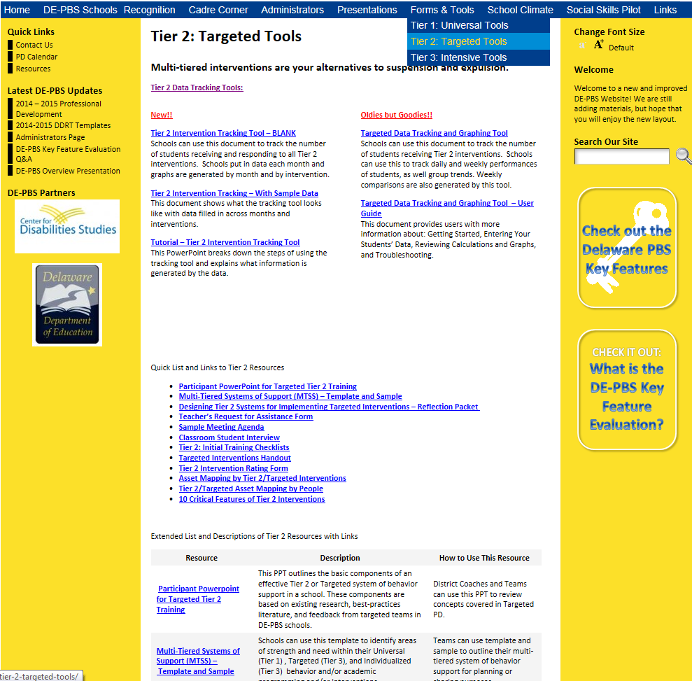
Main Toolbar
Check Out These Tools!

Slide 20
Downloads:Quick List
Downloads:Extended List

Slide 21
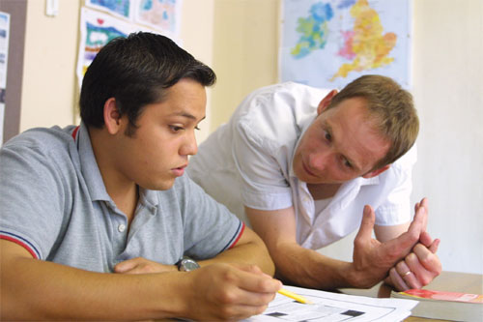
PTR

Slide 22
2014-15 PTR Facilitators
A cohort of eight Delaware educators (seven school psychologists and one teacher)
    Colonial
    Laurel
    Christina
    Capital
    Caesar Rodney
    Red Clay
    Smyrna
4 Elementary Schools, 2 Middle Schools, 1 High School, and 1 Special School

Slide 23
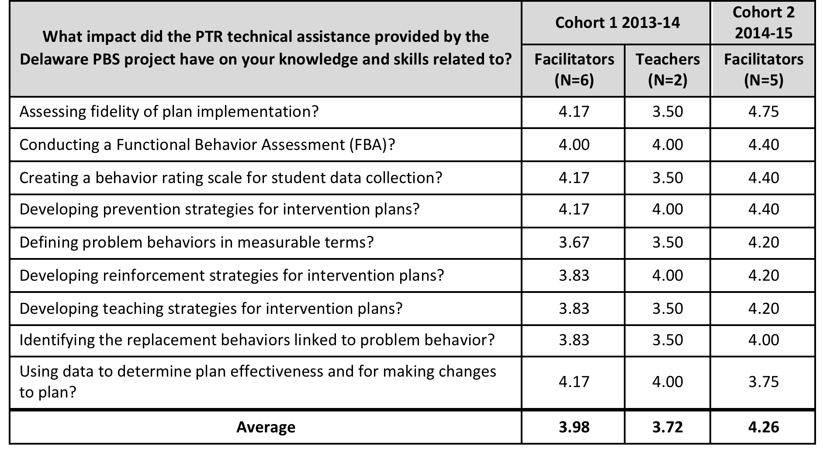
Survey: Impact of PTR technical assistance
Scale:
1 = No Impact, 2 = Small Impact, 3 = Medium Impact,
4 = Large Impact, 5 = Very Large Impact

Slide 24

4 PTR Master Facilitators
Building state and district capacity:
    Project Coach
    Capital
    Colonial
    Red Clay

Slide 25
Planning for 2015-2016
Prevent – Teach – Reinforce (PTR)
  Coaching of new PTR Facilitators for 2015-16
  Brief PTR and Networking with previously trained facilitators
  Continued support of cohort 1 Master Facilitators and identification of new Master Facilitators
  Any interest in new Facilitators or Master Facilitators, please contact Susan Veenema.

Slide 26

2016 DE Inclusion Conference
Date
  March 16, 2016
Keynote Speaker
  Phil Strain on Pre-school PTR
Strand topic ideas?

Slide 27

PEERS

Slide 28
PEERS Facilitator Implementation Fidelity Data
Group 2

Slide 29
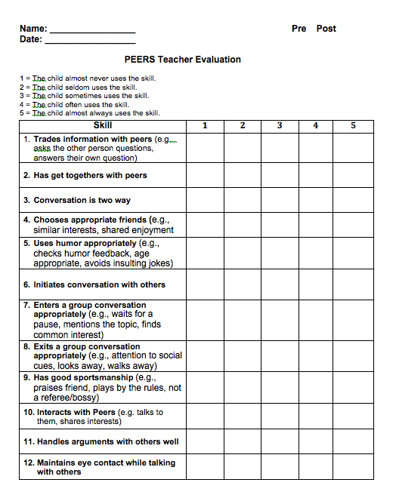

Slide 30
Teacher Rating Scale Baseline Results

Slide 31
Teacher Rating Scale
Pre & Post Data

Slide 32
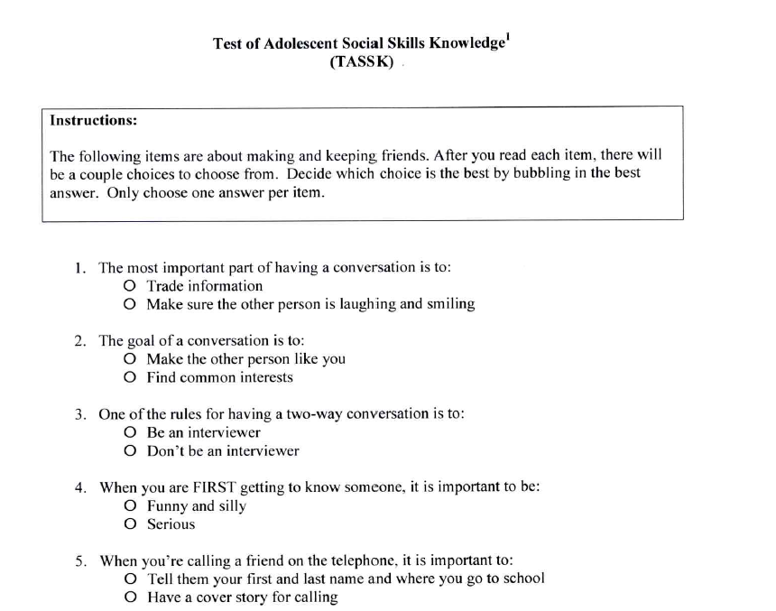

Slide 33
TAASK – Curriculum Based Assessment

Slide 34
TAASK Pre vs. Post data

Slide 35
PEERS 2015-2016 SY
Next Steps….
  Continue implementation with current districts
  Build Capacity within schools and districts
Any possible interest in joining PEERS next year, please contact Susan Veenema to discuss available spots in Cohort 2!

Slide 36
Social Skills Workshop Update
Brandywine SD is holding workshop August 7th
  Facing the Frontal Lobe: Strategies for Teaching Executive Function Skills
Statewide workshop tentatively planned for August 6th
  Socially Savvy and Emotionally Equipped: Strategies for Teaching Social/Emotional Learning Skills
Evening parent workshop

Slide 37
School-wide Team Workshop Series
(Summer – Fall 2015)
PD is Intended for:
  New School-wide PBS teams or
  Previously trained teams that are reorganizing their team and revamping their SWPBS system.
  * New team members training will be held later in the Fall (2015).
The Format of this PD Series:
Interested teams should:
  Email Sandi Bradford sandi@udel.edu by May 15th.
    To receive additional information and a registration form.
  Note: an administrator must attend with the representative team.
Session 1: All teams | Session 2: Individual teams | Session 3: All teams
Date: June 23, 2015 Time: 9:00-3:00 (8:45 registration) Location: Dover Downs | Will be scheduled with individual teams & held at their school (Summer 2015) | Teams come back together again (Fall 2015)

Slide 38
School Climate and Student Success Grant
Component 1: Expanded Evidence-Based PD and Data Integration Tools
  All existing DE-PBS LEAs and schools
  Any new LEAs and/or schools that start DE-PBS
  over the course of the grant
Component 2: Increased Quantity and Quality of Existing TA
  3 priority LEAs, and particularly 9 focus schools, identified as having the greatest needs
    Red Clay
    Brandywine
    Capital

Slide 39
SCSS – Summer Plans
Module Development:
  Multi-Tiered Systems of Support (MTSS) for LEA leadership, district coaches, and building administrators & staff
  Coach and Team Leader PD
  Integration of SEL & SWPBS
  Enhancing Student-student relationships
  Enhancing Teacher-student relationships
District/School Professional Development & Technical Assistance
  9 selected schools
Evaluation Measures
  School Climate Survey enhancements
  DE-PBS Key Feature analysis

Slide 40

SCSS – Fall Plans
State-wide conference for SCSS & DE-PBS
Supporting Multi-tiered Systems of Support
October 2015
Keynote guest: Dr. George Sugai

Slide 41

APR Update & Celebration

Slide 42
data
School Climate Data
DDRT – ODRs
DASNPBS
DE-PBS Key Feature Evaluation

Slide 43
School Climate
153 participating schools
  36,337 students in grades 3 – 12
  6,265 teachers, administrators, and support staff
  20,358 parents/guardians across
Coaches will receive electronic copies of all school reports & district summary
Sharing tools & interpretation worksheets

Slide 44
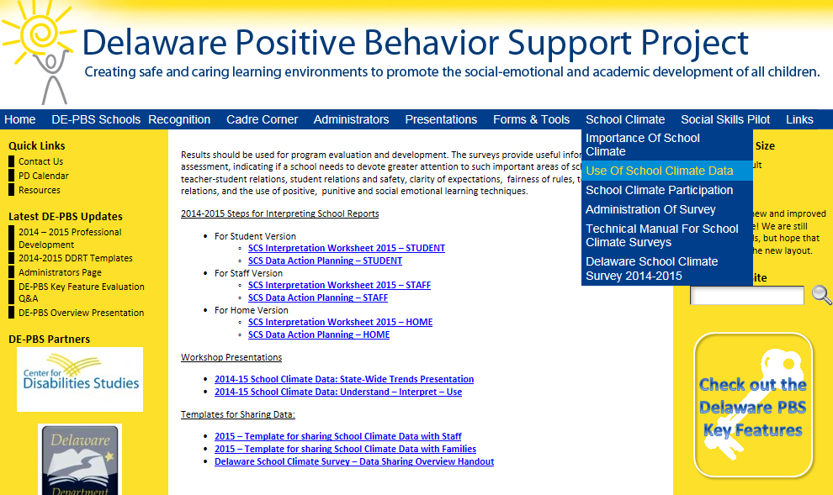

Slide 45
DDRT & DASNPBS
Discipline Data Reporting Tool (DDRT)
  DDRTs – August 2014 – June 2015 - due June 26
  Template available on website
  85 schools submitted DDRT mid-year summary
DE Assessment of Strengths and Needs (DASNPBS)
  Available to teams through June 2015
  10 question survey per implementation area
  Staff perspective on program strength/weakness for use in planning
  15 schools participating (2 paper, 13 online)

Slide 46
Key Feature Evaluation Updates
2015: 28 completed across 13 districts
  92 total 2012-2015

Slide 47

KFE Reminders
Support schools with using report for action planning
15-16 School Year – schools trained in 2007/08 through last summer
Key Feature Status Tracker Tool– use as self-assessment or coach check in

Slide 48
2015-2016 Cadre Planning
2014-2015
2015-2016
3 Meetings - 1/2 day sessions
  October
  January
  Scheduled March/Held May
For consideration:
  Number of meetings
  Timing of meetings
  Topics

Slide 49

District Reflection & Sharing
Reflect on 14-15 School Year
Plans for 15-16 School year

