Slide 1
Student-Student relationships
Research and recommended interventions
October 9th, 2015 – Western Sussex Summit

Slide 2
What format do you think would be most useful?
Decide if you want to show your school climate data
Would you do activities as part of presentation?
How much background does your staff need?
What are the key points to prioritize?
Think about elementary verses secondary audience and select appropriate examples
Need for administrative and district buy-in for the time needed to foster positive relationships
How to build into academics and overall classroom managment

Slide 3
Welcome!
Who we are:
Debby Boyer – Director of the School-Age Unit Jamie Caruso – PBS Coach
University of Delaware –
Center for Disabilities Studies (CDS)
Positive Behavior Support (PBS) Project

Slide 4
Overview
Background to Student-Student Relationships:
What are Student-Student Relationships?
Why are Student-Student Relationships important?
What are the contributing factors to Student-Student Relationships?
Recommended Strategies:
What strategies can you use to promote Student-Student Relationships in your classroom and/or school?
What practical strategies/interventions will you plan to implement? What are your next steps?

Slide 5
Positive Behavioral Intervention and Supports
serves as a structure and process…
that organizes, implements, and evaluates multiple initiatives and strategies…
related to social and behavioral improvement (e.g., character education, asset building/IM40, social skills instruction, bullying prevention, restorative justice practices)
Adapted from “Using Positive Behavioral Interventions & Supports (PBIS) to Help Schools Become More Trauma-Sensitive” developed by Wisconsin Department of Public Instruction
http://sspw.dpi.wi.gov/sites/default/files/imce/sspw/pdf/mhtraumausingpbis.pdf

Slide 6
PBS (a MTSS) for Student Success
Academic Systems
Response to Intervention (RTI)
Behavioral Systems
1 Research-Based System:
Positive Behavior Supports (PBS)
Tier 3/Tertiary Interventions 1-5%
Individual students
Assessment-based
High intensity
1-5% Tier 3/Tertiary Interventions
Individualized Behavior Intervention System
Prevent, Teach, Reinforce System (PTR)
Tier 2/Secondary Interventions 5-15%
Some students (at-risk)
High efficiency
Rapid response
Small group interventions
Some individualizing
5-15% Tier 2/Secondary Interventions
Targeted PBS
Small Group Social Emotional Learning Programs
PEERS
Character Climb
21st Century Mentoring
Tier 1/Universal Interventions 80-90%
All students
Preventive, proactive
80-90% Tier 1/Universal Interventions
School-Wide (SW) PBS
SW Social Emotional Learning Programs
Responsive Classrooms
PATHS
Trauma-Informed Practices
www.delawarepbs.org
Notes:
6

Slide 7
PBS (a MTSS) for Student Success
Behavioral Systems
At all levels, it is important to consider how your interventions are:
Consistent
Inclusive
Culturally Relevant & Responsive
Building Positive Relationships
www.delawarepbs.org
Notes:
7

Slide 8
DE-PBS MTSS Framework Components
Program Development & Evaluation
Problem-Solving/Leadership Team
Data
Professional Development & Resources
Developing SW and Classroom Systems to Prevent Problem Behavior
Expectations and Teaching
Positive Relationships
Correcting Problem Behaviors
Consistent and clear procedures
Disciplinary encounters used as learning opportunities to teach problem solving strategies
Developing Self-Discipline

Slide 9
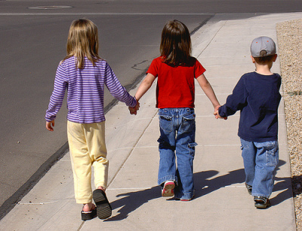
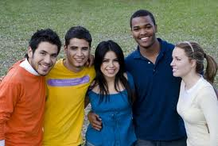
What are Student-student relationships?
Quality of the interactions between students in a school-wide context
Peer acceptance
Social support

Slide 10
Do we have cause for Concern in the area of student Relations?
Examine data, such as from Delaware School Climate Survey
Are student-student relationships viewed favorably across students, teacher/staff, and parents?
Unfavorable responses would indicate the need for interventions and related staff development
Additional data should be gathered and examined to help determine why.

Slide 11
Delaware School Climate Survey
On the Delaware School Climate Survey, student-student relationships is captured by items assessing:
students (including those of different races) getting along and
students demonstrating friendliness, caring, and respect toward each other

Slide 12
Delaware School Climate Surveys 2015 Subscales
Part I : School Climate
Student Survey | Teacher/Staff Survey | Home Survey
Teacher-Student Relations | Teacher-Student Relations | Teacher-Student Relations
Student-Student Relations | Student-Student Relations | Student-Student Relations
Respect for Diversity | Respect for Diversity | Respect for Diversity
Clarity of Expectations | Clarity of Expectations | Clarity of Expectations
Fairness of Rules | Fairness of Rules | Fairness of Rules
School Safety | School Safety | School Safety
Student Engagement School-wide | Student Engagement School-wide
Bullying School-wide | Bullying School-wide
 | Teacher-Home Communications | Teacher-Home Communications
 | Staff Relations
Total School Climate | Total School Climate | Total School Climate
 |  | Parent Satisfaction

Slide 13
Student-Student Relations Subscale Questions
Students are friendly with each other.
Students care about each other.
Students treat each other with respect.
Students get along with each other.

Slide 14
Sample subscale responses associated with student scores (Part I: School Climate) | Percent who Agreed or Agreed a lot
 | Elem School | Middle School | High School
Teacher-Student Relations 7. Teachers care about their students. | 95.6 | 85.8 | 76.4
Student–Student Relations 11. Students are friendly with each other. | 75.8 | 59.7 | 62.5
Student Engagement School-wide 29. Most students work hard to get good grades. | 91.6 | 75.9 | 66.8
Clarity of Expectations 10. Students know how they are expected to act. | 88.2 | 82.7 | 82.6
Bullying School-wide* 9. Students threaten and bully others. | 36.9 | 52.8 | 50.4
School Safety 13. Students feel safe. | 89.4 | 75.8 | 72.2
* = A high score on this subscale is negative because items are negatively worded.

Slide 15
Sample subscale responses associated with teacher/staff scores (Part I: School Climate) | Percent who Agreed or Agreed a lot
 | Elem School | Middle School | High School
Teacher-Student Relations 7. Teachers care about their students. | 99.2 | 97.8 | 98.2
Student–Student Relations 11. Students are friendly with each other. | 93.8 | 81.7 | 84.4
Student Engagement School-wide 29. Most students work hard to get good grades. | 89.1 | 66.8 | 55.8
Clarity of Expectations 10. Students know how they are expected to act. | 97.0 | 92.0 | 86.6
Bullying School-wide* 9. Students threaten and bully others. | 30.1 | 57.6 | 48.0
School Safety 13. Students feel safe. | 97.0 | 82.8 | 84.4
* = A high score on this subscale is negative because items are negatively worded.

Slide 16
Sample subscale responses associated with home scores (Part I: School Climate) | Percent who Agreed or Agreed a lot
 | Elem School | Middle School | High School
Teacher-Student Relations 7. Teachers care about their students. | 97.9 | 92.6 | 88.0
Student–Student Relations 11. Students are friendly with each other. | 89.1 | 72.3 | 73.6
Clarity of Expectations 10. Students know how they are expected to act. | 98.1 | 94.6 | 92.0
Teacher-Home Communication 24. Teachers work closely with parents to help students when they have problems. | 94.1 | 85.7 | 75.3

Slide 17
Why Are Student-Student Relationships Important?
Impact
Mental health & emotional wellbeing
Social & Academic develop-ment
School & Classroom Climate
Buffer life stressors

Slide 18
Impact for Individuals
Students with positive peer relations tend to have:
Higher self-esteem and a more positive self-concept⁴⁻⁵
Greater satisfaction toward school⁶
Greater academic achievement⁷⁻⁸
Greater engagement in school⁹⁻¹³

Slide 19
Impact for Individuals
Students lacking peer acceptance and support from peers tend to experience:
Fewer opportunities to learn social skills & develop healthy friendships¹⁴
More internalizing problems^{4-5, 15-17}
More externalizing problems^{4,15,18}
Drug abuse¹⁹
Bullying from others²⁰⁻²¹
Increased disliking of school or emotional disengagement²²
Greater academic problems, school avoidance, & increased risk of dropping out²³⁻²⁶

Slide 20
Student Characteristics
Student-Student Relationship Contributing Factors
Classroom
Management
&
School-wide
Discipline

Slide 21
Student Characteristics Contributing Factors
Factors contributing to
peer acceptance
Factors contributing to
peer rejection
Aggressive, disruptive, noncompliant behaviors
High social withdrawal or shyness
Low academic engagement
Deficits and deficiencies in the social-cognitive and emotional domains
Communication/language deficits
Difficulty with inhibitory control and delay of gratification
Prosocial skills
Being friendly, cooperative, helpful^{8, 28-29}
Strong academic engagement and achievement among younger children ²⁹⁻³⁰
Nonacademic skills such as athletic ability applied in team sports¹⁴

Slide 22
Classroom management & school-wide discipline Contributing Factors
Positive student-student relationships exist in classrooms and schools that include:
An authoritative approach: emotional support + structure
Teachers who avoid publically demonstrating a strong liking or disliking toward individual students
Teachers/staff who are responsive to social dynamics and peer group affiliations
Peer acceptance increases in classrooms and schools in which responsiveness and student-centered practices receive major focus^{37,44-45}

Slide 23
Classroom management & school-wide discipline Contributing Factors
Positive student-student relationships exist in classrooms and schools that include:
Opportunities for supervised student interactions
Peer-assisted learning activities
Extra curricular activities
Service learning opportunities

Slide 24
Classroom management & school-wide discipline Contributing Factors
Positive student-student relationships exist in classrooms and schools that include:
Behaviors & norms support prosocial behavior, academic engagement, and promote caring
Behaviors & norms oppose antisocial behavior

Slide 25
Classroom Management & School-wide Discipline
Data Analysis
Student-Student Relationship Recommended Strategies
Teaching Social-Emotional Skills
Educator Practices

Slide 26
Reflection Question
What strategies, programs, and/or policies do you currently have in place at your school or in your classroom that promote student-student relationships?

Slide 27
Data Analysis Recommended Strategies
Examine data, such as from Delaware School Climate Survey
Are student-student relationships viewed favorably across students, teacher/staff, and parents?
Unfavorable responses would indicate the need for interventions and related staff development.
Additional data should be gathered and examined to help determine why.
Share results with focus groups.

Slide 28
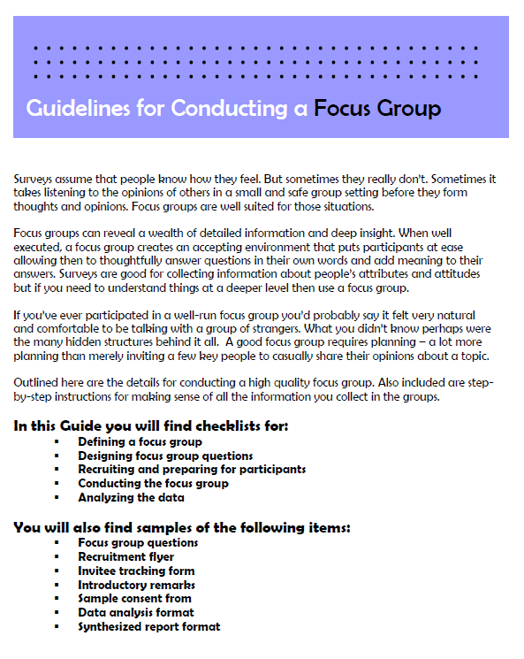
conducting focus groups
Focus group guide
Information on:
Designing questions
Recruiting participants
Conducting the group
Analyzing data
Provides examples
from Duke University (https://assessment.trinity.duke.edu/documents/How_to_Conduct_a_Focus_Group.pdf)

Slide 29
Conducting diverse focus groups
3 groups by engagement:
highly engaged, less engaged, mixed engagement in extracurricular and academic activities
9th grade – 12th grade representations across groups
17 students participated
7 African-American, 8 Caucasian, 2 other
11 female students, 6 male

Slide 30
Student-Student Relationships
Think for a minute about how students in this school get along with each other. What do you think the main problems are?
So that everyone has a chance to talk, please start with what you think the single biggest problem is that keeps kids from getting along better.
Probe further for specific issues, as needed:
Lots of high schools have groups or cliques that may not get along. Does this happen here?
[Give respondents a chance to name a second or third problem so that you develop your understanding of the major concerns.]

Slide 31
We’ve talked a good bit about some of the problems, now we’d like to move to how to improve things…
Student-Student Relationships
What ideas do you have about how to help kids get along better at this school?
Student-Teacher Relationships
What ideas do you have about how to help students and teachers get along better? *
Safety:
What ideas do you have about ways to make students feel safer at school?
School Pride:
What ideas to you have about ways to make students proud of this school?

Slide 32
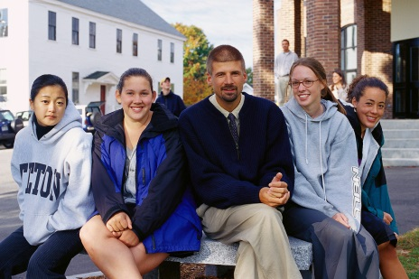
Students’ Feedback (or “Data”)
What Students Considered as Challenges for the School:
1. Groups often do not know,
understand, or like each other
2. Students receive differential treatment
from adults depending on academic work

Slide 33
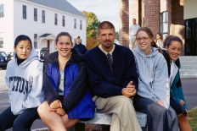
1. Groups often do not know, understand, or like each other
Groups were identified based on several characteristics
Academic program
Neighborhood
Extracurricular activities
There are limited opportunities for groups to work together
Advisory period is seen as more of a hindrance
Differences create misunderstandings
Groups ignore and/or intimidate each other
Hallway concerns
Rumors spreading, especially through technology
Students see it as an individual responsibility to avoid conflict and protect themselves
Avoid problem areas
Concern about inconsistent response by adults to discipline issues
“We don’t know them and they don’t know us.”

Slide 34
2. Students receive differential treatment from adults
Students perceive teachers to be less engaged and less effective in Lower level classes (sense of “giving up”)
Students believe administration is not aware of these issues in the classroom
Students believe that rules are not always enforced fairly
Students in less rigorous classes can get away with more because they are not held to same standard
Personal relationships with adults allow students to get away with things
Positive Behavior Support program is not used consistently
Students who benefit from preferential treatment still view it as unfair
The PBS program is not used consistently.
“One of my teachers will, like before a football game, ask who is going to the football game, and if you raise your hand, he’ll give you two ‘tickets’.”
“And my teacher decided to raise [my grade] to 90 just because she, I guess, she liked me more than the other student…and the other student was left with a B.”

Slide 35
Potential Avenues for Change
Develop more diverse relationships among students
Student Ideas:
Increase positive connections (interactions) between students
More clubs and incentives for joining clubs
Require students to be in at least one extracurricular activity
Provide more language courses
Involve students in projects to clean up the school or other community projects
Create a student-run newspaper
Utilize inspirational speakers
Increase communication within the school and about the school with the community
Additional Project Recommendations:
Revisit use of Advisory for facilitating acceptance
Improve the PBS program
Develop school-wide community service activities
Investigate available transportation and how it impacts student involvement

Slide 36
Potential Avenues for Change (Continued)
Increase communication within the school and about the school with the community
Student Ideas:
Engage the elementary and middle school students from feeder schools to get them excited about attending
Provide updates about alumni and current student accomplishments (diverse types of accomplishments)
Provide teacher professional development on a range of interpersonal skills
Additional Project Recommendations:
Address perception of favoritism and inconsistent enforcement of rules
Consider engage faculty in problem-solving activities to gain consensus on

Slide 37
Potential Avenues for Change (Continued)
Improve the Positive Behavior Support program: Consider Shared Spaces, Classroom Management, School-wide Expectations and Recognition
Student Ideas:
Get students involved in program to improve the school grounds - students are more motivated to keep clean if the school is clean and not cluttered
Have students identify and participate in other school or community projects in both “home communities”
More opportunities for students to show they can be trusted
Additional Project Recommendations:
Reinvigorate student involvement in PBS program
Have students from the “less engaged” groups participate in planning, implementing, and evaluating school climate improvement projects
Utilize student ideas for recognition systems
Increase supervision in trouble areas

Slide 38
Classroom Management & School-wide Discipline Recommended Strategies
Implement strategies to prevent behavior problems and promote positive student-student relationships
Provide models of behaviors associated with peer acceptance
Develop class vision with students
Consistently communicate and highlight social acceptance
School-wide behavioral expectations
Classroom meetings
School-wide activities
Media (newsletter, website)
Strengthen teacher-student relationships
Use praise and other recognitions strategically
Encourage students to praise and reinforce one another for prosocial behavior

Slide 39
effective praise & rewards
Provides general strategies for effectively praising and rewarding students
Gives specific script examples of what to do or what to say to students
Activity for staff practice also available.

Slide 40
Classroom Management & School-wide Discipline Recommended Strategies
Implement additional strategies for preventing behavior problems
Communicate and collaborate with students’ families
Closely monitor and respond to social dynamics of the classroom and school
Observe peer interactions and affiliations
Avoid encouraging hierarchical peer social networks
Arrange seating to promote opportunities for positive social interactions and social acceptance
Restorative Practices

Slide 41
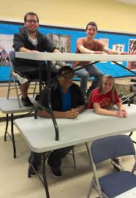
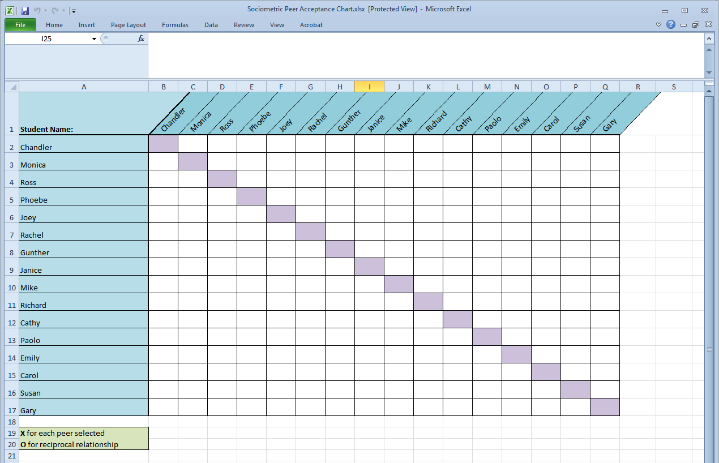
SOCIOMETRIC SEATING TOOL
Excel spreadsheet and instruction guide
Students list 3 peers with whom they would like sit
Track students’ responses in Excel to see who is (and who is not) nominated by one another

Slide 42
Classroom Management & School-wide Discipline Recommended Strategies
When correcting misbehavior, consider how actions taken might impact student-student relationships
Correct privately instead of publicly
Always combine correction with recognition of positive behavior
Teach skills to prevent behavior from reoccurring
Use inductive discipline; communicate impact of behavior on relations with others

Slide 43
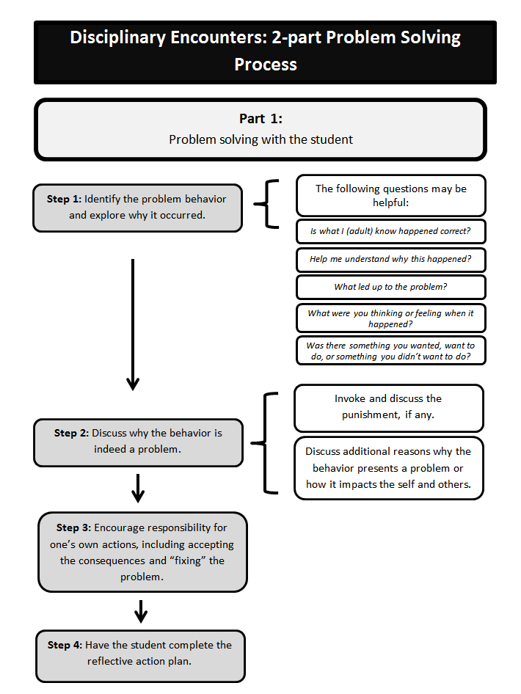
CORRECTING MISBEHAVIOR
Flow chart demonstrating how to:
Problem solve with student
Follow up to support future positive behavior

Slide 44
Educator practices Recommended Strategies
Encourage students to talk to teachers, other school staff, and friends about what might be interfering with positive relations
Individual discussions
Class discussions/meetings
Committees, clubs, government

Slide 45
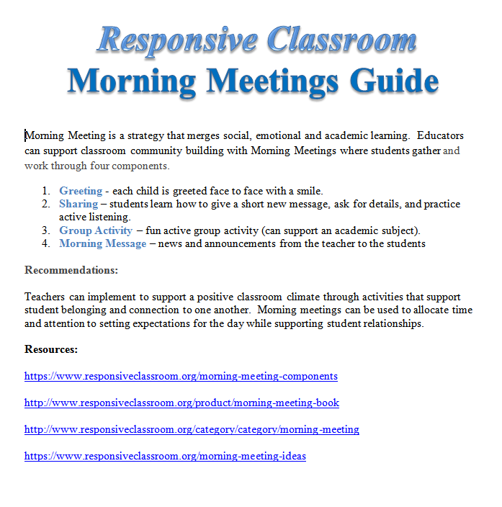
MORNING MEETINGS
Morning meeting guide
Steps to meeting
Resources
Book
Responsive Classroom links
Video Clip
Community Circles

Slide 46
Educator practices Recommended Strategies
Play games that promote fun and social interactions
Provide opportunities for peer-assisted learning
Peer mentoring, buddy systems
Consider whom you group together
Consider grouping students of different races/ethnicities
Encourage students to participate in extracurricular activities and sports
Service-learning opportunities
Identify and showcase students’ skills and talents to help students to get to know each other
Example: “Yellow Pages” activity

Slide 47
yellow pages activity
Students make advertisements for skills they can offer the class
Advertisements copied on yellow paper and made into book
from Responsive Classroom (https://www.responsiveclassroom.org/blog/class-yellow-pages)

Slide 48
Teaching Social-emotional skills Recommended Strategies
Use multiple opportunities in and outside the classroom to teach lessons on peer relations
Direct Instruction – Interactive Modeling
Highlight lessons within school subjects
Focus on student-student relationships during “teachable moments”
Highlight and discuss issues pertaining to social relationships in current events
Adopt a packaged SEL curriculum
Lessons on relationship skills
Demonstrated improvement in peer relationships
Ex: PATHS, Second Step, Responsive Classroom

Slide 49
SEL programs
Resource provides expected outcomes for various programs by categories (e.g., academics, classroom quality, etc.)
Pay special attention to “Social Skills, Prosocial Behavior, and Aggression” column.

Slide 50
Recommended Strategies
Students at Tier 2 & 3

Slide 51
STUDENTS AT TIER 2 & 3 Recommended Strategies
Apply the strategies already mentioned as appropriate at the universal level and for all students
With greater frequency and intensity
More comprehensive
More individualized
Provide social skills/SEL training related to prosocial skills
Universal or Tiers 2/3
Where appropriate, develop a behavioral contract

Slide 52
STUDENTS AT TIER 2 & 3 Recommended Strategies
Ensure targeted students have a supportive relationship with at least one other person
Work closely with the home
Consider implementing the Good Behavior Game
A group contingency behavior reinforcement system
Provide more intensive supports
Individual counseling, family therapy, or parent management training, and social services

Slide 53
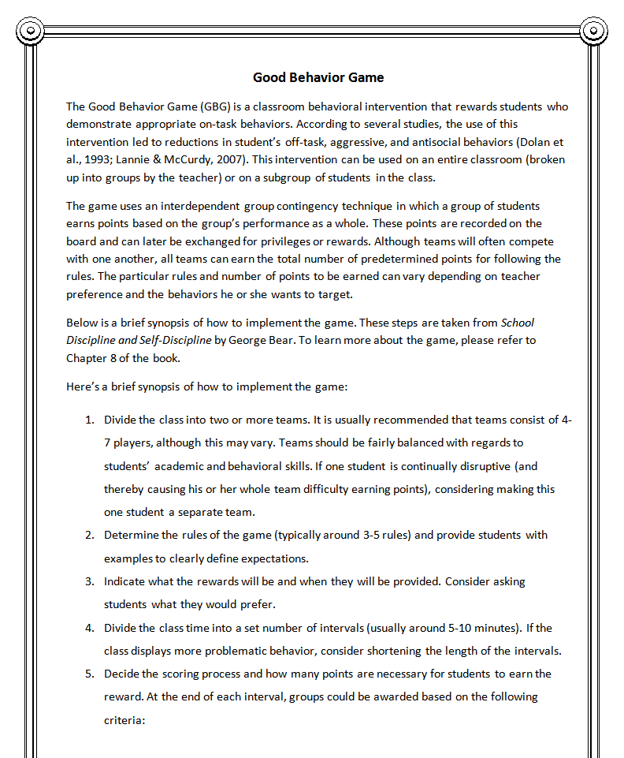
Good behavior game
Handout that provides specific steps to implementing the game.

Slide 54
Making a plan

Slide 55
Planning & Monitoring
Checklist of activities for fostering positive student-student relationships
What strategies & resources to explore?
Consider:
school-wide strategies
team-based strategies (grade level/content)
Individual classroom strategies

Slide 56
Checklist of activities fostering positive student-student relationships
Questions to think about:
What are the strategies my classroom and/or school are currently doing that help foster student-student relationships?
What are the areas for improvement at my school? In my classroom?
What is one strategy or intervention I would like to try in my classroom/school next week?
What are my next steps to start improving student-student relationships at my school?
What kinds of conversation need to be had and with whom?
What data needs to be collected?
What will the timeframe be?
What resources will I need?

Slide 57
Resources on website
Go to the DE-PBS Website: Delawarepbs.org
Click on “Presentations” tab and then on “Western Sussex Summit 2015”
Email us with any questions!
Debby Boyer – dboyer@udel.edu
Jamie Caruso – jcaruso@udel.edu

