Slide 1
Tier 2 Data Workbook Tutorial
DE-PBS Project
Center for Disabilities Studies
Updated 1/28/15
Notes:
Thank you for your interest in using the DE-PBS Tier 2 Workbook. The following is a tutorial regarding how to use the Excel Workbook. Please send your questions, comments and/or recommendations regarding this workbook to Megan Pell at mpell@udel.edu.
This workbook is intended to help schools do the following:
More regularly discuss SYSTEMS-related trends across their Tier 2 interventions (at least monthly is recommended).
More readily share information regarding the important and often extensive Tier 2 intervention efforts happening in the school (with staff, parents, schools boards, and community)

Slide 2
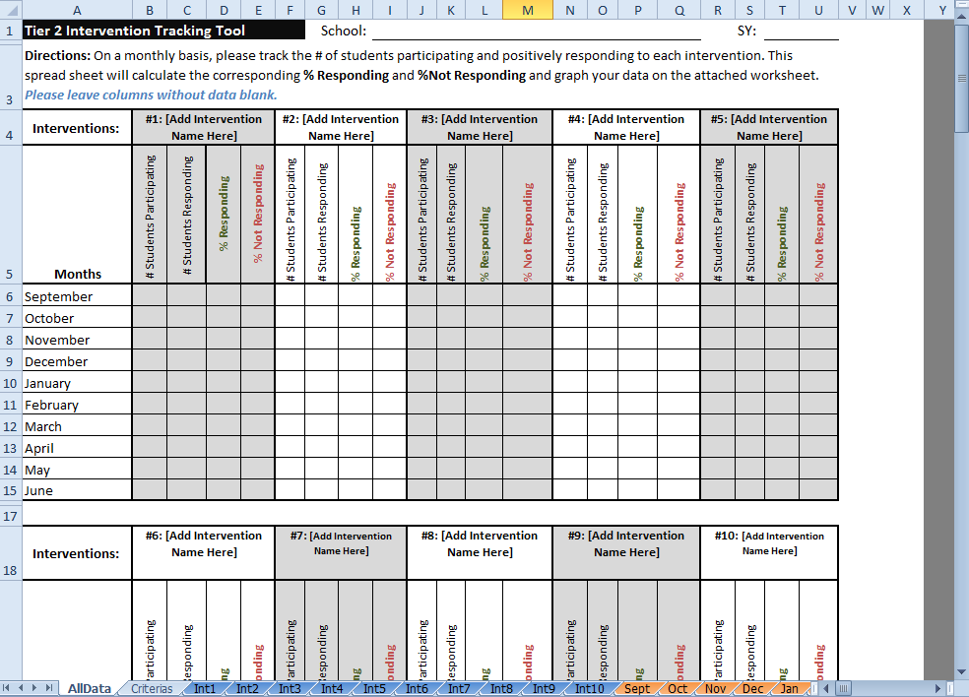
Why use this workbook:
Help make important decision about your Tier 2 programming.
Help others understand the important and extent of your Tier 2 programming.
How to use this tool:
Please review this Powerpoint and update your data monthly in this Excel workbook!
Notes:
Thank you for your interest in using the DE-PBS Tier 2 Workbook. The following is a tutorial regarding how to use the Excel Workbook. Please send your questions, comments and/or recommendations regarding this workbook to Megan Pell at mpell@udel.edu.
This workbook is intended to help schools do the following:
More regularly discuss SYSTEMS-related trends across their Tier 2 interventions (at least monthly is recommended).
More readily share information regarding the important and often extensive Tier 2 intervention efforts happening in the school (with staff, parents, schools boards, and community)

Slide 3
A quick orientation to this tool… this is an Excel workbook but you don’t need to be an Excel expert to use it!
You will just need to enter some numbers and some text from your existing (and any new) Tier 2 intervention-related school activities into this workbook and we’ll show you how and where!
You can always copy and paste any tables and/or graphs from this workbook into other documents (like Word or Powerpoint).

Slide 4
22 Tabs to Help Outline
Your Important Tier 2 Programming
Notes:
Please note:
There are 22 tabs included in this workbook. This may seem like a lot but teams may not use all of them in a given month or year.

Slide 5
Certain cells within these 2 tabs will require data/info
entered by you (but some cells are locked )
Notes:
Please note:
The first 2 tabs included in this workbook are the most important and will be discussed in detail later in this tutorial. These are tabs that link to worksheets that require teams to manually enter intervention names, data, and/or criteria information.

Slide 6
The other 20 tabs are linked to the data/info you enter
(they will generate graphs based on the data you enter)
Notes:
Please note:
The other 20 tabs included in this workbook link to worksheets that provide teams with professional-looking graphs and tables that are based on the data entered under the “AllData” tab. These worksheets will be discussed in detail later in this tutorial.

Slide 7
Before using this workbook, you’ll need…
A list of your current Tier 2 interventions.
This workbook allows you to track 10 interventions simultaneously. If you have more than 10, consider using one workbook to track behavioral interventions and another to track academic interventions.
A monthly data collection method
This workbook allows your Tier 2 team to track the %ages of students responding to those 10 interventions across each month of the SY (September-June). We recommend that schools designate a facilitator for each intervention who can collect and report this data monthly to the team leader(s), who would then enter it into this workbook.
And (at least) the Responding criteria for each intervention
As soon as possible, it is recommended that your team determine the entrance and exit criteria for each intervention, too. Interventions should be fluid and dynamic (and not holding pens for students).

Slide 8
Okay, now to start…
Please open the Excel file named:
“Tier 2 Intervention Tracking with Graphs ADD SCHOOL NAME”
and save the file on your computer by renaming it with your school name.

Slide 9
Step 1: Complete school information at the top of the “AllData” tab
Notes:
Once you open the file, you want to:
add your school name and school year (SY) to this Workbook in these cells, and
save the Workbook on your computer with your school name. Currently, this file is called “Tier 2 Intervention Tracking with Graphs ADD SCHOOL NAME”

Slide 10
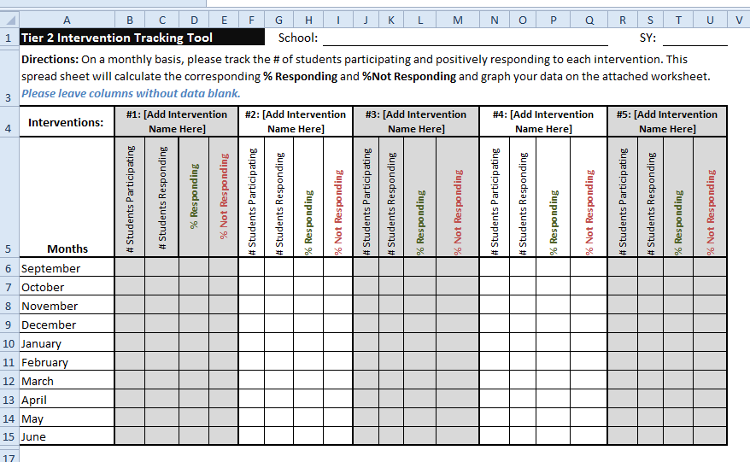
Step 2: Add intervention names to worksheet There is space for up to 10 interventions.
Special note: The intervention name you type in these boxes will automatically show up on all other worksheets that relate to that intervention in this workbook!
Notes:
Now you want to type in the name of each Tier 2 intervention that you want to add to this workbook.
Hint: So you can reference interventions quickly in your team discussions, it can be helpful to keep the #s in each of these boxes.

Slide 11
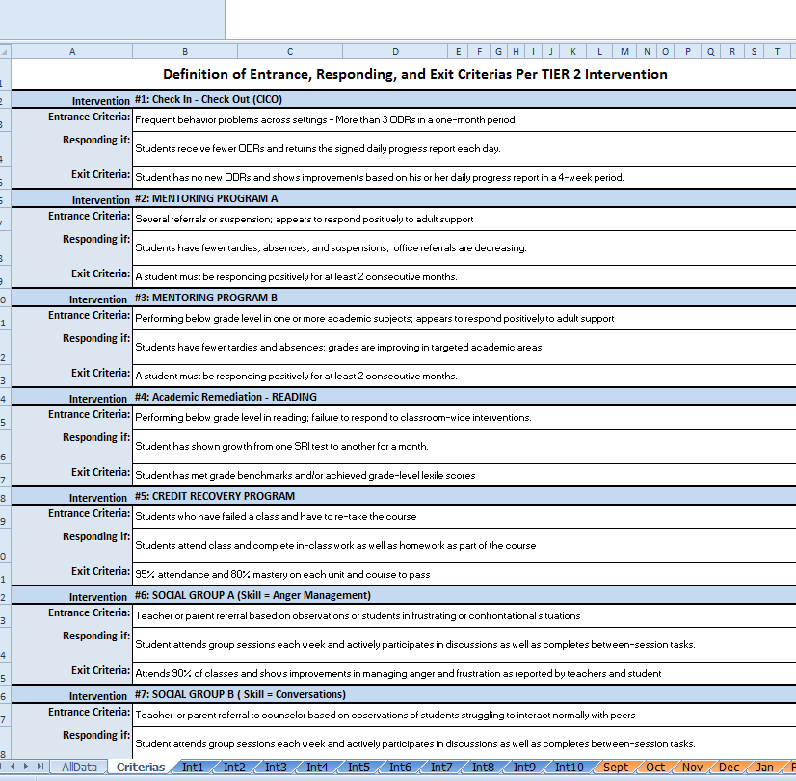
Step 3: Document Intervention Criteria A. Select the second tab “Criteria” B. Define the entrance, responding, and exit criteria for each intervention (Interventions will self-populate based on the names entered on the “AllData” tab)
B
A

Slide 12
Now that you have your basic intervention information saved…
…you can start adding your monthly data!

Slide 13
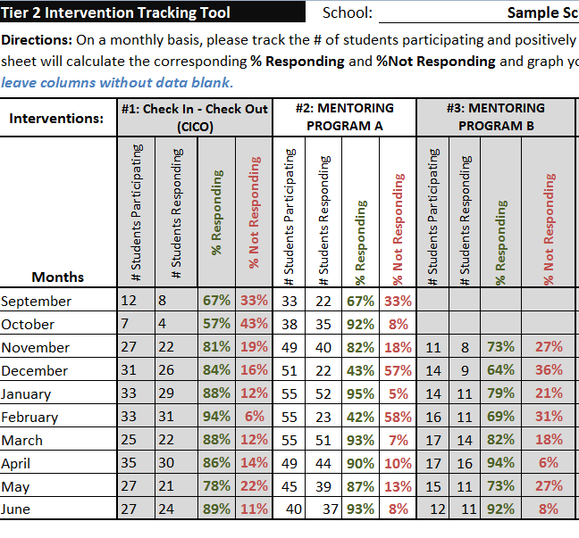
Step 4: Each month, enter: - the # of students are participating in each intervention & -the # of students responding to each intervention.

Slide 14
Step 4: Each month, enter: - the # of students are participating in each intervention & -the # of students responding to each intervention.
The percentage of students responding and not responding will automatically populate once the numbers are entered for each month.

Slide 15
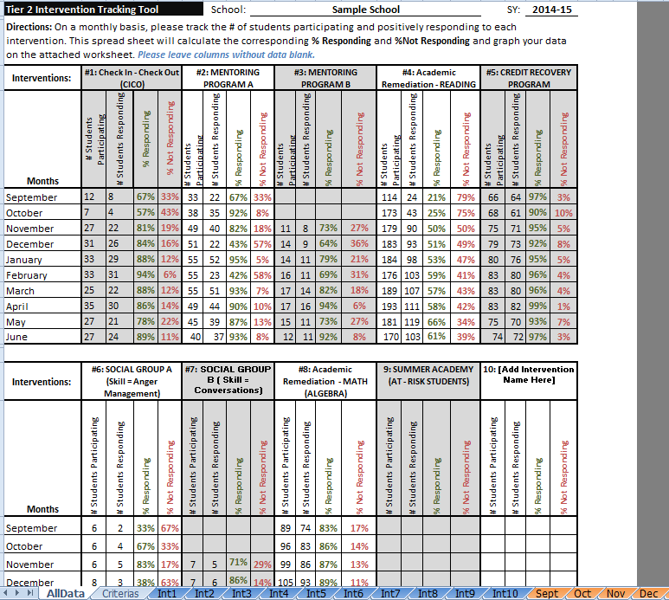
Step 5: Examine your %ages to determine - which interventions are working (70% of students are responding, like CICO above) & - which interventions don’t seem to be working in your current Tier 2 program (less than 70% of students are responding, like the Academic Remediation)

Slide 16
OR Examine your graphs to determine - which interventions are working (70% of students are responding, like CICO above) & - which interventions don’t seem to be working in your current Tier 2 program (less than 70% of students are responding, like the Academic Remediation)

Slide 17
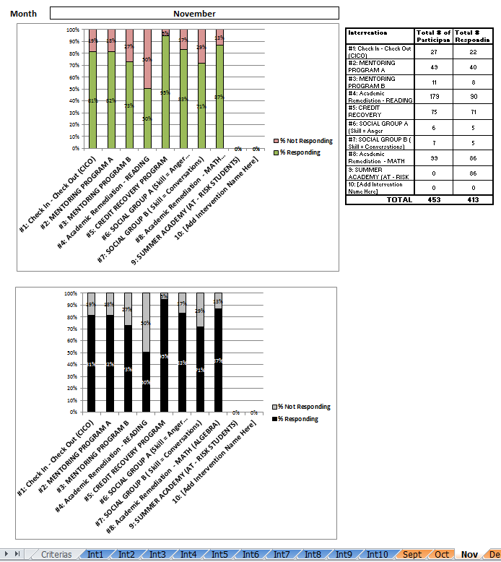
Monthly Graphs
Special Notes:
You cannot change the data in the graph worksheets (they are imported directly from the AllData worksheet).
Each intervention and month tab shows the same graph twice, once in color and once in black and white.
The orange tabs in this workbook provide you with graphs of the interventions by month.
They show the percentage of students responding and not responding to all interventions per month.
Notes:
Special Notes:
You cannot change the data in the graph worksheets (they are imported directly from the AllData worksheet) but you can format the look and size of the text in the accompanying table.
Each intervention and month tab shows the same graph twice, once in color and once in black and white.

Slide 18
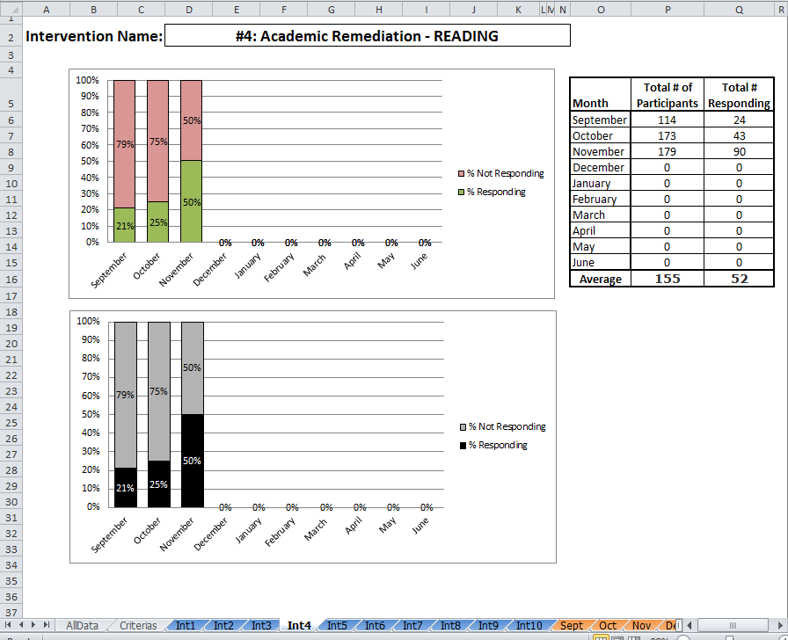
Graphs per Intervention.
Special Notes:
You cannot change the data in the graph worksheets (they are imported directly from the AllData worksheet).
Each intervention and month tab shows the same graph twice, once in color and once in black and white.
The blue tabs in this workbook provide you with graphs of each interventions across the SY.
They show the percentage of students responding and not responding to each intervention each month.
Notes:
Special Notes:
You cannot change the data in the graph worksheets (they are imported directly from the AllData worksheet) but you can format the look and size of the text in the accompanying table.
Each intervention and month tab shows the same graph twice, once in color and once in black and white.

Slide 19
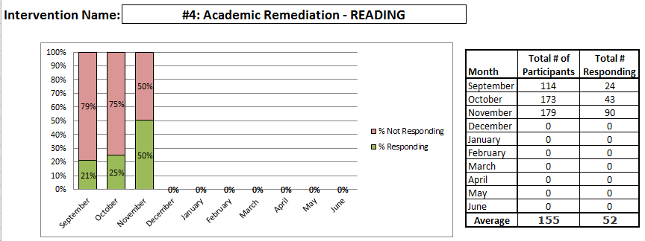
Step 6: For any interventions with low student responses (less than 70%), ask WHY.
If an intervention is working for less than 70% of your enrolled students
– you need to talk about the intervention system. Your discussion may include questions about intervention fidelity and/or retraining in the intervention.
- Conversations about individual students’ lack of response should be addressed in a separate, problem-solving, conversation

Slide 20
Thank you for reviewing this tutorial! For more information about Targeted (Tier 2) programming and tools, please visit our website at delawarepbs.org
DE-PBS Project
Center for Disabilities Studies
Updated 1/28/15
Notes:
Thank you for your interest in using the DE-PBS Tier 2 Workbook. The following is a tutorial regarding how to use the Excel Workbook. Please send your questions, comments and/or recommendations regarding this workbook to Megan Pell at mpell@udel.edu.
This workbook is intended to help schools do the following:
More regularly discuss SYSTEMS-related trends across their Tier 2 interventions (at least monthly is recommended).
More readily share information regarding the important and often extensive Tier 2 intervention efforts happening in the school (with staff, parents, schools boards, and community)

