Slide 1



Team Leader Guide
An informational series of webinars to support leadership skills
Module 1

Slide 2
Effective Leadership
From: Méndez-Morse, S. (1992). Leadership characteristics that facilitate school change. Austin, TX: Southwest Educational Development Laboratory.
[There are] “two dimensions considered necessary for effective leadership — initiating structure, which is primarily concern for organizational tasks, and consideration, which is the concern for individuals and the interpersonal relations between them.”
“Leaders of educational change illustrate this with their vision and belief that the purpose of schools is students' learning.”

Slide 3
Consider these questions …
  Does your administration support your SWPBS Program?
  Does your staff buy-in to your SWPBS Program?
  Do you communicate with District Coach and feel supported by him or her?
  Do you feel comfortable organizing meetings ?
  Do you look at data at least monthly, and have you made changes based on this data?
  Does your school have a plan to monitor fidelity?

Slide 4
Consider these questions …
  Does your administration support your SWPBS Program?
  Does your staff buy-in to your SWPBS Program?
  Do you communicate with District Coach and feel supported by him or her?
  Do you feel comfortable organizing meetings ?
  Do you look at data at least monthly, and have you made changes based on this data?
  Does your school have a plan to monitor fidelity?

Slide 5
Why are we here?
To develop and enhance skills in the areas of Communication and Organization
To provide resources, forms, and information to assist with these skill areas
To develop a network of Team Leaders throughout the state

Slide 6



Communication:

Slide 7
Communication:
Why is this important?
A strong communication structure can promote buy-in from administration and staff, students, parents, and community members.
Communication skills are infused through all aspect of team leadership.

Slide 8

Communication Skills
Reflective Skills
  Paraphrasing
  Summarizing
  Asking Clarifying Questions/
  Requesting Clarification
  Asking Relevant Questions
  Active Listening

Slide 9
Communication
Team Mission and Purpose
As a team, reflect upon district & school mission and vision.
Establish the team’s mission in connection with the big picture of the school and district.
Work towards shared understanding and commitment.
Communicate with school community team membership and mission

Slide 10



Organization:

Slide 11
Team Leaders Organize…
School-wide PBS Team Materials
Scheduled Monthly Meetings / Data Analysis
Professional Development Opportunities
Working with Administration
District Coach Contact
Staff and Student Kick-Offs
Data (Semi-Annually and Annually)

Slide 12
…leads to Communication
Organization in…
School-wide PBS Team Materials
Scheduled Monthly Meetings / Data Analysis
Professional Development Opportunities
Working with Administration
District Coach Contact
Staff and Student Kick-Offs
Data (Semi-Annually and Annually)

Slide 13
…leads to Communication
Organization in…
School-wide PBS Team Materials
Scheduled Monthly Meetings / Data Analysis
Professional Development Opportunities
Working with Administration
District Coach Contact
Staff and Student Kick-Offs
Data (Semi-Annually and Annually)

Slide 14
SW Team Materials
 | Beginning of year | During the year
Organization | Expectations Behavior Matrix Acknowledgment Matrix Lesson Plans | Update lesson plans Keep Working Notebook Updated Agendas
Communication | Lesson Plans Staff Training Kick Offs (Students and Staff) Brochure Website Newsletter | Agendas Meeting Minutes Newsletters Data Lesson Plans

Slide 15
SWPBS Team Materials
Permanent Products Notebook Model
  Program materials the team creates to support implementing a Schoolwide PBS program
  Materials used year to year
  E.g., Expectations/poster templates, behavior matrix, expectation lesson plans
Working Notebook Model
  PBS Team monthly meeting materials
  E.g., agendas, minutes & sign-in documents, data reports

Slide 16
…leads to Communication
Organization in…
School-wide PBS Team Materials
Scheduled Monthly Meetings / Data Analysis
Professional Development Opportunities
Working with Administration
District Coach Contact
Staff and Student Kick-Offs
Data (Semi-Annually and Annually)

Slide 17
Scheduled Monthly Meetings
 | Before Meeting | During Meeting | After Meeting
Organization | Establish a meeting schedule Get Big 5 Data for sharing (from system or data sub-committee) Review action items from last mtg. to discuss | Have template for notetaking Utilize sub-committees for specific initiatives | Make sure Action Plan is updated Add materials to Permanent and Working note(s)
Communication | Create and send out agenda SW Reach out to administration to attend meeting Send reminders to sub-committee if they need to present | Ask for team members to take team roles Maintain meeting norms/ground rules | Share teacher PD needs with school leadership/district coach Share mtg. details with administration, colleagues and district coach

Slide 18
Monthly meeting schedule
Pre-set monthly meeting schedule for the year
  Avoid month to month scheduling to support team participation
Set consistent day & time – e.g., 2nd Tuesday afternoon of the month at 2:20-3:30.
Select location that is distraction-free as possible

Slide 19
Clear Meeting Agenda
Provide an outline for meeting topics
Assign meeting roles ahead of time
Can share through e-mail, print and put in mailboxes, add to staff newsletter

Slide 20
Clear Meeting Agenda
Have a reasonable agenda for each meeting and set time limits per topic
Include:
  Review of data to make informed decisions on program effectiveness
  Revisit action plans/goals and celebrate successes
  Identify information to share with whole staff
    How will this information be shared?

Slide 21
Sample Meeting Agenda
Meeting Date, Time, Location
Action items from previous meeting
Review school-wide data trends
New action items:
  What? How? By Whom? By When?
Communication with staff
  What? How? By Whom? By When?

Slide 22
Facilitating the Meeting
Allow for time restraints and focused discussions for everyone
Facilitate a problem-solving team process for planning, development, implementation, and evaluation of evidence-based practices across all three levels of prevention and intervention (primary, secondary, and tertiary).

Slide 23


Slide 24
Meeting minutes
Meeting Date, Time, and Location
Meeting Participants and Roles
Updates/ Decisions on previous action items
Summary of data reviewed
New action items and person responsible
Communication items
Items for next meeting

Slide 25
Establish Meeting Norms/
Ground Rules
A set of guidelines that a team establishes to shape the interaction of team members with each other and with staff outside the team.
Team norms can encompass as many topics as the team deems necessary for successful functioning.
Post norms and mission at meetings for review & reference

Slide 26
Meeting Norm Examples
  Team problem solving, conflict resolution, and decision making
  Team member interaction in meetings
    Team members use 1 voice at a time
    Hold no side or competing conversations
    Arrive on time
    Work from an agenda
    Record minutes
    End meetings on time
  Team members will make decisions by consensus, but majority will rule if timely consensus is not reached;
  Conflicts will be resolved directly with the persons in conflict.

Slide 27
What role will you play on
PBS Team?
Specific roles can include:
    Facilitator (create the agenda, lead the meeting) *
    Time-keeper (keeps team on task) *
    Recorder/Note-taker (takes and distributes minutes; archives material) *
    Reporter/Communicator (shares information on activities and data to staff, families, and communities) *
    Data Manager (brings data to team meetings)
    Others as needed (consider team/school culture):
      Door keeper
      Jargon buster
      “But” Buster

Slide 28

Parking Lot
Strategy to capture valued ideas, thoughts, concerns, etc. that are not on the meeting agenda
Post-its, index cards, etc. available to all to jot down thoughts to be collected for follow up at end of meeting if time, or post-meeting.

Slide 29

Highlight Your Team Assets
PLAN TO USE the skills/gifts of your team!

Slide 30
Form Subcommittees
As your program is developing and growing, the team may benefit from breaking off into subcommittees that report back to the whole team.
  Data Review & Summary
  Product Development
  Expectation Teaching Plans/Activities

Slide 31

…leads to Communication
Organization in…
School-wide PBS Team Materials
Scheduled Monthly Meetings / Data Analysis
Professional Development Opportunities
Working with Administration
District Coach Contact
Staff and Student Kick-Offs
Data (Semi-Annually and Annually)

Slide 32
Monthly Data Analysis
 | Before Meeting | During Meeting | After Meeting
Organization | Gather Big 5 Data Summarize trends Prepare to share visually | Share Big 5 data trends Brainstorm ideas to address needs Plan next steps | Complete steps from action planning Include data in minutes Enter information in DDRT
Communication | Add data to agenda Gain staff input about data concerns | Share ideas to address trends Determine what will be shared with staff and students and when | Share data and decisions with staff, students, and families Celebrate successes!

Slide 33
Big 5 Data
Average referrals per day per month
Referrals by Location
Referrals by Time
Referrals by Behavior
Referrals by Student

Slide 34
Big 5 Data Analysis
PBS Team Monthly Data Analysis Guide
Date: __________________________
Average Referrals/Day/Month – Every meeting
❑ Review of Average Referral/Day/Month data for current year
❑ Review of comparison Average Referral/Day/Month data
What trends has our data made from last month(s) to this month?
________________________________________________________________________
________________________________________________________________________________________________________________________________________________
What trend(s) has our data made from last year to this year?
________________________________________________________________________
________________________________________________________________________________________________________________________________________________
What has our staff been doing to cause these trends?
________________________________________________________________________
________________________________________________________________________________________________________________________________________________
What has our team been doing to cause these trends?
________________________________________________________________________
________________________________________________________________________________________________________________________________________________
What will our staff and team now do to change or maintain positive trends?
________________________________________________________________________
________________________________________________________________________________________________________________________________________________

Slide 35
Data Summaries
School Climate Data
DDRT/ Discipline referral data
Positive referrals/ shout outs
DASN-PBS
Surveys
Big 5 Data
Other ideas?

Slide 36
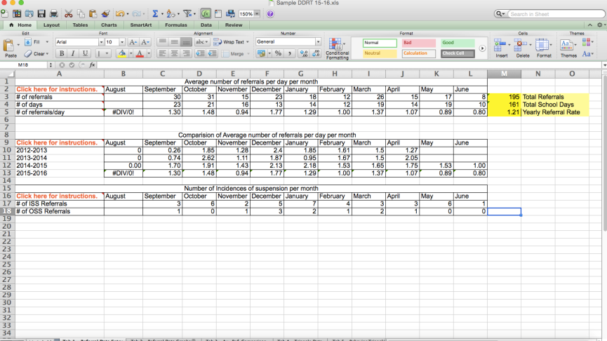
DDRT

Slide 37
…leads to Communication
Organization in…
School-wide PBS Team Materials
Scheduled Monthly Meetings / Data Analysis
Professional Development Opportunities
Working with Administration
District Coach Contact
Staff and Student Kick-Offs
Data (Semi-Annually and Annually)

Slide 38
Professional Development
 | Throughout the Year
Organization | Data collection of PD needs. Decide which staff needs a particular PD.
Communication | Share collected information with administrative . Share PD date/time with staff.

Slide 39
Professional Development
Opportunities for growth and learning
Provided by DE-PBS Project with the Delaware Dept. of Education
  Substitute reimbursement
  Importance of registration and follow-up
Seek out other resources
  DE Inclusion Conference

Slide 40
…leads to Communication
Organization in…
School-wide PBS Team Materials
Scheduled Monthly Meetings / Data Analysis Professional Development Opportunities
Working with Administration
District Coach Contact
Staff and Student Kick-Offs
Data (Semi-Annually and Annually)

Slide 41
Working with Administration
 | Ongoing throughout the year
Organization | Set up regular meeting time with administration Monthly? Quarterly?
Communication | Staff newsletter/ email Sharing minutes Parent/ Student newsletters Phone updates (e-calls) Talk through data sources before team/staff discussion

Slide 42
…leads to Communication
Organization in…
School-wide PBS Team Materials
Scheduled Monthly Meetings / Data Analysis Professional Development Opportunities
Working with Administration
District Coach Contact
Staff and Student Kick-Offs
Data (Semi-Annually and Annually)

Slide 43
District Coach Contact
 | Ongoing throughout the year
Organization | Set up regular meeting time with coach Monthly? Quarterly?
Communication | Monthly data Monthly Agendas Monthly Meeting Minutes Questions

Slide 44
Communicating with District Coach
Information from Cadre Meetings
Professional Development Needs
District Support
District networking and contacts

Slide 45
…leads to Communication
Organization in…
School-wide PBS Team Materials
Scheduled Monthly Meetings / Data Analysis Professional Development Opportunities
Working with Administration
District Coach Contact
Staff and Student Kick-Offs
Data (Semi-Annually and Annually)

Slide 46
Kick-Offs
 | Summer/ Beginning of the Year
Organization | Offer information about your program Assembly Games Parent Volunteers
Communication | Set the tone for the year Support buy-in Welcome input and feedback

Slide 47
…leads to Communication
Organization in…
School-wide PBS Team Materials
Scheduled Monthly Meetings / Data Analysis Professional Development Opportunities
Working with Administration
District Coach Contact
Staff and Student Kick-Offs
Data (Semi-Annually and Annually)

Slide 48
Data (Semi-Annually and Annually)
 | Before | During
Organization | School Climate Survey Previous Year’s ODR Data | DDRT Big 5 Data Visual graphs/ Triangle
Communication | Gain input from staff on areas of need Share information | Newsletter Monthly updates Lesson plans based on need

Slide 49
School Climate Data
Participation e-mails in Fall
Home, Student, and Staff versions
Session in May to guide through the Data Analysis

Slide 50
Delaware Assessment of Strengths and Needs for Positive Behavior Supports (DASNPBS)
What is this?
What’s the purpose?
  Staff survey aligned to Delaware’s Key Features of DE-PBS and major components of schoolwide discipline
  Designed to help schools assess their strengths and needs regarding comprehensive school discipline.
    Program Development & Evaluation
    Prevention: Implementing Schoolwide and Classroom Systems
    Developing Self-Discipline
    Correcting Behavior Problems.
  Schools are encouraged to select 1-2 sections of the survey (10 items each) based on area of implementation focus.
    Self-Assessment and Reflection
    Schoolwide Assessment and Reflection
    Action Planning
    Professional Development Plans

Slide 51
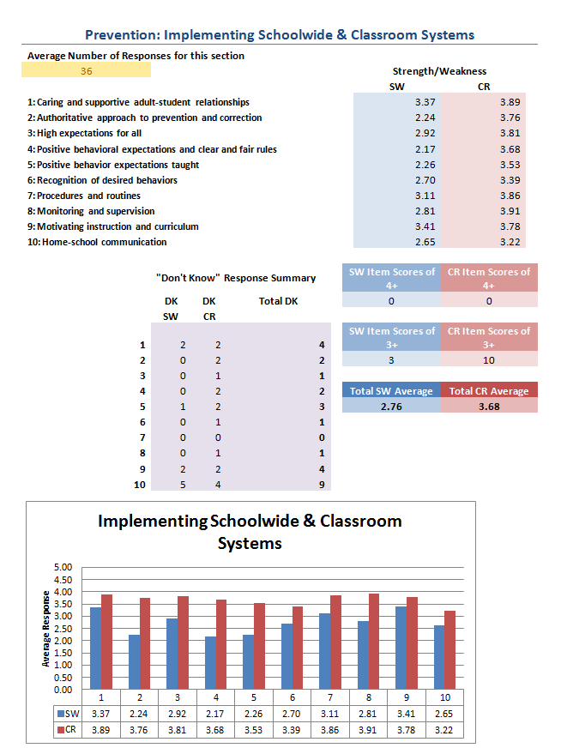

Slide 52
DE-PBS Key Feature Evaluation
The Key Feature Evaluation (KFE) is a tool used to provide feedback to schools based on their School- wide PBS (SW-PBS) program and implementation.

Slide 53
Status Tracker
The Key Feature Status Tracker is a self-assessment tool that your team can use to evaluate your SWPBS program.
Key Feature Status tracker has 4 sections that mirror the SWPBS Framework. Teams are prompted to assess if elements are “In Place,” “Partially in Place,” or “Not in Place.”

Slide 54
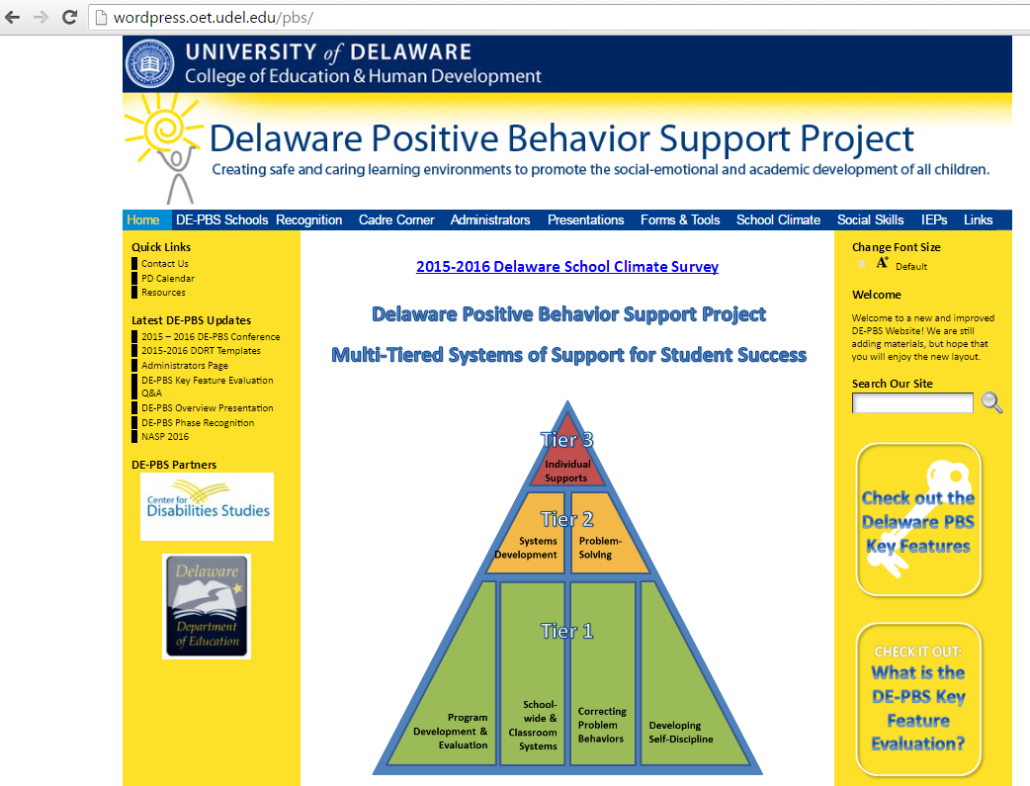
Additional Resources
www.delawarepbs.org
  Templates
  Examples (e.g., Cool Tools)
Other PBS websites
  pbis.org
  interventioncentral.org
  behaviordoctor.org

Slide 55
Click to complete
Team Leader Module 1
Content Reflection. https://delaware.ca1.qualtrics.com/SE/?SID=SV_0uINBZQmCGYiRSt
Note: MOU requirement for SCSS School Team Leaders.
Questions?
Email us at:
  Melissa Ebling mebling@udel.edu
  Sarah Hearn skhearn@udel.edu
  Megan Pell mpell@udel.edu

