Slide 1
Welcome to the
DE-PBS Cadre Meeting
September 27, 2016

Slide 2

DE-PBS Phase Recognition

Slide 3
2015-2016 Recognition Phases
Phase I- Developing a SWPBS System
Phase II- Establishing an Advanced SWPBS System
Phase III- Developing a Tier 2 Problem Solving Team with Tier 2 Interventions
Phase IV- Developing a Strong Tier 2 System

Slide 4
2015- 16 Phase 1 Recipients
School District | School Name
Brandywine | Lancashire Elementary
Cape Henlopen | H. O. Brittingham Elementary
Milford | Morris Early Childhood Center
Red Clay | Cooke Elementary Shortlidge Academy

Slide 5
2015-16 Phase 2 Recipients
School District | School Name
Appoquinimink | Olive B. Loss Elementary Townsend Elementary Waters Middle
Capital | William Henry Middle
Christina | Jennie Smith Elementary McVey Elementary Leasure Elementary
Lake Forest | Lake Forest East Elementary

Slide 6
2015-16 Phase 2 Recipients
School District | School Name
Red Clay | Stanton Middle Lewis Dual Language Academy Richardson Park Elementary

Slide 7
2015-16 Phase 3 Recipients
School District | School Name
Brandywine | Carrcroft Elementary
Capital | Dover High
Christina | Wilson Elementary Gallaher Elementary Keene Elementary
Friend of Family | Brandywine Community
Milford | Lulu Ross Elementary
Red Clay | Marbrook Elementary

Slide 8
2015-16 Phase 4 Recipients
School District | School Name
Appoquinimink | Brick Mill Elementary

Slide 9
Public Notices
Letters to district superintendents and board presidents,
DDOE governors report,
DE-PBS Website posting

Slide 10
16-17 SY Phase Recognition Reminders
Distribution typically in January/February
Application entails end of the year program reflection
Recognition reflects CURRENT year effort; schools maintaining or advancing levels should apply yearly
Process should be a team effort
Application review - May

Slide 11
Professional Development

Slide 12

Housekeeping – School based Contact information
Active with DE-PBS and as such implements School-wide PBS
Main administrator name & email
DE-PBS administrator name & email if different
Team leader(s) name & email contact

Slide 13
Housekeeping -
Substitute Reimbursement
The Department of Education will provide substitute reimbursement for REGISTERED participants.
PFA or IV needs to be completed within 30 days after the training. Please send completed PFA or IV electronically to Beth Draper (beth.draper@doe.k12.de.us).

Slide 14
Summer 2016 - Tier 1: School-wide PBS Team Training
District | School
Brandywine | Mt. Pleasant Elementary
Capital | East Dover
Charter | Early College HS
Charter | Prestige
Indian River | Georgetown Elem
Red Clay | McKean High
Red Clay | Skyline MS
Red Clay | Mote ES
Christina | Pulaski

Slide 15
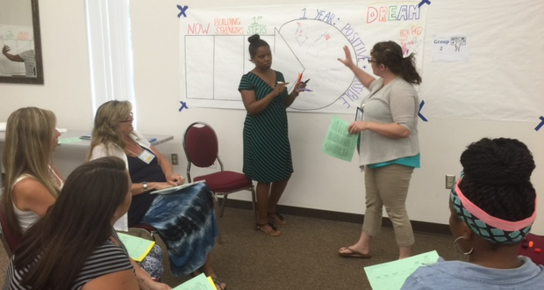
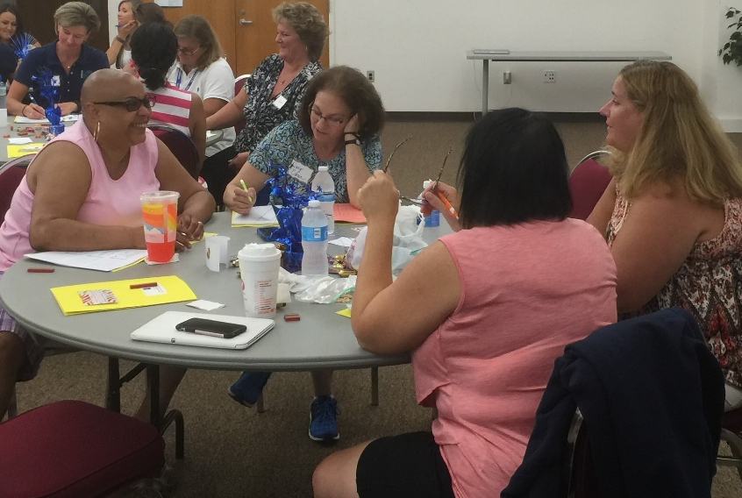
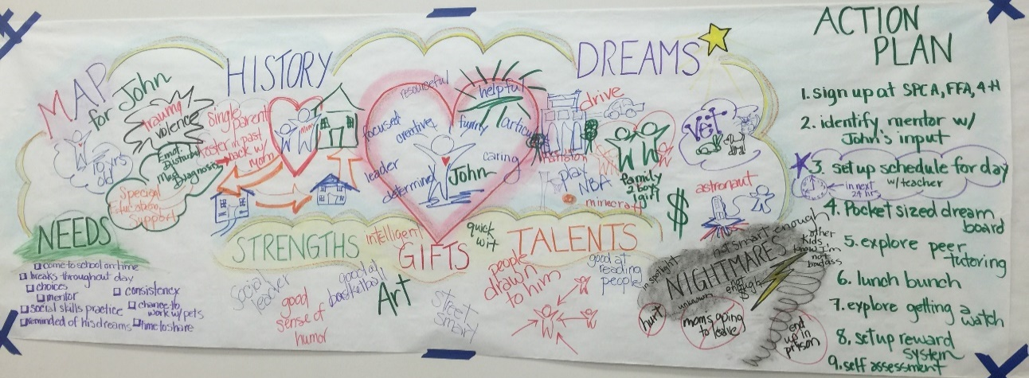
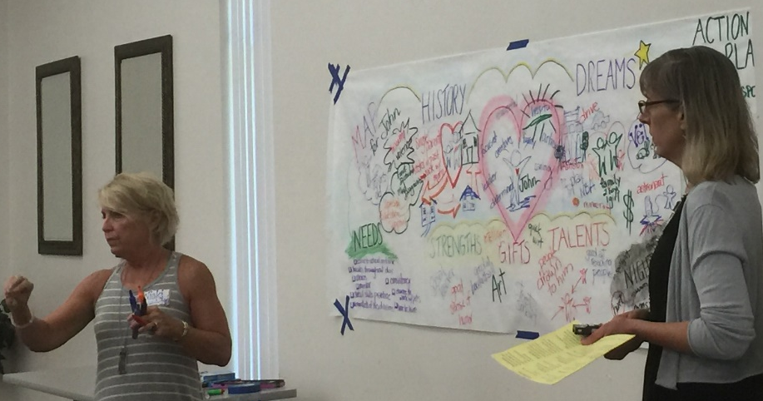
Summer 2016 - Person Centered Planning

Slide 16

Implementation of PEERS in Delaware
Gateway Lab School
Brandywine School District
Seaford School District
Appoquinimink School District
Capital School District
Colonial School District
Cape Henlopen School District
Woodbridge School District
Red Clay School District

Slide 17
PEERS Coaching
Initial Coaching meeting
Fidelity Check of Implementation
Technical Support
Data Collection
Problem Solving
  Scheduling logistics
  Teacher support
  Timing
  Role-Play support
Adaptations for diverse learners
Capacity Building

Slide 18

Addressing Behavioral Concerns of the IEP
Capital
Woodbridge
Brandywine
Colonial
Seaford
Christina
Gateway Lab School
Red Clay
Indian River
Lake Forest
Smyrna (October 2016)
NCCVT (October 2016)

Slide 19
Objectives of the ABCs of IEPs
Review Data Considerations and Other Special Factors
Present Level of Performance and Benchmarks
Making Goals Measurable
Addressing Social Skills
Functional Behavior Assessment and Behavior Support Plans
Collecting Data
Writing Behavioral Goals

Slide 20

ABCs of IEPS Graduates
Colonial
  Wilbur
  Southern
  Wallin
Brandywine
  Mt. Pleasant Elementary

Slide 21
Tier 3: Prevent Teach Reinforce (PTR)
Tier 3: 2 Day Series
The Prevent-Teach-Reinforce (PTR) model is a Tier 3 behavior intervention process. Participants will earn the 5-step, teach/team driven model as well as how to identify the critical components that enhance the success of Tier 3 interventions.
10/4/16 & 1/11/17
9am – 3:30pm

Slide 22
Tier 2 Networking
This session is open to schools that previously participated in the DE-PBS Project Tier 2: Targeted Team Training. Topics and activities include reviewing Tier 2 systems & problem-solving concepts, examining evaluation methods and networking with other implementing teams.
10/18/16
8:30am – 12:00pm

Slide 23
Tier 1: School-wide (SW) PBS
Open to new team members joining existing PBS school teams.
Provides in-depth overview of SWPBS framework components
  Program Development & Evaluation
  Prevention: Implementing SW & CR Systems
  Correcting Problem Behavior
  Developing Self-discipline
11/2/16
9am – 3:30pm

Slide 24
Tier 2: Targeted Team Training
Open to schools with KFE implementation at Proficient or Exemplary
Tier 2 problem-solving team members work to extend current Tier 2 programming for students by establishing a sound system.
Provides an in-depth overview of the recommended features for effective Tier 2 behavior teams, programming, and interventions.
Learn how to identify and secure appropriate Tier 2 interventions that match demonstrated student needs.
11/18/16
9am – 3:30pm

Slide 25
Team Leader PD: 3-part series
The series includes ways to enhance communication with all stakeholders, organize effective team meetings, and use data to make decisions.
Additionally, the series includes sample data collection tools, templates and other resources from the DE-PBS Project to assist team leaders in these areas.

Slide 26

Team Leader Module Series
Timeline for 2016-2017
Fall 2016- Session One Released (now available)
Winter 2016- Session Two to be Released
Spring 2017- Session Three to be Released

Slide 27
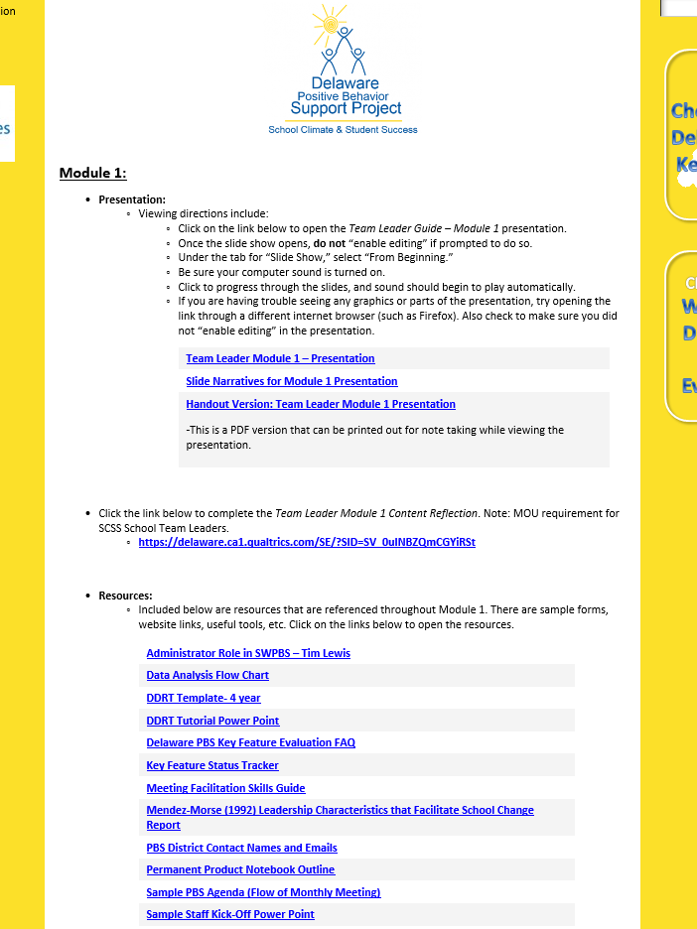
SCSS Modules:
Team Leader Series

Slide 28


Effective Leadership
From: Méndez-Morse, S. (1992). Leadership characteristics that facilitate school change. Austin, TX: Southwest Educational Development Laboratory.
[There are] “two dimensions considered necessary for effective leadership — initiating structure, which is primarily concern for organizational tasks, and consideration, which is the concern for individuals and the interpersonal relations between them.”
“Leaders of educational change illustrate this with their vision and belief that the purpose of schools is students' learning.”

Slide 29
Why are we here?
To develop and enhance skills in the areas of Communication and Organization
To provide resources, forms, and information to assist with these skill areas
To develop a network of Team Leaders throughout the state

Slide 30
Communication:
Why is this important?
A strong communication structure can promote buy-in from administration and staff, students, parents, and community members.
Communication skills are infused through all aspect of team leadership.

Slide 31
…leads to Communication
Organization in…
School-wide PBS Team Materials
Scheduled Monthly Meetings / Data Analysis
Professional Development Opportunities
Working with Administration
District Coach Contact
Staff and Student Kick-Offs
Data (Semi-Annually and Annually)

Slide 32
…leads to Communication
Organization in…
School-wide PBS Team Materials
Scheduled Monthly Meetings / Data Analysis
Professional Development Opportunities
Working with Administration
District Coach Contact
Staff and Student Kick-Offs
Data (Semi-Annually and Annually)

Slide 33
Scheduled Monthly Meetings
 | Before Meeting | During Meeting | After Meeting
Organization | Establish a meeting schedule Get Big 5 Data for sharing (from system or data sub-committee) Review action items from last mtg. to discuss | Have template for notetaking Utilize sub-committees for specific initiatives | Make sure Action Plan is updated Add materials to Permanent and Working note(s)
Communication | Create and send out agenda SW Reach out to administration to attend meeting Send reminders to sub-committee if they need to present | Ask for team members to take team roles Maintain meeting norms/ground rules | Share teacher PD needs with school leadership/district coach Share mtg. details with administration, colleagues and district coach

Slide 34

Click to complete
Team Leader Module 1
Content Reflection. https://delaware.ca1.qualtrics.com/SE/?SID=SV_0uINBZQmCGYiRSt
Note: MOU requirement for SCSS School Team Leaders.
Questions?
Email us at:
  Melissa Ebling mebling@udel.edu
  Sarah Hearn skhearn@udel.edu
  Megan Pell mpell@udel.edu

Slide 35
Building Buy-in
School-wide PBS Team Training Content Sample

Slide 36
Importance of Buy In
Anecdotal information indicates that 80% buy-in from staff is critical to successful implementation
You need buy-in to impact School-wide climate
  Not just hallway climate
Lack of staff buy in due to negative beliefs is a frequently reported barrier to implementation

Slide 37


What is “buy in”
What would it look like if staff bought in to PBS?

Slide 38
Defining “buy in”
Staff are familiar with PBS philosophy and concepts:
  Majority of staff members can summarize the basic concepts of SW-PBS
  Majority staff of know the SW expectations
  Overall commitment to supporting all students
Staff participate in:
  Teaching and acknowledging SW expectations
  Ongoing training opportunities
  Implementation of secondary and tertiary supports

Slide 39

Start with Staff Input about the need
Is there a problem with current school climate and/or student behavior?
  AKA: How is business as usual working for you?
What is the solution? Do staff see PBS as part of the solution?

Slide 40
Ideas for Buy-In
Policy/Management
Training
Data and Research
Drop the PBS language
  Culturally relevant terminology
PBS for everyone
Student involvement
Start small -- target 1-2 areas in need of intervention that effects all staff
Adapted from Jessica Swain-Bradway, Ph.D.
Illinois PBIS Network

Slide 41
Systems First
Build systems to support teacher behaviors FIRST!
  Communication system
    Feedback loop
  Create team & prioritize meetings
    Strong administrative presence, involvement
  Policy review & trainings
    Do your policies make teacher work harder? Easier?
  Data sharing

Slide 42

Management / Policy
District Policy
Administrative leadership
  Active
  Prioritize PBS on meeting minutes, school-wide communication, in daily practices
School policies reflect PBS
  Student and faculty handbook
  Disciplinary consequences

Slide 43
Policy & Implementation Commitment
School Improvement Plan includes school-wide efforts to improve school climate and increase positive behaviors among all students.
  Include measurable goals and objectives
  Uses Data such as School Climate Data & ODR Data
The components of School-wide DE-PBS are implemented with all students (all grades, classrooms, with and without disabilities, etc.)

Slide 44
Training for Staff
Explicit training:
  What is PBS and, What do I have to do?
Frequent training:
  Introductory, Boosters, Need specific topics,
Small group training
  Small Learning Communities, Content area meetings, Workshops for new teachers, substitute teachers
Embedded training: showing PBS alignment with other school initiatives

Slide 45
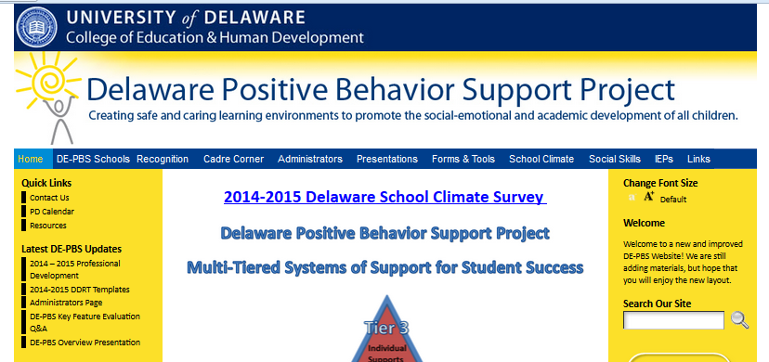
Providing Staff Overview: Resources
  Delaware PBS Project
    Delawarepbs.org
Overview presentation template available here
Technical Assistance Center on Positive Behavioral Interventions and Support
  http://www.pbis.org/

Slide 46
Training, EXAMPLES
“Repeated teacher trainings on what behaviors constituted an office referral and how to complete the referrals contributed to consistency in the use of the forms and reduced inappropriate referrals.”
“All teachers attended secondary level training geared toward PBS in the classroom. Behavior management was linked to instructional success.”

Slide 47
Training, EXAMPLES
“To address teacher buy-in, teachers that are identified as “resisting” PBS are invited to join the PBS team. Ongoing training and information is also provided to teachers to foster buy-in.”
“We change the types of PBS work groups each year, all faculty and staff are asked to participate on one group per year – their choice”.

Slide 48
It is more than training, provide ongoing communication
Twice-monthly / monthly emails
Include in newsletters
  Teachers
  Community
“PBS minute” on morning announcements
“PBS minute” at weekly department / academic meetings
PBS updates at each staff meeting
Communication coordinator / work group

Slide 49
Communication Loop for Staff
Communication is two way
System for staff feedback:
  Surveys (on-line, paper pencil, secret ballots)
  Q & A section at staff meetings
  Grade level or PLC meetings and voting

Slide 50
DATA…so many uses ☺
Use data to:
  Present the extent of “problems”
    EX: 55% of our referrals are for latenesses
  Pinpoint areas of focus
    EX: Most latenesses happen on Mondays and Fridays
  Show improvements
    EX: Since focusing on “Responsible” on-time behaviors we’ve seen a 13% decrease in latenesses.
  Validate teacher concerns
  Shape expectations, acknowledgments, roll-out and booster activities

Slide 51
DATA, Validation station…
Validate teacher concerns by identifying specific problem behaviors through data review:
  ODRs, attendance, grades, state testing, graduation rates, student and staff surveys
Data to create action plan.
  PBS may roll-out may work differently at your school depending on your school needs

Slide 52
Data Sources
  Office Discipline Referral Summaries
  School Climate Data Results
  Attendance Data
  DE Strengths and Needs Assessment

Slide 53
Data, Specific surveys
Get staff feedback on:
  School-wide expectations
  Acknowledgements
  Policies
  Data
  Concerns
  Celebrations

Slide 54
Research Examples for Buy-In
The interaction between problem behavior and academics reaches a critical mass in high school (Morrison et al., 2001, Nelson, Benner, Lane, & Smith, 2004).
“50% of problem behaviors resulting in discipline referrals occur in non-classroom settings (ie. Hallway, cafeteria)” (Nelson, Smith, Colvin, 1995).
“teachers were trained using precorrection, reinforcement (catch them being goods) for appropriate behaviors, and active supervision … resulted in a 42% reduction in problem behaviors” (Oswald et al., 2005).

Slide 55
PBS the PBS-ers
Build on what is already in place:
  Find components of PBS already at work in classrooms and reinforce teacher behaviors.
Team members, talk the talk and walk the walk:
Explicit expectations for teacher behaviors
  Teach
    Model, lead, test
  Check for understanding
  Repeated opportunities to practice correctly
Reinforce
    Recognition for staff behaviors
    Rewards for staff behaviors

Slide 56
PBS for staff, examples:
“Faculty members are eligible for regular raffle drawings for a variety of prizes. Administration also gives “Shout-outs” and “Thank-you Cards” to acknowledge positive staff behavior.”
“Our PRIDE cards are perforated, student names on one half teachers on the other. If a student gets pulled for a reward the teacher who wrote the positive referral also gets a reward. Teachers love it!”
“At staff meetings, teachers are invited to share examples of how our STAR rewards work in the classroom- we share ideas and feel good about our efforts!”

Slide 57
More PBS for staff
STAFF REWARDS:
  PBS parking spot
  Administrator teaches class / takes duty
  Subs for a sub
  Leave school early on a Friday
  Student assistant for a period
  Coffee card
  PBS fridge in the teachers’ lounge

Slide 58

Student Buy-In through
Student Involvement
As early as elementary level, include older students in program implementation
Secondary schools: utilize students on the team, or form a PBS Student Team
Include students that represent all students (consider athletes, academics, student government, uninvolved, kids with referrals)
Use students in teaching lessons, peer-mentoring around PBS, reinforcer ideas, etc.

Slide 59
DDOE Updates

Slide 60
OSEP Dear Colleague Letter on Behavior
IDEA's procedural requirements regarding evaluations, eligibility determinations, Individualized Educational Programs (IEPs), and behavioral supports;
IDEA's IEP content requirements related to behavioral supports;
Circumstances that may indicate potential denials of FAPE (Free and Appropriate Public Education) or of placement in the LRE (Least Restrictive Environment);
Implications for short-term disciplinary removals and other exclusionary disciplinary measures;
Conclusion, including additional information for parents and stakeholders.

Slide 61
Significant Disproportionality
September 27, 2016
PBS Cadre Meeting

Slide 62
Significant Disproportionality
In March 2016, U.S. ED released a Notice of Proposed Rule Making (NPRM) for significant disproportionality.
The NPRM proposes some changes to how states calculate and identify significant disproportionality as well as some changes to coordinated early intervening services (CEIS).
The DDOE has put together a stakeholder group to review the NPRM and make recommendations for Delaware.

Slide 63
What’s coming?
Current
State chosen methodology
State chosen threshold
Number of years of data used
Identified LEAs required to review policies, practices, and procedures
CEIS funds only spent on K-12 non-CWD
Uses 618 data and membership data
Proposed
Common methodology
State chosen threshold
Number of years of data used, up to three years
Identified LEAs required to review policies, practices, and procedures and factors that contribute to significant disp.
CEIS funds can be spent on CWD (ages 3-21) in addition to non-CWD
Uses 618 data and membership data
Stakeholder involvement in
Discretion for those making reasonable progress

Slide 64
Significant Disproportionality
Determine whether significant disproportionality based on race/ethnicity is occurring with respect to:
20 U.S.C. 1418(d) and 34 CFR §300.646
The identification of children as children with disabilities, including identification as children with particular impairments;
The placement of children in particular educational settings;
The incidence, duration, and type of disciplinary actions, including suspensions and expulsions.

Slide 65

Significant Disproportionality
Identification
All disabilities and
Six disability categories:
Intellectual Disability
Specific Learning Disabilities
Emotional Disturbance
Speech or Language Impairments
Other Health Impairments
Autism

Slide 66

Significant Disproportionality
Placement
Children who received educational and related services in the regular class no more than 79 percent of the day and no less than 40 percent of the day
Children who received special education and related services in the regular class for less than 40 percent of the day
Children who received special education and related services in separate schools and residential facilities

Slide 67

Significant Disproportionality
Disciplinary Actions: Must consider all three areas (incidence, duration, type)
For example:
Number of out-of-school suspensions/ expulsions of 10 days or less
Number of out-of-school suspensions (including expulsions) of greater than 10 days
Number of in-school suspensions of 10 days or less
Number of in-school suspensions of greater than 10 days
Total number of disciplinary removals

Slide 68
Significant Disproportionality
Analyze data for:
Students ages 6-21 with disabilities for identification and placement, ages 3-21 for discipline;
All seven racial/ethnic groups.
Do not consider underrepresentation.
Report state’s definition of significant disproportionality as part of SSS-IDEA metadata survey.

Slide 69
Significant Disproportionality
States can choose:
Calculation methodology;
Definition of significant disproportionality;
Minimum cell size requirements;
To use multiple years of data.

Slide 70
Indicator 4A & 4B
Rates of Suspension & Expulsion
Identification of Significant Discrepancy
PBS Cadre – September 27, 2016
Tracy Neugebauer

Slide 71
Rates of Suspension and Expulsion
A. Percent of Local Education Agencies (LEAs) identified by the State
  as having a significant discrepancy in the
  rates of suspensions and expulsions of
  children with disabilities for greater than
  10 days in the school year.
B. Percent of LEAs identified by the State
  as having a significant discrepancy in the
  rates of suspensions and expulsions for
  greater than 10 days in a school year of
  children with disabilities by race and
  ethnicity.

Slide 72
Significant Discrepancy Definition
Rate Ratio Method
  An LEA has a significant discrepancy when the rate of long term suspension/ expulsions for students with disabilities compared to the rate for students without disabilities is greater than the “state bar.”

Slide 73
Significant Discrepancy Definition
Rate Ratio Method
Setting the Bar
Calculated for State suspension rates
Informs decision to set “bar”
Compared to LEA rates to identify significant discrepancy
Propose that “bar” will be reduced each year from initial bar
Please note – not a floating bar – one that changes yearly based on LEA rates

Slide 74
4 A Trend Data
Year | Total Number of Districts | Number of Districts that had Significant Discrepancies | Percent | Rate Ratio
FFY 2012 (using 2011-2012 data) | 39 | 4 | 9.75% | 1.28
FFY 2013 (using 2012-2013 data) | 39 | 1 | 2.56% | 1.26
FFY 2014 (using 2013-2014 data) | 42 | 0 | 0% | 1.24
FFY 2015 (using 2014-2015 data) | 42 | 2 | 4.76% | 1.22

Slide 75
4 B Trend data
Year | Total Number of Districts | Number of Districts that had Significant Discrepancies | Percent | Rate Ratio
FFY 2012 (using 2011-2012 data) | 39 | 4 | 9.75% | 1.28
FFY 2013 (using 2012-2013 data) | 39 | 5 | 12.8% | 1.26
FFY 2014 (using 2013-2014 data) | 42 | 0 | 0% | 1.24
FFY 2015 (using 2014-2015 data) | 42 | 2 | 4.76% | 1.22

Slide 76
Significant Discrepancy
A letter is sent to the district stating the discrepancy
District is asked to conduct a self-assessment
DDOE will review self-assessment to determine whether the district is non-compliant
Corrective Action Plan put in place if non-compliant with one year to correct.

Slide 77
SPP/APR Improvement Activities
Centered around compliance monitoring & technical assistance
Focus of DE-PBS Project
  Increase fidelity of implementation
  Build capacity for Tiered PBS supports
  Provide PD, Technical Assistance, and Progress Monitoring Tools
  Guide use of data for planning & evaluation
    DE Assessment of Strengths and Needs for PBS
    DE PBS Key Feature Evaluation
    DE School Climate Survey – Staff, Students, Home
    Office Referral and Suspension Data
  Collaboration with LEA-based Coaches
  SPDG Initiatives (PTR-PEERS-ABC’s of IEPs)

Slide 78

Questions?
Tracy Neugebauer
tracy.neugebauer@doe.k12.de.us

Slide 79
Coaching

Slide 80
Housekeeping Alert:
Coach contact info
Mailing Address
Email Address
Phone Numbers
  Office
  Cell

Slide 81

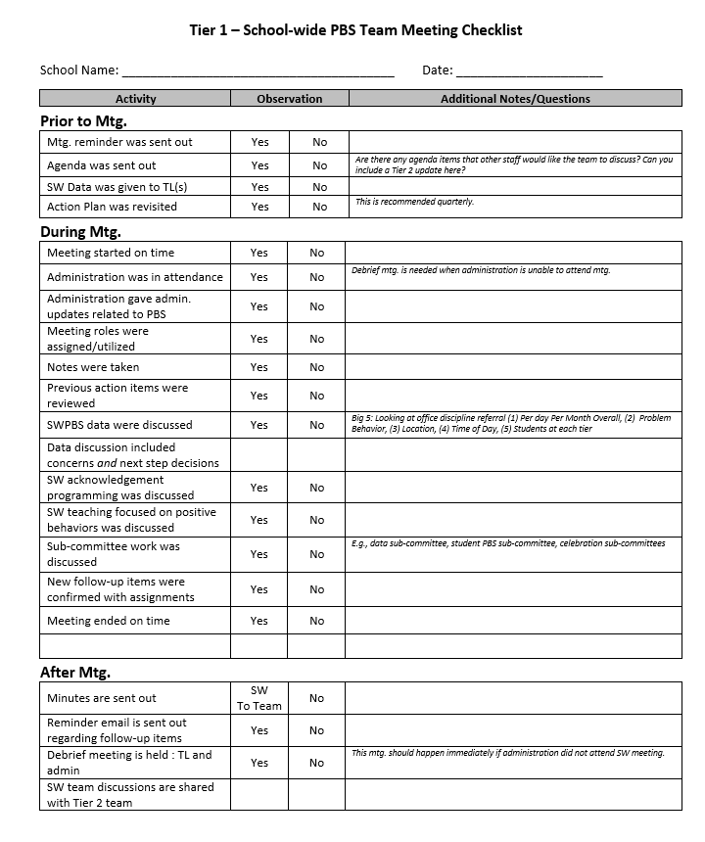
Tier 1 – School-wide PBS Team Meeting Checklist
Use as a coach supporting a team leader
Use as a team leader reflecting on practices
Includes prompts for prior, during and after Tier 1 team meetings

Slide 82

Core Values

Slide 83
Developing a Coaching Vision and Mission Statement
My core values are:
My definition of coaching is:
I coach teams/teachers because:
I know I’m an effective coach when…
I know I did a good job coaching when by the end of a coaching conversation, my client…
I hope that as a result of my coaching, this will be true:

Slide 84
Data

Slide 85
DDRT & DASNPBS
DE Assessment of Strengths and Needs
  10 question survey per implementation area
  Staff perspective on program strength/weakness for use in planning
Discipline Data Reporting Tool (DDRT)
  Template available on website
  Submission 2x per year
    January 13th
    June 23rd

Slide 87
15-16 Statewide Referrals by Student

Slide 88
School Climate Survey 2016-2017
Timeline
Logistics
Enrollment: open through 11/4/16
Survey window:
  Staff: 11/14/16 - 12/16/16
  Student and Home: 1/9/17 - 2/24/17
Results: May 2017
Workshop May 11, 2017
Student, Staff, Home Versions
Paper & Online Options
  Home ONLINE
Survey Contact per school
  Coordinator Checklist

Slide 89
District Level DSCS Reports
Organization:
  Elementary, Middle, High, Other
Presentation of data (average item):
  Conditional formatting used to identify strengths in green & concerns in red
New Calculations (average item):
  Total scores for elementary, middle, high for the district are included for each subscale and total scores
  State average for elementary, middle and high school included as reference point

Slide 90
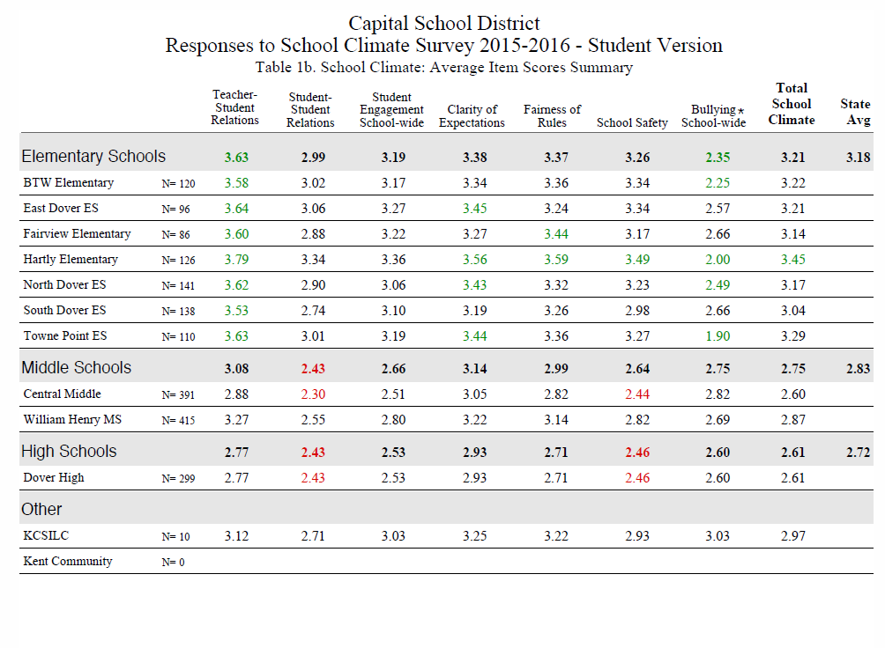

Slide 91

School Climate – 3rd Grade Participation
What we know…
Options to discuss…
Readability at 3rd grade, but not all 3rd graders at that level
3rd grade results are generally more positive
3rd grade - less reliability on some subscales; overall total is reliable
Majority of elementary schools also serve 4-5 grade
Include 3rd graders as optional
Directions/reminders/etc. will state that IF the school chooses to survey 3rd graders, the survey must be read to students at this grade level
Related, if not completing 3rd graders, but previously did, may see decrease in total scores

Slide 92
DE-PBS Key Feature Evaluation

Slide 93
Key Feature Evaluation Process
On-site Evaluation (approx. 3-4 hours)
Sources of Information:
  Interviews with administrator, DE-PBS team leader, teachers/staff, students
  Review of documents
  Schoolwide observations
DE-PBS Key Feature Evaluation Structure
SW PBS Tier 1: Program Development & Evaluation | Prevention: Implementing SW & CR Systems
Correcting Problem Behavior | Developing Self Discipline

Slide 94
Implementation Level Information Distribution & Support
DE-PBS Key Feature Evaluation Scoring Summary
  Overall summary & criteria
  Per section criteria
Narrative report distribution
Determine steps for support
Level | Description
Exploration: | Few elements of implementation
Developing: | Early phase of implementation; some elements adequately in place
Proficient: | Elements in place and implemented
Exemplary: | Implementation shows evidence of innovation and sustainability

Slide 95
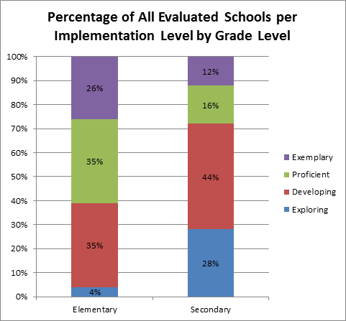
Percentage of Schools by Implementation Level
Elementary vs. Secondary

Slide 96
2016-17 KFE School Visits
New KFEs
  Next cohort of schools not yet evaluated with KFE
  Draft of schools has been shared with coaches
Re-evaluations available by request for recognition

Slide 97
DE-PBS Key Feature Status Tracker
Purpose: To support teams to assess implementation in four main program categories & plan next steps
Broken into four evaluation sections
  SWPBS Tier 1, Prevention, Correcting Problem Behaviors, and Developing Self-Discipline
Tracker includes:
  Key program components for each section
    Teams can use these to assess their program and identify areas to modify or build upon
  Action plan to develop steps towards improving or modifying program components
Can be used for ongoing monitoring

Slide 98

Please mark & protect your calendars for DE-PBS Cadre Meetings on. . .
February 8, 2017
&
April 12, 2017

