Slide 1
Student-Student relationships
Research and recommended interventions
Lead authors: Dr. George Bear and Dr. Lindsey Mantz
University of Delaware
Funding and support from:
DE Positive Behavior Support Project – School Climate & Student Success

Slide 2
Module Structure
Module series goal:
Provide information to schools that can lead to improvements in school climate and behavioral outcomes.
Module narratives provide additional information to accompany PowerPoint Presentation.
Endnotes throughout slides correspond to the references in the module narrative.
Gold star = Resource on Delaware PBS website

Slide 3
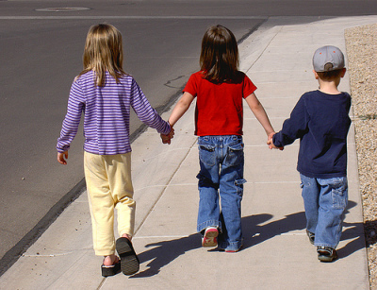
What are Student-student relationships?
Quality of the interactions between students in a school-wide context
Peer acceptance
Social support

Slide 4
Delaware School Climate Survey
On the Delaware School Climate Survey, student-student relationships is captured by items assessing:
students (including those of different races) getting along and
students demonstrating friendliness, caring, and respect toward each other

Slide 5
Why Are Student-Student Relationships Important?
Impact
Mental health & emotional wellbeing
Social & Academic develop-ment
School & Classroom Climate
Buffer life stressors

Slide 6
Impact for Individuals
Students with positive peer relations tend to have:
Higher self-esteem and a more positive self-concept⁴⁻⁵
Greater satisfaction toward school⁶
Greater academic achievement⁷⁻⁸
Greater engagement in school⁹⁻¹³

Slide 7
Impact for Individuals
Students lacking peer acceptance and support from peers tend to experience:
Fewer opportunities to learn social skills & develop healthy friendships¹⁴
More internalizing problems^{4-5, 15-17}
More externalizing problems^{4,15,18}
Drug abuse¹⁹
Bullying from others²⁰⁻²¹
Increased disliking of school or emotional disengagement²²
Greater academic problems, school avoidance, & increased risk of dropping out²³⁻²⁶

Slide 8
Student Characteristics
Student-Student Relationship Contributing Factors
Classroom
Management
&
School-wide
Discipline

Slide 9
Student Characteristics Contributing Factors
Factors contributing to peer acceptance and social support:
Social skills, especially prosocial skills
Being friendly, cooperative, helpful^{8, 28-29}
Strong academic engagement and achievement among younger children ²⁹⁻³⁰
Nonacademic skills such as musical or athletic ability applied in small groups or teams.

Slide 10
Student Characteristics Contributing Factors
Factors contributing to peer rejection^{28, 31-32}
Aggressive, disruptive, noncompliant behaviors
High social withdrawal or shyness
Low academic engagement
Deficits and deficiencies in the social-cognitive and emotional domains
Communication/language deficits
Difficulty with inhibitory control and delay of gratification
**The relations between student characteristics and social rejection often are reciprocal.

Slide 11
Classroom management & school-wide discipline Contributing Factors
Positive student-student relationships exist in classrooms and schools that include:
An authoritative approach: emotional support + structure
Teachers who avoid publically demonstrating a strong liking or disliking toward individual students
Teachers/staff who are responsive to social dynamics and peer group affiliations
Peer acceptance increases in classrooms and schools in which responsiveness and student-centered practices receive major focus^{37,44-45}

Slide 12
Classroom management & school-wide discipline Contributing Factors
Positive student-student relationships exist in classrooms and schools that include:
Opportunities for supervised student interactions
Peer-assisted learning activities
Extra curricular activities
Service learning opportunities

Slide 13
Classroom management & school-wide discipline Contributing Factors
Positive student-student relationships exist in classrooms and schools that include:
Behaviors & norms that support prosocial behavior, academic engagement, and promote caring
Behaviors & norms that oppose antisocial behavior

Slide 14
Examine School Climate Data
Classroom Management & School-wide Discipline
Student-Student Relationship Recommended Strategies
Student-student Relationship Building Activities
Curriculum-based Lessons

Slide 15
Examine School Climate Data Recommended Strategies: Tier 1
Examine data, such as from Delaware School Climate Survey
Are student-student relationships viewed favorably across students, teacher/staff, and parents?
Unfavorable responses would indicate the need for interventions and related staff development.
Look at responses to specific items on surveys (e.g. Student-Student Relationship subscale.
Additional data should be gathered and examined to help determine why.
Share results with focus groups.

Slide 16
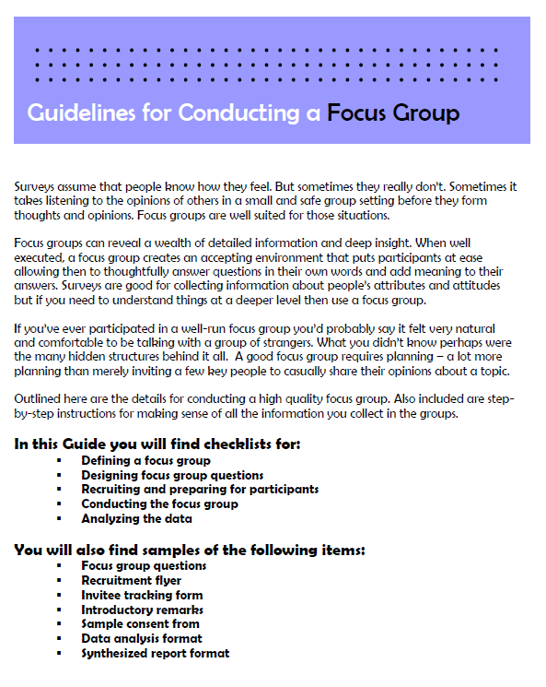
conducting focus groups
Focus group guide
Information on:
Designing questions
Recruiting participants
Conducting the group
Analyzing data
Provides examples
from Duke University (https://assessment.trinity.duke.edu/documents/How_to_Conduct_a_Focus_Group.pdf)

Slide 17
Classroom Management & School-wide Discipline Recommended Strategies: Tier 1
Implement strategies to prevent behavior problems and promote positive student-student relationships
Provide models of behaviors associated with peer acceptance
Use praise and other recognitions strategically
Encourage students to praise and reinforce one another for prosocial behavior
Develop class vision with students
Consistently communicate and highlight social acceptance
School-wide behavioral expectations
Classroom meetings
School-wide activities
Media (newsletter, website)
Strengthen teacher-student relationships

Slide 18
effective praise & rewards
Provides general strategies for effectively praising and rewarding students
Gives specific script examples of what to do or what to say to students
Activity for staff practice also available.

Slide 19
Classroom Management & School-wide Discipline Recommended Strategies: Tier 1
Implement additional strategies for preventing behavior problems
Communicate and collaborate with students’ families
Arrange seating to promote opportunities for positive social interactions and social acceptance
Closely monitor and respond to social dynamics of the classroom and school
Observe peer interactions and affiliations
Avoid encouraging hierarchical peer social networks
Encourage students to talk to teachers, other school staff, and peers about what might be interfering with positive relations

Slide 20
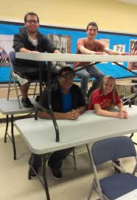
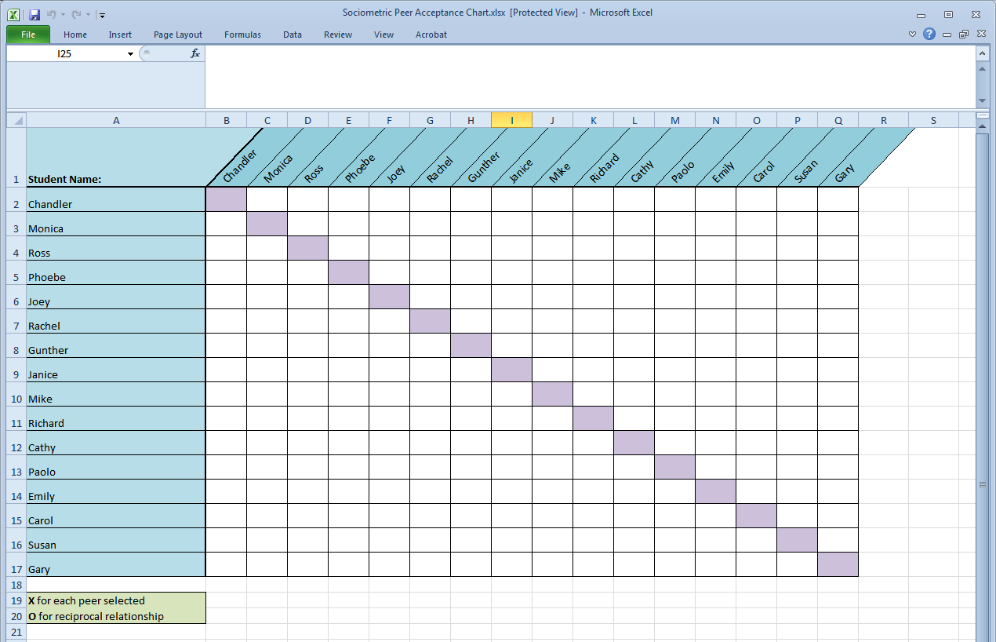
SOCIOMETRIC SEATING TOOL
Excel spreadsheet and instruction guide
Students list 3 peers with whom they would like sit
Track students’ responses in Excel to see who is (and who is not) nominated by one another

Slide 21
Classroom Management & School-wide Discipline Recommended Strategies: Tier 1
When correcting misbehavior, consider how actions taken might impact student-student relationships
Correct privately instead of publicly
Always combine correction with recognition of positive behavior
Teach skills to prevent behavior from reoccurring
Use inductive discipline; communicate impact of behavior on relations with others

Slide 22
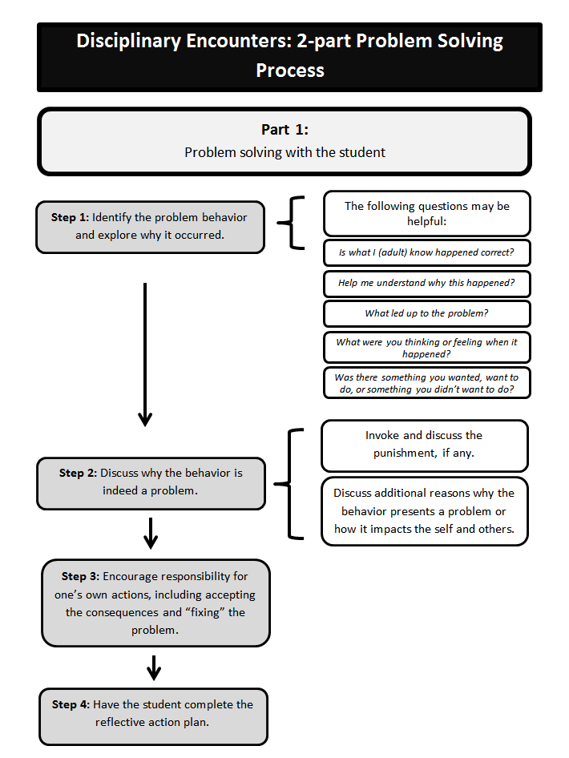
CORRECTING MISBEHAVIOR
Flow chart demonstrating how to:
Problem solve with student
Follow up to support future positive behavior

Slide 23
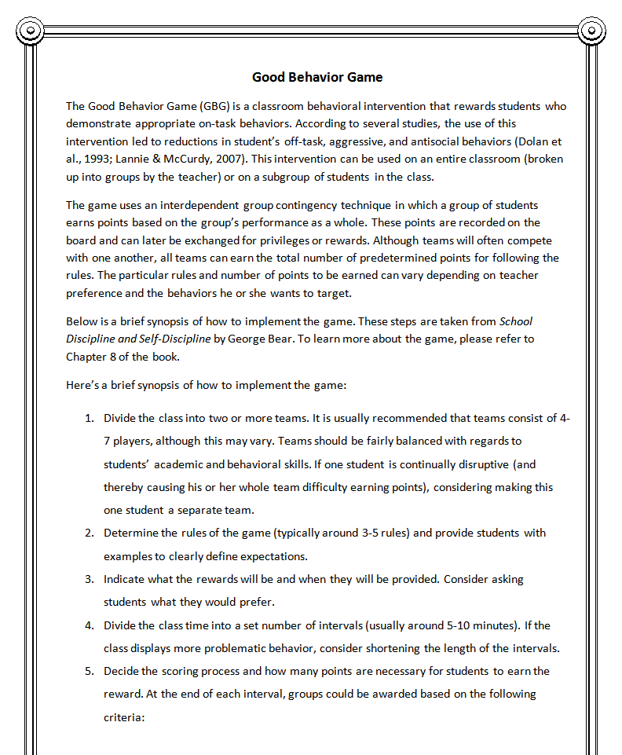
Classroom Management & School-wide Discipline Recommended Strategies: Tier 1
In the classroom, consider
implementing the Good
Behavior Game.
Designed to provide the
frequent monitoring and
reinforcement of targeted behaviors.
Handout that provides
specific steps to
implementing the game.

Slide 24
Relationship Building Activities Recommended Strategies: Tier 1
Provide opportunities for peer-assisted learning
Peer mentoring, buddy systems
Consider whom you group together
Consider grouping students of different races/ethnicities
Encourage students to participate in extracurricular activities and sports
Play games that promote fun and social interactions
Identify and showcase students’ skills and talents to help students to get to know each other
Example: “Yellow Pages” activity

Slide 25
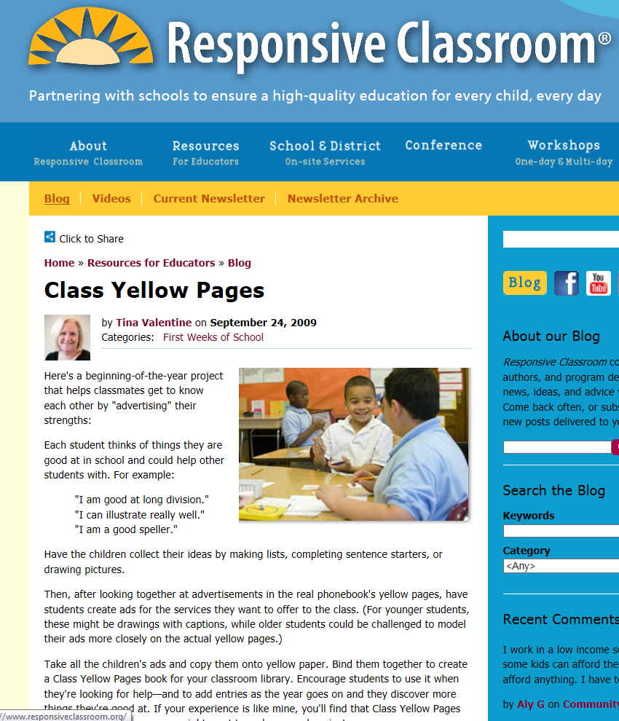
yellow pages activity
Students make advertisements for skills they can offer the class
Advertisements copied on yellow paper and made into book
from Responsive Classroom (https://www.responsiveclassroom.org/blog/class-yellow-pages)

Slide 26
Curriculum-Based Lessons Recommended Strategies: Tier 1
Use multiple opportunities in and outside the classroom to teach lessons on peer relations
Highlight lessons within school subjects
Focus on student-student relationships during “teachable moments”
Highlight and discuss issues pertaining to social relationships in current events
Adopt a packaged SEL curriculum
Lessons on relationship skills
Demonstrated improvement in peer relationships
Ex: PATHS, Second Step, Responsive Classroom

Slide 27
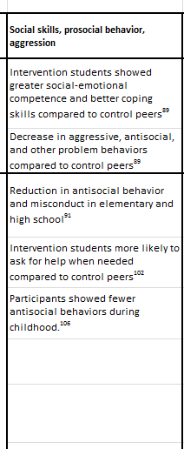
SEL programs
Resource (Excel sheet) provides expected outcomes for various programs by categories (e.g., academics, classroom quality, etc.)
Pay special attention to the “Social Skills, Prosocial Behavior, and Aggression” column.

Slide 28
Recommended Strategies
Students with Tiers 2 & 3 support needs

Slide 29
STUDENTS AT TIER 2 & 3 Recommended Strategies
Apply the strategies already mentioned as appropriate at the universal level and for all students
With greater frequency and intensity
More comprehensive
More individualized
Provide social skills/SEL training related to prosocial skills
Universal or Tiers 2/3
Incredible Years (pre-k – grade 2)
Coping Power (grades 4 – 6)
PEERS (middle and high school)
Where appropriate, develop a behavioral contract

Slide 30
STUDENTS AT TIER 2 & 3 Recommended Strategies
Ensure targeted students have a supportive relationship with at least one other person
Work closely with the home in targeting social and academic skills
Provide more intensive supports
Individual counseling, family therapy, or parent management training, and social services

Slide 31
Making a plan
Who is going to do
what actions by
when?

Slide 32
Thank you
Based on areas of need identified by data, check out other resources provided through the School Climate and Student Success Module Series.
www.delawarepbs.org
Questions can be directed to Sarah Hearn
skhearn@udel.edu

