Slide 1
Teacher-Student Relationships
Research and Recommended Interventions
Lead authors: Dr. George Bear and Dr. Lindsey Mantz
University of Delaware
Funding and support from:
DE Positive Behavior Support Project – School Climate & Student Success

Slide 2
Module Structure
Module series goal:
Provide information to schools that can lead to improvements in school climate and behavioral outcomes.
Module narratives provide additional information to accompany PowerPoint Presentation.
Endnotes throughout slides correspond to the references in the module narrative.
Gold star = Resource on Delaware PBS website

Slide 3
What are Teacher-student relationships?
Quality of the interactions between teachers and students within a classroom and school-wide context
Teacher-student relationships often considered to have three different qualities:
Emotional support
Classroom organization
Instructional support¹
Emotional support is the focus in this presentation

Slide 4
Delaware School Climate Survey
On the Delaware School Climate Survey, teacher-student relationships is captured by items assessing:
Teachers caring about students
Teachers liking students
Teachers listening to students when they have problems
Teachers treating students of all races with respect
Primary focus of this module is student perceptions of teacher-student relationships

Slide 5
Why are teacher-student relationships important?
Impact
Prosocial Behavior & Social Competence
Fewer Externalizing Problems
Greater compliance with teachers

Slide 6
Impact for individuals
Greater peer acceptance and friendships²⁰⁻²³
Greater comfort in seeking help from teachers and other adults in school, such as when being bullied¹⁵
Greater academic achievement^{14, 24-25, 71}
Greater academic initiative and engagement²⁶⁻²⁹
Greater self-esteem, cognitive competence, and internal locus of control³⁰
Greater school satisfaction, liking of school, and school completion³¹⁻³³

Slide 7
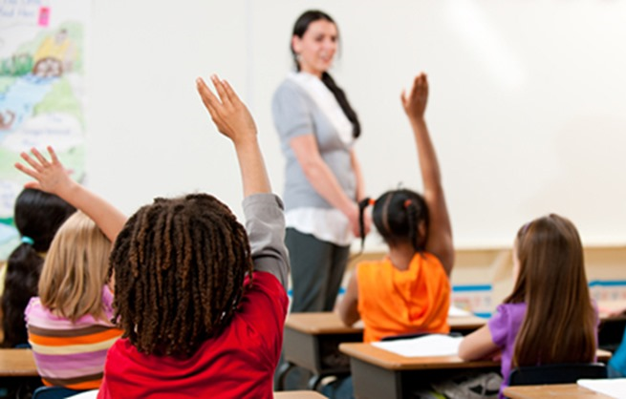
Impact for classroom and school
At classroom and school level, teacher-student relationships influence norms and group behavior
Mostly through classroom management

Slide 8
Student Characteristics
Teacher-Student Relationship Contributing Factors
Classrooms
&
Teachers

Slide 9
Student Characteristics Contributing factors
Students with the following characteristics tend to have less close relationships with teachers:
Frequent antisocial or aggressive behaviors and behavior problems³⁵⁻³⁶
Shy tendencies³⁷
Greater internalizing problems,
such as anxiety and depression¹⁰

Slide 10
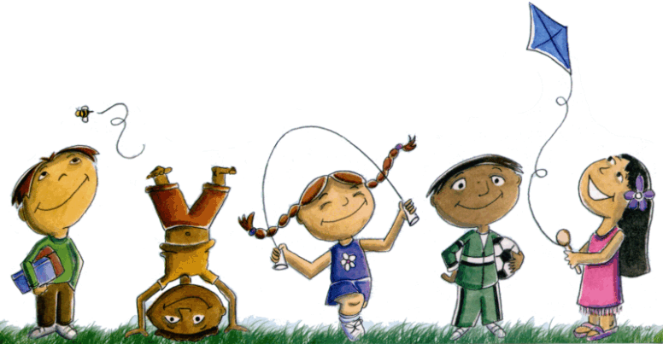
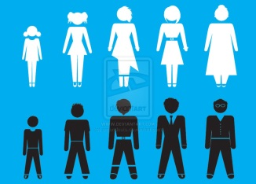
Student characteristics Contributing factors
Although not malleable, student age, gender, and race also are related to teacher-student relationships
Perceptions decrease with age³⁶⁻³⁸
Girls have closer relationships^{1,35}
African-American students tend to view these relationships less favorably³⁶

Slide 11
Classrooms and teachers Contributing factors
Preferred Teachers
Care, guidance, help, attention, and respect
Spend time with students and engage them in their interests
High expectations and well-managed classrooms
Self-efficacy in teaching and classroom management

Slide 12
Classrooms and teachers Contributing factors
Students prefer teachers who:
Use proactive and positive techniques rather than punitive techniques⁴⁹
Make learning fun⁴⁵⁻⁴⁶
Foster student autonomy and self-determination^{46,50}
Communicate often with their families^{36,51}
These same themes emerge in studies of students of various cultures and backgrounds, including studies focusing on African-American and Hispanic students, students who feel alienated, and students living in poverty.⁴⁶

Slide 13
Classrooms and teachers Contributing factors
Teachers who have:
Tend to have more negative relationships with their students
STRESS
DEPRESSIVE
SYMPTOMS
SELF-
EFFICACY

Slide 14
Teacher-Student Relationships Contributing Factors
Recommendations
for Relationship Improvement

Slide 15
Recommended Evidence-Based Strategies and Interventions
Tier 1: designed to be implemented for all students at the school-wide and classroom levels
I. Data to determine needs, strategies and interventions
II. Implement classroom management strategies for prevention of behavior problems and promotion of positive teacher-student relationships
III. Employ strategies and provide opportunities that build and maintain positive teacher-student relationships
IV. Implement an evidence-based SEL curriculum that has been shown to strengthen students’ social-emotional competencies while also fostering positive teacher-student relationships
Tiers 2&3: designed to be implemented with students who have the most difficult time forming positive relationships with teachers.

Slide 16
Data analysis Recommended strategies & Interventions: tier 1
Examine data, such as from Delaware School Climate Survey
Are teacher-student relationships viewed favorably across students, teachers/staff, and parents, and across subgroups within those respondents, including grades (e.g., ninth versus twelfth grade), racial/ethnic groups, and gender?
If an area of need:
Gather and examine more data to determine why these relationships are not viewed positively
Other subscales
Specific items
Share results of the additional data with focus groups

Slide 17
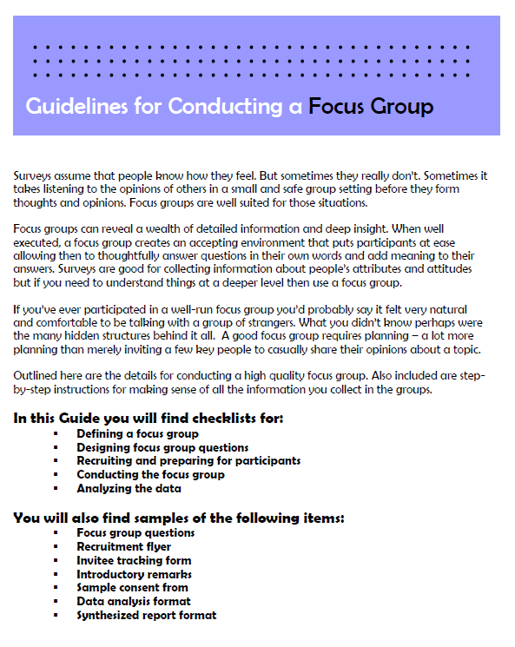
Conducting focus groups
Focus group guide
Information on:
Designing questions
Recruiting participants
Conducting the group
Analyzing data
Provides examples
from Duke University (https://assessment.trinity.duke.edu/documents/How_to_Conduct_a_Focus_Group.pdf)

Slide 18
Classroom management & School-wide discipline recommended strategies
Classroom management strategies
Wise and strategic praise/rewards for prosocial behavior
Model prosocial behavior
Clear expectations, routines, and procedures
Fair rules and consequences
Close monitoring of student behavior
Collaborate with families

Slide 19
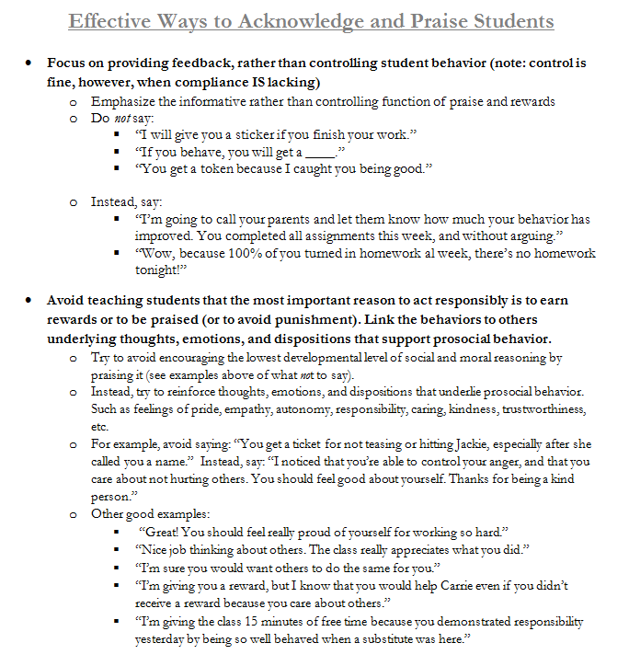
Effective use of praise and acknowledgement
Provides general strategies for effectively praising and rewarding students
Gives specific script examples of what to do or what to say to students
Activity for staff practice also available.

Slide 20
Classroom management & School-wide discipline recommended strategies
Corrective strategies
Correct misbehavior privately, not publicly
Recognize positive behaviors
Emphasize impact of student’s behavior on others
Communicate your dislike for behavior – not student
Communicate shared responsibility
Communicate optimism for future

Slide 21
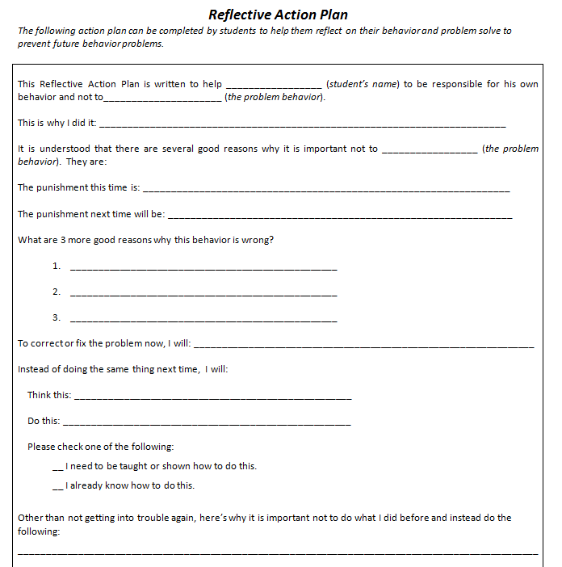
reflective action plan
Plan completed by
students to help them:
Reflect on their
behavior
Problem solve to
prevent future behavior
problems
Courtesy of G. Bear – DE-PBS: Developing Self Discipline Workshop 2011-12

Slide 22
Build relationships with Students recommended strategies
Get to know every student
Spend time individually with students
At least one positive interaction daily
May be more intensive like Banking Time⁴⁷⁻⁵⁶
Greet students every morning
Notice when students have difficulties; listen, show concern
Treat students equally

Slide 23
Banking time
Designed for children in preschool and early elementary grades, but aspects of it would apply to all grades.
Teachers spend individual time with students
Help prevent behavior problems and reduce teacher-student conflict when problem behaviors occur.
From LOOK Consultation
(www.lookconsultation.org/resources/BankingTime-Resource1.pdf)

Slide 24
Build relationships with Students recommended strategies
Communicate your own experiences, thoughts, feelings
Join students for lunch occasionally
Have fun and use humor
Attend sports/extra curricular activities
Reflect upon how well you know your students
Knowing your students activity

Slide 25
Knowing your students activity
Teacher fills in three columns: 1 = students names in class, 2 = something each student likes or is interested in, 3 = note if the student is aware that the teacher knows this about him/her.
Missing information may indicate that teacher needs to spend more time with child, engage in conversation more often, and/or connect with them more.
Adapted from Responsive Classroom (http://www.responsiveclassroom.org/blog/how-well-do-you-know-your-students)

Slide 26
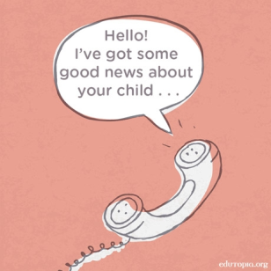
Build relationships with Students recommended strategies
Provide school-wide activities that include teacher and student participation
Advocate for your students
Communicate positive messages about students to their homes

Slide 27
Implement an evidence-based SEL program recommended strategies
Use one that has been shown to strengthen social-emotional competencies and teacher-student relationships
Responsive Classroom
4Rs
RULER
Second Step
See CASEL.org for a list of such
programs, and descriptions of each

Slide 28
Second step
Targets comprehensive SEL skills
Tied to improved social skills and prosocial behavior
Reduces several externalizing and internalizing behaviors related to peer acceptance⁶⁵⁻⁶⁷
From Committee for Children (http://www.cfchildren.org/second-step)

Slide 29
Recommended Strategies
Students with Tier 2 & 3 support needs

Slide 30
STUDENTS AT TIER 2 & 3 Recommended Strategies
Apply the strategies already mentioned as appropriate at the universal level and for all students
With greater frequency and intensity
More comprehensive
More individualized
Provide social skills/SEL training related to prosocial skills
Universal or Tiers 2/3

Slide 31
STUDENTS AT TIER 2 & 3 Recommended Strategies
Collaborate with families
Where appropriate (e.g. Tier 3) develop a behavioral contract
Targeting specific social skills
Consider implementing elements of Check & Connect intervention
Students less likely to drop
out of school⁶⁸
Related to increases in school
engagement⁶⁹

Slide 32
Check and connect intervention
A school staff member regularly assesses the student’s behaviors associated with engagement
The staff member connects with others to implement interventions to increase engagement
Example of monitoring form for teachers and administrators
from University of Minnesota
(http://checkandconnect.umn.edu/resources.html#adminresources )

Slide 33
Making a Plan
Who is going to do
what actions by
when?

Slide 34
Thank you
Based on areas of need identified by data, check out other resources provided through the School Climate and Student Success Module Series.
www.delawarepbs.org
Questions can be directed to Sarah Hearn
skhearn@udel.edu

