Slide 1
HELPING YOUR CHILD IMPROVE Social Skills

Slide 4
Overview
Why are skills for making and keeping friends important?
How can we teach these skills using PEERS?
Walk through Week 1 lesson - Trading information
Walk through Week 6 – Starting and Joining Conversations
PEERS Resources
PEERS groups in Delaware
Friendmaker app
Books
How to be a social coach

Slide 5
WHY do you think we should be teaching adolescents about social skills?
Notes:
Ecologically vaild

Slide 6
Notes:
HC – Defining friends with teens. Social media friends vs intimate friends

Slide 9
Why PEERS for Social Skills?

Slide 10
Why PEERS?
Evidence-Based Social Skills intervention
Skills were developed by looking at what socially successful teens do
Friendship is based on common interests
We find common interests by trading information
Trading information describes good conversation.
Verbal and non-verbal communication

Slide 11
Teaching Methods
Didactic Lessons using specific steps to learn new skill
Ecologically Valid Social Skills
Socratic Method
Use of Buzzwords
Behavior Rehersal Exercises
Coaching with Performance Feedback
Homework Assignments
Role Play Demonstrations
Perspective Taking Questions
Notes:
Pg. 9-10
HC – What part of all this should a parent care about?

Slide 12
Role Plays
Appropriate Example
Inappropriate Example
Use live role plays
Use CD from the Science of Making Friends book
Must be connected to the Perspective Taking Questions!
“What was that like for __________?”
“What do you think _________ thought of me?”
“Is __________ going to want to talk to me again?”
Notes:
Entering Group Conversation (Science of Making Friends) Good and Bad
Importance of Perspective Taking Questions

Slide 13
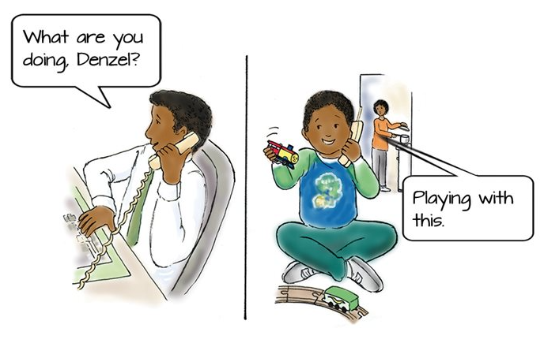
What does denzel think?
http://www.hanen.org/helpful-info/articles/tuning-in-to-others-how-young-children-develop.aspx
Notes:
Denzel doesn’t realize that his dad needs more information to understand what he is talking about. He thinks his dad sees and thinks the same way he does.

Slide 14
Theory of mind or “Tuning in” to others
“The understanding that people don’t share the same thoughts and feelings as you do develops during childhood, and is called theory of mind (Lowry, 2016).”

Slide 15
How theory of mind develops
Infancy and early childhood | Between the ages of 4-5
Learn to pay attention to people and copy them | Understanding “wanting”: different people want different things
Recognize others’ emotions and use words to express them | Understanding “thinking”: different people have different, but potentially true, beliefs about the same things
Know that they are different from other people and have different likes/dislikes from others | Understanding that “seeing leads to knowing”: if you haven’t seen something, you don’t necessarily know about it (like dad on the telephone) and might need more information
Know that people act according to the things they want | Understanding “false belief”: sometimes people believe things that are not true, and they act according to their beliefs
Understand the causes and consequences of emotions (if I throw my toy, mom will be mad) | Understanding “hidden feelings”: people can feel a different emotion from the one they display
Pretend to be like someone else when they play
Notes:
False beliefs example: Imagine you are handed a box of your favourite candy. When you open the box, you see that it is filled with pencils instead of candy. If your friend suddenly came into the room and saw the closed box with pictures of candy on it, what would he or she think was inside? If you answered “candy”, then you understand “false beliefs”, which means you know that someone can believe something that is not true because they don’t share the same knowledge that you do.

Slide 16
Helping children develop theory of mind
Put into words what you are both thinking and feeling when talking with your teen
Follow your teen’s lead – observe their interests and join in play by copying his/her actions and adding ideas
Use “tuning in language” – put your own and your teen’s perspective into words
Role play with your child specific social situations
Use books and/or movies to talk about the characters thoughts and feelings
http://www.hanen.org/helpful-info/articles/tuning-in-to-others-how-young-children-develop.aspx

Slide 17
Perspective taking Questions
“What was that like for __________?”
“What do you think _________ thought of me?”
“Is __________ going to want to talk to me again?”

Slide 19
What makes a good friend?

Slide 20
Characteristics of Good Friendships
Sharing of Common Interests
Caring
Support
Mutual Understanding
Commitment and Loyalty
Honesty and Trust
Equality
Ability to Self-disclose
Conflict Resolution

Slide 21
Didactic lesson: Trading information
The goal of Trading Information is to identify common interests
Rules for Trading Information:
Ask the other person about him or herself
Answer your own questions
Find common interests
Share the conversation
Don’t be a conversation hog
Don’t be an interviewer
Don’t get too personal at first
Notes:
Model this lesson
Show video for trading information

Slide 22
Sample Lesson
Homework Review
Ask about how specific assignments went?
Example: Practice trading information, making a phone call
Have each student share about what they did
Focus on what they did right and not talk about the mistakes
Use prior week buzzwords and concepts
Example: Don’t be an interviewer, Don’t be a conversation hog
Wrap up and share topic for the new week
Notes:
Buzzwords are complex social behaviors that can be identified in a few simple words

Slide 23
Lesson Review and Teen Activity
Have teens list all the steps for the lesson
Be prepared to give prompts as necessary
Teen activity or game which provides opportunities to use social skills

Slide 24
Didactic Lesson: Appropriate use of humor PEERS Week 5
Rules for Appropriate Use of Humor
Be serious when first getting to know someone
Don’t repeat jokes
Humor should be age appropriate
Avoid insult jokes
Avoid dirty jokes
Avoid inside jokes for people who won’t get them
Think about whether it’s the right time to tell jokes
Pay attention to your humor feedback

Slide 25
What is your humor feedback telling you?

Slide 26
Didactic Lesson: Starting and Joining Conversations PEERS Week 6
Steps for Starting Individual Conversations:
1.) Casually look over
2.) Use a prop
3.) Find a common interest
4.) Mention the common interest
5.) Trade information
6.) Assess interest
7.) Introduce yourself

Slide 27
Where can I find a Peers group?
Schools in Delaware
Brandywine School District
Seaford School District
Appoquinimink School District
Capital School District
Colonial School District
Cape Henlopen School District
Woodbridge School District
Red Clay School District
Nemours (A.I. Dupont Hospital for Children)
Delaware Guidance
Autism Delaware (Coming soon!)

Slide 28
Question: What are some of the personal changes you have experienced throughout the school year?
“I have experienced changes of my self-confidence to an extent. I got into sports more and got to know more people. I also learned some new social skills from PEERS. Like how to use humor appropriately, how to handle teasing and most importantly how to make and keep friends….
-HS Student

Slide 29
“At first, we were all a little skeptical about using a scripted curriculum … but as the weeks unfolded we realized just how much the carefully structured, step by step lessons and role plays allowed our students to first learn specific things to do and say and then gave them the time and opportunity to practice these new skills. The ongoing, predictable format of the lessons, role plays, review and homework appeared to decrease the uncomfortableness many students feel when discussing this topic, thus allowing them to build their confidence to interact successfully with their peers.”
Donna H. Carroll
Facilitator, Brandywine School District

Slide 30
Parents role as a social coach
Help your child find the right social group
Remind them friendship is a choice
Organize activities to practice the skills
Direct them back to the skills in the curriculum or on the app
Use the buzzwords and specific language from the curriculum
Don’t tell your teen he or she did something wrong, offer suggestion that start with “How about if...”
Example: How about if next time you are trading information you ask your friend what she likes to do?
Notes:
HC – It would be good to add some tips on when and how to give feedback to their tween / teen. How to broach the subject of skill deficits.

Slide 31
Notes:
HC – Do you have several copies of PEERS and this to show parents?

Slide 32
FriendMaker app

Slide 33
PEERS Contacts
Delaware Department of Education
Tracy Neugabauer
Tracy.Neugabauer@doe.k12.de.us
Delaware Positive Behavior Support Project
Debby Boyer
dboyer@udel.edu
Susan Veenema
susanv@udel.edu
Parent Information Center Delaware
www.picofdel.org
302-999-7394

