Slide 1

Social thinking for elementary students

Slide 2
Topics:
Perspective taking and using “talking” and “thinking” bubbles with your child
Social Stories for teaching social skills
How to “process” social misunderstandings with your child
Resources for finding social/emotional children’s books
Ideas to teach your child about emotions/feelings

Slide 3
What do you mean by “good social skills?”
“Having good social skills simply means people share space with others effectively.”
or
Adapting to others effectively across settings
                (Winner, 2008)

Slide 4
Examples of social skills
Following unwritten social rules of the environment
Sharing space with others
Thinking about others in the shared environment
Learning to regulate one’s own behavior to other people’s thoughts or expectations
Learning to adjust behavior depending on a situation
(Winner, 2008)
Notes:
Power Word: regulate-modify/changing

Slide 5

Myth Busters
Students with social challenges and especially those on the autism spectrum don’t really care about forming relationships. They really don’t want friends.

Slide 6
The reality is…
Students with social challenges:
  Don’t understand HOW to develop relationships
  Have difficulties recognizing expectations
  Struggle with personal problem solving
  Are unaware that others do not share their same thoughts and feelings
  Benefit from direct, step by step teaching and modeling with many opportunities to practice

Slide 7
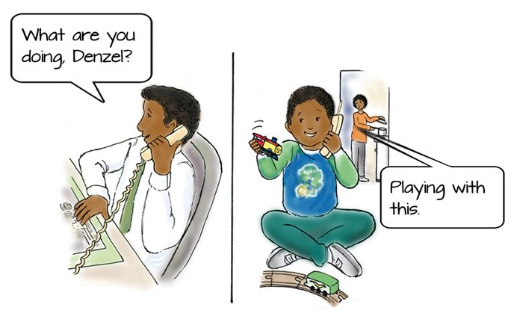
What does denzel think?
http://www.hanen.org/helpful-info/articles/tuning-in-to-others-how-young-children-develop.aspx
Notes:
Denzel doesn’t realize that his dad needs more information to understand what he is talking about. He thinks his dad sees and thinks the same way he does.

Slide 8
Theory of mind or “Tuning in” to others
“The understanding that people don’t share the same thoughts and feelings as you do develops during childhood, and is called theory of mind (Lowry, 2016).”

Slide 9
How theory of mind develops
Infancy and early childhood | Between the ages of 4-5
Learn to pay attention to people and copy them | Understanding “wanting”: different people want different things
Recognize others’ emotions and use words to express them | Understanding “thinking”: different people have different, but potentially true, beliefs about the same things
Know that they are different from other people and have different likes/dislikes from others | Understanding that “seeing leads to knowing”: if you haven’t seen something, you don’t necessarily know about it (like dad on the telephone) and might need more information
Know that people act according to the things they want | Understanding “false belief”: sometimes people believe things that are not true, and they act according to their beliefs
Understand the causes and consequences of emotions (if I throw my toy, mom will be mad) | Understanding “hidden feelings”: people can feel a different emotion from the one they display
Pretend to be like someone else when they play
Notes:
False beliefs example: Imagine you are handed a box of your favourite candy. When you open the box, you see that it is filled with pencils instead of candy. If your friend suddenly came into the room and saw the closed box with pictures of candy on it, what would he or she think was inside? If you answered “candy”, then you understand “false beliefs”, which means you know that someone can believe something that is not true because they don’t share the same knowledge that you do.

Slide 10
Helping children develop theory of mind
Put into words what you are both thinking and feeling when talking with your child
Follow your child’s lead – observe their interests and join in play by copying his/her actions and adding ideas
Use “tuning in language” – put your own and your child’s perspective into words (“I see that you are smiling and happy, you must really like your present!”)
Role play with your child when you pretend together – role play helps children to think about and act out other peoples’ perspectives
Use books to talk about the characters thoughts and feelings
http://www.hanen.org/helpful-info/articles/tuning-in-to-others-how-young-children-develop.aspx

Slide 11
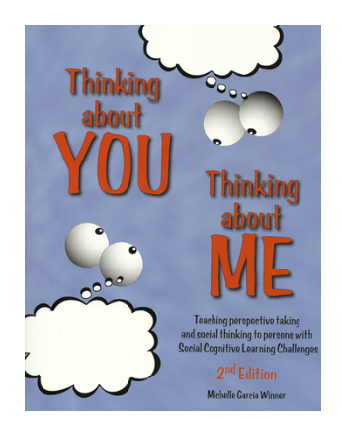
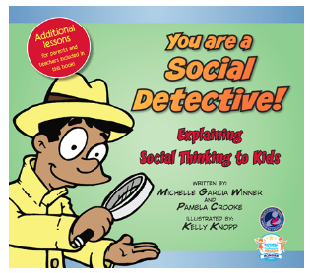

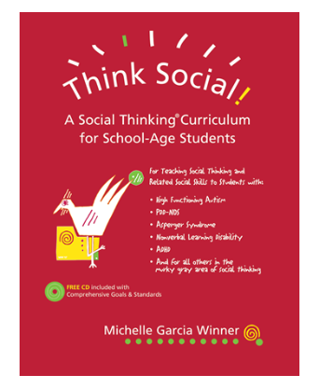

Our Lens… social thinking

Slide 12
Social thinking
Rather than teach children a set of social codes, actions, and patterns of response… social thinking involves teaching students about the thinking process itself and how thinking affects behavior (Winner, 2008)

Slide 13
Intervention for kids with poor social skills, requires teaching more than social skills…
Social Thinking vs. Social Skills
The process of figuring out what another person is thinking or feeling
Set of socially acceptable behaviors that help us share space with others
The Why
The How

Slide 14
Where do we start?
Teach the 4 steps of perspective taking (or being part of a group)
Step One:
As soon as two people share a common space, they have a small thought about each other.
Step Two:
As soon as they have a thought about each other, they consider the intention of the other person(s) in that space. Why is that person near me? What do they want from me?
Step Three:
Each person considers what the other may be thinking about them, using their own thoughts as framework.
Step Four:
The communication partners each monitor and possibly modify their own behavior to keep people thinking about them the way that they want people to think about them.
But what is a thought?
(Winner, 2008)

Slide 15
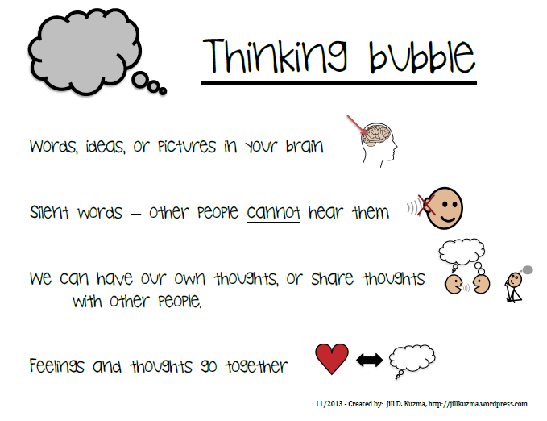
http://jillkuzma.files.wordpress.com/2014/01/talk-think-bubbles-new.pdf

Slide 16
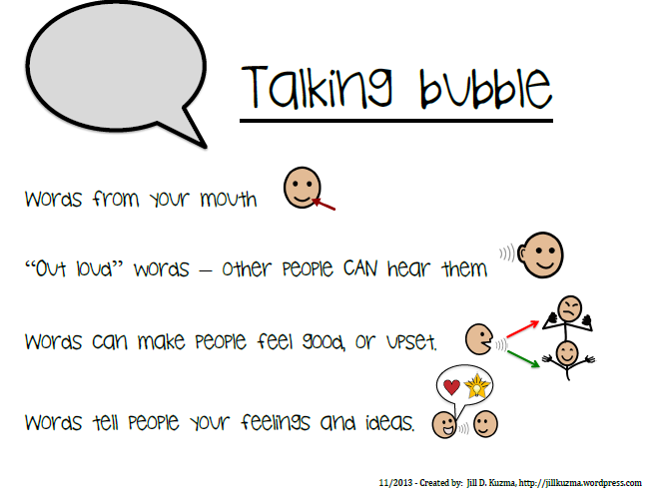
http://jillkuzma.files.wordpress.com/2014/01/talk-think-bubbles-new.pdf

Slide 17

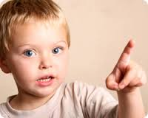
Teaching Ideas: Thought & Talk
We have a picture, words, or an idea in our thinking bubble.
Other people don’t know what is in our thinking bubble
So, we need to pop our thinking bubble, so our words can fall down into a talking bubble. Then, other people can hear our words and ideas.

Slide 18
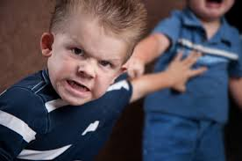
Teaching Ideas: Thought & Talk
“Use your Words…”
Child having a tantrum, hitting, throwing a item… prompt them with a visual cue of a talking bubble.
Teaching Point: Grown-ups don’t know what you want in your thinking bubble. You have to make a talking bubble to tell me what you want.
“Make a Talking Bubble...”
“I don’t know what in is your thinking bubble. Make a talking bubble with your words so I can help you.”

Slide 19

A social story about thoughts
Lily’s Bubbles
More information on social stories later…

Slide 20
“Processing” Social Situations with Your Child
Most social misunderstandings or conflict stem from not understanding another person’s intentions or motivations for doing or saying something.
Many kids learn best with PICTURES. Use pictures with talking bubbles and thinking bubbles to help your child understand a social situation with a sibling, family member, teacher or peer.
This works best when there is a misunderstanding, or your child misinterprets someone’s intentions. (Ex: They were just trying to help you-not take over, They were just teasing you in a friendly way, etc.)

Slide 21
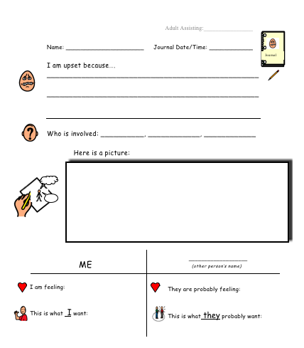
**Processing problems with kids
Notes:
handout

Slide 22

Social stories
“Brief descriptive stories that provide information regarding a social situation.” (CSEFEL, 2017)
Situations are described specific to individuals and circumstances.
Use of images or words to present the situation.
Help children understand social situations and concepts by writing their very own story.
Vanderbilt Kennedy Center

Slide 23
Writing a social story
Story is written in first person from the child’s perspective
Designed to help the child understand the expectations of a situation.
Use reassuring language to answer the who, what, when, where, and why of the situation and/or target behavior
Include descriptive statements (e.g. state the facts) and directive statements (e.g. identify possible responses).
Stories are more descriptive than directive.
New stories should be read frequently and prior to the challenging situation.
Vanderbilt Kennedy Center

Slide 24
Social story topics
What is a mistake
How to open a gift
How to wait in line
Starting a new school
How to greet someone
How to get ready for school
What is sharing
And many more!
See: The New Social Story Book, by Carol Gray for more ideas!

Slide 25
A social story about coming to school
Josalyn can be Happy at School

Slide 26
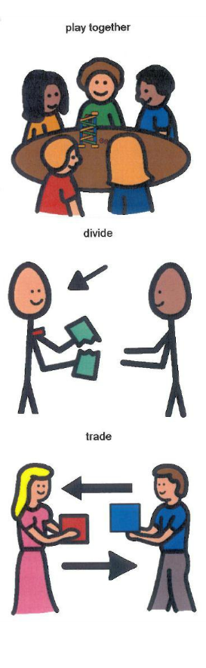
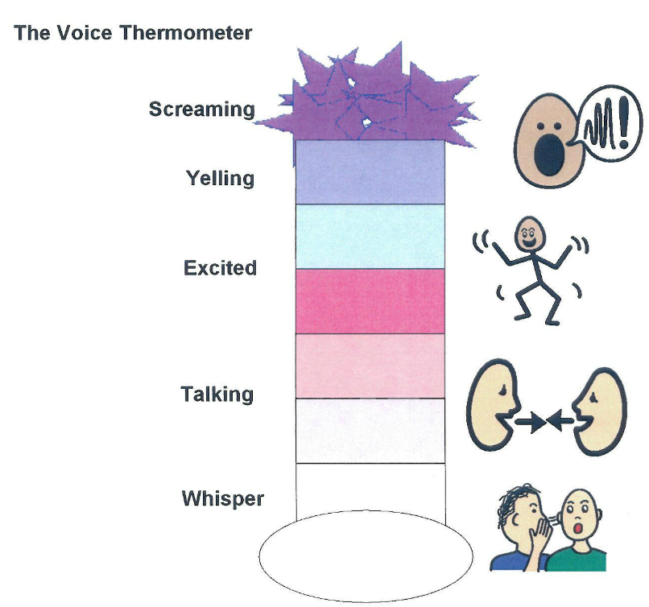

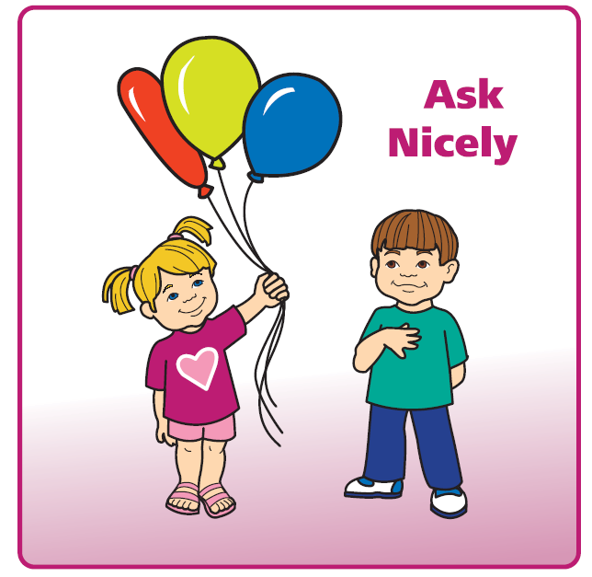
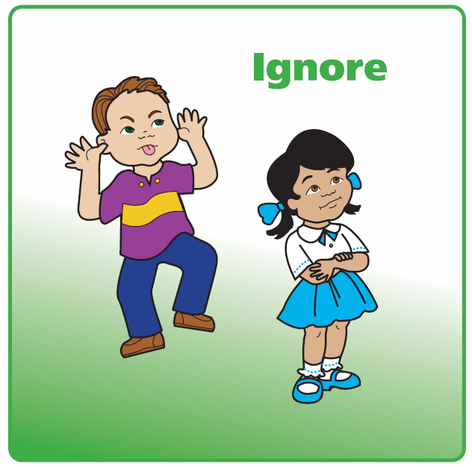
Use visuals to reinforce concepts
Talking can escalate behaviors. Use visuals instead!

Slide 27
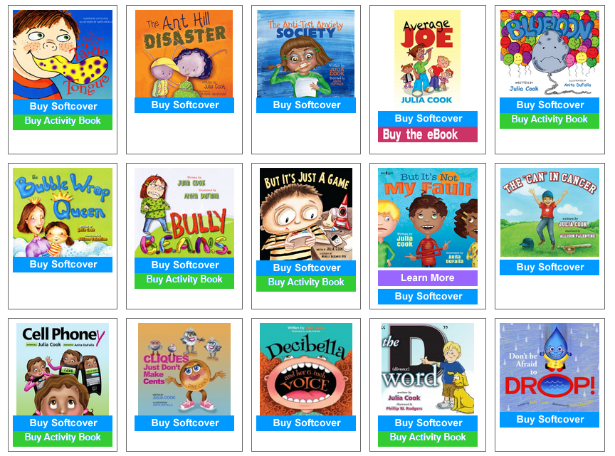
Resources for Social-Emotional Children’s Books
Blog: Books that Heal Kids
http://booksthathealkids.blogspot.com/
Author: Julia Cook
http://www.juliacookonline.com/books/
Like social stories, children’s literature can help explain the expectations of a situation
Notes:
CSEFEL booklist handout

Slide 28
What next?
Teach the 4 steps of perspective taking (or being part of a group)
Step One:
As soon as two people share a common space, they have a small thought about each other.
Step Two:
As soon as they have a thought about each other, they consider the intention of the other person(s) in that space. Why is that person near me? What do they want from me?
Step Three:
Each person considers what the other may be thinking about them, using their own thoughts as framework.
Step Four:
The communication partners each monitor and possibly modify their own behavior to keep people thinking about them the way that they want people to think about them.
(Winner, 2008)
Notes:
Now that we know how to teach about thoughts and ways to explain social expectations to kids using social stories and children’s literature we can continue talking about perspective taking.

Slide 29
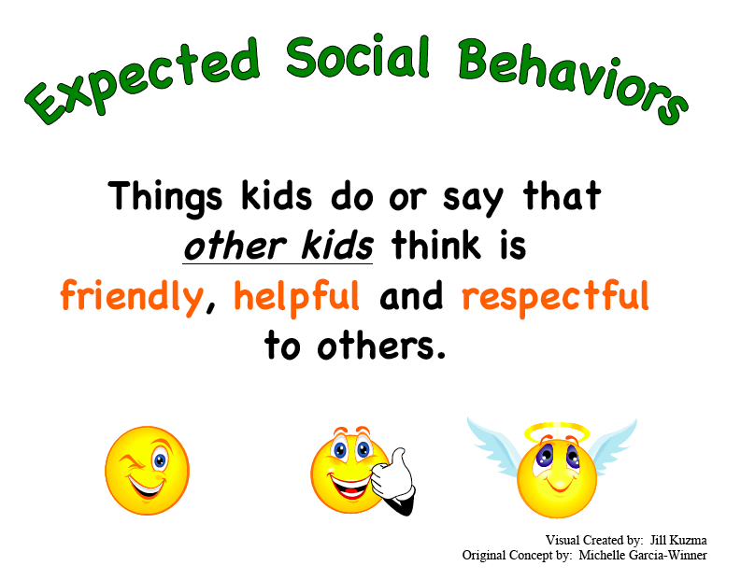
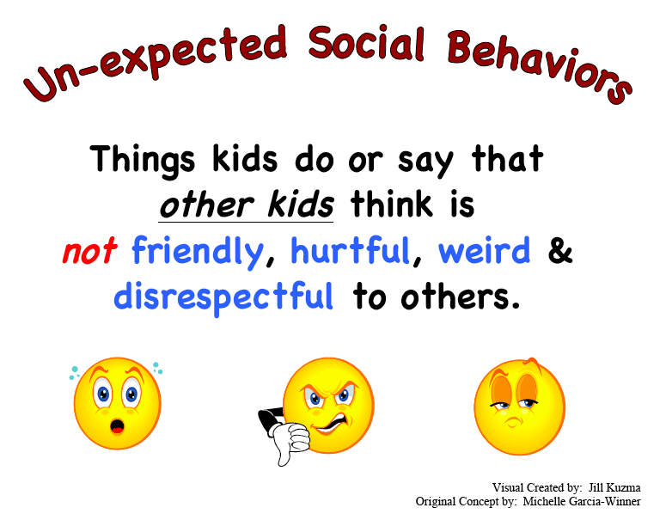
Expected vs. unexpected behavior
Notes:
First, kids have to know what is expected in a given situation. Try this tip at home: Before bringing your child to a new setting or situation, try using the expected vs unexpected behavior language rather than “good” or “bad” behavior.

Slide 30
Social Detective tools
Social detectives use their eyes and ears to figure out what people are thinking, feeling, or planning to do next. When these thoughts combine with what they already know about expected behavior they can figure out how to behave and what other people might do next.
How we teach “Theory of Mind” or Perspective Taking

Slide 31

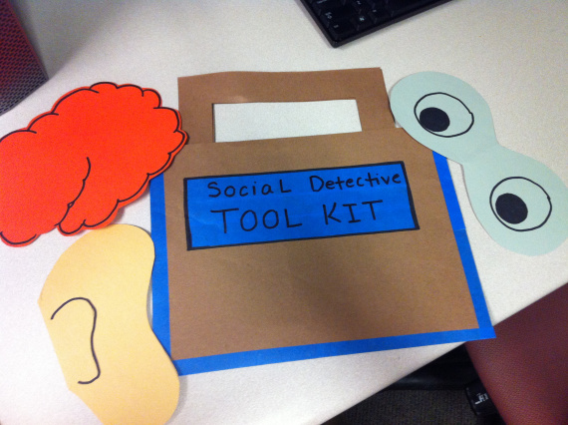
Social Detective Tools
Eyes + Ears + Brain = Expected and What Will Happen Next
Social detectives use their eyes and ears along with what they know in their brains to figure out what is expected and what might happen next!

Slide 32
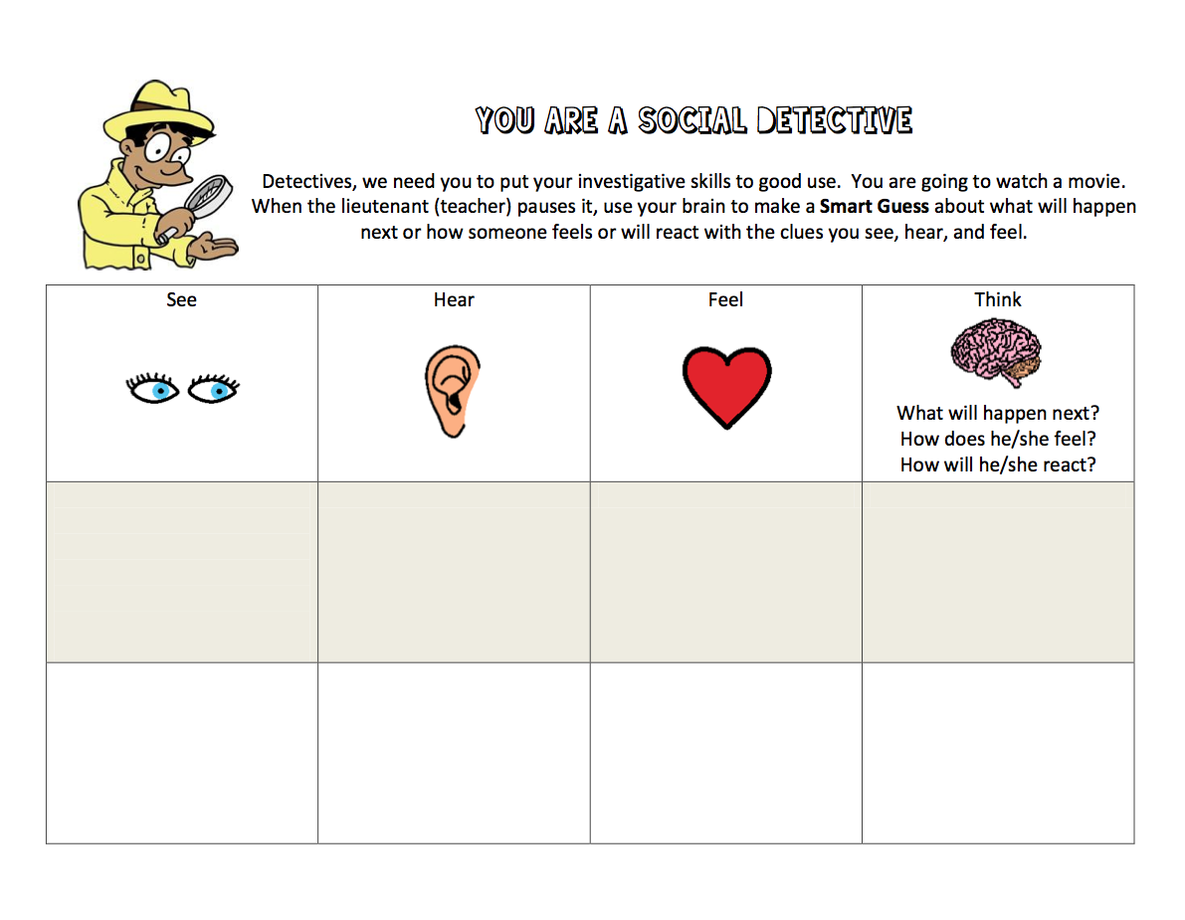
Notes:
You can practice this skill at home, while watching a movie
handout

Slide 33

Social Filter
Our social filter helps us to monitor our behavior so that we can keep others thinking about us the way we want!
Notes:
Now let’s help children understand how to keep people thinking about us the way we want.

Slide 34
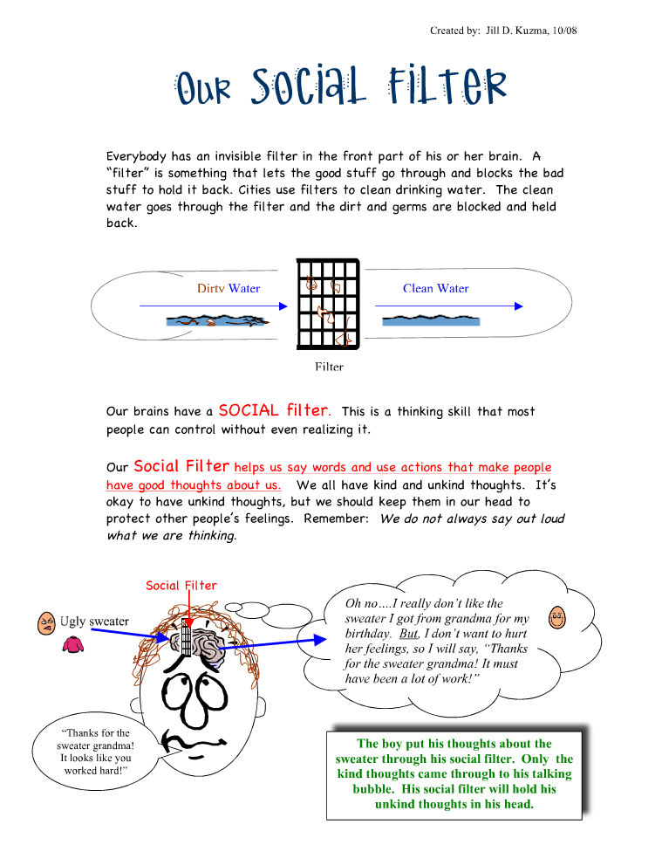
Remember how Theory of Mind develops!

Slide 35
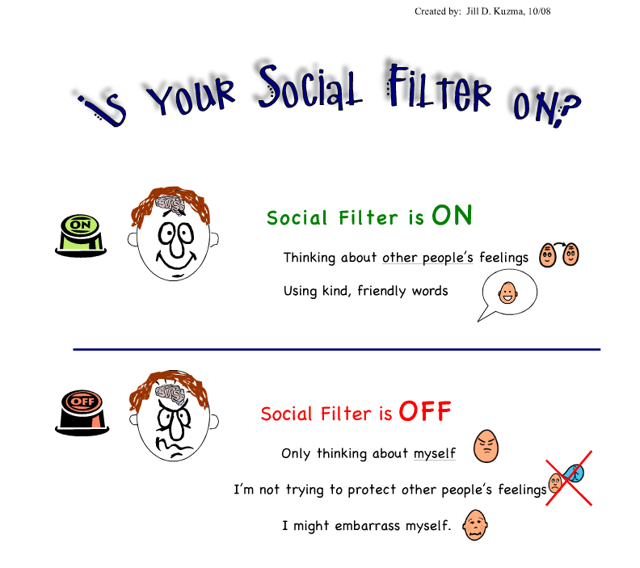

Slide 36
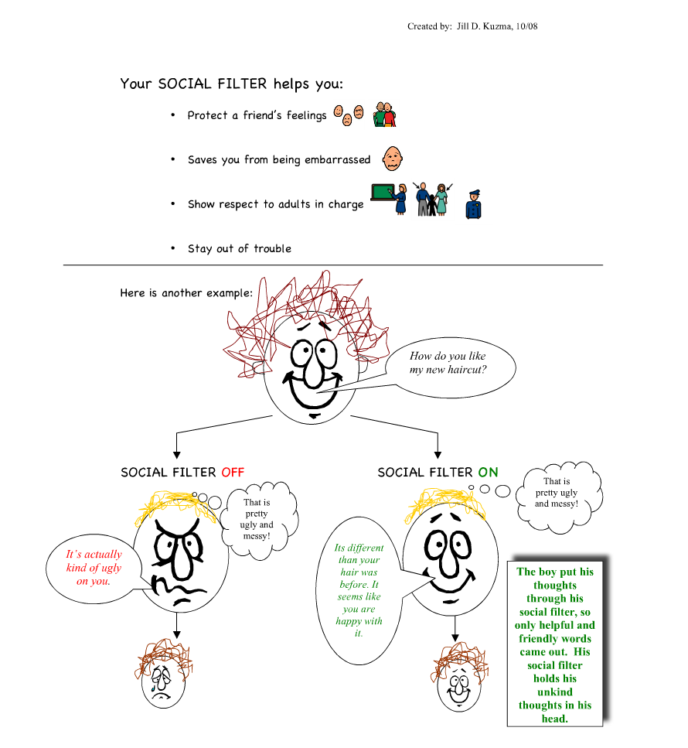

Slide 37

A great book to read at home with your children to reinforce the concept of “social filter”

Slide 38
Understanding emotions
Categorize feelings into 4 zones using level of alertness (blue, green, yellow and red)
Students recognize when they are in the different zones as well as how to use strategies to change or stay in the zone they are in
Students become comfortable and able to share his or her feelings and needs
Notes:
Students learn to adjust their level of alertness or “self regulate” their behavior across settings and situations. But first, they must understand what their body feels like in each zone and have a vocabulary of feeling words.

Slide 39
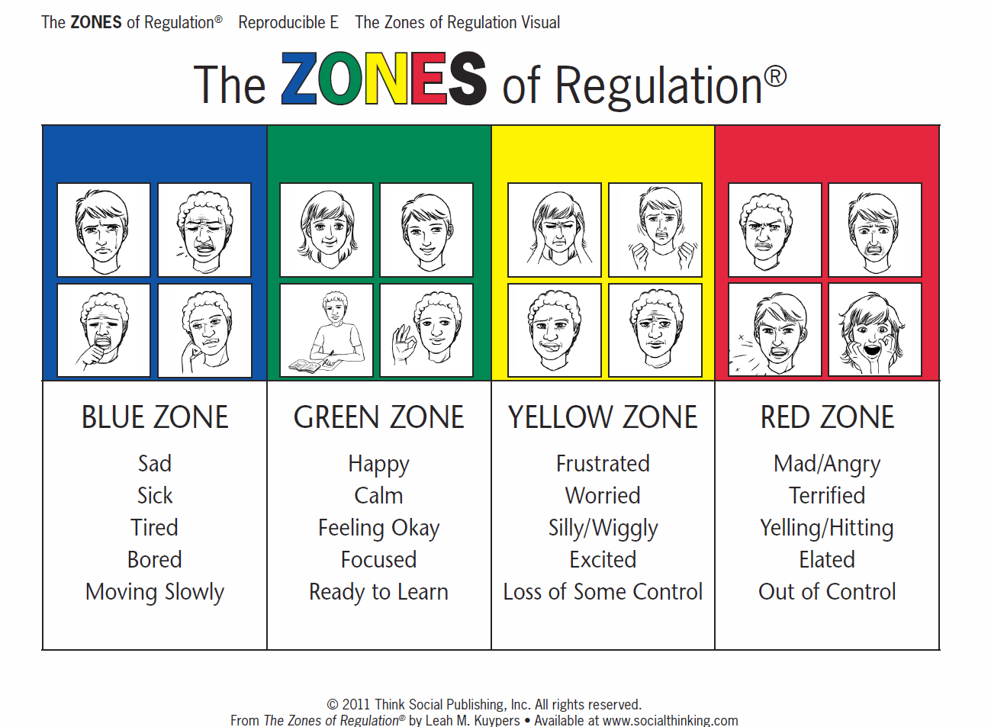
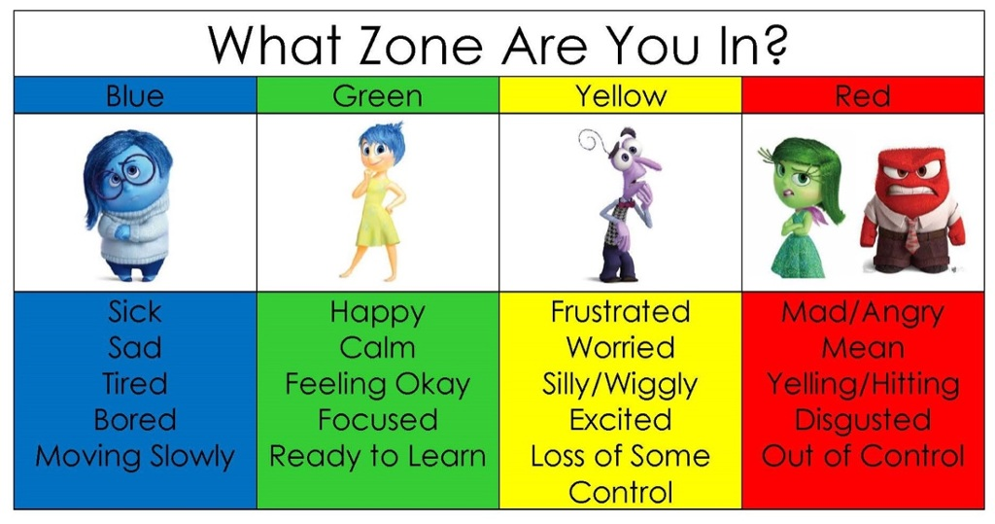
Zones of regulation

Slide 40
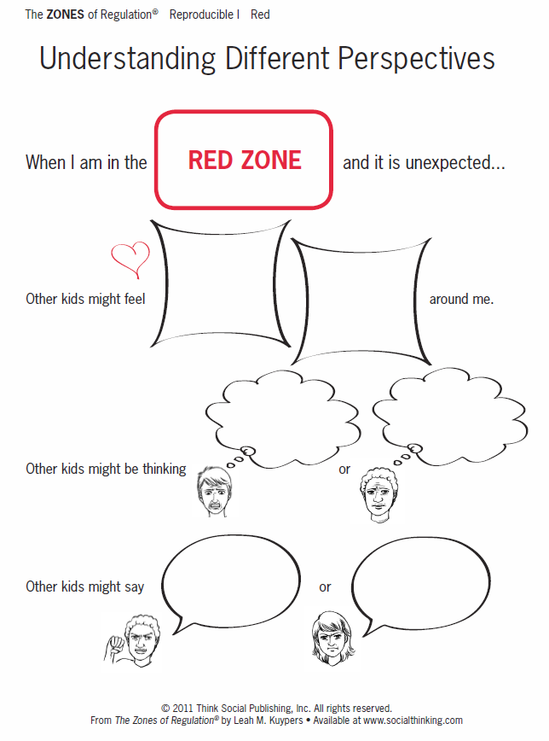
Social thinking concepts work together!
Notes:
Reinforce- all feelings are okay but may be unexpected to other people depending on the situation

Slide 41
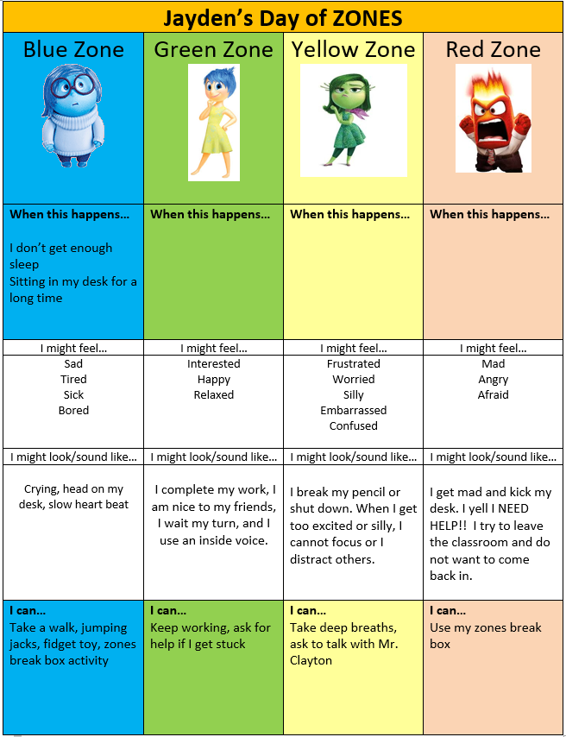
Use the Zones to create a personalized toolbox of coping skills.
Notes:
Handout – a way to practice and categorize coping strategies

Slide 42
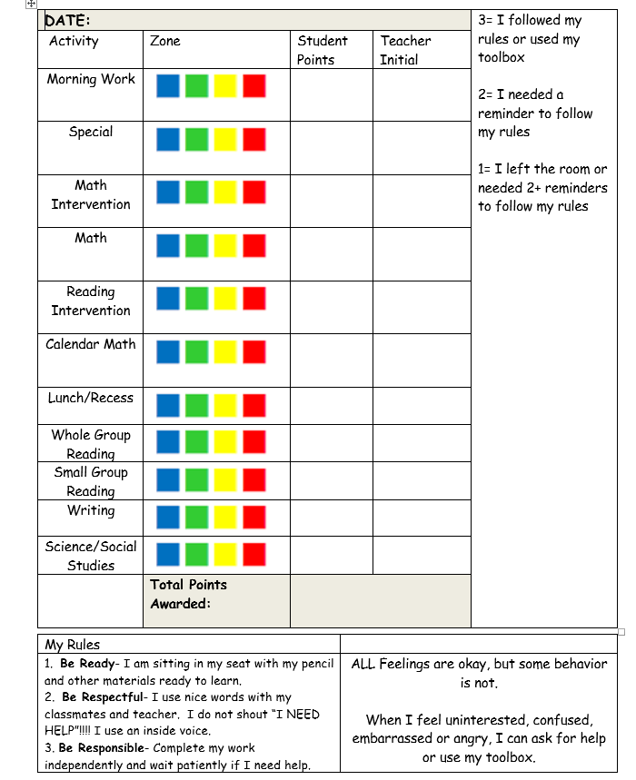
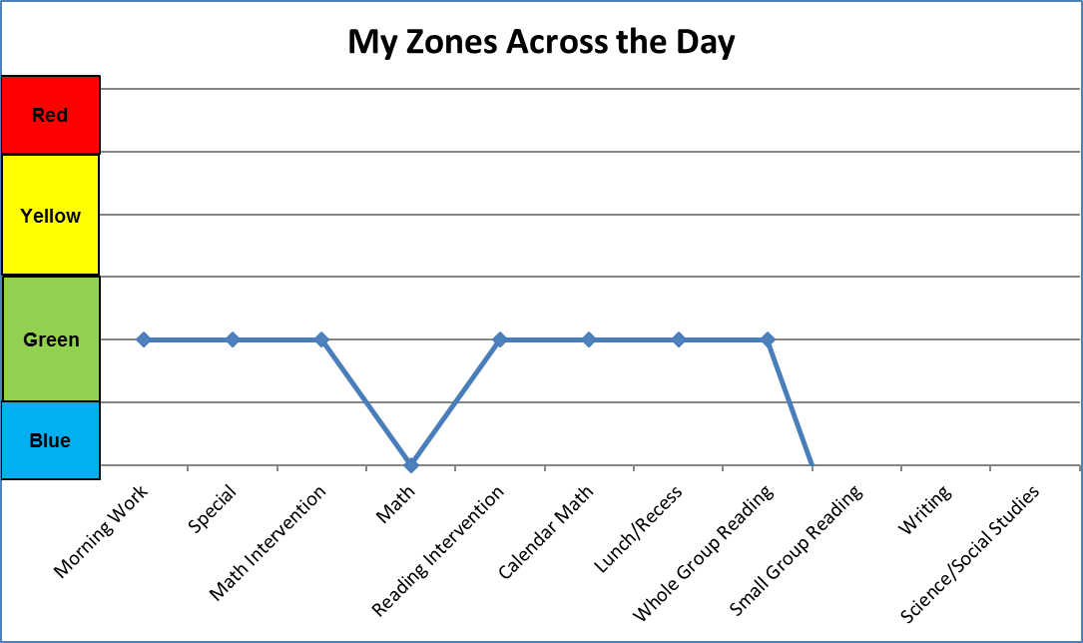
Social skills point card example
Notes:
Here is an example of how you can link social skill concepts into student point cards to encourage self regulation and also to monitor mood throughout the school day (student circles which zone he is in at the beginning of each period).

Slide 43

Questions?

Slide 44
Resources
Children’s Books about Social Skills | Julia Cook: www.juliacookonline.com Books that Heal Kids Blogpost: http://booksthathealkids.blogspot.com/
Websites | Jill Kuzma: https://jillkuzma.wordpress.com/about/ Social Thinking: https://www.socialthinking.com/ Center on Social and Emotional Foundations for Early Learning (CSEFEL):. http://csefel.vanderbilt.edu/
Curriculum | Zones of Regulation, Kuypers (2011) Thinking about You, Thinking about Me, Winner (2007) You are a Social Detective, Winner (2008) Think Social, Winner (2005) The New Social Story Book, Gray (2010)

Slide 45
For more information…
Delaware Department of Education
Tracy Neugabauer
Tracy.Neugabauer@doe.k12.de.us
Delaware Positive Behavior Support Project
Susan Veenema
Project Coach, DE-PBS Project
susanv@udel.edu
Nicole Roberts
Project Coach, DE-PBS Project
robertsn@udel.edu
Parent Information Center Delaware
www.picofdel.org
302-999-7394

