Slide 1
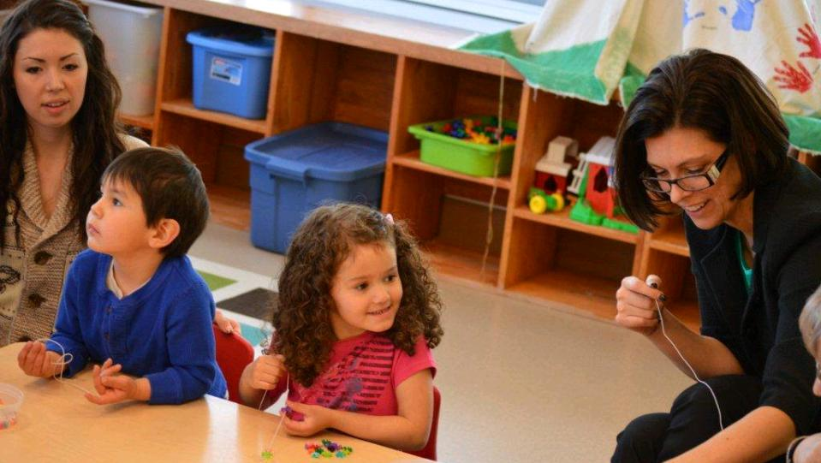
Relating in the Classroom: Educator Emotional Self-Care
Tia Navelene Barnes, Ph.D.
cc: BC Gov Photos - https://www.flickr.com/photos/45802067@N03
Notes:
(1 minute) Introduce the speaker and discuss your interest in this work.

Slide 2
To support our learning…
Be open
Maintain confidentiality
Feelings
Group facilitation
Fun
cc: harmi2009 - https://www.flickr.com/photos/85711600@N00
Notes:
( 1 minute) 1. Be open to the ideas that will be presented today. There will be opportunities to share and discuss with others in the room. While sharing is encouraged it is not required. 2. To support an interactive environment and to help everyone feel comfortable sharing, we ask that personal information that is shared stays here. 3. In this workshop, we will be discussing emotions and so this workshop may evoke a variety of feelings because of the scenarios I present and because of activities that ask you to bring awareness to your own feelings. 4. Group Facilitation agreed-upon methods ( ex., using hand signal to pull group together after small group or individual activities) 5. Fun. I want this to be an enjoyable learning experience.

Slide 3
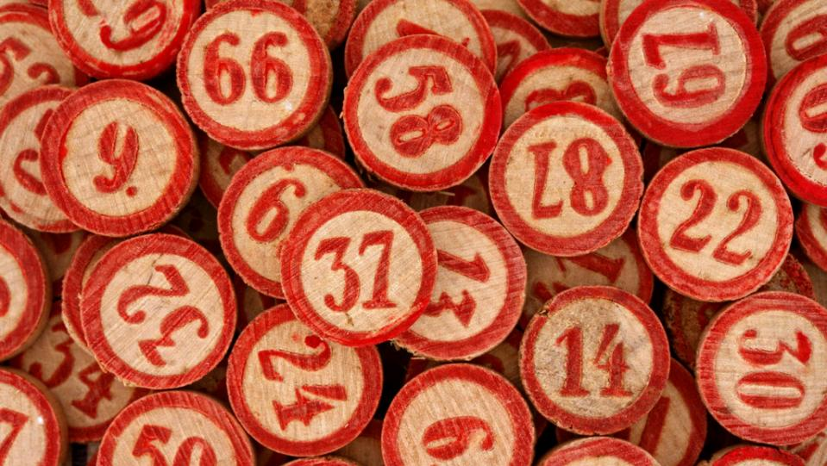
Welcome
Activity
cc: Leo Reynolds - https://www.flickr.com/photos/49968232@N00
Notes:
(7 minutes) : Alternate Game is Self-Care BINGO ACTIVITY ( see materials)
Materials needed: large sticky paper for groups and markers
[Depending on how large the group is you may have participants introduce themselves before they begin]
Ask participants to get into groups of 3-5 [based on number of participants] with others that they don’t see or interact with on a daily basis
Ask participants to, as a group, discuss self-care activities that they engage in or that they know their friends and family engage in
Once the participants have filled their sticky sheet with a list of examples, ask them to add the sheet to an empty wall and have a seat

Slide 4
Review of Materials
Slides with Trainer Notes
Additional Handouts
cc: Paul Watson - https://www.flickr.com/photos/51035609331@N01
Notes:
(3 minutes) In your folders you have hardcopies of the materials that will be used in today’s training. I have also sent out electronic versions of the materials for your use. The materials are: 1. 2 versions of the PowerPoints- 1 for printing and 1 for presenting

Slide 5
We will cover...
Self-care and other-care
Educator stress and burnout
Emotional intelligence
Emotional self-care & mindfulness
Self-care strategies
Self-care assessment & plan
cc: Daniel Kulinski - https://www.flickr.com/photos/7729940@N06
Notes:
read slide ( 1 minute)

Slide 6
Self-Care and Other-Care
“Teaching school is like having jumper cables hooked to your brain, draining all the juice out of you”
-Stephen King, former educator
cc: dbraaten - https://www.flickr.com/photos/80043438@N00

Slide 7
Self-Care and Other-Care
Helping professionals often feel a pull between self-care and other care
May be related to certain personality types being more likely to go into helping professions
Some learn to balance while others face burnout because of the imbalance
cc: DonkeyHotey - https://www.flickr.com/photos/47422005@N04
Notes:
( 1 minute) Helping professionals often feel a pull between self-care and other care May be related to certain personality types being more likely to go into helping professions Some learn to balance both, some face burnout because of the imbalance

Slide 8
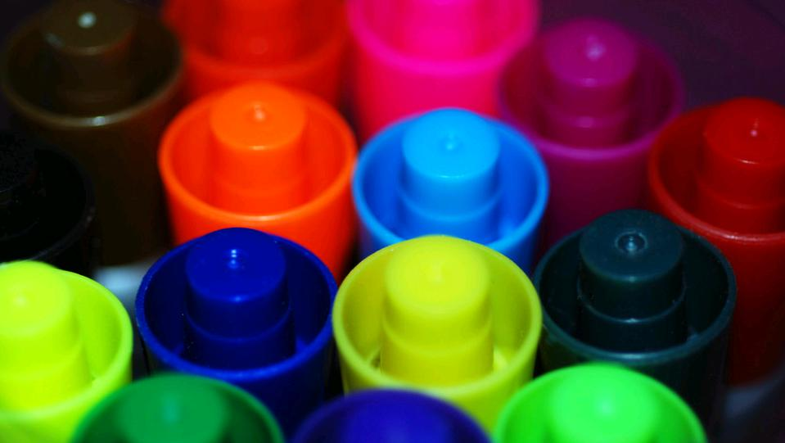
Activity
Skovholt Inventory
cc: incurable_hippie - https://www.flickr.com/photos/49503155381@N01
Notes:
( 20 minutes) Materials needed: Skovholt inventory and pencils/pens
Ask participants to take Skovholt inventory for themselves.

Slide 9
Burnout
Occurs because of prolonged stress
Includes three components
Emotional exhaustion
Depersonalization
Reduced personal accomplishment
cc: christian.rudman - https://www.flickr.com/photos/37219051@N07
Notes:
( 3 minutes) Burnout occurs when educators are exposed to prolonged stress. Maslach and colleagues have studied burnout in helping professions and have noted that burnout occurs in three phases-emotional exhaustion, depersonalization, and reductions in personal accomplishment. Emotional exhaustion, occurs when a person’s emotional energy is drained and the person does not feel like he or she emotionally capable to deal with a situation (Maslach, Schaufeli, & Leiter, 2001). Think of the educator who does not want to get out of bed to go to work or who is tired as soon as they walk into the classroom but may get a boost of energy once it’s time to leave the workplace. Depersonalization occurs when a person feels detached from his or her students and acts in negative and dehumanizing ways (Maslach et al., 2001). This is likely to occur with children who the teacher may label as those with problem behaviors. Examples of depersonalization is viewing the child as “ a little monster” or “the behavior problem”. And the third component of burnout, reduced personal accomplishment, occurs when a person feels like they cannot reach their work-related goals (Maslach et al., 2001). At this point, some will leave the classroom for other professions but others may stay because they have invested a lot of time or they cannot think of something else to do. This is problematic because educators in the reduced personal accomplishment phase who stay in teaching can’t create a positive classroom climate in their state and are also negatively impacting students perceptions of school and teachers. To examine your own levels of burnout, you can purchase Maslach’s burnout inventory online. The information for this is located on the resource sheet.

Slide 10
Burnout leads to….
Inflexible, cynical, negative, and rigid educators
Depressive symptoms
High educator turnover rates
Negative student academic outcomes, negative student-teacher relationships, and lower quality classroom climates
cc: christian.rudman - https://www.flickr.com/photos/37219051@N07
Notes:
(2 minutes) Burnout can lead educators to be inflexible, cynical, negative, and rigid (Freudenberger, 1977). Researchers have also found that burnout can also lead to depressive symptoms (Shin, Noh, Jang, Park, & Lee, 2013; Steinhardt, Smith Jaggars, Faulk, & Gloria, 2011). Educator burnout is also related to high turnover rates which presents a challenging to forming positive educator-student relationships. Moreover, educator burnout leads to negative student academic outcomes and lower quality classroom climates (McLean & Connor, 2015).

Slide 11
Burnout Characteristics
Novice teachers
Lack of social support in the work environment
Lower school socio-economic status
Insufficient training in dealing with problem behaviors
Low autonomy
cc: christian.rudman - https://www.flickr.com/photos/37219051@N07
Notes:
( 1 minute) Research on teacher burnout shows that there are certain educator characteristics and organizational characteristics that are more prone to lead to educator burnout. Among those are: The teacher's years of teaching. New teacher, especially those who are idealistic and passionate are more likely to burnout Those who work in schools where there is a lack of social support from colleagues and administrators are more likely to burnout Those who work in schools serving a high population of students from low socio-economic backgrounds and/or in neighborhoods with low resources are more likely to burnout Those with inadequate training in classroom management or behavior management techniques are more likely to burnout Those who work in environments where educator input is not valued or is discouraged are more likely to burnout. (Change, 2009)

Slide 12
Reflecting on your own experiences…
THINK-PAIR-SHARE
Have you ever experienced burnout or has someone you worked with or that you were close to ever experienced burnout?
If so, how did you know you were experiencing burnout?
How did you feel?
What did you do?
In what ways did this burnout influence your ability to do your job effectively?
cc: Davide Restivo - https://www.flickr.com/photos/43698630@N00
Notes:
(5 minutes)

Slide 13
Emotional Intelligence
A skillset used in the recognition, use, understanding, and management of your own emotions and the emotional state of others to solve social and internal problems and regulate behavior
cc: Victor Bonomi - https://www.flickr.com/photos/15928554@N02
Notes:
(1 minute) A skillset used in the recognition, use, understanding, and management of your own emotions and the emotional state of others to solve social and internal problems and regulate behavior (Mayer & Salovey, 1997; Salovey & Mayer, 1990). Unlike how we typically think of intelligence, this is a skillset. Thus, we can change it. If we have areas where we are currently struggling, we can improve with instruction and practice.

Slide 14
Higher Emotional Intelligence
Greater empathy
Better decision-making
Satisfying relationships
Greater job satisfaction
Lower likelihood of burnout
cc: razgriz2520 - https://www.flickr.com/photos/94889269@N03
Notes:
( 1 minute) read slide

Slide 15
Emotions and Teaching
Teaching is emotional
When teaching it is difficult to be emotionally self-aware because your focus is outward
Not perceiving emotions then makes it more difficult to self-regulate
cc: Vandy CFT - https://www.flickr.com/photos/90729502@N05
Notes:
( 1 minute) Teaching is emotional. When students are angry, sad, wound up they are not in a place to learn. When teachers are in similar emotional states, they may be ineffective in their teaching. To be able to change emotional states teachers must be aware of what state they are in and what state their students are in. It is difficult to be aware of your won emotions when teaching because your focus is outward. Not perceiving emotions then makes it more difficult to self-regulate your emotions because you often become aware of them when they have reached a heightened level. We must then use self-care and mindfulness strategies to be more in touch with our emotions during instruction to help us in regulating our emotions.

Slide 16
Emotional Intelligence includes…
Perceiving emotions
Using emotions to facilitate thought
Understanding emotions
Managing emotions
cc: Victor Bonomi - https://www.flickr.com/photos/15928554@N02
Notes:
(3 minutes) The emotional intelligence skillset includes the following skills: perceiving emotions in yourself and others. This supports the awareness of your emotions before they get to a heightened level. This includes both physiological cues and thoughts. using emotions to facilitate thought is the ability to use or generate emotions to focus attention, communicate feelings, or engage in cognitive processes such as reasoning, problem solving, and decision making. (3) understanding emotions is the ability to label emotions, interpret the meanings that emotions convey, understand the complexity of emotions, and recognize the likely transition of emotions And (4) managing emotions is the ability (a) to stay open to both positive and negative emotions, (b) to engage or detach from an emotion based on its utility, (c) to monitor emotions in relation to oneself and others, and (d) to manage one’s own emotion and the emotion of others by enhancing pleasant emotions and moderating negative emotions without repressing or exaggerating the information that these emotions convey (Mayer et al., 2001).

Slide 17
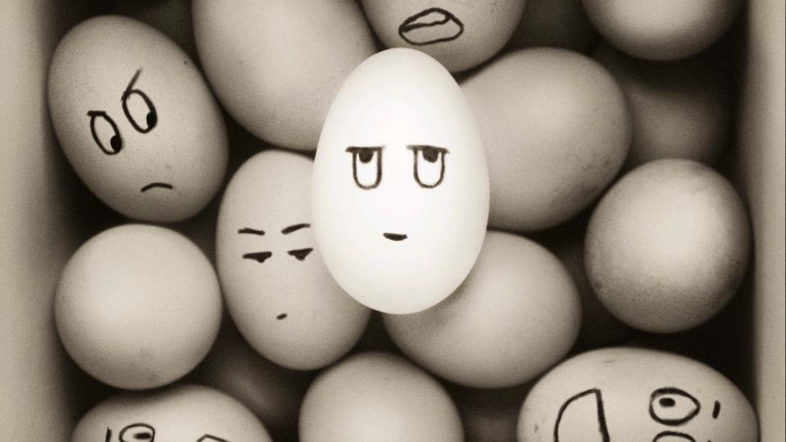
Perceiving Emotions
Ability to interpret cues to determine the emotion of others
Ability to interpret internal cues to determine emotion in oneself
cc: Yannnik - https://www.flickr.com/photos/46098476@N03
Notes:
( 1 MINUTE) Perceiving emotions is your ability to interpret cues to determine the emotion of others -ability to interpret internal cues to determine emotion in oneself

Slide 18
Name that emotion
Notes:
(8 minutes: ~ 1-2 minutes per slide)-HAPPY
Materials needed: emotion cards for each participant ( next 5 slides)
Use emotion cards for this activity and ask participants to raise an emotion card as you present each picture. After presenting the picture and asking participants to raise a card for the emotion. Discuss what cues they noticed that led them to that response. Discuss any differences in responses and what are reasons for those differences. For example, some facial expressions for emotions such as anger and disgust look similar and this is where context may be helpful. Also, there may be some differences in expression based on culture.

Slide 19
Name that emotion
Notes:
(8 minutes: ~ 1-2 minutes per slide)-DISGUSTED
Use emotion cards for this activity and ask participants to raise an emotion card as you present each picture. After presenting the picture and asking participants to raise a card for the emotion. Discuss what cues they noticed that led them to that response. Discuss any differences in responses and what are reasons for those differences. For example, some facial expressions for emotions such as anger and disgust look similar and this is where context may be helpful. Also, there may be some differences in expression based on culture.

Slide 20
Name that emotion
Notes:
(8 minutes: ~ 1-2 minutes per slide)-SAD
Use emotion cards for this activity and ask participants to raise an emotion card as you present each picture. After presenting the picture and asking participants to raise a card for the emotion. Discuss what cues they noticed that led them to that response. Discuss any differences in responses and what are reasons for those differences. For example, some facial expressions for emotions such as anger and disgust look similar and this is where context may be helpful. Also, there may be some differences in expression based on culture.

Slide 21
Name that emotion
Notes:
(8 minutes: ~ 1-2 minutes per slide)-SURPRISED
Use emotion cards for this activity and ask participants to raise an emotion card as you present each picture. After presenting the picture and asking participants to raise a card for the emotion. Discuss what cues they noticed that led them to that response. Discuss any differences in responses and what are reasons for those differences. For example, some facial expressions for emotions such as anger and disgust look similar and this is where context may be helpful. Also, there may be some differences in expression based on culture.

Slide 22
Name that emotion
Notes:
(8 minutes: ~ 1-2 minutes per slide)-CALM
Use emotion cards for this activity and ask participants to raise an emotion card as you present each picture. After presenting the picture and asking participants to raise a card for the emotion. Discuss what cues they noticed that led them to that response. Discuss any differences in responses and what are reasons for those differences. For example, some facial expressions for emotions such as anger and disgust look similar and this is where context may be helpful. Also, there may be some differences in expression based on culture.

Slide 23
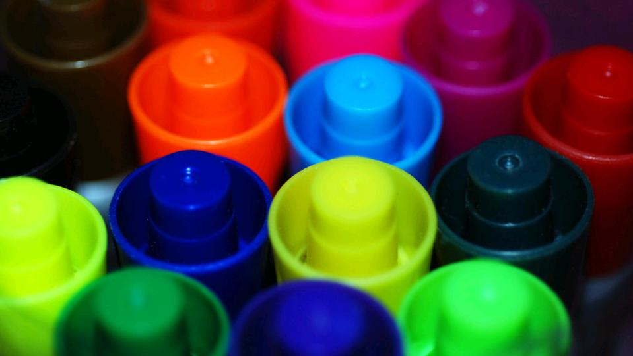
Activity: Internal Cues for Emotions
Create a list of internal cues that let you know when you are feeling an assigned emotion
cc: incurable_hippie - https://www.flickr.com/photos/49503155381@N01
Notes:
(15 minutes)
Materials needed: Markers and sticky paper ( create list of emotions that you want groups to explore)
Break into groups. Assign each group an emotion. Ask the group to create a list of ways that an emotion manifests within each group member. How do you know that you are feeling that emotion? What physiological cues and thoughts run through your mind? Create a list of internal cues that you are feeling the emotion of interest. Ask each group to walk around and look at what others have created and then as a group discuss: Have you noticed differences in how you interpret this emotion and how others do? What cues are similar for you? The key take-aways here are bringing attention to our emotions and checking in with our emotions throughout the day to help in addressing emotions before they boil over and contribute to burnout or a negative classroom climate

Slide 24
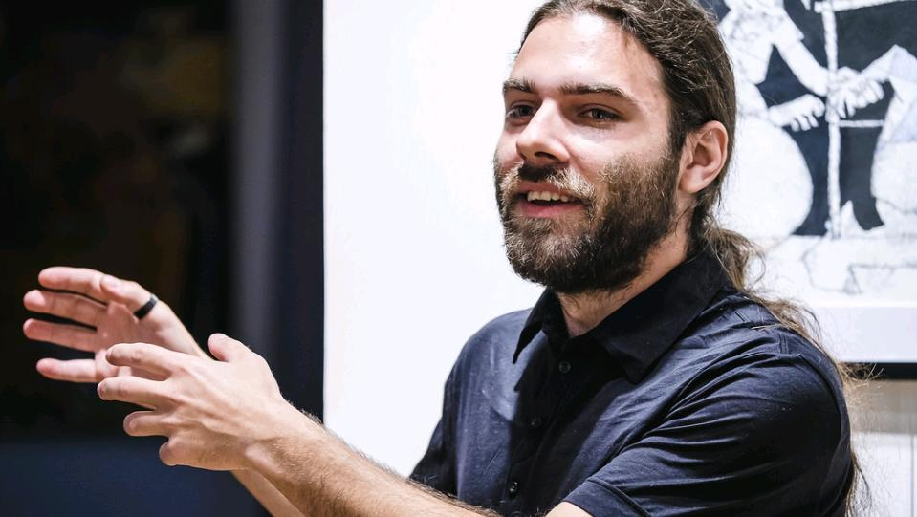
Using Emotions to Facilitate Thought
Ability to redirect and prioritize your thinking based on the emotions associated with those thoughts
Ability to generate emotions that will help facilitate judgment and memory
Ability to use emotional states to improve your problem solving skills and creativity
cc: Berliner.Gazette - https://www.flickr.com/photos/92582247@N08
Notes:
(1 minute) read slide

Slide 25
Concept in Action
Ms. Nixon is a 3rd grade teacher. Her classroom schedule calls for reading and math lessons in the morning and she uses time after lunch for social studies or science lessons. She often dreads this time because her students come back from lunch with high energy and are often too excited, angry, or distracted to get to work on the lesson.
cc: DFAT photo library - https://www.flickr.com/photos/106853342@N04
Notes:
( 5 minutes) Read the First paragraph. Ask participants what are some ways that the teacher can support learning when the students are in these high level emotions? Discuss possible answers such as starting with a cool down period where students have some time to compose themselves and move to a different emotional state. The teacher can use music to facilitate this. The teacher can also create a high energy social studies or science lesson to match the energy of the students. This would be a good time for role-plays, a group game, or to learn a song about a social studies or science concept

Slide 26
Concept in Action
Ms. Nixon has her planning time in the morning while her students are at specials each day. She wants to use her planning time to start preparation for the next week’s lessons but finds that during her planning time she is often very tired and has trouble focusing on the lesson preparation.
cc: DFAT photo library - https://www.flickr.com/photos/106853342@N04
Notes:
( 5 minutes) Read the second paragraph. Ask participants what are some ways that the teacher can tune into her own emotions in the scenario and make a plan to support her preparation. Suggestions could be, she can increase her energy by going for a quick walk before starting the preparation or by listening to upbeat music prior to starting. Another may be for her to use this time for another low energy activity. So, this may be a time that she does some seat work or rests and she may do lesson preparation the last hour of the day once the students leave.

Slide 27
Understanding Emotion
Ability to understand the relationships among different emotions
Ability to perceive the causes and consequences of emotions
Ability to understand complex feelings and contradictory states
Ability to understand that emotions change
cc: Spree2010 - https://www.flickr.com/photos/30098694@N02
Notes:
( 3 minutes) Your ability to understand the relationships among various emotions, perceive the causes and consequences of emotions, understand complex feelings and contradictory states, and understand the transitions among emotions and emotional blends.

Slide 28
Managing Emotion
Ability to be open to both pleasant and unpleasant emotions
Ability to monitor and reflect on your emotions
Ability to detach from or prolong an emotional state
cc: suz or sooze - https://www.flickr.com/photos/25712205@N08
Notes:
(3 minutes) involves being open to both pleasant and unpleasant feelings, monitor and reflect on your emotions, detach or prolong from an emotional state, and managing the emotions in yourself and others.

Slide 29
Group Activity: Updating Self-Care
cc: incurable_hippie - https://www.flickr.com/photos/49503155381@N01
Notes:
( 10 minutes)
Materials needed: Sticky note of self-care activities from activity 1
Review self-care activities sheet from the opening activity. Ask groups to identify which activities were specific to emotional self-care and create a new list specific to emotional self-care activities.

Slide 30
10 MINUTE BREAK
cc: Alfred Hermida - https://www.flickr.com/photos/13238706@N00

Slide 31
What is Self-Care?
Engaging in activities or practices that help
limit or reduce stress:
Physical
Emotional
Spiritual
Intellectual
Social
Relational
Safety and Security
cc: arturodonate - https://www.flickr.com/photos/15790252@N06
Notes:
( 1 minute)
What comes to mind when you think of self-care?
Self care is engaging in activities or practices that help you limit or reduce stress. These activities or practices can fit into seven categories ( read each category). We are focusing on emotional self-care for today’s workshop.

Slide 32
Emotional Self-Care
Identifying, accepting, and expressing a range of emotions
cc: -Reji - https://www.flickr.com/photos/27365066@N02
Notes:
( 1 minute) Emotional self-care refers to activities that help you in identifying, accepting, and expressing a range of emotions. We will talk a bit more about examples as we continue the workshop but first let’s take some time to discuss this as a group and see if you all identified any emotional self-care activities.

Slide 33
Self-Care: Importance for Educators
Improves educator well being, which influences:
educator burnout
educator retention
classroom climate
student outcomes
cc: City of Seattle Community Tech - https://www.flickr.com/photos/67840815@N05
Notes:
( 1 minute)
Self-care is important to educators because it improves educator well being and this reduces educator burnout, supports educator retention, can lead to a more positive classroom climate, and having a positive classroom climate supports student outcomes

Slide 34
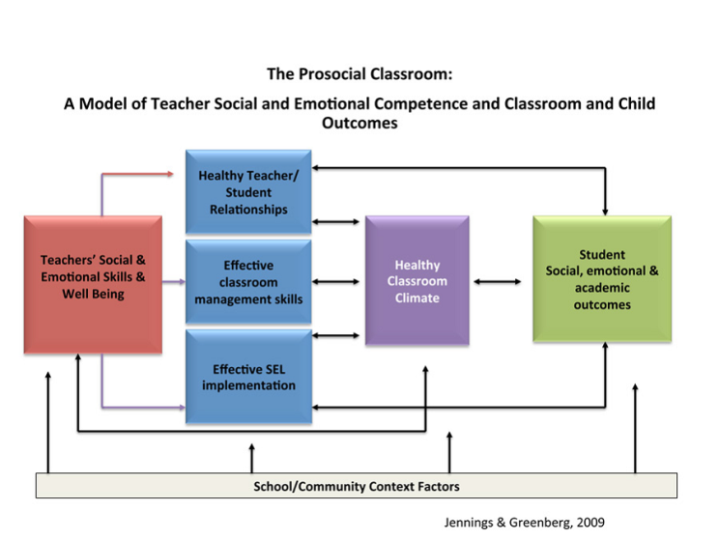
Prosocial Model
Notes:
( 3 minutes)
The theory behind this comes from the prosocial model. Explain the model. Teacher’s social-emotional competence and well-being play vital roles in their ability to cultivate a prosocial classroom climate linked to desired student social-emotional and academic outcomes.

Slide 35
THINK-PAIR-SHARE : Scenario
Before Work:
Your alarm clock doesn’t go off
You’re rushing to get yourself and your children ready for the day
There is a traffic jam due to a car accident on the way to work
You are now very late for work
During Work:
A child has hit another child and both children are crying and screaming
How do you respond?
cc: Hernan Piñera - https://www.flickr.com/photos/67430875@N03
Notes:
(10 minutes)
For this activity let’s take a look at how our emotional state can influence our reaction to a classroom situation.
Imagine that you are a 1st grade teacher….
Before Work:
Your alarm clock doesn’t go off
You’re rushing to get yourself and your children ready for the day
There is a traffic jam due to a car accident on the way to work
You are now very late for work
You finally arrive to work and begin to settle in. You start your morning circle and a child has hit another child and both children are crying and screaming
Keeping in mind the activities that have occurred this morning, how do you think you may respond to this situation?
Take a moment to think to yourself and then turn to a new partner and share. [Ask a few participants to share]

Slide 36
Strategies For Self-Care
Mindfulness
Stress reduction activities
cc: dsevilla - https://www.flickr.com/photos/49014237@N00
Notes:
( 1 minute)
Two strategies for self-care that we will discuss next are Mindfulness which is a strategy that can help you in the moment when you are faced with a challenging situation and stress reduction which can reduce overall stress levels to support you in better regulating emotions when challenges come up

Slide 37
Mindfulness
Developed over time with practice
Two components:
Self-regulation of attention/awareness
Non-judgmental
cc: AlicePopkorn - https://www.flickr.com/photos/14111752@N07
Notes:
( 1 minute)
Mindfulness refers to being in the moment . It is a characteristic and state that can be developed over time with practice. Is consist of 2 components- self-regulation of your attention/awareness and a non-judgmental awareness of the experience.

Slide 38
How To Do It
Mindful awareness
Being in the present-moment experience
Awareness of all dimensions of the experience
cc: Howard Sandford - https://www.flickr.com/photos/137230105@N06
Notes:
( 1 minute)
To be mindful you must have an awareness of what is happening in the moment. This includes being aware of all of the dimensions of the situation. This will include what is happening externally-external sounds, other’s actions and expressions and your internal thoughts feelings and sensations. To support your emotional self-care I am encouraging you to be very mindful of your internal state to help you in determining patterns in your emotions to certain occurrences in your classroom.

Slide 39
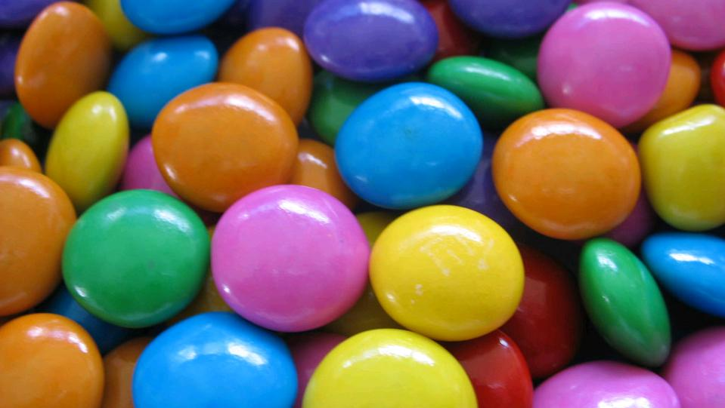
Mindfulness: Candy activity
cc: dipurinku | MERGED - https://www.flickr.com/photos/62219432@N00
Notes:
( 5 minutes)
Materials Needed: Candy
We are now going to do a activity to introduce you to the idea of mindfulness.
Select a candy but do not open it yet.
We will practice your awareness with your senses.
Unwrap the wrapper, what does it sound like?
Look at the candy, what does it look like? What does it feel like? How does it smell?
Put the candy in your mouth how does it taste? What is the texture?
[Spend a few minutes reflecting on the activity….]

Slide 40
Mindfulness: Student scenarios
cc: RelaxingMusic - https://www.flickr.com/photos/83905817@N08
Notes:
(10 minutes)
Now let’s try the activity with a scenario from your own classroom. Think about a situation with a challenging child that occurred in your own classroom recently.
What did the child do? [give a minute to think through the scenario]
What were you feeling?
What was your internal state (body awareness)?
What was your awareness of the environment?
How did you respond?
[Ask the participants to share with those near them ]
This is a pretty difficulty concept to include in the moment and so there is a need to practice this on your own so you are training yourself to become more aware when a situation occurs that provokes a strong emotion. In the resource sheet is a link to a YouTube video that walks you through a body scan activity that helps you in gaining awareness of your physiological reactions to emotion so you will be better able to identify them when faced with a classroom situation.

Slide 41
What to do with known patterns
Uncover the reason for response
Plan ahead for response
Create plan to debrief
cc: erink_photography - https://www.flickr.com/photos/49268016@N04
Notes:
(1 minute) read slide

Slide 42
Stress Reduction
Key to reducing educator burnout
Can influence mental and physical well-being
Influences relationships
cc: Vox Efx - https://www.flickr.com/photos/39096030@N00
Notes:
(1 minute) read slide

Slide 43
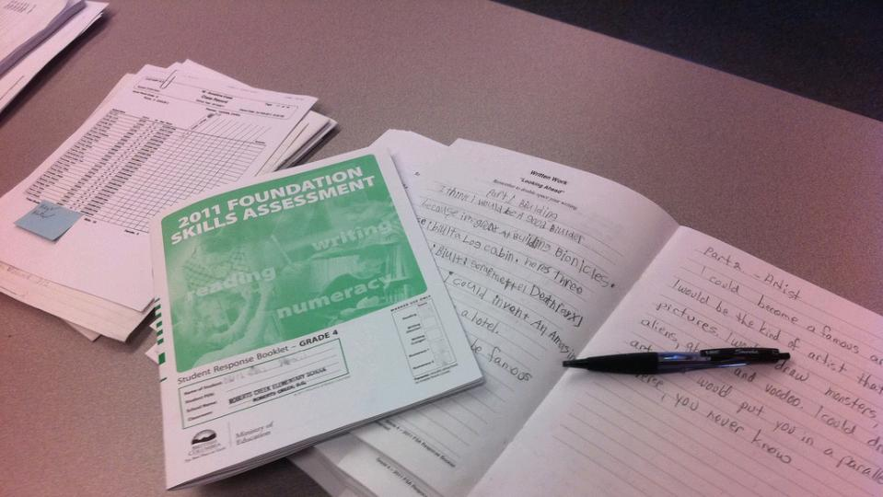
ACTIVITY: Self-care assessment
cc: gibsonsgolfer - https://www.flickr.com/photos/25728552@N00
Notes:
(5 minutes)
Materials needed: Self-care assessment sheet
Take out sheet labeled self-care assessment. Think about a typical workday during the week from the moment you wake up to when you go to sleep. Create a schedule of things you do on a typical day and then review the schedule and determine whether you like each activity and if you are engaging in the activity for your self or others. Then take a moment to calculate the number of hours in a day that you actually enjoy…Do not move on the next part of the activity yet.

Slide 44
ACTIVITY: Create a self-care action plan
cc: Tatiana12 - https://www.flickr.com/photos/98826299@N00
cc: incurable_hippie - https://www.flickr.com/photos/49503155381@N01
Notes:
(10 minutes)
Materials Needed: Paper and a pen/pencil
Now, let’s take a moment to think about some activities that you could add into the work day ( these do not both have to take place on a particular day but just to create a list of possibilities of things you can add into your day to increase your enjoyment and lower your stress. To help in the process, we will take a gallery walk. Stand up and go around the room and look at the self-care activities that others came up with. Are there any that look particularly interesting to you? Write them down [Once everyone sits down ] Since we want to not cause additional stress with self-care, narrow your list to 2-3 activities that you want to incorporate more regularly and write them down. Be modest in your goal and build upon on realistic change

Slide 45
Self-Care Plan: Barriers
Think about the barriers that impact your ability for self-care
In groups generate a list of barriers and problem-solve ideas to remove those barriers
cc: Ame Otoko - https://www.flickr.com/photos/30674850@N00
Notes:
(20 minutes)
Think about the barriers that impact your ability for self-care. Generate a list of barriers and then move to a group to problem-solve ideas to remove those barriers.

Slide 46
Thank You
People who have had a great teacher almost always say, “that teacher saw something in me that I was unable to see in myself”.
–P.J. Palmer
cc: *Lie ... on & off ... too busy ! - https://www.flickr.com/photos/8458761@N08
Notes:
(remaining time ~ 20 minutes)
Thank you attending today’s workshop. I will now open the floor for any additional questions and we can also spend some time reviewing items in the parking lot.

Slide 47
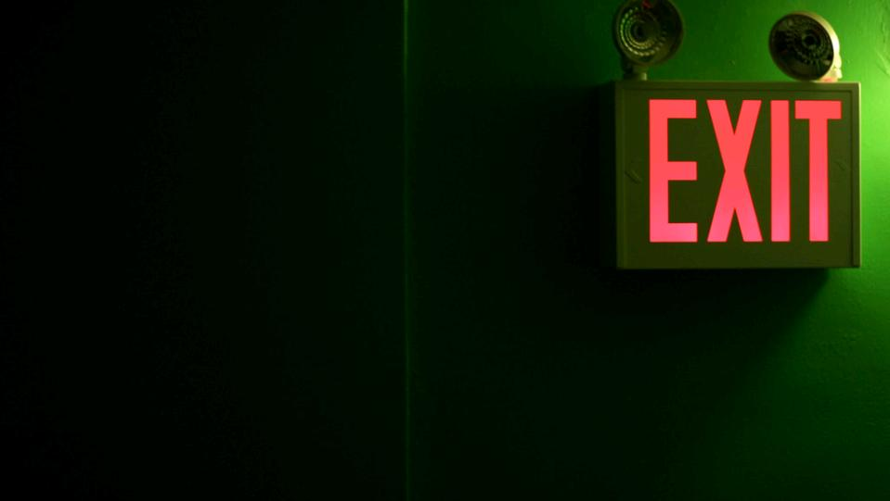
Exit Survey
Please fill out the PD survey from before leaving
cc: sickmouthy - https://www.flickr.com/photos/32224133@N07
Notes:
(10 minutes)

Slide 48
References
Freudenberger, H. J. (1977). Burnout: Occupational hazard of the child care worker. Child Care Quarterly, 6, 90–99. doi:10.1007/BF01554695
Jennings, P. A. (2015). Mindfulness for Teachers: Simple Skills for Peace and Productivity in the Classroom (The Norton Series on the Social Neuroscience of Education). WW Norton & Company.
Maslach, C., Schaufeli, W. B., & Leiter, M. P. (2001). Job burnout. Annual Review of Psychology, 52, 397-422. doi:10.1146/annurev.psych.52.1.397
Mayer, J. D., & Salovey, P. (1997). What is emotional intelligence? In P. Salovey & D. Sluyter (Eds.), Emotional development and emotional intelligence: Educational implications. New York, NY: Basic Books.
Mayer, J. D., Salovey, P., Caruso, D. R., & Sitarenios, G. (2001). Emotional intelligence as a standard intelligence. Emotion, 1, 232-242.doi:10.1037//1528-3542.1.3.232
McLean, L., & Connor, C. M. (2015). Depressive symptoms in third‐grade teachers: Relations to classroom quality and student achievement. Child Development, 86, 945-954. doi:10.1111/cdev.12344
Salovey, P., & Mayer, J. D. (1990). Emotional intelligence. Imagination, Cognition and Personality, 9, 185-211. doi:10.2190/DUGG-P24E-52WK-6CDG
Shin, H., Noh, H., Jang, Y., Park, Y. M., & Lee, S. M. (2013). A longitudinal examination of the relationship between teacher burnout and depression. Journal of Employment Counseling, 50, 124-137. doi:10.1002/j.2161-1920.2013.00031.x
Skovholt, T. M., & Trotter-Mathison, M. (2014). The resilient practitioner: Burnout prevention and self-care strategies for counselors, therapists, teachers, and health professionals. Routledge.
Steinhardt, M. A., Smith Jaggars, S. E., Faulk, K. E., & Gloria, C. T. (2011). Chronic work stress and depressive symptoms: Assessing the mediating role of teacher burnout. Stress and Health, 27, 420-429. doi:10.1002/smi.1394

