Slide 1
Delaware PBS Cadre
Thursday, April 19, 2018

Slide 2
Welcome & Introductions
Name
Role
In my work, I’m rejuvenated by ___________.

Slide 3
Today’s Topics
Multi-tiered System of Support (MTSS) Updates
MTSS Asset Mapping
Professional Development Updates & Resource Sharing
District Planning & Coaching
DE-PBS Phase Recognition
Data Reminders

Slide 4
MTSS Asset Mapping
Review MTSS Initiative Summary
Reflect on initiatives on which you work and support within your district & schools
What are we missing?
Initiative name
Population served – Tier 1, Tier 2, Tier 3
Outcome & fidelity measure(s)

Slide 5
What is a Multi-Tiered System of Support (MTSS)
an evidence-based framework for effectively integrating multiple systems and services to address students’ academic achievement, behavior, and social–emotional well-being.
a strategy for improving outcomes for all students and for creating safe and supportive learning environments free of bullying, harassment, and discrimination.
includes school-wide strategies, targeted supports and individualized student supports.
www.nasp.org

Slide 6
Multi-tiered System of Support Updates
New State Personnel Development Grant (SPDG) grant
Goal 1: “To increase the capacity of the DDOE and LEAs in Delaware to implement an integrated Multi-Tiered System of Support (MTSS), aligned to existing state and LEA initiatives that will lead to increased student outcomes.”
DDOE focus on MTSS and initiative integration & alignment

Slide 7
State → District →School MTSS Capacity
How?
Start at the top
Correct misconceptions
Align related initiatives to ensure success of all
Create common language

Slide 8
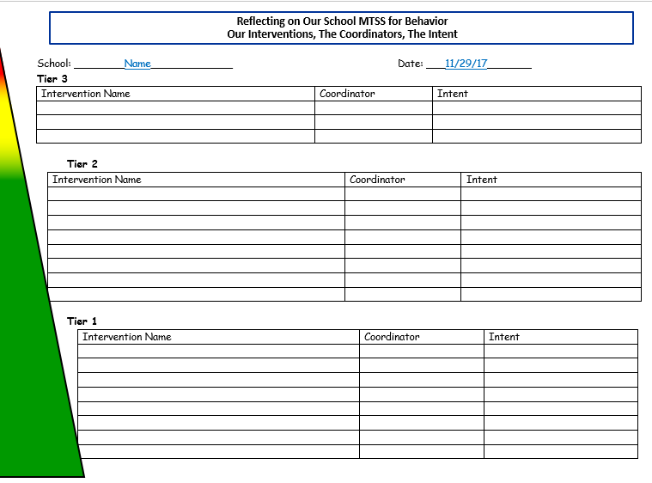
MTSS Tracking: Thinking Ahead

Slide 9
MTSS Tracking Tool Discussion
What do you think about utility of this tool?
Would you find this useful to guide discussion with your school teams?
What are your thoughts on gathering as a summary for all of your schools?

Slide 10
MTSS Professional Development

Slide 11
Housekeeping reminder- Substitute Reimbursement
The Department of Education will provide substitute reimbursement for REGISTERED participants.
PFA or IV needs to be completed within 30 days after the training. Please send completed PFA or IV electronically to Linda Smith(linda.smith@doe.k12.de.us).
All PD confirmation emails will contain PFA/IV information.

Slide 12
Fall 2017 – Winter 2018 Recap
Tier 2-PEERS 10/9/17
Tier 2-Networking 10/26
Tier 3-Supporting Internalizing Behavior 11/15
Tier 2-New Targeted Team 11/19
Tier 1-Establishing Systems of Classroom Supports 12/7
Secondary Forum – 2/28

Slide 13
Tier 2: PEERS
This training is designed to teach educators how to use the PEERS manual.
The PEERS curriculum is for adolescents to focus on skills related to making and keeping friends, and managing peer conflict and rejection.

Slide 14
Tier 2-Networking 10/26
Morning Agenda
Big Picture Review of MTSS
Tier 2 Conversations
Guest Presentations
Lake Forest North Elementary
Gallaher Elementary
Tiered Fidelity Inventory
Team
Intervention
Evaluation
Team Time and Action Planning

Slide 15
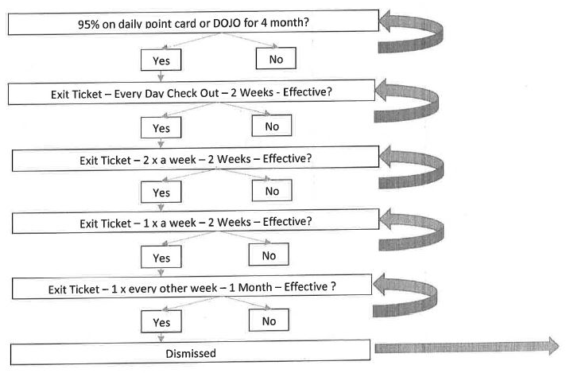
Gallaher Elementary Systems In-Depth
Gallaher Elementary

Slide 16
Lake Forest North Elementary CICO In-depth

Slide 17
Tier 2-New Targeted Team 11/19
Morning:
Pre-Workshop Survey
Tier 2: Systems & Problem-Solving Conversations
Recommended Best Practices and Tiered Fidelity Inventory (TFI)
Guest Presentation: Gallaher Elementary School (2016-2017 Recognition Recipient)
Afternoon:
Problem-Solving Best Practices
Check-In/Check-Out: Systems and Problem-Solving
Asset Mapping
Action Planning

Slide 18
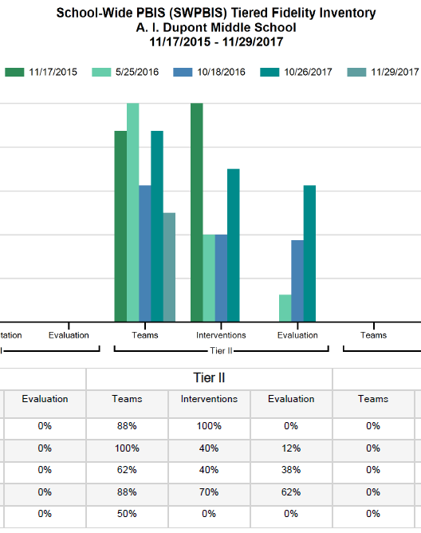
Bridge Activity: The TFI

Slide 19
Tier 2 Related Discussion
Are you having any district-wide Tier 2 related meetings or PD events in your district? If so, what do they look like and who is attending?
What are the Tier 2 data tracking tools you are using – either at the intervention or systems-level?

Slide 20
Tier 3 PD Sessions
Advanced Prevent Teach Reinforce (PTR) to Address Internalizing Behavior
100+ participants
School Refusal Assessment Scale
District System Redesign Pilot
Cape Henlopen & Red Clay District Teams
Tier 3 Myths
5 Ensures

Slide 21
Taking Tier 3 to the District to Ensure…
training/coaching, advanced support, monitoring school teams
screening, training/coaching, monitoring student plans
conduct assessments, develop interventions
Results based Tier 3
Under-standing
Skills
Professional Supports
Aligned infra-structures
Policies & procedures
District Level Team
School Level Teams
Student Level Teams

Slide 22
Tier 1: Establishing Systems of Positive Classroom Behavior Supports (PCBS)
PD Goals:
Explore preventative and response practices to create a nurturing and productive classroom learning environment
Develop an initial plan of support for building consistency, fluency, and capacity with these practices among all staff

Slide 23
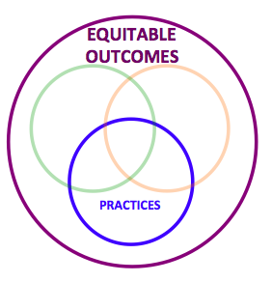
Positive Classroom Behavioral Supports
Define and Teach Rules and Routines aligned with School-wide Expectations (Classroom Matrix)
Identify Continuum of Practices for Responding to Behavior
Arrange physical space to prompt appropriate behavior
Employ Active Supervision
Develop Class-Wide Group Contingencies
Provide Multiple Opportunities to Respond

Slide 24
Team Action Planning & PCBS Discussion
What follow up is needed to support participating teams with this content and planning?
What support would be helpful to you as coaches to support teams with this content?

Slide 25
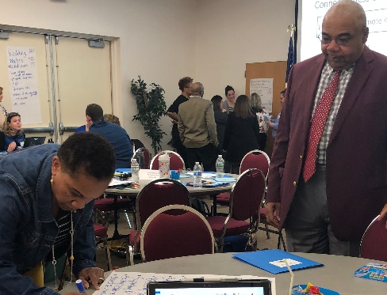
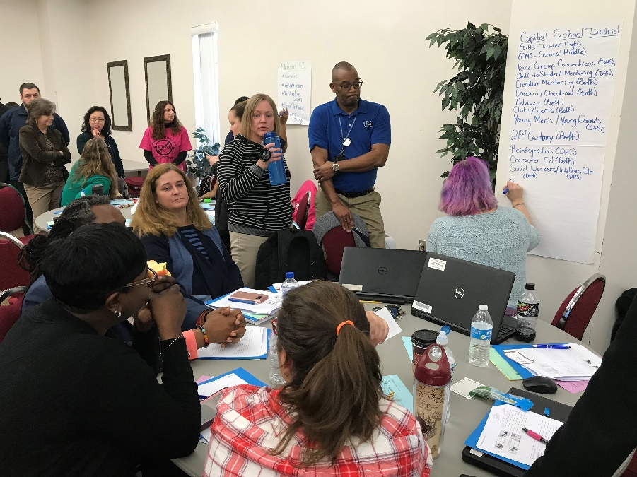
Secondary Forum 2/28
Participants:
9 districts, 17 schools
48 folks (including 5 district coaches)
This year’s topics:
Building communication across Tier 1 & 2 teams
Using Surveys to Gauge Relationships
Connect-the -Dots
Connections Screening
Planning for advisory
Recognition strategies
Mini-Presentations:
Dover High School
McKean High School
Talley Middle School
Please see http://wh1.oet.udel.edu/pbs/secondary-forum/

Slide 26
Connectedness Screening
Started in 2010 at Burrillville High School in Rhode Island, Kim Pristawa, School Psychologist
Purpose
identify potentially at-risk students in the social-emotional area by examining students’ perceptions of connectedness with adults and peers in school.
identify a target group of students who may need social-emotional intervention
help in choosing an adult to support student when needed
Screening looks at both adults and peers simultaneously

Slide 27
Burrillville High School Confidential Survey for ADULTS
Directions: Please list the names of up to 6 students in this building whom you feel you have a good, personal connection with. These could be students who seek your advice/guidance for personal or academic matters (Teachers: they may not necessarily be current students in your classes.)
I have a good connection with the following student(s) at Burrillville HS:
______________________________________________
______________________________________________
______________________________________________
______________________________________________
______________________________________________
______________________________________________

Slide 28
Burrillville High School Confidential Survey for STUDENTS
Directions: Please list the name(s) of one or more adult(s) and peer(s) in this building whom you feel you have a good connection with. These adults should be people you trust, you know care about you, and you feel you can talk to if you have a problem.
I have a good connection with the following adult(s) at Burrillville HS:
_______________________________________________________
_______________________________________________________
_______________________________________________________
◻Place a check in this box if you feel you DO NOT have a good connection with any adult in the building
I have a good connection with the following peer(s)/classmate(s) at Burrillville HS:
_______________________________________________________
_______________________________________________________
_______________________________________________________
◻ Place a check in this box if you feel you DO NOT have a good connection with any peer in the building

Slide 29
Connectedness Screening
Pristawa, K. 2017. A universal screening process for school connectedness. National Association of School Psychologists. San Antonio, TX.

Slide 30
Upcoming: School Climate Data Workshop -5/14/18
Open to all participating schools & district support staff
Del-tech 727 – Dover, DE
Morning workshop
Statewide overview
Understanding data reports & interpretation tools
Data Processing Time
Afternoon planning time available

Slide 31
SWPBS Team Training
Not enough interest to hold state-wide session on 7/11 date
Project is addressing needs of schools that did indicate interest
Planning to include a 1-day School-wide PBS session next school year

Slide 32
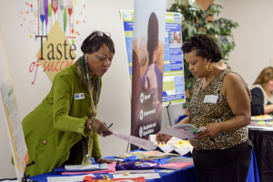
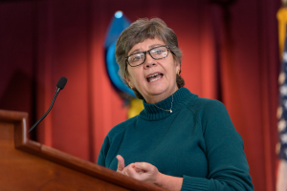
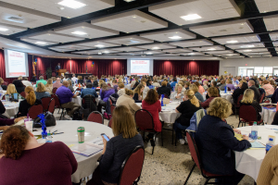
Looking ahead: DE-PBS Celebration Conference
Timing
Topics
School highlight ideas
Keynote guests

Slide 33
District Planning & Coaching

Slide 34
Is MTSS/PBS part of your district’s strategic plan?
Is there a team that oversees the implementation of the plan?
Is there a subgroup around MTSS or related goals supporting school climate, behavior and/or SEL?

Slide 35
District Planning

Slide 36
Coaching Supports – Thinking Ahead
Planning for summer team time; for coaches and teams
Discussing team leader transitions as needed
Discussing team membership transitions as needed

Slide 37
DE-PBS Phase Recognition
2017-2018

Slide 38
Recognition Phases & Materials
Phase I- Developing a SWPBS System
Phase II- Establishing an Advanced SWPBS System
Phase III- Developing a Targeted Team (Problem Solving Conversations)
Phase IV- Establishing a Targeted Team (Systems Conversations)
NEW: Online Applications
Reflection Guides
Frequently Asked Questions

Slide 39
17-18 SY Phase Recognition Reminders
Distribution in early March
Application entails end of the year program reflection
Recognition reflects CURRENT year effort; schools maintaining or advancing levels should apply yearly
Process should be a team effort
Application review - May

Slide 40
Phase Related Timeline
If a KFE is required or wanted, please contact Sarah Hearn (skhearn@udel.edu) no later than March 30, 2018
Project Staff can review applications beforehand if received by May 1, 2018
Applications due Friday, June 29, 2018
If confirmation is not received by July 16, 2018 please contact Sarah Hearn.
Notifications sent the week of September 17, 2018

Slide 41
It’s a Conversation
Do you have district conversations encouraging folks to apply for recognition?
Do you have time available to provide TA in completing the application process?
How do you use the recognition application or process as a tool with your teams?

Slide 42
Data Reminders: DDRT & DASNPBS
Discipline Data Reporting Tool (DDRT)
Template available on website
Submission 2x per year
January 13th
June 23rd
DE Assessment of Strengths and Needs
10 question survey per implementation area
Staff perspective on program strength/weakness for use in planning

Slide 43
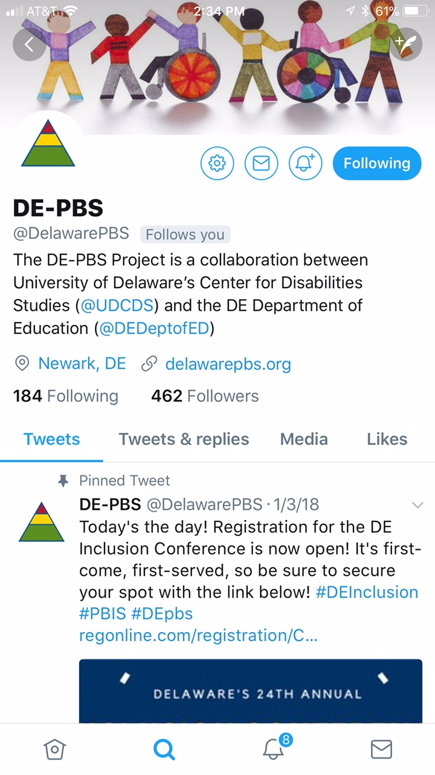
Twitter
@DelawarePBS
#Depbs
#PBIS (national)

Slide 44
Schoology

Slide 45
2018-2019 Cadre Planning
Are you happy with current timing?
3 Meetings
1/2 day sessions
Fall/Winter/Spring
Are you happy with current structure?
Updates (Data & PD)
Items for review & feedback
New ideas/tools to share
What topics would you like to see?

Slide 46
Resource Reminder Check out our website for PD materials, forms & tools and related links and resources
WWW.Delawarepbs.org

