Slide 1

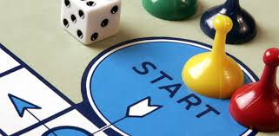
It Starts with Adults:
Self-care Strategies for Teachers
Debby Boyer, Delaware Positive Behavior Support Project
NEPBIS Leadership Forum, May 2018

Slide 2
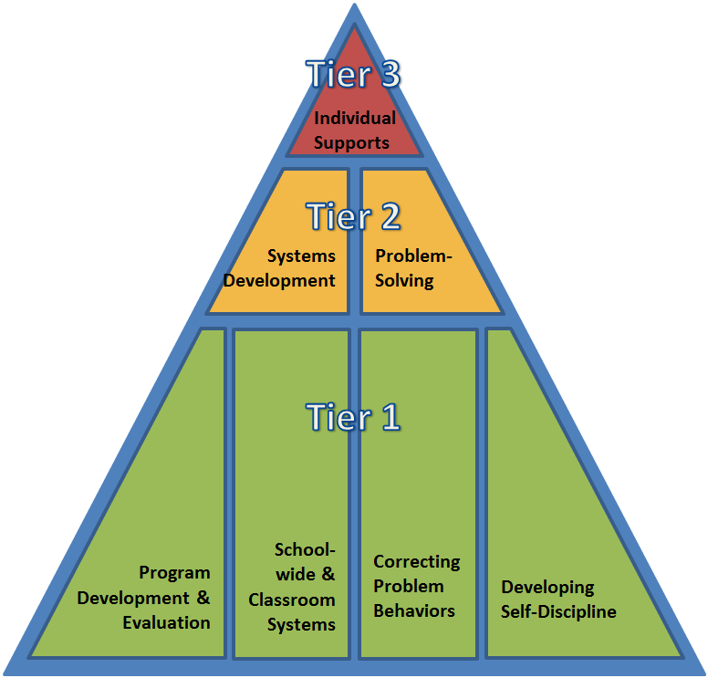


DE-PBS Project is on going collaboration between the Delaware Department of Education and the UD Center for Disabilities Studies

Slide 3
Objectives
Understand importance of educator emotional awareness and self-care
Identify specific self-care strategies
Reflect on current needs
Create self-care action plan
Notes:
Self-care and why it is important
Educator stress and burnout
Emotional intelligence
Emotional self-care
Self-care strategies
Self-care assessment & plan

Slide 4
MetLife Survey of the American Teacher
Survey of 1,000 K-12 public school teachers in 2012
About half (51%) of teachers reported being under great stress several days a week or more.
This was an increase of 15 percentage points over the 36% of teachers reporting this in 1985.
27% reported being under great stress almost every day
Half of principals (48%) also reported being under great stress several days a week or more
Notes:
https://files.eric.ed.gov/fulltext/ED542202.pdf
Conducted by phone
Less satisfied teachers are more likely to be located in schools that had declines in professional
development (21% vs. 14%) and in time for collaborationwith other teachers(29% vs. 16%) in the padt 12 months

Slide 5
Self-Care: Importance for Educators
Improves educator well being, which influences:
  educator burnout
  educator retention
  classroom climate
  student outcomes
cc: City of Seattle Community Tech - https://www.flickr.com/photos/67840815@N05
Notes:
( 1 minute)
Self-care is important to educators because it improves educator well being and this reduces educator burnout, supports educator retention, can lead to a more positive classroom climate, and having a positive classroom climate supports student outcomes

Slide 6
Self-Care and Other-Care
“Teaching school is like having jumper cables hooked to your brain, draining all the juice out of you”
-Stephen King, former educator

Slide 7
Self-Care and Other-Care
Helping professionals often feel a pull between self-care and other care
May be related to certain personality types being more likely to go into helping professions
Some learn to balance both, some face burnout because of the imbalance
Notes:
( 1 minute)
Helping professionals often feel a pull between self-care and other care
May be related to certain personality types being more likely to go into helping professions
Some learn to balance both, some face brnout because of the imbalance

Slide 8
Burnout
Occurs because of prolonged stress
Includes three components
  Emotional exhaustion
  Depersonalization
  Reduced personal accomplishment
Notes:
( 3 minutes)
Burnout occurs when educators are exposed to prolonged stress. Maslach and colleagues have studied burnout in helping professions and have noted that burnout occurs in three phases-emotional exhaustion, depersonalization, and reductions in personal accomplishment.
Emotional exhaustion, occurs when a person’s emotional energy is drained and the person does not feel like he or she emotionally capable to deal with a situation. Think of the educator who does not want to get out of bed to go to work or who is tired as soon as they walk into the classroom but may get a boost of energy once it’s time to leave the workplace.
Depersonalization occurs when a person feels detached from his or her students and acts in negative and dehumanizing ways (Maslach et al., 2001). This is likely to occur with children who the teacher may label as those with problem behaviors. Examples of depersonalization is viewing the child as “the behavior problem”.
And the third component of burnout, reduced personal accomplishment, occurs when a person feels like they cannot reach their work-related goals (Maslach et al., 2001). At this point, some will leave the classroom for other professions but others may stay because they have invested a lot of time or they cannot think of something else to do. This is problematic because educators in the reduced personal accomplishment phase who stay in teaching can’t create a positive classroom climate in their state and are also negatively impacting students perceptions of school and teachers.
To examine your own levels of burnout, you can purchase Maslach’s burnout inventory online. The information for this is located on the resource sheet.

Slide 9
Burnout leads to….
Inflexible, cynical, negative, and rigid educators
Depressive symptoms
High educator turnover rates
Negative student academic outcomes, negative student-teacher relationships, and lower quality classroom climates
Notes:
(2 minutes)
Burnout can lead educators to be inflexible, cynical, negative, and rigid (Freudenberger, 1977).
Researchers have also found that burnout can also lead to depressive symptoms (Shin, Noh, Jang, Park, & Lee, 2013; Steinhardt, Smith Jaggars, Faulk, & Gloria, 2011).
Educator burnout is also related to high turnover rates which presents a challenging to forming positive educator-student relationships. Moreover, educator burnout leads to negative student academic outcomes and lower quality classroom climates (McLean & Connor, 2015).
The teacher's years of teaching. New teacher, especially those who are idealistic and passionate are more likely to burnout
Those who work in schools where there is a lack of social support from colleagues and administrators are more likely to burnout

Slide 10
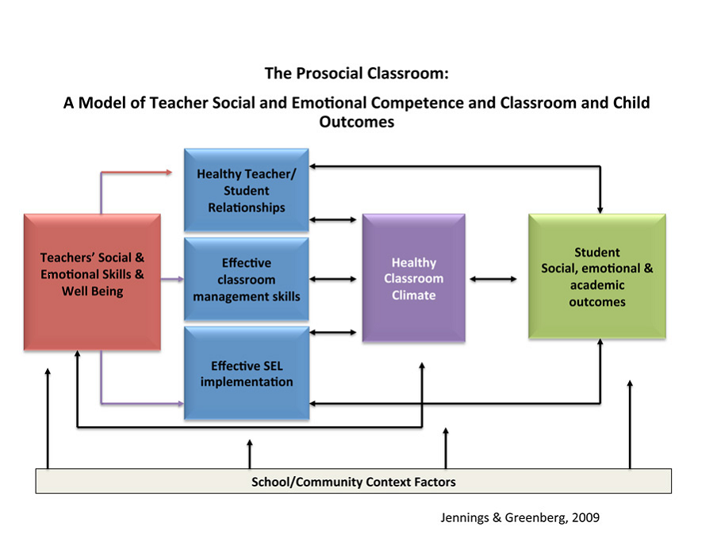
The Importance of Self-care: Prosocial Model
Notes:
( 3 minutes)
Why is this so important?
The theory behind this comes from the prosocial model.
Teacher’s social-emotional competence and well-being play vital roles in their ability to cultivate a prosocial classroom climate linked to desired student social-emotional and academic outcomes.

Slide 11
Prevention includes Teacher Well Being
MTSS/PBS
SEL
Positive School Climate
Teachers’ Social & Emotional Skills & Well Being
Internalizing Problems
Externalizing Problems
Notes:
Added Teacher bubble based on work of Jennings and Greenberg (2009) Teacher’s social-emotional competence and well-being play vital roles in their ability to cultivate a prosocial classroom climate linked to desired student social-emotional and academic outcomes.

Slide 12
CARE for Teachers:
Mindfulness-based PD program for teachers
Included emotion skills instruction, mindful awareness and stress reduction practices
Teachers in CARE cohort showed no decline in emotional support from beginning to end of year
Overall significant improvement in emotional support and classroom organization
Jennings, et al, 2017
Notes:
224 teachers
Classroom observations using CLASS – Pianta
assess emotional support and classroom organization

Slide 13

ACTIVITY: Skovholt Professional Resiliency and Self-Care Inventory
Look at Section 1: Professional Vitality
  Notice anything you resonate with or anything that surprises or concerns you
Notes:
(4 minutes)
Ask participants to take time to fill out the Skovholt inventory. Explain that this is a measure for all practitioners in the helping professions and so some questions may not seem relevant or worded differently
Just do section 1
After completing the inventory, respond to the questions that Skovholt included at the end of the inventory. Keep this mind as we move next to our discussion on burnout and self-care. ( if time allows, you can have participants reflect as a group on their own results).

Slide 14
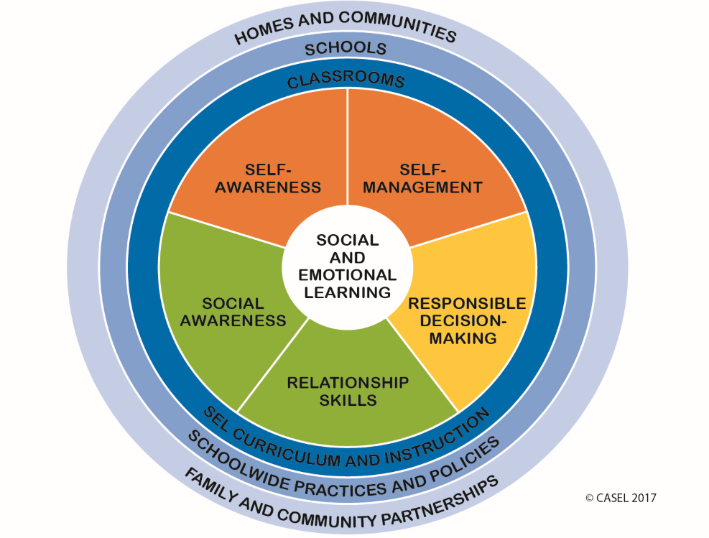

Slide 15
CASEL: SEL Competencies
Self-Awareness
Self-Management
Identifying emotions
Accurate self-perception
Recognizing strengths
Self-confidence
Self-efficacy
Impulse control
Stress management
Self-discipline
Self-motivation
Goal setting
Organizational skills
Notes:
Self-Awareness
The ability to accurately recognize one’s own emotions, thoughts, and values and how they influence behavior. The ability to accurately assess one’s strengths and limitations, with a well-grounded sense of confidence, optimism, and a “growth mindset.”
Self-Management
The ability to successfully regulate one’s emotions, thoughts, and behaviors in different situations — effectively managing stress, controlling impulses, and motivating oneself. The ability to set and work toward personal and academic goals.

Slide 16

Step One: Emotional Intelligence
A skillset used in the recognition, use, understanding, and management of your own emotions and the emotional state of others to solve social and internal problems and regulate behavior
Notes:
( 1 minute)
A skillset used in the recognition, use, understanding, and management of your own emotions and the emotional state of others to solve social and internal problems and regulate behavior (Mayer & Salovey, 1997; Salovey & Mayer, 1990). Unlike how we typically think of intelligence, this is a skillset. Thus, we can change it. If we have areas where we are currently struggling, we can improve with instruction and practice.

Slide 17
Higher Emotional Intelligence
Greater empathy
Better decision-making
Satisfying relationships
Greater job satisfaction
Lower likelihood of burnout
Notes:
( 1 minute)
Emotional intelligence is related to having greater empathy, better decision-making skills, more satisfying relationships and better social skills, and a lower likelihood of burnout and greater job satisfaction.

Slide 18

Emotions and Teaching
Teaching is emotional
When teaching it is difficult to be emotionally self-aware because your focus is outward
Not perceiving emotions then makes it more difficult to self-regulate
Notes:
( 1 minute)
Teaching is emotional. When students are angry, sad, wound up they are not in a place to learn. When teachers are in similar emotional states, they may be ineffective in their teaching.
To be able to change emotional states teachers must be aware of what state they are in and what state their students are in. It is difficult to be aware of your won emotions when teaching because your focus is outward.
Not perceiving emotions then makes it more difficult to self-regulate your emotions because you often become aware of them when they have reached a heightened level.
We must then use self-care and mindfulness strategies to be more in touch with our emotions during instruction to help us in regulating our emotions.

Slide 19
Emotional Intelligence includes…
Perceiving emotions
Using emotions to facilitate thought
Understanding emotions
Managing emotions
Notes:
( 3 minutes)
The emotional intelligence skillset includes the following skills:
perceiving emotions in yourself and others. This supports the awareness of your emotions before they get to a heightened level. This includes both physiological cues and thoughts.
using emotions to facilitate thought is the ability to use or generate emotions to focus attention, communicate feelings, or engage in cognitive processes such as reasoning, problem solving, and decision making.
(3) understanding emotions is the ability to label emotions, interpret the meanings that emotions convey, understand the complexity of emotions, and recognize the likely transition of emotions
And
(4) managing emotions is the ability (a) to stay open to both positive and negative emotions, (b) to engage or detach from an emotion based on its utility, (c) to monitor emotions in relation to oneself and others, and (d) to manage one’s own emotion and the emotion of others by enhancing pleasant emotions and moderating negative emotions without repressing or exaggerating the information that these emotions convey
(Mayer et al., 2001).

Slide 20
Perceiving Emotions
Ability to interpret cues to determine the emotion of others
Ability to interpret internal cues to determine emotion in oneself

Slide 21

Name that emotion
Notes:
(8 minutes: ~ 1-2 minutes per slide)-HAPPY
Use emotion cards for this activity and ask participants to raise an emotion card as you present each picture. After presenting the picture and asking participants to raise a card for the emotion. Discuss what cues they noticed that led them to that response. Discuss any differences in responses and what re reasons for those differences. For example, some facial expressions for emotions such as anger and disgust look similar and this is where context may be helpful. Also, there may be some differences in expression based on culture.

Slide 22
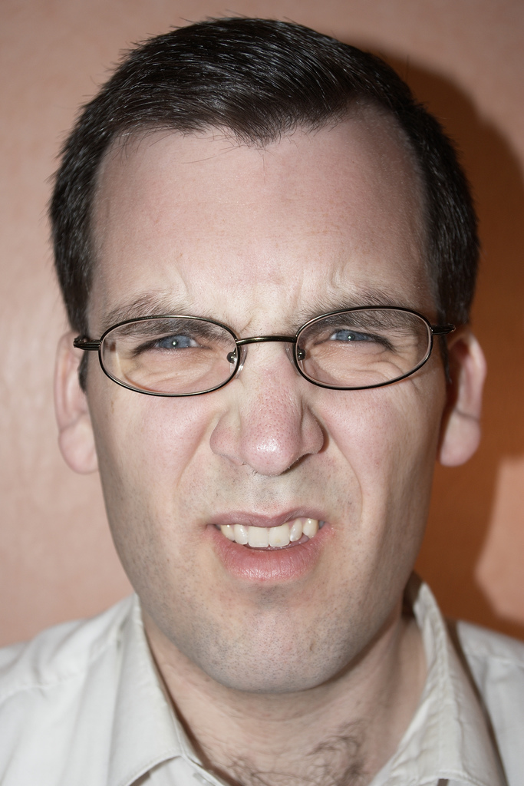
Name that emotion
Notes:
(8 minutes: ~ 1-2 minutes per slide)-DISGUSTED
Use emotion cards for this activity and ask participants to raise an emotion card as you present each picture. After presenting the picture and asking participants to raise a card for the emotion. Discuss what cues they noticed that led them to that response. Discuss any differences in responses and what re reasons for those differences. For example, some facial expressions for emotions such as anger and disgust look similar and this is where context may be helpful. Also, there may be some differences in expression based on culture.

Slide 23

Name that emotion
Notes:
(8 minutes: ~ 1-2 minutes per slide)
Use emotion cards for this activity and ask participants to raise an emotion card as you present each picture. After presenting the picture and asking participants to raise a card for the emotion. Discuss what cues they noticed that led them to that response. Discuss any differences in responses and what re reasons for those differences. For example, some facial expressions for emotions such as anger and disgust look similar and this is where context may be helpful. Also, there may be some differences in expression based on culture.

Slide 24

Name that emotion
Notes:
(8 minutes: ~ 1-2 minutes per slide)
Use emotion cards for this activity and ask participants to raise an emotion card as you present each picture. After presenting the picture and asking participants to raise a card for the emotion. Discuss what cues they noticed that led them to that response. Discuss any differences in responses and what re reasons for those differences. For example, some facial expressions for emotions such as anger and disgust look similar and this is where context may be helpful. Also, there may be some differences in expression based on culture.

Slide 25
Emotional Self-Care
Identifying, accepting, and expressing a range of emotions
Notes:
( 1 minute)
Emotional self-care refers to activities that help you in identifying, accepting, and expressing a range of emotions. We will talk a bit more about example as we continue the workshop but first let’s take some time to discuss this as a group and see if you all identified any emotional self-care activities.

Slide 26
Activity: Internal Cues for Emotions
Create a list of internal cues that let you know when you are feeling an assigned emotion
Use to bring attention to our emotions to help address before they reach boiling point
Notes:
15 minutes
Break into groups. Assign each group an emotion. Ask the group to create a list of ways that an emotion manifests within each group member. How do you know that you are feeling that emotion? What physiological cues and thoughts run through your mind? Create a list of internal cues that you are feeling the emotion of interest. Ask each group to walk around and look at what others have created and then as a group discuss:
Have you noticed differences in how you interpret this emotion and how others do? What cues are similar for you?
The key take-aways here are bringing attention to our emotions and checking in with our emotions throughout the day to help in addressing emotions before they boil over and contribute to burnout or a negative classroom climate

Slide 27
Positive Self-talk
Listen to what you are saying to yourself
Challenge your self-talk:
  Is there actual evidence for what I am thinking?
  What would I say if a friend were in a similar situation?
  Is there a more positive way of looking at this?
  Am I keeping everything in perspective?
  Can I do anything to change what I’m feeling bad about?
Change your self-talk
Notes:
Try countering negative thoughts – instead of “Il never be able to do this” – ask “Is there anything I can do that will help me be able to do this?”

Slide 28

Concept in Action
Ms. Nixon is a 3rd grade teacher. Her classroom schedule calls for reading and math lessons in the morning and she uses time after lunch for social studies or science lessons. She often dreads this time because her students come back from lunch with high energy and are often too excited, angry, or distracted to get to work on the lesson.
cc: DFAT photo library - https://www.flickr.com/photos/106853342@N04
Notes:
( 5 minutes) Read the First paragraph. Ask participants what are some ways that the teacher can support learning when the students are in these high level emotions? Discuss possible answers such as starting with a cool down period where students have some time to compose themselves and move to a different emotional state. The teacher can use music to facilitate this. The teacher can also create a high energy social studies or science lesson to match the energy of the students. This would be a good time for role-plays, a group game, or to learn a song about a social studies or science concept

Slide 29
Concept in Action
Ms. Nixon has her planning time in the morning while her students are at specials each day. She wants to use her planning time to start preparation for the next week’s lessons but finds that during her planning time she is often very tired and has trouble focusing on the lesson preparation.
cc: DFAT photo library - https://www.flickr.com/photos/106853342@N04
Notes:
( 5 minutes) Read the second paragraph. Ask participants what are some ways that the teacher can tune into her own emotions in the scenario and make a plan to support her preparation. Suggestions could be, she can increase her energy by going for a quick walk before starting the preparation or by listening to upbeat music prior to starting. Another may be for her to use this time for another low energy activity. So, this may be a time that she does some seat work or rests and she may do lesson preparation the last hour of the day once the students leave.

Slide 30
Self-Care is:
Engaging in activities or practices that help
limit or reduce stress
                Physical
                Emotional
                Spiritual
                Intellectual
                Social
                Relational
                Safety and Security
cc: arturodonate - https://www.flickr.com/photos/15790252@N06
Notes:
( 1 minute)
Managing our emotions involces Self-care
What comes to mind when you think of self-care?
Self care is Engaging in activities or practices that help you limit or reduce stress. These activities or practices can fit into seven categories ( read each category.
We are focusing on emotional self-care for today’s workshop.

Slide 31

Strategies For Self-Care
Mindfulness
Stress reduction activities
cc: dsevilla - https://www.flickr.com/photos/49014237@N00
Notes:
( 1 minute) 1:45 pm
Two strategies for self-care that we will discuss next are Mindfulness which is a strategy that can help you in the moment when you are faced with a challenging situation and stress reduction which can reduce overall stress levels to support you in better regulating emotions when challenges come up

Slide 32
Mindfulness
Developed over time with practice
Two components:
      Self-regulation of attention/awareness
      Non-judgmental
cc: AlicePopkorn - https://www.flickr.com/photos/14111752@N07
Notes:
( 1 minute)
Mindfulness refers to being in the moment . It is a characteristic and state that can be developed over time with practice. Is consist of 2 components- self-regulation of your attention/awareness and a non-judgemental awareness of the experience.

Slide 33

Mindfulness: Student scenarios
Think of a challenging situation with a student
What were you feeling?
What was your internal state (body awareness)?
What was your awareness of the environment?
How did you respond?
cc: RelaxingMusic - https://www.flickr.com/photos/83905817@N08
Notes:
(10 minutes)
Now let’s try the activity with a scenario from your own classroom. Think about a situation with a challenging child that occurred in your own classroom recently.
What did the child do? [give a minute to think through the scenario]
What were you feeling?
What was your internal state (body awareness)?
What was your awareness of the environment?
How did you respond?
[Ask the participants to share with those near them ]
This is a pretty difficulty concept to include in the moment and so there is a need to practice this on your own so you are training yourself to become more aware when a situation occurs that provokes a strong emotion. In the resource sheet is a link to a YouTube video that walks you through a body scan activity that helps you in gaining awareness of your physiological reactions to emotion so you will be better able to identify them when faced with a classroom situation.

Slide 34

What to do with known patterns
Uncover the reason for response
Plan ahead for response
Create plan to debrief
cc: erink_photography - https://www.flickr.com/photos/49268016@N04
Notes:
Once you’ve reflected on your reactions to challenging behavior and are aware of patterns you can now start to explore and uncover the reason for the response. You can then use this insight to come up with a plan for how you will react in the future and create a plan to debrief in particularly challenging situations

Slide 35
Reducing Stress and coping during stress
Develop proactive coping strategies when you feel your emotions rising
Map out your day and identify times or tasks that make you feel the most stressed and develop a plan to address
Establish coming home rituals to create clear boundary
  Talk to colleague to process emotional day
  Write about before you leave
  Create to do list
  Listen to audiobook or call friend on way home
  Play uplifting music
  Sit in silence to decompress
Notes:
Stress reduction is important for reducing teacher burnout, influences our relationships, and can influence your mental and physical well-being. Our reactions to stress is also known as the "fight-or-flight" response because it evolved as a survival mechanism, enabling people and other mammals to react quickly to life-threatening situations. The body can also overreact to stressors that are not life-threatening, such as traffic jams, work pressure, and family difficulties. In doing so, we invoke the same reactions that can result in scary physical symptoms such as damage to our cardiovascular system. Emotional regulation is key. In addition to emotion regulation in the moment through mindfulness, we can work at cultivating better well-being through the use of self-care activities to build our resiliency.

Slide 36
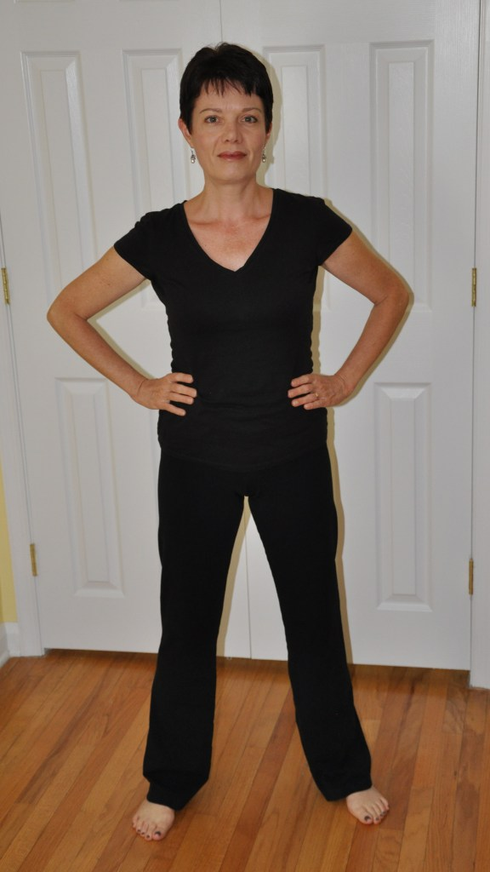
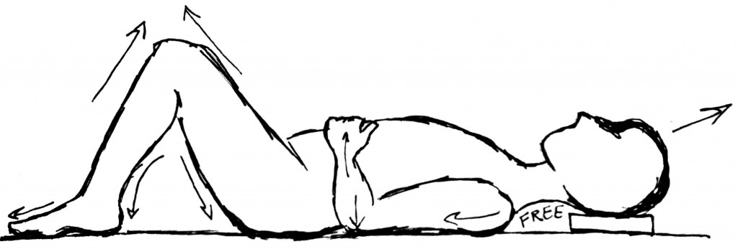
Wonder Woman Pose and Constructive Rest
Guided practice activity – 2 min
  https://imogenragone.com/boost-your-wonder-woman-with-the-alexander-technique/
Constructive Rest & Alexander Technique
  https://sound-direction.com/constructive-rest/
Notes:
Alexander Technique
Amy Cuddy

Slide 37

ACTIVITY: Create a self-care action plan
cc: Tatiana12 - https://www.flickr.com/photos/98826299@N00
cc: incurable_hippie - https://www.flickr.com/photos/49503155381@N01
Notes:
(5 minutes)
Look at you self-care asssesment and let’s take a moment to think about some activities that you could add into the work day ( these do not both have to take place on a particular day but just to create a list of possibilities of things you can add into your day to increase your enjoyment and lower your stress.
To help in the process, look around the room and look at the self-care activities that others came up with. Are there any that look particularly interesting to you? Write them down
Select to 1-3 activities that you want to incorporate more regularly and write them down. Be modest in your goal and build upon on realistic change

Slide 38


Keep your plan alive: Wellness-accountability buddy
Finding a peer or a group who agree(s)to support you and encourage you to keep you wellness goals
Using a PLC as a time to check in with each other
Notes:
From Edutopia article

Slide 39
Creating a System of Care for Educators
Apply PBIS concepts to the adults the building
  Create clear expectations
  Provide high rates of positive attention
  Support positive relationships

Slide 40
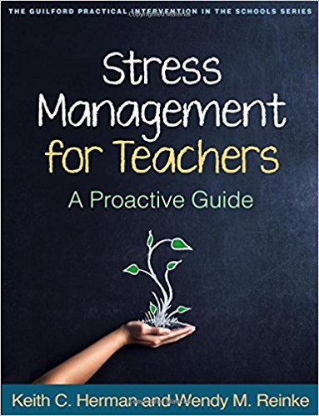
Resources
Article on Developing Your Self-Care Plan
https://socialwork.buffalo.edu/resources/self-care-starter-kit/developing-your-self-care-plan .html
Stress Management for Teachers

Slide 41
Thank you!
Debby Boyer: dboyer@udel.edu
Delawarepbs.org
Notes:
Megan

