Slide 1

State
District
School
State and District Leadership:
Strategies to get the
PBIS job done.
Sarah Hearn – Delaware PBS Project
Sarah Schmittinger-Kashner – Red Clay Consolidated School District

Slide 2


The Delaware Positive Behavior Support Project is a collaboration with the DE Department of Education, the UD Center for Disabilities Studies, and
Delaware Public Schools.
Vision create safe and caring learning environments to promote the social-emotional and academic development of all children.

Slide 3
Session Learning Objectives
Identify strategies used by state PBIS project in facilitating district-level MTSS for behavior planning
Explore the district’s structures and strategies used to systematically provide ongoing professional development and coaching to school-based team leaders
Examine one district’s process for developing a District MTSS Behavior Leadership Team

Slide 4

Quick Delaware & Red Clay Statistics
DELAWARE INFORMATION
“The First State”
2nd Smallest State in the US with a length of 96 miles long and a width between 9 and 35 miles
3 counties with 43 LEAs – approximately 220 Public Schools with 64% involved with DE-PBS Project
RED CLAY CONSOLIDATED SCHOOL DISTRICT
Largest public school district in the state
Serves more than 16,000 students
15 elementary schools, 6 middle schools, 5 high schools, and 3 special education schools

Slide 5

Let’s explore capacity building strategies used by the Delaware PBS Project to implement MTSS for behavior

Slide 6
History Snapshot
With longevity of project comes navigating shifts in focus.
  PBIS as Tier 3, special education driven initiative → School-wide Tier 1, focus on all initiative
  Focus on more tangible reinforcement → Use of positive praise & social-emotional learning focus
  Training school-based teams → Establishing district systems to drive team-based PD & supports

Slide 7
School Climate Transformation Grant Goals
To increase the state’s capacity to provide training and technical assistance (TA), which includes enhancing districts’ capacity to support schools’ implementation of multi-tiered systems of support (MTSS)
To improve school climate and behavioral outcomes for all students through MTSS

Slide 8
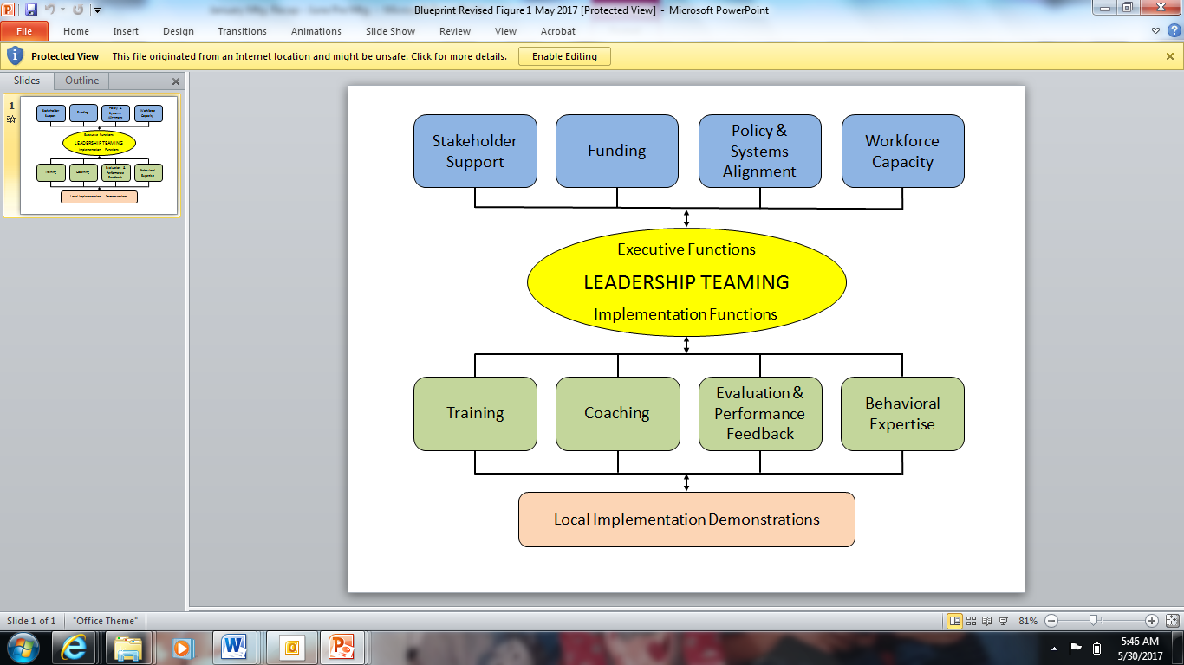
State → District →School
MTSS Capacity
PBIS/MTSS Implementation Blueprint
How?
Start at the top
  Correct misconceptions
  Align related initiatives to ensure success of all
  Create common language

Slide 9
Leadership Team Elements
Authority to address state or district implementation (e.g., policy, professional development, evaluation, scheduling, funding).
Representation from the appropriate range of stakeholders from the local community
Completes self-assessment & develops a 3-5 year action plan
Uses formal procedures for securing majority agreements from members of implementation unit for decision-making and policy and procedural approval and problem solving challenges, conflicts, etc.
Informs other leadership personnel on implementation outcomes (e.g., fidelity, student outcomes, professional development).

Slide 10

Delaware PBS State Advisory – New Turf
Membership
  DE Dept. of Education
  University of DE
  LEA and school representatives
  Children’s Dept.
  Health & Human Services
Meeting topics
  Establish common MTSS understanding
  Review existing efforts; Clarify misconceptions
  Statewide initiative alignment

Slide 11
Where do we start?

Slide 12

State-wide Initiatives
Understanding → Alignment
Coordinate and lead process with executive level team
Define valued outcome(s)
Develop inventory of current related initiatives
Identify core systems features for initiatives targeted for alignment
Analyze and make decisions about conflicts and duplicative elements; identify missing fidelity and outcome measures
Design plan for effective alignment including implementation, evaluation and PD

Slide 13
PBIS/SEL Initiatives
How do we all fit in?
Name | DE - PBS
Lead organization | DE Department of Education UD Center for Disabilities Studies
Population served | MTSS – Tier 1-2-3
Goals of initiative | Create safe and caring learning environments that promote the social-emotional and academic development of all children Improve school climate Decrease office referrals, suspensions Decrease disproportionality rates
Outcomes & fidelity measures | School climate data ODR Systems fidelity – Tier 1 & Tier 2 Tier 3 – support plan fidelity (TATE)
Type of PD & Coaching | In-person workshops Online PD materials (new) Coaching through district staff
Prompt: Reflect on initiative on which you work, consult or research
Note the following per initiative:
  Lead organization
  Population served – Tier 1, Tier 2, Tier 3
  Goals
  Outcome & fidelity measure(s)
  Types of training & coaching provided

Slide 14
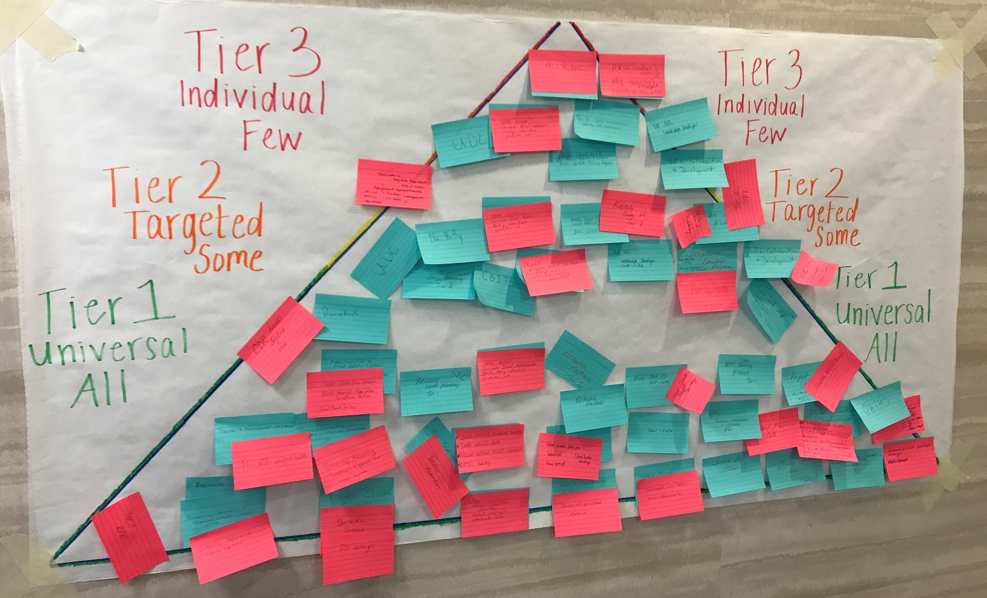

Slide 15

Delaware District Structures
Cadre of District Coaches
MTSS Behavior District Leadership
Coaches identified in districts with schools active with the DE-PBS Project
Coaches selected by district
Coaches have variety of roles, time allocated to PBIS and PBIS knowledge & coaching skills
Gather 3 times per year
Identifying key district staff along with coach(es) with whom we can examine data, problem-solve & plan
Part of planning is establishing representative district team

Slide 16
MTSS FOR BEHAVIOR/SOCIAL-EMOTIONAL LEARNING
DISTRICT LEVEL READINESS CONSIDERATIONS
In the district, is there a need and desire to promote positive school climate, reduce suspensions and behavior referrals, and improve academics?
  Which data sources support this?
Is there desire and commitment from district leadership to support implementation of a multi-tiered system of support (MTSS) for behavior/social-emotional learning (SEL) across all schools?
  How does this connect to your district’s existing strategic plan?
  Does district leadership need additional information on MTSS?

Slide 17
MTSS FOR BEHAVIOR/SOCIAL-EMOTIONAL LEARNING
DISTRICT LEVEL READINESS CONSIDERATIONS
With support from district administration, is there commitment to developing & maintaining a 3-5 year district-wide action plan to build & sustain the MTSS/PBS/SEL framework across all schools?
  What are potential avenues for collaboration/coordination based on existing initiatives and plans within district?
  How will your district work with schools interested in MTSS/PBS/SEL framework development & implementation?
  Considering readiness, buy-in and need, how will schools be identified to receive training and support?
Which district representative(s) will serve as the MTSS District Coordinator(s) (i.e., lead contact, core decision makers) for all behavior/SEL initiatives within your district?
  Who is in the current leadership role for related initiatives, such as school climate & discipline, social-emotional learning, etc.?

Slide 18
MTSS FOR BEHAVIOR/SOCIAL-EMOTIONAL LEARNING
DISTRICT LEVEL READINESS CONSIDERATIONS
Is development of a district team a desired action item for the district and supported by administration? This team of stakeholders would be supported by the DE-PBS Project to lead development of action plan and drive implementation efforts.
  What teaming structure would be a good match for our district context?
  Do we have existing teams with similar goals with which we can integrate?
  Would it make sense for our district to utilize a smaller core implementation/development team with a broader, representative team to support data-based action planning and implementation efforts?
Who are the MTSS for Behavior/SEL Coaches with allocated time & skills identified by the MTSS District Coordinator(s) to receive DE-PBS Project support and provide in-district professional development and technical assistance?

Slide 19
DE-PBS & Red Clay District Partnership Shift
DE-PBS through School Climate & Student Success partnership has MOU with Red Clay District
  District leadership team imbedded
Conducted PBIS Blueprint as baseline & provide direction
Technical assistance shifted from select schools to district behavior support leaders
  District team development guidance (discussing vision, outcomes, membership)
  Ongoing leadership team agenda development & debrief support
  Ongoing PD through project, such as coaching content & Tier 3 Redesign

Slide 20

Let’s explore strategies used by the Red Clay Consolidated School District to systematically implement MTSS for behavior.

Slide 21
Strategies
Professional development focus
MTSS Team Leader structures & supports
District coaching & monitoring
Establishing district leadership team

Slide 22
District Demographics
Enrollment by Race/Ethnicity | 2016-17 | 2017-18
African American | 20.5% | 20.7%
American Indian | 0.3% | 0.3%
Asian | 6.6% | 6.7%
Hawaiian | 0.1% | 0.1%
Hispanic/Latino | 26.4% | 27.0%
White | 43.6% | 42.3%
Multi-Racial | 2.5% | 2.9%
Students- 17,032
Schools- 27
PBIS Schools- 14
English Language Learners- 14.7%
Special Education- 14.1%
Low Income- 34.1%

Slide 23

District-wide Multi-Tiered System of Support-
Where did we start?
Evaluated current MTSS status
  Tier 1- School-wide
  Tier 2/3- Problem Solving teams
  Why did we need a district-wide process?
    Every building operating in silos
    Continuity for students/staff
  Positive Outcome- Built MTSS system into district strategic plan

Slide 24
  School Level MTSS Implementation
    Team Development
    Training- PST process
Team leader for each tier per building
Team membership- 6-8 people, representative teams
Meeting once a month for Tier 1
Meeting twice a month for Tier 2/3 PST
  Systems/student cases
Administration
Team Leaders
Building Staff and faculty
District office

Slide 25
How Does the District and State Support This?
Building level meetings
  PBIS (School –wide), one hour per month, 6-8 team members
  PST (Tier 2/3), two meetings per month, one hour each, 6-8 members
      Systems Meeting
      Student Cases
District level team leader meetings
  Substitute coverage for PBIS Team Leader meetings every other month
  Substitute coverage for PST Team Leader meetings quarterly
  PST and PBIS Team leader stipends yearly
State level ongoing professional development
  Tier 1 School-wide PBS & Systems for Positive Classroom Behavior Support
  Tier 2 – Targeted team training & networking opportunities
  FBA/ BSP training in Prevent-Teach-Reinforce (PTR) process
  State supported substitutes

Slide 26
Team Leader Networking and District Training Structure
Team Structure & Language Used:
  Tier 1 Teams = School-wide Teams with PBIS leads
  Tier 2/3 Teams = Problem-Solving Teams with PST leads
Team Leaders- One per building for each tier (or co-leaders)
    Name submission from Principals yearly for team leader position
District Coach trains & supports team leaders on the following schedule:
    PST team leaders meet 4 times a year
    PBIS team leaders meet every other month
    PST and PBIS team leaders as well as suspending building administrator meet two times a year.
    PST and PBIS teams- Ongoing collaboration within schools (shared members)
    District coach supports building level custom PD
    Maintenance- District coach meets individually with building admin and team leader every spring.

Slide 27
Sample Agenda Topics from Team Leader Meetings
Thinking CAP Discussion- In quads, discuss possible alternatives to external suspensions that you think might work to decrease student misbehaviors. Make a short list of the interventions and be ready to give a brief description of the two three interventions you came up with as a group. Be ready to share out in 6 minutes.
Clint Smith- “The Danger of Silence” https://www.ted.com/talks/clint_smith_the_danger_of_silence?language=en
Disciplinary Alternatives to Suspensions - Hanover
Video- The Behavior Education Program: a check-in, check-out intervention for students at risk

Slide 28
Sample Agenda Topics from Team Leader Meetings
Student Scenarios- what would YOU recommend for any two of the four students?
School Climate & Youth Development (Handout: Discuss @ school)
Discipline: Effective School Practices (Handout: small group discussion)
How to use school climate data (staff)- Large Group Discussion
PST Brainteaser
Childfind Regulations and questions
Cause I Ain’t Got a Pencil (Poem)

Slide 29
District Coach- Spring Maintenance Meeting- Sample Agenda
Strengths of the PBIS program (current year)
Areas of Growth
Goals for the (next) school year
Using Big 5 data in faculty and PBIS meetings?
  What data sources?
  How often?
Review triangle data. Reflections.
Assessment Measures: Survey Monkey: Strength and Needs Assessment, School Climate Survey, TFI or Key Feature Evaluation?
Summer planning meetings/PD?
How can the district provide support next year?

Slide 30

An Increase in Emotional Intensity

Slide 31

Dependence on Role-Bound Authority

Slide 32

A Dependence on Punishment

Slide 33
Next: “We need a behavior support team”
District Vision and Strategic Plan
Behavior Support Coaches – 2 staff
  Attend Bi-monthly Behavior Support Team (BST) problem solving meetings
  Behavior Coaches meet with each building team leader one a month
    Answers building specific questions
    Develops upcoming agendas for Tier 1 or Tier 2/3 meetings
    Action Planning
    Attends building MTSS meetings
  Train on MTSS district wide (tier 1, classroom management, teacher toolbox)
  Provide custom building based faculty training, PLCs, targeted teams
  Classroom management consultation with teachers

Slide 34
Next: “We need a behavior support team”
District vision and strategic plan
Behavior Analyst- 2 staff
  Attend weekly Behavior Support Team (BST) problem solving meetings
  Provide professional development district-wide
  Support monthly psychologist meeting PD- 45 min-1 hr.
      Topics include: FBA,BSP, self-care, internalizing behaviors, developing coping skill goals, how to collect meaningful data.
  Consult on Tier 3 student cases
      Paper review and feedback
      Observation of student
      Consultation with building based psychologist
      Observation, Consultation and development of documents

Slide 35
Multi-Tiered System of Support
Tier 1 Team
Leader
School-wide
Team
Tier 2 Team Leader
PST Team
Tier 3 Team Leader
PST Team
Plans SW & Class-wide supports
System
Conversations
Uses process data; evaluates overall effectiveness; does not involve discussion of individual students
Problem Solving Conversations
Matches students to interventions and monitors progress, making adjustments as needed
Uses Process data; determines overall intervention effectiveness
Universal Support through SW Program
Explicit Teaching of Expectations
CICO
FBA/BSP
PTR
Person Centered Planning
Group interventions
Group w. individual
features
Brief
FBA/BSP
DE-PBS Project March 2015
Adapted from the Illinois PBIS Network
Notes:
35
35

Slide 36
  How did we determine what the process would look like for the Tier2/3 problem solving team structure?
    Response to Intervention (RTI) under the IDEA
    State Administrative Code
      Problem Solving in General Education and Instructional Support Teams
      Response to Intervention Procedures

Slide 37
Looking forward as a District
Assessed and identified current areas of need
  Increase social-emotional learning curricula district wide
  Additional training in basic FBA/BSP development
  Additional training in data collection and goal setting
  Increase support for students with highest needs
  Increasing district partnership to get mental health supports to students
  Continuing to build MTSS in every building
Increasing MTSS fidelity district wide

Slide 38
Developing a Red Clay District’s
MTSS Behavior Leadership Team
Membership
  Cross district-level groups (pulling from silos)
  Strategic school level invitations
    PBIS & Non-PBIS
    Elementary & Secondary
    Successful & Struggling

Slide 39
Developing a Red Clay District’s
MTSS Behavior Leadership Team
Agenda Topics
  MTSS understanding & current district structures
  Discuss desired outcomes for district MTSS efforts
  Current data exploration (fidelity, tier 3 survey, etc.)
  Student case study & problem-solving discussion
  District-wide MTSS expectations: required vs. flexible components

Slide 40
MTSS Tier Level | Required Components | Flexible Components
Tier 3: Data, Systems & Practices in place for FEW | Problem-solving Team Data-based Decision Making & Data Collection Functional Behavior Assessment & Behavior Support Plans | Individual Interventions Person centered planning PTR: Prevent-Teach-Reinforce
Tier 2: Data, Systems & Practices in place for SOME | Problem-solving Team Data-based Decision Making & Data Collection Relationship Building Intervention (minimum 1) Skill-based Small Group Intervention (minimum 1) | Additional Relationship Building Interventions Additional Skill-based Small Group Intervention based on building identified needs (may be aligned with re-teaching of social/emotional curriculum)
Tier 1: Data, Systems & Practices in place for ALL | Tier 1 Leadership Team Data-based decision making & Data Collection School-wide Expectations Teaching/Re-teaching of Expectations Major/Minor Flow Chart System for Correcting Problem Behavior Systems Meeting with Special/Student Services staff (minimum monthly) | Home Matrix Use of Incentives Social/Emotional Curriculum Integrated initiatives w/in Tier 1 MTSS Responsive Classrooms Leader in Me Trauma-Informed Practices

Slide 41
What’s Next
Strengthen State leadership & MTSS understanding
  MTSS – A & MTSS-B
Support related State initiative integration
Enhanced development of district leadership teams
Expanding deeper understanding of district team to provide supports efforts

Slide 42

Thank you!
Questions? Ideas?
Sarah Hearn
skhearn@udel.edu
Sarah Schmittinger-Kashner
sarah.kashner@redclay.k12.de.us
Delaware PBS Project
Center for Disabilities Studies
University of Delaware
www.delawarepbs.org

