Slide 1

Mindfulness for Self-Regulation: Classroom Strategies for Teachers
Delaware Positive Behavior Support Project
Niki Roberts Ed.S.
NEPBIS Leadership Forum, May 2018

Slide 2
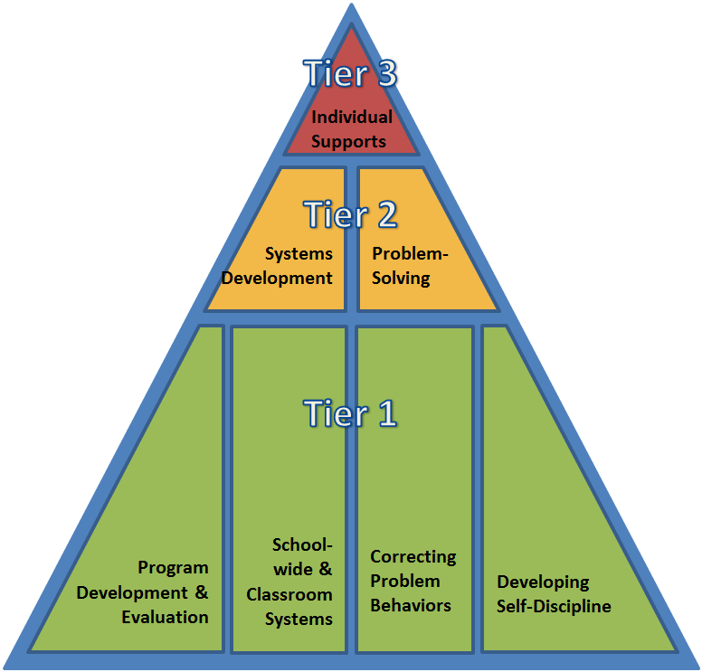


DE-PBS Project is on going collaboration between the Delaware Department of Education and the UD Center for Disabilities Studies

Slide 3
Take a moment to complete the MAAS survey
Brown & Ryan, 2003

Slide 4
Purpose
To link principles of mindfulness and self-regulation
To gain exposure to classroom strategies which foster mindfulness
To map mindfulness strategies onto a classroom PBS matrix

Slide 5
Can you think of a student like this?
Jimmy loves playing soccer at recess. One day, he races out onto the playground with his friends and notices the soccer goals have been moved. No soccer today. Jimmy runs to the teacher and begs her to call for the soccer goals. The teacher reminds him that there are other choices but he continues to escalate and begins to cry. He takes most of the recess period to calm down before choosing an alternate activity.
What skills does Jimmy need to enjoy recess,
even when his favorite activity is unavailable?

Slide 6
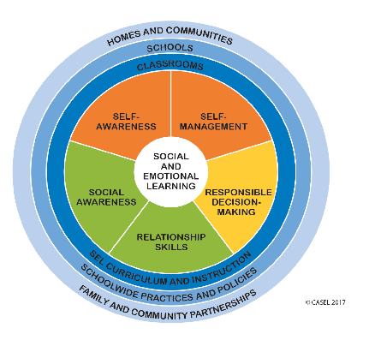
SEL Skills to Self Regulate
Self awareness (identify emotions)
Self management (impulse control)
Social awareness (perspective taking)
Relationship skills (communication)
Decision making (solve problems)

Slide 7
A child with good self regulation skills can
Stop playing that video game and come to dinner
Pick up their toys when asked
Turn their attention to an adult when asked
Withhold the impulse to
  Grab another’s toy
  Hit another child
  Scream when they don’t get their way
Maintain attention to a particular task even in the context of distractions
Biglan, 2018

Slide 8
Mindfulness Defined
"Mindfulness means paying attention in a particular way: on purpose, in the present moment, and nonjudgmentally (Jon Kabat-Zinn).”
“The process of noticing new things and drawing novel distinctions which keeps us situated in the present (Ellen Langer).”

Slide 9
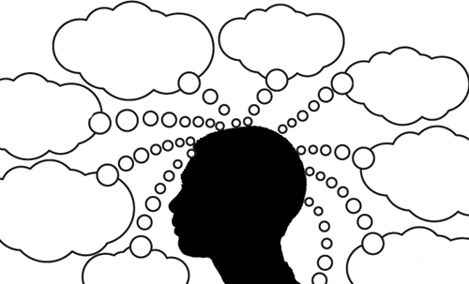
The ability to purposefully attend to thoughts, feelings and sensations while ignoring others.
Attention
Helps a student to:
NOTICE their thoughts, feelings and sensations
Prevent escalation of difficult emotions
Felver et al., 2013
Notes:
Self-regulation involves: any action an individual directs at themselves so as to result in a change in their behavior (from what they might otherwise have done) in order to change the likelihood of a future consequence or attainment of a goal.

Slide 10
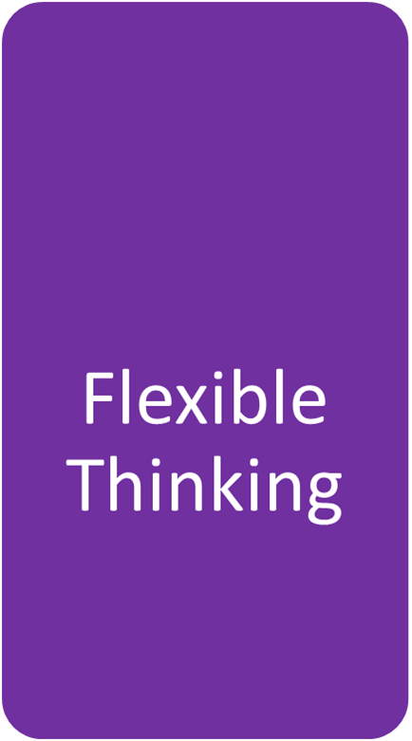
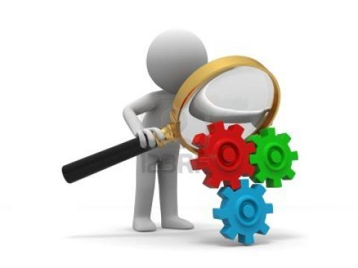
An orientation to the current experience that is characterized by curiosity, openness and acceptance.
Helps a student to:
Think about their experiences in new ways,
Slow down to control impulses
Notice things for what they are (neither + or -)
Understand that events are not inherently good or bad: it is thinking them that makes them so.
Felver et al., 2013

Slide 11
What is Mindfulness?
Stimulus
Flexible Thinking
Response
Attention
Mindfulness
Notes:
This visual shows how mindfulness changes our responses to stimulus. In this model, our attention is situated in the present. We are actively focusing our attention on important stimuli while suppressing or ignoring other stimuli. The person is curious about the stimuli and accepts it for what it is (neither + or -). This in turn, causes the person to consider multiple ways to respond or view a situation from different perspectives.

Slide 12
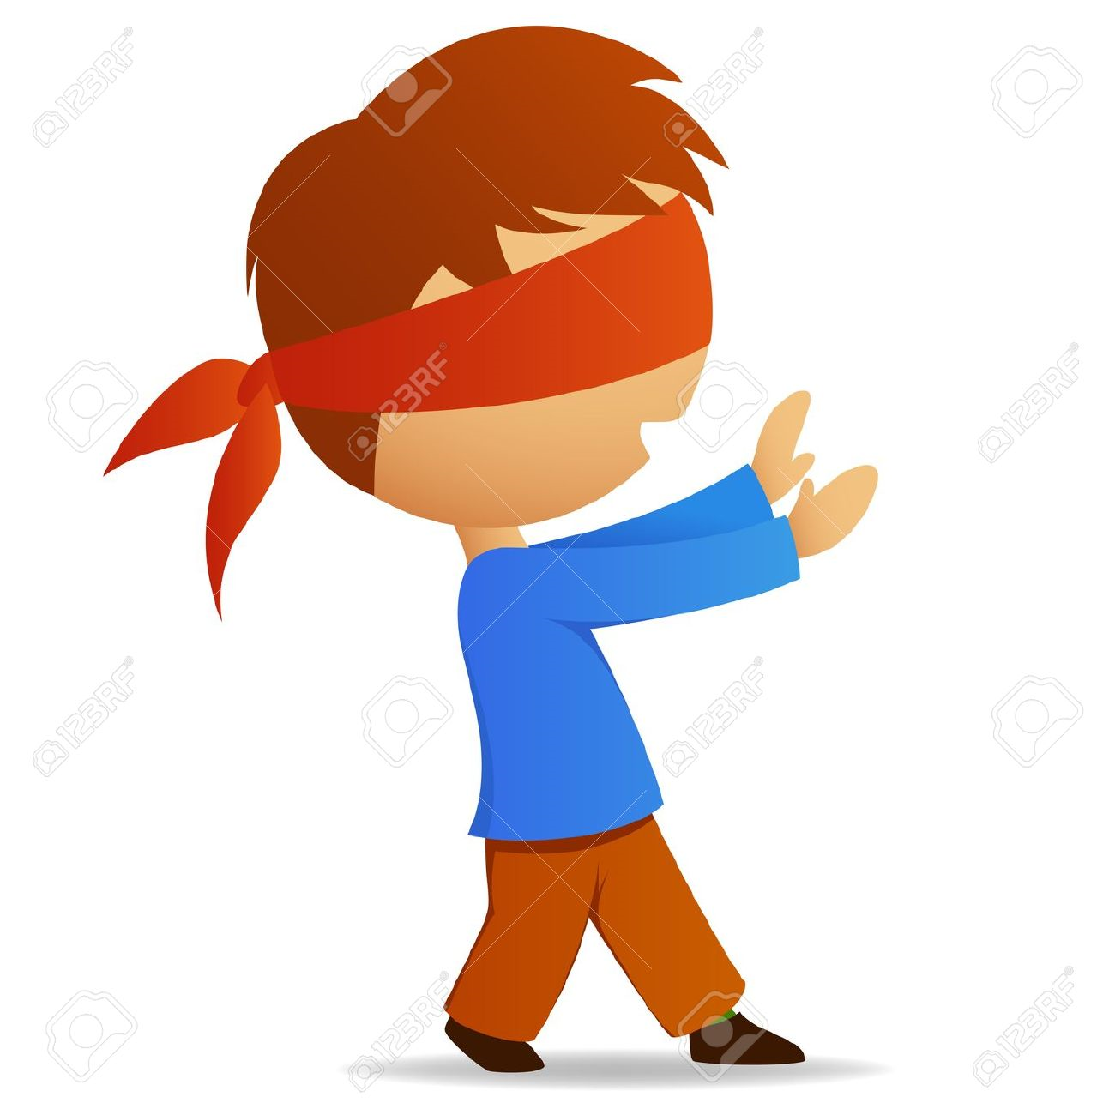
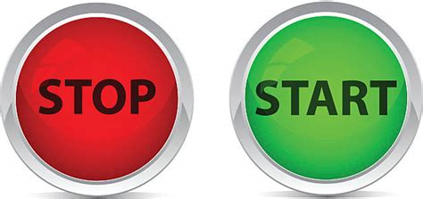
What is Mindlessness?
Stimulus
Categorical Thinking
Response
Automaticity
Mindlessness
Notes:
This visual shows how mindlessness changes our responses to stimulus. In this model, our attention is essentially acting on patterns of past responses. Rather than actively noticing present stimuli the person relies on past modes of thinking (think stereotypes). This in turn, causes the person to respond on auto pilot (think habits).

Slide 13
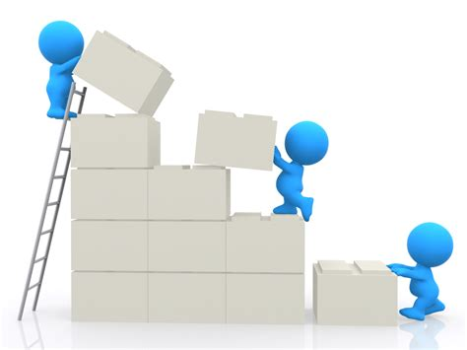
Let’s put it all together…
Attention
Flexible Thinking
Mindfulness
Self Regulation
Notes:
Mindfulness helps students to build self regulation or the ability to manage ourselves to achieve our goals.

Slide 14
Survey Says…

Slide 15
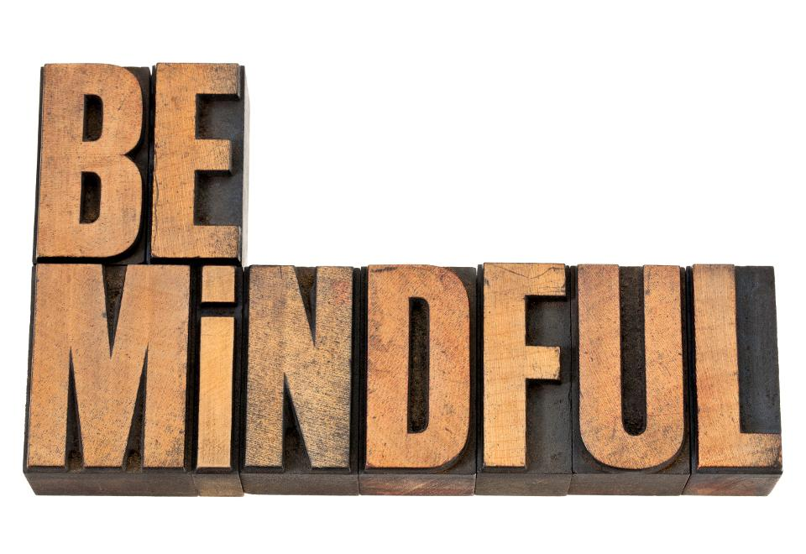
Seek out, create, and notice new things.
Realize how behavior can be understood differently in different contexts.
Reframe mistakes into successes.
Be aware that stress (and all emotions) are the result of our views about events.
Be authentic.
(Caprino, 2014)
Notes:
You can start being more mindful TODAY… without a meditation practice. Here are some quick tips to be more mindful at work and home.
Example of musicians changing only a small part of their music; improved their quality of performance or salespeople making a new pitch. Allows us to become more creative in developing new solutions to problems.
Words and deeds – their own and others – make sense given the context in which they were delivered. If a child acts in a way that you think is hurtful or impulsive, the person did it for reasons that made sense to him or her.
Try this:: think of a coworker or friend that has done something that would typically embarrass or anger you. Now, think of three positive reasons that the individual might have acted in this way. How did it make sense from his/her perspective? By coming up with positive reasons for another’s behavior, you’re more likely to be more understanding, empathetic, and open to seeing the situation in new and positive ways.
Post it note example → instead of focusing on the failure; consider the components that were beneficial.
Things are not intrinsically either positive or negative; we make them so by our thoughts and judgements.
Try this: Consider a particular event which would normally cause you stress. First, think of three outcomes that you perceive are “negative” that generate fear. Then, think of three reasons why this negative event you fear may not even occur. Finally, think of three reasons why, if this perceived “negative” event were to occur, it could have positive ramifications in the long run. The key is to understand that stress is created by your interpretations of events, not the events themselves. Greater awareness of your thoughts and judgments creates greater choice.
If you are untrue to yourself, nothing else in your life can work positively. Being authentic means that you are willing to question the conventional wisdom of what “works,” what doesn't, what's allowed, and what isn't.
Try This: Today, identify three things you don’t like about yourself. What is the positive version of each of these traits? Can you reframe what you don’t like to create a more positive interpretation of your qualities and traits? For example, are you “slow” or merely contemplative? Are you “impulsive and rash,” or simply spontaneous? Are you “obstinate” or determined and tenacious?

Slide 16
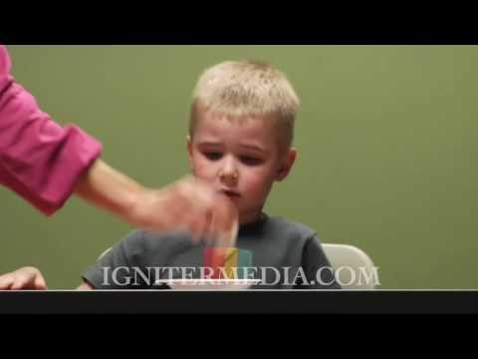
Self Regulation skills at Work…
https://www.youtube.com/watch?v=QX_oy9614HQ
What self regulation strategies did the children use to avoid eating the marshmallow?
How might mindfulness enhance the self regulation skills of the children who did not wait to eat the marshmallow?

Slide 17
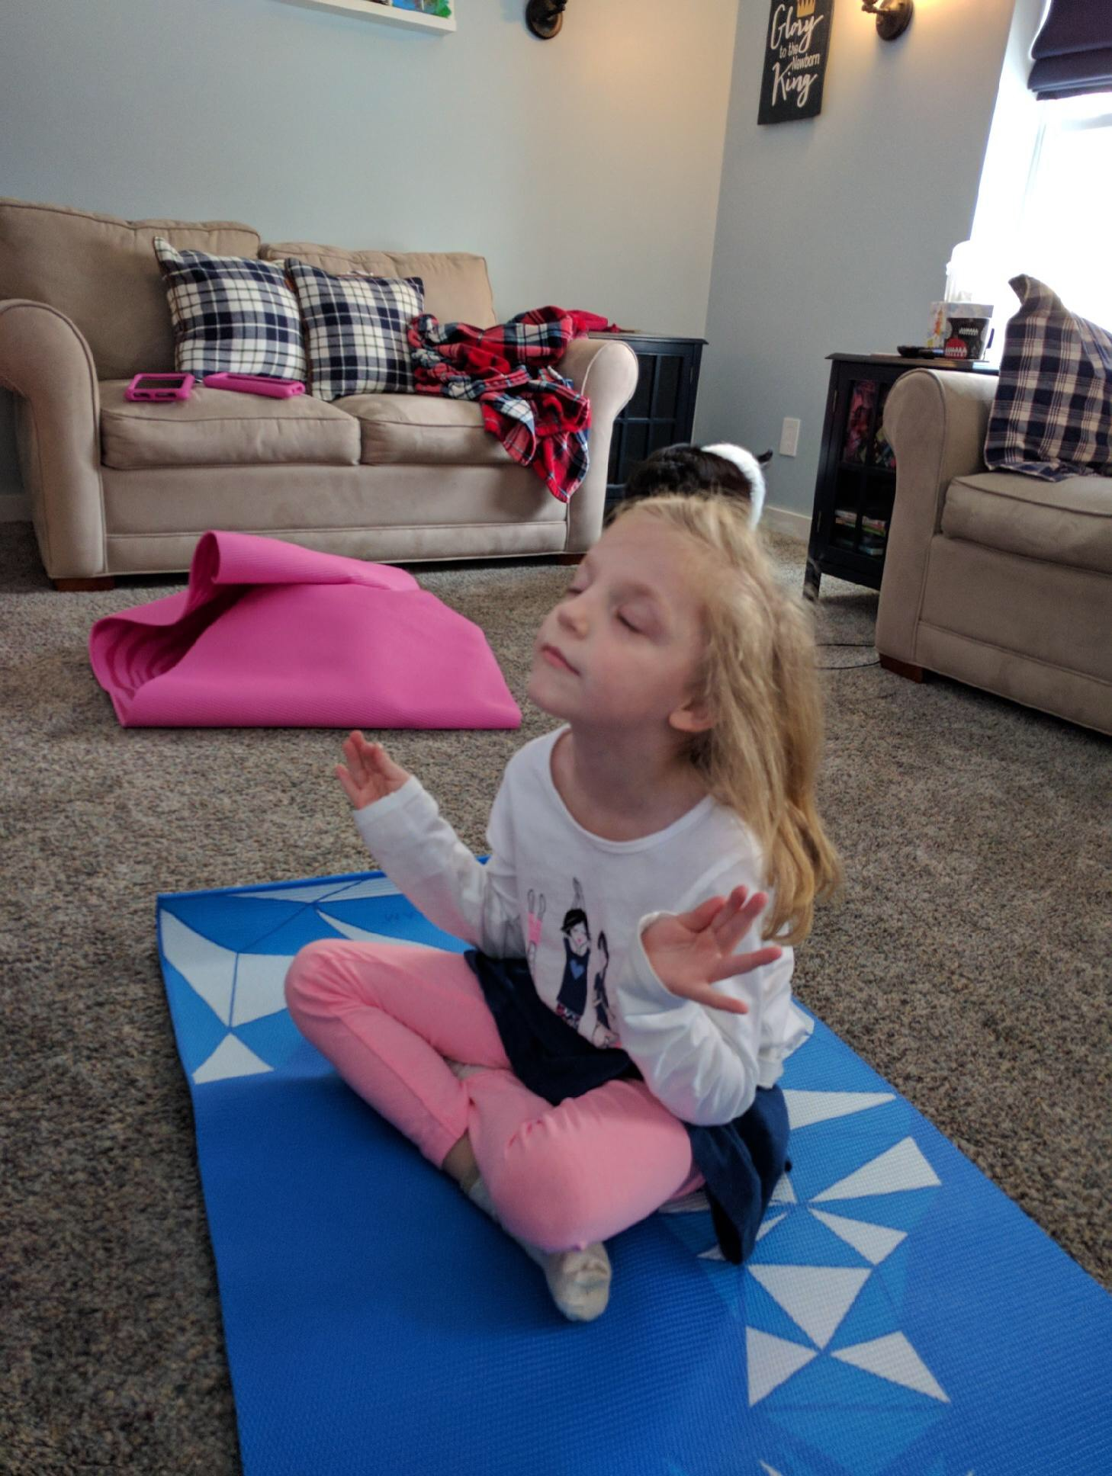
Mindfulness Tools for Students
Notes:
Ring the chime, raise your hand when you no longer hear the sound
mindful snacking

Slide 18
Research about MBI with youth
Small to moderate effect sizes
Typical outcomes measures include: cognitive performance, emotional problems, stress/coping, resilience and third party ratings (e.g. parent and teacher questionnaires related to aggression, social skills, wellbeing, or attention)
Results were strongest in relation to cognitive performance and resilience to stress
Results suggest MBI have the greatest impact with at risk youth
Zenner, Hermleben-Kurz & Walach, 2014
Zoogman et. al., 2014

Slide 19
Common Elements of MBIs
Breath awareness,
working with thoughts and emotions,
psycho-education,
awareness of the senses and practices of daily life,
group discussion,
body-scan,
kindness practices,
home practice,
body-practices (like yoga)
Zenner, Hermleben-Kurz & Walach, 2014).

Slide 20
Breathing and Mindfulness
Breathing is always with us, so paying attention to it requires nothing extra
We breathe 20,000 times a day (15 per minute)
When we feel panicky, there is a decrease of carbon dioxide in the blood
Diaphragmatic breathing is a method of balancing the oxygen and carbon dioxide levels in the blood. It only takes 4 minutes to re-regulate the system via diaphragmatic breathing
Holland & Sisson, 2014

Slide 21
4x4 Breathing
Focus on breathing for 4 minutes, counting to 4 (one count per second) on inhales and 4 on exhales
The breathing is diaphragmatic
Later increase to 8 seconds on the exhale
4x4 breathing cuts your rate of breath in half, and at 4x8 then breathing is only 5 breathes per minute.
Focusing on the long exhale slows the heart rate down/stops the fight or flight response
Holland & Sisson, 2014

Slide 22
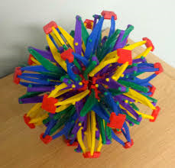
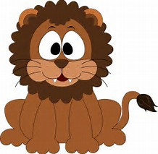
Breath Awareness
Belly Breathing, Alternate Nostril Breathing, Count to Ten, good in/bad out, bumble bee breath
Long slow breaths activate the parasynthetic nervous system which controls the relaxation response
2 to 1 Breath, Lion Breath, Bunny Breath, Conductor Breath
Quick breaths activate the synthetic nervous system which controls the arousal response

Slide 23
Working with Thoughts/Emotions
Movie directors: constantly playing scripts and clips in our minds. Often leads to an emotional experience.
We often react and respond to the script in our minds, not what is actually occurring in the present.
Automatic pilot
80-90% of our thinking is repetitive
Our thinking minds should be tools; pick it up when we need it, then set them down (at times we make connections and predictions)

Slide 24
The Guest House
This being human is a guest house.
Every morning a new arrival.
Ajoy, a depression, a meanness,
some momentary awareness comes
as an unexpected visitor
Welcome and entertain them all!
Even if they’re a crowd of sorrows,
who violently sweep our house
Empty of it’s furniture,
Still, treat each guest honorably.
He may be clearing you out
For some new delight.
The dark thought, the shame, the malice,
Meet them at the door laughing,
And invite them in.
Be grateful for whoever comes,
because each has been sent
as a guide from beyond.
-Rumi
Discussion Questions:
What do you think the poem means?
“Bad” moments help you know that other moments are “good.” What does this mean to you?
What feelings are in your guest house right now?
When you experience negative feelings, can you just take them in as information for yourself? How might you do that?
How do you currently deal with negative emotions?
What does Rumi mean that negative emotions can “clear you out for some new delight?”
Biegel, 2009, pg. 73-75
Notes:
Create handout

Slide 25
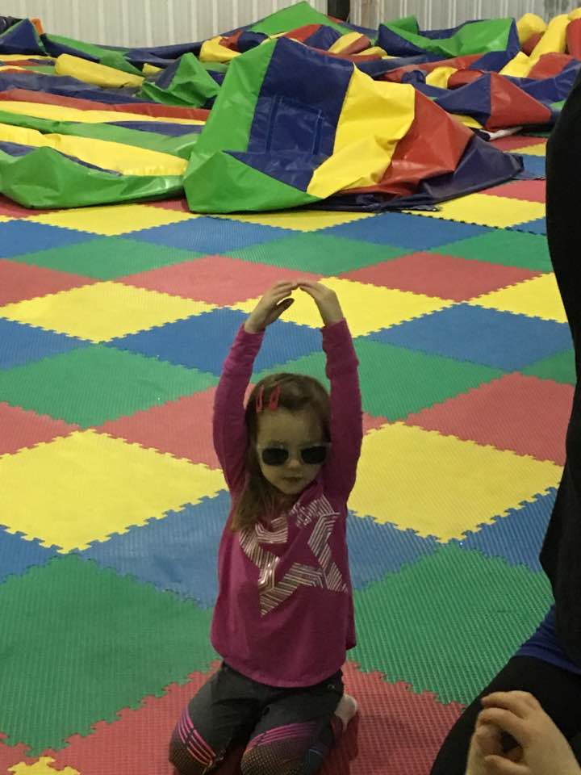
Social Stories

Slide 26

Automatic Thoughts
Helpful Self Talk | Unhelpful Self Talk
I can do this | This is too hard
I’m awesome at this | I’m not good at this
I can keep trying | I give up
I can always keep trying OR I can ask for help | I can’t make this any better
Plan A didn’t work | Good thing there are 25 more letters of the alphabet
Rate Yourself on a Scale on how much you believe the thoughts about yourself 1 (not at all) to 5 (completely)
Nothing works out for me
People don’t understand me
I make too many mistakes
I am not good enough
When we feel good, we have a harder time believing these things about ourselves and the thoughts don’t come up. But when we are stressed, these thoughts pop up more frequently. Our mood affects our thinking and our thinking affects our mood.
(Vo, 2015)

Slide 27
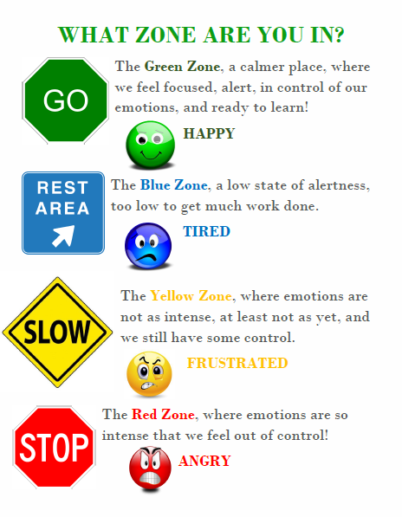
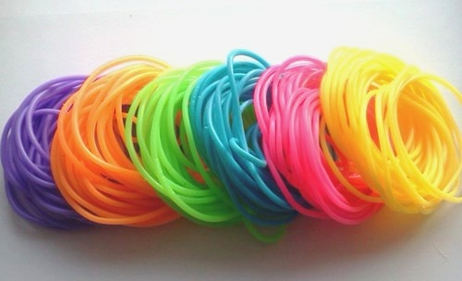
Working with Thoughts and Emotions
https://www.transformingeducation.org/rubber-bracelets-birthdays-and-wonder/

Slide 28
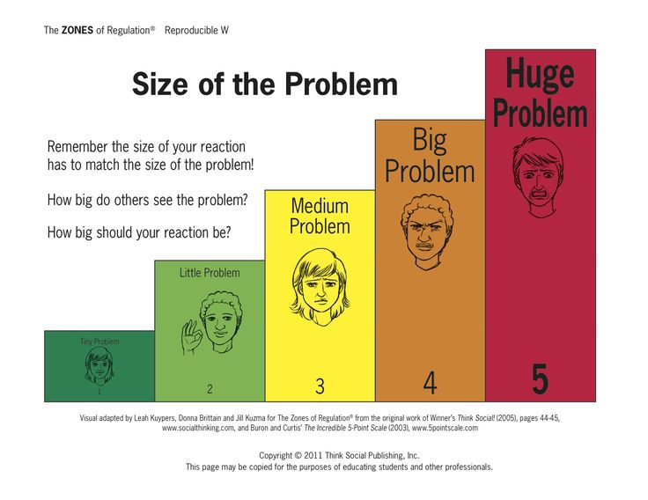
Size of the Problem
Remember: stress (and all emotions) are the result of our thoughts about events.

Slide 29


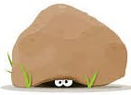
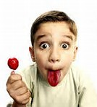
Awareness of the Senses
Outside/in Meditation
Chime Listening
Intuition Game
Mindful Eating
Notes:
Tuning in, is about focusing your attention on one thing while noticing any distractions that may arise.

Slide 30
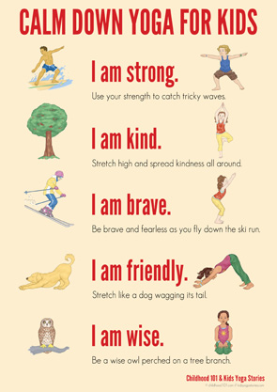
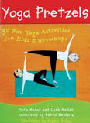
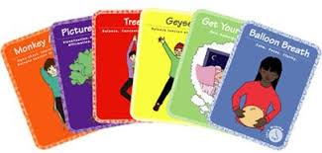
Body Practices
Musical poses,
Pose of the day,
What am I?
Strike a pose
Consider adding pose cards or a poster to your classroom’s break area
Notes:
The key with poses is to notice how they make you feel. What happens when you experience a difficult balancing pose? How do you persevere when it’s hard?

Slide 31
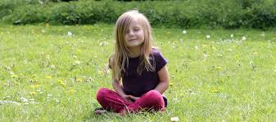
The Body Scan Meditation
Notes:
Start at the top of his head, and tell him to think about how different parts of his body “feel,” moving down the body from his head to his toes as the activity progresses.
You might ask things like: How does your hair feel? What about your forehead? What’s happening with your ears today? Are they feeling like ears?
Then suggest he bring his attention to his shoulders. Tell him to think about how they might move a little as he breathes in and out. And so on and so forth, all the way down to his toes.
Some of these questions may elicit giggles from the child; he’s probably never thought about what his hair “feels like.” This is why it’s a fantastic idea to provide a model of your own before asking him to participate. As you think aloud, use relatable words. For example, you might say, “My hair feels soft and twisty” or “Today my forehead is a little tingly in the middle.”
When it’s over, ask the child how it felt during the exercise and how he feels now.

Slide 32
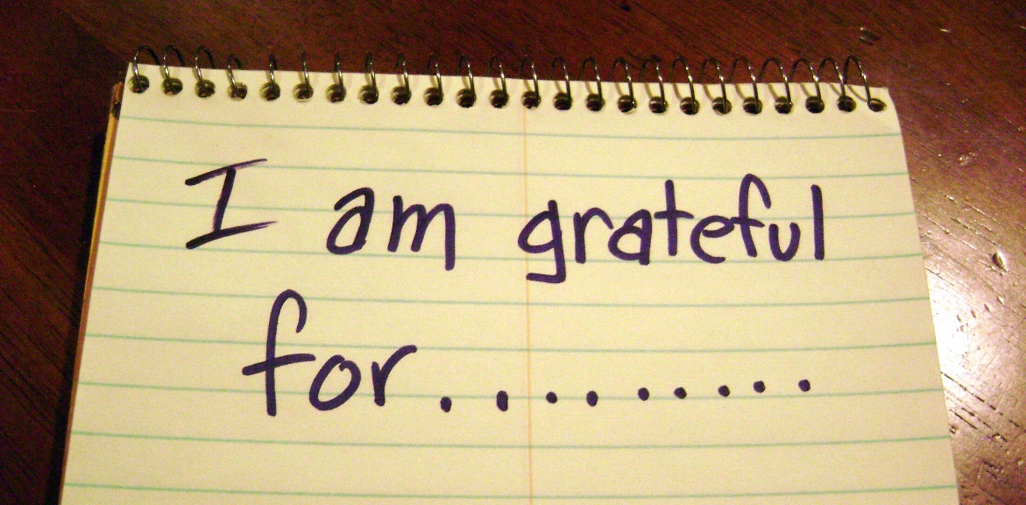
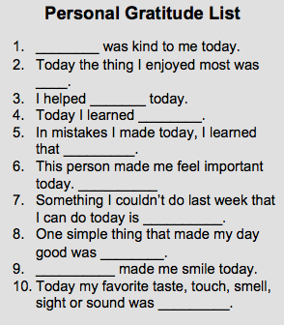
Kindness Practices
Define Kindness as a universal classroom expectation
Link kindness to brain research: mirror neurons
Use a job list that includes rotating roles for everyone in the class (or a list of acts of kindness that students can sign up for periodically)
Practice giving and receiving complements
Gratitude exercises
Notes:
Helps us to learn to be authentic!

Slide 33
Kindness Practices
Loving Kindness Meditation
Notes:
Helps us to learn to be authentic!

Slide 34


Group Sharing
Mindfulness Discussion Expectations:
Listen all the way to the end of the question before answering.
Listen with your whole body without reacting until others finish speaking.
Pay such close attention to what someone else is saying that you could repeat or explain in to someone else.
Listen for ideas that are different than your own and ask questions if you don’t understand.
When you notice you are tuned out, try a mindfulness trick to re-join the conversation.
Notes:
Point out that people have different perspectives about the same quote.

Slide 35
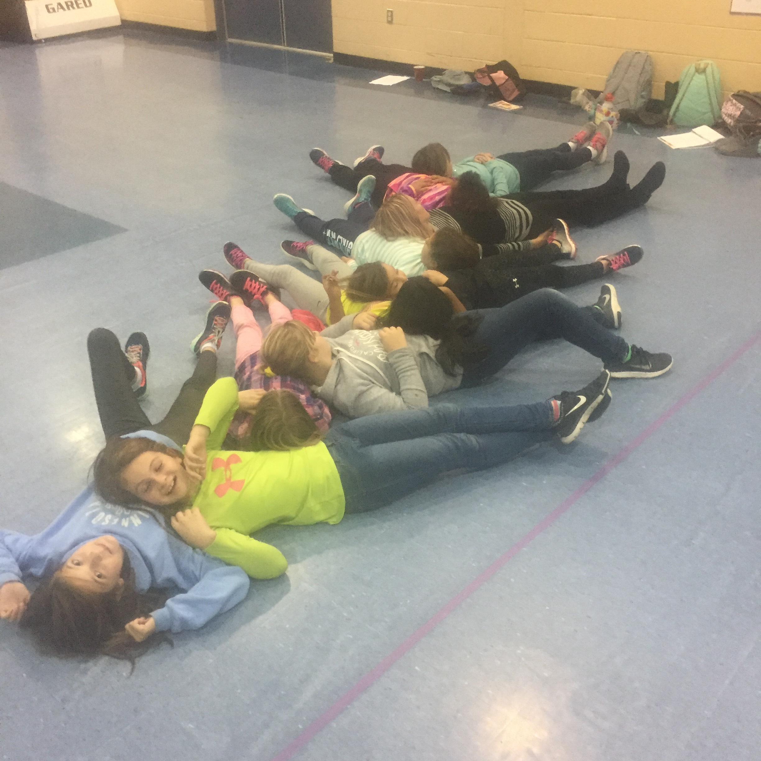
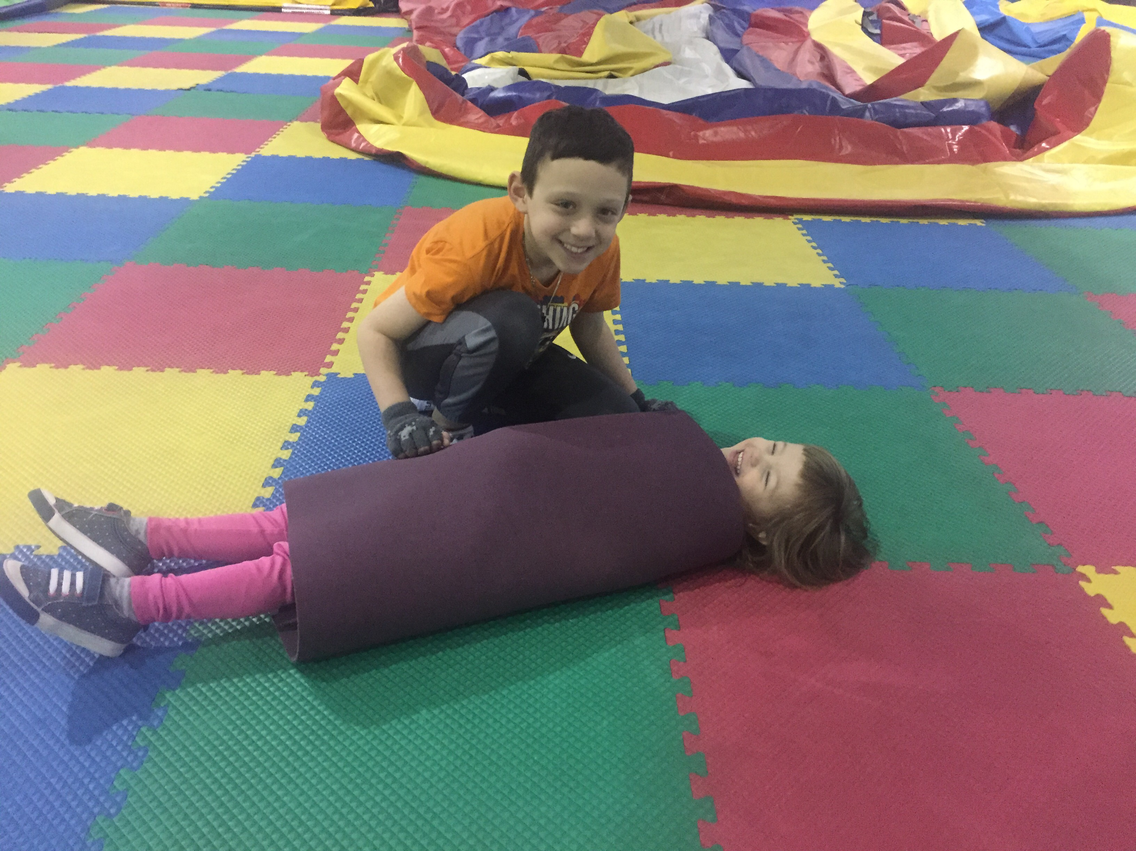
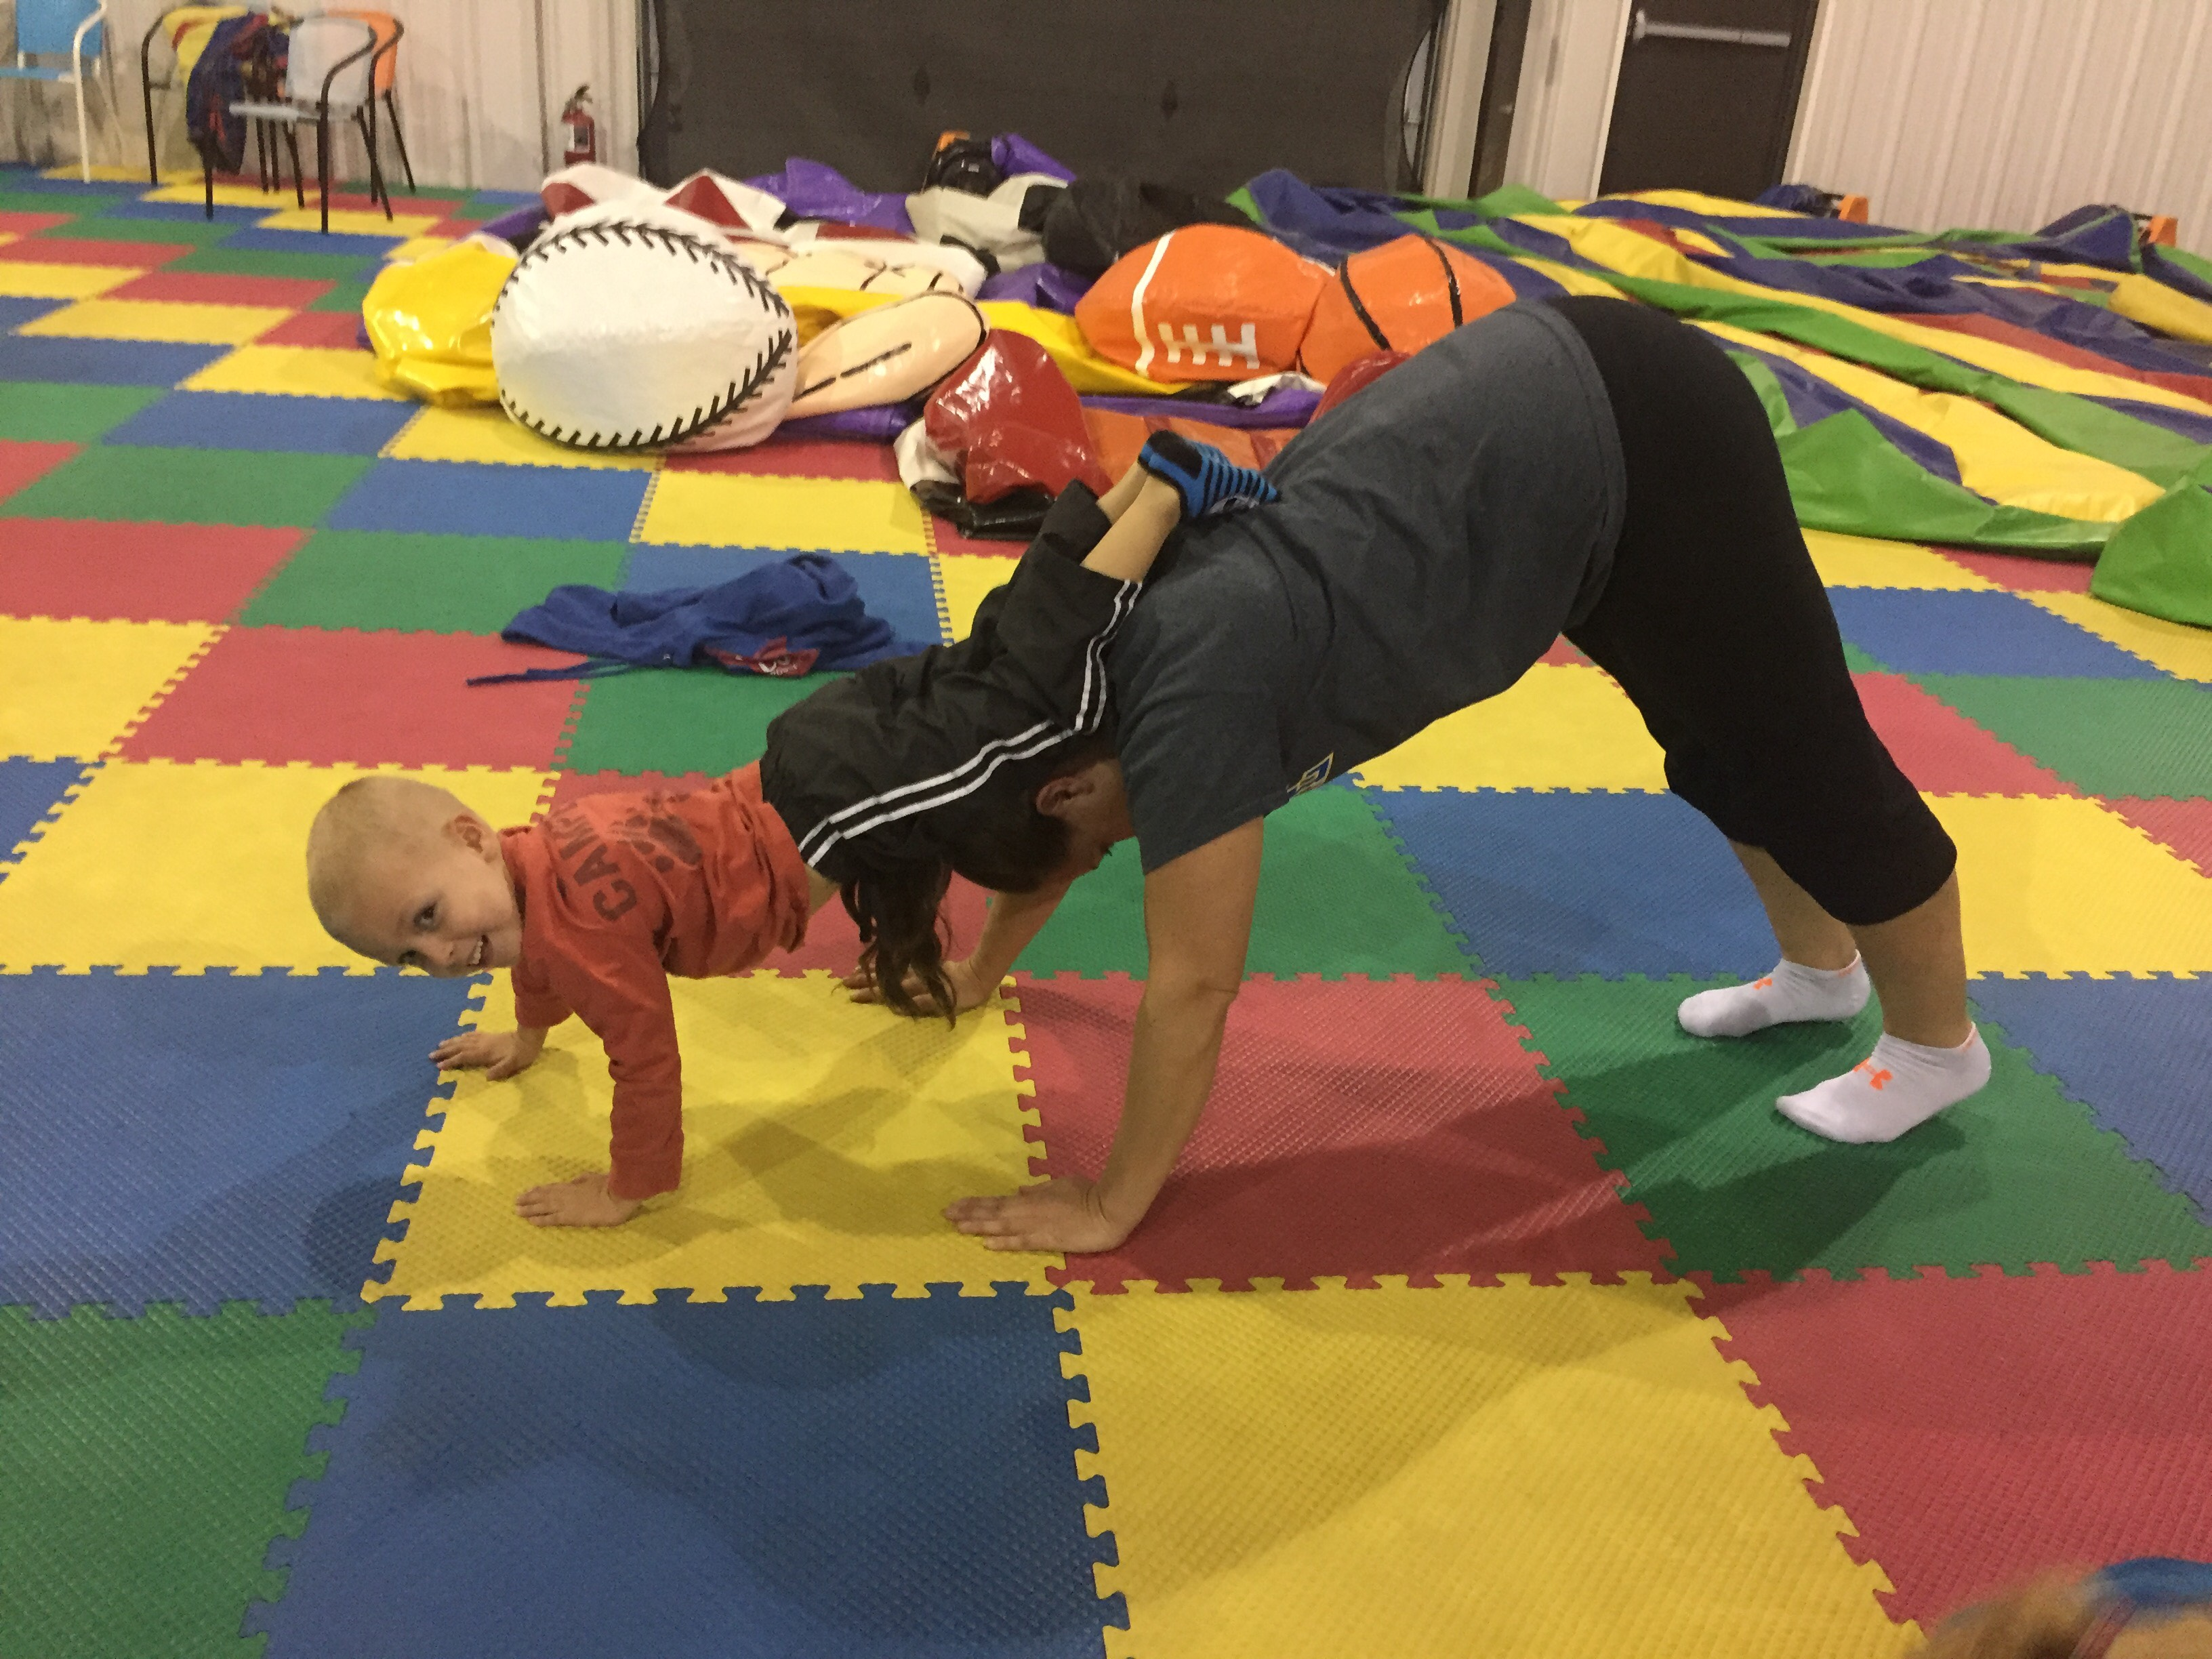
Group Games

Slide 36
Mindfulness and PBiS
1:1
FBA/BIP
Group mindfulness with students of similar needs
DBR; prompting/reinforcing use of Strategies
Integrated with School Wide PBIS Program
Daily mindfulness practices
Mindfulness research has shown greater improvements in outcome measures at follow up.
Daily mindfulness activities helps bring students back to the previous practices.
Holland & Larkin, 2014

Slide 37
Expectation | Mindfulness Skill
Be Safe | I use 4x4 breathing when I sense strong emotions
 | I label the size of the problem before I act
Be Respectful | I listen to others before I react or respond
 | I find multiple ways to solve a problem
 | I look for ways to demonstrate kindness
 | I care about how others feel and think
Be Responsible | I observe my thoughts and emotions when I am learning
 | I learn from my mistakes
 | I use my tools to stay tuned-in during class

Slide 38
School-wide Expectations | Classroom Rules | Classroom Routines/Procedures, Socio Emotional Skills
 |  | Entering Classroom | Resolving Conflict | Making Friends | Cooperative Learning Groups
 | Attention Signal : 4 fingers = 4x4 breathing
Be Respectful | Use kind words & actions Use appropriate voice level | Enter/exit classroom prepared Use inside voice | Think of multiple ways to solve the problem |  | Listen to others Accept differences Encourage others Wait your turn to speak
Be Responsible | Follow adult directions Take care of materials/equipment | Place materials in correct area Begin warm-up promptly | Give an “I” Statement Think about how others feel |  | Use Time Wisely Contribute Complete your part
Be Safe | Keep hands, feet & objects to self Use all equipment & materials appropriately | Walk | Use 4x4 breathing in a safe space Label the size of the problem before acting |  | Use Materials Carefully Stay in your designated area
SEL Skill
Specific Behaviors
Notes:
Here is an example of a matrix, in which the teacher embedded social emotional skills as a classroom activity. Resolving conflicts and making friends were deemed critical classroom activities to teach, pre-correct and provide feedback for.
When choosing which to include ask that the teacher, identify important procedures and socio emotional skills that are important for the classroom. Use your expectations as well as the activities (e.g. routine, procedures, specific social skill) that the teacher feels are important to stress within their class and/or grade level.

Slide 39
Matrix can be a working document…
You can add skills to it as they are taught.
Notes:
Here is an example of a separate matrix, in which the teacher pulled out specific behaviors she called “coping skills” and embedded them across the matrix. As each coping skill was explicitly taught, reinforced and pre-corrected throughout the year, she added to the list.

Slide 40
Questions?
Niki Roberts
robertsn@udel.edu
302-831-6735
www.delawarepbs.org

Slide 41
Resources
Biglan, T. (2018). The pax good behavior game: a powerful supplement to PBIS. [PowerPoint slides]. Retrieved from: https://new.apbs.org/sites/default/files/conference-2016/presentations/swk105-biglan-apbs2018.pdf
Brown, K.W. & Ryan, R.M. (2003). The benefits of being present: Mindfulness and its role in psychological well-being. Journal of Personality and Social Psychology, 84, 822-848.
Butler, J. (2016). Mindful classrooms: The educator guide. Publisher: Author.
Caprino, K. (2014, Feb 12). 5 mindfulness steps that guarantee increased success and vitality. Retrieved from https://www.forbes.com/sites/kathycaprino/2014/02/12/5-mindfulness-steps-that-guarantee-increased-success-and-vitality/#19bc51066710
Felver, J., Doerner, E., Jones, J., Kaye, N., & Merrell, K. (2013). Mindfulness in school psychology: applications for intervention and professional practice. Psychology in the Schools, 50(6), 531-547.
Flynn, L. (2013). Yoga for children: 200+ yoga poses, breathing exercises, and meditations for healthier, happier, more resilient children. Avon, MA: Adams Media.
Guber, T. L., Kalish, L. (2005). Yoga pretzels: 50 fun yoga activities for kids and grownups. Cambridge, MA: Barefoot Books.
Holland & Sisson (n.d.). Advanced mindfulness and acceptance practice in the schools. [PowerPoint slides]. Retrieved from https://nasp.inreachce.com/
Holland & Larkin (2014). A three tiered prevention-intervention school based mindfulness program. [Poster]. Retrieved from: http://mps.milwaukee.k12.wi.us/MPS-English/CAO/Documents/PBIS/Mindfulness3TiersHandout.pdf
IgniterMedia. (2009, Sep 24). The Marshmallow Test [Video file]. Retrieved from https://youtu.be/QX_oy9614HQ
Kuypers, L. M. (2011). The zones of regulation: A curriculum designed to foster self-regulation and emotional control. Santa Clara, CA: Think Social Publishing, Inc.
Langer, E. J. (1997). The power of mindful learning. Cambridge, MA: Da Capo Press.
Rechtschaffen, D. (2014). The way of mindful education: Cultivating well-being in teachers and students. New York, NY: W. W. Norton & Company, Inc.
Snel, E. (2013). Sitting still like a frog: Mindfulness exercises for kids (and their parents). Boulder, CO: Shambhala Publications.
Vo, D. X. (2015). The mindful teen: powerful skills to help you handle stress one moment at a time. Oakland, CA: Instant Help Books.
Zenner, C., Herrnleben-Kurz, S., & Walach, H. (2014). Mindfulness-based interventions in schools-a systematic review and meta-analysis. Frontiers in Psychology, 5, 603.
Zoogman, S., Goldberg, S.B., & Hoyt, W.T. (2014). Mindfulness interventions with youth: A meta-analysis. Mindfulness, 6(2), 290-302.

